Slide 1
Video Analytics - SBI
Powered By - Microsoft Corporation Pvt Ltd.

Slide 2

Problem Being Solved
Surveillance is being constantly carried out via Video Cameras at Branches, ATMs & Offices of the Bank. As a proactive measure and to protect against unscrupulous elements, the video feed is constantly monitored by personnel at Command Centres / Control rooms.
The solution should be able to constantly scan multiple video footage for Suspicious Activities, breaks/Interruptions in the footage, or any activity that needs attention.
The solution should be able to count the number of people and calculate the time taken for activity on the premises and Identify known facilitators.
It should be in the Communication with Control / Command Centres / Vendors and have a Feedback mechanism for false positives / incorrect classification for enhancement in the model.

Slide 3
Approach taken to create the model
Third Eye – An advanced AI solution capable of identifying various suspicious activities happening on bank premises, through CCTV footage.
This smart solution uses Computer Vision and Deep Learning powered face recognition in order to identify know miscreants and bank facilitators.
It will also display the live count of people on the premises and monitor their activities, and time and display in the dashboard which will be visible to Command Centre employees.
This solution is named as Third Eye because all the SBI branches have an on-premise security guard and this will serve as an additional third eye to keep a check on theft and suspicious activities.

Slide 4
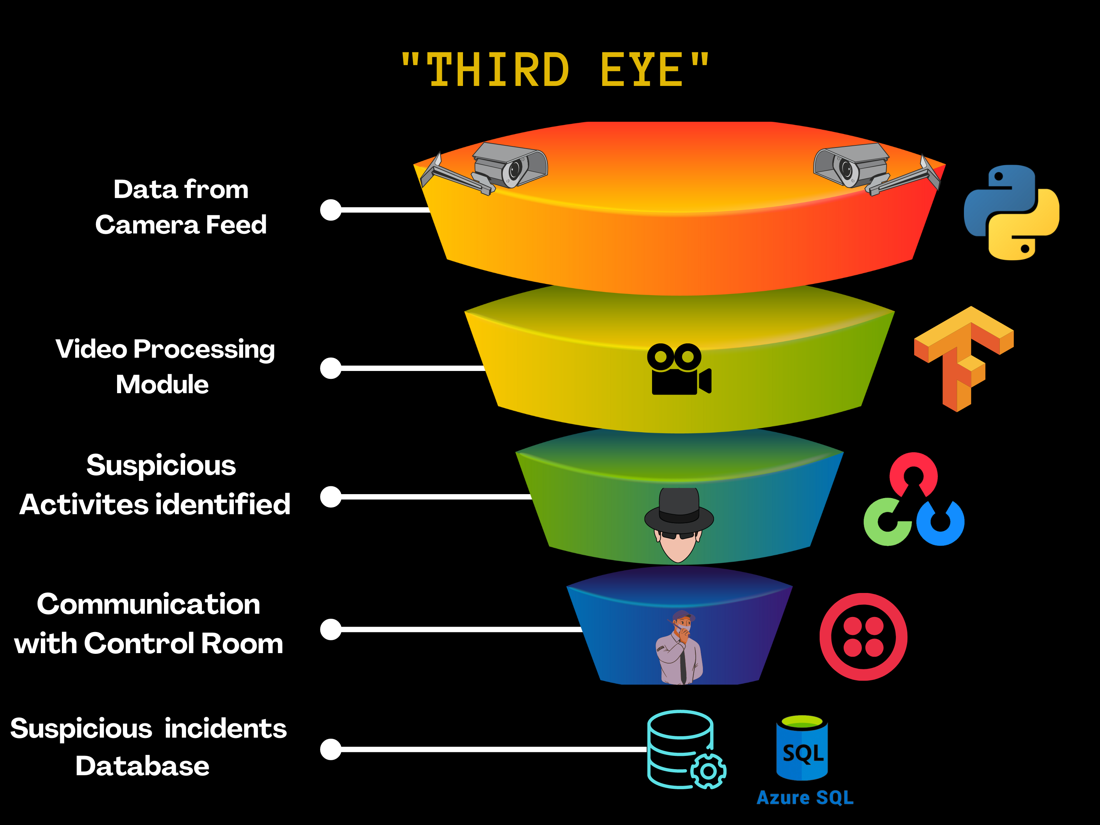
FLOWCHART

Slide 5
Technical Approach
Data Feeding Module – This module will capture the live CCTV footage from various cameras installed at SBI branches, ATMs, etc. The module will handle data extraction from all types of CCTV cameras like domes and bullets.
Video Processing Module – This is the core component of the whole solution and will deal with video processing and analytics. It will process videos of all formats, resolutions, and FPS to generate insights. Artificial Intelligence and Deep Learning framework, TensorFlow will be used to identify suspicious activities.
Suspicious Activities identified – Suspicious activities like the following will be identified -:
Hazardous Objects are being brought into the premises.
Break / Interruption in footage
Tampering with the cameras / sensitive or high priority area within premises.

Slide 6
Technical Approach
Along with identifying suspicious activities, the solution will also be capable of performing :
Calculating the Count of People
Identification of known miscreants
Identification of known facilitators
Identifying Fire / Theft related incidents taking place
Communication with Command Centres: - This module will be responsible for communicating all the suspicious activities and statistics to Control/Command centers. It will also give an option to authorized personnel for giving feedback in regard to false positives / incorrect classification in order to improve the accuracy of the trained model.
Database: - All the suspicious activities will be stored in an Azure SQL Database with a timeframe, a clip of the video, and other details like location, date, etc. This data will help in the investigation of theft or mischief.

Slide 7


Prerequisites
Resolution - At least 720p
FPS - More than 10 FPS

Slide 8
Functional requirements
Suspicious Activities Identified in the Live Security Camera feed.
Communicating the alerts to the Security Personnel at the command centers/control rooms.
Monitoring the data feed and storing the skeptical incidents in the Microsoft Azure SQL Database.
Non-Functional requirements
Feedback mechanism for false positives / incorrect classification by the model.
Time is taken to successfully report these doubtful incidents to the authorities and in the database.
Supporting Assumptions
Constant Video Feed with a stable FPS and a fixed resolution.
Availability of necessary servers/devices in the SBI premises to run the model.

Slide 9
Reasons why our solution should be considered
Our solution will be capable enough to work on footage captured by any standard bullet/dome cameras.
Detection of any hazardous objects such as arms and ammunition, a person with a covered mask face, and many other similar suspicious activities.
Feedback mechanisms for false positives / incorrect classification to further enhance the model will also be implemented in our solution.
Our model will take into account the time taken as well as accuracy to detect such incidents.
The whole solution will be built and deployed using the Microsoft Azure Services which will make it easily accessible from any SBI premises.

Slide 10

Submitted By: Saksham Gupta; Kritika Ahuja; Shiva Thavani
Email: sakshamgupta1074@gmail.com; kritikaahuja.287@gmail.com; Thavani.shiva3@gmail.com
Mobile No: 7404325114; 7015122456; 7901913699

