Slide 1
SER502 Project
NovelC Demonstration
Team - 9
Abhinaw Sarang (1217265205)
Sagar Khar (1217125416)
Saksham Jhawar (1217883758)
Smit Dharmeshumar Shah (1217106696)

Slide 2
Overview of Demonstration
Language Introduction
Features
Tools used
High Level Design
Tool Installation
Language Grammar – Tokenization and Parsing
Interpreter (Evaluator)
Sample run

Slide 3
Language Introduction
Our language is inspired from existing languages such as Python and Java.
Easy to code, because of familiar keywords used.
Grammar is written in Python whereas Evaluator is written in SWI-Prolog.
The name novelC has been chosen considering the situation this language was developed in.

Slide 4
Features
Data types
Integer (int)
String (string)
Boolean (bool)
Mathematical Operators
Addition
Subtraction
Multiplication
Division
Parenthesis (Additional feature)
Logical Operators (Additional features)
Equals / Not Equals
Greater than / less than
Greater than equals / less than equals
String Equal
String Concatenation
Boolean Operators
And
Or
Not
Ternary

Slide 5
Features (Continued)
Decision Constructs
If-else
If-elseif-else (Additional feature)
Loop Constructs
Traditional For loop
While loop
Do While loop (Additional feature)
For in range loop

Slide 6
Tools used
Tokenization and Parse tree generation using Python Lark
Evaluation of Parse tree in SWI - Prolog
Bash script for single point execution

Slide 7
Tool Installation
Prerequisite: Python3+ ,SWI-Prolog
Pip install lark-parser

Slide 8
High Level Design
Lark
Input file
Bash Script
.nc Input
Parse Tree
CLI Output
Prolog Evaluator

Slide 9
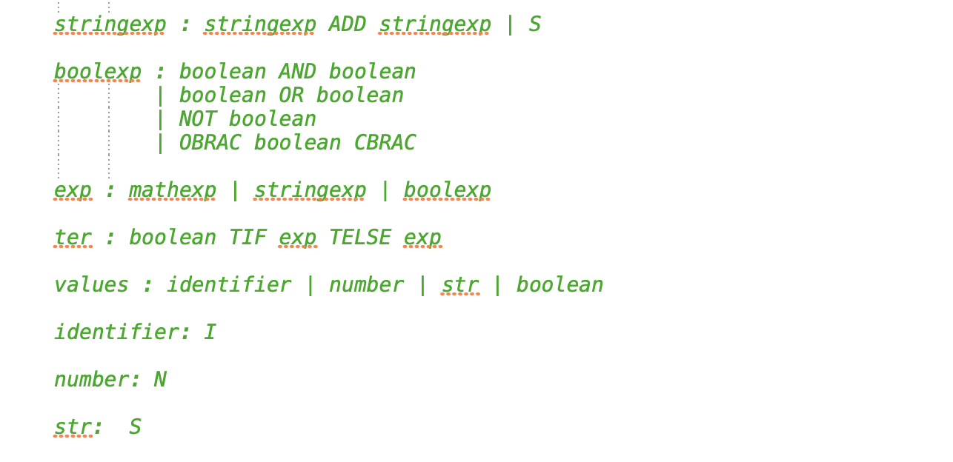
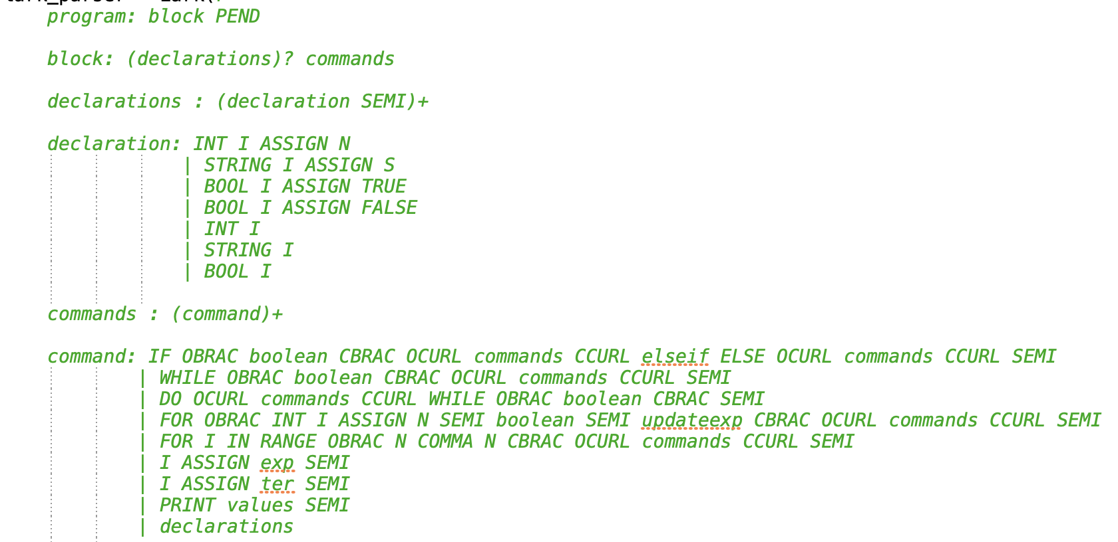
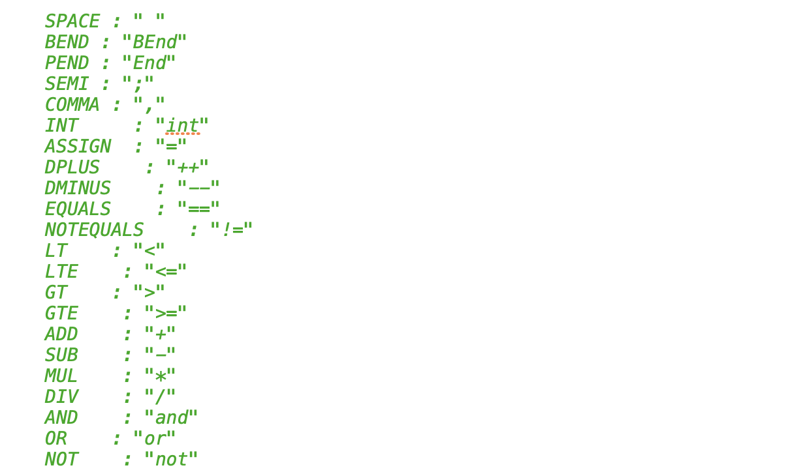
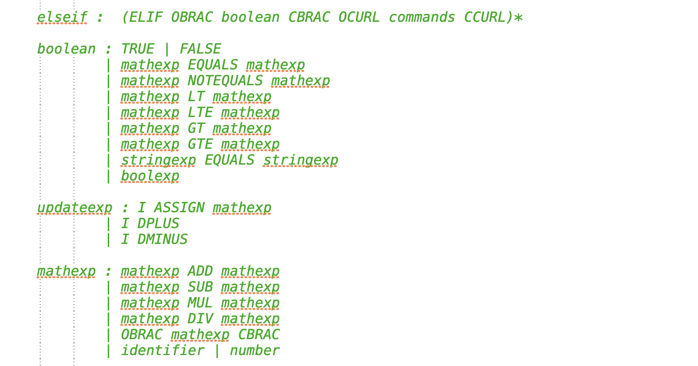
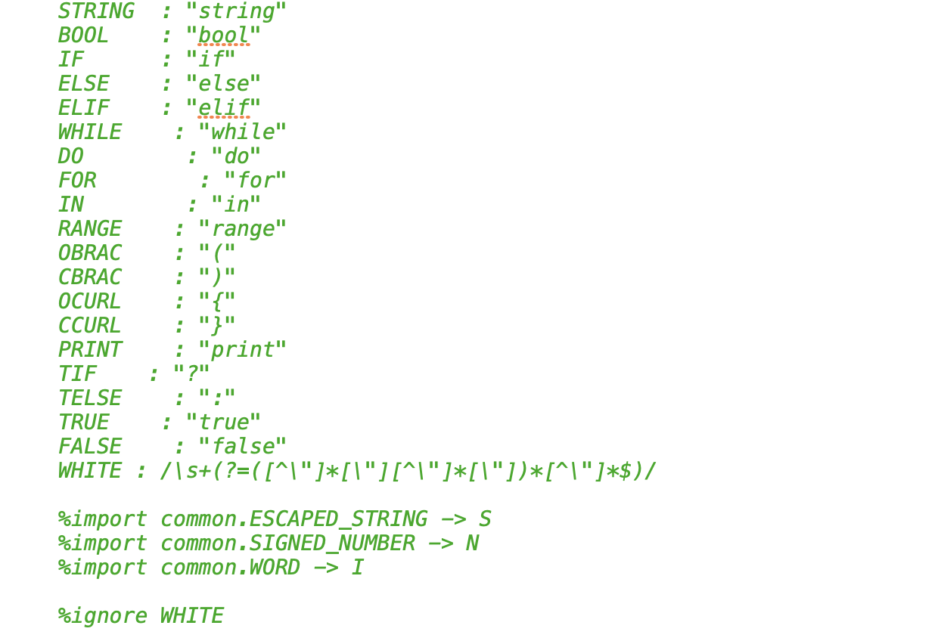
Grammar

Slide 10
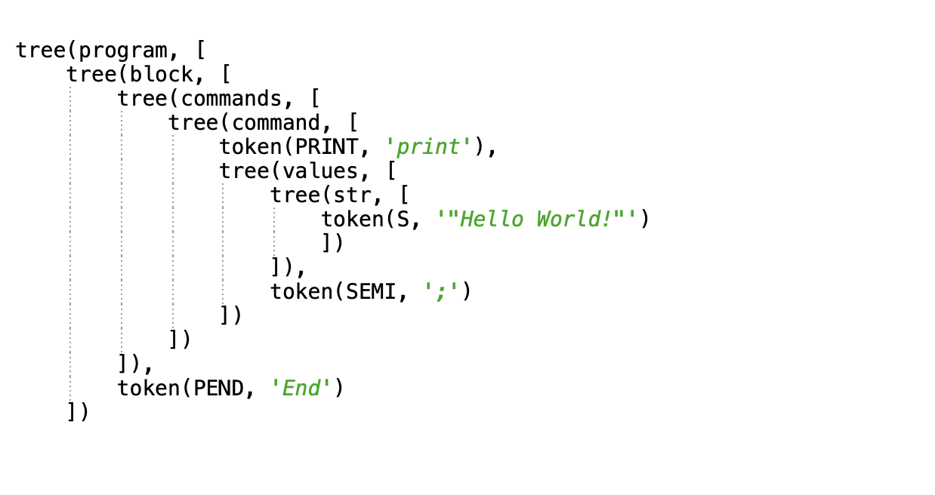
Parse Tree Generation

Slide 11
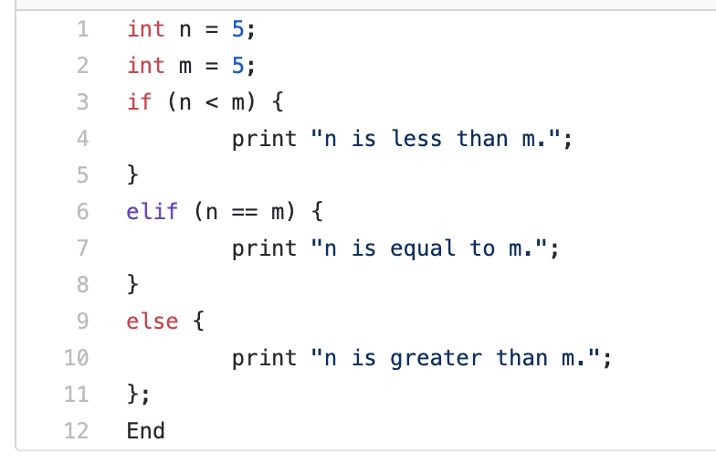
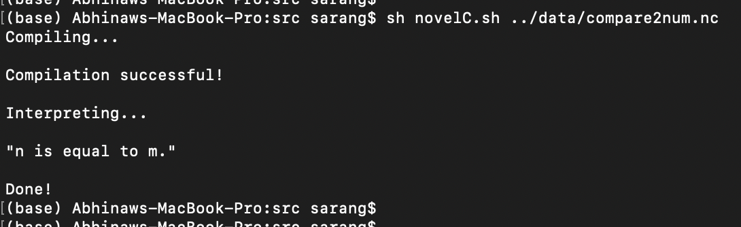
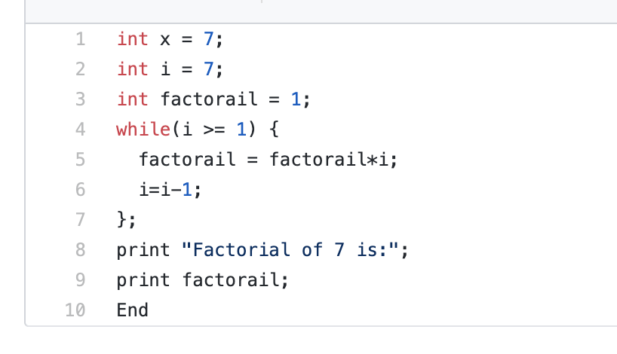
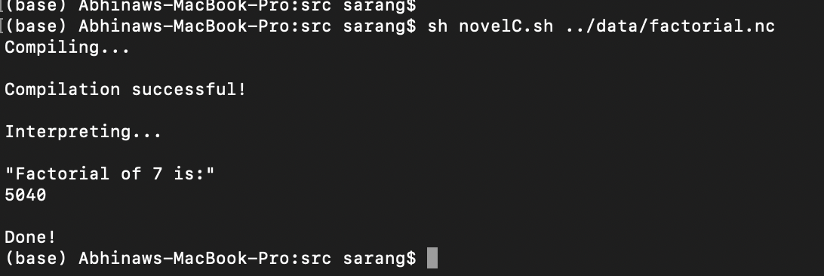
Program Snapshots

Slide 12
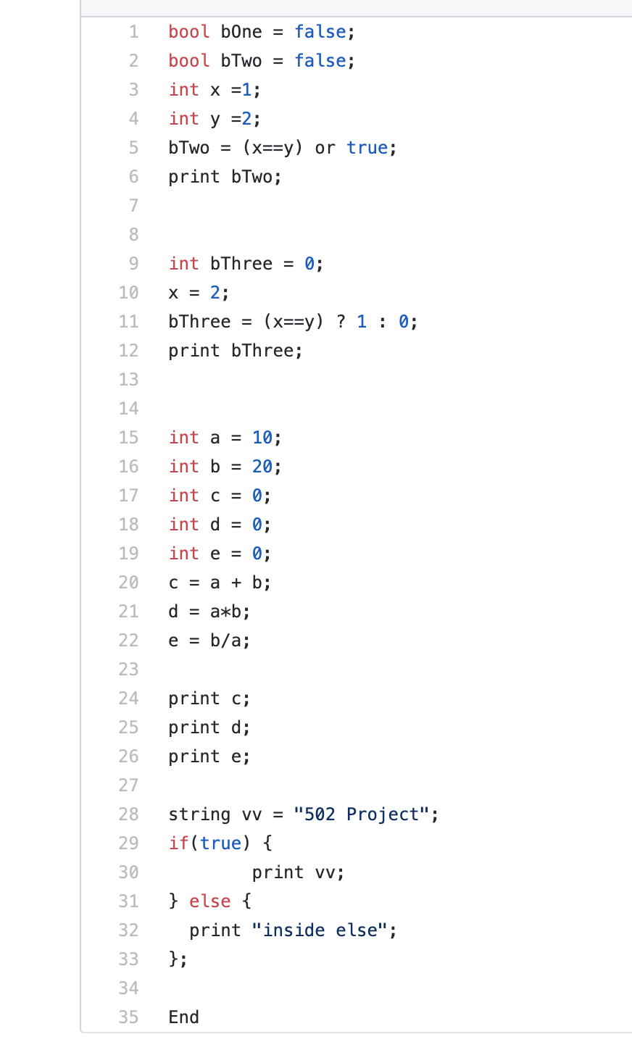
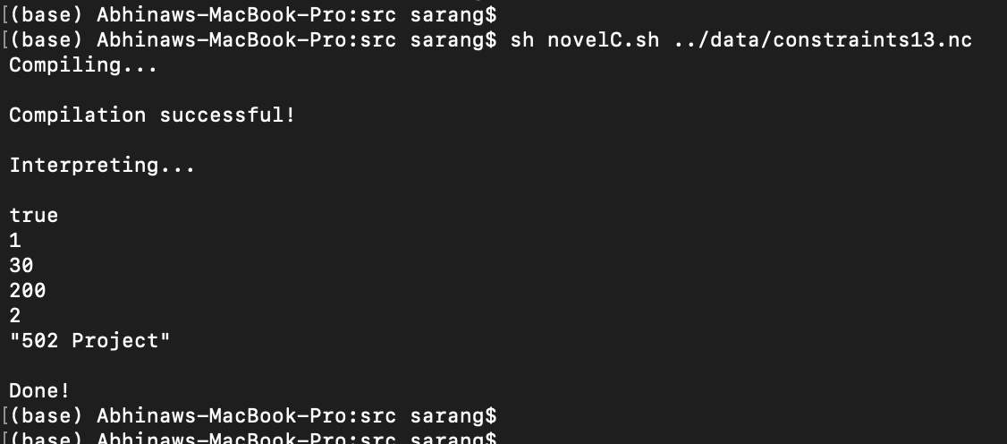
Program Snapshots (Continued)

Slide 13
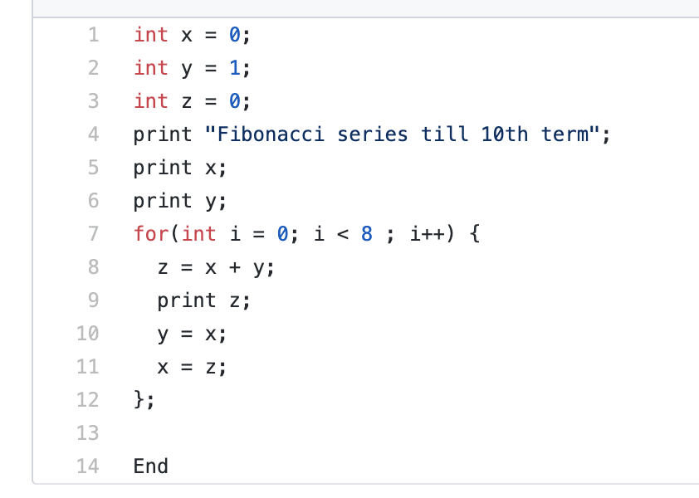
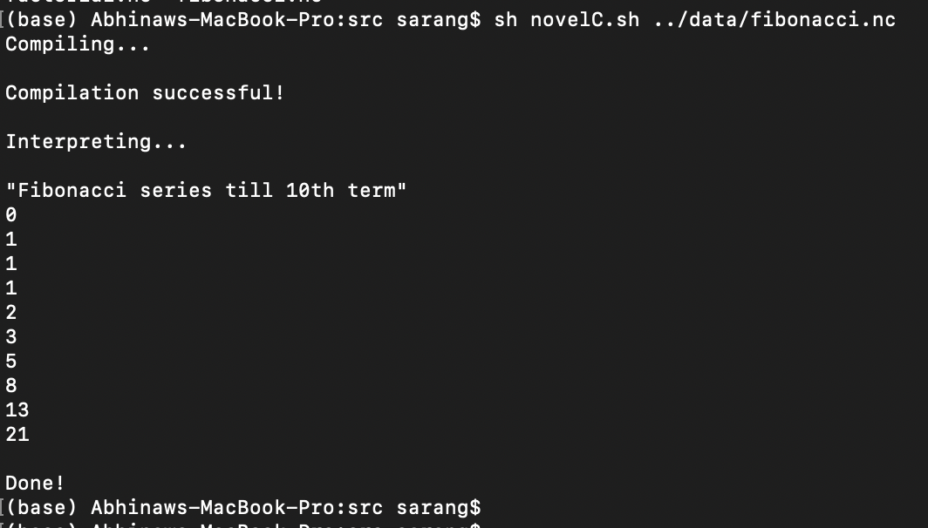
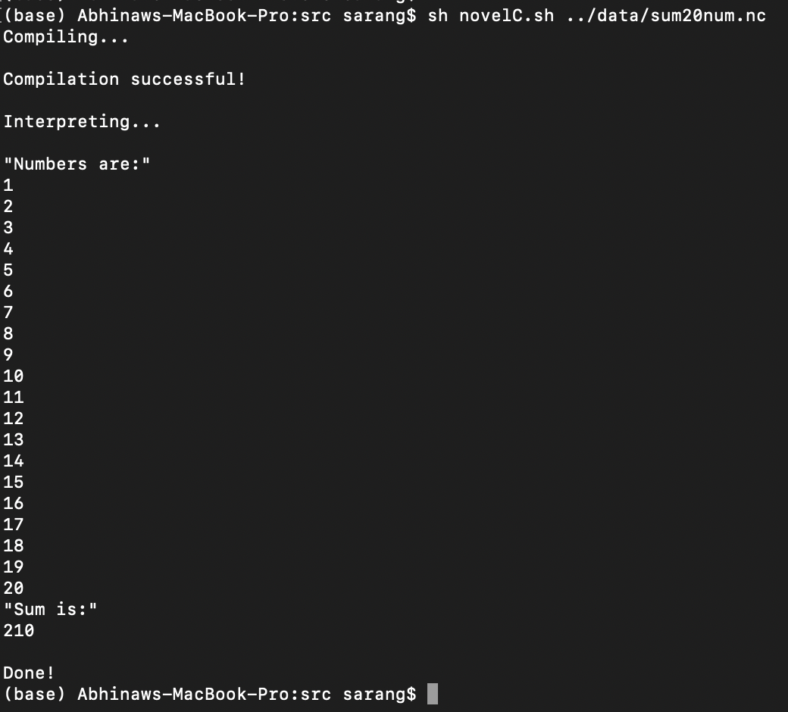
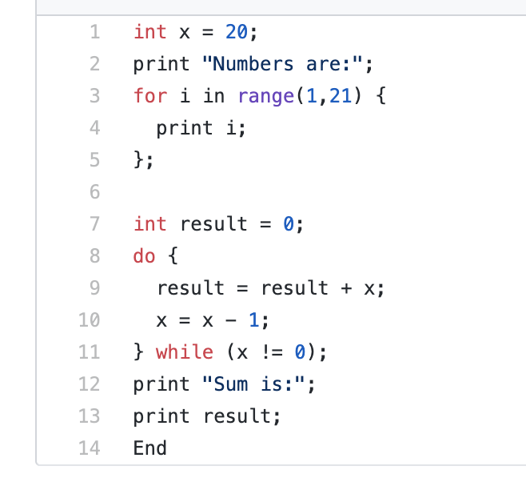
Program Snapshots (Continued)

Slide 14
Thank you and Stay Safe!

