Slide 1

Flight Fare Prediction
Group 2

Slide 2
Research Papers used
Predicting Flight Prices in India | 2017 | Click here
A Framework for Airfare Price Prediction: A Machine Learning Approach | 2019 | Click here
Predicting The Price Of A Flight Ticket With The Use Of Machine Learning Algorithms | 2019 | Click here
Survey on Air Price Prediction using Machine Learning Algorithms | 2019 | Click here
Predicting Airfare Prices Manolis Papadakis(Stanford) | NA | Click here

Slide 3


Predicting Flight Prices in India
Achyut Joshi, Himanshu Sikaria, Tarun Devireddy, Dr. Vivek Vijay
DATA SET
collected using scraping, many airlines companies data from their sources.
MODELS USED
MULTIPLE MODELS
MAXIMUM ACCURACY ACHIEVED
0.818 ( Adjusted R squared score)

Slide 4
Features Used:
Origin City
Destination City
Departure Date
Departure Time
Arrival Time
Total Fare
Airway Carrier
Duration
Class Type - Economy/Business
Flight Number
All data is for BOM-DEL route from Jan to Apr 2017

Slide 5
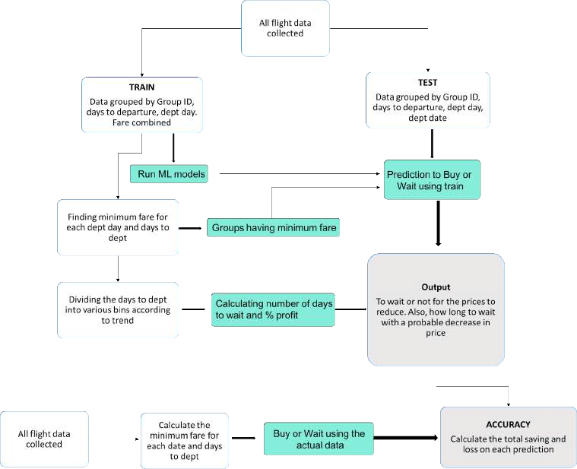

Slide 6
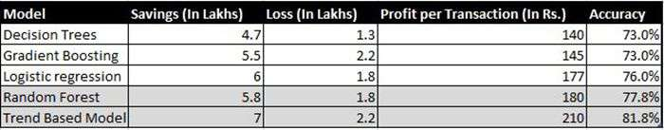
Key Highlights:
● Flight prices almost always remain constant or increase between the major cities
● Tourist routes and routes that offer services involving Tier-2 cities of the country have uneven trends related to the increase and decrease of airline ticket prices.
● The model in the worst case almost breaks even with the profits and losses, and most case saves an average of about Rs. 200 per transaction when predicting to wait.
● Routes with data collected over the longer duration of time tend to facilitate with much more accurate predictions in the model and thus lead to higher average savings.

Slide 7
A Framework for Airfare Price Prediction: A Machine Learning Approach
Tianyi Wang∗, Samira Pouyanfar∗, Haiman Tian∗, Yudong Tao
DATA SET
The Airline Origin and Destination Survey (DB1B) and the Air Carrier
Statistics database (T-100)
MODELS USED
Multiple Models
MAXIMUM ACCURACY ACHIEVED
0.869 (Adjusted R squared score)
A Framework for Airfare Price Prediction: A Machine Learning Approach

Slide 8
Feature used :
1 Passengers Volume (0.0565)
2 Load Factor (0.0402)
3 Competition Factor (0.0387)
4 Distance between airports (0.5096)
5 Seat Class (0.2698)
6 Low Cost Carrier Presence (0.0193)
7 Consumer Price Index (CPI) (0.0083)
8 Crude Oil Price (0.0069)
9 Quarter (0.0049)
ALL DATA IS FROM (DB1B) & (T-100)

Slide 9
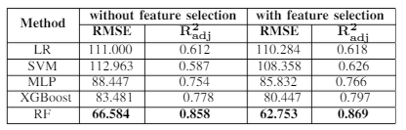
KEY HIGHLIGHTS :
Here feature selection means variable with least effect is cancelled out.

Slide 10
KEY HIGHLIGHTS :
Method | RMSE | R2adj
LR | 112.039 | 0.599
SVM | 109.914 | 0.615
MLP | 94.569 | 0.715
XGBoost | 90.419 | 0.739
RF | 70.575 | 0.804
THIS IS DONE FOR IMPORTANT FEATURE WITH HIGH SCORES. NOTE THAT ACCURACY HAS DECREASED BY 7%.

Slide 11

Predicting The Price Of A Flight Ticket With The Use Of Machine Learning Algorithms
Supriya Rajankar, Neha Sakharkar, Omprakash Rajankar
Dataset Used Own data ,collected using scraping
Models Used Multiple models
Maximum accuracy achieved
0.68(R2 score)

Slide 12
Features Used
Date of journey
Time of Departure
Place of Departure
Time of Arrival
Place of Destination/Arrival
Airway company
Total Fare
All data is for BOM-DEL route from Feb to Apr 2019

Slide 13
Key highlights
Machine Learning(ML) algorithms | R-squared | MAE | MSE
Decision tree | 0.67 | 0.13 | 0.21
Random forest | 0.68 | 0.13 | 0.21
K-NN | 0.65 | 0.13 | 0.22
Linear Regression | 0.40 | 0.19 | 0.29

Slide 14
Survey On Air Price Prediction Using Machine Learning Algorithms.
Abhilash , Ranjana Y , Shilpa S, Zuveda A Khan
DATA SET
Collected using scraping, Pricing Data From Sources And Data Mining
MODELS USED
RIPPER MODEL
MAXIMUM ACCURACY ACHIEVED
0.745 ( R2 score)

Slide 15
Features Used:
Measures Of Variable Importance.
Different Class Weighting.
Missing Variable Imputation.
Visualisation.
Outlier Detection.
Unsupervised Learning.

Slide 16
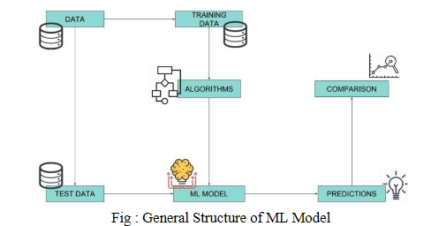

Slide 17
Key Highlights:
1.It was difficult for the customer to purchase air ticket due to the high complexity of the pricing models applied by the airlines because the prices change dynamically.Many features that can vary the base price of a ticket was not considered.
2.There were problems that was encountered during manual data collection and previous works done in the field of airfare price prediction.
3.From the experiments we concluded which features influence the airfare prediction at most.Future this project could be extended to predict the airfare prices with higher performance considering few other features.

Slide 18
Predicting Airfare Prices
Manolis Papadakis
DATA SET
Collected using scraping Bing Travel Website to collect data for 43 days
ALGORITHMS USED
Ripple Down Rule Learner, Logistic Regression & Linear SVM algorithms
MAXIMUM ACCURACY ACHIEVED
74.5% (using Ripple Down Rule Learner Algorithm)

Slide 19
Features used in this Model
Proposed Features
number of unsold seats (and recent fluctuations on that number), as a measure of demand
state of competing options on the same route (number of available seats on similar flights, current price for those flights, recent price fluctuations)
date/time of booking, especially days left until departure
recent price for the same ticket, and recent fluctuations of the price
Practically usable Features
date/time of booking, especially days left until departure
recent price for the same ticket, and recent fluctuations of the price

Slide 20
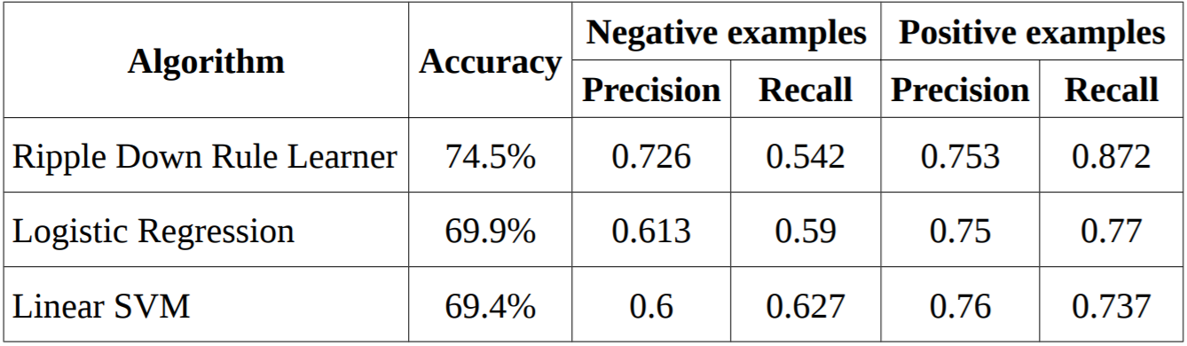
Key Highlights

Slide 21
Thankyou!
Group 2
Group Members
1. Saksham Sharma
2. Aditya Raj Singh
3. Ritik Nageshwar
4. Akhil Sahani
5. Yash Sukhdeve

