Slide 1
NAIVE BAYES CLASSIFICATION
BY: SAKSHAM JAIN
CSE 4TH YEAR

Slide 2
BAYESIAN CLASSIFICATION
Problem statement:
  Given features (X1,X2,…,Xn) – Dependent Features
  Predict a label (Y)

Slide 3
THINGS WE’D LIKE TO DO
Spam Classification
  Given an email, predict whether it is spam or not
Medical Diagnosis
  Given a list of symptoms, predict whether a patient has disease X or not
Weather
  Based on temperature, humidity, etc… predict if it will rain tomorrow

Slide 4
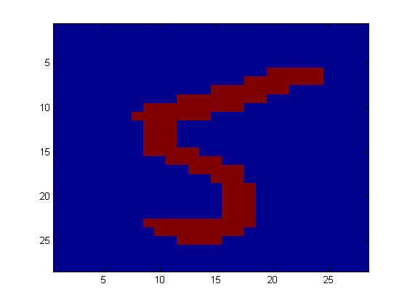
ANOTHER APPLICATION
Digit Recognition
X₁,…,X_{n} ∈ {0,1} (Black vs. White pixels)
Y ∈ {5,6} (predict whether a digit is a 5 or a 6)
Classifier
5

Slide 5

THE BAYES CLASSIFIER
It is a good strategy to predict:
  (for example: what is the probability that the image represents a 5 given its pixels?)
So … How do we compute that?

Slide 6
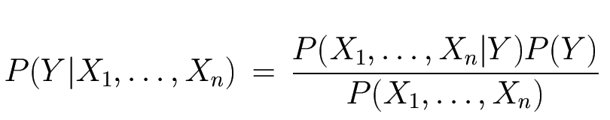
THE BAYES CLASSIFIER
Use Bayes Rule!
Why did this help? Well, we think that we might be able to specify how features are “generated” by the class label
Likelihood
Prior
Normalization Constant

Slide 7
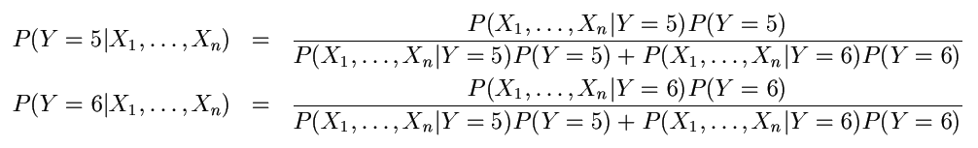
THE BAYES CLASSIFIER
Let’s expand this for our digit recognition task:
To classify, we’ll simply compute these two probabilities and predict based on which one is greater

Slide 8
MODEL PARAMETERS
The problem with explicitly modeling P(X₁,…,X_{n}|Y) is that there are usually way too many parameters:
  We’ll run out of space
  We’ll run out of time
  And we’ll need tons of training data (which is usually not available)

Slide 9
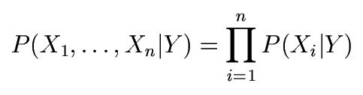
THE NAIVE BAYES MODEL
The Naive Bayes Assumption: Assume that all features are independent given the class label Y
Equationally speaking:

Slide 10
WHY IS THIS USEFUL?
# of parameters for modeling P(X₁,…,X_{n}|Y):
  2(2^{n}-1)
# of parameters for modeling P(X₁|Y),…,P(X_{n}|Y)
  2n

Slide 11
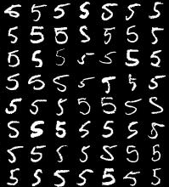
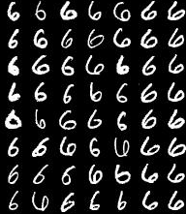
NAIVE BAYES TRAINING
Now that we’ve decided to use a Naïve Bayes classifier, we need to train it with some data:
MNIST Training Data

Slide 12
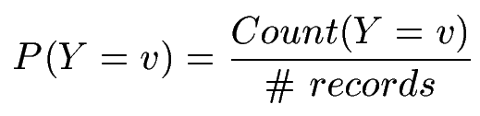

NAIVE BAYES TRAINING
Training in Naïve Bayes is easy:
  Estimate P(Y=v) as the fraction of records with Y=v
  Estimate P(X_{i}=u|Y=v) as the fraction of records with Y=v for which X_{i}=u
(This corresponds to Maximum Likelihood estimation of model parameters)

Slide 13
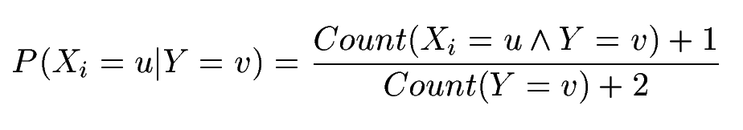
NAIVE BAYES TRAINING
In practice, some of these counts can be zero
Fix this by adding “virtual” counts:
  (This is like putting a prior on parameters and doing MAP estimation instead of MLE)
  This is called Smoothing

Slide 14
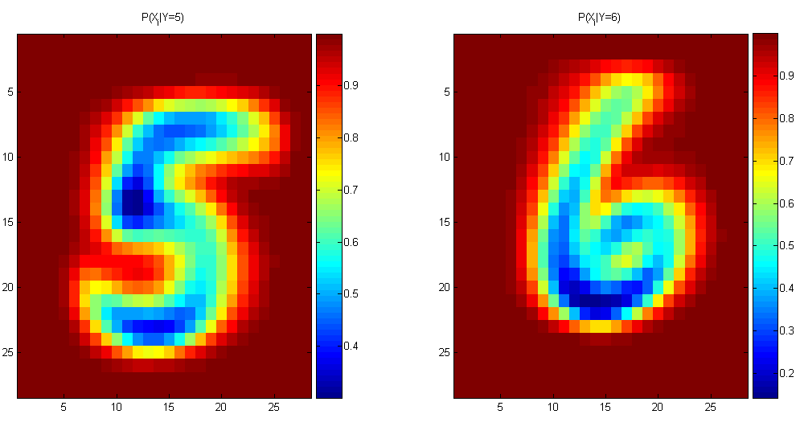
NAIVE BAYES TRAINING
For binary digits, training amounts to averaging all of the training fives together and all of the training sixes together.

Slide 15
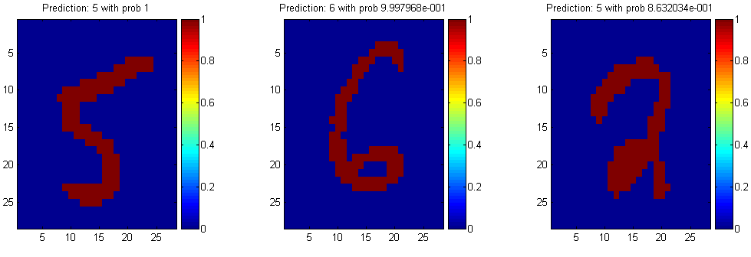
NAIVE BAYES CLASSIFICATION

Slide 16
ANOTHER EXAMPLE OF THE NAIVE BAYES CLASSIFIER
The weather data, with counts and probabilities
outlook |  |  | temperature |  |  | humidity |  |  | windy |  |  | play
 | yes | no |  | yes | no |  | yes | no |  | yes | no | yes | no
sunny | 2 | 3 | hot | 2 | 2 | high | 3 | 4 | false | 6 | 2 | 9 | 5
overcast | 4 | 0 | mild | 4 | 2 | normal | 6 | 1 | true | 3 | 3
rainy | 3 | 2 | cool | 3 | 1
sunny | 2/9 | 3/5 | hot | 2/9 | 2/5 | high | 3/9 | 4/5 | false | 6/9 | 2/5 | 9/14 | 5/14
overcast | 4/9 | 0/5 | mild | 4/9 | 2/5 | normal | 6/9 | 1/5 | true | 3/9 | 3/5
rainy | 3/9 | 2/5 | cool | 3/9 | 1/5
A new day
outlook | temperature | humidity | windy | play
sunny | cool | high | true | ?

Slide 17
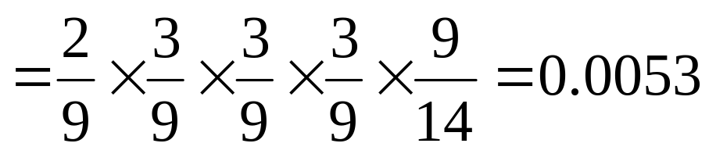
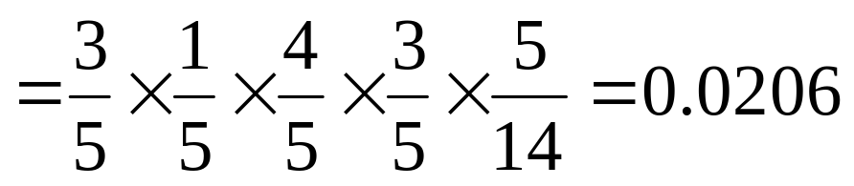
Likelihood of yes
Likelihood of no
Therefore, the prediction is No

Slide 18
OUTPUTTING PROBABILITIES
What’s nice about Naive Bayes (and generative models in general) is that it returns probabilities
  These probabilities can tell us how confident the algorithm is
  So… don’t throw away those probabilities!

Slide 19
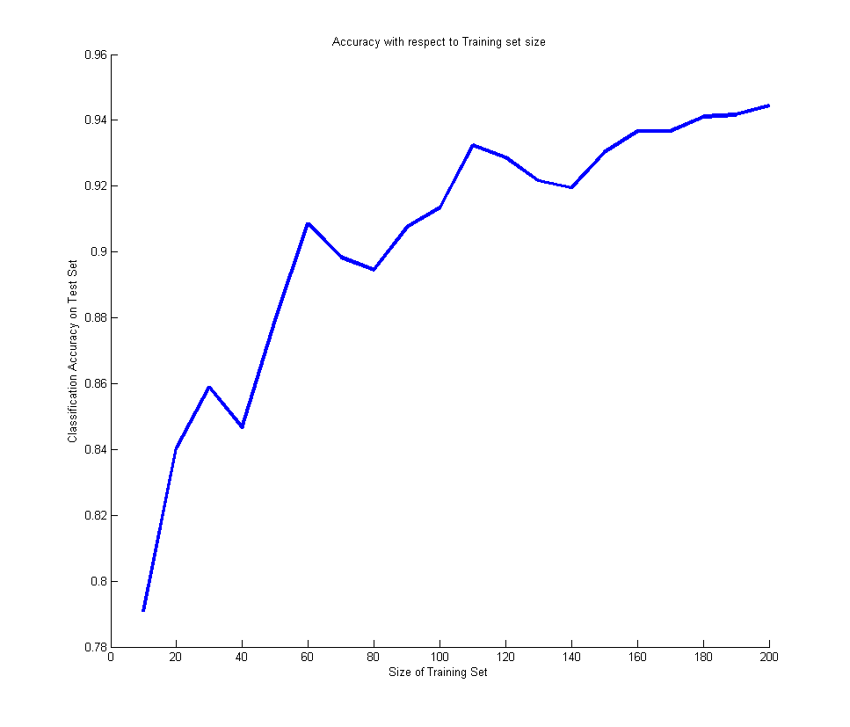
PERFORMANCE ON A TEST SET
Naive Bayes is often a good choice if you don’t have much training data!

Slide 20
NAIVE BAYES ASSUMPTION
Recall the Naïve Bayes assumption:
  that all features are independent given the class label Y
Does this hold for the digit recognition problem?

Slide 21
CONCLUSIONS
Naive Bayes is:
  Really easy to implement and often works well
  Often a good first thing to try
  Commonly used as a “punching bag” for smarter algorithms

Slide 22
ANY QUESTIONS?

