Slide 1
Team name – Topians
Team members:-
Shashank Pant
Tarun Bhambhani
Sagar Mochi
Saksham kumar

Slide 2
Idea
Our idea aims towards finding a solution for the problems uploaded by student. As the student uploads his problem in our program, we use web scraping Technique to get the correct answer for our student.

Slide 3
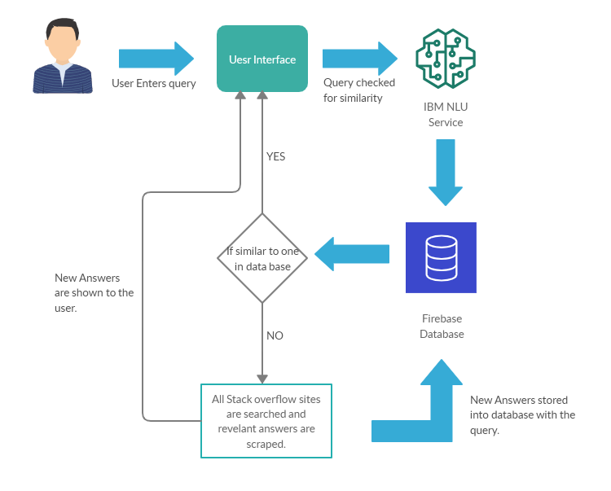
Flow diagram

