Slide 1
DOCKER

Slide 2
Install Docker
Following are the steps to install Docker on Ubuntu:
Install required Packages
Setup Docker repository
Install Docker On Ubuntu

Slide 3
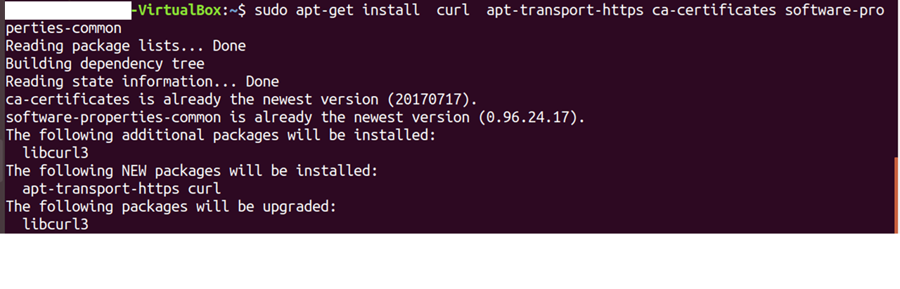
1. Install Required Packages:
There are certain packages we require in our system for installing Docker.
sudo apt-get install curl apt-transport-https ca-certificates software-properties-common

Slide 4
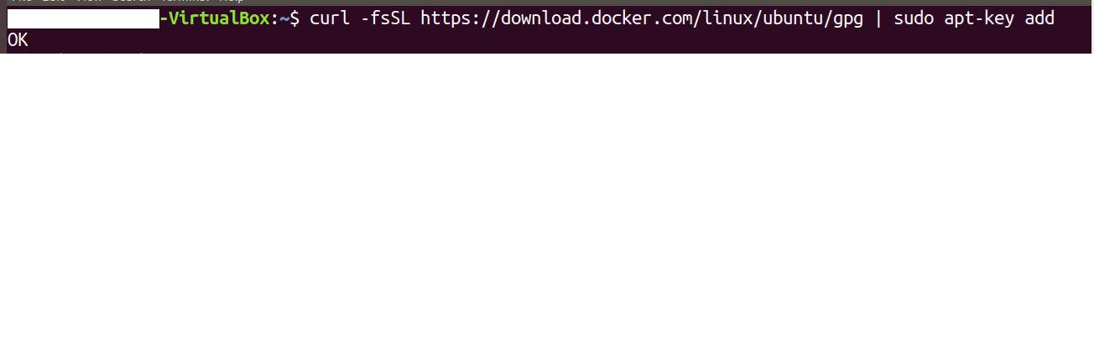
2. Setup Docker Repository:
Now, import Dockers official GPG key to verify packages signature before installing them with apt-get.
Run the below command on terminal:
curl -fsSL https://download.docker.com/linux/ubuntu/gpg | sudo apt-key add

Slide 5
Now, add the Docker repository on the Ubuntu system which contains Docker packages including its dependencies, for that execute the below command:
sudo add-apt-repository "deb [arch=amd64] https://download.docker.com/linux/ubuntu $(lsb_release -cs) stable"

Slide 6
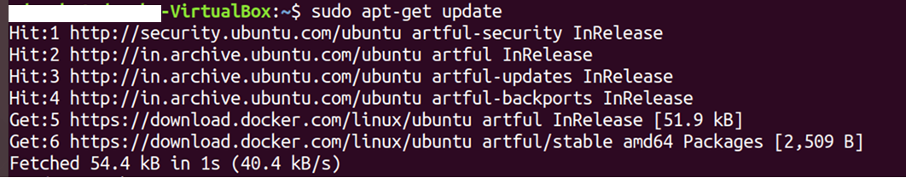
3. Install Docker On Ubuntu:
Now you need to upgrade apt index and install Docker community edition, for that execute the below commands:
sudo apt-get update sudo apt-get install docker-ce

Slide 7
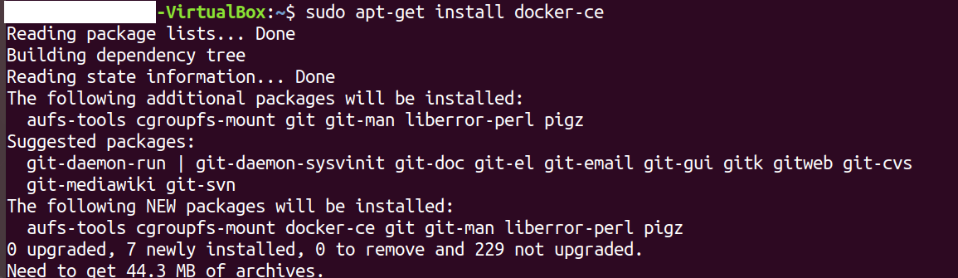

Slide 8
Docker Compose
Docker Compose is basically used to run multiple Docker Containers as a single server.
Example:
Suppose if there is an application which requires WordPress, Maria DB and PHP MyAdmin.
We can create one file which would start both the containers as a service without the need to start each one separately.
It is useful especially if we have a microservice architecture.

Slide 9
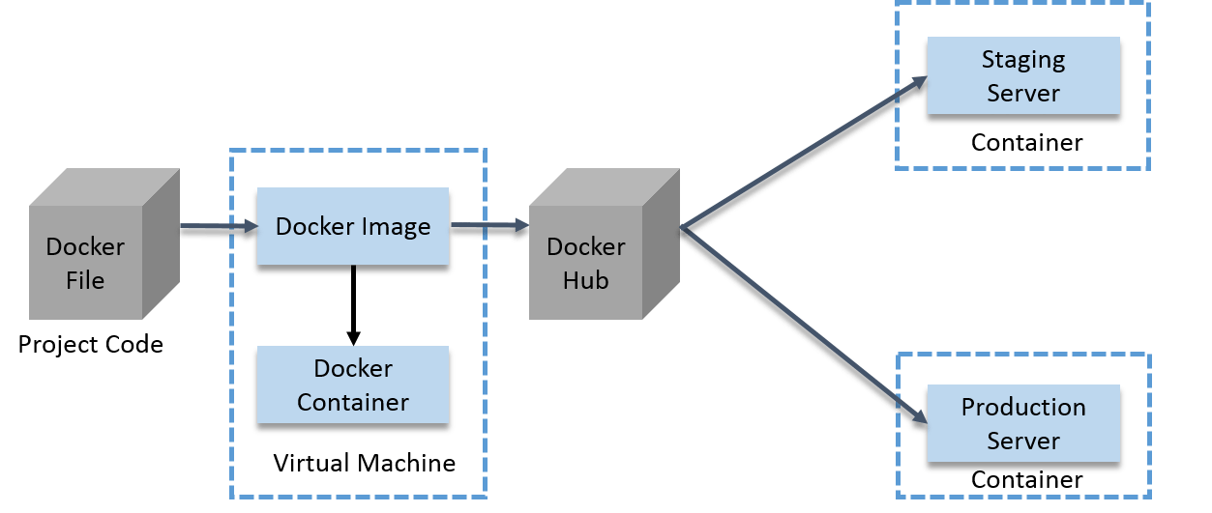
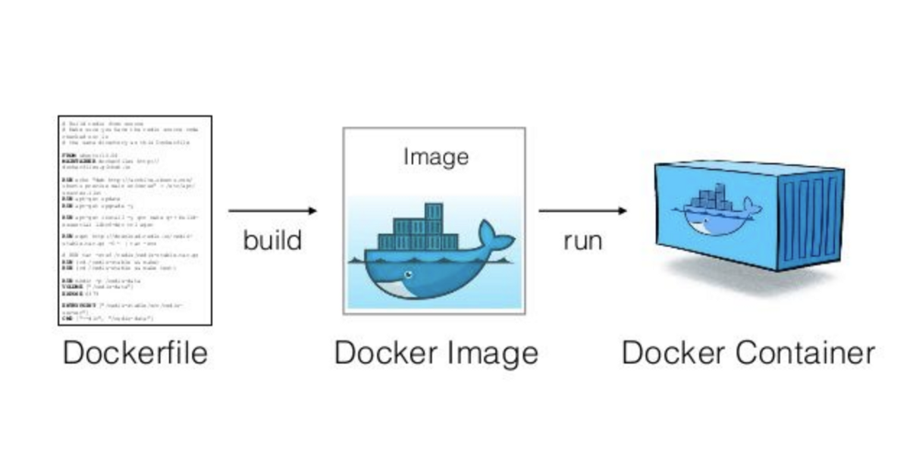

Slide 10
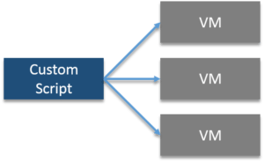
Indiana University Case-Study
Indiana University is a multi-campus public university system in the state of Indiana, United States.
Problem Statement
They were using custom scripts to deploy the applications in the VM.
Their environment was optimized for their legacy Java-based applications.
Their growing environment involves new products that aren’t solely java based.
In order to give their students the best experience possible, the University needed to begin modernizing the applications.

Slide 11
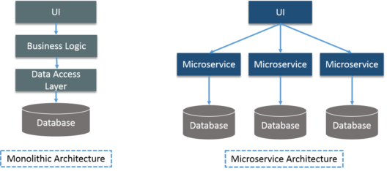
The University wanted to improve the way they architect applications, by moving to a microservices based architecture for their applications.
Security was needed for student’s data such as SSNs and student health data

Slide 12
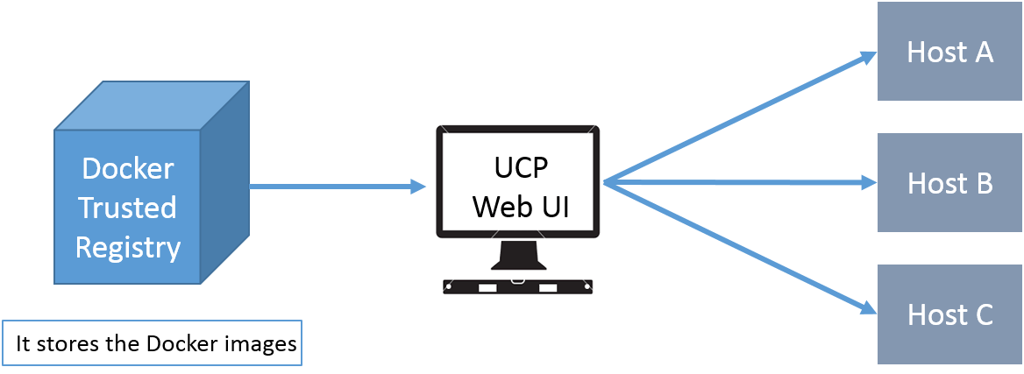
Solution:
All the problems were addressed by Docker Data Center (DDC)

Slide 13
Docker Enterprise Components
1️⃣ Docker Trusted Registry (DTR) 🏦
A secure storage for Docker images.
Ensures trusted and verified images for deployment.
2️⃣ Universal Control Plane (UCP) Web UI 🌐
Centralized management for the entire cluster.
Enables easy deployment of services using stored Docker images.
3️⃣ IT Ops Automation with UCP ⚙️
IT teams use UCP to provision Docker-installed software on hosts.
Simplifies application deployment by eliminating manual setup.
4️⃣ LDAP Integration for Access Management 🔐
UCP and DTR integrate with LDAP servers to streamline user authentication and access control.
🚀 Key Benefit: Provides secure, scalable, and automated management of containerized applications

Slide 14
Docker Hands-On
Docker Compose: It is a tool for defining and running multi-container Docker applications.
With Docker Compose, we can use a Compose file to configure our application’s services.
Then, using a single command, we can create and start all the services from our configuration.
Suppose we have multiple applications in various containers and all those containers are linked together. So, we don’t want to execute each of those containers one by one. into we want to run those containers with a single command.
That’s where Docker Compose comes into the picture.
With it you can run multiple applications in various containers with a single command. i.e. docker-compose up.

Slide 15
Example: Deploying WordPress with Docker Compose
To deploy a WordPress site using Docker Containers, we need three main components:
1️⃣ WordPress Container 📝 (CMS for managing content) 2️⃣ MariaDB Container 🗄️ (Database to store WordPress data) 3️⃣ PhpMyAdmin Container ⚙️ (For managing the database)
Steps to Set Up WordPress with Docker Compose
✅ Step 1: Install Docker & Docker Compose
Ensure Docker is installed on your system.
Install Docker Compose to manage multi-container applications.
✅ Step 2: Deploy WordPress & MariaDB Containers
Use official WordPress and MariaDB Docker images.

Slide 16
Step 3: Configure PhpMyAdmin
Link PhpMyAdmin with MariaDB for easy database management.
Step 4: Run the ContainersUse docker-compose up -d to start all containers.
Step 5: Access WordPressOpen your browser and visit http://localhost:8000 to configure WordPress.
Outcome: A fully functional WordPress site running in Docker Containers, ensuring easy deployment, scalability, and portability.

Slide 17
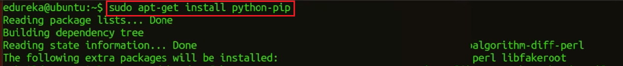
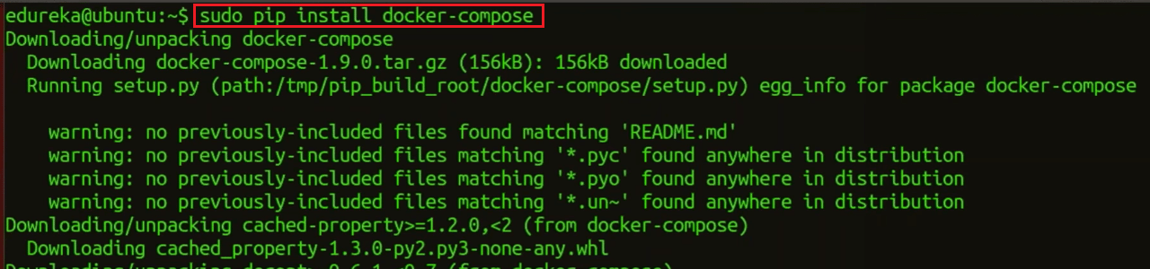
Install Docker Compose:
Install Python Pip first: sudo apt-get install python-pip
Now, you can install Docker Compose: sudo pip install docker-compose

Slide 18
Install WordPress:
Create a wordpress directory: mkdir wordpress
Enter this wordpress directory: cd wordpress/
In this directory create a Docker Compose YAML file, then edit it using gedit:
sudo gedit docker-compose.yml

Slide 19
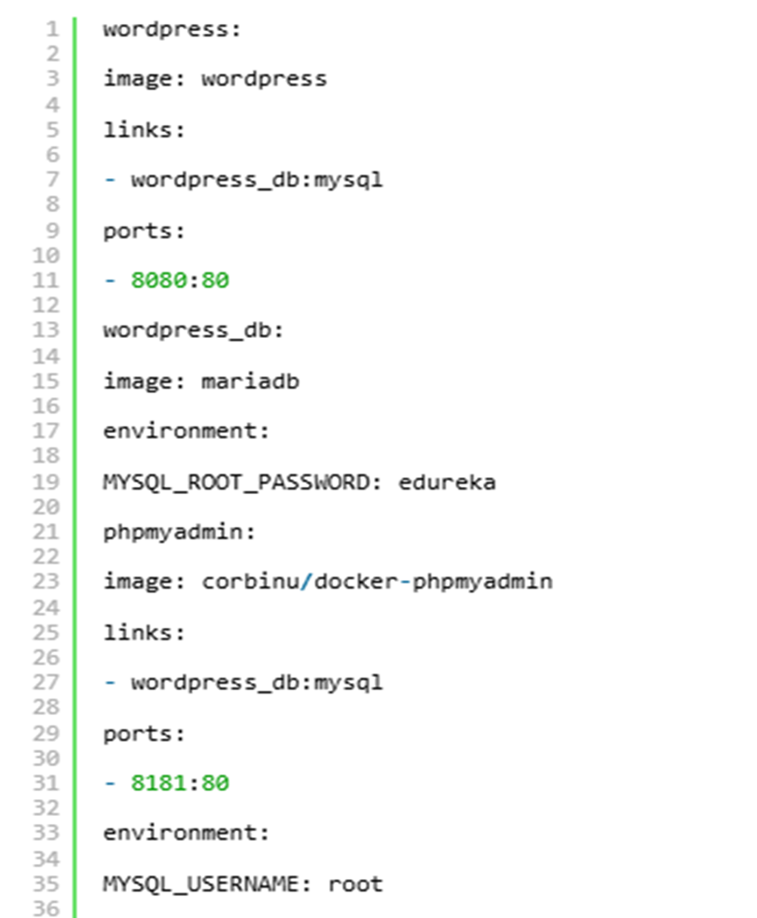
Paste the below lines of code in that yaml file:
wordpress:
image: wordpress
links:
- wordpress_db:mysql
ports:
- 8080:80
wordpress_db:
image: mariadb
environment:

Slide 20
MYSQL_ROOT_PASSWORD: edureka
phpmyadmin:
image: corbinu/docker-phpmyadmin
links:
- wordpress_db:mysql
ports:
- 8181:80
environment:
MYSQL_USERNAME: root
MYSQL_ROOT_PASSWORD: mitali

Slide 21


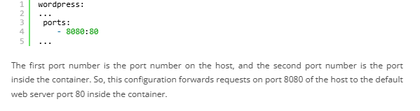

Slide 22
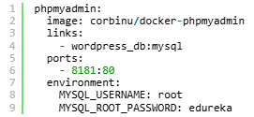
# This pulls the docker-phpmyadmin image by community member corbinu.
# It links the phpmyadmin container to the wordpress_db container with the alias "mysql."
# This allows phpmyadmin to communicate with the database container using the hostname "mysql."
# It maps port 80 of the phpmyadmin container to port 8181 of the host system for web access.
# Additionally, it sets environment variables for the MariaDB username and password.
# Unlike the WordPress image, this image does not automatically inherit MYSQL_ROOT_PASSWORD.
# Therefore, we manually copy the MYSQL_ROOT_PASSWORD value from the wordpress_db container
# and set the username to "root."

Slide 23
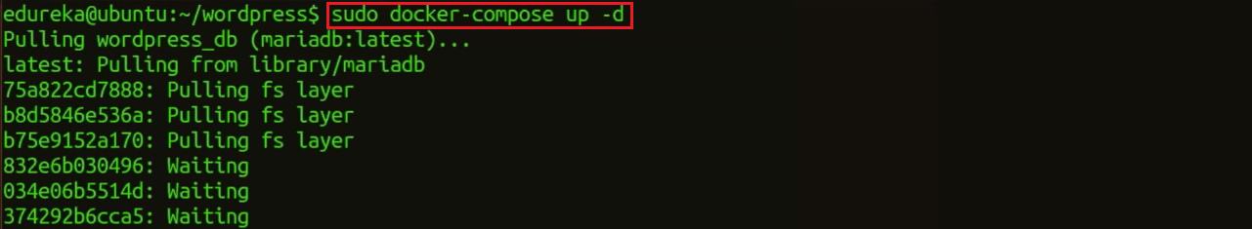
Now start the application group: docker-compose up -d
That’s all we have to do. We can add as many containers as we like this way ,and link them all up in any way we please.

Slide 24
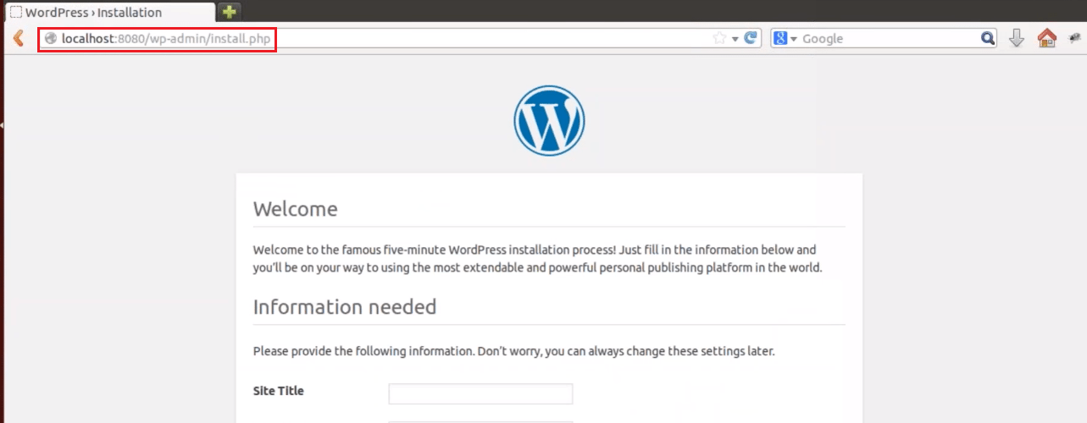
Now, in the browser go to port 8080, using the public IP or host name:
localhost:8080
Fill this form and click on install WordPress.

Slide 25
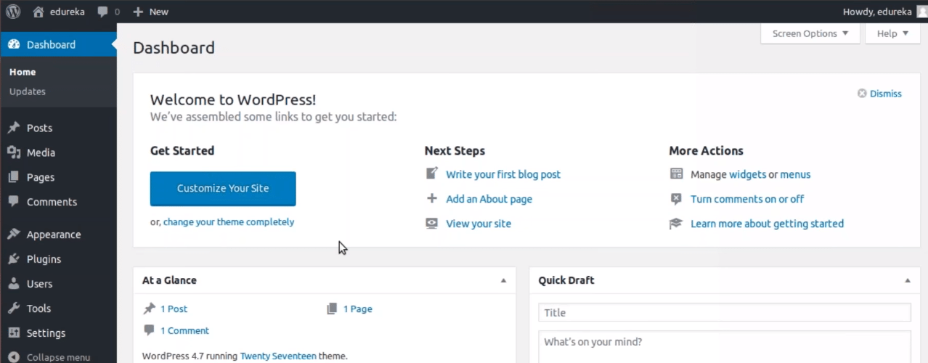

Slide 26
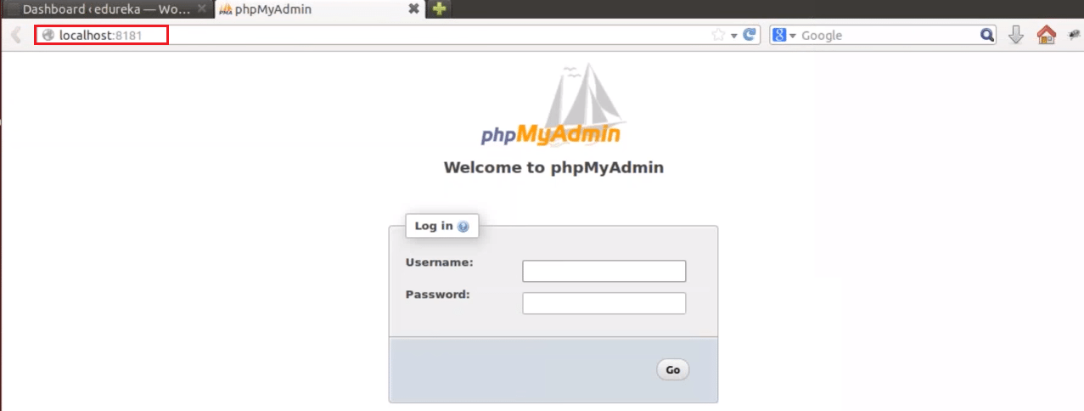
Once it is finished, visit the server’s IP address again (this time using port 8181, e.g. localhost:8181). We’ll be greeted by the phpMyAdmin login screen:

Slide 27
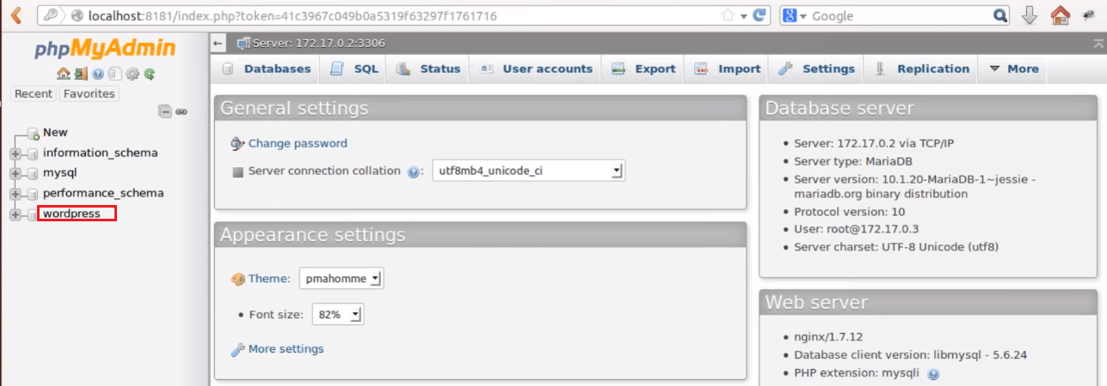
Go ahead and login using username root and password we have set in the YAML file, and we’ll be able to browse your database.
We notice that the server includes a wordpress database, which contains all the data from our WordPress install.

