Slide 1
Online Algorithms
Lecture notes for lectures given by
Dr. Ely Porat, Bar-Ilan University
Notes taken by:
Navot Akiva
Yair Kaufman
Raz Lin
Ohad Lipsky
July 2001

Slide 3
Examples
The Investor Problem:
An investor has a given sum of money and he want to invest it to maximize his gain. He has various options:
Buy funds.
Buy Bonds
Invest in the stock market.

Slide 5
In the offline case he has a full information so he can compute the optimal strategy to maximize his profit.
An online algorithm is a strategy which at each point in time decides what to do based only on past information and with no (or inexact) knowledge about the future.

Slide 7
Finding the best-looking hitchhiker:
Scenario:
You are on a trip from Tel-Aviv to Haifa - a road of 100 km.
At every km there’s a hitchhiker.
You can pick only one hitchhiker.
Once you picked a hitchhiker you cannot pick any other one.
You can’t go back and you obviously want to pick the best-looking one.

Slide 8
Obviously the offline algorithm would have 100% success, since it knows where each hitchhiker is located.

Slide 9
A_{ON} will do the following:
Drive half of the way and remember the prettiest hitchhiker so far. After half of the way take the first hitchhiker who is prettier than the one you’ve remembered.
Theorem:
With this algorithm you have 25% chance for taking the best-looking hitchhiker.

Slide 11
Proof:
Denote:
Y₁ - the prettiest hitchhiker.
Y₂ - the 2nd prettiest hitchhiker.
Looking at the probability tree, we get:
1/2
1/2
Y₂ is in the 1st half
1/2
Y₂ is in the 2nd half
1/2
Y₁ in the 2nd half
Y₁ is in the 1st half

Slide 12
We will pick the best-looking hitchhiker iff she is located in the second half of the road, and the second-most pretty hitchhiker is on the first half of the road.
If this is the case we remember how pretty was the second-most pretty hitchhiker, and thus to choose a prettier hitchhiker than her, is to choose the prettiest one.
This case happens with probability of ¹/₂ * ¹ / ₂ = ¹ / ₄.

Slide 13
The Ski Rental Problem:
Consider a skier who at each day needs to either rent skis for $1 or buy a pair of skis for $T which he can use for the rest of the ski season.
Offline Algorithm:
Rent if the length of the season is < T and buy otherwise.
An online strategy would rent for k days and on the k + 1 day will buy.
What should be that k to minimize the cost?

Slide 14
An offline algorithm knows that the length of the season is L, and then it’s obvious that he should rent if L < T and buy otherwise.
Unfortunately, the skier doesn’t know when the ski season will end.

Slide 15
Ski Rental Problem - Online Strategies:
1. Buying on the first day (k = 1)
Claim: This strategy is T-Competitive

Slide 16
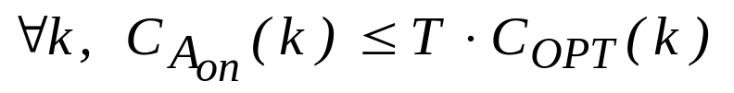
If L = 1 then instead of renting for one day and paying $1 (in the offline algorithm) we bought for $T.
Thus, the worst input sequence is obtained when the season only lasts one day (L = 1).
C_{ON}(A_{L = k = 1}) = C_{ON}(A_{k = 1}) = T.
C_{OPT}(A_{L = 1}) = 1 = min{C_{OPT}(A_{L})}.
This is the worst case since if L > 1 the price of OPT will be > $1, and the price of ON will still be $T.

Slide 17

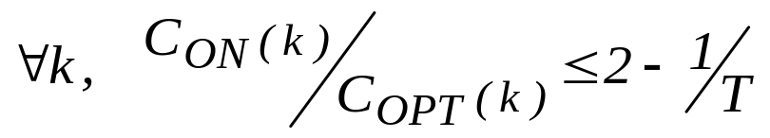
2. Rent for (T - 1) days and buy on the T^{th} day
Theorem: This algorithm is (2 - ¹/_{T})-Competitive
Proof:
for L < T: C_{ON} = C_{OPT}.
L T: C_{ON} = 2T - 1
C_{OPT} = T

Slide 19
3. Rent for k days and buy on the (k + 1)^{th} day
In the worst scenario the (k + 1)^{th} day is the last day.
C_{ON} = k + T
C_{OPT} = min{k, T}
For every online strategy there is a case in which you will pay at least twice as the optimum offline strategy.

Slide 21
Finding the Hole:
You are standing in front of an infinite fence and you know that there is a hole somewhere in the fence.
A_{ON} will start with a step of size 1 and will go each time to the other direction in steps that are power of 2.
For example:
2^{j} + ε
2^{j+1}
2^{j}
2
1

Slide 23
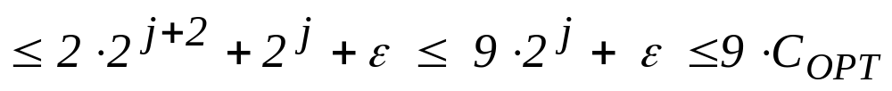
Theorem:
A_{ON} is 9-Competitive
Proof:
The worst case is if the hold is just after 2^{j}, i.e. in 2^{j} + ε.
C_{OPT} = 2^{j} + ε.
C_{ON} = 2(1 + 2 + … 2^{j+1}) + 2^{j} + ε

Slide 25


Helping the monkey find the banana:
We want to teach our monkey to be smart. We do this by having 3 infinite corridors. The banana is placed only in one of them, somewhere on the way. The monkey can go on and forth for as long as it wants.
?

Slide 27
First Attempt:
Using BFS algorithm: steps of 1 - 1 - 1, 2 - 2 - 2, 3 - 3 - 3, and so on.
Theorem:
This online algorithm isn’t competitive.

Slide 28
In BFS the monkey goes 1 step in the first corridor, returns. Then it goes 1 step in the second corridor and returns. And then 1 step in the third corridor and returns.
After that it goes 2 steps in the first corridor and returns. Then 2 steps in the second corridor and returns and then 2 steps in the third corridor and returns.
Then 3 (3 - 3 - 3) steps and so on.

Slide 29


Proof:
The worst case is when the banana is at distance (m + ε) at the last corridor.
Our algorithm will walk a distance of
3 2(1 + 2 + 3 + …+ m) + 2 2(m + 1) + (m +ε ) (m + 1) C_{OPT}.

Slide 30
The offline algorithm will walk just m + 1 steps in the right corridor.
The online algorithm will have to walk in steps of 1’s in each corridor till it gets to m + 1.
The algorithm will go (1 + 2 + 3 + … + m) at each corridor. Then it’ll walk another m + 1 steps in 2 corridors and m + ε steps at the last corridor.
The sum of that series is approximately (m + 1)².
This algorithm isn’t competitive since the cost is dependent in m and isn’t constant.

Slide 31
Second Attempt:
Let the monkey go in steps that are power of 2, i.e:
1 - 1 - 1, then 2 - 2 - 2, 4 - 4 - 4 and etc.
Theorem:
This online algorithm is 12-competitive.
Proof:
Let’s assume that the banana is on some corridor in distance m + ε from the beginning.
The monkey goes

Slide 32
C_{ON} = m.
Fact: 1 + 2 + 4 + … 2^{i} + … + m < 2m

Slide 33
Introduction
An offline algorithm has a full information in advance so it can compute the optimal strategy to maximize its profit (minimize its costs).
An online algorithm is a strategy which at each point in time decides what to do based only on past information and with no (or inexact) knowledge about the future.

Slide 34
Typically when we solve a problem we assume that we know all the data a priori. However, in many situations the input is only presented to us as we proceed.

Slide 35

Definition:
The competitive-ratio of algorithm A is C_{A} if for any n > N₀ and for any sequence R_{n},
where c is independent of n.

Slide 37
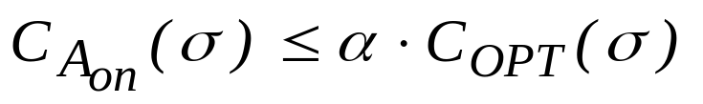
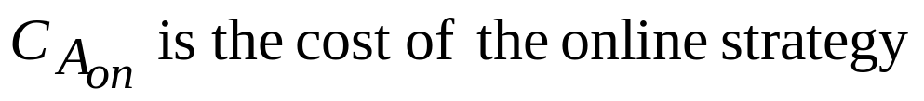
Definition 1:
An online algorithm A_{on} is α-competitive if for all input sequences σ,
where: C_{OPT} is the cost of the optimal offline algorithm

Slide 38
In order to evaluate the online strategy we will compare its performance with that of the best offline algorithm.
This is also called competitive analysis.

Slide 39
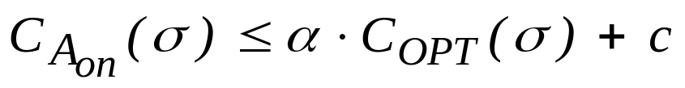
Definition 2:
An online algorithm A_{on} is α-competitive if for all input sequences σ,
where:C_{OPT} is the cost of the optimal offline algorithm
c is some constant independent of σ

Slide 41
Paging Algorithms
Consider a two level memory system, consist a large slow memory at size n and a small fast memory (cache) at size k , such that k << n.
A request for a memory page is served if the page is in the cache. Otherwise, a page fault occurs, so we must bring the page from the
main memory to the cache.
Definition:
A paging algorithm specifies which cache’s page to evict
on a fault.
The paging algorithm is an example of a cache replacement online algorithm

Slide 42
The situation is a CPU that has access to memory pages only through a small fast memory called cache- at size of k pages.
The need is for an online algorithm to satisfy the requests at minimum cost.
Each request specifies a page in the memory system that we want to access. The cost to be minimized is the total page fault incurs, at a request sequence.

Slide 43
The Lower Bound [Sleator and Tarjan] :
Theorem:
Let A be a deterministic online paging algorithm.
If A is α-competitive, then α ≥ k.
Proof:
Let S={p₁,p₂, … , p_{k+1}} be a set of k+1 arbitrary memory pages.
Assume w.l.g. that A and OPT initially have p₁, … , p_{k} in their
cache.
In the worst case A has a page fault on any request σ_{t}.

Slide 44
If our paging algorithm is online – then the decision, which page to evict from the cache, must be made without the knowledge of any future requests.
A has a page fault for any request, because the adversary can ask each time for a page that is not in the cache.

Slide 45
    OPT however, when serving σ _{t} can evict a page not requested for the next k-1 requests σ _{t+1}, … , σ_{t+k-1}. Thus, on any k consecutive requests OPT has at most one fault.

Slide 46
OPT make one fault on each k arbitrary pages requested, because it knows all requests sequence ahead.

Slide 47
The Marking Algorithm
The Algorithm:
    1.Unmark all slots at the cache.
    2. Partition the requests sequence σ into phases, where each
    phase includes requests for accessing k distinct pages, and
    ends just before the k+1 distinct page is requested. Each
    new page that is accessed is marked whether it was
    already in the cache or it was brought due to fault.
    3. When a page is brought to the cache due to a fault, it is
    placed at the first unmarked slot at the cache.
    4. At the end of a phase, unmark all slots in cache.

Slide 48
If the requested page is in the cache but unmarked – mark it.
If all pages in cache are marked – it’s the end of the phase, and we clear all marks.
The insertion of a page brought to the cache is deterministic – therefore it is at the first available cache slot.

Slide 49
Key Property:
    The Marking algorithm never evicts a page, which is already marked.
Theorem:
The Marking algorithm is k-competitive.
Proof:
Claim:
The cost incurred by the Marking algorithm is at
most k per a phase.

Slide 50
    The cost incurred by the Marking algorithm is at most k per a phase, because on every fault we mark the page, and in each phase we access only k distinct pages – which means only k fetches to the cache.

Slide 51
Assume the following:
      p₁ p₂ p₃ …..p_{m} s₁ s₂ s₃ ……
      phase σ_{i} phase σ_{i+1}
p₁ started a new phase so it must have caused a page fault.
p₁, p₂, …, p_{m} contains requests for k distinct pages and s₁ started a new phase, so s₁ must be distinct from them. Thus, the request sub-sequence p_{2 … ,} p_{m} ,s₁ includes requests for k distinct pages all different from p₁ so we must have a page fault at least on one of these pages, because s₁ starts a new phase.
Thus, for any adversary we can associate a cost of 1 per phase.

Slide 52
For any adversary we can associate a cost of 1 per phase.
Let p₁ be the first request at the phase σ_{i}, so after that request the adversary must contain p₁ in the cache.
Now, up to and including the first request of the next phase there are at least k distinct pages- all distinct from p₁. Thus the adversary must have a page fault for at least one of these pages.

Slide 53
LRU and FIFO [Sleator and Tarjan]:
Definition 1:
LRU (Least Recently Used) – on a page fault, evict the
page in the cache that was requested least recently.
Definition 2:
FIFO (First In First Out) – on a page fault, evict the
page that has been in the cache for the longest time.
We will prove that LRU is k-competitive. The proof for FIFO is similar

Slide 55

Theorem:
LRU algorithm is k-competitive.
Proof:
Consider an arbitrary requests sequence σ = σ_{1,} σ₂ …, σ_{m} ,
we will prove that
w.l.g assume that both LRU and OPT starts with the same cache.
Partition σ into phases P_{0,}P₁, P₂ … such that LRU has at most k
faults on P_{0,} and exactly k faults on P_{i} for every i ≥ 1.
We will show that OPT has at least one page fault during each
phase P_{i} .
For phase P₀ it’s obvious.

Slide 56
Partitioning σ into phases can be obtained easily.
Start at the end of σ , and scan the requests sequence. Whenever a k faults made by LRU are counted – cut off a new phase.
By showing that OPT has at least one page fault during each phase we will establish the desired bound .
For phase P₀ there is nothing to show since LRU and OPT starts with the same cache- and OPT has a page fault on the first request that LRU has a fault.

Slide 57

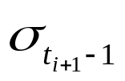
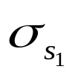
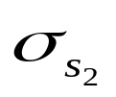
    Consider an arbitrary phase P_{i} , i ≥ 1.
    Let be the first request of P_{i} and the last request at P_{i} .
    Let p be the last page requested at phase P_{i-1} .
Lemma:
    P_{i} contains requests to k distinct pages that are different from p.
Lemma proof:
  If LRU faults on the k requests that are for distinct k pages that are all different from p, the lemma holds.
  If LRU faults twice on page q at phase P_{i ,}
There exists = q , = q , such that t_{i} ≤ S₁ ≤ S₂ ≤ t_{i+1} –1

Slide 59
After served q is at the cache, and it is evicted at time t with S₁ < t < S₂ , as it is the least recently used page in cache.
Thus … σ_{t} contains requests to k+1 distinct pages , at
least k of which must be different from p.
    If within a phase P_{i} LRU does not fault on a same page twice, but on one fault page p is evicted, in similar way as above the lemma holds.
If the lemma holds, OPT must have a page fault on a single phase P_{i.}

Slide 60
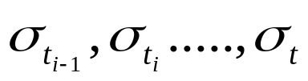
If within a phase P_{i} LRU does not fault on a same page twice, but on one fault p is evicted , let t ≥ t_{i} be the first time when p is evicted.
Using the same argument as above, we obtain that the subsequence must contain k+1 distinct pages.
If the lemma holds, OPT must have a page fault on a single phase P_{i} . OPT has page p in it fast memory at the end of P_{i-1} and thus cannot have all the other k pages requested at P_{i} in it’s cache.

Slide 61
Randomized Online Algorithms
One shortcoming of any deterministic online algorithm is that one can always exactly determine the behavior of the algorithm for an input s. And thus he can affect the behavior of the algorithm.
This motivates the introduction of randomized online algorithms which will have better behavior in this respect.

Slide 63
Definition:
A randomized online algorithm A is a probability distribution {A_{x}} on a space of deterministic online algorithms.
Definition:
An oblivious adversary knows the distribution on the deterministic online algorithms induced by A, but has no access to its coin-tosses.

Slide 64
Informally, a randomized algorithm is simply an online algorithms that has access to a random coin.
The second definition actually says that the adversary doesn’t see any coin-flips of the algorithm. This entails that the adversary must select his “nasty” sequence in advance, and thus he cannot diabolical inputs to effect the behavior of the algorithm.
Randomization is useful in order to hide the status of the online algorithm.

Slide 65
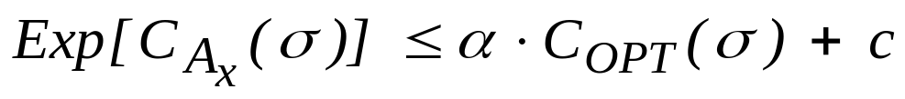
Definition:
A randomized online algorithm A distributed over deterministic online algorithm {A_{x}}is α-competitive against any oblivious adversary if for all input sequences σ,
where:
C_{OPT} is the cost of the optimal offline algorithm
c is some constant independent of σ
x
x

Slide 67

RMA - Random Marking Algorithm
RMA is a non-deterministic algorithm for paging. It is similar to the deterministic Marking algorithm.
The Algorithm:
For each request sequence I do:
1. Unmark all k pages within the cache.
2. For each σ_{i} I :
2.1 If σ_{i} is already in the cache , mark it.
2.2 Else:
2.2.1 If all the pages are marked - unmark all the pages.
2.2.2 Choose a random unmarked page and replace it with σ_{i}
and mark it.
.

Slide 68
The definition of a phase doesn’t depend on the coin-tosses but only on the input sequence. The coin-tosses only affect the behavior of the algorithm within a phase.

Slide 69
Example of RMA on a cache of size 4:
p₁
p₁
p₆
p₆
p₂
p₅
p₂
p₆
p₂
p₃
p₂
p₃
p₅
p₅
p₅
p₄
p₄
p₄
p₃

Slide 71
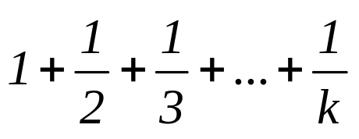

Theorem:
RMA is 2H_{k}-Competitive, where H_{k} is the k^{th} harmonic number,
i.e.: H_{k} =
Fact:
Proof:
Let σ be a fixed input sequence.
We partition the requests into phases, each phase ends just before the k+1 distinct page is requested, i.e., each phase starts after all the markings are deleted.

Slide 72
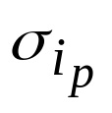
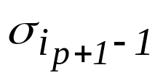
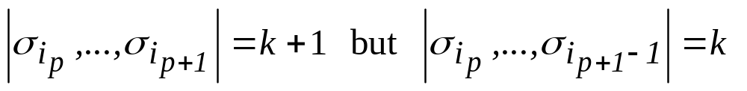
We will need to show that
Note that by our phases division:
The first phase begins on the first page fault.
The (i + 1)^{st} phase starts on the request following the last request
of phase i.
If phase p starts on then it ends on where

Slide 73
Definitions:
Stale requests are requests for pages that are unmarked, but
was marked in previous phase.
Clean requests are request for pages that are neither stale
nor marked.

Slide 74
For each clean request we have to pay a price of 1 regardless of the coin-tosses, since a clean item was not requested in the previous phase and wasn’t requested yet in the current phase, and thus it’s not in the cache of the RMA algorithm.
Stale pages are pages that were in the cache when phase i begins.
Pages that were in the cache when phase i began (stale pages) may have been evicted. If they were evicted we need to pay 1 for bringing them back in when they are requested again.

Slide 75
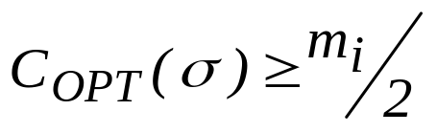

Denote:
m_{i} = the number of clean requests in phase i.
We will prove:
(a)
(b)
RMA is 2H_{k}-competitive

Slide 76
The cost of both algorithms is calculated by the number of cache misses each algorithm causes in the phase.

Slide 77
Lemma:
Proof:
Denote:
S_{OPT} - The set of pages in the cache for OPT.
S_{RMA} - The set of pages in the cache for RMA.
d_{B} - | S_{OPT} - S_{RMA} | at the beginning of the phase.
d_{E} - | S_{OPT} - S_{RMA} | at the end of the phase.

Slide 78
d_{B} counts the number of different items that S_{OPT} has and S_{RMA} doesn’t have at the beginning of the phase.
d_{E} counts the number of different items that S_{OPT} has and S_{RMA} doesn’t have at the end of the phase.

Slide 79
Since there are m_{i} clean page requests and the contents of OPT’s cache differs from RMA’s cache in d_{B} pages, then at least m_{i} - d_{B} pages will not be in OPT’s cache either.
So OPT has at least m_{i} - d_{B} cache misses.
OPT will also have cache misses due to its looks ahead.

Slide 80
Since there are d_{B} items that are in OPT’s cache and not in RMA’s caches, some of these items might be requested in the current phase and thus will not cause a cache miss.
However, we know that the m_{i} pages will cause RMA’s to a cache miss. Thus, at least m_{i} - d_{B} pages are also not in OPT’s cache and they will be requested during the phase and will generate a cache miss for OPT.
Due to look ahead, OPT might prefer to evict pages it will need in the current round to have less misses in the following rounds, however, that will cause it cache misses in this round.

Slide 81
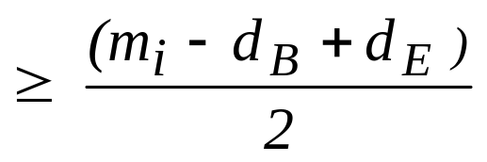
d_{E} counts pages that were requested in this phase and have been evicted from the cache by OPT.
Each of these pages must have been a cache miss, and thus OPT has at least d_{E} cache misses.
Therefore:
# of cache misses for OPT in a phase max(m_{i} - d_{B}, d_{E})

Slide 82
The contents of RMA’s cache (S_{RMA}) at the end of the phase are only the k distinct pages that were requested during the phase.
The contents of OPT’s cache (S_{OPT}) at the end of the phase may be different from RMA’s, which means it must have evicted some of those pages.
The d_{E} pages must have been a cache miss because that in order to cause a page that was requested in the round to be evicted a miss must be generated.
The last inequality holds since the maximum of 2 numbers is at least there average.

Slide 83

We’ve found a bound for the number of misses in a phase.
If we add up this sum for many phases we get that the average or amortized number of cache misses for OPT is

Slide 84
If we add the sum for many phases, then d_{E} for one round is equal to d_{B} for the next (since the number of different items in the cache at the end of the round is equal to the number of different items in the cache at the beginning of the following round).
So all the d_{B}’s and d_{E}’s cancel except the first and the last, but their contribution is negligible if we sum over enough phases (we can also assume that both RMA and OPT start with the same cache, so the first d_{B} is equal 0).

Slide 85

Lemma:
Proof:
Every request to a clean page causes a cache miss. Since there are m_{i} clean requests there are at least m_{i} misses.
RMA also causes a miss if there’s a request for a stale page that has been evicted in the current phase.
The probability of stale page requests causing a cache miss is maximized when all the requests for clean pages come before the requests for stale pages.

Slide 86
We try to find a competitive ratio so we will assume that the worst case happens and that all the clean requests come before the stale requests. The stale requests may or may not cause a miss.
This is the worst case since the clean requests cause certain cache misses and then the probability the we’ve evicted a stale page is higher.

Slide 87
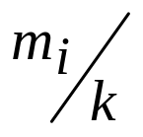
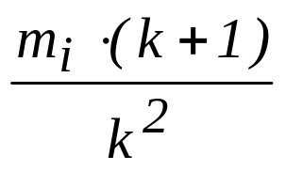
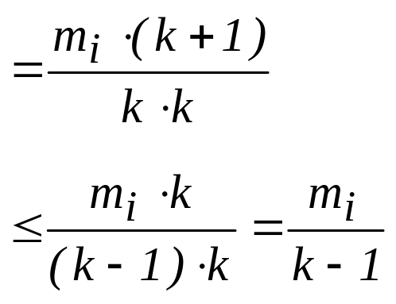
There are k - m_{i} requests for stale pages.
Since the m_{i} clean page requests go first, when the first stale page request happens, m_{i} out of k of the pages have been evicted (at random), so:
Pr[the 1st stale page request cause a miss] =
At the second stale page request:
Pr[the 2nd stale page request cause a miss] =

Slide 88
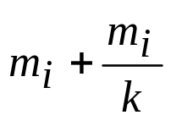

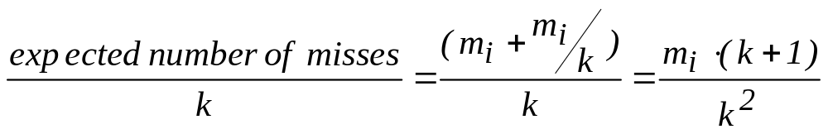
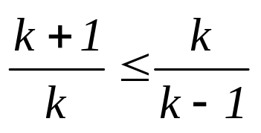
There are k distinct pages requested in a phase.
Since there are m_{i} clean requests there must be k - m_{i} requests for stale pages in the phase, since a page requested for the first time in the phase is unmarked at that time (and therefore is either stale or clean).
At the second stale page request, the expected number of misses is
(m_{i} misses caused by the clean page requests and expected number of misses for the first stale page request) and the
probability of another miss is:
The inequality holds since

Slide 89
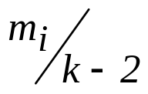
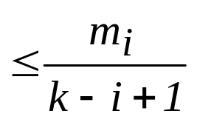
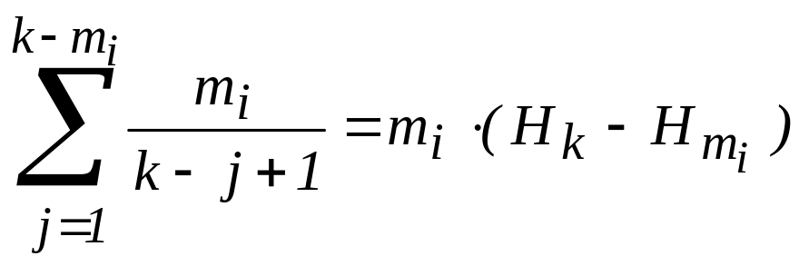
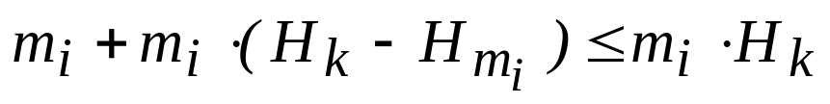
If we repeat this process we find the next term is bounded by
and etc., and in general:
Pr[a miss at the i^{th} stale page request]
Now,
So the total expected number of misses for RMA, counting both clean and stale page requests is

Slide 90

because H_{mi} is at least 1.

Slide 91
Lower Bound for Randomized Online Paging Algorithms
Theorem:
The competitive ratio of any randomized algorithm for the paging problem is at least H_{k}.
Proof:
We’ll actually prove the following lemma:
Lemma:
There is a random distribution on request sequences so that any deterministic algorithm on that distribution has competitive ratio H_{k}.

Slide 92
It will be suffice to prove the lemma, since the definition of randomized algorithm actually discuss algorithm which are randomly distributed over deterministic online algorithm.

Slide 93
Proof:
Consider a set of k + 1 pages. Consider request sequences of length N >> k generated at random as follows:
The first request is chosen uniformly at random form the k + 1
items.
Request j is chosen uniformly at random from the k items not
requested in request j - 1.
Now we partition the sequence of requests to phases. A phase is the shortest sequence that includes requests for k distinct pages.
Lemma: The length of each phase is kH_{k}.

Slide 94
The partition to phases is just like the partition in the paging algorithms (deterministic and random) we’ve discussed earlier.

Slide 95
Proof:
The problem of computing how many request needed till we reach k + 1 distinct pages is equivalent to the coupon collector problem, in which you have k + 1 boxes and you need to fill every box with at least one ball, where each ball has an equal probability for falling into each box.
The analogy to paging is as follows:
- empty box corresponds to an unmarked page.
- full box corresponds to a marked page.
- balls correspond to requests for pages.
- When all the boxes are full, all the pages are marked and a new phase begins.

Slide 96
We need to find the expected number of requests that we need to make in order to have k distinct pages.
The request for pages are independent with probability ¹/_{k} for each page.

Slide 97
Let’s look at T₁, T₁ + T₂, …, T₁ + T₂ + … + T_{k}, whereas:
after T₁ = 1 request we have the first page;
after another T₂ requests we will get a request to a page that is different from the first page, and so on.
We need to find Exp(T₁ + T₂ + … + T_{k}) =
Exp(T₁) + Exp(T₂) + … + Exp(T_{k})
Exp(T₁) = 1
T₂ has a geometric (^{k - 1}/_{k}) distribution so Exp(T₂) = ^{k}/_{k-1}
Since the mechanism controlling T₃ is independent of the past information, we get that Exp(T₃) = ^{k}/_{k-2} and so on.

Slide 98
The first equality holds since Exp(cX + dY) = cExp(X) + dExp(Y) for X, Y random variables and c, d constants.
Exp(T₁) = 1 since T₁ must equal 1.
We can look at each request after the first like a coin toss with probability of ^{k - 1}/_{k} of getting a head (= getting a page which is different from the first), and since T₂ is the number of tosses needed to get the first head, it entails that T₂ has a geometric (^{k - 1}/_{k}) distribution.
T₃ is independent of the past information under the assumption of equal abundance and uniform random distribution.

Slide 99
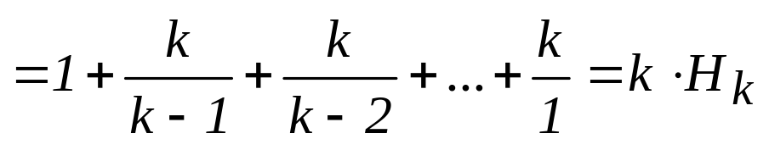
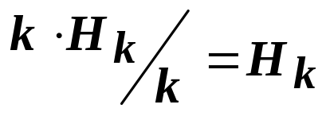
Thus we get that Exp(T₁) + Exp(T₂) + … + Exp(T_{k}) =
Thus, the length of each phase is kH_{k}.
Now, the offline algorithm evicts at the end of each phase the element that is requested at the end of the next round. Thus, the offline algorithm has one miss per phase.
The probability that the online algorithm has a miss in each step is ¹/_{k} . Thus, the expected number of misses the online algorithm has is
per phase
And thus the competitive ratio is H_{k} .

Slide 100
We can examine T₃ as waiting for any one of the k - 2 pages that haven’t yet been requested. It is like a coin toss with probability of ^{k - 2}/_{k} of getting a head (= getting a page which is different from the first and second), so T₃ has a geometric
(^{k - 2}/_{k}) distribution.

Slide 101
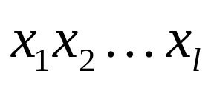
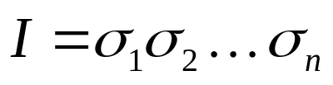


The List Accessing Problem
Definition
Input: linked list
a sequence I of requested accesses
where .
The cost of accessing is the location of the item in the list counted from the front.
Given I (online), our objective is to minimize the cost of accessing the items in the list

Slide 103
While processing the accesses we can modify the list in two ways:
free transpositions: after an access, the requsted item may be moved at no cost closer to the front of the list.
paid transpositions: at any time we can swap two adjacent list items at a cost of 1.

Slide 105
Deterministic Online Algorithms
Move-To-Front (MTF)
Move the requested item to the front of the list.
Transpose (TRANS)
Exchange the requested item with the immediately preceding item in the list
Frequency-Count (FC)
Maintain a frequency count for each item in the list. Items are stored in non-decreasing order of accesses. After item is accessed its frequency counter is updated and item moved forward (if necessary) to maintain list order.

Slide 107

We will prove the following two facts:
Theorem 1:
The Move-To-Front algorithm is 2-competitive.
Theorem 2:
Let A be a deterministic online algorithm for the List Accessing Problem. If A is c-competitive, then .

Slide 108
Pay attention to the fact that in theorem 2 we prove a lower bound to the competitiveness.

Slide 109


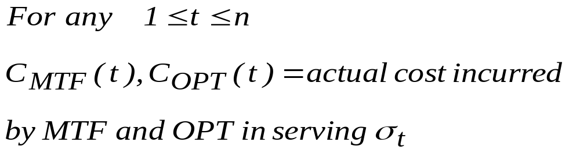
Proof 1:
Definitions: The potential function Φ : For any
Φ(t) = The number of inversions in Move-To- Front’s list with respect to OPT’s list, after is served.
An inversion is a pair x,y of items such that x occurs before y in Move-To-Front’s list and after y in OPT’s list.

Slide 110
Move-To-Front and OPT start with the same list, so the initial potential is 0.

Slide 111
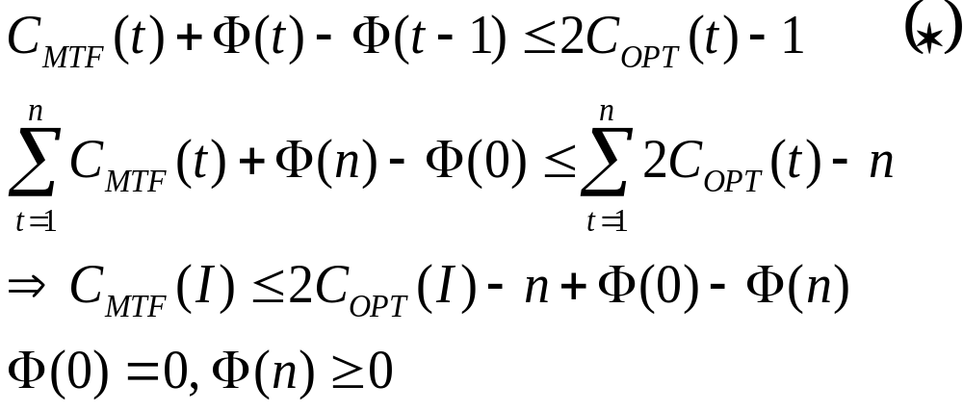
We will show that for any t
then
and because
the theorem follows.

Slide 112

The amortized cost incurred by Move-To-Front on is defined as:

Slide 113

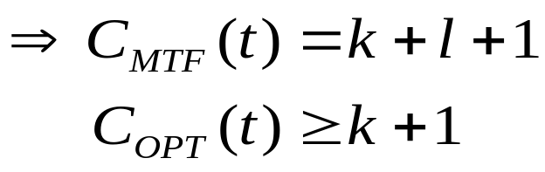
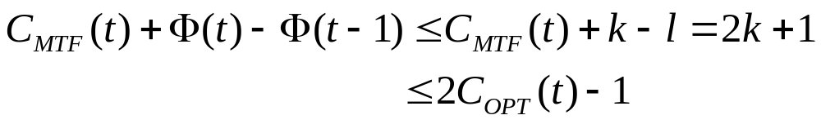
We will show inequality (*) For an arbitrary t.
Let: x = the item requested by .
k = number of items before x in MTF’s and OPT’s list
l = number of items before x in MTF’s list but follow x in OPT’s list.
When MTF serve and moves x to the front of the list, l inversions are destroyed and at most k new inversions are created.
Thus

Slide 115

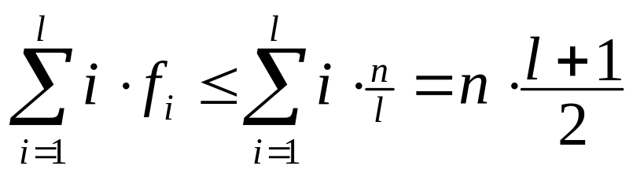
Proof 2:
Consider a list of l items. n requests in I.
We construct a “bad” request sequence for A with cost
Let OPT be the optimum static offline algorithm. OPT first sorts the items in the list in order of nonincreasing request frequencies and then serves I without making any exchanges.
If the list is sorted by request frequencies, the worst case is that all frequencies are n/l (then we didn’t gain anything from sorting).
Thus accesses costs:

Slide 116

We can take instead of OPT the static offline algorithm because we prove a lower bound.
Each request is made to the item that is stored at the last position in A’s list. n requests, each will cause cost l, lead us to the cost nl.
If the frequencies are not equal the cost will be lower, because then we’ll put the more frequent items closer to the beginning, causing more cheap accesses and less expensive accesses.

Slide 117
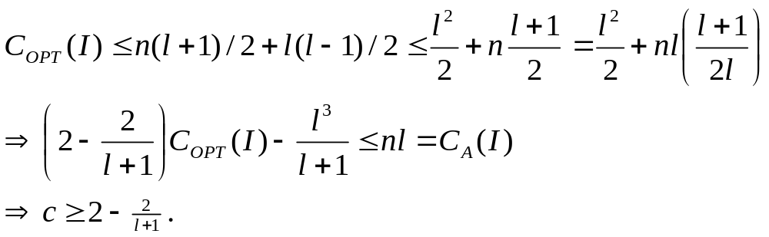
Rearranging the list cost at most l(l-1)/2. Then the requests in I can be served at a cost of at most n(l+1)/2.
Thus
The theorem follows because the competitive ratio must hold for all list lengths.

Slide 119

Randomization
Algorithm Bit
Each item in the list maintains a bit that is complemented whenever the item is accessed. If an access cause a bit to change to 1, then the requested item is moved to the front of the list. The bits are initialized independently and uniformly at random.
Theorems:
1. The Bit algorithm is 1.75-competitive against any oblivious adversary.
2. Let A be a randomized online algorithm for the List Accessing Problem. If A is c-competitive against any oblivious adversary, then .

Slide 121
The k-Server Problem
Motivation:
There are k servers for your drink requests. They come sequentially, and the response is quick (before the next request is up).

Slide 123
Special cases of the k-server problem
Paging
  The k-server problem with a uniform distance metric.
Two-headed Disk
  k servers are the 2 heads

Slide 124
Paging
The paging problem is a special case of the k-server problem, in which the k servers are the k slots of the fast memory, V is the set of pages and d(u,v)=1 for u≠v. In other words, paging is just the k-server problem but with a uniform distance metric.
Two-headed Disk
You have a disk with concentric tracks. Two disk-heads can be moved linearly from track to track. The two heads are never moved to the same location and need never cross. The metric is the sum of the linear distances the two heads have to move to service all disk’s I/O requests. Note that the two heads move exclusively on the line that is half the circumference and the disk spins to give access to the full area.

Slide 125
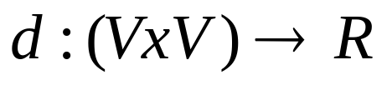
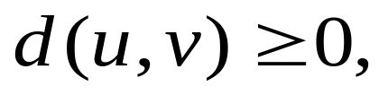
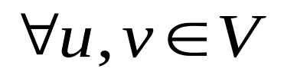
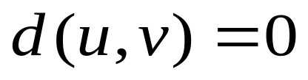
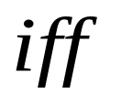

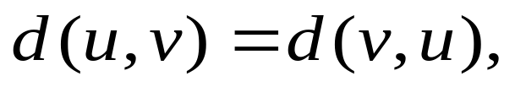
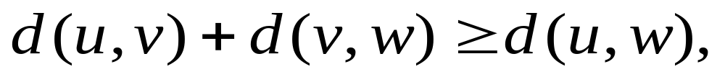
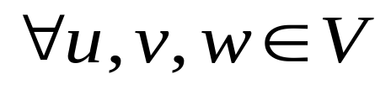
Definition 1:
The k-Server Problem
A metric space is a set of points V along with a distance function
s.t.

Slide 126
Sometimes it is convenient to think of a finite metric space over n points as the complete weighted graph over n vertices with weights corresponding to distance between the corresponding points. Similarly, given a weighted (not necessarily complete) graph, we can associate a metric space with it by letting the distance between any pair of points to be the (weighted) length of the shortest path between them in the graph.

Slide 127
Definition 2: (The k-server problem)
The input is a metric space V, a set of k “servers” located at points in V, and a stream of requests σ₁,σ₂,…, each of which is a point in V.
For each request, one at a time, you must move some server from its present location to the requested point.
The goal is to minimize the total distance traveled by all servers over the course of the stream of requests.

Slide 129
Lemma:
For any stream of requests, on-line or off-line, only one server needs to be moved at each request.
Proof:
Assume, by contradiction, that we don’t need to move only one server.
In response to some request, σ_{i} in your stream, you move server j to point σ_{i} and, in order to minimize the overall cost, you also move server k to some other location, perhaps to “cover ground” because of j’s move.

Slide 131
If server k is never again used, then the extra move is a waste, so assume server k is used for some subsequent request σ_{m}. However, by the triangle inequality, server k could have gone directly from its original location to the point σ_{m} at no more cost than stopping at the intermediate position after request σ_{I}.

Slide 133
Theorem:
Let A be a deterministic on-line k-server algorithm in an arbitrary metric space.
If A is α-competitive, then α ≥ k.

Slide 134
For any metric space, the competitive ratio of the k-server problem is at least k.
Moreover, this lower bound holds for any randomized algorithm against an adaptive on-line adversary.

Slide 135
Proof:
Let |S|= k+1, the set of points initially covered by A’s servers + one other point.
σ= σ₁,…,σ_{m}, a request sequence.
Let B₁,…,B_{k} , k algorithms such that B_{j} initially covers all points in S except for j.
Whenever a requested point x_{t} is not covered, B_{j} moves the server from x_{t-1} to x_{t}.

Slide 136
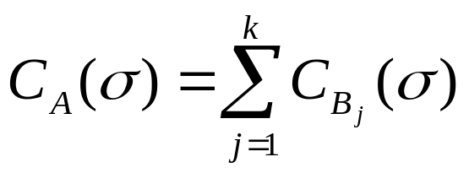
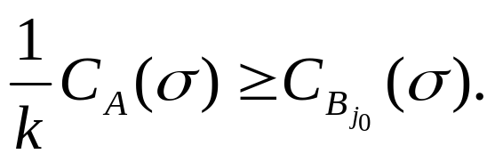
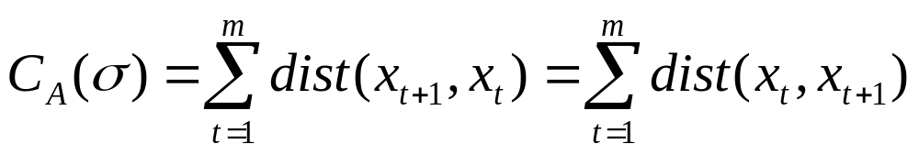
We will construct a request sequence σ and k algorithms B₁,…B_{k} such that
Thus, there must exist a j₀ such that
Let S be the set of points initially covered by A's servers plus one other point. We can assume that A initially covers k distinct points so that S has cardinality k+1.
A request sequence σ= σ₁,…,σ_{m} is constructed in the following way: At any time a request is made to the point not covered by A's servers.
For t=1,…,m, let σ_{t}=x_{t}. Let x_{m+1} be the point that is finally uncounted. Then

Slide 137
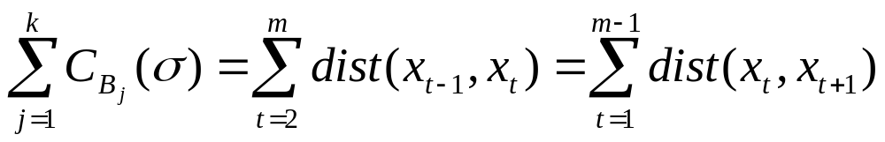
At any time a request is made to the point not covered by A’s servers, thus
At any step, only one of the algorithms B_{j} has to move that thus

Slide 138
Let y₁,…,y_{k} be the points initially covered by A. Algorithm B_{j},
1 ≤ j ≤ k, is defined as follows: Initially, B_{j} covers all points in S except for y_{j}. Whenever a requested point x_{t} is not covered, B_{j} moves the server from x_{t-1} to x_{t}.
Let S_{j}, 1 ≤ j ≤ k, be the set of points covered by B_{j}'s servers. We will show that throughout the execution of σ, the sets S_{j} are pairwise different. This implies that at any step, only one of the algorithms B_{j} has to move a server, thus
The last sum is equal to A's cost, except for the last term, which can be neglected on long request sequences.

Slide 139
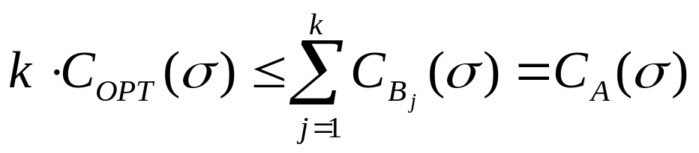
therefore

Slide 140
Consider two indices j, l with 1 ≤ j, l ≤ k. We show by induction on the number of requests processed so far that S_{j}≠S_{l}. The statement is true initially. Consider request x_{t}= σ_{t}. If x_{t} is in both sets, then the sets do not change. If x_{t} is not present in one of the sets, say B_{j}, then a server is moved from x_{t-1} to x_{t}. Since x_{t-1} is still covered by B_{l}, the statement holds after the request.

Slide 141
The GREEDY Algorithm
When request i arrives, it is serviced by the closest server to that point.
Lemma:
The GREEDY algorithm is not α-competitive for any α.

Slide 142
The most obvious on-line algorithm for the k-server problem is GREEDY, in which a given request is serviced by whichever server is closest at the time.

Slide 143
Proof:
It enough to show one case where we’ll see that the algorithm isn’t competitive.
Consider two servers 1 and 2 and two additional points a and b, positioned as follows:
1
2
a
b
Now take a sequence of requests ababab… GREEDY will attempt to service all requests with server 2, since 2 will always be closest to both a and b, whereas an algorithm which moves 1 to a and 2 to b, or vice versa, will suffer no cost beyond that initial movement. Thus GREEDY can’t be α-competitive for any α.

Slide 145
The BALANCE Algorithm
Request i, is serviced by whichever server, x, minimizes this:
D_{x}+d(x,i)
where
D_{x} is the distance traveled so far by server x
d(x,i) is the distance x would have to travel to service request i.
Lemma:
BALANCE is k-competitive only when |V|=k+1.

Slide 146
At all times, we keep track of the total distance traveled so far by each server, D_{server}, and try to “even out” the workload among the servers.
When request i arrives, it is serviced by whichever server, x, minimizes the quantity D_{x}+d(x,i), where D_{x} is the distance travelled so far by server x, and d(x,i) is the distance x would have to travel to service request i.

Slide 147
Lemma:
BALANCE is not competitive for k=2.
Proof:
Consider the following instance:
The metric space corresponds to a rectangle abcd where d(a,b)=d(c,d)=α is much smaller than d(b,c)=d(a,d)=β.
If the sequence of requests is abcdabcd…, the cost of BALANCE is β per request, while the cost of OPT is α per request.
Note:
A slight variation of BALANCE in which one minimizes D_{x}+2d(x,I) can be shown to be 10-competitive for k=2.

Slide 149


The Randomized Algorithm, HARMONIC
For a request at point a
Move server s_{i}, 1 ≤ i ≤ k, with probability
to the request.
The HARMONIC algorithm has a competitive ratio of
The HARMONIC competitiveness of is not better than k(k+1)/2.

Slide 150


While GREEDY doesn’t work very well on its own, the intuition of sending the closest server can be useful if we randomize it slightly. Instead of sending the closest server every time, we can send a given server with probability inversely proportional to its distance from the request.
Thus for a request a we can try sending a server at x with probability 1/(Nd(x,a)) for some N. Since, if On is the set of on-line servers we want
we set

