Slide 1
Session Objective
Illustrate corelation, covariance and PCA through real example.
Compare the significance use of covarice and corelation.

Slide 2
Poll Question-01
Q1: Are Mean and Standard Deviation precalculation required for correlation analysis ?
Ch1: Yes
Ch2: No

Slide 3
Correlation Analysis
Correlation coefficient (also called Pearson’s product moment coefficient)
where n is the number of tuples, and are the respective means of A and B, σ_{A} and σ_{B} are the respective standard deviation of A and B, and Σ(a_{i}b_{i}) is the sum of the AB cross-product.
If r_{A,B} > 0, A and B are positively correlated (A’s values increase as B’s). The higher, the stronger correlation.
r_{A,B} = 0: independent; r_{AB} < 0: negatively correlated

Slide 4
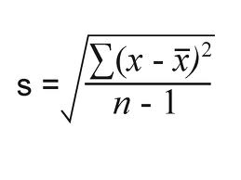
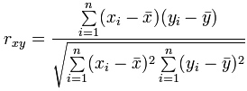
Transformation of Correlation Equation
The standard deviation (Sample) is represented as:

Slide 5
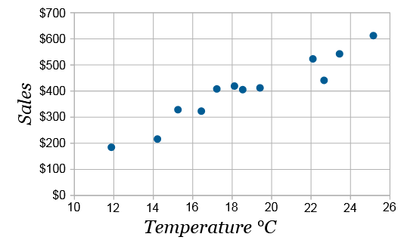
Example of Correlation of Two Attributes
Ice Cream Sales vs Temperature
Temperature °C | Ice Cream Sales
14.2° | $215
16.4° | $325
11.9° | $185
15.2° | $332
18.5° | $406
22.1° | $522
19.4° | $412
25.1° | $614
23.4° | $544
18.1° | $421
22.6° | $445
17.2° | $408
Ice Cream Sales vs Temperature
Temperature °C | Ice Cream Sales
14.2° | $215
16.4° | $325
11.9° | $185
15.2° | $332
18.5° | $406
22.1° | $522
19.4° | $412
25.1° | $614
23.4° | $544
18.1° | $421
22.6° | $445
17.2° | $408

Slide 6
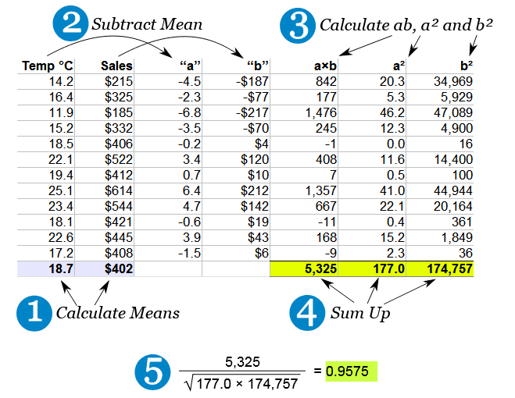
Calculation of Correlation of Two Attributes

Slide 7
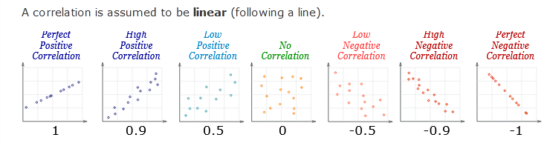
Decission from Correlation Measure
Correlation can have a value:
+1 is a perfect positive correlation
0 is no correlation (the values don't seem linked at all)
-1 is a perfect negative correlation

Slide 8
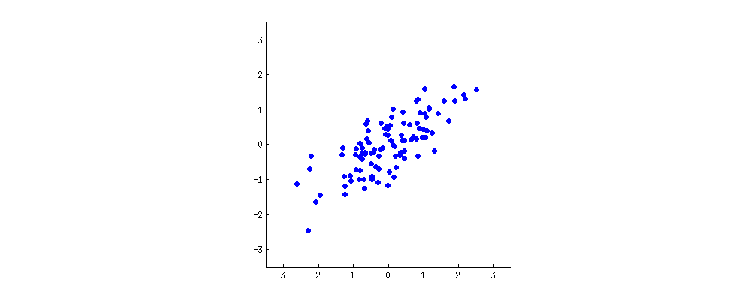
Principal Component Analys (PCA)

Slide 9
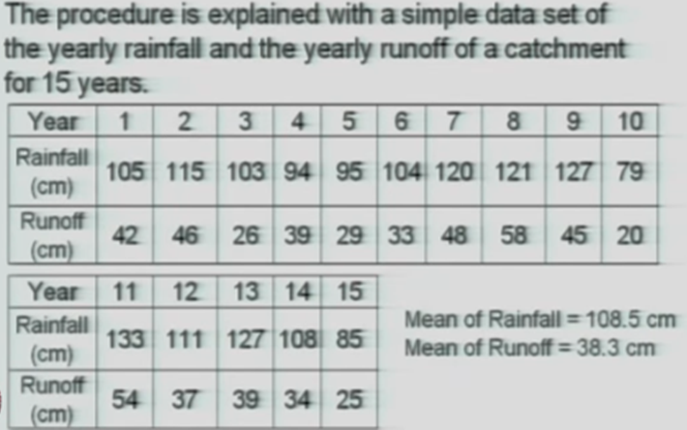
Example of PCA

Slide 10
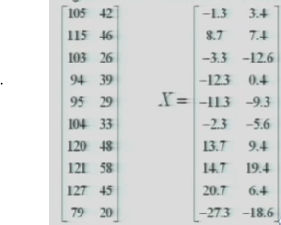
Data Normalization Applied before PCA

Slide 11
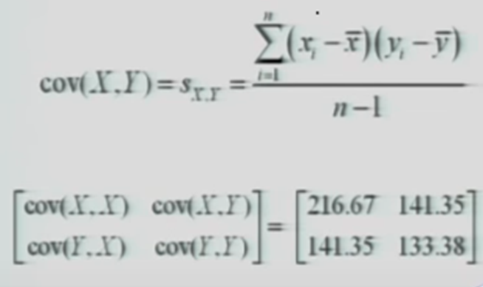
Determining Co-Variance Matrix

Slide 12
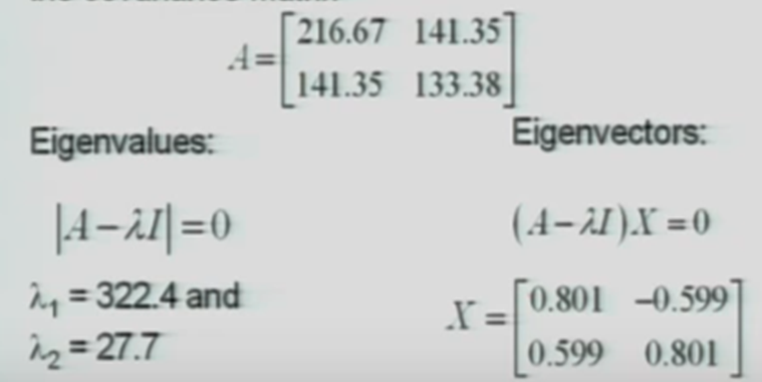
Calculation of Eigenvalue and Eigenvectors from Covariance

Slide 13
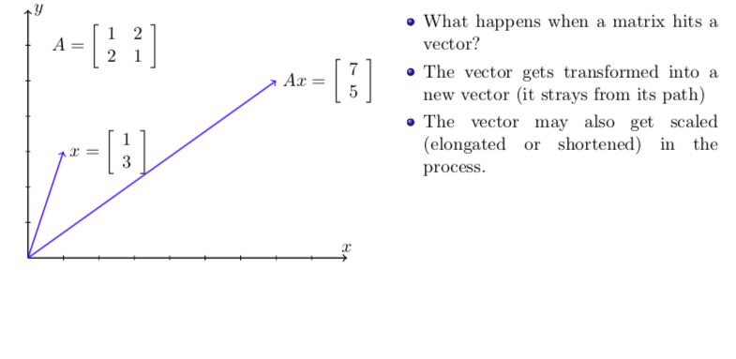
What is Eigen value and Eigen Vector ?

Slide 14
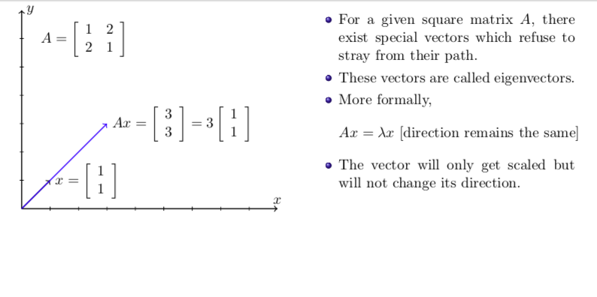

Slide 15
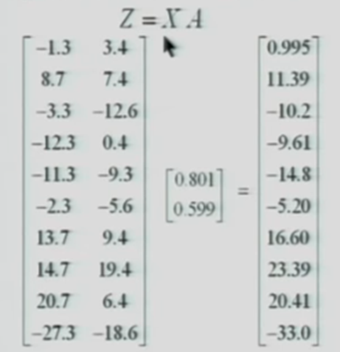
Transformation of Two-Dimensional Data to One Dimensional by Multipling Eigen Vector Matrix

Slide 16
Differences between Co-Variance and Co-relation
What is the Correlation?
Correlation is a step ahead of covariance as it quantifies the relationship between two random variables. In simple terms, it is a unit measure of how these variables change with respect to each other (normalized covariance value).
Unlike covariance, the correlation has an upper and lower cap on a range. It can only take values between +1 and -1. A correlation of +1 indicates that random variables have a direct and strong relationship.
On the other hand, the correlation of -1 indicates that there is a strong inverse relationship, and an increase in one variable will lead to an equal and opposite decrease in the other variable. 0 means that the two numbers are independent.

Slide 17
What is Covariance?
Covariance measures how the two variables move with respect to each other and is an extension of the concept of variance (which tells about how a single variable varies). It can take any value from -∞ to +∞.
The higher this value, the more dependent the relationship is. A positive number signifies positive covariance and denotes that there is a direct relationship. Effectively this means that an increase in one variable would also lead to a corresponding increase in the other variable provided other conditions remain constant.
On the other hand, a negative number signifies negative covariance, which denotes an inverse relationship between the two variables. Though covariance is perfect for defining the type of relationship, it is bad for interpreting its magnitude.

Slide 18
References
Han J & Kamber M, “Data Mining: Concepts and Techniques”, Third Edition, Elsevier, 2011.
https://www.mathsisfun.com/data/correlation.html
https://www.youtube.com/watch?v=TqCnD1avqMY

Slide 19
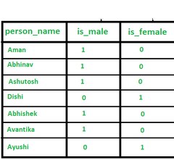
Important Questions
Q1: Are both corelation and covariance represent the linear relationship of two variables?
Q2: What is the cons of PCA ?
Q3: How corelation may be useful to avoid data redudancy?
Q4: Is there any data redudancy in the above table could you recommend a solution?
Q5: Is eigen value multiplication with a vector extend the same vector?

Slide 21
Simple Regression Analysis
Hint for Next Class Topic

