Slide 1
GLA University, Mathura
DATABASE MANAGEMENT SYSTEM
Course Code: BCSC1003
Dr. Varun Mishra
Asst. Professor CSE
Notes:
1

Slide 2
Introduction to DBMS
Collection of interrelated data
Set of programs to access the data
DBMS contains information about a particular enterprise
DBMS provides an environment that it both convenient and
Efﬁcient to use

Slide 3
more
Another definition (know these):
A database is a collection of organized, interrelated data, typically relating to a particular enterprise.
A Database Management System (DBMS) is a set of programs for managing and accessing databases.

Slide 4
Database Applications
Anywhere there is data, there could be a database:
Banking - accounts, loans, customers
Airlines - reservations, schedules
Universities - registration, grades
Sales - customers, products, purchases
Manufacturing - production, inventory, orders, supply chain
Human resources - employee records, salaries, tax deductions
Credit card transactions - purchases on credit cards, generation of monthly statements
Telecommunication - keeping records of calls made

Slide 5
University Database Example
Application program examples
Add new students, instructors, and courses
Register students for courses, and generate class rosters
Assign grades to students, compute grade point averages (GPA) and generate transcripts
In the early days, database applications were built directly on top of file systems i.e. Traditional File Systems.

Slide 6
Drawbacks of using file systems to store data
Data redundancy and inconsistency
Multiple file formats, duplication of information in different files
Difficulty in accessing data
Need to write a new program to carry out each new task
Data isolation — multiple files and formats
Integrity problems
Integrity constraints (e.g., account balance > 0) become “buried” in program code rather than being stated explicitly
Hard to add new constraints or change existing ones

Slide 7
more
Atomicity of updates
Failures may leave database in an inconsistent state with partial updates carried out
Example: Transfer of funds from one account to another should either complete or not happen at all
Concurrent access by multiple users
Concurrent access needed for performance
Uncontrolled concurrent accesses can lead to inconsistencies
Example: Two people reading a balance (say 100) and updating it by withdrawing money (say 50 each) at the same time
Security problems
Hard to provide user access to some, but not all, data
Database systems offer solutions to all the above problems

Slide 8
Purpose of Database System
Database Management Systems were developed to handle the following difﬁculties of typical ﬁle-processing systems supported by conventional operating systems.

Slide 9
Purpose & Goals of DBMS
Benefits of the database approach:
1. The data can be shared.
2. Redundancy can be reduced.
3. Inconsistency can be avoided (to some extent).
4. Transaction support can be provided.
5. Integrity can be maintained.
6. Security can be enforced.
7. Conflicting requirements can be balanced.
8. Standards can be enforced.

Slide 10
Database Languages

Slide 11
DBMS Languages
Data Definition Language (DDL)
Data Manipulation Language (DML)
Data Control Language (DCL)
Transaction Control Language (TCL)

Slide 12
Data Definition Language (DDL) :
Statements are used to define the database structure or schema. Some examples: CREATE - to create objects in the database
ALTER - alters the structure of the database
DROP - delete objects from the database
TRUNCATE - remove all records from a table, including all spaces allocated for the records are removed
COMMENT - add comments to the data dictionary
RENAME - rename an object

Slide 13
Data Manipulation Language (DML)
Language for accessing and manipulating the data organized by the appropriate data model.
Two classes of languages:
– Procedural – user speciﬁes what data is required and how to get those data
– Nonprocedural – user speciﬁes what data is required without specifying how to get those data

Slide 14
more
Some examples: SELECT - Retrieve data from the a database
INSERT - Insert data into a table
UPDATE - Updates existing data within a table
DELETE - deletes all records from a table, the space for the records remain
MERGE - UPSERT operation (insert or update)
CALL - Call a PL/SQL or Java subprogram
EXPLAIN PLAN - explain access path to data
LOCK TABLE - control concurrency

Slide 15
Data Control Language (DCL)
Some examples:
GRANT - gives user's access privileges to database
REVOKE - withdraw access privileges given with the GRANT command

Slide 16
Transaction Control (TCL)
Statements are used to manage the changes made by DML statements. It allows statements to be grouped together into logical transactions. Some examples: COMMIT - save work done
SAVEPOINT - identify a point in a transaction to which you can later roll back
ROLLBACK - restore database to original since the last COMMIT
SET TRANSACTION - Change transaction options like isolation level and what rollback segment to use

Slide 17
DBMS Users and Abstraction

Slide 18
Database Users
Users are differentiated by the way they expect to interact with the system.
Application programmers – interact with system through DML calls
Sophisticated users – form requests in a database query language
Specialized users – write specialized database applications that do not ﬁt into the traditional data processing framework
Naive users – invoke one of the permanent application programs that have been written previously

Slide 19
Database Administrator
Coordinates all the activities of the database system; the database administrator has a good understanding of the enterprise’s information resources and needs.
Database administrator’s duties include:
– Schema deﬁnition
– Storage structure and access method deﬁnition
– Schema and physical organization modiﬁcation
– Granting user authority to access the database
– Specifying integrity constraints
– Acting as liaison with users
– Monitoring performance and responding to changes in
requirements

Slide 20
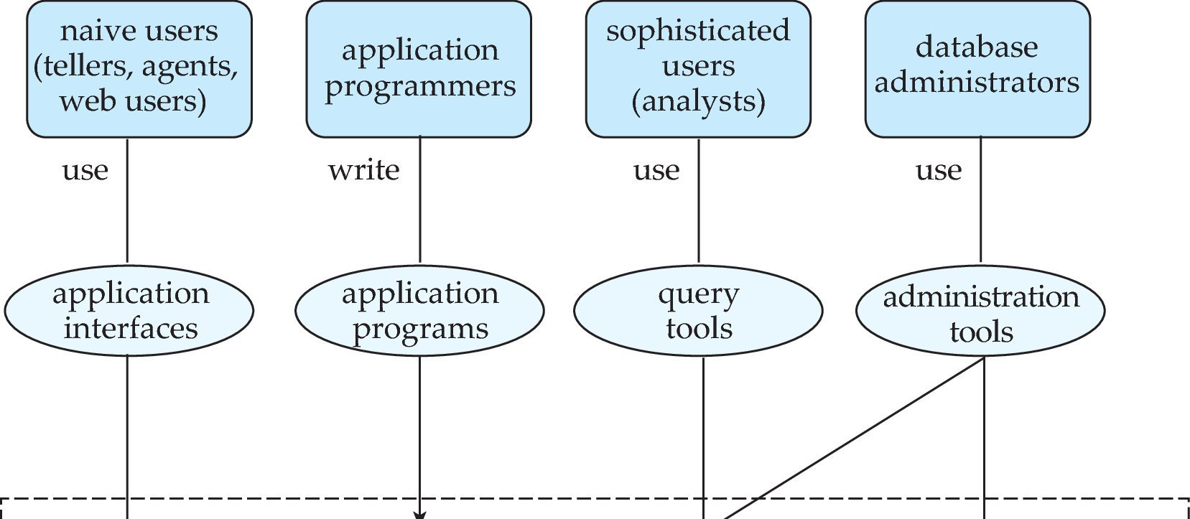
Database Users and Administrators
Database
Notes:
20

Slide 21
View of Data
An architecture for a database system
View level
View 1
View 2
View n
.....
Logical level
Physical level

Slide 22
Levels of Abstraction
Physical level - defines low-level details about how data item is stored on disk.
Logical level - describes data stored in a database, and the relationships among the data (usually conveyed as a data model, e.g., an ER diagram).
View level - defines how information is presented to users. Views can also hide details of data types, and information (e.g., salary) for security purposes.

Slide 23
Data Independence
Ability to modify a schema deﬁnition in one level without affecting a schema deﬁnition in the next higher level.
The interfaces between the various levels and components should be well deﬁned so that changes in some parts do not seriously inﬂuence others.

Slide 24
Data independence
1.Physical data independence
is the ability to modify the physical schema without causing application programs to be rewritten.
2.Logical data independence
is the ability to modify the logical schema without causing application programs to be rewritten.

Slide 25
Instances and Schemas
Similar to types and variables in programming languages
Schema –
The logical structure of the database (e.g., set of customers and accounts and the relationship between them)
The overall design of the database is called the database schema.
Physical schema: database design at the physical level
Logical schema: database design at the logical level
Instance –
The actual content of the database at a particular point in time.
The collection of information stored in the database at a particular moment is called an instance of the database.

Slide 26
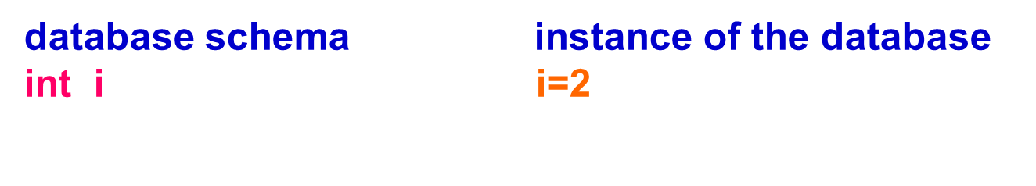

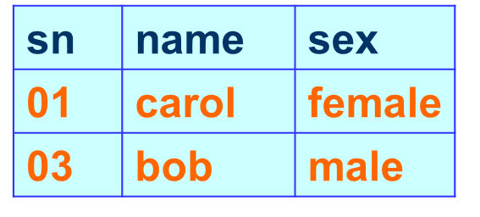


Slide 27
DBMS Models

Slide 28
Data Models
The phrase “data model” is used in a couple of different ways.
Frequently used (use #1) to refer to an overall approach or philosophy for database design and development.
For those individuals, groups and corporations that subscribe to a specific data model, that model permeates all aspects of database design, development, implementation, etc.

Slide 29
The purpose of developing the data model is to define:
Data
Relationships between data items
Semantics of data items
Constraints on data items
In other words, a data model defines the logical schema, i.e., the logical level of design of a database.
A data model is typically conveyed as one or more diagrams (e.g., ER or UML diagrams).
This early phase in database development is referred to as data modeling.

Slide 30
DBMS Data Models
The entity-relationship model
The object oriented model
Relational model
Network model
Hierarchical model

Slide 31
The Entity Relationship Model or E-R Model

Slide 32

History of E-R Model
E-R Model was proposed by Dr. Peter Chen (currently professor at Louisiana State University)
Chen’s original paper on E-R Model is the 35th most sited paper in computer science
Chen has written papers interconnecting E-R model and linguistics

Slide 33
Entity Relationship Model
Models an enterprise as a collection of entities and relationships
Entity: a “thing” or “object” in the enterprise that is distinguishable from other objects
Described by a set of attributes
Relationship: an association among several entities
Represented diagrammatically by an entity-relationship diagram.

Slide 34
Entity
Entity - distinguishable “thing” in the real world
For example,
in a school database, students, teachers, classes, and courses offered can be considered as entities. All these entities have some attributes or properties that give them their identity.
Entities are represented by: Rectangle
Entity type name (singular, no spaces, capital letter at start of each word)
space for attributes

Slide 35
Entity & Entity Sets
An Entity is an object that exists and is distinguishable from other objects. For instance, John Harris with S.I.N. 890-12-3456 is an entity, as he can be uniquely identified as one particular person in the universe.
An entity may be concrete (a person or a book, for example) or abstract (like a holiday or a concept).
An entity set is a set of entities of the same type (e.g., all persons having an account at a bank).
Entity sets need not be disjoint. For example, the entity set employee (all employees of a bank) and the entity set customer (all customers of the bank) may have members in common.

Slide 36
Strong vs. Weak Entity
Strong (or regular) entity -
An entity set that has a primary key is termed as strong entity set.
Entities have an independent existence
Weak entity
An entity set that does not have sufficient attributes to form a primary key is termed as a weak entity set.
Weak entity is an entity that depends on another entity.
Weak entity doesn't have key attribute of their own. Double rectangle represents weak entity.
Existence dependent on some other entity

Slide 37

Example
Say, for example, we have a statement
“A Student lives in a Home.”
STUDENT is obviously a strong entity having a primary key Roll.
But HOME may not have a unique primary key, as its only attribute Address may be shared by many homes (what if it is a housing estate?). HOME is a weak entity in this case.
The ERD of this statement would be like the following

Slide 38
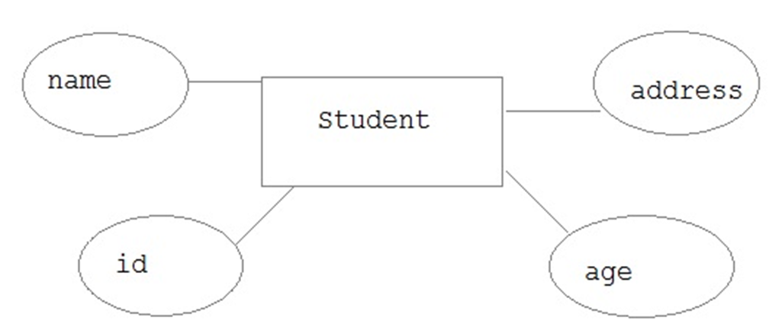
Attributes
An Attribute describes a property or characteristic of an entity. For example, Name, Age, Address etc can be attributes of a Student.
An attribute is represented using eclipse.

Slide 39
Types of Attributes
Attributes can be
simple (atomic) e.g. Surname; date of birth
composite e.g. address (street, town, postcode)
multi-valued e.g. phone number
complex nested multi-valued and composite
base or derived e.g. D.O.B. ; age
Key
Relationship types can also have attributes! (see later)

Slide 40
Notation for attributes
Primary Key marked {PK}
Composite attribute
Derived Attribute
{PPK}
Partial Key - part of composite PK - or of a weak entity
Multi-Valued Attribute (number of values in [ ] brackets)

Slide 41
Definition: Types of Attributes
Simple attribute − Simple attributes are atomic values, which cannot be divided further. For example, a student's phone number is an atomic value of 10 digits.
Composite attribute − Composite attributes are made of more than one simple attribute. For example, a student's complete name may have first_name and last_name.
Derived attribute − Derived attributes are the attributes that do not exist in the physical database, but their values are derived from other attributes present in the database. For example, average_salary in a department should not be saved directly in the database, instead it can be derived. For another example, age can be derived from data_of_birth.

Slide 42
more
Single-value attribute − Single-value attributes contain single value. For example − Social_Security_Number.
Multi-value attribute − Multi-value attributes may contain more than one values. For example, a person can have more than one phone number, email_address, etc.

Slide 43
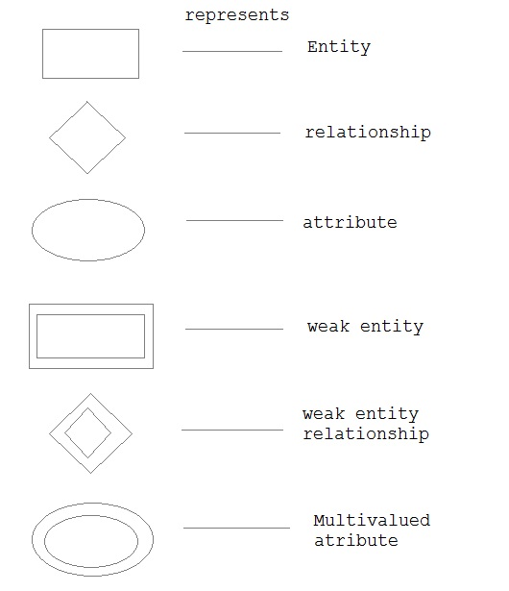
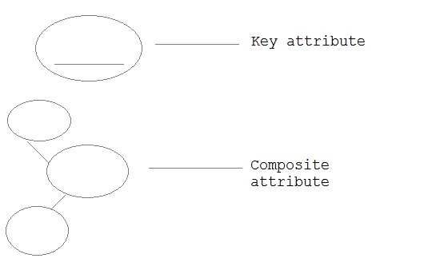
Summary of Notation

Slide 44
Keys
Key is an attribute or collection of attributes that uniquely identifies an entity among entity set.
For example, the roll_number of a student makes him/her identifiable among students.
Super Key − A set of attributes (one or more) that collectively identifies an entity in an entity set.
Candidate Key − A minimal super key is called a candidate key. An entity set may have more than one candidate key.
Primary Key − A primary key is one of the candidate keys chosen by the database designer to uniquely identify the entity set.

Slide 45
Keys: more
Alternate Key: This is the candidate key which is not chosen as the primary key of the table. They are named so because although not the primary key, they can still identify a row.
Composite Key: Sometimes one key is not enough to uniquely identify a row. E.g. in a single class Roll is enough to find a student, but in the entire school, merely searching by the Roll is not enough, because there could be 10 classes in the school and each one of them may contain a certain roll no 5. To uniquely identify the student we have to say something like “class VII, roll no 5”. So, a combination of two or more attributes is combined to create a unique combination of values, such as Class + Roll.
Foreign Key: Sometimes we may have to work with an attribute that does not have a primary key of its own. To identify its rows, we have to use the primary attribute of a related table. Such a copy of another related table’s primary key is called foreign key

Slide 46
Keys
A key is a set of one or more column whose combined values are unique among all occurrences in a given table.
A key is the relation of specifying uniqueness based on the property of Uniqueness.

Slide 47
Types of Keys
1. Primary Key
2. Candidate key
3. Super Key
4. Composite Key
5. Foreign Key

Slide 48
Candidate Key
When more than one or grouped attributes serve as a unique identifier, they are each called as Candidate Key.
Candidate key are those attributes of a relation which passes the property of uniqueness and irreducibility.

Slide 49
Candidate Key
Suppose that ‘K’ is a set of attributes of relation ‘R’, it is represented as R(K), then, ‘K’ is the candidate key of relation R if and only if it possess both of the following properties:
Uniqueness
Irreducibility

Slide 50
Candidate Key
Uniqueness Property:
It states that no legal value of relation ‘R’ ever contains two distinct tuples with the same value of ‘K’.
Irreducibility Property:
It states that no proper subset of K has the uniqueness property.

Slide 51
For example,
If (name, class) is unique that it can be identify as the candidate key if and only if name & class individually are not unique.
i.e.
name != unique
class != unique
throughout the table. In this relation, name and class collectively known as COMPOSITE KEY also.

Slide 52
Super Key
The Super Key is defined as an attribute or a set of attributes that uniquely identify a tuple within a relation.
A Super key has the uniqueness property but not necessarily the irreducibility property.

Slide 53
More
A candidate key is a special case of Super key.
All attributes in a relation taken together are Super key because only one row in a relation has a given value for all relation attributes.

Slide 54
More
Consider a following relation:
R student (Roll no, Name, Class)
Here, if roll no is unique in the relation student then set of attributes (Roll no, Name, Class) is a super key for this student relation.

Slide 55
More
These set of attributes are also unique but this combination of keys is not having irreducibility property.
Because, roll no which is one subset of Super key is also unique itself. Super key is not followed by irreducibility property.

Slide 56
More
Hence,
Candidate key =
Super key – Primary key

Slide 57
Primary Key
It is defined as the candidate key that is selected to identify tuples uniquely within the relation. The primary key is an attribute that uniquely identify a specific instance of an activity.

Slide 58
Primary Key
The primary key can not contain any NULL values because it cannot uniquely identify multiple NULL values.

Slide 59
Foreign Key
As, we have already studied the concept of parent and child table, we say that
Column in the child table that references the primary key of parent table is called as FOREIGN KEY.

Slide 60
Foreign Key
They are used to link together two or more different tables which have some form of relationships with each other.
RDBMS = DBMS + Referential integrity (Foreign key)

Slide 61
Foreign Key
For example, Consider a relation:
student(roll no, name and address)
Another relation
Studentinfo(marks, subject, class, roll no)
In this relation, studentinfo, the attribute roll no is considered as foreign key for the parent table student.

Slide 62
Relationships
A relationship is “.. An association among entities (the participants)..”
Represented by Diamonds.
Relationships link entities with each other
Name: verb, capital start letter, arrow indicates direction in which verb makes sense

Slide 63
Relationship sets
A set of relationships of similar type is called a relationship set.
Entity-relationship diagrams don't show single entities or single instances of relations.
Rather, they show entity sets and relationship sets.
Example:
a particular song is an entity.
The collection of all songs in a database is an entity set.
The eaten relationship between a child and her lunch is a single relationship.
The set of all such child-lunch relationships in a database is a relationship set.

Slide 64
Relationships: constraints
The degree of a relationship type
binary (connects 2 entity types)
unary/ recursive (connects 1 entity type with itself)
complex (connects 3 or more entity types)
Ternary (connects 3)
Relationship constraints - cardinality
one to one (1:1)
one to many (1:m)
many to many (m:n)
Relationship constraints – participation
full/mandatory
or partial/optional
Degree
Multiplicity

Slide 65
Relationships: Degree
Binary relationship
Recursive (Unary) relationship - example
Complex relationship –
here ternary

Slide 66
Relationships: Mapping Cardinalities
Cardinality defines the number of entities in one entity set, which can be associated with the number of entities of other set via relationship set.
These are of four types:
One to One
One to Many
Many to One
Many to Many

Slide 67

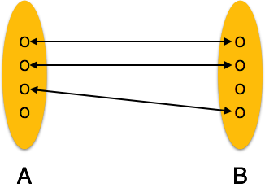
One to One
One-to-one − One entity from entity set A can be associated with at most one entity of entity set B and vice versa.
One-to-one relation
E.g. A teacher teaches a student. Only one teacher is teaching only one student.

Slide 68

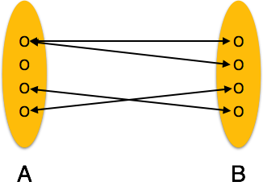
One to Many
One-to-many − One entity from entity set A can be associated with more than one entities of entity set B however an entity from entity set B, can be associated with at most one entity.
One-to-many relation
E.g. A teacher teaches students.
Only one teacher is teaching many students.

Slide 69

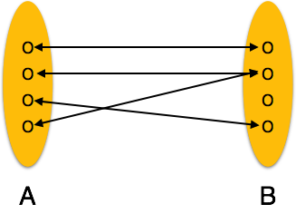
Many to One
Many-to-one − More than one entities from entity set A can be associated with at most one entity of entity set B, however an entity from entity set B can be associated with more than one entity from entity set A.
Many-to-one relation
E.g. Teachers teach a student. Many teachers are teaching only one student.

Slide 70
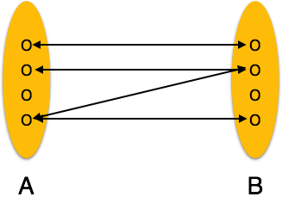

Many to Many
Many-to-many − One entity from A can be associated with more than one entity from B and vice versa.
Many-to-many relation
E.g. Teachers teach students.
In any school or college many teachers are teaching many students. This can be considered as a two way one-to-many relationship.

Slide 71
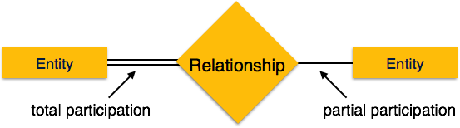
Relationships: Participation
Participation Constraints
Total Participation − Each entity is involved in the relationship. Total participation is represented by double lines.
Partial participation − Not all entities are involved in the relationship. Partial participation is represented by single lines.

Slide 72
Entity Relationship(E-R) Diagram in DBMS
A graphical representation of the entities and the relationships between them.
Entity relationship diagrams are a useful medium to achieve a common understanding of data among users and application developers.
In data modeling, an entity-relationship model (ERM) is a representation of structured data; entity-relationship modeling is the process of generating these models. The end-product of the modeling process is an entity-relationship diagram (ERD), a type of Conceptual Data Model or Semantic Data Model.

Slide 73
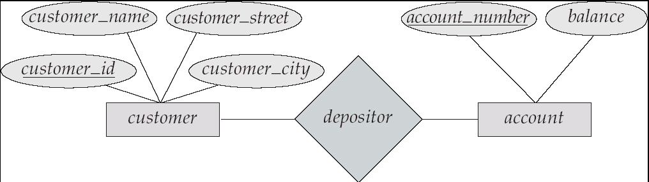
ER Diagram
Represented diagrammatically by an entity-relationship diagram:

Slide 74
Design of E-R Model

Slide 75
Exercise
To design an Entity Relationship (ER) model for a
college database

Slide 76
Say we have the following statements.
A college contains many departments
Each department can offer any number of courses
Many instructors can work in a department
An instructor can work only in one department
For each department there is a Head
An instructor can be head of only one department
Each instructor can take any number of courses
A course can be taken by only one instructor
A student can enroll for any number of courses
Each course can have any number of students

Slide 77
Let's start our design
Step 1 : Identify the Entities
What are the entities here?
From the statements given, the entities are
Department
Course
Instructor
Student

Slide 78
Step 2 : Identify the relationships
One department offers many courses. But one particular course can be offered by only one department. hence the cardinality between department and course is One to Many (1:N)
One department has multiple instructors . But instructor belongs to only one department. Hence the cardinality between department and instructor is One to Many (1:N)
One department has only one head and one head can be the head of only one department. Hence the cardinality is one to one. (1:1)
One course can be enrolled by many students and one student can enroll for many courses. Hence the cardinality between course and student is Many to Many (M:N)
One course is taught by only one instructor. But one instructor teaches many courses. Hence the cardinality between course and instructor is Many to One (N :1)

Slide 79
Step 3: Identify the key attributes
"Department_Name" can identify a department uniquely. Hence Department_Name is the key attribute for the Entity "Department".
Course_ID is the key attribute for "Course" Entity.
Student_ID is the key attribute for "Student" Entity.
Instructor_ID is the key attribute for "Instructor" Entity.

Slide 80
Step 4: Identify other relevant attributes
For the department entity, other attributes are location
For course entity, other attributes are course_name,duration
For instructor entity, other attributes are first_name, last_name, phone
For student entity, first_name, last_name, phone

Slide 81
Step 5: Draw complete ER diagram
By connecting all these details, we can now draw ER diagram as shown in next slide.

Slide 82
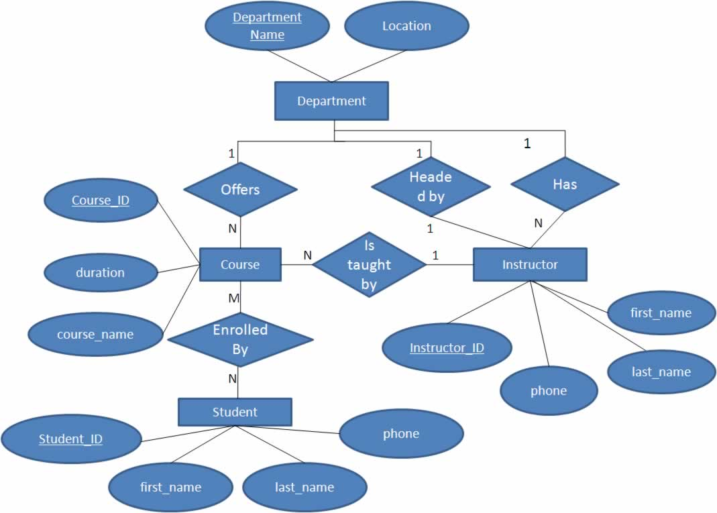

Slide 83
Advantages and Disadvantages of ER Modeling ( Merits and Demerits of ER Modeling )

Slide 84
Advantages
ER Modeling is simple and easily understandable. It is represented in business users language and it can be understood by non-technical specialist.
Intuitive and helps in Physical Database creation.
Can be generalized and specialized based on needs.
Can help in database design.
Gives a higher level description of the system.

Slide 85
Disadvantages
Physical design derived from E-R Model may have some amount of ambiguities or inconsistency.
Sometime diagrams may lead to misinterpretations

Slide 86
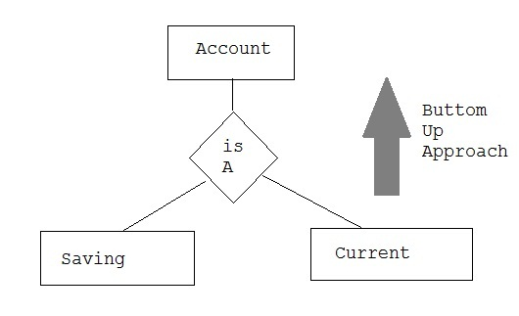
Generalization
Generalization is a bottom-up approach in which two lower level entities combine to form a higher level entity. In generalization, the higher level entity can also combine with other lower level entity to make further higher level entity.

Slide 87
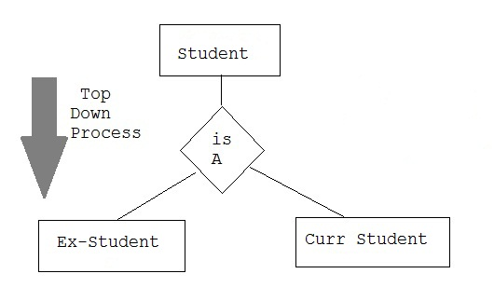
Specialization
Specialization is opposite to Generalization. It is a top-down approach in which one higher level entity can be broken down into two lower level entity. In specialization, some higher level entities may not have lower-level entity sets at all.

Slide 88
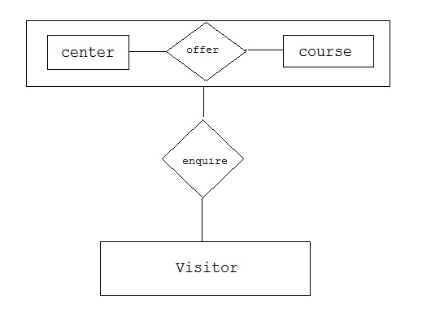
Aggregation
Aggregation is a process when relation between two entity is treated as a single entity. Here the relation between Center and Course, is acting as an Entity in relation with Visitor.

Slide 89
The Network Model
Created to
Represent complex data relationships more effectively
Improve database performance
Impose a database standard
Conference on Data Systems Languages (CODASYL)
Database Task Group (DBTG)

Slide 90
The Network Model (continued)
Schema
Conceptual organization of entire database as viewed by the database administrator
Subschema
Defines database portion “seen” by the application programs that actually produce the desired information from data contained within the database
Data Management Language (DML)
Defines the environment in which data can be managed

Slide 91
The Network Model (continued)
Schema Data Definition Language (DDL)
Enables database administrator to define schema components
Subschema DDL
Allows application programs to define database components that will be used
DML
Works with the data in the database

Slide 92
The Network Model (continued)
Resembles hierarchical model
Collection of records in 1:M relationships
Set
Relationship
Composed of at least two record types
Owner
Equivalent to the hierarchical model’s parent
Member
Equivalent to the hierarchical model’s child

Slide 93
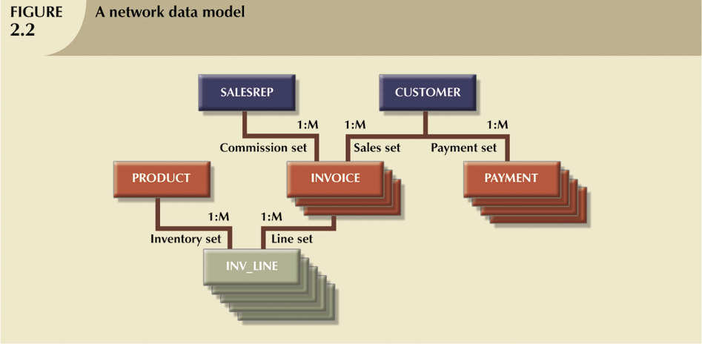
The Network Model (continued)

Slide 94
The Network Model (continued)
Disadvantages
Too cumbersome
The lack of ad hoc query capability put heavy pressure on programmers
Any structural change in the database could produce havoc in all application programs that drew data from the database
Many database old-timers can recall the interminable information delays

Slide 95
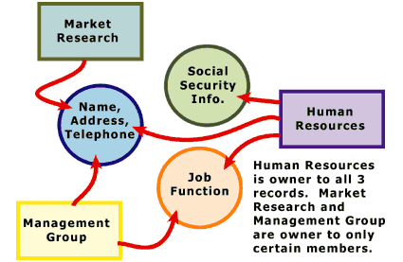
Network model

Slide 96
Network data model
Class
Relationships:
one-to-one
one-to-many
many-to-one
many-to-many
Student
Instructor
Grade
ID
Department

Slide 97
Network data model
Advantages
flexible, fast, efficient
Disadvantages
Complex
Restructuring can be difficult because of changing all the pointers

Slide 98
Summary
Hierarchical and network data models have generally been replaced by the relational data model
Relational databases dominate the database market
Oracle
Informix
SQL Server
DB2
……..

Slide 99
Object Oriented Model in DBMS
Object DBMSs add database functionality to object programming languages.
They bring much more than persistent storage of programming language objects.
A major benefit of this approach is the unification of the application and database development into a seamless data model and language environment. As a result, applications require less code, use more natural data modeling, and code bases are easier to maintain.

Slide 100
Relationship Model in DBMS
A branch of set theory that deals with logical relationships between sets. The Relational Model underlies OOA/D Class Models.
This is a more general model than the Relational Data Model.
In an OOA/D context explicate identity and referential attributes are not required.
In an OOA/D context relationships are much more abstract than in the Relational Data Model.
In addition, the logical properties include behaviors as well as data.

Slide 101
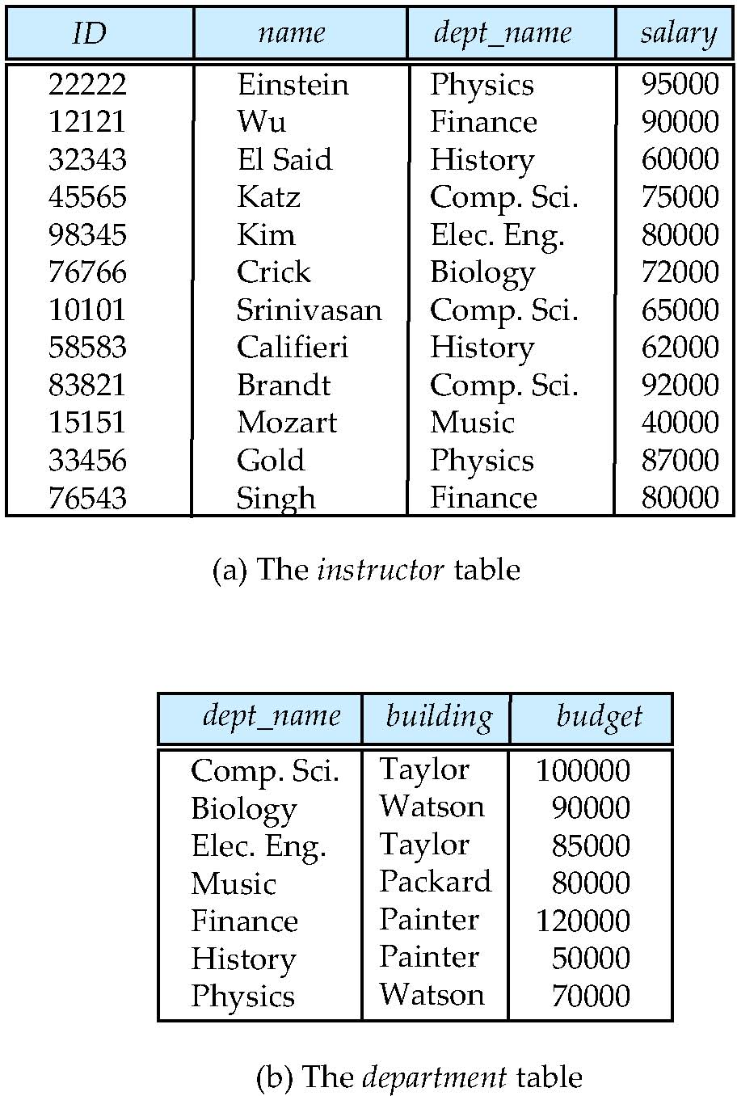
Relational Model
Example of tabular data in the relational model

Slide 102
A Sample Relational Database

Slide 103
Network Model in DBMS
The popularity of the network data model coincided with the popularity of the hierarchical data model.
Some data were more naturally modeled with more than one parent per child.
So, the network model permitted the modeling of many-to-many relationships in data.
The basic data modeling construct in the network model is the set construct.
A set consists of an owner record type, a set name, and a member record type.

Slide 104
DBMS Hierarchical Model
The hierarchical data model organizes data in a tree structure.
There is a hierarchy of parent and child data segments.
This structure implies that a record can have repeating information, generally in the child data segments.
Data in a series of records, which have a set of field values attached to it.
It collects all the instances of a specific record together as a record type.

Slide 105
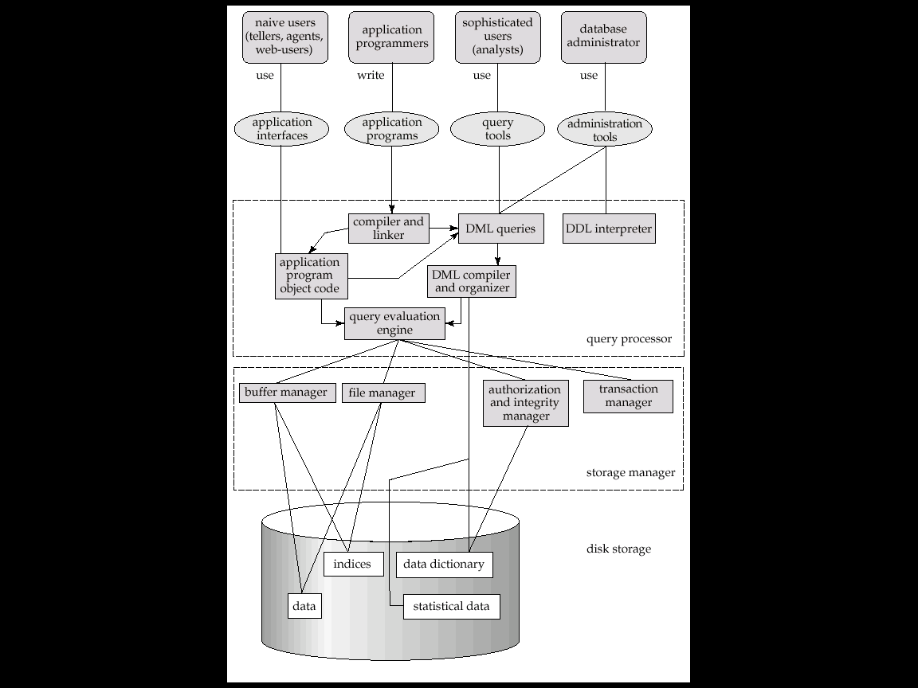
Overall System Architecture

Slide 106
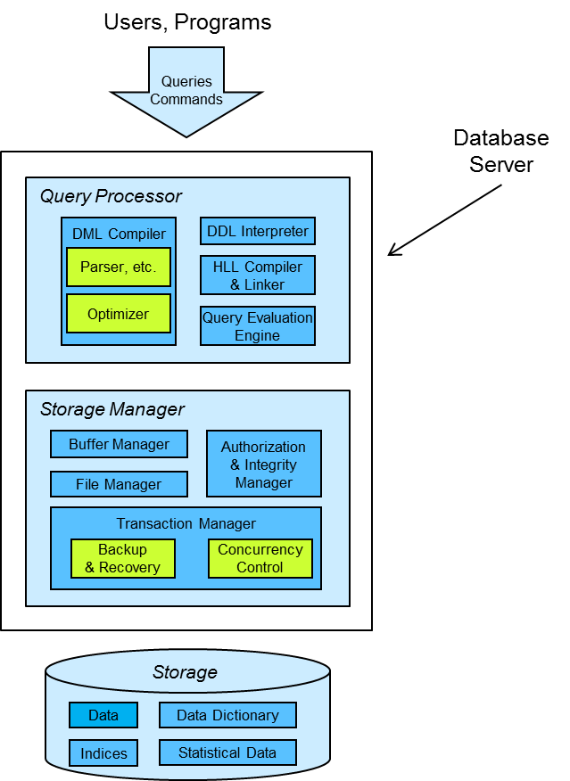

Slide 107
More
The following components of a DBMS are of interest to us:
transaction manager
buffer manager
file manager
authorization and integrity manager
query optimizer

Slide 108
Transaction Management
A transaction is a collection of operations that performs a single logical function in a database application
The transaction manager performs two primary functions:
backup and recovery
concurrency control
Backup and recovery ensures that the database remains in a consistent (correct) state despite failures:
system, power, network failures
operating system crashes
transaction failures.
Concurrency-control involves managing the interactions among concurrent transactions.

Slide 109
Storage Management
A storage manager is a program module that provides the interface between the low-level data stored in the database and the application programs and queries submitted to the system.
The storage manager is responsible for the following tasks:
– interaction with the ﬁle manager
The file manager is responsible for managing the files that store data.
formatting the data files
managing free and used space in the data files
defragmenting the data files
inserting and deleting specific data from the files
– efﬁcient storing, retrieving, and updating of data

Slide 110
Authorization and Integrity management
The authorization & integrity manager performs two primary functions:
data security
data integrity
Data security:
ensure that unauthorized users can’t access the database
ensure that authorized users can only access appropriate data
Data integrity:
in general, maintains & enforces integrity constraints
maintains data relationships in the presence of data modifications
prevents modifications that would corrupt established data relationships

Slide 111
Query Optimization
A given query can be implemented by a DBMS in many different ways.
The query optimizer attempts to determine the most efficient strategy for executing a given query.
The strategy for implementing a given query is referred to as a query plan.

Slide 112
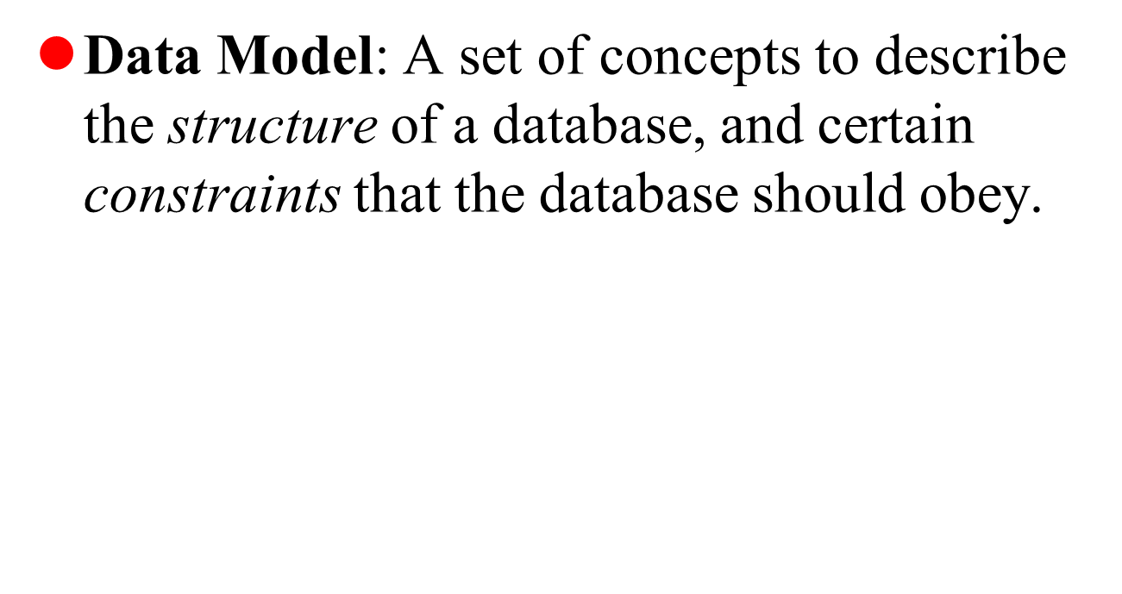
Data Model

Slide 113
The Importance of Data Models
Data models
Relatively simple representations, usually graphical, of complex real-world data structures
Facilitate interaction among the designer, the applications programmer, and the end user
End-users have different views and needs for data
Data model organizes data for various users

Slide 114
History of Data Models
Relational Model: proposed in 1970 by E.F. Codd (IBM), first commercial system in 1981-82. (DB2, ORACLE, SQL Server, SYBASE, INFORMIX).
Network Model: Adopted heavily due to the support by CODASYL (CODASYL - DBTG report of 1971), IDMS (Cullinet - now CA), DMS 1100 (Unisys), IMAGE (H.P.), VAX -DBMS (Digital Equipment Corp.).
Hierarchical Data Model:.Resulted in the IMS family of systems. The most popular model.

Slide 115
History of Data Models
Object-oriented Data Model(s): several models have been proposed for implementing in a database system.
Object-Relational Models: Most Recent Trend. Started with Informix Universal Server. Exemplified in the latest versions of Oracle-10i, DB2, and SQL Server etc. systems.

Slide 116
Data Model Basic Building Blocks
Entity - anything about which data are to be collected and stored
Attribute - a characteristic of an entity
Relationship - describes an association among entities
One-to-many (1:M) relationship
Many-to-many (M:N or M:M) relationship
One-to-one (1:1) relationship
Constraint - a restriction placed on the data

Slide 117
The Evolution of Data Models (continued)
Hierarchical
Network
Relational
Entity relationship
Object oriented (OO)

Slide 118
The Hierarchical Model
Developed in the 1960s to manage large amounts of data for complex manufacturing projects
Basic logical structure is represented by an upside-down “tree”

Slide 119
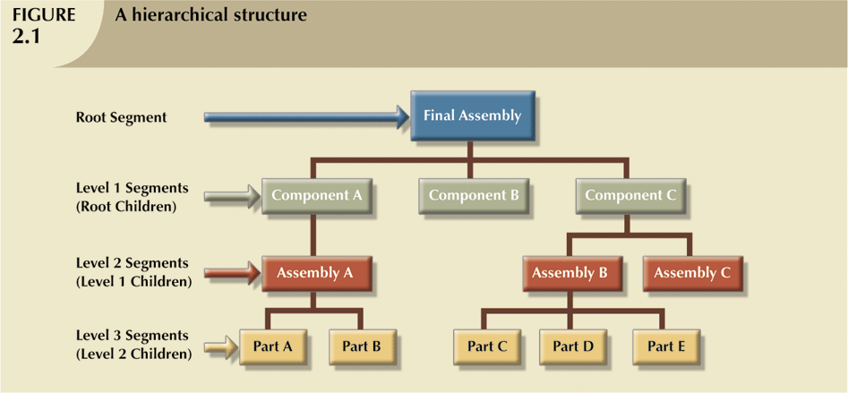
The Hierarchical Model (continued)

Slide 120
The Hierarchical Model (continued)
The hierarchical structure contains levels, or segments
Depicts a set of one-to-many (1:M) relationships between a parent and its children segments
Each parent can have many children
each child has only one parent

Slide 121
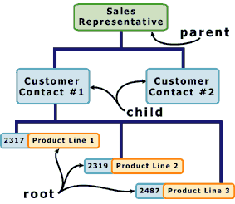
Hierarchical database model

Slide 122
Hierarchical data model
Class
Parent-child relationship:
one-to-one
one-to-many
Student
Instructor
Grade
ID
Department

Slide 123
The Hierarchical Model (continued)
Advantages
easy to search
add new branches easily

Slide 124
The Hierarchical Model (continued)
Disadvantages
Complex to implement
Difficult to manage
Lacks structural independence
Implementation limitations
Lack of standards

Slide 125
Closure of Attribute Sets
Given a set α of attributes of R and a set of functional dependencies F, we need a way to find all of the attributes of R that are functionally determined by α.
This set of attributes is called the closure of α under F and is denoted α+

Slide 126
Closure of Attribute Sets
Finding α+ is useful because:
if α+ = R, then α is a super key for R
if we find α+ for all α⊆ R, we've computed F+ (except that we'd need to use decomposition to get all of it).

Slide 127
Algorithm
result := α
repeat
temp := result
for each functional dependency β → γ in F do
if β ⊆ result then
result := result ∪ γ
until temp = result

Slide 128
Example
Compute the closure for relational schema R={A,B,C,D,E} A-->BC CD-->E B-->D E-->A List candidate keys of R.

Slide 129
Solution
Solution:
R={A,B,C,D,E}
F, the set of functional dependencies A-->BC, CD-->E, B-->D, E-->A
Compute the closure for each β in β → γ in F
Closure for A
A+ = ABCDE, Hence A is a super key
Iteration | result | using
1 | A
2 | ABC | A-->BC
3 | ABCD | B-->D
4 | ABCDE | CD-->E
5 | ABCDE

Slide 130
Solution
Closure for CD
CD+ = ABCDE, Hence CD is a super key
Iteration | result | using
1 | CD
2 | CDE | CD-->E
3 | ACDE | E-->A
4 | ABCDE | A-->BC
5 | ABCDE

Slide 131
Solution
Closure for B
B+ = BD, Hence B is NOT a super key
Iteration | result | Using
1 | B
2 | BD | B-->D
3 | BD

Slide 132
Solution
Try applying Armstrong axioms, to find alternate keys.
B-->D
BC-->CD (by Armstrong’s augmentation rule)
Closure for BC
BC+ = ABCDE, , Hence BC is a super key
Iteration | result | using
1 | BC
2 | BCD | BC-->CD
3 | BCDE | CD-->E
4 | ABCDE | E-->A

Slide 133
Solution
Closure for E
E+ = ABCDE
Iteration | result | using
1 | E
2 | AE | E-->A
3 | ABCE | A-->BC
4 | ABCDE | B-->D
5 | ABCDE

Slide 134
Solution
A and E are minimal super keys.
To see whether CD is a minimal super key, check whether its subsets are super keys.
C+ = C
D+ = D
Since C and D are not super keys, CD is a minimal super key.
To see whether BC is a minimal super key, check whether its subsets are super keys.
B+ = BD
C+ = C
Since B and C are not super keys, BC is a minimal super key.
Since A, BC, CD, E are minimal super keys, they are the candidate keys.
A, BC, CD, E

Slide 135
Object Oriented Model in DBMS
Object DBMSs add database functionality to object programming languages.
They bring much more than persistent storage of programming language objects.
A major benefit of this approach is the unification of the application and database development into a seamless data model and language environment. As a result, applications require less code, use more natural data modeling, and code bases are easier to maintain.

Slide 136
Relationship Model in DBMS
A branch of set theory that deals with logical relationships between sets. The Relational Model underlies OOA/D Class Models.
This is a more general model than the Relational Data Model.
In an OOA/D context explicate identity and referential attributes are not required.
In an OOA/D context relationships are much more abstract than in the Relational Data Model.
In addition, the logical properties include behaviors as well as data.

Slide 137
Relational Model
Example of tabular data in the relational model

Slide 138
A Sample Relational Database

Slide 139
Network Model in DBMS
The popularity of the network data model coincided with the popularity of the hierarchical data model.
Some data were more naturally modeled with more than one parent per child.
So, the network model permitted the modeling of many-to-many relationships in data.
The basic data modeling construct in the network model is the set construct.
A set consists of an owner record type, a set name, and a member record type.

Slide 140
DBMS Hierarchical Model
The hierarchical data model organizes data in a tree structure.
There is a hierarchy of parent and child data segments.
This structure implies that a record can have repeating information, generally in the child data segments.
Data in a series of records, which have a set of field values attached to it.
It collects all the instances of a specific record together as a record type.

Slide 141
Overall System Architecture

Slide 143
More
The following components of a DBMS are of interest to us:
transaction manager
buffer manager
file manager
authorization and integrity manager
query optimizer

Slide 144
Transaction Management
A transaction is a collection of operations that performs a single logical function in a database application
The transaction manager performs two primary functions:
backup and recovery
concurrency control
Backup and recovery ensures that the database remains in a consistent (correct) state despite failures:
system, power, network failures
operating system crashes
transaction failures.
Concurrency-control involves managing the interactions among concurrent transactions.

Slide 145
Storage Management
A storage manager is a program module that provides the interface between the low-level data stored in the database and the application programs and queries submitted to the system.
The storage manager is responsible for the following tasks:
– interaction with the ﬁle manager
The file manager is responsible for managing the files that store data.
formatting the data files
managing free and used space in the data files
defragmenting the data files
inserting and deleting specific data from the files
– efﬁcient storing, retrieving, and updating of data

Slide 146
Authorization and Integrity management
The authorization & integrity manager performs two primary functions:
data security
data integrity
Data security:
ensure that unauthorized users can’t access the database
ensure that authorized users can only access appropriate data
Data integrity:
in general, maintains & enforces integrity constraints
maintains data relationships in the presence of data modifications
prevents modifications that would corrupt established data relationships

Slide 147
Query Optimization
A given query can be implemented by a DBMS in many different ways.
The query optimizer attempts to determine the most efficient strategy for executing a given query.
The strategy for implementing a given query is referred to as a query plan.

Slide 148
Objectives
Some common uses of database systems.
File-based systems.
Typical functions of a DBMS.
Major components of the DBMS environment.
History of the development of DBMSs.
Advantages and disadvantages of DBMSs
Three-level architecture

Slide 149
Examples of Database Applications
Purchases from the supermarket
Purchases using your credit card
Booking a holiday at the travel agents
Using the local library
Taking out insurance
Using the Internet
Studying at university
Many more …….

Slide 150
Types of Databases and Database Applications
Numeric and Textual Databases
Multimedia Databases
Geographic Information Systems (GIS)
Data Warehouses
Real-time and Active Databases
A number of these databases and applications are described later in the book (see Chapters 24,28,29)

Slide 151
File-Based Systems
Collection of application programs that perform services for the end users (e.g. reports).
Each program defines and manages its own data.

Slide 152
Limitations of File-Based Approach
Separation and isolation of data
Each program maintains its own set of data.
Users of one program may be unaware of potentially useful data held by other programs.
Duplication of data
Same data is held by different programs.
Wasted space and potentially different values and/or different formats for the same item.

Slide 153
Basic Definitions
Database: A collection of related data.
Database Management System (DBMS): A software package/ system to facilitate the creation and maintenance of a computerized database.
Database System: The DBMS software together with the data itself. Sometimes, the applications are also included.

Slide 154
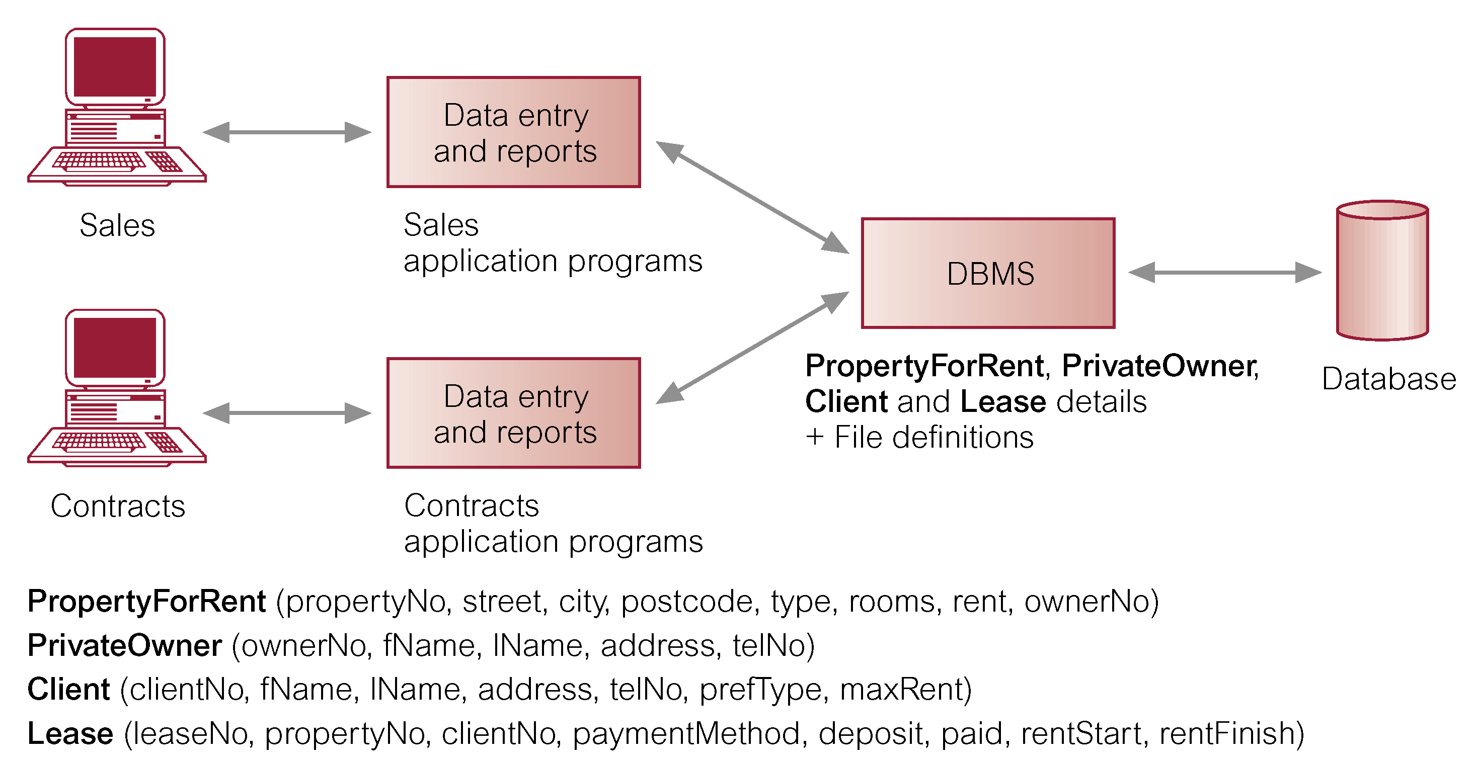
Database Management System (DBMS)

Slide 155
Typical DBMS Functionality
Define a database : in terms of data types, structures and constraints
Construct or Load the Database on a secondary storage medium
Manipulating the database : querying, generating reports, insertions, deletions and modifications to its content
Concurrent Processing and Sharing by a set of users and programs – yet, keeping all data valid and consistent

Slide 156
Typical DBMS Functionality
Other features:
Protection or Security measures to prevent unauthorized access
“Active” processing to take internal actions on data
Presentation and Visualization of data

Slide 157
Components of DBMS Environment
Hardware
PC, workstation, mainframe, a network of computers.
Software
DBMS, operating system, network software (if necessary) and also the application programs.
Data
Used by the organization and a description of this data called the schema.
Procedures
Instructions and rules that should be applied to the design and use of the database and DBMS.
People

Slide 158
Roles in the Database Environment
Data Administrator (DA)
Database Administrator (DBA)
Database Designers (Logical and Physical)
Application Programmers
End Users (naive and sophisticated)

Slide 159
Example of a Database (with a Conceptual Data Model)
Mini-world for the example: Part of a UNIVERSITY environment.
Some mini-world entities:
STUDENTs
COURSEs
SECTIONs (of COURSEs)
(academic) DEPARTMENTs
INSTRUCTORs
Note: The above could be expressed in the ENTITY-RELATIONSHIP data model.

Slide 160
Example of a Database (with a Conceptual Data Model)
Some mini-world relationships:
SECTIONs are of specific COURSEs
STUDENTs take SECTIONs
COURSEs have prerequisite COURSEs
INSTRUCTORs teach SECTIONs
COURSEs are offered by DEPARTMENTs
STUDENTs major in DEPARTMENTs
Note: The above could be expressed in the ENTITY-RELATIONSHIP data model.

Slide 161
Main Characteristics of the Database Approach
Self-describing nature of a database system: A DBMS catalog stores the description of the database. The description is called meta-data). This allows the DBMS software to work with different databases.
Insulation between programs and data: Called program-data independence. Allows changing data storage structures and operations without having to change the DBMS access programs.

Slide 162
Main Characteristics of the Database Approach
Data Abstraction: A data model is used to hide storage details and present the users with a conceptual view of the database.
Support of multiple views of the data: Each user may see a different view of the database, which describes only the data of interest to that user.

Slide 163
Main Characteristics of the Database Approach
Sharing of data and multiuser transaction processing : allowing a set of concurrent users to retrieve and to update the database. Concurrency control within the DBMS guarantees that each transaction is correctly executed or completely aborted. OLTP (Online Transaction Processing) is a major part of database applications.

Slide 164
Advantages of Using the Database Approach
Controlling redundancy in data storage and in development and maintenance efforts.
Sharing of data among multiple users.
Restricting unauthorized access to data.
Providing persistent storage for program Objects (in Object-oriented DBMS’s )
Providing Storage Structures for efficient Query Processing

Slide 165
Advantages of Using the Database Approach
Providing backup and recovery services.
Providing multiple interfaces to different classes of users.
Enforcing integrity constraints on the database.
Drawing Inferences and Actions using rules

Slide 166
Disadvantages of DBMSs
Complexity
Size
Cost of DBMS
Additional hardware costs
Cost of conversion
Performance
Higher impact of a failure

Slide 167
Historical Development of Database Technology
Early Database Applications: The Hierarchical and Network Models were introduced in mid 1960’s and dominated during the seventies. A bulk of the worldwide database processing still occurs using these models.
Relational Model based Systems: The model that was originally introduced in 1970 was heavily researched and experimented with in IBM and the universities. Relational DBMS Products emerged in the 1980’s.

Slide 168
Historical Development of Database Technology
Object-oriented applications: OODBMSs were introduced in late 1980’s and early 1990’s to cater to the need of complex data processing in CAD and other applications. Their use has not taken off much.
Data on the Web and E-commerce Applications: Web contains data in HTML (Hypertext markup language) with links among pages. This has given rise to a new set of applications and E-commerce is using new standards like XML (eXtended Markup Language).

Slide 169
Extending Database Capabilities
New functionality is being added to DBMSs in the following areas:
Scientific Applications
Image Storage and Management
Audio and Video data management
Data Mining
Spatial data management
Time Series and Historical Data Management
The above gives rise to new research and development in incorporating new data types, complex data structures, new operations and storage and indexing schemes in database systems.

Slide 170
When not to use a DBMS
Main inhibitors (costs) of using a DBMS:
High initial investment and possible need for additional hardware.
Overhead for providing generality, security, concurrency control, recovery, and integrity functions.
When a DBMS may be unnecessary:
If the database and applications are simple, well defined, and not expected to change.
If there are stringent real-time requirements that may not be met because of DBMS overhead.
If access to data by multiple users is not required.

Slide 171
When not to use a DBMS
When no DBMS may suffice:
If the database system is not able to handle the complexity of data because of modeling limitations
If the database users need special operations not supported by the DBMS.

Slide 172
Hierarchical & Network Model Advantages and Disadvantages

Slide 173
Hierarchical Model
The Hierarchical Data Model is a way of organizing a database with multiple one to many relationships.
Was developed in the 1960s.
The Hierarchical model was essentially born from the first mainframe database management system. It uses an upside-down tree to structure data. The top of the tree is the parent and the branches are children. Each child can only have one parent but a parent can have many children.

Slide 174
Hierarchical Model
The structure is based on the rule that one parent can have many children but children are allowed only one parent. This structure allows information to be repeated through the parent child relations created by IBM and was implemented mainly in their Information Management System. (IMF), the precursor to the DBMS.

Slide 175
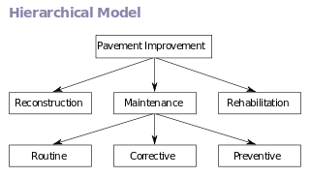
Hierarchical Model

Slide 176
Advantages
Have many different structures and forms.
Structures data in an upside-down tree. (Simplifies data overview)
Manages large amounts of data.
Express the relationships between information.
Many children per parent.
Distribute data in terms of relationships.
Improve data sharing.

Slide 177
Disadvantages
One parent per child.
Complex (users require physical representation of database)
Navigation system is complex.
Data must be organized in a hierarchical way without compromising the information.
Lack structural independence.
Many too many relationships not supported.
Data independence.

Slide 178
Network Model
In 1965 C.W. Bachman developed the first network data model to present complex data relationships more effectively than the hierarchical model. He tried to impose a database standard with his model and also wanted to improve database performance.
It was in 1971 that the Conference on Data System Languages or CODASYL officially or formally defined the Network model. The network databases arrange its data as a directed graph and have a standard navigational language.

Slide 179
Network Model
The network model is a database model conceived as a flexible way of representing objects and their relationships. Its distinguishing feature is that the schema, viewed as a graph in which object types are nodes and relationship types are arcs, is not restricted to being a hierarchy or lattice.
The network model replaces the hierarchical model with a graph thus allowing more general connections among the nodes.
The main difference of the network model from the hierarchical model is its ability to handle many to many relationship. In other words it allow a record to have more than one parent.

Slide 180
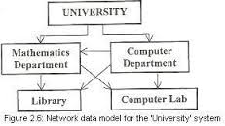
Network Model

Slide 181
Advantages
1.) Conceptual simplicity-Just like the hierarchical model, the network model is also conceptually simple and easy to design.
2.) Capability to handle more relationship types-The network model can handle the one to many and many to many relationships which is real help in modelling the real life situations.
3.) Ease of data access-The data access is easier and flexible than the hierarchical model.
4.) Data integrity- The network model does not allow a member to exist without an owner.
5.) Data independence- The network model is better than the hierarchical model in isolating the programs from the complex physical storage details.
6.) Database standards

Slide 182
Disadvantages
1.) System complexity- All the records are maintained using pointers and hence the whole database structure becomes very complex.
2.) Operational Anomalies- The insertion,deletion and updating operations of any record require large number of pointers adjustments.
3.) Absence of structural independence-structural changes to the database is very difficult.

Slide 183
Hierarchical Model Data definition and implementation

Slide 184
Data Definition in the Hierarchical Model
- Hierarchical data definition language (HDDL)
record type
data item of a record type
key clause
parent
virtual record type
virtual parent
CHILD NUMBER clause (the left-to-right order)
ORDER BY clause
(the order of individual records of the same record type)
sequence key

Slide 185
- Example
SCHEMA NAME = COMPANY
HIERARCHIES = HIERARCHY1, HIERARCHY2
RECORD
NAME = EMPLOYEE
TYPE = ROOT OF HIERARCHY2
DATA ITEMS =
FNAME CHARACTER 15
MINIT CHARACTER 1
LNAME CHARACTER 15
SSN CHARACTER 9
BDATE CHARACTER 9
ADDRESS CHARACTER 30

Slide 186
- Example
SEX CHARACTER 1
SALARY CHARACTER 10
KEY = SSN CHARACTER 10
ORDER BY LNAME, FNAME
RECORD
NAME = DEPARTMENT
TYPE = ROOT OF HIERARCHY1
DATAITEMS =
DNAME CHARACTER 15
DNUMBER INTEGER
KEY = DNAME
KEY = DNUMBER
ORDER BY DNAME

Slide 187
- Example
RECORD
NAME = DLOCATION
PARENT = DEPARTMENT
CHILD NUMBER = 1
DATA ITEMS =
LOCATION CHARACTER 15
RECORD
NAME = DMANAGER
PARENT = DEPARTMENT
CHILD NUMBER = 3
DATA ITEMS =
MGRSTARTDATE CHARACTER 9
MPTR POINTER WITH VIRTUAL PARENT = EMPLOYEE

Slide 188
- Example
RECORD
NAME = PROJECT
PARENT = DEPARTMENT
CHILD NUMBER = 4
DATA ITEMS =
PNAME CHARACTER 15
PNUMBER INTEGER
PLOCATION CHARACTER 15
KEY = PNAME
KEY = PNUMBER
ORDER BY PNAME

Slide 189
- Example
RECORD
NAME = PWORKER
PARENT = PROJECT
CHILD NUMBER = 1
DATA ITEMS =
HOURS CHARACTER 4
WPTR POINTER WITH VIRTUAL PARENT = EMLPOYEE
RECORD
NAME = DEMPLOYEES
PARENT = DEPARTMENT
CHILD NUMBER = 2
DATA ITEM =
EPTR POINTER WITH VIRTUAL PARENT = EMPLOYEE

Slide 190
- Example
RECORD
NAME = DEPENDENT
PARENT = EMPLOYEE
CHILD NUMBER = 2
DATA ITEMS =
DEPNAME CHARACTER 15
SEX CHARACTER 1
BIRTHDATE CHARACTER 9
RELATIONSHIP CHARACTER 10
ORDER BY DESC BIRTHDATE

Slide 191
- Example
RECORD
NAME = ESUPERVISEE
PARENT = EMPLOYEE
CHILD NUMBER = 1
DATA ITEMS =
DEPNAME POINTER WITH VIRTUAL PARENT = EMLPOYEE

Slide 192
Data Manipulation in the Hierarchical Model
- Hierarchical data manipulation language (HDML)
a record-at-a-time
HDML must be embedded in a host language such as COBOL, PL/1,
Pascal, ...
user-work-area - programs
currency indicators
- current of database: a single hierarchical schema and its current
database records
- current of hierarchy for each hierarchical schema
- current of record type for each record type
command classification
- retrieval: GET
- record update: INSERT, DELETE, REPLACE
- current record: GET HOLD

Slide 193
- GET
GET FIRST <record type name> [WHERE <condition>]
GET NEXT <record type name> [WHERE <condition>]
$GET FIRST EMPLOYEE WHERE SALARY < ‘20000.00’;
while DB_STATUS = 0 do
begin
writeln (P_EMPLOYEE.FNAME, P_EMPLOYEE.LNMAE);
$GET NEXT EMPLOYEE WHERE SALARY < ‘20000.00’
end

Slide 194
GET
GET (FIRST | NEXT) PATH
<hierarchical path> [WHERE <condition>]
$GET FIRST PATH EMPLOYEE, DEPENDENT
WHERE EMPLOYEE.FNAME=‘John’ AND
DEPENDENT.DEPNAME=‘John’;
while DB_STATUS = 0 do
begin
writeln (P_EMPLOYEE.LNAME, P_EMPLOYEE.BDATE,
P_DEPENDENT.BIRTHDATE);
$GET NEXT PATH EMPLOYEE, DEPENDENT
WHERE EMPLOYEE.FNAME=‘John’ AND
DEPENDENT.DEPNAME=‘John’
end

Slide 195
GET
GET NEXT <child record type name>
WITHIN [VIRTUAL] PARENT [<parent record type name]
[WHERE <condition>]
$GET FIRST PATH DEPARTMENT, PROJECT
WHERE DEPARTMENT.DNAME=‘Research’;
while DB_STATUS = 0 do
begin
writeln (P_PROJECT.PNAME);
$GET NEXT PROJECT WITHIN PARENT
end;

Slide 196
- Calculating aggregate functions: COUNT, AVERAGE, ...
$GET FIRST PATH DEPARTMENT, DEMPLOYEE;
while DB_STATUS = 0 do
begin
total_sal :=0; no_of_emps :=0;
writeln (P_DEPARTMENT.DNAME);
while DB_STATUS = 0 do
begin
$GET VIRTUAL PARENT EMPLOYEE;
total_sal := total_sal + conv_sal(P_EMPLOYEE.SALARY);
no_of_emps := no_of_emps +1;
$GET NEXT DEMPLOYEES WITHIN PARENT DEPARTMENT
end
writeln (‘no of emps =’, no_of_emps, ‘avg sal of emps =’,
total_sal/no_of_emps);
$GET NEXT PATH DEPARTMENT, DEMPLOYEES
end;

Slide 197
- Update: INSERT, DELETE, REPLACE
P_EMPLOYEE.FNAME := ‘John’;
P_EMPLOYEE.LNAME := ‘Smith’;
P_EMPLOYEE.MINIT := ‘F’;
P_EMPLOYEE.SSN := ‘567875432’;
P_EMPLOYEE.ADDRESS := ‘40 N.W. 80TH ...’;
P_EMPLOYEE.BDATE := ‘10-Jan-55’;
P_EMPLOYEE.SEX := ‘M’;
P_EMPLOYEE.SALARY := ‘30000.00’;
$INSERT EMPLOYEE FROM P_EMPLOYEE;

Slide 198
- Update: INSERT, DELETE, REPLACE
$GET HOLD FIRST EMPLOYEE WHERE SEX = ‘M’;
while DB_STATUS = 0 do
begin
writeln (P_EMPLOYEE.LNAME, P_EMPLOYEE.FNAME);
$DELETE EMPLOYEE
$GET HOLD NEXT EMPLOYEE WHERE SEX = ‘M’
end;

Slide 199
- Update: INSERT, DELETE, REPLACE
$GET FIRST PATH DEPARTMENT, DEMPLOYEE
WHERE DNAME = ‘Reseach’;
while DB_STATUS = 0 do
begin
$GET HOLD VIRTUAL PARENT EMPLOYEE OF DEMPLOYEES
P_EMPLOYEE.SALARY := P_EMPLOYEE.SALARY * 1.1;
$REPLACE EMPLOYEE FROM P_EMPLOYEE
$GET NEXT DEMPLOYEES WHERE PARENT DEPARTMENT
end;

Slide 200
Parent/child relationships
department
dname
dnumber
mgrname
mgrstartdate
employee
project
name
ssn
bdate
address
pname
pnumber
plocation
Two parent/child relationships are in the above schema:
department/employee
department/project

Slide 201
Parent/child instances
department
dname
dnumber
mgrname
mgrstartdate
employee
project
name
ssn
bdate
address
pname
pnumber
plocation
Using the data we had previously seen in Ch 7, we can depict the following 3 instances of department/employee:
Headquarters
Research
Administration
Borg
Smith
Wong
Narayan
English
Zelaya
Wallace
Jabbar

Slide 202
department
dname
dnumber
mgrname
mgrstartdate
employee
project
name
ssn
bdate
address
pname
pnumber
plocation
Using the data we had previously seen in Ch 7, we can depict the following 3 instances of department/project:
Headquarters
Research
Administration
Reorganization
ProductX
ProductY
ProductZ
Computerization
Newbenefits

Slide 203
Navigational - not set-oriented - you retrieve one record at a time
Retrieval
GU, Get unique
GN, Get next
GNP, Get next within parent
Updating
ISRT, Insert
DLET, Delete
REPL, Replace
Data Manipulation
retrieve a specific record
using your current position, get the next record in the database
using your current position, get the next child record for that parent
GU, GN, GNP, ISRT, DLET, REPL are IMS command names

Slide 204
Navigating through the database
Consider the database
Headquarters
Research
Borg
Reorganization
Smith
ProductX
Wong
ProductY
Administration
Narayan
ProductZ
English
Zelaya
Computerization
Wallace
Newbenefits
Jabbar
GU Department (dname=headquarters)
Loop
GNP
exit when status code = ????
End Loop
Program would retrieve the Department record and all of its dependents

Slide 205
Relational & E-R Model Advantages and Disadvantages

Slide 206
Relational Model
The relational data model was introduced in 1970 by Edgar F. Codd. He worked for IBM. All data is represented as simple tabular data structures which the user can access through a high-level non-procedural language. In 1974 IBM proposed a new high-level non-procedural language - SEQUEL (renamed into SQL in 1990).

Slide 207
Advantages
Structured independence is promoted.
Users do not have to know the physical representation of the database.
Use of SQL language to access data.
Easier database design.
Tabular view improves simplicity.
Support large amounts of data.
Data independence.
Multi-level relationships between data sets
No need to predefined data relationships.

Slide 208
Disadvantages
Data anomalies.
People need training if they want to use the system effectively and efficiently.

Slide 209
E-R Model
Dr. Peter Pin-Shan Chen introduced the entity relationship data model in 1976. It is a graphical representation of entities that became popular very quickly because it complemented the relational database model concepts.

Slide 210
Advantages
A very important data modelling tool.
An extended Entity-Relationship diagram allows more details.
Multi-valued attributes.
Structured independence.
Organize the data into categories defining entities & the relationships between them.
Visual representation.
Data independence.

Slide 211
Disadvantages
Limited relationship representation.
Loss of information (when attributes are removed from entities).
No data manipulation language.
Limited constraint representation.

Slide 212
Transactions concepts
Collection of operations that form a single logical unit of work are called transactions.

Slide 213
Transactions concepts
A database system must ensure proper execution of transactions despite failures.
It must manage concurrent execution of transactions to avoid inconsistency.

Slide 214
Transactions concepts
A transaction is a unit of program execution that accesses and possibly updates various data items.
A program contains statements of the form begin transaction and end transaction.

Slide 215
Transactions concepts
The transaction consists of all operations executed between the begin transaction and end transaction.

Slide 216
ACID PROPERTIES
To ensure integrity of the data the database system should maintain following transaction properties.
Atomicity
Consistency
Isolation
Durability

Slide 217
Atomicity: Either all operations of the transaction are reflected properly in the database or none are.
Consistency: Execution of a transaction in isolation preserves the consistency of the database.

Slide 218
Isolation:
Even though multiple transactions execute concurrently each transaction is unaware of other transactions executing concurrently in the system.

Slide 219
Durability:
After a transaction completes successfully the changes it has made to the database persist even if there are system failures.
All acid properties must executed properly for any transaction.

Slide 220
Transaction Operations
It has two basic operations.
Read(x) ,
which transfers the data item x from the database to a local buffer belonging to the transaction that executed the read operation.

Slide 221
Transaction Operations
2. Write(x) ,
which transfers the data item x from the local buffer to the transaction that executed the Write back to the database.

Slide 222
Example
Let T(i) be a transaction that transfers Rs. 50 from account A to account B. This transaction can be defined as:
T(i): read (A)
A:= A-50
write(A)
read(B)
B:= B+50
write(B)

Slide 223
Structured Query Language (SQL) commands DDL, DML, DCL and TCL

Slide 224
SQL
Language for describing database schema and operations on tables
DDL, DML, DCL and TCL are considered sublanguages of SQL

Slide 225
SQL
The four main categories of SQL statements are as follows:
1. DML (Data Manipulation Language) 2. DDL (Data Definition Language) 3. DCL (Data Control Language) 4. TCL (Transaction Control Language)

Slide 226
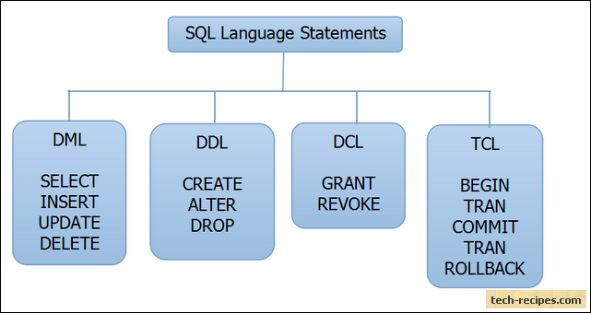
SQL language statements

Slide 227
DML
DML is abbreviation of Data Manipulation Language.
It is used to retrieve, store, modify, delete, insert and update data in database.
DML statements affect records in a table.

Slide 228
DML Operations
SELECT – Retrieves data from a table
INSERT – Inserts data into a table
UPDATE – Updates existing data into a table
DELETE – Deletes all records from a table

Slide 229
DDL
DDL is abbreviation of Data Definition Language.
It is used to create and modify the structure of database objects in database.
It handles the design and storage of database objects.

Slide 230
DDL Operations
CREATE – Creates objects in the database
ALTER – Alters objects of the database
DROP – Deletes objects of the database
TRUNCATE – Deletes all records from a table and resets table identity to initial value.

Slide 231
DCL
DCL is abbreviation of Data Control Language.
It is used to create roles, permissions, and referential integrity as well it is used to control access to database by securing it.

Slide 232
DCL Operations
GRANT –
Gives user’s access privileges to database.
It allows users to read/write on certain database objects
REVOKE –
Withdraws user’s access privileges to database given with the GRANT command
keeps users from read/write permission on database objects

Slide 233
TCL
TCL is an abbreviation of Transactional Control Language.
It is used to control and manage different transactions occurring within a database and to maintain integrity of data within SQL statements.

Slide 234
TCL Operations
BEGIN Transaction – opens a transaction
COMMIT Transaction – commits a transaction
ROLLBACK Transaction – ROLLBACK a transaction in case of any error

Slide 235
Distributed Systems and Distributed Databases

Slide 236
Distributed System
A distributed system is a model in which components located on networked computers communicate and coordinate their actions by passing messages.
They help in sharing different resources and capabilities to provide users with a single and integrated coherent network.

Slide 237
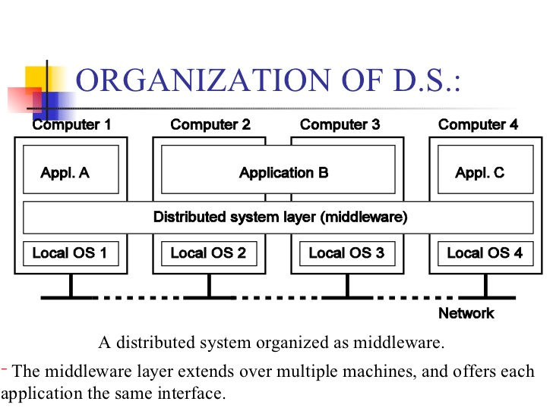

Slide 238
Features of Distributed System
A distributed system allows resource sharing, including software by systems connected to the network at the same time.
Components in the system are concurrent. The components could be multiple but will generally be autonomous in nature.

Slide 239
Features of Distributed System
A global clock is not required in a distributed system. The systems can be spread across different geographies.
Compared to other network models, there is greater fault tolerance in a distributed model.

Slide 240
Goals of Distributed System
Transparency:
Achieving the image of a single system image without concealing the details of the location, access, migration, concurrency, failure, relocation, persistence and resources to the users.
Openness:
Making the network easier to configure and modify.

Slide 241
Goals of Distributed System
Reliability:
Compared to a single system, a distributed system should be highly capable of being secure, consistent and have a high capability of masking errors.

Slide 242
Goals of Distributed System
Performance:
Compared to other models, distributed models are expected to give a much-wanted boost to performance.
Scalability:
Distributed systems should be scalable with respect to geography, administration or size.

Slide 243
Challenges of Distributed System
Security is a big challenge in a distributed environment, especially when using public networks.
Fault tolerance could be tough when the distributed model is built based on unreliable components.

Slide 244
More Challenges of Distributed System
Coordination and resource sharing can be difficult if proper protocols or policies are not in place.
Process knowledge should be put in place for the administrators and users of the distributed model.

Slide 245
Distributed system examples
telecommunication networks:
Telephone and cellular networks,
Computer networks as Internet,
Wireless sensor networks,
Routing algorithms,

Slide 246
Distributed system examples
Network applications:
World Wide Web,
Multiplayer Online games
Virtual Reality communities,
Network file systems
distributed information processing systems such as banking systems and airline reservation systems;

Slide 247
Distributed system examples
Real time process control:
aircraft control systems,
Industrial control systems

Slide 248
Distributed Database
A single logical database that is spread physically across computers in multiple locations that are connected by a data communications link

Slide 249
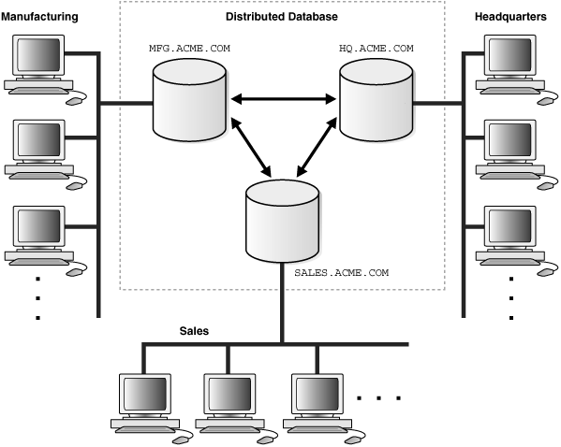

Slide 250
Applications of Distributed Database
Business unit autonomy and distribution
Data sharing
Data communication costs
Data communication reliability and costs
Multiple application vendors
Database recovery
Transaction and analytic processing

Slide 251
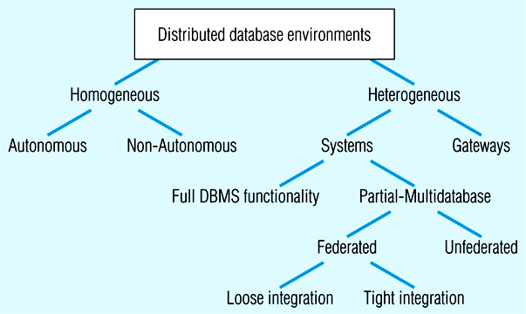
DD Environments

Slide 252
Types of Distributed database
Homogeneous DD –
If the data is distributed but all servers run the same DBMS software.
Heterogeneous DD –
If different sites run under the control of different DBMS, essentially autonomously, are connected to enable access to data from multiple sites.

Slide 253
Homogeneous –
Same DBMS at each node
Autonomous - Independent DBMSs
Non-autonomous - Central, coordinating DBMS
Easy to manage, difficult to enforce

Slide 254
Heterogeneous –
Different DBMSs at different nodes
Systems – With full or partial DBMS functionality
Gateways - Simple paths are created to other databases without the benefits of one logical database
Difficult to manage, preferred by independent organizations

Slide 255
Systems - Supports some or all functionality of one logical database
Full DBMS Functionality - All distributed DB functions
Partial-Multi database- Some distributed DB functions

Slide 256
Partial Multi-database:
Federated - Supports local databases for unique data requests
Loose Integration - Local dbs have their own schemas
Tight Integration - Local dbs use common schema
Unfederated - Requires all access to go through a central, coordinating module

Slide 257
Advantages of Distributed Database over Centralised Database
Increased reliability/availability
Local control over data
Modular growth
Lower communication costs
Faster response for certain queries

Slide 258
Disadvantages of Distributed Database compared to Centralised Database
Software cost and complexity
Processing overhead
Data integrity exposure
Slower response for certain queries

Slide 259
End of Today’s Lecture
Thank You

