Slide 1
Session Objective
Develop a regression model that predict a variable from multiple independent variables

Slide 2
Poll Question-01
Q1:Small sum square error lead better regression mode.
Ch1: Yes
Ch2: No

Slide 3
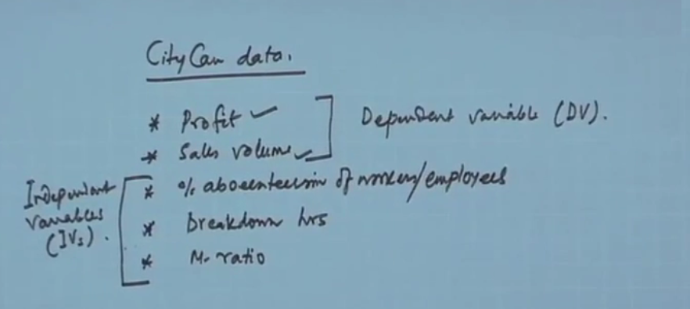
Example of Multiple Regression

Slide 4
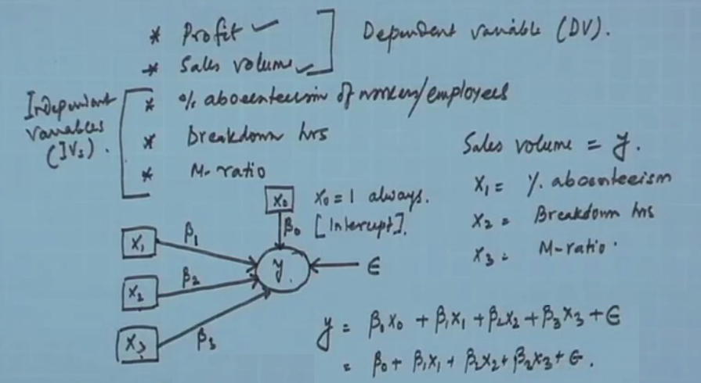
Representation of Regression Model

Slide 5
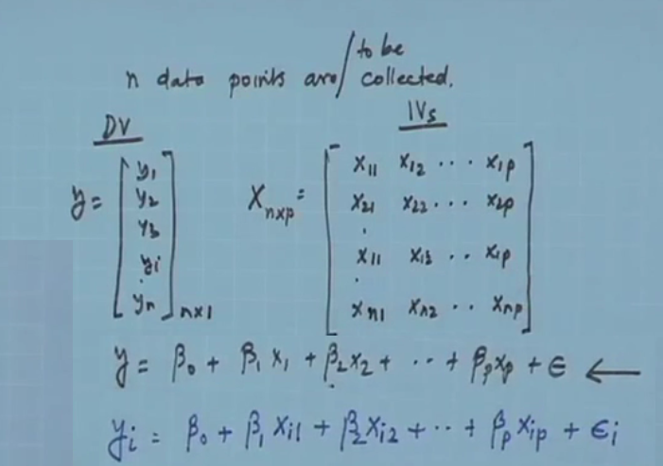
Cont..

Slide 6
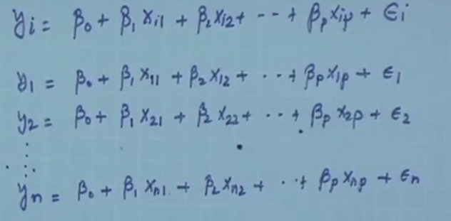

Slide 7
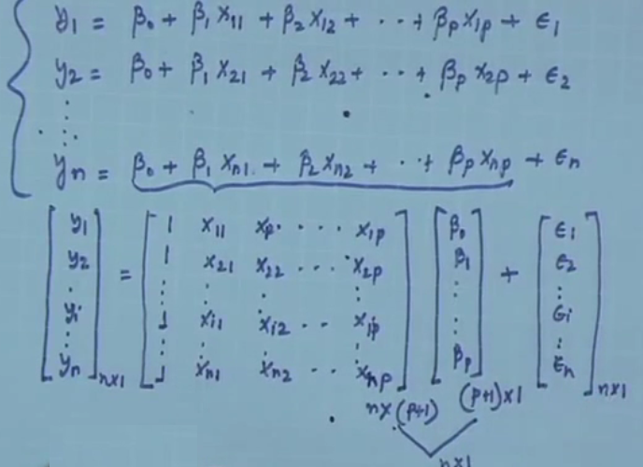

Slide 8
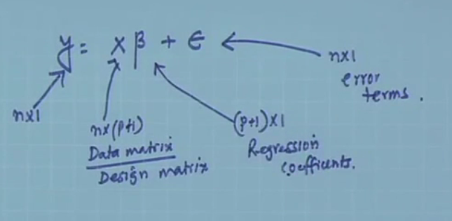

Slide 9
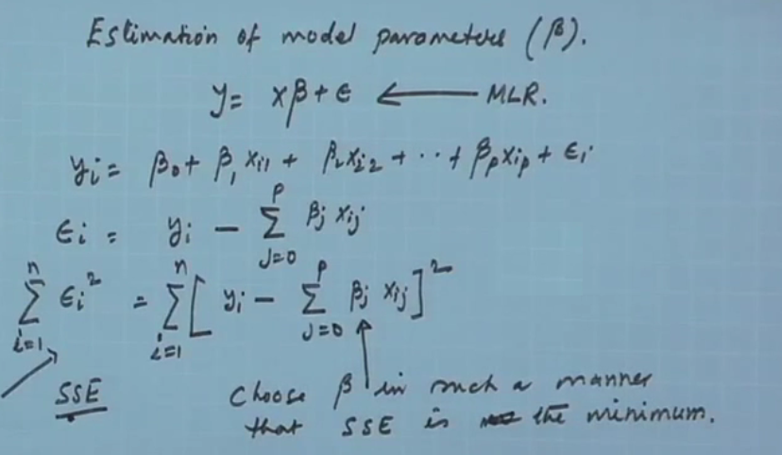
Derivation of Multiple Regression

Slide 10
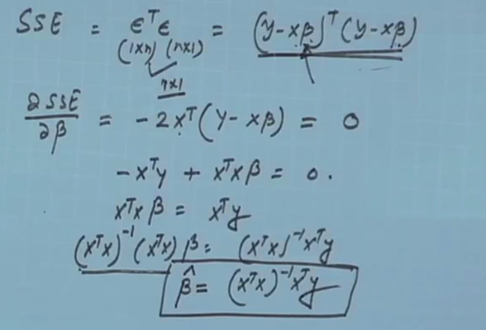

Slide 11
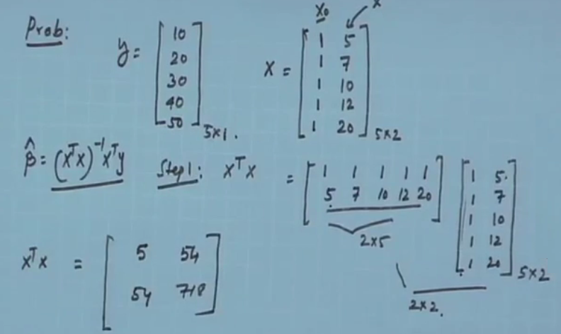
Example of Multple Regression

Slide 12
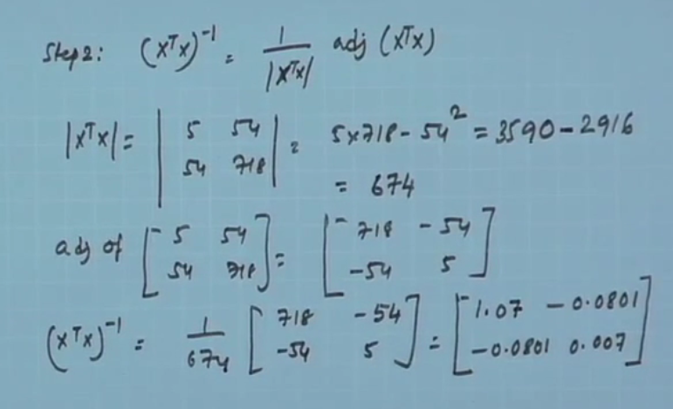
Cont..

Slide 13
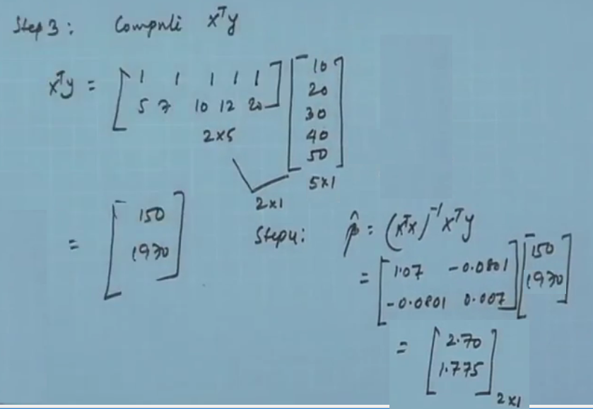
Cont..

Slide 14
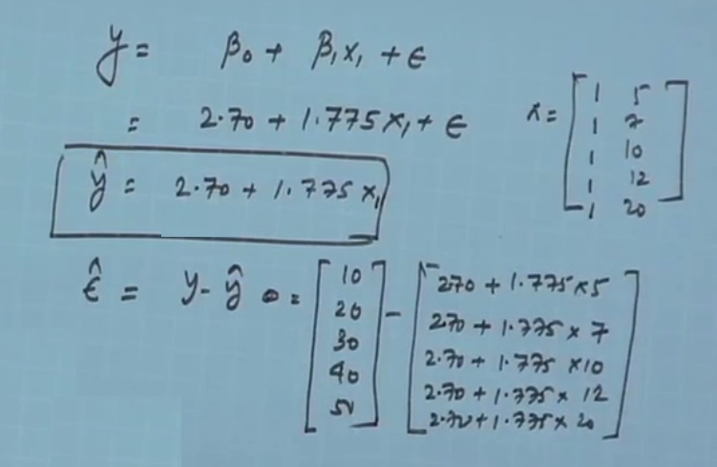
Cont..

Slide 15
References
Han J & Kamber M, “Data Mining: Concepts and Techniques”, Third Edition, Elsevier, 2011.
https://www.youtube.com/watch?v=lWlCWbhaem8

Slide 16
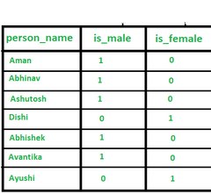
Important Questions
Q1: Are both corelation and covariance represent the linear relationship of two variables?
Q2: What is the cons of PCA ?
Q3: How corelation may be useful to avoid data redudancy?
Q4: Is there any data redudancy in the above table could you recommend a solution?
Q5: Is eigen value multiplication with a vector extend the same vector?

Slide 17
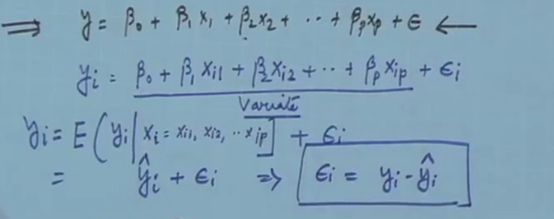
Understand of Multiple Regression

Slide 18
CO2: Completed, CO3: Will commence from next class.
Hint for Next Class Topic

