Slide 1
DRUG DISCOVERY AND DESIGN...
AISR PROJECT ~ Saksham Saxena
~ Vanshika Raghav
~ Suparshva Bhatnagar
~ Rishabh Baghel

Slide 2
Idea and Motivation....
Discovering a new drug from scratch for a specific disease is a costly and time taking process.
There are major disadvantages of the existing Drug Discovery methods, for example, even after years research, only one out of 1000 hits get approved as often the active compound maybe too toxic, not bioavailable, or too costly to manufacture.
So we are instead applying a reverse approach. Repurposing.
Drug Repurposing involves the investigation of existing drugs for new therapeutic purposes.
The base of our model lies in the efficient prediction of drug-target interactions (DTIs).
Much learning has already been done in this field. However, many interactions have not yet been detected, and the accuracy of the existing models is also not very high.
We plan to train them and use the ML model to find the exact drug’s functional group-binding pocket of the protein interaction.
We plan to order the drugs using an efficiency score. For this, the exact parameters affecting the interaction will be considered.
REFERENCES
El-Behery, H., Attia, A. F. (2021), “Similar molecules are usually associated with similar protein targets”
https://www.sciencedirect.com/science/article/pii/S1476927121001031?via%3Dihub
https://www.niser.ac.in/~smishra/teach/cs460/2021/project/21cs460_group14/
https://github.com/debankit/21cs460_group14

Slide 3

Relevant Papers Used...
El-Behery, H., Attia, A. F. (2021). Efficient machine learning model for predicting drug-target interactions with case study for Covid-19. Computational Biology and Chemistry, 93, 107536. DOI
Vuignier, K., Schappler, J., Veuthey (2010). Drug–protein binding: a critical review of analytical tools. Analytical and Bioanalytical Chemistry, 398(1), 53–66. DOI
Mohapatra, S., Nath, P., Chatterjee, M. & Satapathi, S. (2020). Repurposing therapeutics for COVID-19: Rapid prediction of commercially available drugs through machine learning and docking. PLOS ONE, 15(11), e0241543. DOI
Young, D. C. (2009). Computational Drug Design. Wiley. DOI
Baseline and Expectation
For the ML model we plan to first start with the normal clustering algorithms and also Support Vector Machine(SVM). We will then try to use a decision tree based Random Forest(RF) Method.
We expect that our model can predict the test data results with high accuracy so as to be better than the existing algorithms.
The extended use of the model can be that whenever a new small heterocyclic molecule is synthesised by some researcher, he/she can use our algorithm to predict the molecule’s likelihood to be a drug.
Conversely by using this model researchers can save time and resources while producing a new drug as they can test their design’s applicability before even synthesizing it. (Basically, Gaussian for medicinal chemists)

Slide 4
First step: Data Gathering and Pre pre-processing
We needed a dataset that contains the number of functional groups in different molecules along with the information that they are active or inactive in inhibiting a particular protein or protein substance that is in turn responsible for some disease.
That seemed so easy, until we did not find any.
I embarked on a thorough exploration of the internet in pursuit of the perfect dataset for drug classification and discovery. I scoured various platforms such as Kaggle and DrugBank, meticulously examining each dataset available. Additionally, I delved into numerous research papers pertaining to drug classification and discovery in machine learning.
Despite extensive searching, I was unable to find a dataset that fully met my requirements. However, my perseverance led me to a groundbreaking research paper that ultimately fulfilled all my needs.

Slide 5
In the pursuit of an efficient tool to convert 3D molecule representations into their corresponding number of functional groups, the UC Irvine team's groundbreaking solution was discovered. This tool enables direct conversion from SMILE representations of molecules to the count of different functional groups they contain.
Despite challenges integrating this tool into existing codebases, manual conversion methods were employed. Nevertheless, two datasets containing SMILE representations of molecules and their activity levels in inhibiting the E.Coli bacteria and HIV virus were identified.
To process these datasets efficiently, a strategy was devised to convert SMILE representations into their corresponding functional group counts in batches. This approach proved essential as the initially sought tool couldn't handle large numbers of molecules simultaneously. Through diligent batch processing, the datasets were successfully transformed, ensuring compatibility with research objectives.

Slide 6
Second step: Baseline Implementation *We have taken the prepared datasets as input and converted into two lists containing the features and labels. *We have split the dataset into 30 percent testing data and 70 percent training data. *We have implemented Decision tree classifier, Naive Bayes classifier, Random Forest classifier, SVM and SGD models.

Slide 7
On HIV dataset
On E.Coli dataset
MODELS | Accuracy | F1 Score (weighted)
Decision Tree | 0.89 | 0.885
Naive Bayes | 0.86 | 0.801
Random Forest | 0.92 | 0.908
SVM | 0.896 | 0.866
SGD | 0.843 | 0.849
MODELS | Accuracy | F1 Score (weighted)
Decision Tree | 0.873 | 0.868
Naive Bayes | 0.866 | 0.804
Random Forest | 0.896 | 0.880
SVM | 0.88 | 0.834
SGD | 0.843 | 0.842
We have tried to mix the data of both the E-Coli and HIV so that we can classify the different molecules to check if they are helpful in these two diseases. Our model holds and thus our plan has been quite successful as of yet.
MODELS | Accuracy | F1 Score (Weighted)
Decision Tree | 0.876 | 0.871
Naive Bayes | 0.893 | 0.842
Random Forest | 0.924 | 0.915
SVM | 0.908 | 0.877
SGD | 0.874 | 0.868

Slide 8
Deep Learning Model For the HIV Dataset *We have split the dataset containing around 3000 rows into 20 percent test data and 80 percent training data. *We have used the Standard Scaler so as to not confuse the neural network regarding the weights of the features. *We have used the tensorflow library to train our model. There are 4 Dense layers with 3 Relu Activation function and 1 last Sigmoid activation function. *We have taken two different learning rate cases. In case of 0.03 learning rate, we found that after around 60 epochs, the model is overfitting. (Training Accuracy = 0.82 in 50 epochs) *In 0.01 learning rate, we get a good result after 100 epochs. (Training Accuracy = 0.93 in 100 epochs) *With Learning Rate of 0.03

Slide 9
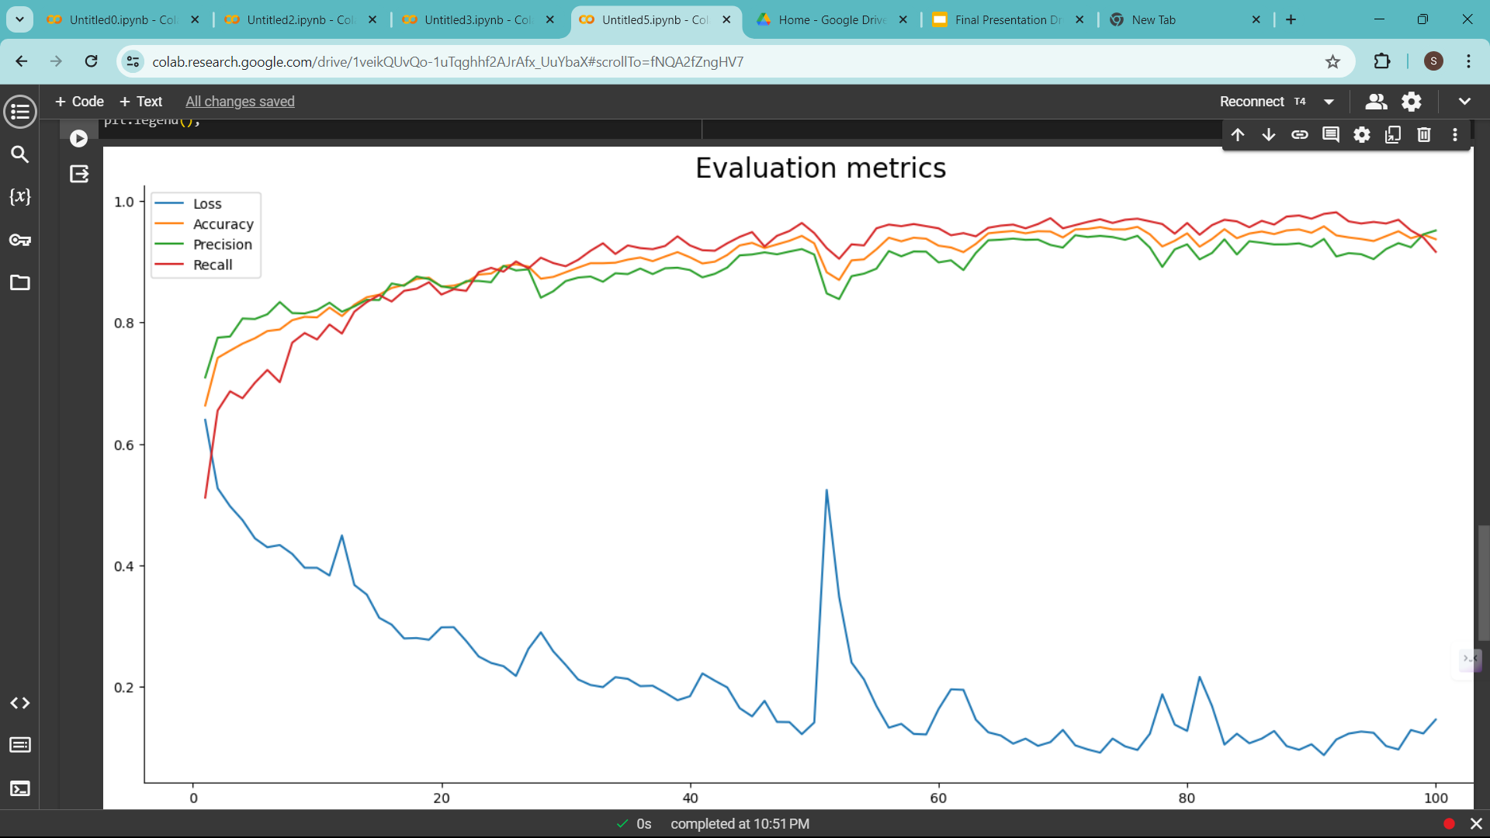
Evaluation graph of 0.1 learning rate

Slide 10
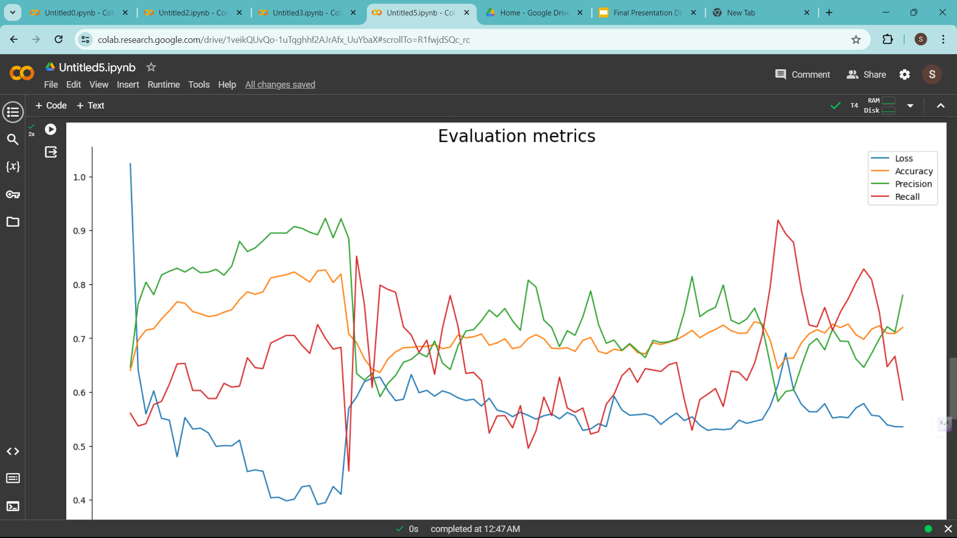
Evaluation Graph for 0.3 Learning Rate

Slide 11
Limitations and Conclusions Although these results might seem very promising and give the conception that now given any new small molecule our model can predict whether it can be used as a drug for some disease, that is misleading. Drug designing is a very complicated process(what we learned in the hard way) and this model, if extended to all major diseases, given their databases are publicly available(which isn’t, all due credit to big pharma), will definitely help drug designers to make better predictions. A small molecule being active for a particular disease causing protein doesn’t imply it can be used as a drug. ‘Active’ is a broad term as interpreted by Mohapatra et al. includes even those which just interact with the protein(not necessarily block the foreign disease causing element get attached). Other factors like Docking efficiency, Orientation of the molecule, tautomerism or conjugation if present also comes into play. But, there are softwares like AdMET and Vina AutoDOCK to do that. Our model acts as an enabling technology and helps make researchers make better predictions by narrowing down their search significantly. Ideas to Improve We believe, the output we get from our model can again be used in the model created in our reference papers, thereby increasing the accuracy of getting a viable new drug. If we can increase the number of datapoints, then we can get a better trained model.

Slide 12


