Slide 1
Exploring the Efficacy of ear Images for biometrics identification
Sakshamdeep Singh – 50475857
Ashutosh Rastogi - 50486793

Slide 2
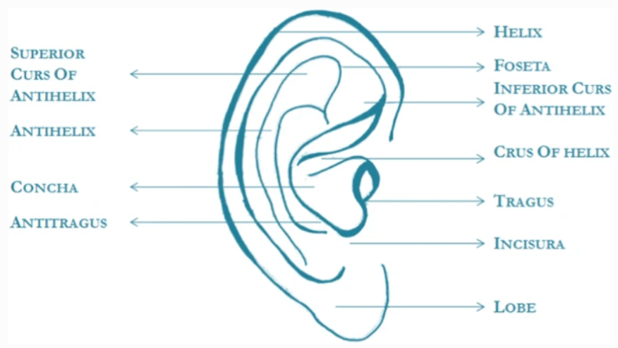
Research Problem
Automatic person identification from ear images is an active field of research within the biometric community.
Like other biometrics such as face, iris and fingerprints, ear also has a large amount of specific and unique features that allow for person identification.
Three important factors for person identification are temporal consistency, ease of acquisition, and uniqueness to everyone.

Slide 3
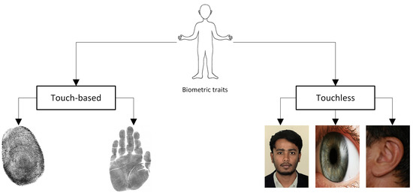
Advantages
In the worldwide outbreak of COVID-19 situation, most of the face identification systems fail due to the mask wearing scenario.
The human ear is a perfect source of data fora passive person identification as it does not involve the cooperativeness of the human whom we are trying to recognize
Additionally, the ear can be acquired in a contactless and nonintrusive manner.

Slide 4
Novelty and Main Contribution
Using state of the art YOLOv8 (You Only Look Once) model for ear detection. YOLO popular object detection algorithm that can detect objects in real-time is the YOLO model. This method is quicker and more effective than conventional object detection techniques.
The project's primary contribution would be the creation of an accurate and efficient person classification system based on ear detection and the YOLO paradigm. This system could be utilized for a variety of purposes, including biometric identification, security systems, and healthcare.

Slide 5
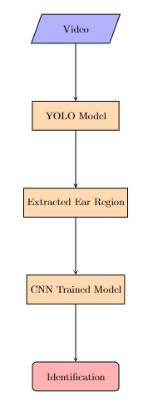
Approach
The workflow begins with an input in the form of a video capture, which is obtained using OpenCV.
This video feed is processed by the YOLO model, which extracts the region of the ear.
The extracted ear region is then used as input to a trained CNN model for identification.

Slide 6
Related Works
Ahila Priyadharshini, R., Arivazhagan, S. & Arun, M. A deep learning approach for person identification using ear biometrics. Appl Intell 51, 2161–2172 (2021). https://doi.org/10.1007/s10489-020-01995-8
Raveane, W.; Galdámez, P.L.; González Arrieta, M.A. Ear Detection and Localization with Convolutional Neural Networks in Natural Images and Videos. Processes 2019, 7, 457. https://doi.org/10.3390/pr7070457

Slide 7
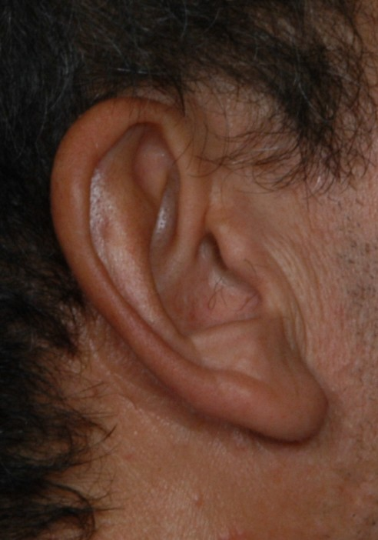
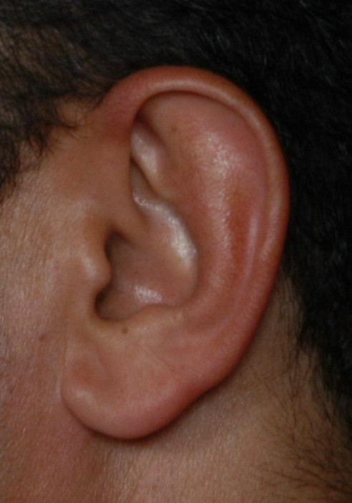
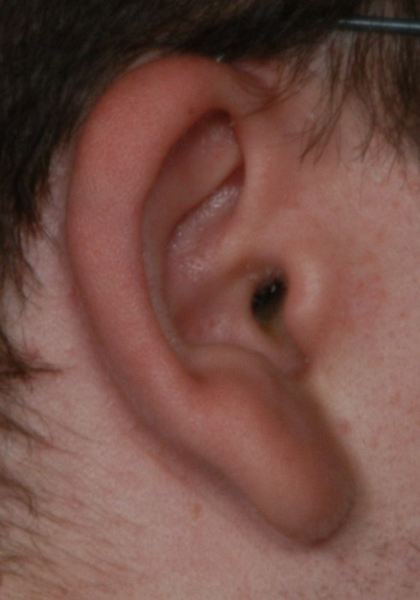
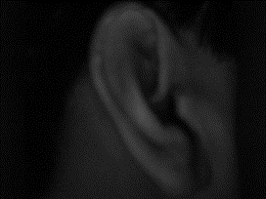
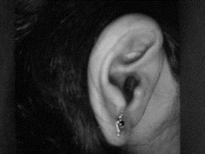
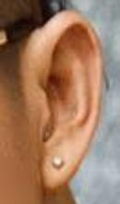

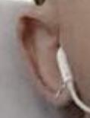
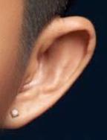
Dataset
AMI dataset
100 subjects
492 * 702 pixels
700 images
IIT Delhi Ear Database version 1.0
125 subjects
493 images
272 * 204 pixels
EarVN1.0: A new large-scale ear images dataset in the wild
164 Asian Individuals (98 males, 66 females)
28,412 Color Images
Unconstrained conditions

Slide 8
Evaluation Protocol
Some common metrics we will be using in our biometric identification systems include:
True Accept Rate (TAR): The percentage of genuine matches that are correctly identified by the system.
False Accept Rate (FAR): The percentage of impostor matches that are incorrectly identified as genuine by the system.
True Reject Rate (TRR): The percentage of impostor matches that are correctly rejected by the system.
False Reject Rate (FRR): The percentage of genuine matches that are incorrectly rejected by the system.
Equal Error Rate (EER): The point at which the FAR and FRR are equal.
These metrics used to evaluate the performance of an ear biometric identification system and to compare its performance with other biometric identification systems.

Slide 9
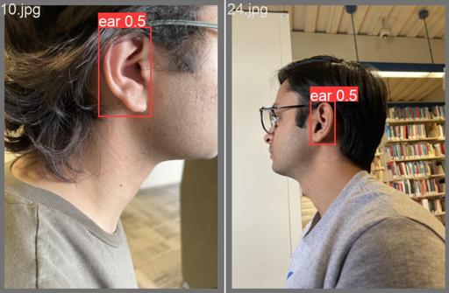
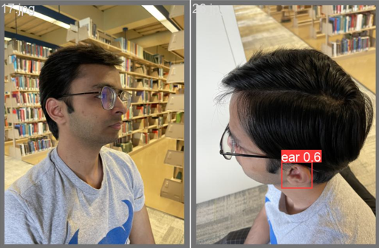
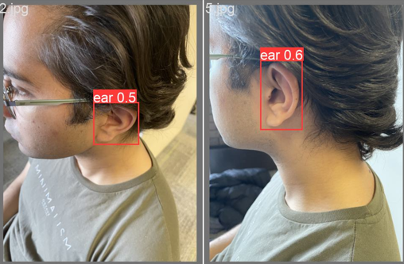
Interim Result Analysis - Detection

Slide 10
Future Work and Improvements
Detection
Improve the detection performance.
Provide more dataset and train a bigger YOLO model.
Multiple ear detection evaluation has not been done yet. Current approach assumes the model will detect single ear per frame.
The precision of the YOLO model depends on the extent and quality of the dataset used for training. The collection of a larger and more diverse dataset of ear images, including images with varying skin tones, ear shapes, and occlusions, could be the subject of future research.
Recognition

Slide 11
References
Ahila Priyadharshini, R., Arivazhagan, S. & Arun, M. A deep learning approach for person identification using ear biometrics. Appl Intell 51, 2161–2172 (2021). https://doi.org/10.1007/s10489-020-01995-8
Raveane, W.; Galdámez, P.L.; González Arrieta, M.A. Ear Detection and Localization with Convolutional Neural Networks in Natural Images and Videos. Processes 2019, 7, 457. https://doi.org/10.3390/pr7070457
Mursalin, M.; Ahmed, M.; Haskell-Dowland, P. Biometric Security: A Novel Ear Recognition Approach Using a 3D Morphable Ear Model. Sensors 2022, 22, 8988. https://doi.org/10.3390/s22228988
A. Kumar and C. Wu, "Automated Ear Identification using Ear Imaging," Pattern Recognition, vol. 45, no. 3, pp.956-968, March 2012.

Slide 12
Questions?

