Slide 1
PROJECT REPORT · MERN STACK
Neighborhood Skill
& Tool Sharing Exchange
A secure, hyper-local peer-to-peer platform for renting tools and sharing skills within a verified neighborhood.
GROUP NAME: TEAM NEIGHBORSHARE
Course Code
SCA002
Guided by
Bharath Reddy
SUBMITTED BY
Rahul Rathod — 12508547
Sujal Bhatia — 12502429
Ansh Bhatia — 12502420
Saksham Shakya — 12502712
School of Computer Application · Lovely Professional University

Slide 2
ABSTRACT
Turning Idle Tools & Idle Time Into a Local Economy
In modern neighborhoods, people often own expensive tools or hold specialized skills that sit unused, while others nearby need exactly those resources for short-term tasks. NeighborShare bridges this gap with a full-stack MERN application that lets verified neighbors rent physical tools and offer professional or casual skills within a secure, community-driven ecosystem — reducing consumption, cutting costs, and strengthening local bonds.
Booking & Availability
Browse, request, approve, and manage tool and skill bookings with real-time conflict prevention.
Secure Payments & Trust
Razorpay-powered deposits, rental fees, and a proprietary Trust Score with reviews.
Real-Time Communication
Socket.io chat lets neighbors coordinate logistics without sharing phone numbers.
Admin Moderation
A dedicated dashboard for oversight, dispute resolution, and account enforcement.
FULL STACK
Neighborhood Skill & Tool Sharing Exchange
TEAM MEMBERS
2

Slide 3
TECH STACK
Built on the MERN Stack, Optimized with Modern Tooling
FRONTEND
BACKEND
React 19 & React Router v7
Node.js & Express 5
Component-based SPA with client-side routing
Scalable REST API server framework
Vite
MongoDB & Mongoose
Next-generation, ultra-fast frontend build tooling
Flexible NoSQL data modeling
Tailwind CSS v4
JWT & Bcrypt
Utility-first responsive styling
Secure authentication & password hashing
Lucide React / React Icons
Socket.io
Consistent iconography across the UI
WebSocket-based real-time messaging
Socket.io-client
Razorpay
Real-time chat & notification updates
Payment gateway for deposits & rentals
Axios
Nodemailer
Promise-based API request handling
Automated email notifications & reminders
Neighborhood Skill & Tool Sharing Exchange
3

Slide 4
ARCHITECTURE
Project Structure at a Glance
A clean client / server separation keeps UI, business logic, and data access independent.
CLIENT (React + Vite)
SERVER (Node + Express)
index.html
SPA entry — single root <div> React mounts into
server.js
Entry point — starts Express, DB, and Socket.io
src/main.jsx
Application entry point; wraps global providers
app.js
Configures middleware, routes, and error handlers
src/App.jsx
Root component; holds React Router routing logic
models/
Mongoose schemas — User, Tool, Skill, Booking…
src/pages/
Full views — Home, Login, ToolDetails, Dashboard…
controllers/
Core business logic behind every endpoint
src/components/
Reusable UI blocks — Navbar, ToolCard, Footer…
routes/
Maps URLs (GET/POST/PUT/DELETE) to controllers
src/context/ & services/
Auth context and API service wrappers
middleware/ & utils/
Auth guards, rate limiting, email & token helpers
Neighborhood Skill & Tool Sharing Exchange
4

Slide 5
API DOCUMENTATION
68 RESTful Endpoints Across 14 Modules
9
6
7
5
13
6
5
Auth
Users
Tools
Skills
Bookings
Admin
Chat
/api/auth
/api/users
/api
/api/skill
/api
/api/admin
/api/chat
4
4
3
2
2
1
1
Payments
Reviews
Reports
Notifications
Trust Score
Wishlist
System
/api
/api/review
/api
/api/notifications
/api
/api/wishlist
/api
Every endpoint is fully wired to the React frontend and structured for scalable, serverless-ready deployment.
Neighborhood Skill & Tool Sharing Exchange
5

Slide 6
KEY DIFFERENTIATORS
Solving Real Neighborhood Problems, Not Just Listings
1
Escrow-Protected Rentals
2
Unified Tool + Skill Marketplace
Razorpay-powered security deposits let neighbors safely lend high-value tools — deposits are claimable through the admin panel if items are damaged or not returned.
One platform for both physical items and human expertise — rent a lawnmower and hire someone to use it, in the same ecosystem.
3
Hyper-Local Verified Trust
4
Privacy-First Coordination
Neighborhood verification plus a proprietary Trust Score and review system replace anonymous, global freelance matching.
Real-time in-app chat via Socket.io means logistics are coordinated without ever exchanging personal phone numbers.
Neighborhood Skill & Tool Sharing Exchange
6

Slide 7
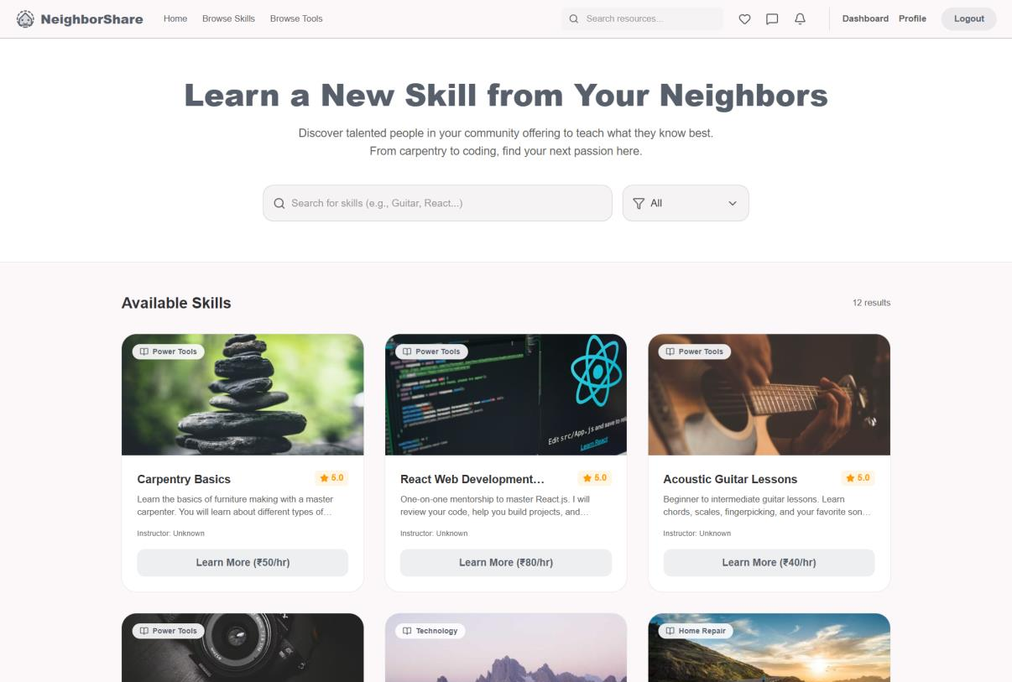
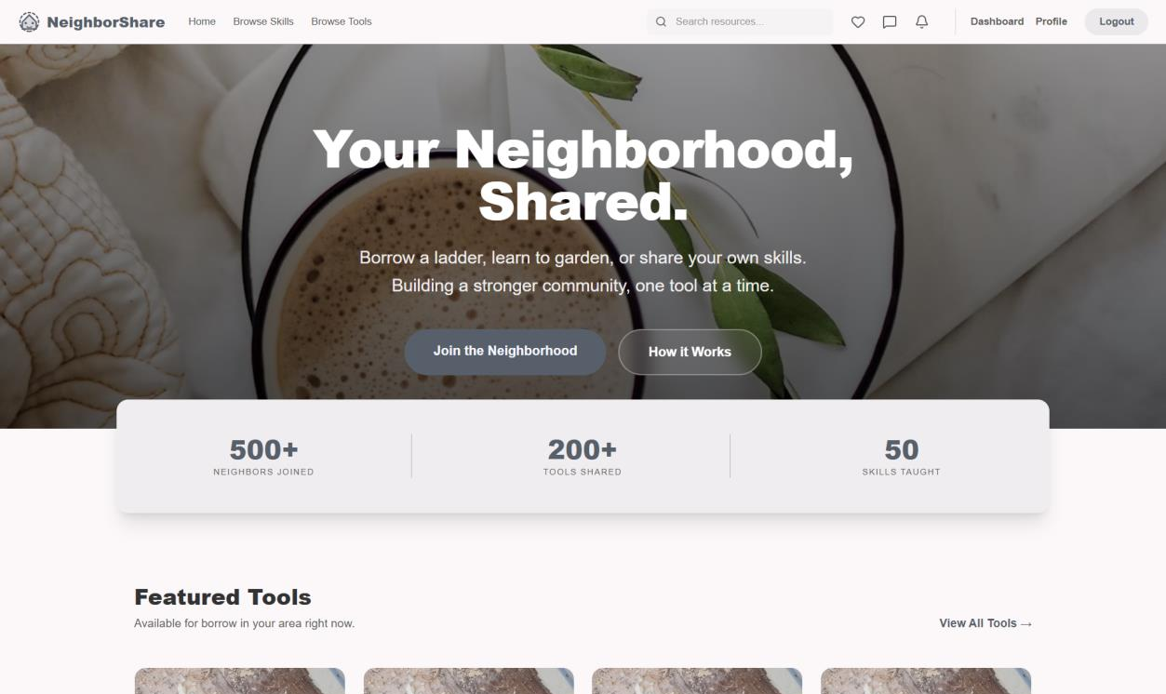
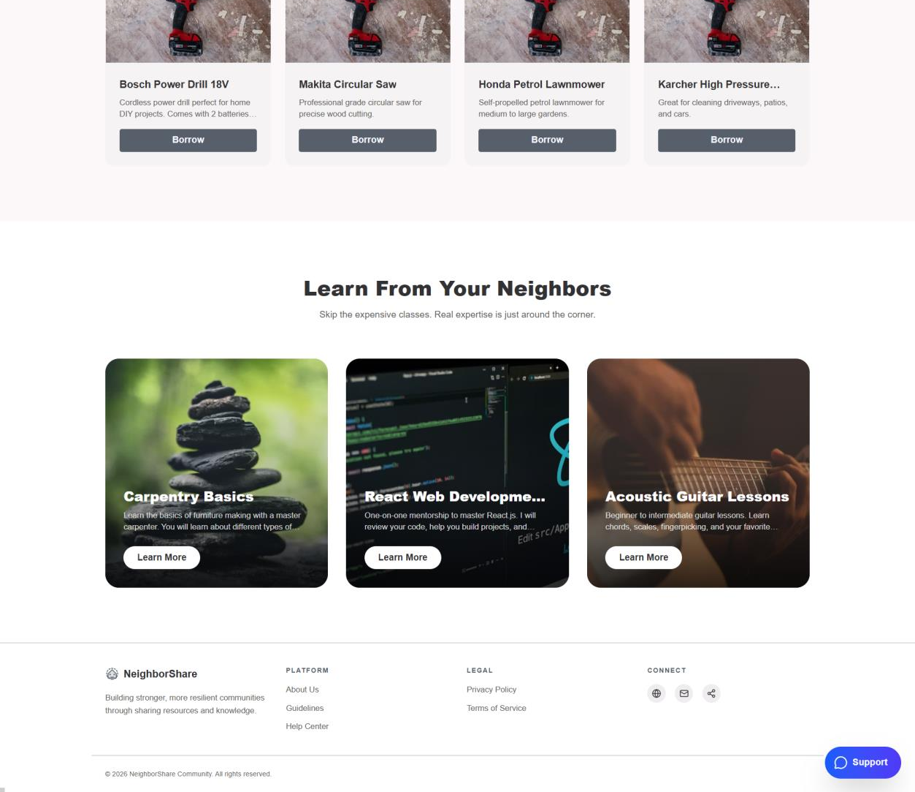
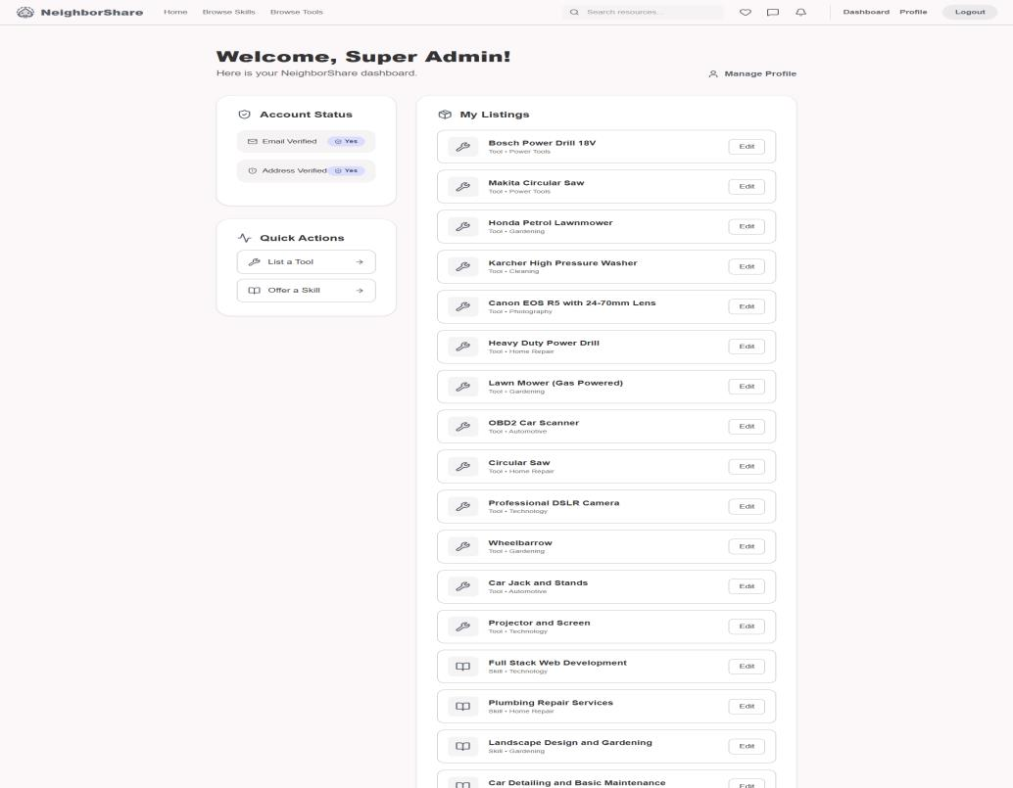
IMPLEMENTATION
Results — Live Interface Walkthrough
Homepage — Hero & Stats
Authentication — Sign In
User Dashboard
Browse Tools Catalog
Neighborhood Skill & Tool Sharing Exchange
7

Slide 8
TEAM NEIGHBORSHARE
Team Contributions
Saksham Shakya
1
Authentication & User Module
Ansh Bhatia
2
Payments & Admin Dashboard
Rahul Rathod
3
Real-Time Chat & Notifications
Sujal Bhatia
4
Booking module & tool listing
Neighborhood Skill & Tool Sharing Exchange
8

Slide 9
Conclusion
NeighborShare transforms high-risk, informal neighborhood borrowing into a formal, reliable, and sustainable localized micro-economy — combining escrow-protected payments, a unified tool & skill marketplace, verified trust, private real-time chat, and automated booking lifecycle management on a single, scalable MERN foundation.
500+
200+
NEIGHBORS JOINED
TOOLS SHARED
50
68
SKILLS TAUGHT
APIS BUILT
GITHUB REPOSITORY
github.com/sakshamshakya337/Neighbor-hood-SkillTool-Sharing-Exchange
Thank You
git clone https://github.com/sakshamshakya337/Neighbor-hood-SkillTool-Sharing-Exchange.git
Team NeighborShare · School of Computer Application, LPU

