Slide 1

MPFT: Multipath Reliable File Transfer over Parallel TCP Paths
Mini-project presentation
Computer Networks Laboratory (CSE20110)
Department of Computer Engineering and Technology
Saksham Singh Sisodiya – PRN 1262242908
Parth Dande – PRN 1262242629
Anupria Gupta – PRN 1262241349
Group [No.] Panel [PANEL] Batch [Batch]
Faculty: Dr. Priti Chakurkar
Academic Year: 2026–2027
Presentation date: [Date]
Computer Networks Laboratory CSE20110
15 seconds
Notes:
Introduce the project and group (15 s).

Slide 2
Problem and Objectives
PROBLEM
One TCP connection uses one network path and starts again from zero if it breaks, so extra links sit idle and a lost connection wastes the whole transfer [1][2].
Users: anyone moving large files between hosts with several links. Scope: one file, one sender, one receiver, emulated paths on one machine.
OBJECTIVES
1
Send one file in chunks over N parallel TCP paths using a shared work queue.
2
Detect corruption (header CRC, chunk and file SHA-256) and repair it by retransmission.
3
Survive a dead or silent path and resume interrupted transfers.
Computer Networks Laboratory CSE20110
40 seconds
Notes:
One TCP connection uses one path and restarts from zero. MPFT splits a file into chunks over parallel TCP paths, verifies integrity, survives failures and resumes (40 s).

Slide 3
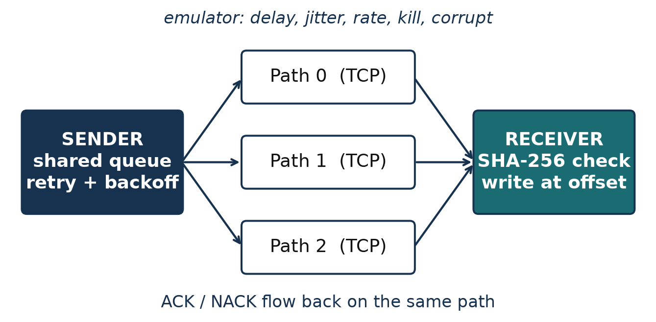
Proposed Design and Tools
TOOLS
PROTOCOLS
ADDRESSING
Python 3.15, standard library
macOS, pytest
FastAPI dashboard
Wireshark Lua dissector
TCP per path
Own 20-byte header + CRC-32
SHA-256 per chunk and file [5]
Receiver 0.0.0.0:9000
Emulated paths 127.0.0.1:9201–9203
Dashboard 127.0.0.1:8080
Computer Networks Laboratory CSE20110
45 seconds
Notes:
Sender, receiver and emulated paths; own 20-byte header with CRC; SHA-256 per chunk and for the whole file (45 s).

Slide 4
Implementation and Working
SCHEDULER (WORK STEALING)
WORKING
queue = PriorityQueue()
path_worker(p): # 1 thread/path
i = queue.get()
send CHUNK i, wait <= 5 s
ACK -> record bytes, RTT
NACK/timeout/reset ->
requeue(i)
requeue(i): max 5 tries,
backoff, retry goes first
1 Sender hashes file once
2 Paths pull chunks from queue
3 Receiver checks SHA-256, writes at offset
4 Whole-file hash, rename, DONE
IMPLEMENTATION
TROUBLESHOOTING
protocol.py, sender.py, receiver.py, emulator.py, status.py (about 970 lines)
Dashboard in web/
Recovery took 6.9 s: retries waited behind fresh chunks.
Fix: priority queue, retries first. Result: 0.15 s.
Computer Networks Laboratory CSE20110
55 seconds
Notes:
Paths pull chunks from a shared queue, so faster paths carry more. A failed chunk goes back to the queue ahead of fresh ones (55 s).

Slide 5
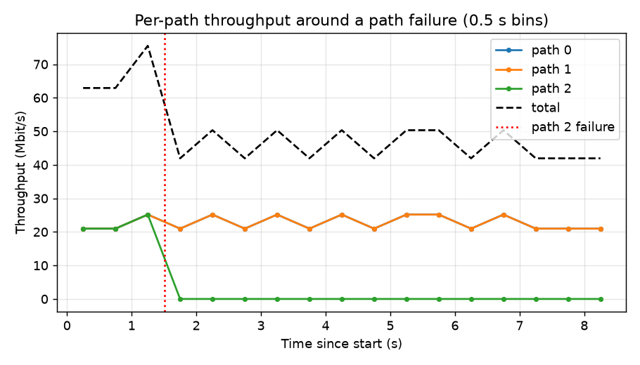
Testing and Results
TEST
EXPECTED
50 MB file, 40 Mbit/s paths: 1–8 paths; path 2 killed at 1.5 s; 0/1/5 % corrupted chunks
Goodput grows with paths; hash matches after failure or corruption
OBSERVED
OBJECTIVES ACHIEVED
23.0 to 171.9 Mbit/s; failure run succeeded, recovery 0.15 s; 5 % corruption: 12 of 200 chunks resent
O1–O5. 50 automated tests passed (1 skipped)
Computer Networks Laboratory CSE20110
50 seconds
Notes:
Goodput scales from 23 to 172 Mbit/s with 8 paths; a killed path is recovered in 0.15 s; corruption is repaired by retransmission (50 s).

Slide 6
Working Demonstration
FUNCTION TO DEMONSTRATE
Send a file over 3 emulated paths while one path dies; the receiver still gets a verified file.
Launch: Start receiver, emulator (3 paths, one dies at 6 s) and dashboard
mpft receive | mpft emulate | mpft dashboard
1
Send: Run the transfer over the three paths
mpft send big.bin --to 127.0.0.1:9201,...:9202,...:9203
2
Show: Watch the dashboard: path 2 goes down, its chunk is resent on another path
hash status turns verified
3
Success criterion: sender reports success, a path is marked dead, 1 or more retransmissions, and the output SHA-256 equals the input's.
Computer Networks Laboratory CSE20110
65 seconds
Notes:
Live demo with a path dying mid-transfer (65 s).

Slide 7
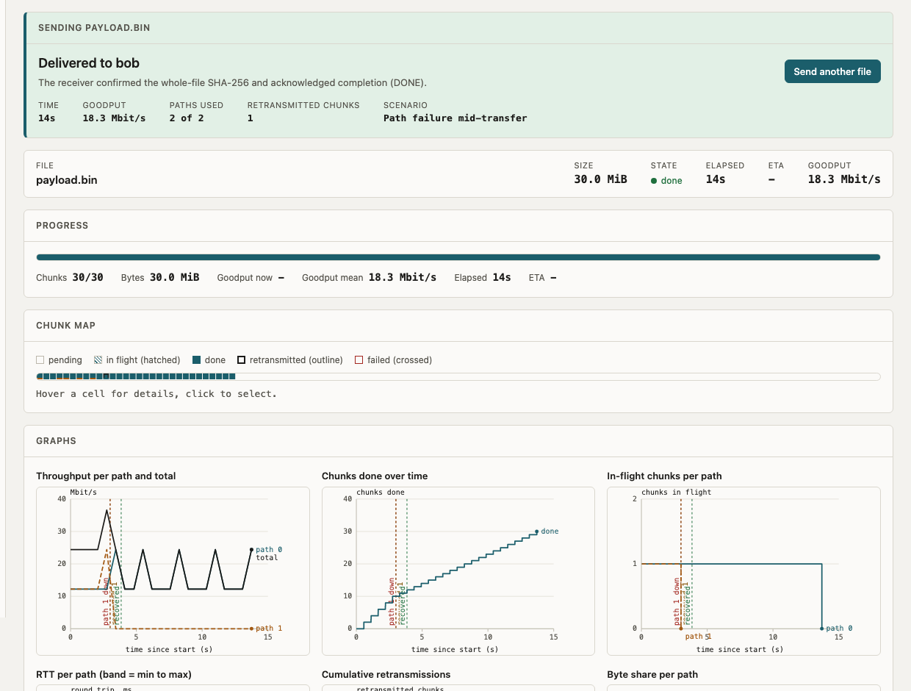
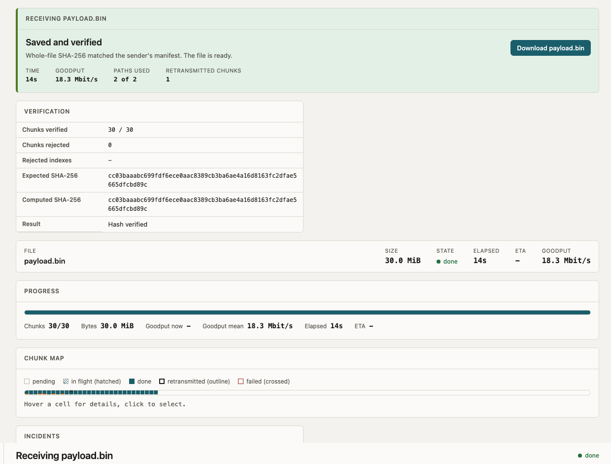
Views and Scenarios
Sender: Delivered, send another
Receiver: verified, Download
Eight scenarios: clean, slow, asymmetric, lossy, heavy loss, path failure, path flap, total failure (nothing saved, no download).
Graphs now use real time: throughput from chunk completions, millisecond axis under 2 s.
Computer Networks Laboratory CSE20110
35 seconds
Notes:
Same session, two roles: sender sees delivery, receiver sees verification and Download. Pick a scenario in the Send form to show success and failure (35 s).

Slide 8
Conclusion and Contributions
OUTCOME
APPLICATION
Working multipath transfer with chunk and file verification, failure recovery and resume
Large files over several links (Wi-Fi plus Ethernet, LAN plus VPN)
LIMITATION
FUTURE SCOPE
One chunk in flight per path; tested on emulated paths on one machine only
Sliding window per path; real two-machine test with Wireshark captures
TEAM CONTRIBUTIONS
Saksham Singh Sisodiya
Protocol, sender, receiver, resume, web UI
Parth Dande
Emulator, experiments, presentation
Anupria Gupta
Wireshark, dashboard views, test report
AI use: Claude Code helped write code, tests and documents; all results come from running the code.
Computer Networks Laboratory CSE20110
30 seconds
Notes:
Summarise outcome, limits (emulated, stop-and-wait), future work, contributions and AI use (30 s).

Slide 9
References
[1] J. Eddy, “Transmission Control Protocol (TCP),” RFC 9293, IETF, 2022.
[2] M. Allman, V. Paxson and E. Blanton, “TCP Congestion Control,” RFC 5681, IETF, 2009.
[3] A. Ford et al., “TCP Extensions for Multipath Operation with Multiple Addresses,” RFC 8684, IETF, 2020.
[4] C. Raiciu et al., “How hard can it be? Designing and implementing a deployable Multipath TCP,” USENIX NSDI, 2012.
[5] NIST, “Secure Hash Standard (SHS),” FIPS PUB 180-4, 2015.
Cited on slides 2–3: TCP [1][2], multipath background [3][4], SHA-256 [5].
Computer Networks Laboratory CSE20110
Backup slide
Notes:
Suggested time: Backup slide. Replace all bracketed placeholders and prompts with your own project details. Keep explanations brief. Total time across slides 1–7 is 5 minutes, including the demonstration. Slide 8 is for reference during questions.

