Slide 1


Slide 2
PROJECT BY:
1.) YASH CHAUHAN
1st Year / 2018
2.)ROHAN MUJOO
1st Year / 2018

Slide 3
INTRODUCTION
Our project simply put is a “SELF AWARE SURVEILLANCE ROBOT”.
Self Aware Surveillance Robot is a robot which aims to improve the flat terrain (buildings/tactical operations etc.) surveillance facilities and ensure the safety of our soldiers.
With this project we aim to create a robot that’s capable of being aware of its surroundings, i.e. knows the difference between living and dead by employing the use of PIR (passive infrared) sensor.
This robot is intended to help the soldiers and army men in operations and act as the ultimate surveillance kit.

Slide 4
FEATURES
INTENDED FEATURES
FEATURES BEING DEMONSTRATED BY US
To sense living and dead. (PIR (passive infrared) sensor)
To get live footage/feed. (Camera module)
To track position 24/7. (GPS module)
To send messages. (GSM module)
To be wary of gases around it. (Gas sensor(s))
Back to home feature
Employing use of Misc. Sensors (ultrasound , temperature etc.)
To sense living and dead(PIR (passive infrared) sensor)
To send messages.(GSM module)
To be wary of gases around it.(Gas sensor(s))
Employing use of Misc. Sensors (ultrasound , temperature etc.)

Slide 5
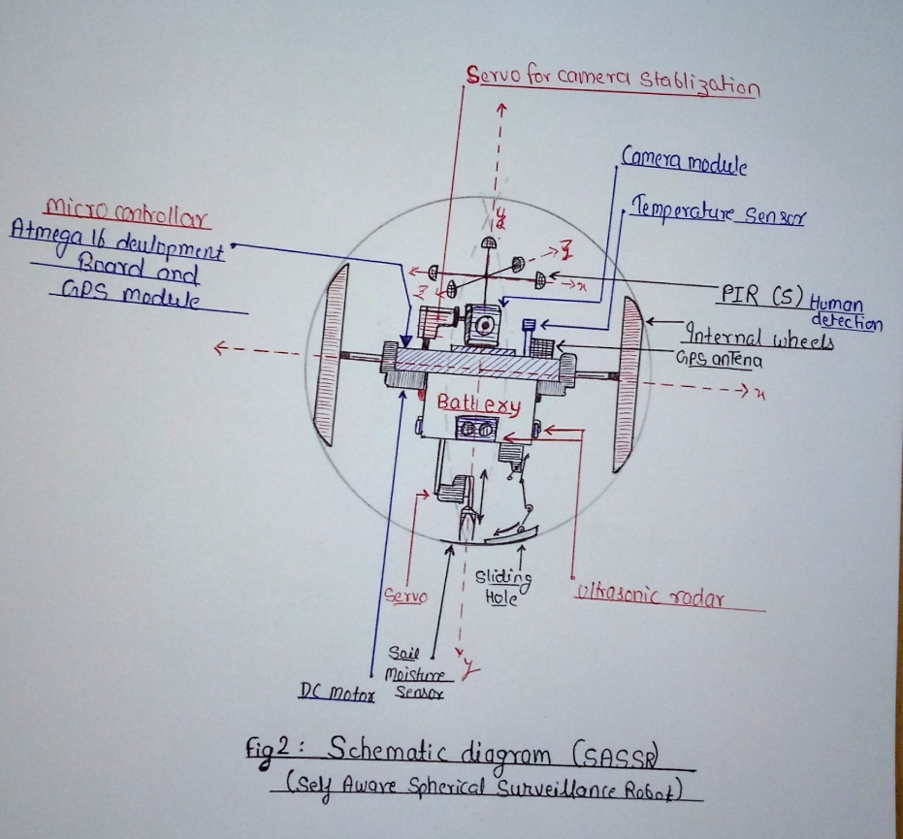
This is how we hope the final schematic diagram of project would look like.
The project we are currently making isn’t quite similar to this schematic diagram due to lack of resources and lack of actual raw material required to make it.
Still we have tried our level best to display all features we can and make our project how we intended it to actually be like.

Slide 6
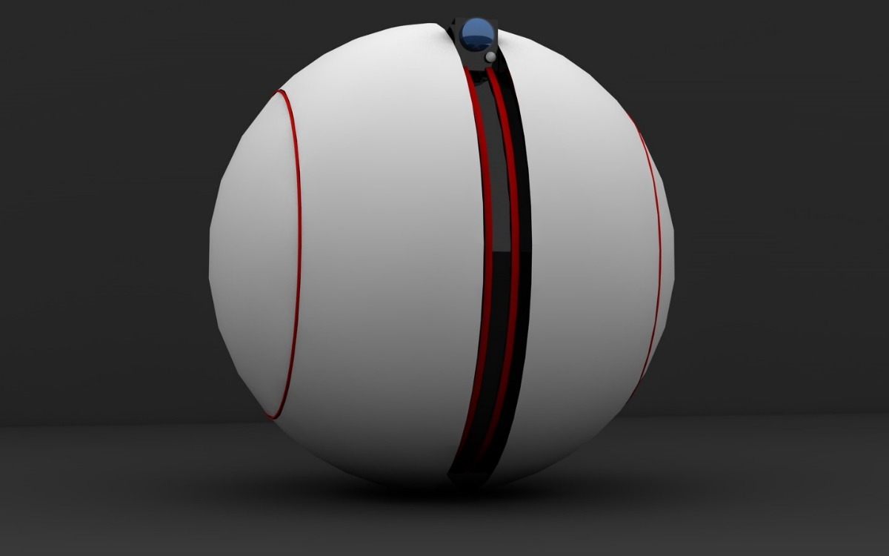
OUR IDEA
As we mentioned earlier, this is a surveillance robot which has been made with the aim to be the ultimate companion for our brave soldiers.
It is supposed to be a one of a kind robot that has never been made, and will hopefully be able to revolutionize the conventional thinking associated with surveillance robots.
Our robot would be equipped with a camera module, PIR sensor, GPS module, GSM module, Appropriate Gas sensors, and other sensors ( accelerometer, Soil sensor, Temperature sensor etc.).
It will also have the ability to map its way, i.e. it would be able to avoid all obstacles irrespective of their size or type.
EXPECTED PRODUCT

Slide 7
Originality And Other Aspects
(Whether the idea is original or derived from some established technology or process?)
The idea is heavily inspired from the star wars toy robots that got popular due to the recent theatrical release of the new star wars movie in the star wars franchise.
Our inspiration from it though, is 100% original. There has never been a single instance where a spherical robot has been used for defense purposes.
(Whether the solution is state of the art or conventional)
I feel this project is an amazing combination of a sate of the art idea using conventional methods. We are using a completely new application of the idea that already existed in form of a toy for kids.

Slide 8
Working
Our robot would roll around and the components inside would stay stationary.(In the same fashion as that of a gyroscope.)
The robot would be free to move in all directions and would take reading through a PIR sensor to see if there’s any living being around it or not. If it happens to encounter a living being it will cease all its functions and try to camouflage with its surroundings.
Other sensors inside the robot would take readings around the robot such as temperature, moisture, poisonous gasses etc. and relay the details back to the base in form of a message if any irregularities are noted.
There’ll also be a camera that can send live feed of its surroundings back to its base.

Slide 9
Details
Concept
Self Aware Surveillance Robot is a spherical robot which will contain a camera and a PIR sensor which are being stabilized by a gyroscope parallel to the ground, so it can provide a stable and clear footage of its surroundings along with all the important details (like living or non-living things in surrounding, gasses in surrounding etc.) to the soldiers. Another feature provided by PIR is that, if the robot is in presence of humans it will freeze and lock itself in an attempt to look like a normal object camouflaging with the surrounding. The Ball itself isn’t completely transparent and contains a transparent strip (one way mirror film) through which above mentioned devices can perform all the above mentioned tasks. Size of the robot would ideally be 20-30cm so the robot can go unnoticed in its surroundings. (The size can be reduced if proper technical team works on it as we are only thinking of using premade market bought sensors).The robot will move with help of either, High torque DC motors or steppers. Servo motors will be used to work with the gyroscope and help stabilize the camera module and PIR sensor. Few finishing touches such as applying anti dust and moisture spray to keep the robot clean in all cases so that all the footage obtained is clear as well, making a small shaft/opening so as to employ future improvements and new sensors in the robots.

Slide 10
Challenges
The biggest challenge we feel is making our robot more compact so as to increase its stealth ability i.e. it’s ability to blend in with its surroundings without having to reduce its functionality.
For fruition , our project requires use of nanotechnology to scale it to its most optimum size. And currently Nanotechnology has been gaining popularity and thus we feel its not farfetched to think our project can be made more compact and efficient at the same time.
Another huge problem we might face not having time and money.

Slide 11

GSM MODULE
Due to GSM module being a hard device to work with. (has issues while trying to be calibrated each time before use)
We prepared some test readings beforehand.
This is the screenshot one of message one would expect to get if the gas sensor detects flammable gases.
We used deodorant as a means to test the gas sensor as it contains several flammable gasses.
(This is the last successful reading we’ve managed to take)

Slide 12
Expenditure
SNO | COMPONENT | AVAILBILTY | QTY | PRICE | TOTAL PRICE
1 | CHASSIS | Unavailable | 1 | 2000 | 2000
2 | 12v BATTERY | Available | 2 | 550 | 1100
3 | Arduino Uno | Available | 2 | 350 | 700
4 | HIGH TORQUE DC MOTOR | Available | 2 | 1400 | 2800
5 | STEPPER | Available | 2 | 2000 | 4000
6 | CAMERA MODULE | Available | 1 | 2500 | 2500
7 | HIGH TORQUE SERVO MOTOR | Available | 4 | 950 | 3800
8 | GAS SENSORS | Available | 5 | - | 1250
9 | GPS MODULE | Available | 1 | 1150 | 1150
10 | XBEE MODULE | Available | 1 | 1400 | 1400
11 | GYROSCOPIC SENSOR | Available | 1 | 300 | 300
12 | GSM Module | Available | 1 | 800 | 800
13 | PIR | Available | 5 | 100 | 500
14 | MISC |  | - | - | 500
 |  | TOTAL |  |  | 22800/-
 |  | UNCALCULATED EXPENDITURE |  |  | 5000/-

Slide 13
 |  | Modern Battlefields and Warfare.
Fully Automatic
S
W
O
T
Strength
Weaknesses
Opportunities
Threats
Unique and one of a kind
Stability.
Special operations.
If spotted can be easily damaged.
Equivalent to a soldier.
Size.
Might fall into wrong hands during operations if not handled properly.

Slide 14
THANK YOU!

