Slide 1

Automation Testing with Appium

Slide 2
Our Agenda
Introduction of Appium
Features of Appium
Appium supported drivers
Implementation
Architecture of Appium
Advantages & Disadvantages
Installation Process
Questions?

Slide 3
Introduction
What is Appium:
Appium is an open-source automation tool or framework
It is a HTTP server written in NodeJS.
It allows us to automate the different type of mobile applications, it could be a web, native or hybrid application.

Slide 4
Features
● Appium is an open-source tool
● Appium is cross-platform
● It supports multiple programming languages(java, python, ruby, c# and many more)
● Appium can work on the Virtual as well as on real devices.

Slide 5
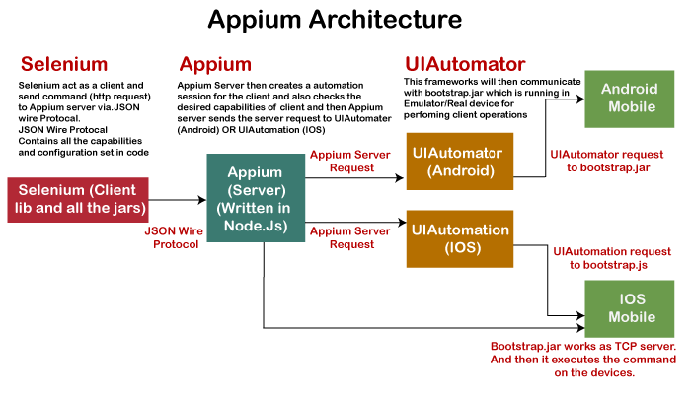
Appium Architecture

Slide 6
Session
● The session is a communication medium between client and Appium server.
01
● The client can create a session by sending the request to the server.
02
● This session req contains desired capabilities.
03

Slide 7
Desired Capabilities
Desired capabilities are a list of keys and values sent to the Appium server for creating a new session.
For example: If we want to create an android session for testing an android app, we will be required to provide these fields in the desired capabilities file.
● platformName : Which defines on which platform we are performing testing.
● platformVersion : Operating system version is defined in this field.
● deviceName : Name of the device which we are using to run our tests on.
● app : Defines the path to the installation file i.e. APK or .IPA file from where the driver can get and install the application to the device.

Slide 8
Example
{
"deviceName": "emulator-5554",
"platformName": "android",
"appPackage": "com.android.calculator2",
"appActivity": "com.android.calculator2.Calculator",
"noReset": true
}
Note: It is in the JSON format.

Slide 9
Appium supported drivers
● Apple's XCUITest
● Apple's UI Automation
● UI Automator/UI Automator2

Slide 10
Advantages & Disadvantages
● It is open-source tool.
● It allows us the capability to test on web, native and hybrid app.
● It is cross platform tool.
● Since the tests depend on remote web-driver, so it is bit-slow.
● It does not support the android device below 16 android level.
● Lack of detailed report.
Advantages
Disadvantages

Slide 11
ADB
● ADB stands for Android Debug Bridge.
● It is a versatile command-line tool that lets you communicate with any connected device.
● It is used for installing and debugging apps in emulator and real devices as well.

Slide 12
Appium Installation
Prerequisite:
● Java-JDK
● Android-SDK
● Node-JS

Slide 13

Commands
Command for installing APPIUM:
npm install -g appium
Check whether Appium is installed or not:
appium -v
To start Appium
Appium
To check connected devices
adb devices

Slide 14
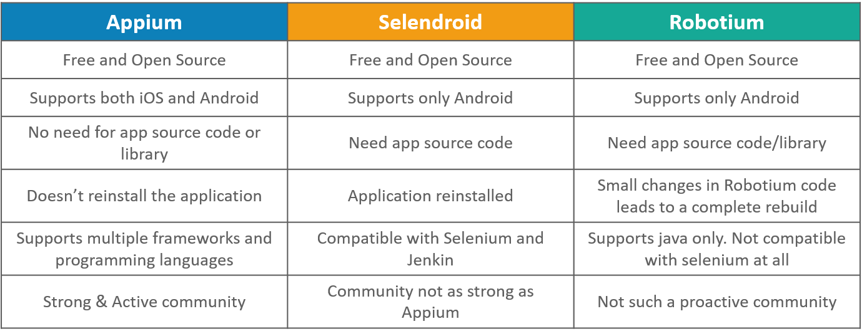
Appium vs Selendroid vs Robotium

Slide 15
Implementation

Slide 16
Questions?

Slide 17
To Know more about Appium: https://github.com/sakshamvarshney-qait/Appium_Maven_Framework/blob/master/README.md

Slide 18
For any Queries or Concerns
Mail me at sakshamvarshney@qainfotech.com

Slide 19
THANK YOU

