Slide 1
GFViewer 2.0
From a legacy prototype to a hardened multigene-family genomics platform
• Rewritten rendering engine, unified I/O, style system, and multi-format export
• Re-architected web portal: async jobs, in-browser editor, hardening, CI
• Analytics suite expanded with seven new spatial-statistics modules (SciPy-free)
• Consolidated test-dataset collection with reproducible synthetic genomes
• Worked example throughout: Test dataset 1 — Babesia sp. MO1, 18 multigene families
Chakravarty S. & Lonardi S. · Lonardi Lab, UC Riverside · NIH 1-R01-AI169543-01

Slide 2
At a glance
What changed between the legacy tool and version 2
• Engine — Bio.Graphics.BasicChromosome + per-chromosome GenBank files on disk → in-process matplotlib renderer
• Inputs — xlsx / csv / tsv only → + BED (3 modes), GFF3, GTF, with strict validation and clear errors
• Families — hard ceiling of 19 colours → programmatic palette, soft cap ~40, “collapse rare → Other”
• Output — PDF (+ a fragile PNG path) → PDF / SVG / PNG / JPG / TIFF / EPS + one-click ZIP bundles
• Web app — synchronous subprocess, string-scraped errors, multi-day outages → async job API, structured errors, disk caps, health probe, gunicorn, GitHub Actions CI
• Interactivity — none (static PDF) → in-browser SVG editor: pick families & chromosomes, recolour, drag legend/labels, regenerate, re-export
• Analytics — a handful of per-family counts → full spatial-statistics suite, 7 new modules, Benjamini–Hochberg FDR everywhere
• Distribution — clone-and-run script → pip-installable gfviewer command + full install/CLI guide + Install page
GFViewer 2.0 · changes from the legacy tool, web portal & analytics
2

Slide 3
Reviewer comments and how they were addressed (1 / 2)
Reviewer concern (from the revision plan) | How it is addressed in GFViewer 2.0 | Status
Figure engine built on Bio.Graphics.BasicChromosome — writes a GenBank file per chromosome to disk and re-reads it; fragile and slow | Rendering rewritten from scratch on matplotlib; fully in-process, no disk round-trip. Legacy engine kept as gfviewer.legacy for one release. | Done
Hard ceiling of ~19 gene families (fixed colour dictionary) | Programmatic palette (20 fixed maximally-distinct + generated beyond); readability warning >25; soft cap 40 with “collapse rare → Other”; per-gene labels optional/off; legend auto multi-column or its own page. | Done
Reads only Excel / CSV / TSV; should accept standard genome-annotation formats | Unified load_features() adds BED (3 auto-detected modes), GFF3 and GTF; 0-based ↔ 1-based handled; strict validation with explicit error messages. | Done
Figure appearance is hard-coded in the source | Style surface via CLI flags + web form + reusable YAML/JSON style file: per-element fonts, legend, figure size/DPI/orientation/background/title, tick glyph, telomere & centromere styling. | Done
Limited export options | PDF / SVG / PNG / JPG / TIFF / EPS from one render; selectable DPI; one-click ZIP (“as produced” and “re-rendered in every format”). | Done
GFViewer 2.0 · changes from the legacy tool, web portal & analytics
3

Slide 4
Reviewer comments and how they were addressed (2 / 2)
Reviewer concern (from the revision plan) | How it is addressed in GFViewer 2.0 | Status
Web application unreliable — “Internal Server Error for days” | Diagnosed: synchronous subprocess.run + weak cleanup exhausted disk / worker threads; errors were recovered by scraping stdout for “Error”. Fixed: in-process engine, Agg backend, async job API, real error pages, upload + per-job disk caps, TTL cleanup, gunicorn config, /api/health, pinned deps, 93-test suite + GitHub Actions CI. | Done
Results are a static figure; no interactivity | Inline-SVG + JS editor: pick families & chromosomes, recolour, drag legend/labels, change fonts/marks/legend/orientation, Regenerate (server re-render from cached data — no re-upload), export current state; static fallback if JS is off. | Done
Provide quantitative localization statistics, not just a picture | Analytics module: per-family counts, density, sub-telomeric vs interior, distance-to-telomere, tandem arrays, telomere-bias permutation test, co-localization — plus 7 new modules (Ripley K/L, duplication mode, chromosome enrichment / strand / richness, centromere + arm + positional profile, hotspot BED, family-proximity clustering); BH-FDR throughout; downloadable tables + on-page summary. | Done
Modernize the interface toward the lab’s SPICE-style UI | Planned as the next milestone: card-based workflow selection, minimalist header with Docs / Support, capability bullets instead of one dense form, standardized footer. Engine and API are already decoupled so this is a template-only change. | Next
GFViewer 2.0 · changes from the legacy tool, web portal & analytics
4

Slide 5
Deferred — to be addressed in the manuscript revision
Manuscript-text changes only; no tool change required — handled by the authors
• Figure 1 and its legend — expand to explain every visual element (telomere caps, centromere glyph, gene ticks, shared scale, colour → family mapping) tied to the underlying data
• Introduction — distinguish “gene families” (cross-species ortholog groups, no duplication) from “multigene families” (intragenomic, duplication-derived)
• Introduction — add one line describing the Babesia organisms (apicomplexan, tick-borne haemoparasites)
All tool-facing reviewer comments (engine, family limit, input formats, customization, export, web-app robustness, interactivity, quantitative analytics) are implemented and verified. The three points above are wording/figure changes to the paper and are being incorporated in the revised manuscript by the authors.
GFViewer 2.0 · changes from the legacy tool, web portal & analytics
5

Slide 6
Legacy vs. version 2 — architecture
Aspect | Legacy tool | GFViewer 2.0
Rendering | BasicChromosome; a GenBank file per chromosome on disk | In-process matplotlib (Agg) renderer, cm coordinates
Orientation | Horizontal only, ad-hoc sizing | Horizontal or vertical; auto layout; multi- / single-page
Input formats | Excel / CSV / TSV table | + BED (3 modes) + GFF3 + GTF; auto-detected
Validation | Minimal; cryptic tracebacks | Unified loader; explicit, actionable errors
Family colours | Fixed 19-colour dict; breaks beyond | 20 fixed + generated palette; warn >25, cap 40
Styling | Edit the source | CLI flags + web form + YAML/JSON style file
Export | PDF, brittle PNG | PDF / SVG / PNG / JPG / TIFF / EPS; DPI; ZIP bundles
Web execution | subprocess.run; stdout scraped for 'Error' | Thread-pool engine behind an async job API
Robustness | Disk fills; server wedged 'for days' | Upload + disk caps, TTL cleanup, /api/health, gunicorn
Tests / CI | None | 93 pytest tests + GitHub Actions (Py 3.8–3.12) + packaging
GFViewer 2.0 · changes from the legacy tool, web portal & analytics
6

Slide 7
Rendering engine rewrite
Reviewer item 1
• matplotlib replaces BasicChromosome — round-capped ideograms drawn in centimetres with set_aspect('equal'); no GenBank round-trip to disk
• Strand-split marks — + strand above the axis, − below; glyph styles: line, lollipop, triangle, box, arrow
• Centromere rendering — cytogenetic primary-constriction / diamond glyph when a centromere track is supplied
• Automatic layout — page height/width, chromosome pitch and label gutters computed from content; adjacent-chromosome label collisions resolved; labels kept in view (horizontal & vertical)
• SVG carries hooks — every artist gets a gid (gfv-fam-*, gfv-chrom-*, gfv-legend, gfv-label-*, gfv-title) so the browser editor can manipulate it
• Legacy engine preserved — importable as gfviewer.legacy for one release
GFViewer 2.0 · changes from the legacy tool, web portal & analytics
7

Slide 8
Unified input layer
Reviewer item 3 — load_features() + validation
• Table — gene_id, gene_family, chromosome, start, end, strand; header synonyms; 1-based inclusive; a 'centromere' family (strand 0) marks centromeres
• BED, three auto-detected modes — (a) several files, one family per file; (b) one file + gene_id→family mapping; (c) a single file, column 4 = family. 0-based half-open converted automatically
• GFF3 / GTF — gene-like feature types kept; family from --family-attr (default search gene_family, Family, gene_biotype, Name, …)
• Genome — FASTA, .fai, UCSC chrom.sizes, or a chrom,length table
• Genes on unknown sequences — choose: error, drop, or keep as unplaced contigs; out-of-bounds coordinates clip / error / keep
• Strict validation — every failure mode has a specific message instead of a stack trace
GFViewer 2.0 · changes from the legacy tool, web portal & analytics
8

Slide 9
Family scaling, customization & export
Reviewer items 2, 4, 5
• Gene-family limit lifted
– First 20 colours are a fixed maximally-distinct set; further colours generated programmatically
– Readability warning above ~25 families; hard cap at 40 unless --collapse-rare folds the rarest into “Other” (--keep protects families)
– Per-gene ID labels optional and OFF by default; legend auto multi-column or its own page
• Customization surface — CLI flags + web form + reusable YAML/JSON style file
– Font family/size per element, legend position/columns/frame/title, figure size/DPI/orientation/background/title, tick glyph, telomere & centromere styling
• Multi-format export — PDF / SVG / PNG / JPG / TIFF / EPS from one render; selectable DPI
– “All output (ZIP)” bundles every file as produced; “Every format (ZIP)” re-renders the figure and each analytics chart in all five figure formats
GFViewer 2.0 · changes from the legacy tool, web portal & analytics
9

Slide 10
Web portal — re-architecture & hardening
Reviewer item 6
• Root cause of the legacy outage — synchronous subprocess.run renders + weak cleanup exhausted disk / worker threads; errors were recovered by scraping stdout for the substring “Error”
• In-process engine — no subprocess; matplotlib forced to the Agg backend
• Async job model — submit → job id → poll status → results page; ThreadPoolExecutor, in-memory registry mirrored to meta.json
• Structured errors — real error pages; validation messages surfaced verbatim
• Resource limits — MAX_CONTENT_LENGTH, per-job disk cap, logged TTL-based cleanup
• Ops — app factory + blueprints, env-var config, GET /api/health readiness probe, gunicorn (1 worker + threads keeps the registry coherent)
• Quality gate — requirements pinned, environment.yml, 93-test pytest suite + GitHub Actions CI on Python 3.8–3.12, CLI smoke-tests on every bundled dataset
GFViewer 2.0 · changes from the legacy tool, web portal & analytics
10

Slide 11
Web portal — interactive results editor
Reviewer item 7
• Inline SVG + vanilla-JS editor — no framework; static image fallback if JS is off
• Choose what to draw — per-family and per-chromosome checkboxes, each with a “Select all”; de-selected families also drop out of the legend
• Restyle live — recolour families, drag the legend and labels, change fonts, mark style, legend position, orientation
• Regenerate — server re-renders from the cached features (no re-upload); layout & spacing recomputed for the kept subset
• Export current state — PDF / SVG / PNG / JPG / EPS on demand
• Analytics inline — the four analytics figures embedded with per-chart format buttons and CSV links; two ZIP buttons for bulk download
GFViewer 2.0 · changes from the legacy tool, web portal & analytics
11

Slide 12
Distribution — pip-installable CLI + Install page
• pyproject.toml — console entry point gfviewer = gfviewer.cli:main ; trove classifiers, keywords, project URLs; core dependencies exclude Flask (web portal is the [web] extra)
• Packaging files — LICENSE (MIT), MANIFEST.in, scripts/build_wheel.sh (build + twine check + optional publish), scripts/smoke_cli.sh
• docs/INSTALL.md — requirements, five install paths (PyPI / GitHub / editable / conda / venv+pipx), verify, upgrade, full CLI reference with worked examples, exit codes, troubleshooting
• Web — new /install page mirrors the guide with download buttons; /install/guide.md serves the raw Markdown; “Install” added to the nav; home & Help pages link to it
• CI — a package job builds the wheel, installs it into a clean venv, runs the entry point on a real dataset, uploads the artifacts
GFViewer 2.0 · changes from the legacy tool, web portal & analytics
12

Slide 13
Analytics — baseline suite
• Per-family counts — genes on chromosomes vs. unplaced contigs; per-chromosome breakdown
• Density & size — genes per Mb (genome and per chromosome), gene-length distribution
• Sub-telomeric vs. interior — normalized distance to the nearer chromosome end; sub-telomere fraction (bp or arm-fraction)
• Telomere-proximity permutation test — null re-places each family's genes uniformly on the same chromosomes, keeping per-chromosome counts and gene lengths fixed
• Tandem-array detection — runs of ≥2 same-family genes within --cluster-gap; per-array and per-family summaries (frac_clustered, largest array)
• Optional pairwise co-localisation — genes of A within a window of a gene of B vs. the permutation null
• Outputs — analytics_*.csv + analytics_summary.json + a genes-per-family chart
GFViewer 2.0 · changes from the legacy tool, web portal & analytics
13

Slide 14
Analytics — seven new modules
# | Module | What it computes | Output(s)
1 | Multi-scale clustering — 1-D Ripley's K/L | Edge-corrected 1-D Ripley K per family (≥5 genes), pooled across chromosomes, as L(t)−t on a 1 kb–1 Mb ladder with a permutation envelope; peak scale = characteristic clustering distance | analytics_ripley.csv + figure
2 | Duplication mode | Each gene labelled tandem / proximal / dispersed from its nearest same-family gap; per-family fractions + predominant mode | analytics_duplication_modes.csv; dup_mode column
3 | Chromosome enrichment, strand bias, richness | Family×chromosome binomial vs. length-proportional expectation; per-family +/− binomial vs. 0.5; per-chromosome family count, Shannon H, evenness, dominant family | 3 CSVs (enrichment, strand_bias, chromosome_richness)
4 | Centromere / arm analytics + positional profile | With a centromere track: centromere-proximity permutation test + p-/q-arm binomial. Always: 20-bin gene density along normalized position (“metachromosome”) | centromere_bias.csv, arm_bias.csv, positional_profile.csv + figure
5 | MGF hotspot scan | Sliding window, all families pooled; Poisson test vs. a uniform rate; FDR-significant windows merged | analytics_hotspots.csv + .bed (BED6)
6 | Family–family proximity + clustering | F×F matrix of mean cross-nearest-neighbour distance (diag = within-family NN); average-linkage clustering → order + k clusters | analytics_family_proximity.csv + heatmap
7 | Benjamini–Hochberg FDR everywhere | q_value + significant_fdr on every per-family / per-pair / per-window test (α = 0.05) | columns across all tables
GFViewer 2.0 · changes from the legacy tool, web portal & analytics
14

Slide 15
Analytics — implementation notes
• SciPy-free — permutation nulls, the 1-D Ripley estimator, binomial & Poisson tail probabilities, lgamma, and Benjamini–Hochberg are all hand-rolled on NumPy + pandas
• Permutation null (shared) — re-place a family's genes uniformly on the same chromosomes; per-chromosome counts and gene lengths held fixed; seedable
• Guards — Ripley needs ≥5 placed genes per family and caps permutations; headline “most clustered” ignores 2-gene families
• Unplaced genes — counted in genes_per_family but excluded from every chromosome-level test
• Reproducible — --seed fixes every null; --permutations, --ripley-scales, --cluster-gap, --proximal-window, --hotspot-window/step, --proximity-clusters all exposed on the CLI
GFViewer 2.0 · changes from the legacy tool, web portal & analytics
15

Slide 16
Provided test datasets
Dataset | Organism | Chr | Genes | Families | Formats provided
data_test_1 | Babesia sp. MO1 | 3 | 125 | 18 | xlsx + chrom table + colour map
data_test_2 | Babesia sp. MO1 (subset) | 3 | ~55 | 6 | csv + chrom table + colour map
data_test_3 | Babesia duncani | 3 | ~30 | 10 | tsv + genome FASTA (has centromeres)
formats/ | same 6-family set, re-expressed | 3 | ~55 | 6 | BED, per-family BED, BED + mapping.tsv, GFF3, GTF
synthetic/arabidopsis_10 | A. thaliana (TAIR10 lengths) | 5 | ~170 | 10 | genes.tsv + genome.txt + colours (seeded)
synthetic/celegans_20 | C. elegans (WBcel235 lengths) | 6 | ~380 | 20 | genes.tsv + genome.txt + colours (seeded)
All under static/tests/ (rebuilt by python tests/make_fixtures.py ). Synthetic families are placed with one of four spatial patterns (tandem array / sub-telomeric / chromosome-enriched / dispersed) under fixed seeds so the analytics have signal to detect. The web home page lists every dataset with Run and Download; “Download every dataset (ZIP)” bundles them all.
GFViewer 2.0 · changes from the legacy tool, web portal & analytics
16

Slide 17
Test dataset 1 — overview
Babesia sp. MO1 · worked example for the rest of the deck
• Input — data_test_1.xlsx (125 genes), chrs_test_1.txt (chr1 4.14 Mb, chr2 3.66 Mb, chr3 2.32 Mb; 10.12 Mb total), colors_test_1.txt (MGF1–MGF18 → palette 1–18)
• Command — gfviewer -d data_test_1.xlsx -g chrs_test_1.txt -c colors_test_1.txt -o out/ -f png svg pdf --analytics --permutations 1000 --seed 0 --label-mode family --tick-style lollipop
• Composition — 18 families; sizes from 27 genes (MGF1) down to 1 (MGF12); all 125 genes placed on chromosomes, none unplaced
• Headline — 81 / 125 genes (64.8%) are sub-telomeric; largest & densest family MGF1; most-clustered family MGF18 (100% in an array)
• 17 analytics tables + summary JSON + 4 figures produced; the next slides show the figures and the key tables verbatim
GFViewer 2.0 · changes from the legacy tool, web portal & analytics
17

Slide 18
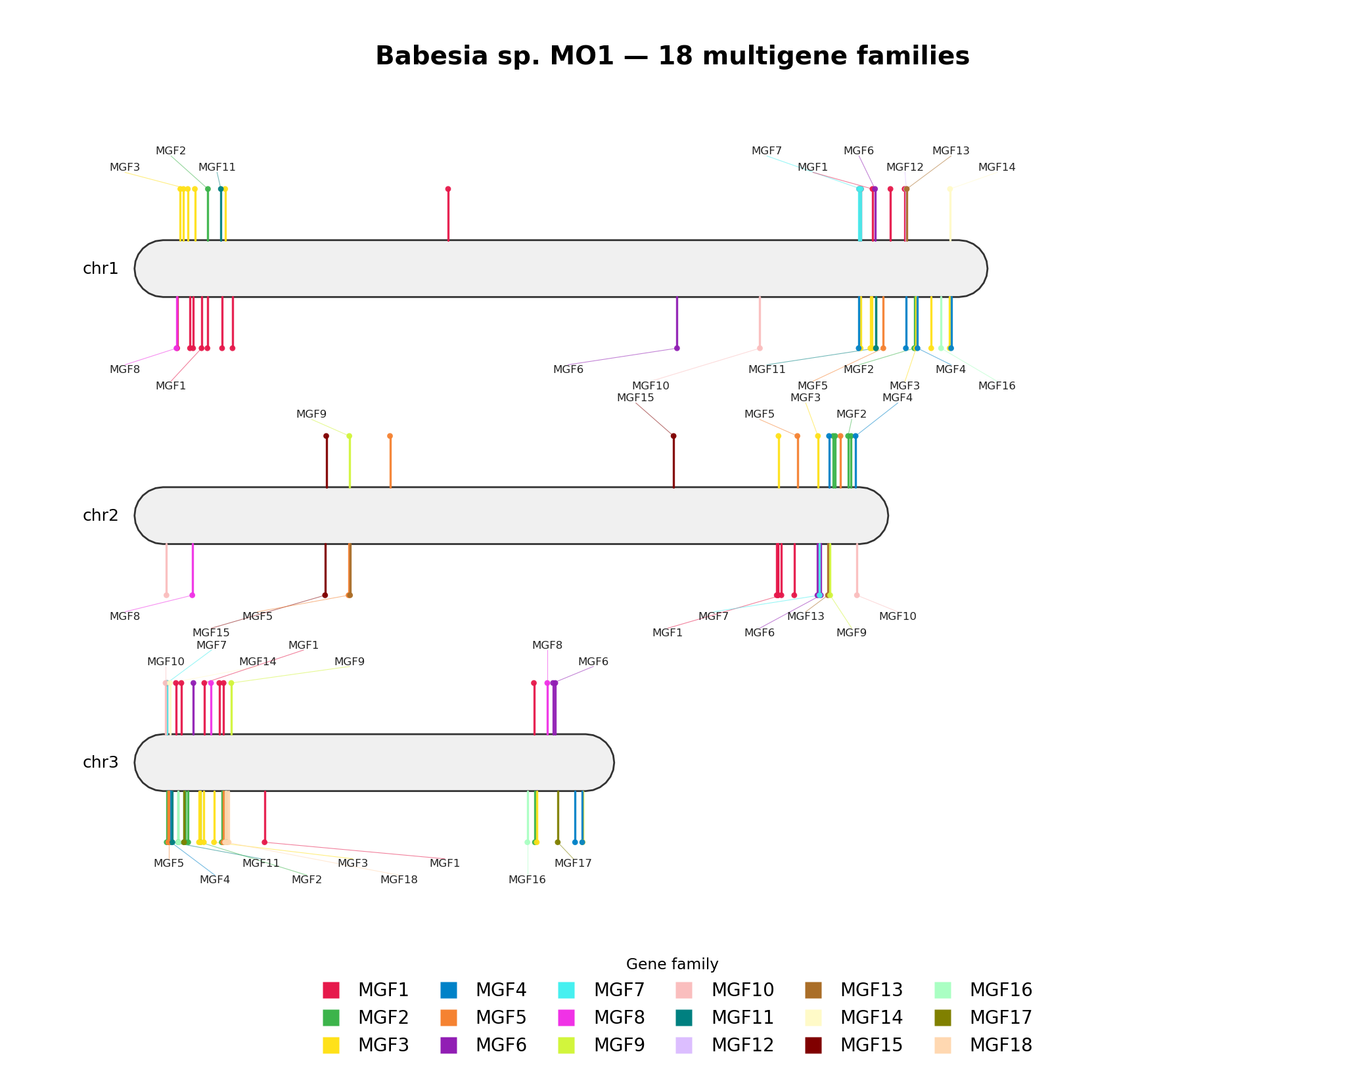
Test dataset 1 — chromosome ideogram
gfviewer.png · one label per family cluster, lollipop marks
Every family in its own colour; + strand above each chromosome axis, − strand below. The genes pile up at both chromosome ends and leave the interiors almost empty — the sub-telomeric bias that the analytics quantify.
GFViewer 2.0 · changes from the legacy tool, web portal & analytics
18

Slide 19
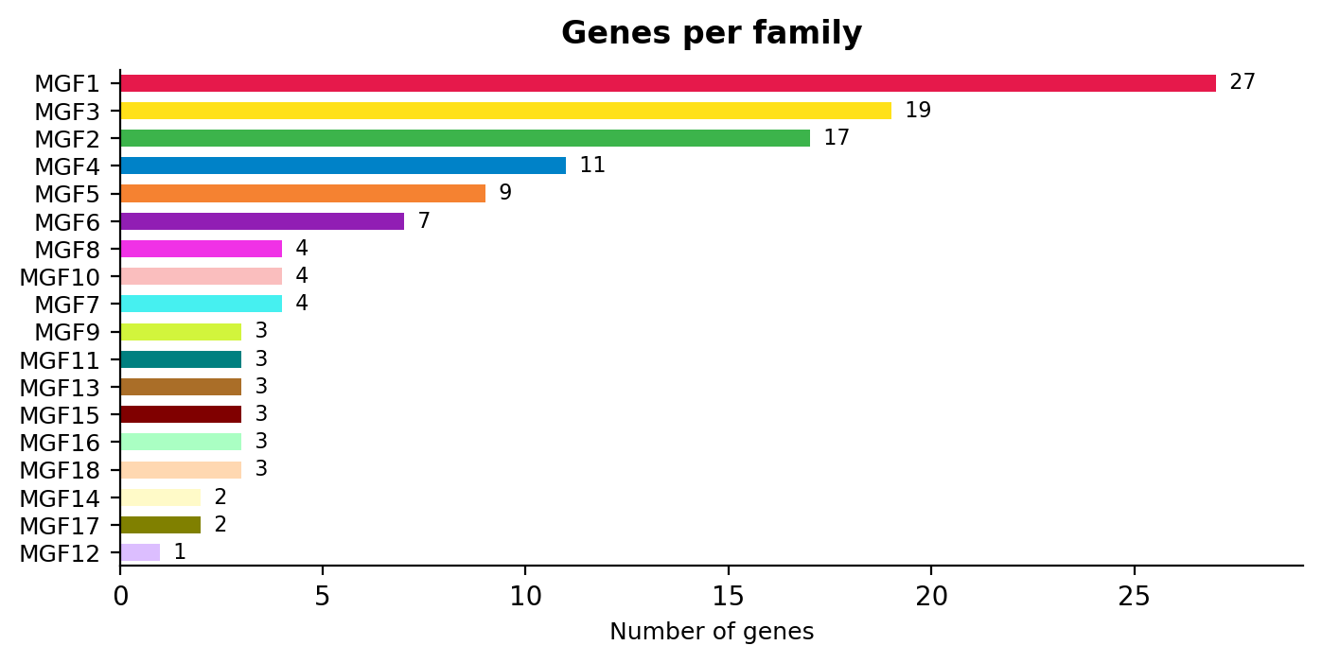
Test dataset 1 — genes per family
analytics_genes_per_family.csv / .png
Family | On chr | Unplaced | Total
MGF1 | 27 | 0 | 27
MGF3 | 19 | 0 | 19
MGF2 | 17 | 0 | 17
MGF4 | 11 | 0 | 11
MGF5 | 9 | 0 | 9
MGF6 | 7 | 0 | 7
MGF7 | 4 | 0 | 4
MGF8 | 4 | 0 | 4
MGF10 | 4 | 0 | 4
MGF9 / 11 / 13 / 15 / 16 / 18 | 3 each | 0 | 3
MGF14 / 17 | 2 each | 0 | 2
MGF12 | 1 | 0 | 1
18 families, 125 genes, 0 unplaced. A steep size distribution: the top three families hold half of all genes.
GFViewer 2.0 · changes from the legacy tool, web portal & analytics
19

Slide 20
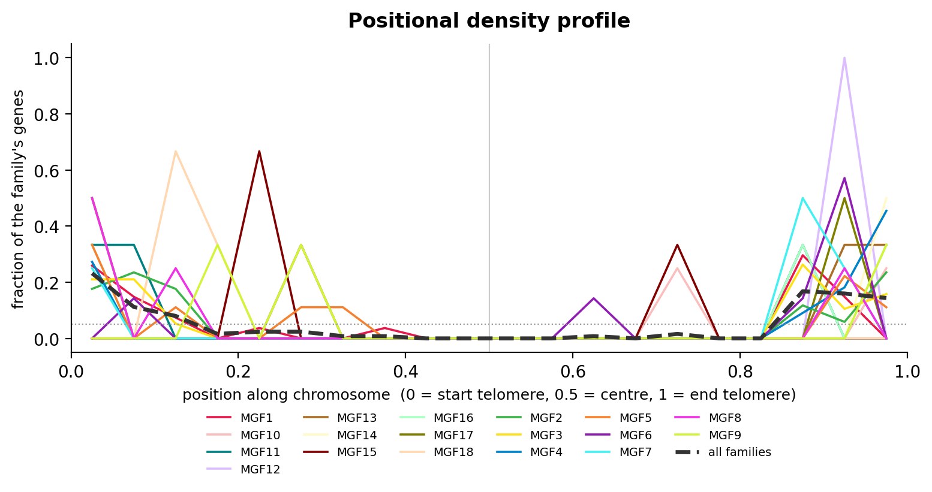
Test dataset 1 — positional density & telomere bias
analytics_positional_profile.csv + analytics_telomere_bias.csv (1000 permutations)
Family | n | obs. d̄ | null d̄ | q | FDR sig.
MGF1 | 27 | 0.197 | 0.503 | 0.000 | yes
MGF4 | 11 | 0.070 | 0.498 | 0.000 | yes
MGF2 | 17 | 0.135 | 0.500 | 0.000 | yes
MGF3 | 19 | 0.140 | 0.502 | 0.000 | yes
MGF14 | 2 | 0.028 | 0.509 | 0.000 | yes
MGF5 | 9 | 0.219 | 0.498 | 0.006 | yes
MGF10 | 4 | 0.133 | 0.498 | 0.016 | yes
MGF7 | 4 | 0.158 | 0.494 | 0.016 | yes
MGF8 | 4 | 0.127 | 0.500 | 0.016 | yes
MGF6 | 7 | 0.228 | 0.500 | 0.032 | yes
MGF11 | 3 | 0.133 | 0.497 | 0.033 | yes
MGF16 | 3 | 0.131 | 0.499 | 0.036 | yes
MGF13 / 18 / 9 / 12 / 15 / 17 | 1–3 | — | ~0.50 | >0.05 | no
d̄ = mean normalized distance to the nearer chromosome end (0 = telomere, 0.5 = centre). 12 of 18 families are significantly telomere-proximal after Benjamini–Hochberg FDR; every observed d̄ sits far below the ~0.5 permutation null.
GFViewer 2.0 · changes from the legacy tool, web portal & analytics
20

Slide 21
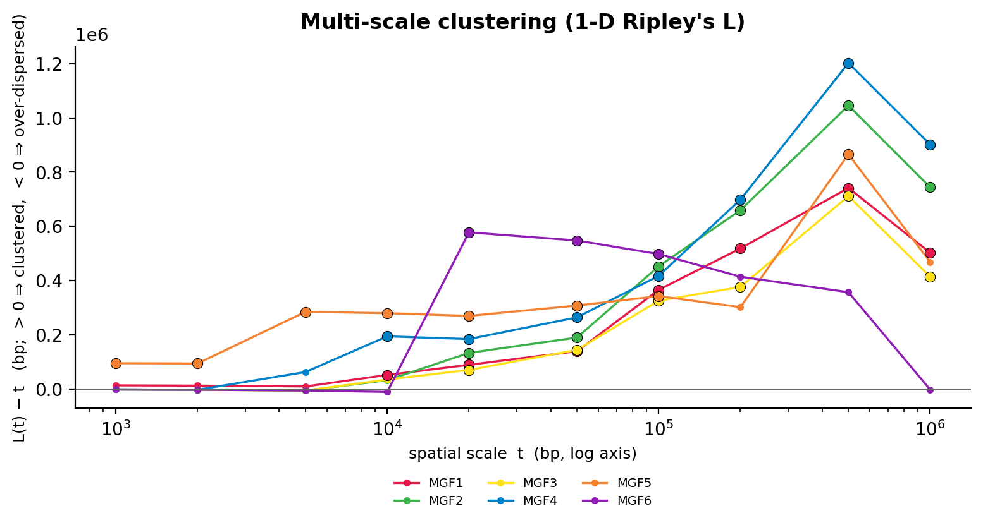
Test dataset 1 — multi-scale clustering (Ripley's L)
analytics_ripley.csv + summary.ripley_clustering (families with ≥5 placed genes)
Family | peak scale | peak L(t)−t | significant scales
MGF1 | 500 kb | 7.4×10⁵ | 10 kb – 1 Mb
MGF2 | 500 kb | 1.05×10⁶ | 20 kb – 1 Mb
MGF3 | 500 kb | 7.1×10⁵ | 20 kb – 1 Mb
MGF4 | 500 kb | 1.20×10⁶ | 10 kb – 1 Mb
MGF5 | 500 kb | 8.7×10⁵ | 1 kb – 100 kb, 500 kb
MGF6 | 20 kb | 5.8×10⁵ | 20–50–100 kb
L(t)−t > 0 means clustered at that scale. All six eligible families are significantly clustered across a broad range; MGF1–MGF5 peak at ~500 kb (chromosome-arm-scale super-clusters), MGF6 peaks tighter at ~20 kb.
GFViewer 2.0 · changes from the legacy tool, web portal & analytics
21

Slide 22
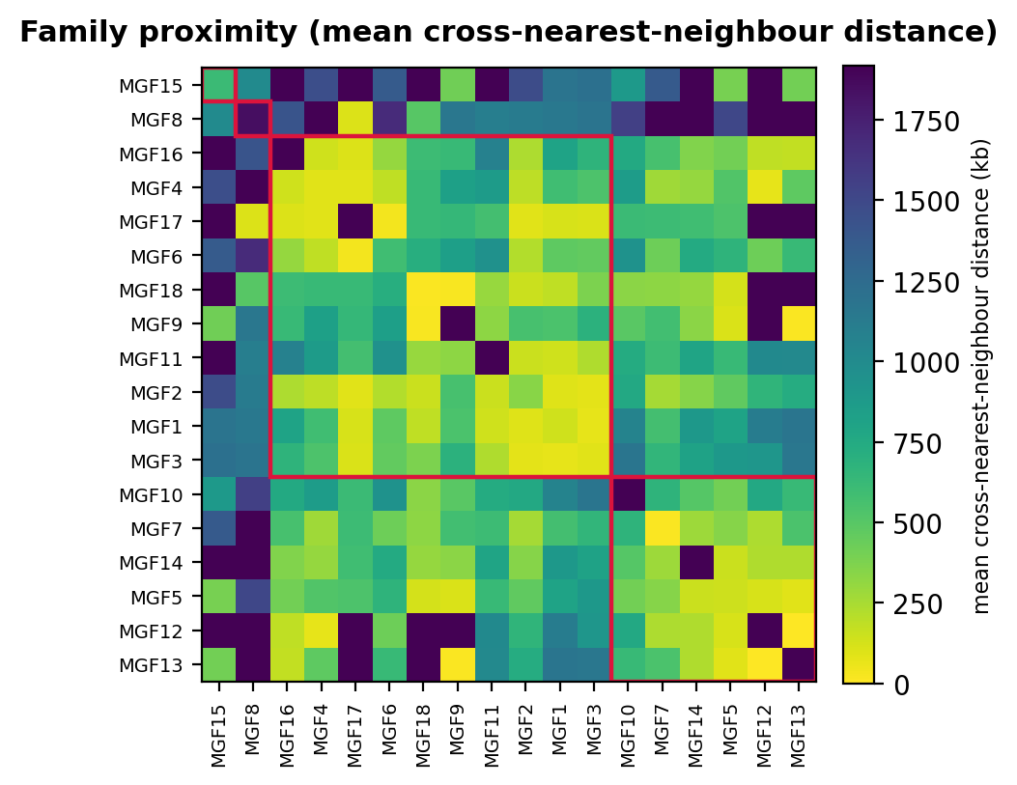
Test dataset 1 — family–family proximity
analytics_family_proximity.csv · average-linkage clustering, auto k = 4
Cluster | Families
1 | MGF15 (singleton)
2 | MGF8 (singleton)
3 | MGF16, MGF4, MGF17, MGF6, MGF18, MGF9, MGF11, MGF2, MGF1, MGF3
4 | MGF10, MGF7, MGF14, MGF5, MGF12, MGF13
Cell = mean distance from a gene of family A to the nearest gene of family B on the same chromosome (kb; darker = closer). The large yellow block (cluster 3) is a core set of ten families whose members are consistently interleaved in the same sub-telomeric neighbourhoods.
GFViewer 2.0 · changes from the legacy tool, web portal & analytics
22

Slide 23
Test dataset 1 — duplication mode & tandem arrays
analytics_duplication_modes.csv + analytics_array_summary.csv
Family | tandem | proximal | dispersed | predominant | n arrays | genes in arrays | frac. clustered
MGF1 | 15 | 10 | 2 | tandem | 5 | 15 | 0.56
MGF2 | 11 | 4 | 2 | tandem | 4 | 11 | 0.65
MGF3 | 10 | 7 | 2 | tandem | 3 | 10 | 0.53
MGF4 | 5 | 6 | 0 | proximal | 2 | 5 | 0.45
MGF5 | 3 | 4 | 2 | proximal | 1 | 3 | 0.33
MGF6 | 4 | 0 | 3 | tandem | 2 | 4 | 0.57
MGF18 | 3 | 0 | 0 | tandem | 1 | 3 | 1.00
MGF15 | 2 | 0 | 1 | tandem | 1 | 2 | 0.67
MGF7 | 2 | 0 | 2 | tandem | 1 | 2 | 0.50
MGF8 / 9 / 10 / 11 / 13 / 16 / 17 / 14 / 12 | 0 | 0 | all | dispersed | 0 | 0 | 0.00
Larger families (MGF1–MGF3, MGF6, MGF18) are built by tandem/proximal duplication; the many 2–4-gene families are dispersed singletons scattered among the sub-telomeres.
GFViewer 2.0 · changes from the legacy tool, web portal & analytics
23

Slide 24
Test dataset 1 — multigene-family hotspots (BED output)
analytics_hotspots.csv + analytics_hotspots.bed (Poisson window scan, BH-merged)
ID | chrom | start | end | len (bp) | genes | families | genes/Mb | min q
hotspot_1 | chr1 | 50,001 | 250,000 | 200,000 | 11 | 4 | 55.0 | 2.6e–3
hotspot_2 | chr1 | 300,001 | 400,000 | 100,000 | 4 | 3 | 40.0 | 3.2e–2
hotspot_3 | chr1 | 3,550,001 | 3,800,000 | 250,000 | 14 | 8 | 56.0 | 3.2e–5
hotspot_4 | chr1 | 3,800,001 | 4,000,000 | 200,000 | 8 | 6 | 40.0 | 6.0e–4
hotspot_5 | chr2 | 3,150,001 | 3,300,000 | 150,000 | 5 | 2 | 33.3 | 4.2e–3
hotspot_6 | chr2 | 3,350,001 | 3,650,000 | 300,000 | 15 | 10 | 50.0 | 3.5e–4
hotspot_7 | chr3 | 1 | 400,000 | 400,000 | 38 | 15 | 95.0 | 3.6e–7
Seven FDR-significant regions, all at chromosome ends. hotspot_7 packs 38 genes from 15 of the 18 families into the first 400 kb of chr3 (95 genes/Mb vs. a genome background of ~12). BED score = min(1000, −10·log10 q).
GFViewer 2.0 · changes from the legacy tool, web portal & analytics
24

Slide 25
Test dataset 1 — per-chromosome richness & takeaways
analytics_chromosome_richness.csv
Chromosome | length | genes | families | Shannon H | evenness | dominant | genes/Mb
chr1 | 4.14 Mb | 44 | 14 | 2.13 | 0.81 | MGF1 (30%) | 10.6
chr2 | 3.66 Mb | 31 | 12 | 2.35 | 0.95 | MGF1 (19%) | 8.5
chr3 | 2.32 Mb | 50 | 15 | 2.42 | 0.89 | MGF2 (20%) | 21.5
• chr3 is the smallest but the most gene-dense (21.5 genes/Mb) and the most family-rich (15 of 18)
• All three chromosomes are highly even — no single family dominates any chromosome
• Consistent story across every module: MGF genes in Babesia sp. MO1 are strongly sub-telomeric, tandemly amplified in the large families, and organised into a few dense multi-family hotspots at the chromosome ends
GFViewer 2.0 · changes from the legacy tool, web portal & analytics
25

Slide 26
Status & what's next
• Done — engine rewrite, unified I/O (BED/GFF3/GTF), family scaling, style system, multi-format export, web-portal hardening, interactive editor, baseline + 7 new analytics modules, consolidated test datasets, pip packaging + Install page
• Verification — 93 automated tests pass; CI on Python 3.8–3.12; wheel builds and installs into a clean environment; CLI smoke-tested on every bundled dataset
• Reviewer comments — all eight tool-facing concerns implemented and verified (see the “Reviewer comments” slides)
• Next — SPICE-style UI redesign (card-based workflow, minimalist header, capability bullets) — the one remaining reviewer item
• Manuscript — Figure 1 legend, “gene family” vs. “multigene family” wording, and a Babesia description are text-only edits, deferred to the manuscript revision
Deck assets rendered from data_test_1.xlsx with the shipping gfviewer CLI (1000 permutations, seed 0).
GFViewer 2.0 · changes from the legacy tool, web portal & analytics
26

