Slide 1
Maximization of Coverage with Minimum Directed Sensors in a Randomly Deployed Wireless Sensor Network using Graph Theoretic Approach
Sakshar Chakravarty (1305002)
Laboni Sarker (1305115)
Supervised By
Dr. A K M Ashikur Rahman
Professor, CSE, BUET

Slide 2
Introduction
A system consisting of wireless sensors and targets
Both deployed randomly

Slide 3
Introduction (Contd.)
2 types of sensors:
Isotropic
Circular coverage
Directional (within the scope of this thesis)
Coverage in a particular direction
example: camera

Slide 4
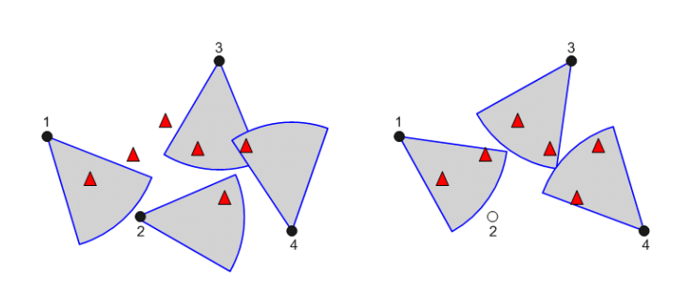
Introduction (Contd.)
Fig: A random deployment scenario

Slide 5
Objectives
Maximization of target coverage
Minimization of active sensors
It is an NP-hard problem.
Formulate different heuristics to achieve a near optimal solution better than the existing one’s

Slide 6
System Classification
2 classes of deployment on the basis of the ratio between the number of directional sensors and targets:
Under Provisioned System
No point of minimization of active sensors.
Over Provisioned System ( within the scope of this thesis)
Minimization of active sensors is an important aspect

Slide 7
Applications
Area surveillance
Tracking and environmental monitoring
Telecommunications

Slide 8
Literature Review
Work | Principle | Description | Comments
Ai and Abouzeid 2006 | Sensor-oriented Greedy Heuristic | Integer Linear Programming (ILP) Centralized Greedy Algorithm (CGA) Distributed Greedy Algorithm (DGA) | Poor performance in over-provisioned system ILP is not scalable to solve large scale scenario CGA and DGA fail to resolve tie between sensors

Slide 9
Literature Review
Work | Principle | Description | Comments
Munishwar and Abu-Ghazaleh 2013 | Sensor-oriented Modified Greedy Heuristic | Centralized Force-directed Algorithm (CFA): Priority is given to the sensors covering targets in a single pan. | Poor performance in over-provisioned system Fails to minimize the number of active sensors

Slide 10
Literature Review
Work | Principle | Description | Comments
Munishwar et al. 2011 | Sensor-oriented Communication between sensors | Distributed Force-directed Algorithm (DFA): Each sensor assigns a unique priority Area based or target based approach Each sensor orients itself towards maximal coverage pan. This orientation information exchanged among sensors. If overlapping coverage found, higher priority sensor prevails. | Fails to minimize the number of active sensors

Slide 11
Literature Review
Work | Principle | Description | Comments
H. Zannat et al. 2016 | Target-oriented | Greedy Target Oriented Heuristic (GTOH) Pure Target Oriented Heuristic (PTOH) Hybrid Target Oriented Heuristic (HTOH) | Fails to minimize the number of active sensors.

Slide 12
Literature Review
Work | Principle | Description | Comments
Fusco and Gupta 2009 | k-coverage problem | Centralized Greedy Algorithm: Assumption: Each sensor has overlapping pans instead of discrete pans. | Huge variation among targets in achieving the desired k-coverage.
 | Some approximation algorithms related to directional sensors | orient all the given sensors in order to maximize coverage place and orient a minimum number of sensors in order to cover the given area place and orient the given number of sensors to maximize the area covered

Slide 13
Literature Review
Work | Principle | Description | Comments
Malek et al. 2016 | Balanced k-coverage problem | Improved the k-coverage solution proposed by Fusco and Gupta (2009) to achieve balanced k-coverage. | Reduced the number of uncovered targets as well as providing k-coverage to targets as much as possible

Slide 14
Overview
All the heuristics are formulated based on greedy approach
Either sensor-oriented or target-oriented
In all the works, selection of a sensor and fixing its orientation are merged into a single step
Most of them fail to achieve active sensor minimization, only focusing on coverage maximization
k-coverage problems address fault tolerance issue, we limit ourselves only to 1-coverage.

