Slide 1
CMPE 255 DATA MINING | SPRING 2026 | FINAL PROJECT
Record-Based Medical
Diagnostic Assistant
FP-Growth association rules + biomedical RAG, fused.
Sakshat Nandkumar Patil · Vineet Kumar · Aishwarya Madhave
Department of Computer Engineering, San Jose State University

Slide 2
SLIDE 01 / THE PROBLEM
Why diagnostic decision support is hard
Two failure modes in deployed clinical-AI tools today
Hand-built ontologies
OUR APPROACH
Expensive to maintain, brittle to new vocabulary, and they lock you into one domain expert's mental model. Updates lag the literature by years.
Auditable by construction
Every prediction is grounded in two complementary signals: (1) an FP-Growth rule mined from real patient records, and (2) a biomedical passage retrieved from MedQuAD. The clinician sees both. The clinician decides.
Black-box LLMs
Confident-sounding outputs without citations. Hallucination is silent. A clinician cannot defend the answer to a peer or to a patient.
Scope: 41 disease classes · 131 symptom tokens · 4,920 patient transactions · 24,063 indexed passages
CMPE 255 Spring 2026 | Patil, Kumar, Madhave
1 / 7

Slide 3
SLIDE 02 / ARCHITECTURE
System at a glance
Three-tier stack covering all six proposal steps
WEB CLIENT
Next.js 14 · Symptom picker · Live alpha slider · Pipeline timeline · Insights dashboard
▼
FASTAPI MICROSERVICE (Python 3.11, MPS-aware)
STEP 1
STEP 2
STEP 3
STEP 4
STEP 5
STEP 6
Data ETL
FP-Growth Mining
Knowledge Base
RAG Pipeline
Hybrid Fusion
Evaluation
Sakshat
Sakshat
Vineet
Vineet, Aishwarya
Aishwarya
Aishwarya
FusedScore(d) = a · RetrievalSim(d) + (1 - a) · MiningConf(d) Default a = 0.3
▼
DATA TIER
23,839 rules · 24,063 passages · FAISS (offline) or Pinecone Serverless 3072d (production) · Azure OpenAI embeddings + GPT-5.3 explainer
CMPE 255 Spring 2026 | Patil, Kumar, Madhave
2 / 7

Slide 4
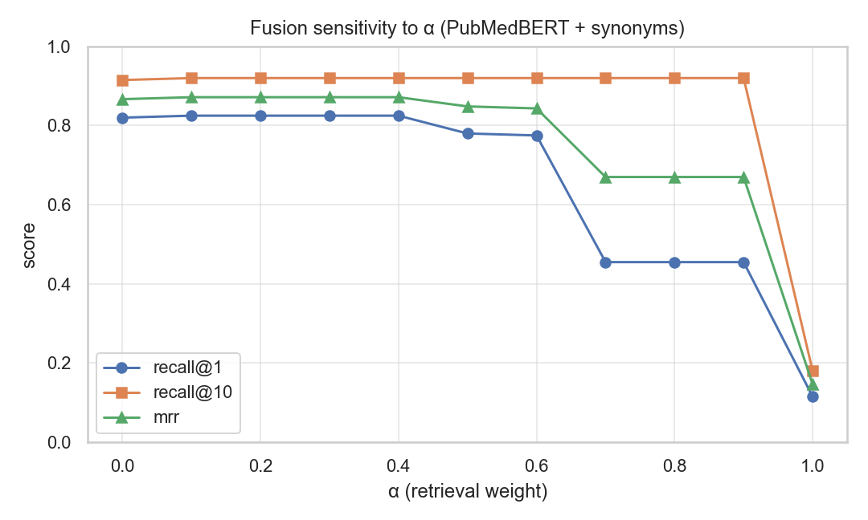
SLIDE 03 / RESULTS
Headline metrics, 200 synthetic test cases
Fusion beats mining alone. Retrieval alone is unusable.
RECALL @ 1
RECALL @ 10
MRR
LATENCY p95
0.825
0.890
0.857
20 ms
fused, MiniLM, a = 0.3
+2.0 over mining-only
+2.8 over mining-only
M3 Pro, default config
Variant | Mode | R@1 | R@10 | MRR
mining-only | a = 0.0 | 0.790 | 0.870 | 0.829
MiniLM | retrieval | 0.130 | 0.180 | 0.151
MiniLM | fused 0.3 | 0.825 | 0.890 | 0.857
MiniLM + syn | fused 0.3 | 0.820 | 0.895 | 0.857
PubMedBERT + syn | fused 0.3 | 0.815 | 0.875 | 0.843
Alpha sweep: plateau on [0.1, 0.4]; collapse for a >= 0.7.
Takeaway: fusion lifts R@1 by +3.5 over the strong mining-only baseline. The signals are complementary.
CMPE 255 Spring 2026 | Patil, Kumar, Madhave
3 / 7

Slide 5
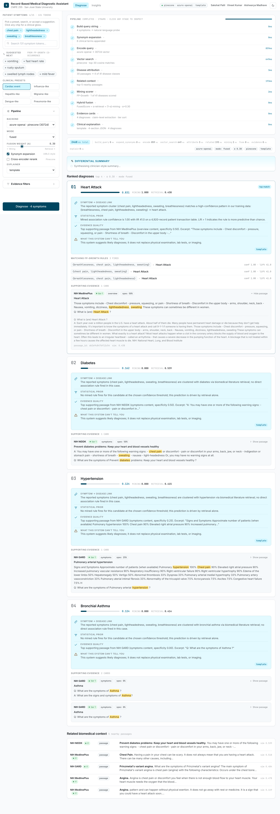
SLIDE 04 / LIVE DEMO
Cardiac-event preset, end-to-end
Switch to the browser; if it fails, the screenshot is the demo
DEMO SCRIPT (~5 min)
Cardiac event walkthrough
1. Click the Cardiac event preset.
2. Heart Attack ranks #1 (fused 0.831).
3. Read the 4-section clinical card.
4. Click a chip for symptom gloss + synonyms.
5. Drag the alpha slider, rankings re-fuse.
6. Filter to MedlinePlus only.
7. Toggle to OpenAI explainer.
8. Open Insights tab for live latency.
Production demo: Azure OpenAI 3072d + Pinecone + GPT-5.3 explainer.
CMPE 255 Spring 2026 | Patil, Kumar, Madhave
4 / 7

Slide 6
SLIDE 05 / LESSONS
What didn't work, and what we changed
Three real bugs caught during development, all regression-tested
#1 min_support = 0.01
#2 Passage-text attribution
#3 hav matched have
Check-in 3 used 0.01. 21 of 41 diseases had no rules, so fusion was useless for those classes. Fix: dropped to 0.005. 100% disease coverage. The overlap weighting in MiningScorer.score neutralises the noisier rule list.
We matched a passage to a disease using its question AND answer body. Every "What is Chest Pain?" article got attributed to every cardiopulmonary disease. Fix: focus first, question second, never the answer body.
Disease keyword index had "hav" (Hepatitis A virus). Substring matching pulled it out of the word "have", which is in basically every passage. Fix: word-boundary regex for single-token keywords. Multi-word phrases stay substring. Regression test in test_disease_keywords.py.
Also tried and dropped: always-on cross-encoder (+100 ms for marginal gain), Cohere reranker by default (403 on free Pinecone tier).
CMPE 255 Spring 2026 | Patil, Kumar, Madhave
5 / 7

Slide 7
SLIDE 06 / CONCLUSION
What we shipped, and where it goes next
SHIPPED
FUTURE WORK
■ Reproducible FP-Growth pipeline, 23,839 rules, 100% disease coverage
■ Three encoder backends: MiniLM 384d, PubMedBERT 768d, Azure 3072d
■ Pinecone Serverless production index (24,063 vectors, 3072d)
■ Claim-level evidence cards with NIH source-tier badges
■ Dual explainer: deterministic template + structured OpenAI
■ 155 pytest tests passing (147 unit, 8 live integration)
■ 82.5% R@1, 0.857 MRR. 12 ms p50 end-to-end on the offline path.
■ UMLS-backed automatic synonym mining (replace curated dict)
■ Cross-encoder over <disease, passage> pairs in the default path
■ Held-out vocabulary eval on the Synthea FHIR pipeline
■ Open-domain disease universe via UMLS canonicalisation
■ Learned fusion (XGBoost) using rule lift, source tier, overlap
Questions?
github.com/sakshat-patil/Symptom-Based-Disease-Identification-via-RAG
CMPE 255 Spring 2026 | Patil, Kumar, Madhave
6 / 7

