Slide 1
Intro_3

Slide 2
Keys
In addition to attribute columns, a dimension table contains a unique key column that uniquely identifies each row in the table. In fact, it's common for a dimension table to include two key columns:
A surrogate key is a unique identifier for each row in the dimension table. It's often an integer value that is automatically generated by the database management system when a new row is inserted into the table.
An alternate key is often a natural or business key that identifies a specific instance of an entity in the transactional source system - such as a product code or a customer ID.
You need both surrogate and alternate keys in a data warehouse, because they serve different purposes. Surrogate keys are specific to the data warehouse and help to maintain consistency and accuracy in the data. Alternate keys on the other hand are specific to the source system and help to maintain traceability between the data warehouse and the source system.

Slide 3
Special types of dimension tables
Special types of dimensions provide additional context and enable more comprehensive data analysis.
Time dimensions provide information about the time period in which an event occurred. This table enables data analysts to aggregate data over temporal intervals. For example, a time dimension might include columns for the year, quarter, month, and day in which a sales order was placed.
Slowly changing dimensions are dimension tables that track changes to dimension attributes over time, like changes to a customer's address or a product's price. They're significant in a data warehouse because they enable users to analyze and understand changes to data over time. Slowly changing dimensions ensure that data stays up-to-date and accurate, which is imperative to making good business decisions.

Slide 4
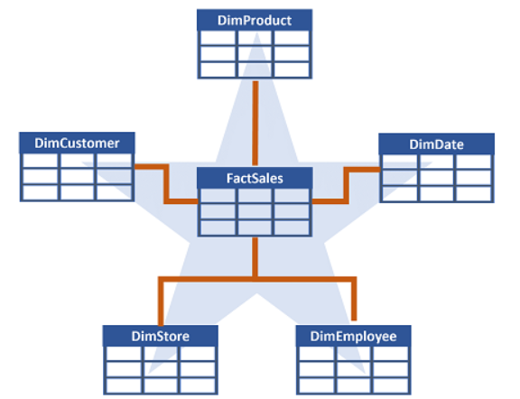
Data Warehouse Schema design
In most transactional databases that are used in business applications, the data is normalized to reduce duplication. In a data warehouse however, the dimension data is generally de-normalized to reduce the number of joins required to query the data.
Often, a data warehouse is organized as a star schema, in which a fact table is directly related to the dimension tables, as shown in this example:
You can use the attributes of something to group together numbers in the fact table at different levels. For example, you could find the total sales revenue for a whole region or just for one customer. The information for each level can be stored in the same dimension table.

Slide 5
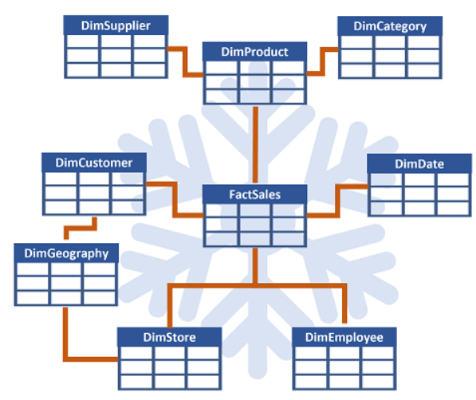
schema type
If there are lots of levels or some information is shared by different things, it might make sense to use a snowflake schema instead. Here's an example:
In this case, the DimProduct table has been split up (normalized) to create separate dimension tables for product categories and suppliers.
Each row in the DimProduct table contains key values for the corresponding rows in the DimCategory and DimSupplier tables.
A DimGeography table has been added containing information on where customers and stores are located.
Each row in the DimCustomer and DimStore tables contains a key value for the corresponding row in the DimGeography table.

Slide 6
Ingest data
There are a few ways to ingest data into a Fabric data warehouse, including Pipelines, Dataflows, cross-database querying, and the COPY INTO command. After ingestion, the data becomes available for analysis by multiple business groups, who can use features such as cross-database querying and sharing to access it.

Slide 7
Clone the table
You can create zero-copy table clones with minimal storage costs in a data warehouse. These clones are essentially replicas of tables created by copying the metadata while still referencing the same data files in OneLake. This means that the underlying data stored as parquet files is not duplicated, which helps in saving storage costs.
Development and testing: Clones allow developers and testers to create copies of tables in lower environments, facilitating development, debugging, testing, and validation processes.
Data recovery: In the event of a failed release or data corruption, table clones can retain the previous state of data, enabling data recovery.
Historical reporting: They help create historical reports that reflect the state of data at specific points in time and preserve data at specific business milestones.

Slide 8
Staging table
After creating tables in a data warehouse, it's important to consider the process of loading data into those tables. A common approach is to use staging tables. In Fabric, you can use T-SQL commands to load data from files into staging tables in the data warehouse.
Staging tables are temporary tables that can be used to perform data cleansing, data transformations, and data validation. You can also use staging tables to load data from multiple sources into a single destination table.
Usually, data loading is performed as a periodic batch process in which inserts and updates to the data warehouse are coordinated to occur at a regular interval (for example, daily, weekly, or monthly).

Slide 9
Load process
Generally, you should implement a data warehouse load process that performs tasks in the following order:
Ingest the new data to be loaded into a data lake, applying pre-load cleansing or transformations as required.
Load the data from files into staging tables in the relational data warehouse.
Load the dimension tables from the dimension data in the staging tables, updating existing rows or inserting new rows and generating surrogate key values as necessary.
Load the fact tables from the fact data in the staging tables, looking up the appropriate surrogate keys for related dimensions.
Perform post-load optimization by updating indexes and table distribution statistics.

Slide 10
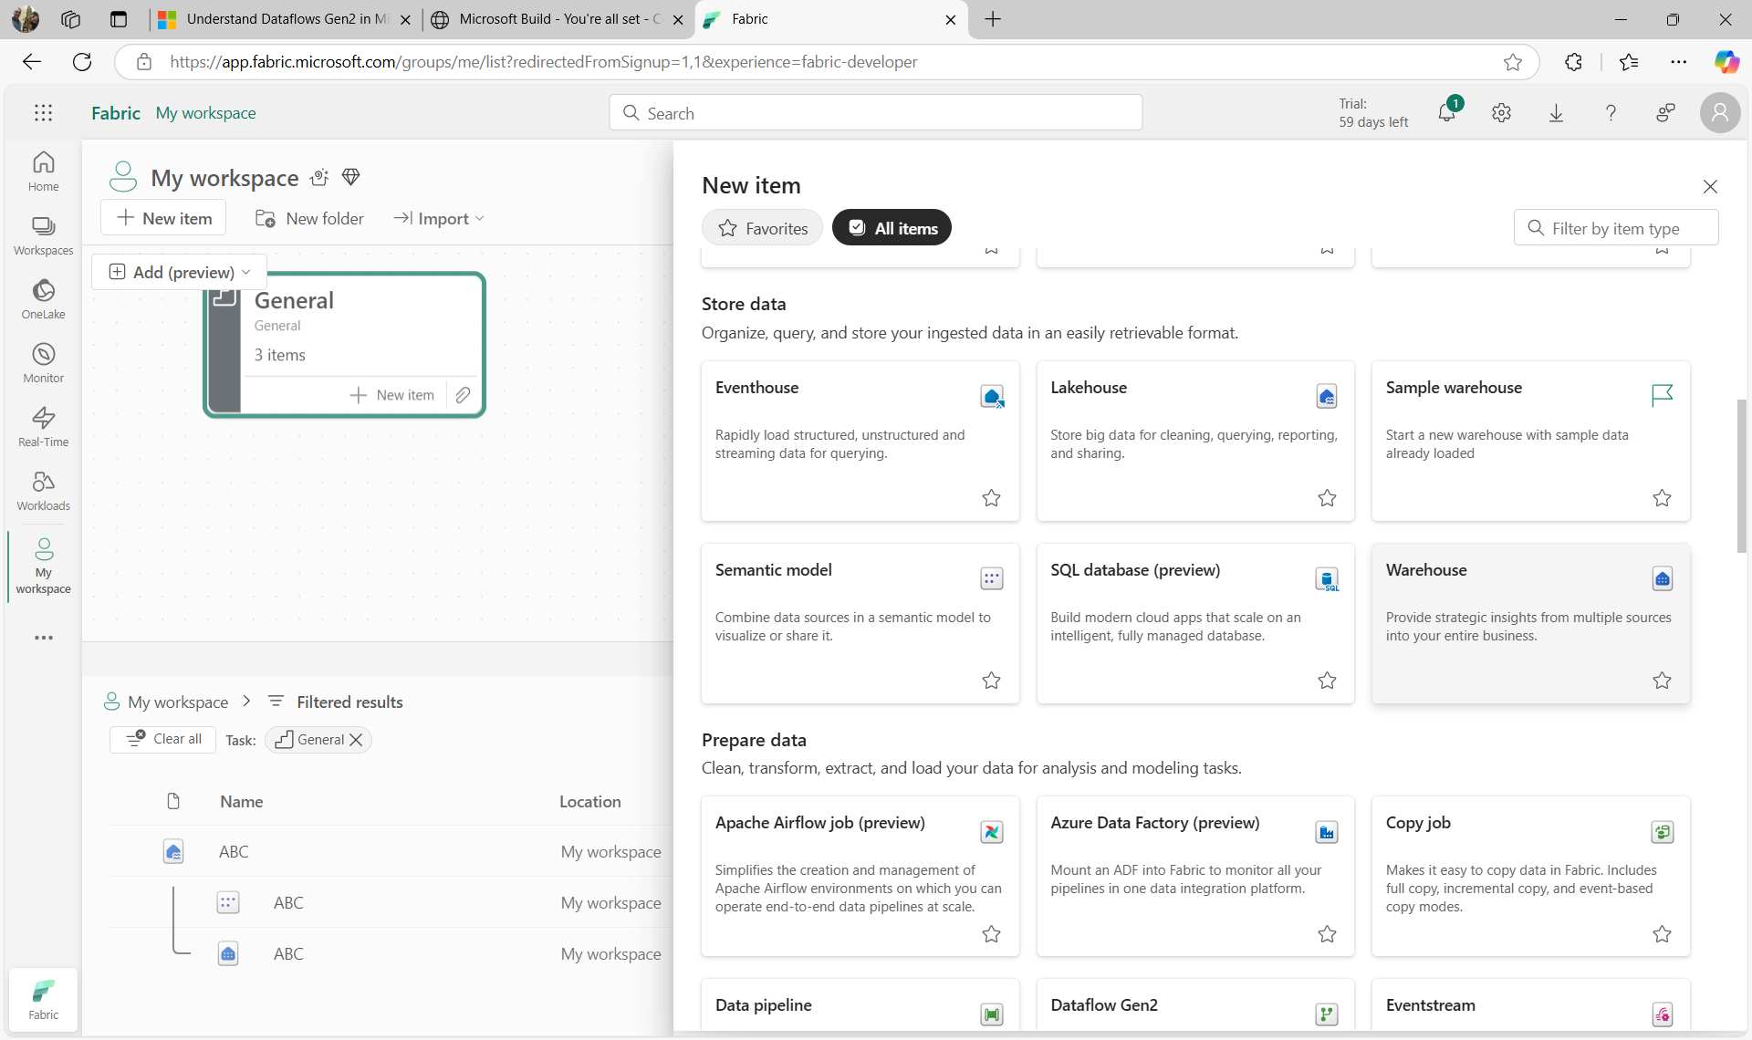

Slide 11
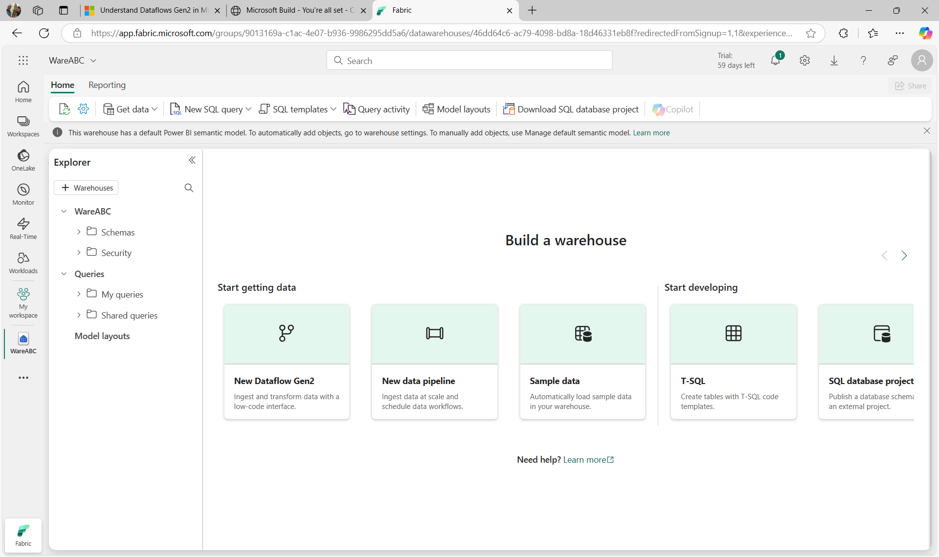

Slide 12
Loading the data
Loading the data in the lakehouse

Slide 13
Steps to upload
Get data
New Dataflow Gen2
Upload the data from the below link

Slide 14
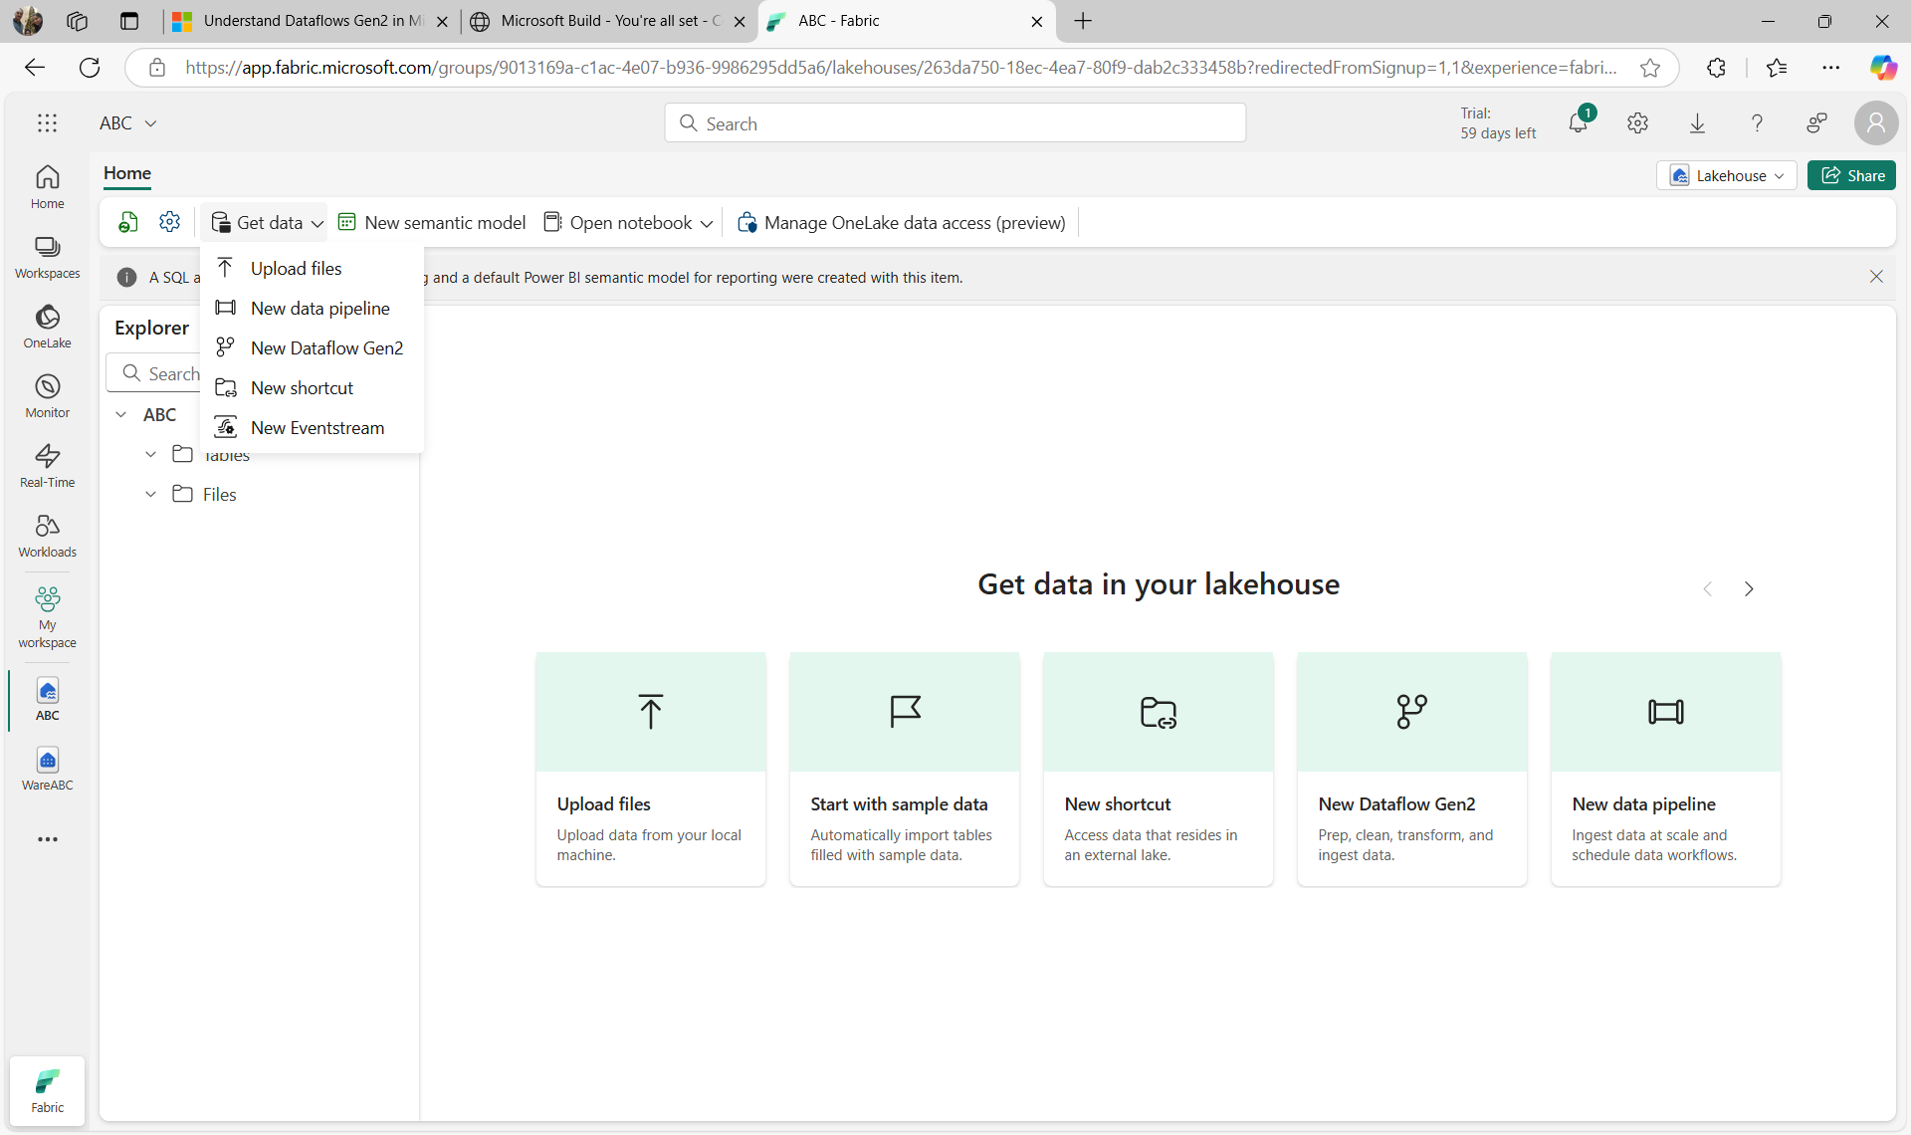

Slide 15
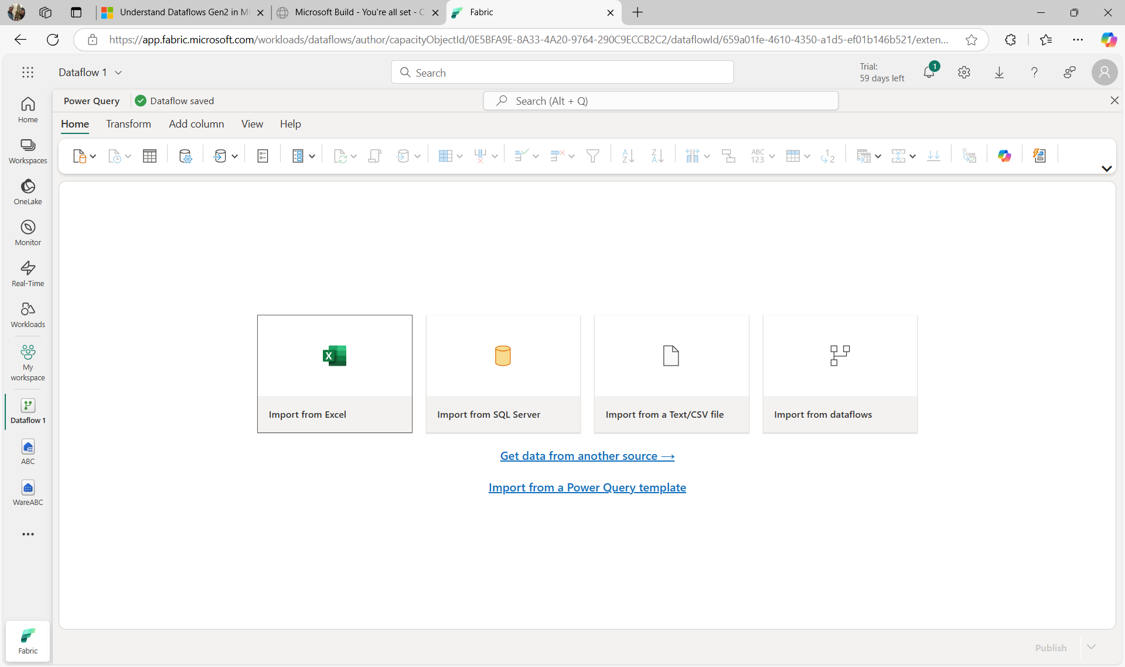

Slide 16
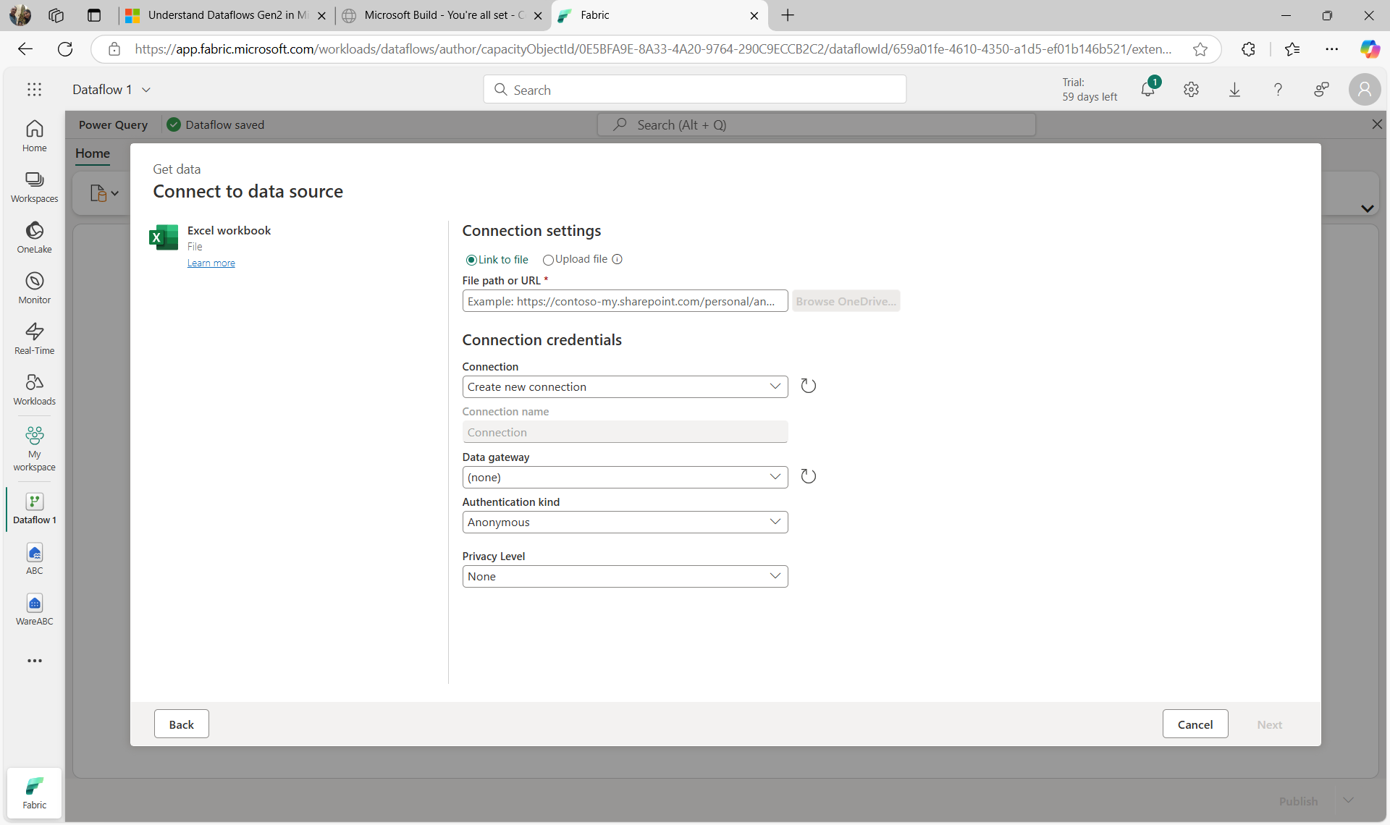
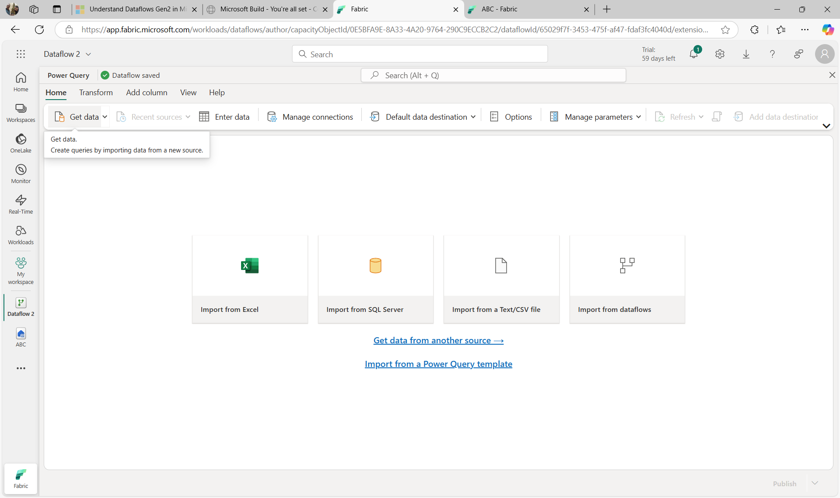

Slide 17
Query and transform the data
Now that you know how to implement a data warehouse in Fabric, let's prepare the data for analytics.
There are two ways to query data from your data warehouse. The Visual query editor provides a no-code, drag-and-drop experience to create your queries. If you're comfortable with T-SQL, you may prefer to use the SQL query editor to write your queries. In both cases, you can create tables, views, and stored procedures to query data in the data warehouse and Lakehouse.
There's also a SQL analytics endpoint, where you can connect from any tool.

Slide 18
Prepare data for analysis and reporting
A semantic model defines the relationships between the different tables in the semantic model, the rules for how data is aggregated and summarized, and the calculations or measures that are used to derive insights from the data. These relationships and measures are included in the semantic model, which is then used to create reports in Power BI.
You can easily switch between the Data, Query, and Model view Fabric using the menu in the bottom left corner of the screen. The Data view shows the tables in the semantic model, the Query view shows the SQL queries that are used to create the semantic model, and the Model view shows the semantic model.

Slide 19
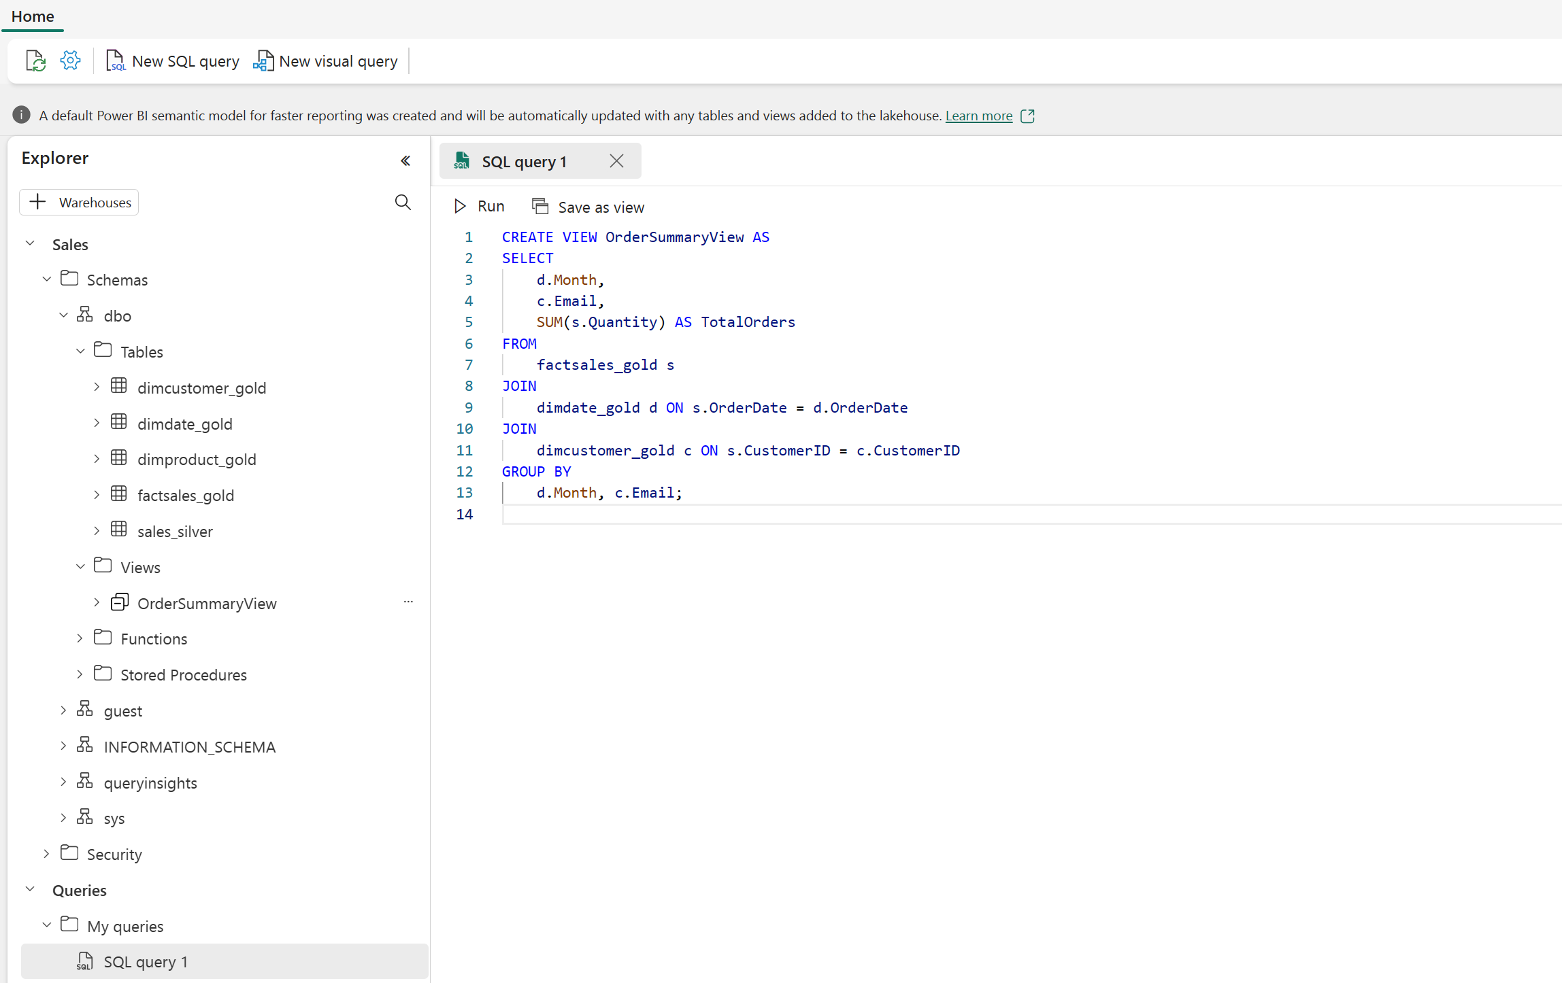

Slide 20
Query data using the SQL query editor
The SQL query editor provides a query experience that includes intellisense, code completion, syntax highlighting, client-side parsing, and validation. If you've written T-SQL in SQL Server Management Studio (SSMS) or Azure Data Studio (ADS), you'll find it familiar.
To create a new query, use the New SQL query button in the menu. You can author and run your T-SQL queries here. In the example below we're creating a new view for analysts to use for reporting in Power BI.

Slide 21
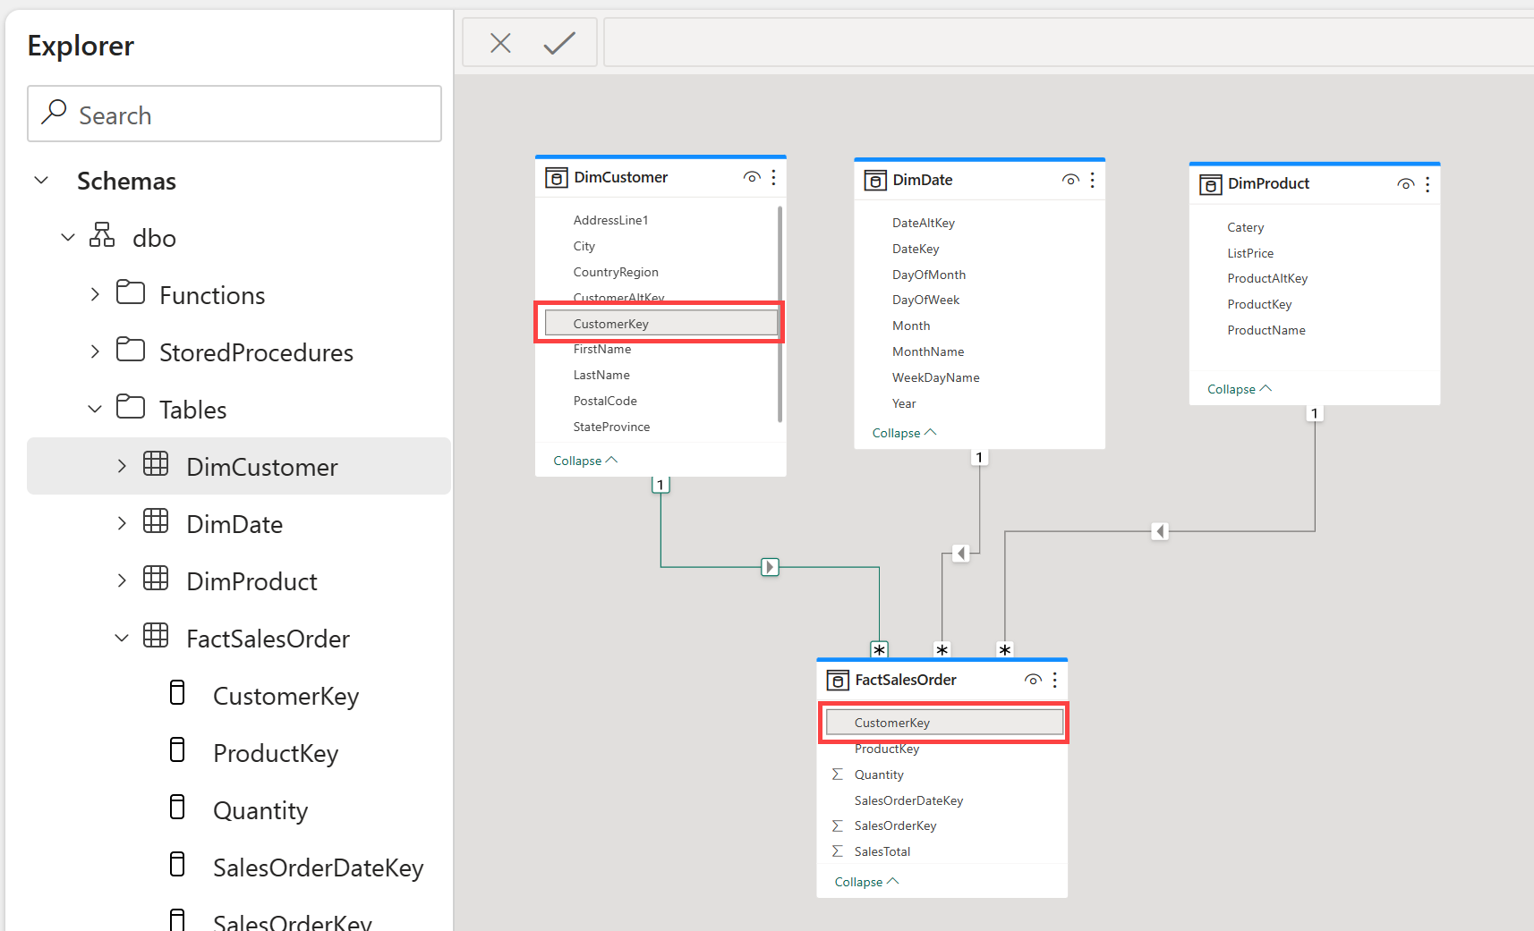
Build relationships
Relationships allow you to connect tables in the semantic model. Create relationships between tables in your data warehouse using a click-and-drag interface in Fabric in the Model view.

Slide 22
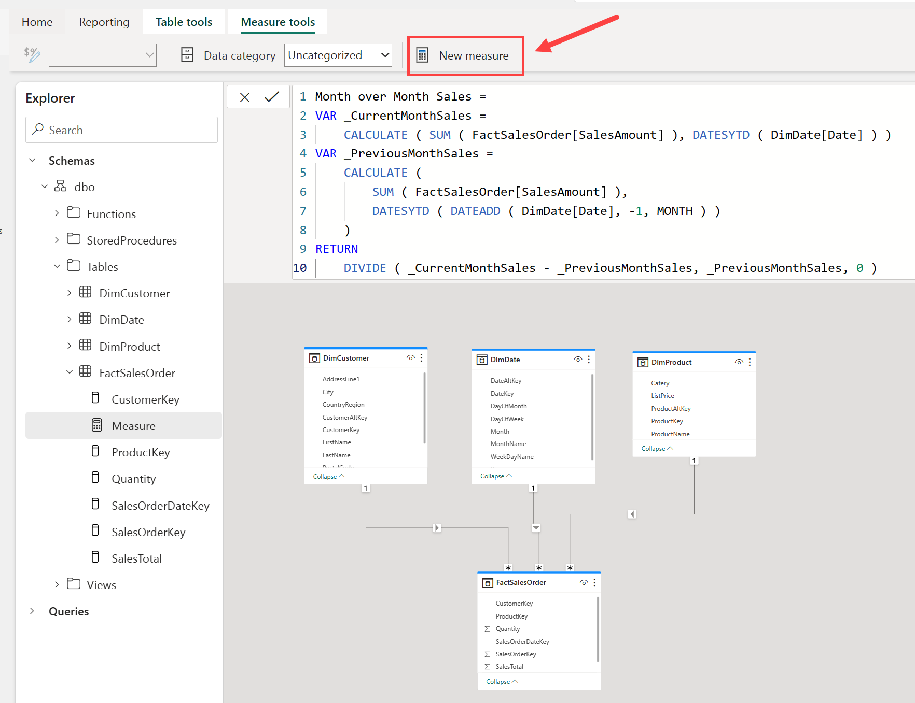
Create measures
Measures are the metrics that you want to analyze in your data warehouse. You can create measures in Fabric by using the New measure button in the Model view
Measures are calculated fields that are based on the data in the tables in your data warehouse using the Data Analysis Expressions (DAX) formula language.

Slide 23
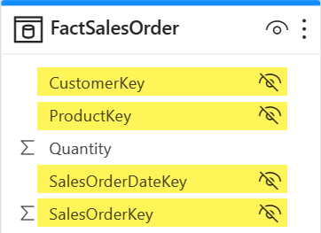
Hide fields
Building out the semantic model is a critical component to preparing your data for use in downstream reporting. To simplify things for your report builders, you can hide elements from view, either a table or a column. Right-click on the table or column and select Hide. Hiding fields removes the table or column from the model view, but it will still be available for use in the semantic model.

Slide 24
Semantic model
Every time a data warehouse is created, Fabric creates a semantic model for analysts and/or business users to connect to for reporting.
Semantic model has metrics that are used to create reports. Simply put, analysts use the semantic model you created in your warehouse, which is stored in a semantic model. If you're familiar with Power BI, working with semantic models created by the data warehouse experience will be straightforward.
Semantic models are automatically kept in sync with the data warehouse, so you don't have to worry about maintaining them. You can also create custom semantic models to meet your specific needs.

Slide 25
Default semantic model
There's also a default semantic model automatically created for you in Fabric. It inherits business logic from the parent lakehouse or warehouse, which initiates the downstream analytics experience for business intelligence and analysis. This semantic model is managed, optimized, and kept in sync for you.
New tables in the Lakehouse are automatically added to the default semantic model. Users can also manually select tables or views from the warehouse they want included in the model for more flexibility. Objects that are in the default semantic model are created as a layout in the model view.

Slide 26
Secure and monitor your data warehouse
Data warehouse security is important to protect your data from unauthorized access. Fabric provides a number of security features to help you secure your data warehouse. These include:
Role-based access control (RBAC) to control access to the warehouse and its data.
SSL encryption to secure the communication between the warehouse and the client applications.
Azure Storage Service Encryption to protect the data in transit and at rest.
Azure Monitor and Azure Log Analytics to monitor the warehouse activity and audit the access to the data.
Multifactor authentication (MFA) to add an extra layer of security to user accounts.
Microsoft Entra ID integration to manage the user identities and access to the warehouse.

Slide 27
Permission
Data in Fabric is organized into workspaces, which are used to control access and manage the lifecycle of data and services. Appropriate workspace roles are the first line of defense in securing your data warehouse.
In addition to workspace roles, you can grant item permissions and access through SQL.

Slide 28
Item permission
In contrast to workspace roles, which apply to all items within a workspace, you can use item permissions to grant access to individual warehouses. This enables you to share a single data warehouse for downstream consumption.
You can grant permissions to users via T-SQL or in the Fabric portal. Grant the following permissions to users who need to access your data warehouse:
Read: Allows the user to CONNECT using the SQL connection string.
ReadData: Allows the user to read data from any table/view within the warehouse.
ReadAll: Allows user to read data the raw parquet files in OneLake that can be consumed by Spark.
A user connection to the SQL analytics endpoint will fail without Read permission at a minimum.

Slide 29
Monitoring
Monitoring activities in your data warehouse is crucial to ensure optimal performance, efficient resource utilization, and security. It helps you identify issues, detect anomalies, and take action to keep the data warehouse running smoothly and securely.
You can use dynamic management views (DMVs) to monitor connection, session, and request status to see live SQL query lifecycle insights. With DMVs, you can get details like the number of active queries and identify which queries are running for an extended period and require termination.
There are currently three DMVs available to use in Fabric:
sys.dm_exec_connections: Returns information about each connection established between the warehouse and the engine.
sys.dm_exec_sessions: Returns information about each session authenticated between the item and engine.
sys.dm_exec_requests: Returns information about each active request in a session.

Slide 30
Query monitoring
Use 'sys.dm_exec_requests' to identify long-running queries that may be impacting the overall performance of the database, and take appropriate action to optimize or terminate those queries.
Start by identifying the queries that have been running for a long time. Use the following query to identify which queries have been running the longest, in descending order:

Slide 31
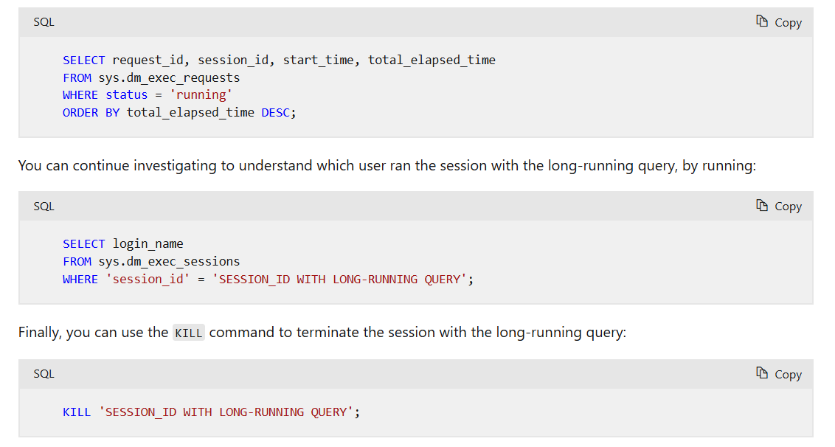

Slide 32
Zero copy clone
Zero copy clone is way to copy the table without duplicating the data file of table.
A zero-copy clone creates create the replica of the table by copying the metadata, while still referencing the same datafiles in Onelake
The metadata is copied while the underlying data of the table stored as parquet file is not copied
This means upon creation a table clone is independent and separate copy of the data from its source.
Any changes made on the source of clone table are not reflected in the clone table
Similarly, any changes made on the table clone are not reflected on the source of clone table.
Syntax:
create table abc.tbl_clone_name as clone of table_name

Slide 33
Benefits of zero-copy clone
Table clone facilitate development and testing processes by creating copies of tables in lower environments
Table clones provide consistent reporting and zero-copy duplication of data for analytical workloads and machine learning modeling and testing.
Table clones provide the capability of data recovery by retaining the previous state of the data.

