Slide 1


Slide 2
Contents
Introduction of finance
Overview of financial management
Financial ratios &there uses
Major types of investment
Inflation and its impact
Importance of credit
basic of personal budgeting
How to build an emergency fund

Slide 3
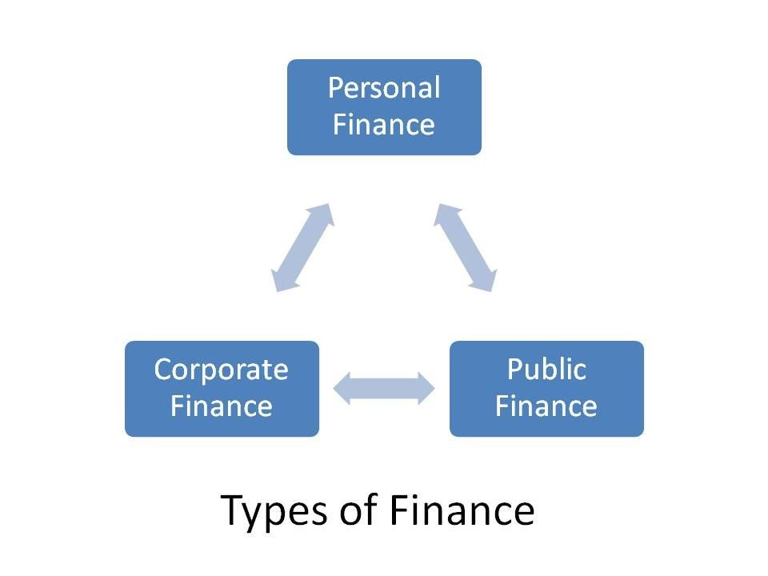
Introduction
Finance is defined as the management of money.
It includes activities such as investing, borrowing, lending, budgeting, saving, and forecasting
The three main areas of finance:
Personal finance : managing your money
Corporate finance: managing business money
Public finance: managing government money
The purpose of finance is to allocate money at the right place and right.

Slide 4
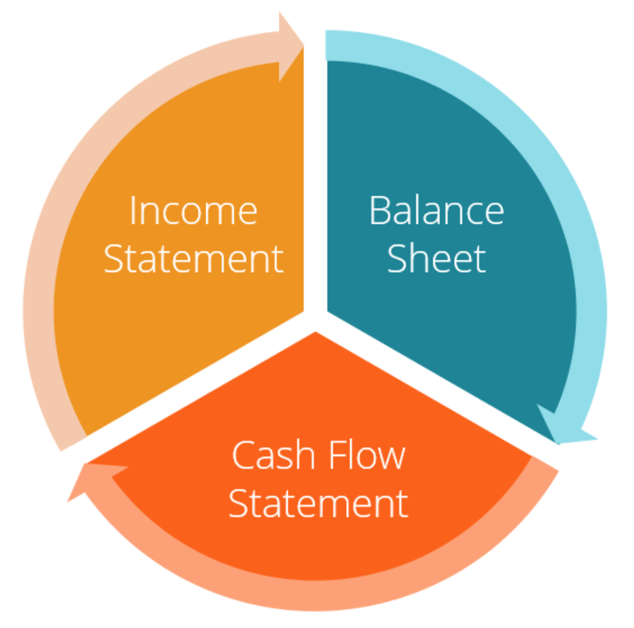
Overview of Financial Statement
Income statement shows a company’s revenues and expenses.
Balance sheet shows assets ,liabilities, and equity.
Cash flow statement shows how money flows in and out .
These statements help understand the financial health of a business.

Slide 5
Financial Ratios and Their Uses
Profitability Ratio: measures how much profit a business is making .
Liquidity Ratio: indicates how much cash a business has to pay it debts.
Leverage Ratio: shows how much debt a business is using .
Ratio helps assess business business performance and stability .

Slide 6
Major types of Investment
Stocks : buying shares in a company .
Bonds : lending money to government or companies with fixed interest returns .
Mutual funds : pooled money managed by professionals.
Real estate : investing in property for long term gains.

Slide 7
Inflation and Its Impact
Inflation means the rise in prices of goods and services.
Inflation reduce the purchasing power of money .
High inflation makes living expenses more expenses.
Government and central banks create policies to control inflation

Slide 8
Importance of Credit Score
Credit score is a number that shows your ability to repay loans .
Good credit score makes it easier to get loans with lower interest rates
Timely payment of bills and loans helps builds credit score.
Late payment can reduce credit score, causing financial difficulties.

Slide 9
Basic of personal budgeting
Creating a budget helps controls your income
It is important to track monthly income
Separate essenstial expenses (bills, groceries) from discretionary expenses.
Always allocate a portion of your budget for savings

Slide 10
How to Build an Emergency Fund
Emergency funds protects you from unexpected financial problems .
Keep at least 3-6 months 'worth of expensive saved as an emergency fund .
Keep emergency funds in accounts where money can be withdrawn quickly.
Save small amounts regularly to build the fund over time .

Slide 11
THANK YOU
NAME – SAKSHI
BATCH ID- 241004514302

