Slide 1

Library Management API using FastAPI
Presented by :- Sakshi choudhari

Slide 2
Agenda
Business Problem & Objective
Tech Stack
Project Structure & Architecture
Database Layer (SQLAlchemy model + SQLite)
Pydantic Schemas
API Endpoints (CRUD)
Core Logic: Create, Search, Update, Delete
Error Handling & Key Features
Conclusion & Future Enhancements
Q&A

Slide 3
Business Problem & Objective
The problem
Objective
Libraries and small institutions still track books manually or in spreadsheets.
Searching, updating and removing records is slow and error-prone.
Different apps (web, mobile) need one shared backend.
Build a REST API to manage a book collection.
Support full CRUD: add, view, search, update, delete.
Prevent duplicate titles and return clear errors.
Persist data in SQLite so it survives restarts.
Notes:
Explain why a backend API is useful: any frontend can plug into it.

Slide 4
Tech Stack
FastAPI
SQLAlchemy
Web framework: routing, dependency injection, auto-generated /docs
ORM: maps the Book class to the books table
SQLite
Pydantic
Lightweight file database (books.db), no server needed
Request / response validation and typing
Notes:
CORS middleware is also enabled so a browser frontend can call the API.

Slide 5
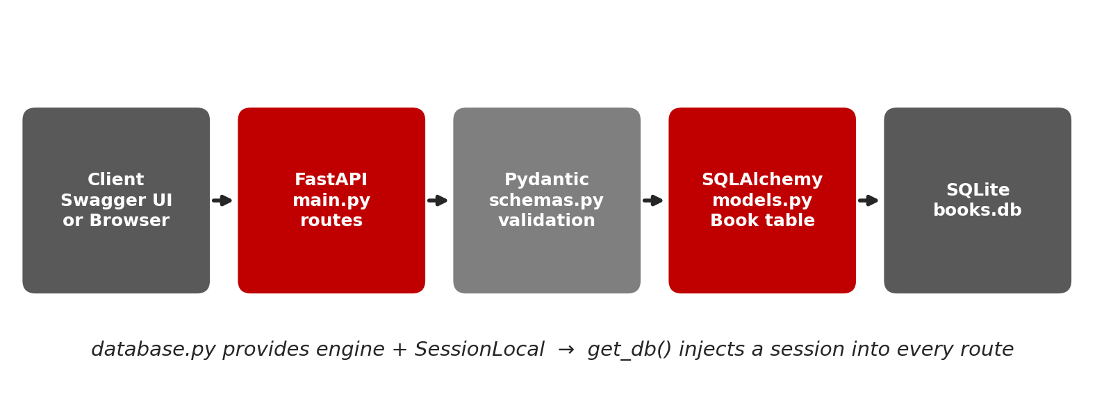
Project Structure & Architecture
main.py – routes | models.py – DB table | schemas.py – validation | database.py – engine & session
Notes:
Walk left to right: request enters FastAPI, is validated by Pydantic, processed with a SQLAlchemy session, stored in SQLite.

Slide 6
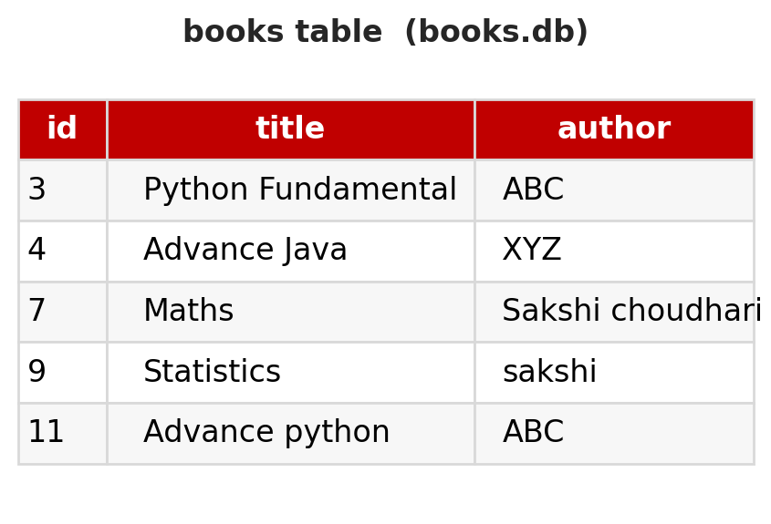
Database Layer
# database.py
engine = create_engine(
'sqlite:///./books.db',
connect_args={'check_same_thread': False})
SessionLocal = sessionmaker(
autocommit=False, autoflush=False,
bind=engine)
# models.py
class Book(Base):
__tablename__ = 'books'
id = Column(Integer, primary_key=True)
title = Column(String, nullable=False)
author = Column(String, nullable=False)
Tables are created at startup with Base.metadata.create_all()
Notes:
The table image shows the actual rows currently in books.db.

Slide 7
Pydantic Schemas
BookCreate
BookUpdate
BookResponse
title: str
author: str
Used for POST /books
title: str
author: str
Used for PUT /books/{id}
id: int, title, author
from_attributes=True
Converts ORM object to JSON
Invalid or missing fields are rejected automatically with a 422 error before our code runs.

Slide 8
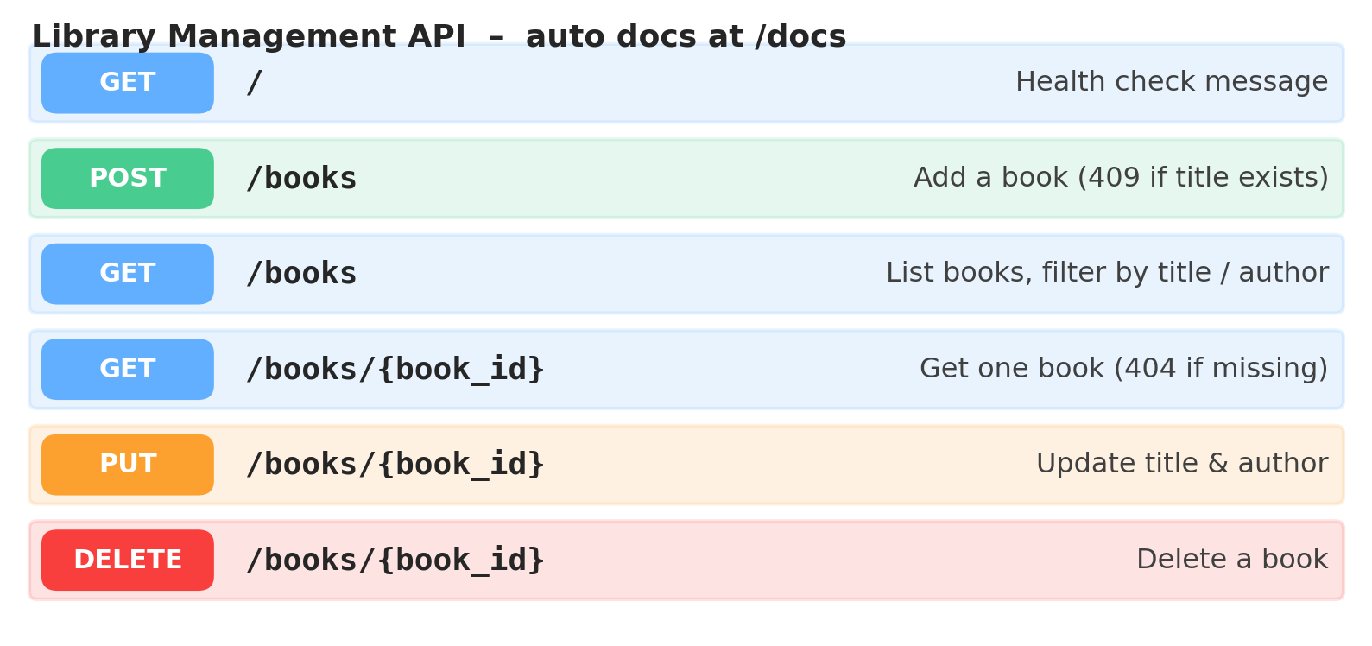
API Endpoints (CRUD)
FastAPI generates this interactive documentation automatically at /docs.

Slide 9
Core Logic: Create & Search
@app.post('/books', status_code=201)
def add_book(book: BookCreate, db=Depends(get_db)):
existing = db.query(BookModel).filter(
BookModel.title == book.title).first()
if existing:
raise HTTPException(409, 'Book already exists')
db_book = BookModel(title=book.title,
author=book.author)
db.add(db_book); db.commit()
db.refresh(db_book)
Create
Checks for a duplicate title, returns 409 if found, otherwise 201.
Search
GET /books?title=py&author=abc uses ilike for case-insensitive partial matching.

Slide 10
Core Logic: Update & Delete
PUT /books/{id}
DELETE /books/{id}
Finds the book by id, updates title and author, commits and returns the updated record.
Finds the book, deletes it, returns a success message.
Not found? Clear error
Missing id returns HTTP 404 with the message: Book with ID {id} not found.

Slide 11
Key Features & Error Handling
201
404
409
422
Created – new book saved
Not Found – id does not exist
Conflict – duplicate title
Validation – bad request body
• One DB session per request through get_db() and Depends
• CORS enabled for frontend integration
• Auto docs with Swagger UI at /docs

Slide 12
Conclusion & Future Enhancements
What we built
Next steps
A working CRUD REST API with validation, search and duplicate protection.
Clean separation: routes, models, schemas, database.
Pagination and sorting
User authentication (JWT)
Borrow / return tracking
Alembic migrations and unit tests

Slide 13
Q&A
Questions?
Live demo: run uvicorn main:app --reload and open /docs

Slide 14

THANK YOU

