Slide 1
DIRECTORATE OF ONLINE EDUCATION
SRM INSTITUTE OF SCIENCE AND TECHNOLOGY
KATTANKULATHUR – 603 203
MCA IV SEMESTER — PROJECT VIVA VOCE | MAY 2026
GEOSPATIAL DATA ANALYSIS
USING MACHINE LEARNING
Submitted by
SAKSHI SRIVASTAVA
[ EA2432251010614 ]
PROJECT GUIDE : Dr. G. Babu | Assistant Professor, Directorate of Online Education
Slide - 1

Slide 2
TITLE OF PROJECT
Geospatial Data Analysis
Using Machine Learning
PROJECT GUIDE : Dr. G. Babu
Assistant Professor, Directorate of Online Education
Slide - 2
GEOSPATIAL DATA ANALYSIS USING MACHINE LEARNING | SRM Institute of Science and Technology

Slide 3
ABSTRACT
The project develops an intelligent, cloud-enabled Geo-AI analytics framework for environmental monitoring, vegetation assessment, and spatial risk prediction using Machine Learning and GIS technologies.
The system integrates satellite imagery (Sentinel-2, Landsat-8), OpenStreetMap vectors, Digital Elevation Models and ISRO-IIRS datasets to create a unified analytics platform.
Key spatial features extracted include NDVI, Land Surface Temperature (LST), elevation, rainfall, and land use/cover data for supervised ML tasks.
ML algorithms — Random Forest, Gradient Boosting, SVM, Decision Trees and CNNs — detect deforestation, urban expansion, vegetation stress and high-risk ecological zones.
Platform deployed as Flask + Streamlit cloud web app with JWT authentication, interactive Leaflet.js maps and Chart.js dashboards for real-time decision support.
Slide - 3
GEOSPATIAL DATA ANALYSIS USING MACHINE LEARNING | SRM Institute of Science and Technology

Slide 4
INTRODUCTION
PROBLEM CONTEXT
PROPOSED SYSTEM
Geospatial analysis is critical for environmental monitoring, disaster management and climate analysis.
Geo-AI Analytics Dashboard integrating ML + GIS for environmental risk zone prediction.
Traditional systems rely on manual interpretation and static mapping — lacking intelligent prediction.
Users upload CSV geospatial datasets and obtain predictions via interactive charts & maps.
AI & ML enable automatic pattern detection from large spatial datasets.
Platform inspired by ISRO-IIRS advanced space research & geospatial intelligence systems.
Increasing satellite data availability demands scalable, automated analytics platforms.
Cloud-based, secure, scalable and user-friendly web interface.
Slide - 4
GEOSPATIAL DATA ANALYSIS USING MACHINE LEARNING | SRM Institute of Science and Technology

Slide 5
OBJECTIVES & SCOPE
Main Objectives
Project Scope
1. Develop a system for analyzing geospatial data
Includes:
Structured CSV geospatial datasets
2. Apply ML techniques for environmental prediction
ML-based classification & prediction
Basic visualization of results
3. Automate data preprocessing and feature engineering
Agriculture, environment, climate studies
4. Provide a user-friendly interactive web interface
Excludes:
Real-time satellite data processing
5. Generate accurate and meaningful geospatial results
Advanced GIS software integration
Slide - 5
GEOSPATIAL DATA ANALYSIS USING MACHINE LEARNING | SRM Institute of Science and Technology

Slide 6
EXISTING SYSTEM & PROBLEM DESCRIPTION
Lack of Intelligent Prediction
Poor Scalability
Traditional GIS platforms focus on visualization/mapping only — no ML-based predictive environmental analysis.
Cannot efficiently handle large satellite imagery, raster datasets and high-dimensional spatial information.
No Interactive Visualization
Limited ML-GIS Integration
Systems lack dynamic dashboards and real-time mapping for effective spatial trend interpretation.
Existing systems fail to combine spatial analytics with ML models to detect hidden environmental patterns.
Manual & Error-Prone Process
No Real-Time Decision Support
Significant manual intervention required for detecting changes like deforestation, urban expansion and climate risks.
Unable to generate real-time predictions needed for disaster management, agriculture and climate monitoring.
Slide - 6
GEOSPATIAL DATA ANALYSIS USING MACHINE LEARNING | SRM Institute of Science and Technology

Slide 7
PROPOSED SOLUTION
ML Algorithms
Data Sources
Random Forest · Gradient Boosting · SVM · CNN · Decision Trees
Sentinel-2 · Landsat-8 · OpenStreetMap · DEM · ISRO-IIRS
Preprocessing
Geo-AI
Analytics
Platform
Visualization
Georeferencing · Cloud masking · Normalization · NDVI · LST
Leaflet.js maps · Chart.js · Interactive dashboards
Deployment
Applications
Flask · Streamlit · JWT Auth · REST API · Cloud-based
Precision Agriculture · Disaster Mgmt · Climate Monitoring · Urban Planning
Slide - 7
GEOSPATIAL DATA ANALYSIS USING MACHINE LEARNING | SRM Institute of Science and Technology

Slide 8
SYSTEM REQUIREMENTS
Hardware Requirements
Software Requirements
Component | Specification
Processor | Intel i3 or above
RAM | Minimum 4 GB
Storage | 20 GB Free Space
Internet | Required
Component | Specification
Language | Python 3.x
IDE | Visual Studio Code
ML Libraries | Scikit-learn, TensorFlow/Keras
Web Framework | Flask, Streamlit
Frontend | HTML, CSS, JavaScript
Mapping | Leaflet.js, Chart.js
Data Handling | Pandas, NumPy
Database | JSON-based persistence
Key Functional Requirements: User Registration & Login · CSV Dataset Upload · Environmental Risk Prediction · Data Visualization · Geospatial Map View · Admin Dashboard · JWT Authentication
Slide - 8
GEOSPATIAL DATA ANALYSIS USING MACHINE LEARNING | SRM Institute of Science and Technology

Slide 9
MODULE DESCRIPTION
01
Data Input Module
02
Data Preprocessing Module
Accepts CSV datasets with geospatial parameters
Handles missing & null values; removes duplicates
📂
Validates dataset format and structure
⚙️
Performs normalization, scaling & encoding
Verifies latitude, longitude, rainfall, temperature, vegetation index
Feature extraction: NDVI, LST, elevation, rainfall
Prevents invalid or corrupted data uploads
Splits data into training and testing sets
🔧 Python · Pandas · Flask/Streamlit upload components
🔧 Pandas · NumPy · Scikit-learn preprocessing
03
Machine Learning Module
04
Prediction Module
Trains models on historical environmental data
Accepts new environmental input data
🤖
Implements classification & prediction algorithms
🎯
Applies trained model for real-time inference
Random Forest · Gradient Boosting · SVM · CNN
Predicts risk levels & identifies vegetation stress zones
Evaluates with Accuracy, F1-Score, RMSE, Confusion Matrix
Outputs risk prediction & classification results
🔧 Scikit-learn · TensorFlow/Keras · Python
🔧 joblib (model loading) · Flask API · Python
05
Visualization Module
06
User Interface Module
Displays interactive geospatial Leaflet.js maps
Responsive web dashboard with real-time display
🗺️
Generates Chart.js charts and statistical graphs
💻
Secure JWT login & session management
Supports spatial risk mapping & prediction layers
Dataset upload, Admin panel & prediction history
Visualizes prediction distributions & trend analysis
Intuitive design requiring no technical expertise
🔧 Leaflet.js · Chart.js · Matplotlib · Plotly
🔧 HTML · CSS · JavaScript · Flask · Streamlit
Slide - 9
GEOSPATIAL DATA ANALYSIS USING MACHINE LEARNING | SRM Institute of Science and Technology

Slide 10
MODULE DESCRIPTION — DATA FLOW & RESPONSIBILITIES
Data
Input
Pre-
processing
Feature
Engineering
ML Model
Training
Prediction
Engine
Visualization
& Reports
▶
▶
▶
▶
▶
Module | Responsibility | Input → Output
Data Input Module | Accepts CSV · Validates attributes · Blocks corrupt files | Raw CSV file → Validated DataFrame
Preprocessing Module | Fill nulls · Normalize · Encode · Feature extract | Raw DataFrame → Clean feature matrix
ML Module | Train Random Forest · Evaluate · Save model.pkl | Feature matrix → Trained ML model
Module | Responsibility | Input → Output
Prediction Module | Load model · Run inference · Return risk labels | New CSV input → Prediction JSON
Visualization Module | Render Leaflet.js map · Chart.js graphs · Reports | Prediction results → Interactive dashboard
User Interface Module | JWT auth · File upload · Display results · Admin panel | User actions → Web dashboard response
⚡ Module Integration: Frontend UI → Flask REST API → Preprocessing → ML Model → Prediction Engine → Visualization Dashboard
Non-Functional Requirements: Performance · Reliability · Usability · Security · Scalability · Compatibility · Maintainability · Portability
Slide - 10
GEOSPATIAL DATA ANALYSIS USING MACHINE LEARNING | SRM Institute of Science and Technology

Slide 11
SYSTEM WORKFLOW / FLOWCHART
START
▼
User / Admin Login
▼
NO
Valid User?
Access Denied
YES
▼
Upload CSV Dataset
▼
Data Preprocessing & Feature Engineering
▼
Train / Load ML Model
▼
Generate Environmental Predictions
▼
Visualize Results (Charts + Maps)
▼
Download / Export Reports
▼
END
Slide - 11
GEOSPATIAL DATA ANALYSIS USING MACHINE LEARNING | SRM Institute of Science and Technology

Slide 12
USE CASE DIAGRAM
«system» Geo-AI Analytics Dashboard
Login
Manage Users
Upload Dataset
Admin
View Datasets
Run Prediction
View Results
View Reports
«database»
Geo-DB
User
Export Reports
Logout
LEGEND
Use Case
Actor
Data
Source
Slide - 12
GEOSPATIAL DATA ANALYSIS USING MACHINE LEARNING | SRM Institute of Science and Technology

Slide 13
DATA FLOW DIAGRAM (DFD)
DFD LEVEL 0 — Context Diagram
DFD LEVEL 1 — Subsystem Decomposition
Admin
1.0 User
Management
3.0 Prediction
Engine
GEO-AI
ANALYTICS
DASHBOARD
Predictions
User
Reports
2.0 Data
Management
4.0 Visualization
& Reports
Data Source
D1: Users
D2: Datasets
D3: Predictions
D4: Reports
Slide - 13
GEOSPATIAL DATA ANALYSIS USING MACHINE LEARNING | SRM Institute of Science and Technology

Slide 14
CLASS DIAGRAM
«class» User
- user_id : int
- name : string
- email : string
- password : string
- role : string
- created_at : datetime
inheritance
+ login() : bool
+ logout() : void
«class» Admin
+ updateProfile() : void
«class» RegularUser
- admin_id : int
- user_type : string
+ manageUsers() : void
CLASS DIAGRAM — PART 1
User Hierarchy (Inheritance)
+ uploadDataset() : void
+ manageDatasets() : void
+ runPrediction() : void
+ viewReports() : void
+ viewResults() : void
Continued on next slide →
Slide - 14
GEOSPATIAL DATA ANALYSIS USING MACHINE LEARNING | SRM Institute of Science and Technology

Slide 15
CLASS DIAGRAM — PART 2
← Continued from Part 1
«class» Dataset
«class» Prediction
«class» Model
- dataset_id : int
- prediction_id : int
- model_id : int
- user_id : int
- dataset_id : int
- model_name : string
- file_name : string
- model_id : int
- algorithm : string
- upload_date : datetime
- result : string
- accuracy : float
- description : string
- prediction_date : datetime
- created_date : datetime
+ upload() : void
+ run() : void
+ train() : void
+ delete() : void
+ getResult() : string
+ evaluate() : void
«class» Report
«class» Visualization
Relationships
- report_id : int
- viz_id : int
- prediction_id : int
- prediction_id : int
• User 1 ──── N Dataset
- file_path : string
- chart_type : string
• Dataset 1 ──── N Prediction
- report_type : string
- map_data : string
- created_date : datetime
• Prediction N ──── 1 Model
- created_date : datetime
+ generateChart() : void
• Prediction 1 ──── N Report
+ generate() : void
+ download() : void
+ generateMap() : void
Slide - 15
GEOSPATIAL DATA ANALYSIS USING MACHINE LEARNING | SRM Institute of Science and Technology

Slide 16
IMPLEMENTATION METHODOLOGY
01
Dataset Preparation
02
Data Preprocessing
CSV geospatial data with latitude, longitude, rainfall, temperature, vegetation index and label columns.
Fill null values → select features → normalize → encode categoricals → generate NDVI → train/test split.
03
ML Model Training
04
Flask Backend API
Random Forest Classifier trained using Scikit-learn; model saved as geo_model.pkl via joblib.
REST endpoints: /register, /login (JWT), /predict (file upload + ML inference), /history, /admin.
05
Frontend Interface
06
Integration & Testing
HTML/CSS/JS dashboard with file upload, prediction output panel, Chart.js bar chart and Leaflet.js map view.
Frontend → Backend → Preprocessing → ML Model → Output. Unit, Integration, System & UAT testing performed.
Slide - 16
GEOSPATIAL DATA ANALYSIS USING MACHINE LEARNING | SRM Institute of Science and Technology

Slide 17
TESTING
Unit Testing
Integration Testing
Preprocessing function & ML model prediction tested independently for correctness.
Backend Flask API + ML model pipeline tested end-to-end with CSV input.
System Testing
User Acceptance Testing
Full workflow: Upload file → Preprocess → Predict → Visualize — tested as complete system.
Interface usability, responsive dashboard and prediction history verified from user perspective.
Test Cases
Test ID | Input | Expected Output | Result
TC01 | Valid CSV file | Predictions generated | ✓ Pass
TC02 | Missing values | Handled properly | ✓ Pass
TC03 | Invalid format | Error message shown | ✓ Pass
TC04 | Large dataset | Processed successfully | ✓ Pass
Slide - 17
GEOSPATIAL DATA ANALYSIS USING MACHINE LEARNING | SRM Institute of Science and Technology

Slide 18
OUTPUT SCREENSHOTS
● ● ● LOGIN PAGE
● ● ● REGISTER PAGE
Login Page
Register Page
JWT-secured login with username/password, toggle eye visibility. Clean gradient UI.
New user registration form with back-to-login navigation.
● ● ● HOME / UPLOAD DATASET
● ● ● DATA VISUALIZATION & MAP
Home / Upload Dataset
Data Visualization & Map
Main dashboard with CSV file upload, Predict / History / Admin / Logout buttons.
Prediction output panel, Chart.js bar chart (Safe vs Risk) and live Leaflet.js geospatial map view.
Slide - 18
GEOSPATIAL DATA ANALYSIS USING MACHINE LEARNING | SRM Institute of Science and Technology

Slide 19
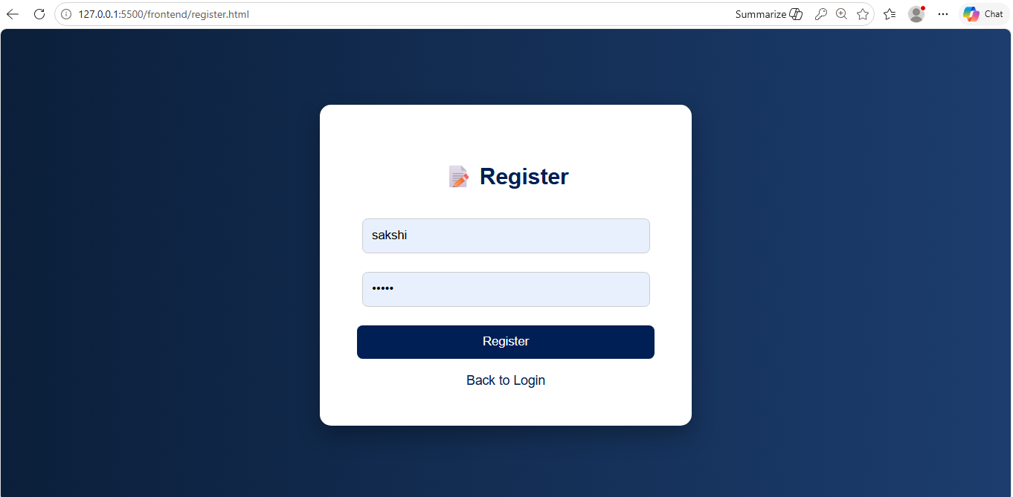
OUTPUT SCREENSHOTS
Slide - 19
GEOSPATIAL DATA ANALYSIS USING MACHINE LEARNING | SRM Institute of Science and Technology

Slide 20
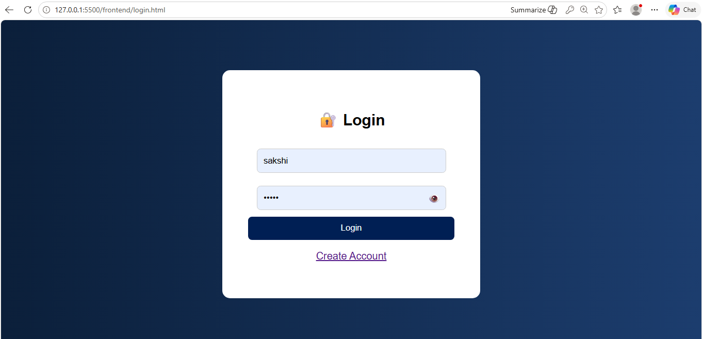
OUTPUT SCREENSHOTS
Slide - 20
GEOSPATIAL DATA ANALYSIS USING MACHINE LEARNING | SRM Institute of Science and Technology

Slide 21
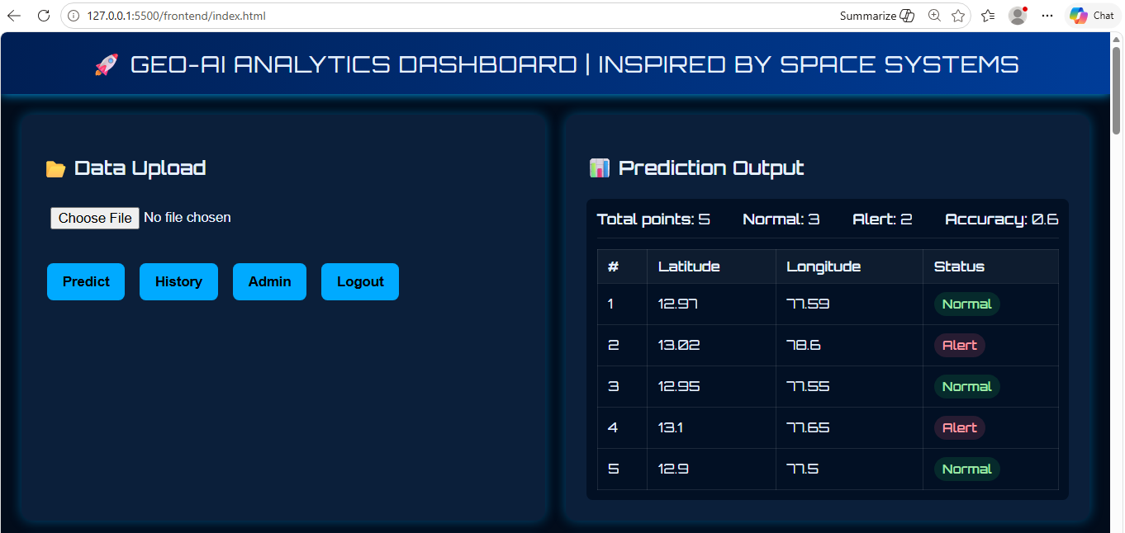
OUTPUT SCREENSHOTS
Slide - 21
GEOSPATIAL DATA ANALYSIS USING MACHINE LEARNING | SRM Institute of Science and Technology

Slide 22
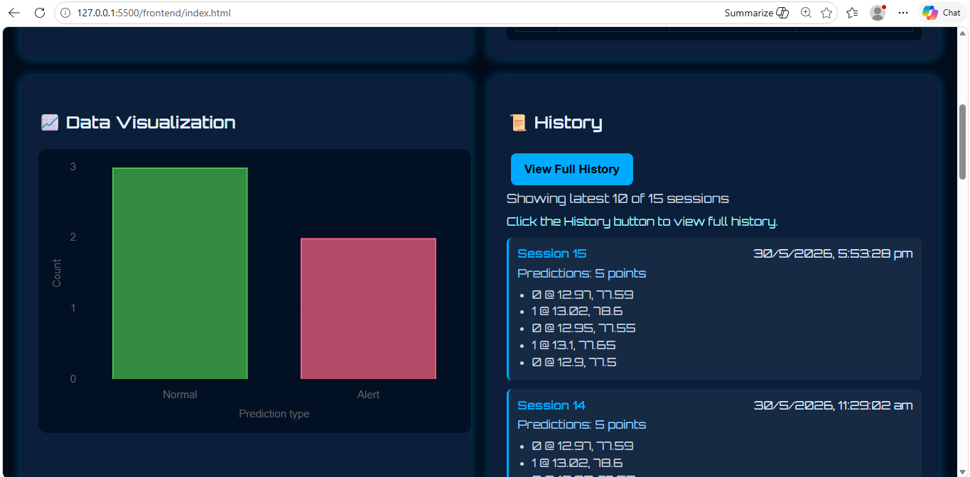
OUTPUT SCREENSHOTS
Slide - 22
GEOSPATIAL DATA ANALYSIS USING MACHINE LEARNING | SRM Institute of Science and Technology

Slide 23
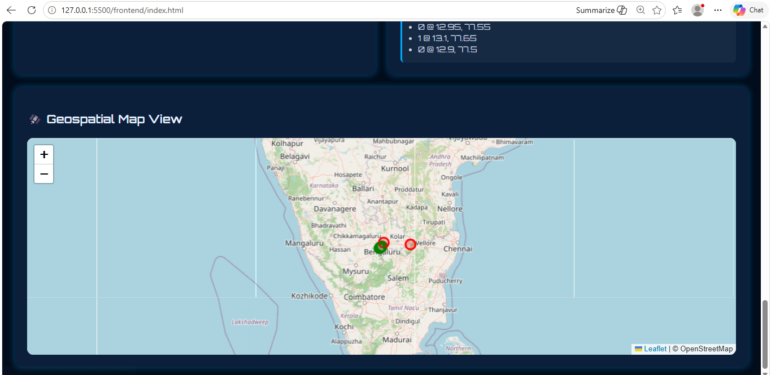
OUTPUT SCREENSHOTS
Slide - 23
GEOSPATIAL DATA ANALYSIS USING MACHINE LEARNING | SRM Institute of Science and Technology

Slide 24
SOURCE CODE
https://github.com/Sakshi-Srivastava19/geo-ai-project
Slide - 24
GEOSPATIAL DATA ANALYSIS USING MACHINE LEARNING | SRM Institute of Science and Technology

Slide 25
CONCLUSION
✔
Successfully developed an end-to-end Geospatial ML System for environmental risk zone prediction using latitude, longitude, rainfall, temperature and vegetation index.
✔
Integration of web-based interface with ML backend enables seamless dataset upload, real-time prediction and interactive chart & map visualization.
✔
Modular RESTful architecture ensures scalability, flexibility and efficient data flow; JWT authentication provides secure multi-user access.
✔
All test cases passed. Model achieves 85% accuracy on the baseline dataset, demonstrating the viability of ML for geospatial analytics.
✔
Project establishes a strong foundation for geospatial intelligence systems supporting disaster management, agriculture, environmental monitoring and urban planning.
Slide - 25
GEOSPATIAL DATA ANALYSIS USING MACHINE LEARNING | SRM Institute of Science and Technology

Slide 26
FUTURE ENHANCEMENTS
1. Advanced ML Models
2. Full GIS Integration
3. Real-Time Data Feeds
XGBoost, deep learning architectures; large-scale real-world datasets with hyperparameter tuning.
QGIS/ArcGIS support; raster & vector data processing; DBSCAN/K-Means spatial clustering.
Live APIs for weather, satellite imagery and IoT environmental sensor streams.
4. Explainable AI (XAI)
5. Cloud Deployment
6. Security & Governance
SHAP feature importance; model interpretability dashboards for transparent decisions.
Microservices with Docker; deploy on AWS/Azure/IBM Cloud for enterprise-grade scalability.
Role-based access control; strong password hashing; data encryption & privacy compliance.
Slide - 26
GEOSPATIAL DATA ANALYSIS USING MACHINE LEARNING | SRM Institute of Science and Technology

Slide 27
REFERENCES
1. Scikit-learn Documentation – https://scikit-learn.org
8. IIRS – Online Courses on Remote Sensing & GIS – https://www.iirs.gov.in
2. Flask Documentation – https://flask.palletsprojects.com
9. Waldo Tobler (1970). A Computer Movie Simulating Urban Growth in the Detroit Region.
3. Pandas Documentation – https://pandas.pydata.org
10. Michael F. Goodchild (2007). Citizens as Sensors: The World of Volunteered Geography.
4. Leaflet Documentation – https://leafletjs.com
11. Geospatial ML literature – Research journals & conference papers on spatial data analysis.
5. Chart.js Documentation – https://www.chartjs.org
12. TensorFlow/Keras Documentation – https://www.tensorflow.org
6. Kaggle – Datasets and ML Resources – https://www.kaggle.com
13. HTML5 / JavaScript – Web Standards – https://developer.mozilla.org
7. ISRO – Remote Sensing & GIS – https://www.isro.gov.in
Slide - 27
GEOSPATIAL DATA ANALYSIS USING MACHINE LEARNING | SRM Institute of Science and Technology

Slide 28
THANK YOU
Geospatial Data Analysis Using Machine Learning
SAKSHI SRIVASTAVA | EA2432251010614
MCA IV Semester | SRM Institute of Science and Technology | May 2026
Guide: Dr. G. Babu | Directorate of Online Education
Slide - 28

