Slide 1
HEXAWARE FINAL
PROJECT
GROUP - 4
Sai Anish
Sakshi Rathi
Sara Pricilla
Swetha

Slide 2
PROJECTS
01
02
Serverless Data Processing
Walmart ETL Analytics

Slide 3
Introduction
This project focuses on building a serverless data processing and machine learning pipeline using Azure.
The goal is to enable cost-effective, scalable, and automated data workflows without managing traditional servers or clusters.
We use Azure Synapse Serverless SQL for raw data exploration directly from Data Lake.
Azure Functions are used to trigger Databricks jobs for ETL and ML tasks in a serverless fashion.
The entire workflow is code-managed via Azure DevOps and supports CI/CD for deployment and monitoring.
A KMeans clustering model is built using Spark MLlib and tracked with MLflow.

Slide 4
Objective
Serverless Data Processing
ETL Problem:
Use Azure Synapse Serverless SQL for raw data exploration directly on ADLS Gen2.
Trigger Azure Databricks jobs using Azure Functions for scalable transformation.
Code and infra managed via Azure DevOps repos and ARM templates.
ML Problem:
Create serverless training pipelines in Databricks with on-demand clusters.
Train customer segmentation model (KMeans) using Spark MLlib.
Deploy using CI/CD jobs triggered via DevOps pipelines and monitored via MLflow.

Slide 5
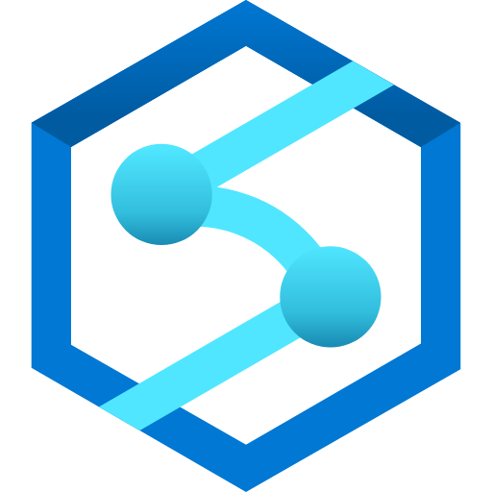





Tools
Synapse Analytics
ADLS gen2
Databricks
Storage Container
Function App
Devops

Slide 6
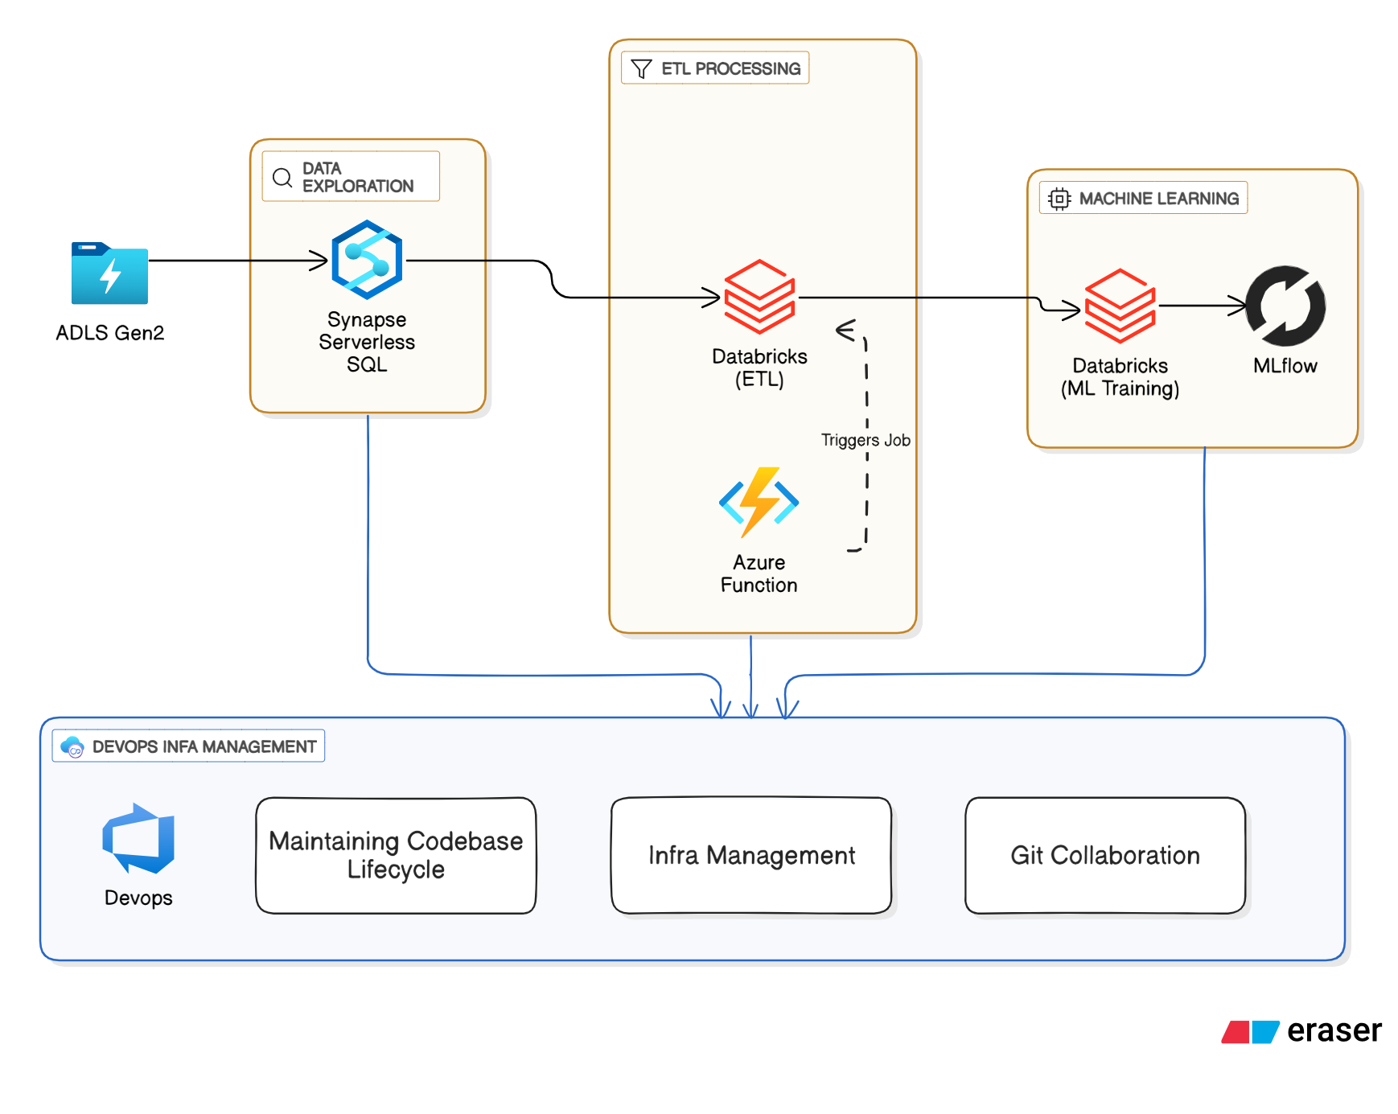
Architecture

Slide 7
Project Workflow
1) Data Collection & Exploration
Data Source:
Azure Data Lake Storage Gen2 (ADLS Gen2)
Dataset:
NYC Yellow Taxi Trip Data (yellow-tripdata-2024-01.csv)
Tools Used:
Azure Synapse Serverless SQL for querying raw data
Activities Performed:
Data schema inspection
Missing value and data quality checks
Initial statistics and insights generation

Slide 8
2) ETL Orchestration
Triggering with Azure Function (VS Code):
Built a Python-based Azure Function inside Visual Studio Code using a virtual environment.
The function (function_app.py) acts as an HTTP trigger.
It calls a Databricks job using the Databricks REST API when executed via func start.
ETL in Azure Databricks (Spark):
The job processes the dataset yellow-tripdata-2024-01.csv stored in ADLS Gen2.
The ETL follows the Medallion Architecture:
Bronze Layer: Raw data ingestion
Silver Layer: Data cleaning, null handling, formatting
Gold Layer: Business-ready, analytics-optimized data
Data was accessed by mounting ADLS Gen2 into Databricks.

Slide 9
3) Machine Learning Pipeline
Clustering with K-Means (Spark MLlib):
Applied K-Means Clustering on the Silver/Gold layer data.
The algorithm grouped similar trip records based on features like:
Trip Distance
Fare Amount
Passenger Count
Trip Duration
Model Monitoring with MLflow:
Used MLflow (built-in with Databricks) to track experiments:
Parameters: e.g., number of clusters k
Metrics: e.g., Silhouette Score to evaluate cluster quality
Enabled better model selection and fine-tuning using the MLflow UI.

Slide 10
4) CI/CD & Monitoring
Deployment Pipelines:
Azure DevOps pipelines automate deployment of code and infrastructure
Includes both ETL processes and ML workflows
Model Promotion:
CI/CD flow handles model registration and staging using MLflow
Monitoring & Alerts:
MLflow UI for model metrics
Azure Monitor for job failures and performance alerts
Ensures reliability and consistency of the system

Slide 11
Conclusion
Successfully built a fully serverless and automated data processing pipeline using Azure.
Achieved scalable machine learning training with Databricks and Spark MLlib.
Ensured reproducibility and traceability using MLflow for model tracking.
Implemented automated orchestration through Azure Functions and DevOps pipelines.
Significantly reduced infrastructure management overhead and boosted deployment speed.
Enabled end-to-end integration of data exploration, transformation, ML, and CI/CD

