Slide 1

Netflix Shows & Movies Analysis
Insights from Power BI & Python
Presented by: Sakshi Hiwale
Date: June 2025

Slide 2



Objective of the Analysis
Analyze Netflix content trends
Understand content distribution by year, genre, country
Visualize patterns using Power BI
Clean and explore data using Python

Slide 3
Dataset Overview
Source: Netflix title dataset
Total entries: ~8800
Columns: Title, Type, Country, Date Added, Rating, Duration, etc.
Tools used: Python (EDA), Power BI (Dashboards)

Slide 4
Data Cleaning Steps
Removed null values in key fields (e.g., country, date_added)
Converted date formats to datetime
Converted duration to numeric
Filtered only Movies and TV Shows

Slide 5
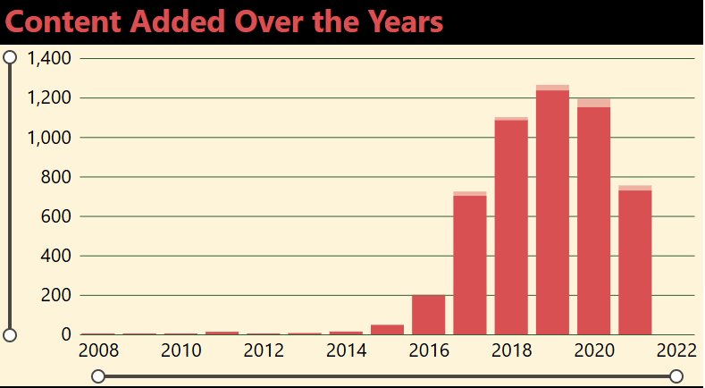
Content Released by Year
Sharp increase in content after 2016
Peak around 2018–2020
Bar chart shows annual content count

Slide 6

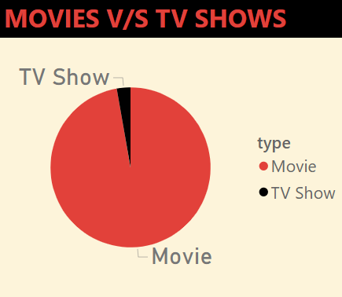
Movies vs TV Shows
Netflix has more movies than TV shows
Visualized using pie chart in Power BI

Slide 7
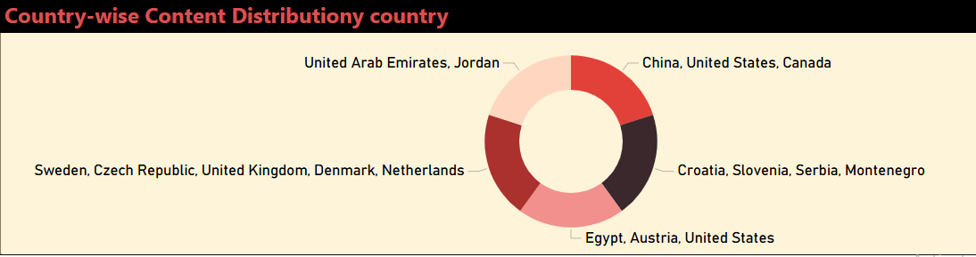
Top Countries by Content
USA has the most content
Followed by India, UK, Canada
Bar graph used for comparison

Slide 8
Rating Distribution
Most content is rated TV-MA and TV-14
Power BI chart used to show distribution
Indicates adult-heavy catalog

Slide 9
Popular Genres
Drama, Comedy, Action are most common
Word cloud or bar chart used
Genre extraction done in Python

Slide 10
Key Insights
Netflix increased production after 2016
Strong international focus
Adult content dominates
Opportunity to expand family/kid content

Slide 11


Tools Used
Python (Pandas, Matplotlib) for data cleaning
Jupyter Notebook for EDA
Power BI for dashboards and visuals

Slide 12
Conclusion
Netflix's strategy is content-heavy and diverse
Trending towards originals and international shows
Recommendation: Invest in trending genres and countries

