Slide 1

Submitted by:Sakshi Birendra MahtoRegistered Number: 7354135940
ISTANBUL’S SHOPPING MALL ANALYSIS
Customer Analytics Report | 2021 – 2023
PRDA-05: Customer Data Analysis Project Team ID: PTID-CDA-FEB-26-1308
Submitted by: Sakshi Birendra Mahto
Email: sakshibirendra1028@gmail.com
Batch ID: 22-SEP-25-CDA-BUN-040-WDM0930-PUN
Course: Certified Data Analyst

Slide 2
Project Objective
What we aim to achieve through this analysis
🔍 Analyze Customer Behaviour
📈 Identify Revenue Trends
99,457
₺251.5M
₺2,529
01
Understand purchasing patterns across gender, age, category and location for 99,457 transactions.
02
Track revenue performance across 2021–2023, by year, quarter, month and shopping mall.
👥 Study Gender & Age Patterns
💳 Understand Payment Methods
03
Compare buying habits, product preferences and spending across gender and 5 age groups.
04
Analyze Cash, Credit Card and Debit Card usage across demographics and product categories.
🏬 Evaluate Mall Performance
📊 Build Power BI Dashboard
05
Rank and compare all 10 Istanbul shopping malls by revenue, volume and category mix.
06
Create an interactive dashboard with slicers, KPIs, charts and business recommendations.

Slide 3
Dataset Overview
Key metrics at a glance
99,457
₺251.5M
₺2,529
3.0
Total Transactions
Total Revenue
Avg Basket Value
Avg Qty / Transaction
Column Reference
Top Categories by Volume
invoice_no
Unique transaction ID
Clothing
34,487
customer_id
Unique customer ID
Cosmetics
15,097
gender
Customer gender
age
Customer age (18–69)
Food & Bev
14,776
category
Product category (8)
Toys
10,087
quantity
Units per transaction (1–5)
Shoes
price
Unit price in ₺
10,034
payment_method
Cash / Credit / Debit
Technology
4,996
invoice_date
Transaction date
shopping_mall
Mall name (10 malls)

Slide 4
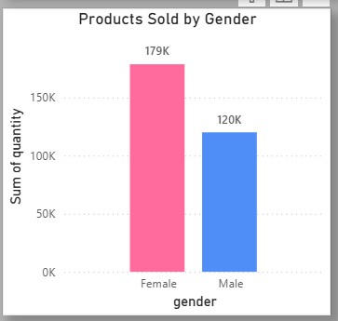
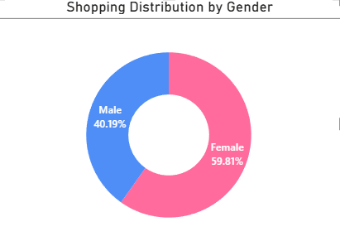
Gender Analysis — Distribution & Sales Volume
Tasks 1 & 2
💡 Female customers dominate at 59.8% of total shoppers. They also purchased more units (178,659 vs 120,053), confirming a stronger overall purchasing intensity.

Slide 5
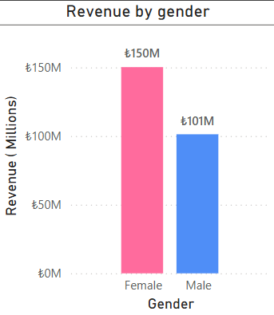
Gender Analysis — Revenue Generated
Task 3
₺150.2M
Female Revenue
₺101.3M
Male Revenue
59.7%
Female Share
💡 Female customers generated ₺150.2M (59.7%) vs ₺101.3M for males. Revenue gap is proportional to transaction volume — average spend per transaction is similar across genders.

Slide 6
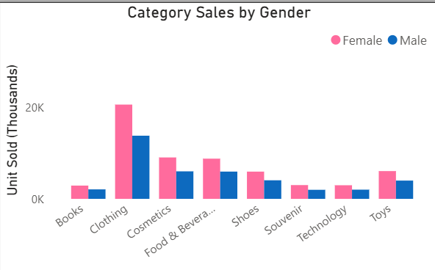
Category Distribution by Gender
Task 4
💡 Clothing dominates all genders. Female shoppers lead in every category — especially Clothing and Toys. Technology is the narrowest gender gap, suggesting cross-gender appeal.

Slide 7
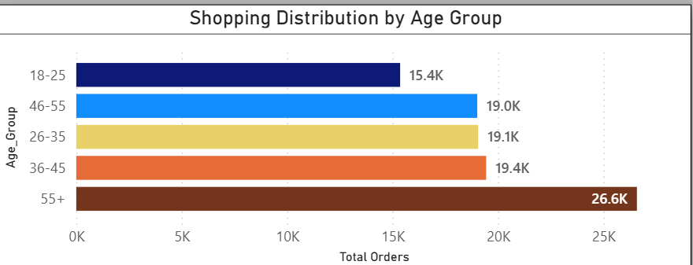
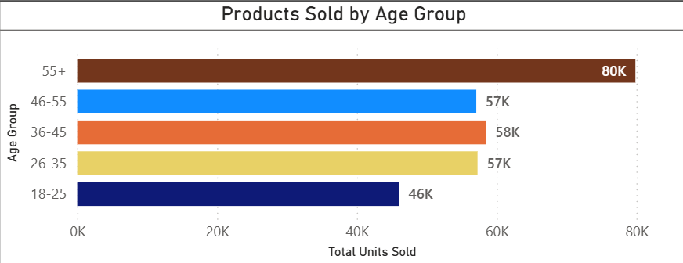
Age Group Analysis — Distribution & Sales Volume
Tasks 5 & 6
💡 The 55+ age group is both the largest segment (26,587 customers) AND the highest-volume buyers (79,850 units). Younger shoppers (18-25) are the smallest and least active group.

Slide 8
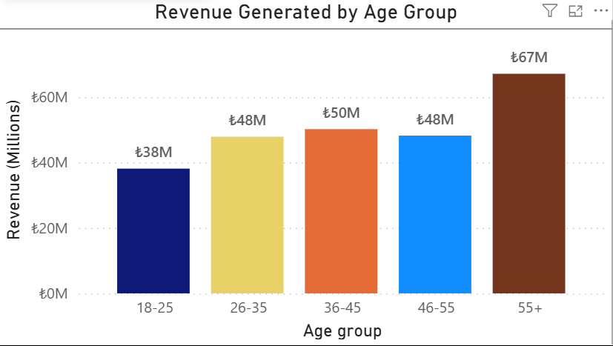
Age Group Analysis — Revenue Generated
Task 7
18-25 → ₺38.1M
26-35 → ₺47.9M
36-45 → ₺50.2M
46-55 → ₺48.2M
💡 55+ customers generated the highest revenue at ₺67.1M — 26.7% of total revenue. Retailers should prioritize loyalty programs for older customers while growing the 18-35 youth segment.
55+ → ₺67.1M

Slide 9
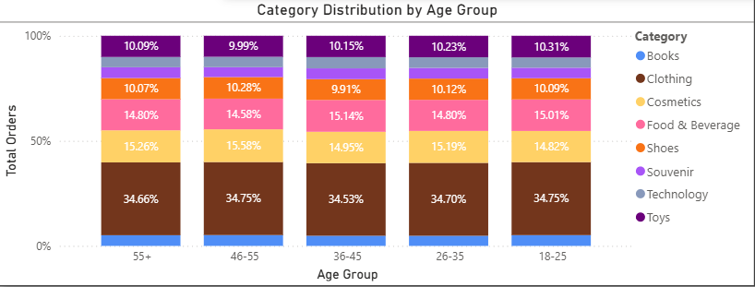
Category Distribution by Age Group
Task 8
💡 Clothing dominates across all age groups (~34%). Category preferences remain relatively stable — suggesting consistent buying behaviour. Technology interest slightly rises in the 36-45 bracket.

Slide 10
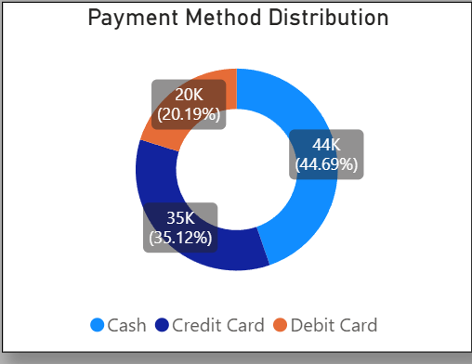
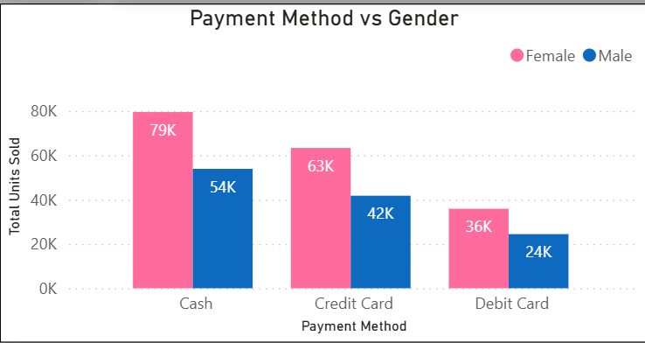
Payment Method — Distribution & Gender Relation
Tasks 9 & 10
💡 Cash is the dominant payment method (44.7%). Gender has minimal influence on payment preference — both male and female follow the same Cash > Credit > Debit pattern.

Slide 11
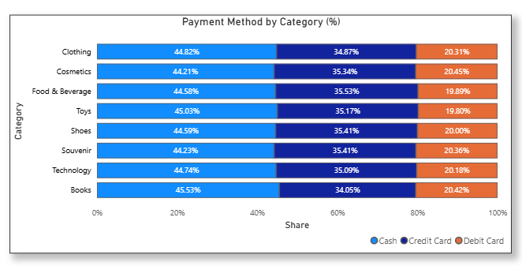
Payment Method vs Category
Task 9 — Extended
💡 Payment mix is broadly consistent across categories. High-value categories (Technology, Clothing) see slightly higher credit card usage, suggesting customers prefer installment options for big purchases.

Slide 12
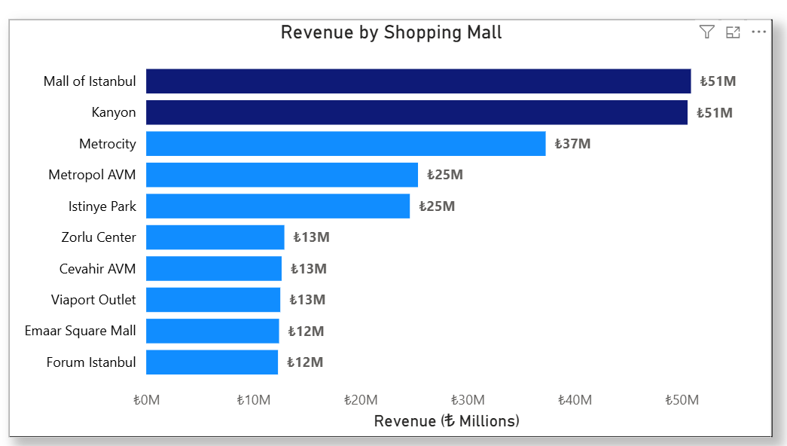
Shopping Mall Performance
Task 11 — Visualization
💡 Mall of Istanbul & Kanyon are top performers at ~₺50.5M each. Bottom-tier malls (Forum Istanbul, Emaar) generate ~₺12.3–12.4M — significant gap suggesting opportunity for strategic investment.

Slide 13
Key Insights & Strategic Recommendations
Task 11 — Business Inputs
👩 Target Female Customers
👴 Senior Segment is King
Women = 59.8% of shoppers & 59.7% of revenue. Invest in female-focused campaigns, loyalty rewards, and exclusive female-centric product lines.
55+ = largest customer group & top revenue driver (₺67.1M). Launch senior loyalty cards, senior-hour discounts, and comfortable in-mall facilities.
👗 Double Down on Clothing
💳 Promote Digital Payments
Clothing = 45.3% of all revenue (₺114M). Expand fashion offerings, seasonal collections, and cross-sell with Shoes (₺66.5M) for outfit bundles.
Cash still dominates at 44.7%. Incentivize credit/debit card usage via cashback and reward points to improve payment data and reduce cash handling costs.
🏬 Invest in Underperforming Malls
📱 Grow the Youth Segment
Forum Istanbul & Emaar Square earn <₺12.5M vs ₺50M at top malls. Conduct footfall analysis and targeted marketing to uplift performance.
18-25 is the smallest segment. Introduce digital-first experiences, social media campaigns, and tech/gaming product zones to attract younger shoppers.

Slide 14
Thank You
Istanbul’s Shopping Mall Analysis | 2021 – 2023
Data Source: Datamites • 99,457 Records • 10 Malls

