Slide 1
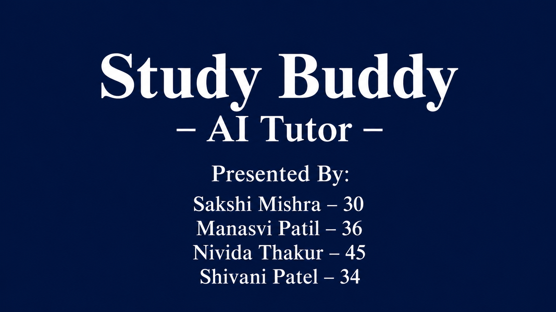

Slide 2
COLLEGE PROJECT • VIVA PRESENTATION
AI TUTOR
Using Prompt Engineering
An educational assistant concept that uses carefully designed prompts to support explanations, context-based question answering, summarisation and programming help.
PYTHON • STREAMLIT • PROMPT TEMPLATES
Presented by: [Your Name] | Department: [Your Department]
01/10

Slide 3
Problem Statement
01 • THE NEED
Students need explanations that are clear, focused and adapted to their questions.
• Complex topics can be difficult to understand from overly technical answers.
• Vague instructions can lead to inconsistent AI responses.
• Students need help summarising notes, asking questions and understanding code.
• Unstructured answers may be difficult to reuse for learning or revision.
CLARITY
Explanations should be understandable.
CONSISTENCY
Prompts should specify expected responses.
LEARNING SUPPORT
One interface can support multiple study tasks.
Problem: use prompt engineering to guide an AI-style tutor toward structured, useful responses.
02/10

Slide 4
Proposed Solution
02 • OUR APPROACH
The project organises tutoring tasks into reusable prompt templates and provides a simple interface to test them.
01
02
03
04
05
Select a task
Enter content
Apply prompt
View response
Evaluate
Choose a tutoring prompt
Question, passage or code task
Clear instructions and format
Review generated output
Compare prompts on fixed tasks
• Codebase includes a prompt playground, reusable templates, example packs and A/B evaluation.
• Question-answering and code-assistant paths include Groq API integration; other demo paths use local deterministic logic.
• Codebase includes a prompt playground, reusable templates, example packs and A/B evaluation.
• Question-answering and code-assistant paths include Groq API integration; other demo paths use local deterministic logic.
• Codebase includes a prompt playground, reusable templates, example packs and A/B evaluation.
• Question-answering and code-assistant paths include Groq API integration; other demo paths use local deterministic logic.
• Codebase includes a prompt playground, reusable templates, example packs and A/B evaluation.
• Question-answering and code-assistant paths include Groq API integration; other demo paths use local deterministic logic.
• Codebase includes a prompt playground, reusable templates, example packs and A/B evaluation.
• Question-answering and code-assistant paths include Groq API integration; other demo paths use local deterministic logic.
03/10

Slide 5
Features of the AI Tutor
03 • KEY FEATURES
01 Context-Based Q&A
02 Summarisation
03 Programming Support
Answer using supplied context and acknowledge missing information.
Convert a passage into key points for revision.
Explain approaches, edge cases and testing steps.
04 Structured Output
05 Reusable Templates
06 Prompt Evaluation
Generate a defined JSON structure.
Six patterns: summary, classification, JSON, Q&A, code help and tone rewrite.
Compare prompts on 15 tasks; chart and CSV output.
Interface: Streamlit | Logic: Python | Data: JSON + Pandas | Optional model integration: Groq API
04/10

Slide 6
System Architecture
04 • WORKING FLOW
Student Input
Streamlit UI
Prompt Template
Response Engine
Output
Question / passage / code
Select task and prompt
Instructions + examples
Local demo / Groq API
Answer / summary / code help
PROMPT LIBRARY
EVALUATION MODULE
templates.json + few_shot_examples.json
15-task dataset + rule-based scoring
The interface, prompt assets, response generation and evaluation are separated so each component can be tested or improved.
05/10

Slide 7
Prompt Engineering in the Project
05 • PROMPT DESIGN
ROLE / TASK
CONSTRAINTS
OUTPUT FORMAT
“Act as a programming tutor. Explain the approach…”
Specify concise output, preserve facts and avoid invented details.
Request bullets, one label or valid JSON keys.
CONTEXT
FEW-SHOT EXAMPLES
HONESTY
Provide the passage or question to answer from.
Input-output examples illustrate expected response patterns.
Say when the supplied context does not contain the answer.
Example: “Answer using only the supplied text. If the answer is not present, say that the text does not specify it.”
Effective prompts define the task, context, constraints and expected output.
06/10

Slide 8
Testing & Evaluation
06 • HOW PROMPTS ARE ASSESSED
15 TEST TASKS
PROMPT A / B
SCORING RULES
REPORT
Fixed inputs across five task families.
Baseline and improved instructions on the same inputs.
Checks format, labels, required terms and keys.
Average scores, difference, chart and CSV.
Task families
Evaluation limitation
• Summarisation
• Classification
• Structured JSON
• Question answering
• Code assistant
• Default evaluator uses deterministic local logic for most tasks.
• Q&A and code-assistant paths contain Groq API calls.
• Simulator scores are not proof of real tutoring quality.
A stronger study uses the same real model/settings for A and B and adds human review.
07/10

Slide 9
Application Demonstration
07 • DEMO FLOW
• Run: streamlit run app.py
• Open Prompt Playground and choose a task template.
• Enter a passage or question; optionally include few-shot examples.
• Generate and inspect the response; download prompt + output.
• Open A/B Evaluation and run the 15-task benchmark.
• Show the score summary, chart and CSV export.
AI TUTOR • RESPONSE PREVIEW
Selected task: Context-based Q&A
INPUT
Passage: Solar panels convert sunlight into electricity.
Question: What do they convert?
RESPONSE IDEA
Solar panels convert sunlight into electricity.
Use this as a walkthrough and show the actual app for the live demo.
08/10

Slide 10
Results
08 • PROJECT OUTPUT
The prototype provides a workflow for testing prompt-based learning assistance.
6 PROMPT TEMPLATES
PROMPT PLAYGROUND
MODEL-BASED PATHS
Reusable patterns for common text and learning tasks.
Select a template, enter input and inspect output.
Groq integration for Q&A and code-assistant scenarios.
15-TASK EVALUATION
VISUAL SUMMARY
EXPORT
Fixed benchmark with transparent scoring rules.
Average scores, A/B difference and per-task chart.
Download prompt output as JSON and evaluation as CSV.
Do not claim measured improvement unless you have run and verified the evaluation. Offline simulator scores are demonstration outputs, not real AI-tutor performance.
09/10

Slide 11
Conclusion & Future Scope
09 • TAKEAWAYS
Prompt engineering can make educational AI interactions more structured and task-focused.
• Reusable templates organise instructions for different learning tasks.
• Context and output constraints support clarity and consistency.
• Few-shot examples demonstrate the expected response style.
• A/B evaluation offers a repeatable way to inspect prompt behaviour.
FUTURE 1
Connect a real LLM across all task types.
FUTURE 2
Add learner level and subject-specific modes.
FUTURE 3
Add human-reviewed accuracy and usefulness metrics.
Thank you • Questions?
10/10

