Slide 1
Agentic RAG Framework for Automated
Legal Case Analysis & Decision Support
A staged retrieval ablation on IL-PCSR (Indian statute & precedent retrieval), external validation on BSARD, and a citation-verified agentic case-analysis assistant
Team Members: Samudraneel Sarker, Patil Sakshi, Manpreet Kaur, Nikhil Kumar · Mentor: Dr Vibhav
github.com/sakshi-patil-1111/legal-rag
Notes:
Title slide. Fill in presenter and supervisor names before presenting.

Slide 2
MOTIVATION
Why legal case analysis needs better retrieval
■ Overloaded courts: Indian courts carry a massive pending-case backlog; lawyers spend hours locating applicable statutes and binding precedents.
■ Long, dense inputs: a single judgment averages ~3,400 words (queries) and precedents average ~7,500 words — far beyond typical embedding context windows.
■ LLMs alone hallucinate: generic chatbots invent sections and case names; legal advice must be grounded in verifiable sources.
■ Open question: which retrieval design choices actually work on Indian legal text — lexical, dense, hybrid, reranked or agentic?
Goal
Given the facts of a case, retrieve the statutes that apply (LSR) and the prior cases it should cite (PCR), then produce an auditable, citation-verified analysis.
Approach
Rigorous, config-driven ablation of every pipeline stage on a public benchmark, followed by an agentic layer and web demo built on the best configuration.
Agentic RAG for Legal Case Analysis | IL-PCSR
2 / 16
Notes:
Frame the two tasks: LSR (Legal Statute Retrieval) and PCR (Prior Case Retrieval).

Slide 3
SCOPE
Research questions & contributions
RQ1
Lexical vs dense vs hybrid
Contributions
Which first-stage retriever works best for statutes vs precedents?
■ Reproducible, config-driven experiment framework (BM25, dense, hybrid, chunkers, rerankers, evaluator).
■ Near-reproduction of the IL-PCSR paper's best lexical PCR result.
■ First rhetorical-role and PRF ablations reported on IL-PCSR.
■ Evidence of task asymmetry: PCR is lexical, LSR is semantic.
■ Benchmarked agentic loop with citation validation + AI web demo.
RQ2
Representation
Does chunking, n-gram indexing or rhetorical-role filtering help on long judgments?
RQ3
Reranking
Do cross-encoder or LLM listwise rerankers improve a strong candidate pool?
RQ4
Agentic control
Does an LLM route→retrieve→reflect loop beat single-shot retrieval, and can it ground its output?
Agentic RAG for Legal Case Analysis | IL-PCSR
3 / 16

Slide 4
BENCHMARK
Dataset: IL-PCSR (EMNLP 2025 Findings)
5,017 / 627 / 627
936
3,183
~3,383
2.69 / 3.87
train / dev / test queries
statute candidates
precedent candidates
avg words per query
avg relevant statutes / precedents
Two tasks, one query
Evaluation protocol
■ LSR — Legal Statute Retrieval: case judgment → relevant statutory provisions (short docs, ~650 words).
■ PCR — Prior Case Retrieval: case judgment → precedents it should cite (long docs, ~7,485 words).
■ Queries are full judgments with citations/entities masked, annotated with rhetorical roles (Facts, Issue, Reasoning...).
■ Metrics: macro F1@k, MAP, MRR, Recall@k, NDCG@k; bootstrap 95% CIs.
■ Selection: all tuning on the dev split (627 q); test split run once for the final table.
■ Caveat: paper reports best-k F1 on test; ours are F1@10 on dev — comparisons are approximate.
■ Access: gated HF dataset, loaded via scripts/download_il_pcsr.py.
Agentic RAG for Legal Case Analysis | IL-PCSR
4 / 16

Slide 5
SYSTEM DESIGN
Overall architecture
First-stage retrievers
BM25 (bm25s)
unigram · 2-gram · 5-gram
Evaluator
F1@k · MAP · MRR · CIs
Case text
(judgment / facts)
Query layer
direct · roles · PRF
Rerankers
cross-encoder · LLM listwise
Dense encoders
Qwen3-Emb · BGE · SAILER · BGE-M3
LegalAgent
dossier + citations
Hybrid fusion
Reciprocal Rank Fusion (k=60)
Chunkers: whole-doc · fixed-512 · recursive-512
Statute index
936 provisions
Precedent index
3,183 judgments
Web demo: Python API server + React UI
Everything is config-driven (configs/*.json → scripts/run_phase1.py); each run logs config, git commit, per-query outputs and aggregated summaries under results/<stage>/.
Agentic RAG for Legal Case Analysis | IL-PCSR
5 / 16
Notes:
Package: src/legal_rag (retrievers, chunking, query, reranker, evaluator, legal_agent, llm, factory).

Slide 6
METHODOLOGY
Staged ablation — one variable at a time
A
BM25 baseline
B
Dense retrievers
C
Hybrid fusion
D
Chunking
Whole-doc unigram, then 2-gram / 5-gram shingles
BGE-small, Legal-Embed, SAILER, Qwen3-Emb 0.6B / 4B, BGE-M3
BM25 n-gram + dense via RRF
Whole-doc vs fixed-512 vs recursive-512 (50 overlap)
E
Reranking
F
Query ablations
G
Agentic loop
H
Final test run
Cross-encoder vs LLM listwise over top-50
Rhetorical-role filtering, pseudo-relevance feedback
Route → retrieve → reflect → synthesise
Champion config evaluated once on test
No Cartesian product: each stage fixes the winner of the previous one. Compute: local CPU, Kaggle T4, Modal A10G; BM25 k1=1.6, b=0.7 (paper settings).
Agentic RAG for Legal Case Analysis | IL-PCSR
6 / 16

Slide 7
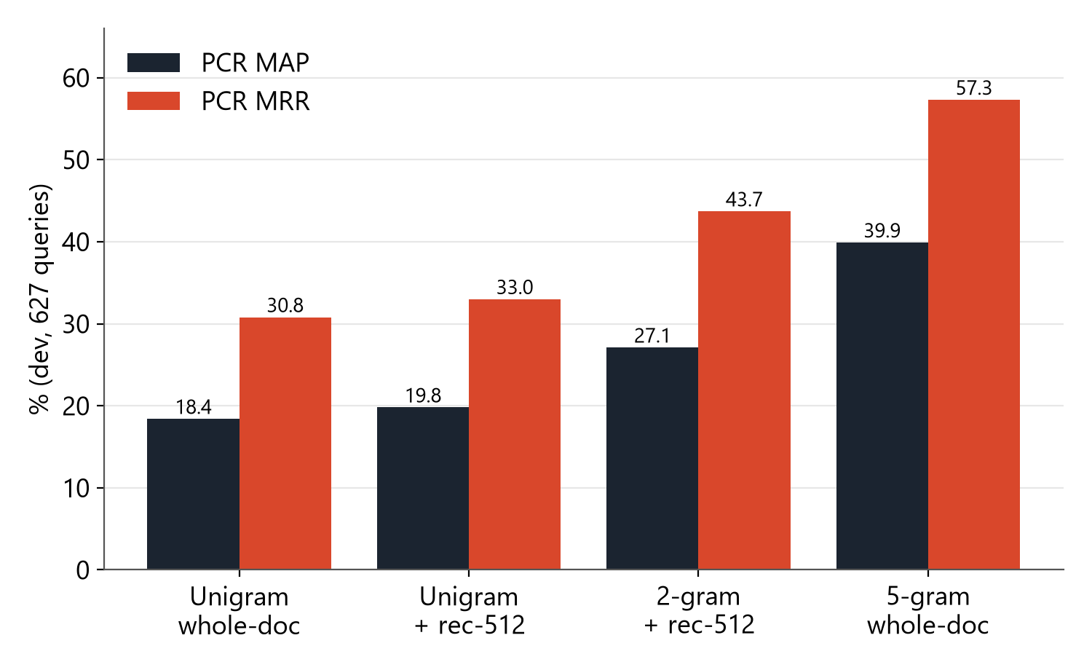
RESULTS · RQ1/RQ2
Lexical retrieval: n-grams win on precedents
What we found
■ Recursive-512 chunking lifts unigram BM25 on both tasks (LSR F1@10 8.4 → 11.5%).
■ 5-gram shingles over whole documents capture citation-style phrasing: PCR MAP 39.9%, MRR 57.3%.
■ Best-k F1 32.2% vs the paper's 33.3% — a near-reproduction of their best lexical row.
■ Independently rebuilt on Kaggle CPU: 20.8 / 40.0 / 57.4 (F1@10/MAP/MRR).
Agentic RAG for Legal Case Analysis | IL-PCSR
7 / 16

Slide 8
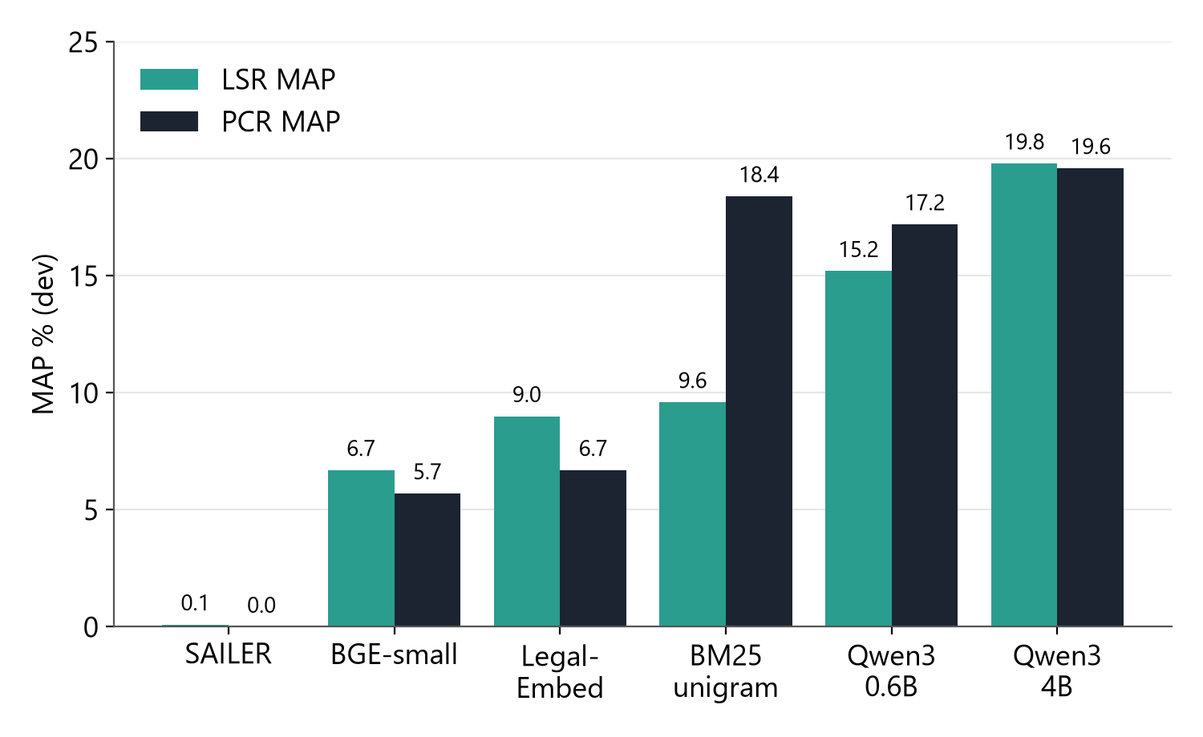
RESULTS · RQ1
Dense retrieval: only long-context encoders compete
What we found
■ Short-context encoders (512 tokens) see only the opening of a ~3,400-word query — all lose to BM25.
■ SAILER off-the-shelf is near random (0.0–0.2 F1); it needs task fine-tuning.
■ Qwen3-Embedding-4B is the best LSR retriever: MAP 19.8% (2× BM25 unigram).
■ On PCR even Qwen3-4B (MAP 19.6%) is far behind 5-gram BM25 (39.9%).
■ ⇒ LSR is semantic, PCR is lexical.
Agentic RAG for Legal Case Analysis | IL-PCSR
8 / 16

Slide 9
RESULTS · RQ1
Hybrid fusion and the “fusion dilution” effect
Method (dev) | LSR F1@10 | LSR MAP | LSR MRR | PCR F1@10 | PCR MAP | PCR MRR
BM25 5-gram (whole doc) | — | — | — | 20.7 | 39.9 | 57.3
Qwen3-Emb-0.6B | 12.6 | 15.2 | 30.9 | 11.1 | 17.2 | 27.2
Qwen3-Emb-4B | 14.3 | 19.8 | 37.4 | 12.6 | 19.6 | 29.9
RRF: 5-gram + Qwen3-0.6B | 13.7 | 17.9 | 38.8 | 19.2 | 30.0 | 45.1
RRF: 5-gram + Qwen3-4B | 14.7 | 19.1 | 40.5 | 19.7 | 31.6 | 46.4
BGE-M3 dense+sparse RRF | 7.8 | 6.0 | 13.5 | 12.0 | 18.4 | 30.5
LSR: fusion helps
PCR: fusion dilutes
Best MRR of any first-stage method (40.5%) — lexical and semantic signals are complementary when both legs are reasonable.
A weak dense leg drags 5-gram BM25 down (MAP 39.9 → 31.6). RRF only helps when the legs are of comparable strength.
Agentic RAG for Legal Case Analysis | IL-PCSR
9 / 16

Slide 10
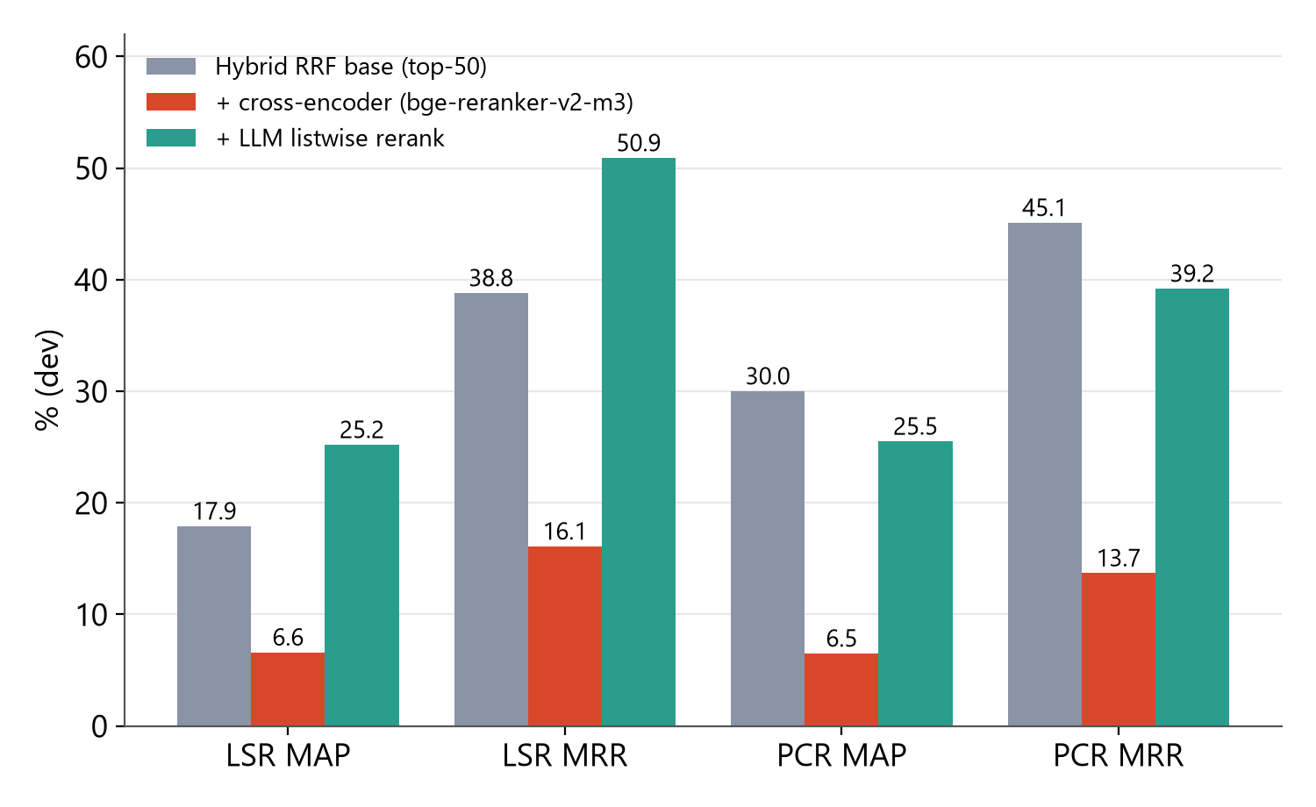
RESULTS · RQ3
Reranking: LLMs help statutes, cross-encoders hurt
What we found
■ Cross-encoder truncated at 2K tokens judges only the query's opening section — PCR R@10 drops from ~53% to 19%.
■ LLM listwise rerank (gpt-6-luna, top-50 → 10) gives the best LSR numbers: MAP 25.2%, MRR 50.9%, F1@2 23.8%.
■ Same reranker mildly hurts PCR (MAP 30.0 → 25.5): a generic relevance prompt ignores precedent-citation signals.
■ Reranking is task-asymmetric.
Agentic RAG for Legal Case Analysis | IL-PCSR
10 / 16

Slide 11
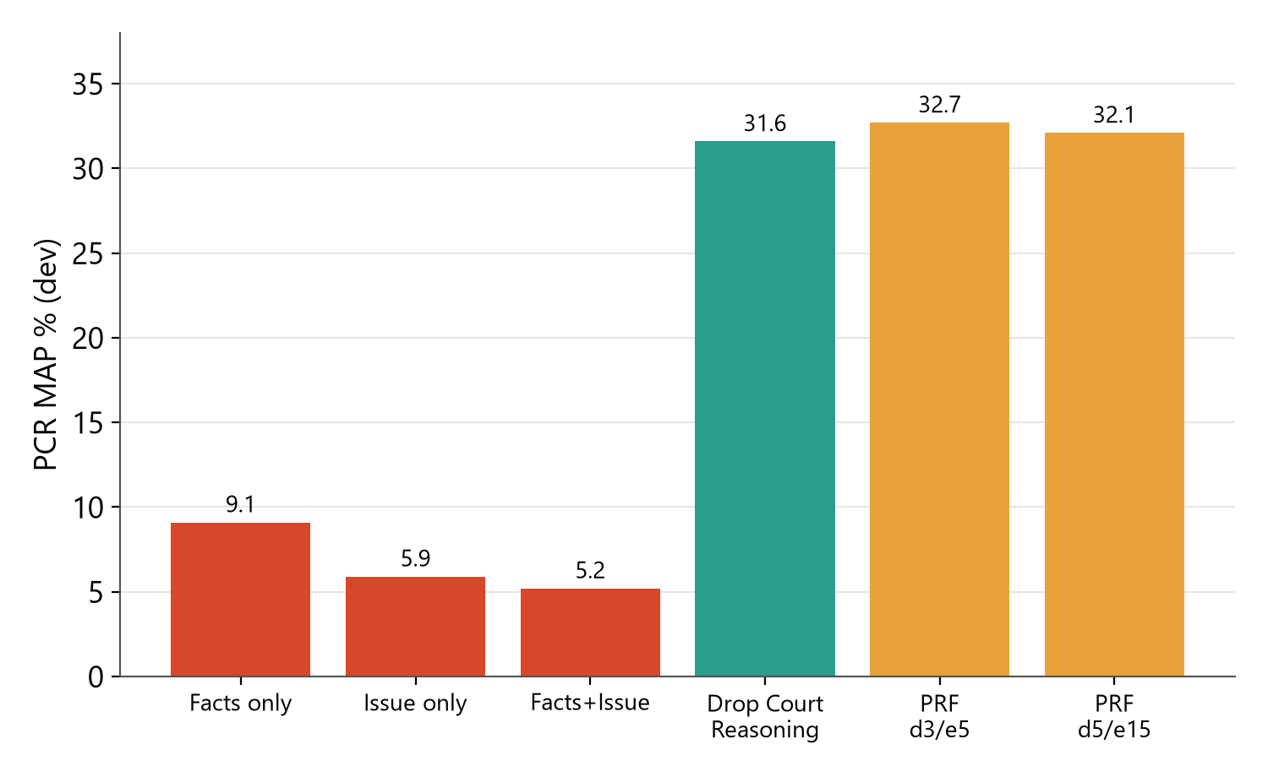
RESULTS · RQ2
Query ablations: what did not work (and why it matters)
Rhetorical roles
■ No single section (Facts / Issue) can retrieve alone: ~4–6% F1.
■ Dropping Court Reasoning is nearly free on PCR and slightly helps LSR (+0.7 MAP, +1.2 MRR).
Pseudo-relevance feedback
■ ΔMAP ≈ 0 on both filtered and full 16.8M-shingle 5-gram indexes.
■ Queries are already long and redundant; expansion adds noise.
PCR, 5-gram BM25, min_df=2 index, dev split.
Agentic RAG for Legal Case Analysis | IL-PCSR
11 / 16

Slide 12
POSITIONING
How we compare with the IL-PCSR paper
Row | Split / metric | LSR F1 / MAP / MRR | PCR F1 / MAP / MRR
Paper: best lexical (5-gram BM25) | test, best-k | 16.98 / 17.88 / 40.08 | 33.29 / 43.98 / 58.55
Paper: para-wise BM25 2-gram | test, best-k | 18.59 / 21.82 / 44.32 | 27.87 / 38.15 / 52.32
Paper: SAILER fine-tuned | test, best-k | 23.49 / 31.42 / 50.25 | 15.00 / 20.43 / 27.72
Paper: GPT-4.1 rerank (stage 2) | test, best-k | 46.11 / 61.06 / 81.55 | 43.31 / 54.43 / 68.88
Ours: 5-gram BM25 | dev, best-k | — | 32.2 / 39.9 / 57.3
Ours: RRF + LLM listwise rerank | dev, best-k | 23.8 / 25.2 / 50.9 | —
Ours: BM25 + recursive-512 | test, F1@10 | 12.9 (F1) | 17.9 (F1)
■ Without any fine-tuning, we approach the paper's best lexical PCR row and exceed its non-fine-tuned LSR rows on MAP/MRR.
■ Protocols differ (dev vs test, F1@10 vs best-k), so we claim “approaches”, never “beats”; fine-tuned GNN and GPT-4.1 stage-2 rows remain ahead.
Agentic RAG for Legal Case Analysis | IL-PCSR
12 / 16

Slide 13
EXTERNAL VALIDATION
BSARD: zero-shot transfer to French statutes
Configuration | R@10 | R@100 | MAP@100 | MRR@100
BM25 unigram + context | 14.81 | 41.23 | 17.31 | 25.73
Qwen3-Embedding-0.6B | 22.71 | 51.65 | 26.71 | 39.35
Qwen3-Embedding-4B | 29.59 | 67.67 | 36.91 | 51.20
RRF: BM25 + Qwen3-0.6B | 22.08 | 54.62 | 25.88 | 37.62
RRF: BM25 + Qwen3-4B | 25.09 | 64.91 | 29.81 | 41.45
Published best (fine-tuned) | — | 74.78 | — | —
Beats every zero-shot baseline
Rules are query-conditional
RRF (54.62) and 4B dense (67.67) exceed the best zero-shot rows — word2vec 49.41, BM25 40.13; 4B alone nears the fine-tuned ceiling (74.78).
Unigram wins on 8-word questions; 5-gram collapses (0.83 F1). Fusion helps only when legs compete: +3.0 R@100 over 0.6B, −2.8 when 4B dominates.
Agentic RAG for Legal Case Analysis | IL-PCSR · BSARD
13 / 16

Slide 14
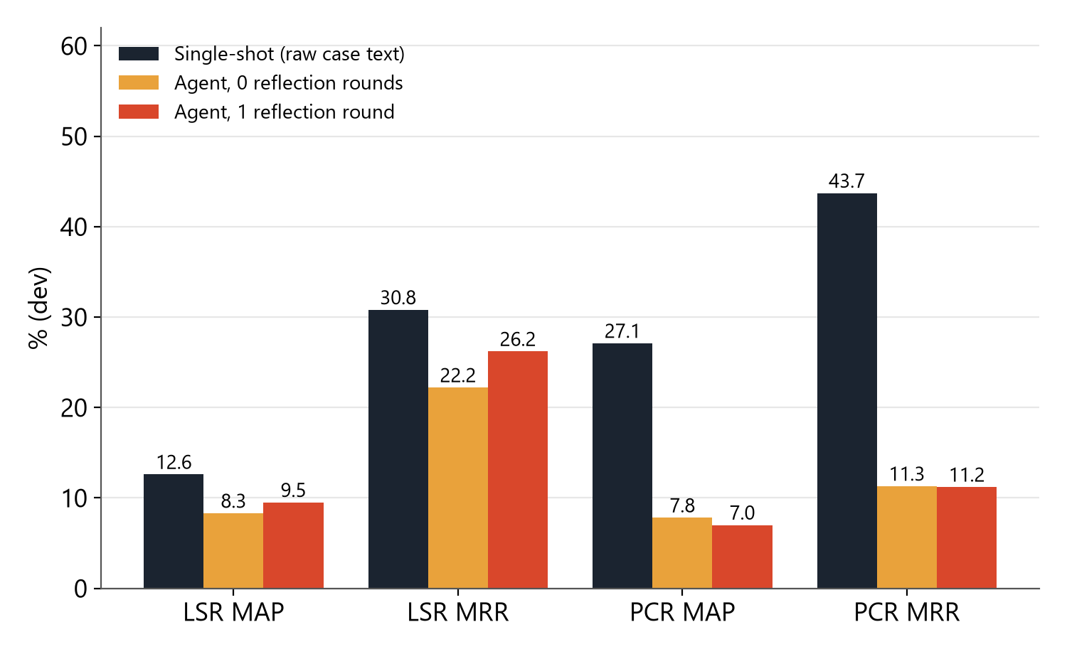
RESULTS · RQ4
Agentic layer: LegalAgent
Route
Retrieve
Reflect
Synthesise
Validate
What we found
LLM plans per-corpus queries
(statute / precedent)
BM25 / dense / hybrid
retrievers as tools
Bounded: is evidence
sufficient? refine query
JSON dossier: issue, statutes,
precedents, analysis, action
Drop citations not in
retrieved set; log warnings
■ LLM-written short queries lose the lexical detail BM25 needs: PCR MAP 27.1 → 7.8.
■ One reflection round slightly helps LSR (MAP 8.3 → 9.5), not PCR.
■ Synthesis is the agent's strength: 49/50 complete dossiers, 167 citations, 0 invalid after validation.
■ ⇒ Demo feeds raw case text to retrieval and uses the LLM for synthesis + verification.
Single-shot: full dev (627 q); agent arms: 50 dev queries, gpt-6-luna, real LLM calls.
Agentic RAG for Legal Case Analysis | IL-PCSR
14 / 16

Slide 15
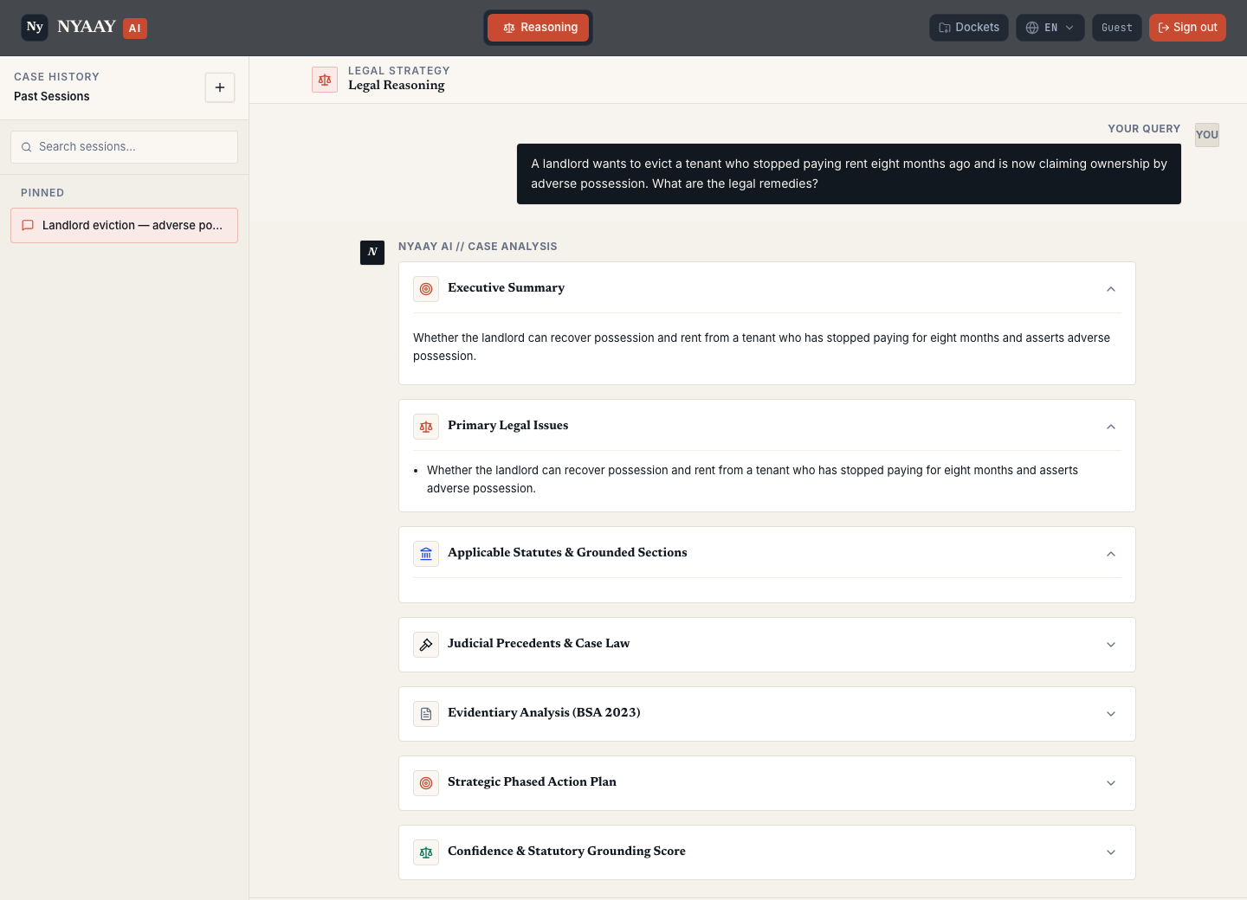
SYSTEM
Web demo: AI decision-support interface
Features
■ Adapted React frontend (demo_app/) served by scripts/demo_server.py on :8090.
■ Runs the ablation-recommended config: raw case text → BM25 statute + precedent corpora → LLM synthesis → citation validation.
■ Dossier cards: executive summary, legal issues, grounded statutes, precedents, action plan, confidence score.
■ Statute coverage expanded with 302 Indian central acts (28,074 sections); evidence excerpts and reflection-gated re-routing.
■ Conversation history with pin / rename / delete and ?conv=<id> deep links; any OpenAI-compatible or Gemini LLM.
Agentic RAG for Legal Case Analysis | IL-PCSR
15 / 16

Slide 16
WRAP-UP
Conclusions, limitations & future work
Key takeaways
Limitations
Future work
■ PCR is lexical: 5-gram BM25 is the champion.
■ LSR is semantic: long-context dense + LLM rerank wins.
■ Fusion and reranking help only when components are matched to the task.
■ Agents add value in grounded synthesis, not in query rewriting.
■ Dev-vs-test and F1@10-vs-best-k protocol gap with the paper.
■ Single seed; no fine-tuned GNN baseline.
■ LLM rerank sees 1,000-char snippets, not full documents.
■ API-model drift; external validation on one corpus (BSARD) so far; agent benchmarked on 50 queries.
■ Contrastive fine-tuning of Qwen3-Emb-0.6B on 5,017 train queries.
■ LLM rerank over a stronger pool with task-aware prompts.
■ Learning-to-rank fusion (LambdaMART) instead of RRF.
■ Cross-task conditioned retrieval (statutes ↔ precedents).
■ Single final test-split run of the champion config.
■ Extend external validation to COLIEE, LeCaRD and CAIL.
Thank you · Questions?
Agentic RAG for Legal Case Analysis | IL-PCSR
16 / 16

