Slide 1
Agentic RAG Framework for Automated
Legal Case Analysis & Decision Support
A staged retrieval ablation on IL-PCSR, external validation on BSARD and AILA,
and a citation-verified agentic case-analysis assistant.
Samudraneel Sarker Patil Sakshi Manpreet Kaur Nikhil Kumar Mentor: Dr Vibhav Prakash Singh
github.com/sakshi-patil-1111/legal-rag

Slide 2
The problem
Ask a chatbot the punishment for murder and it will produce a confident section number.
Nothing in the output tells a reader whether that citation is real.
In legal work, where lawyers and judges may come to depend on AI, fabricated citations and hallucinations are a critical risk.
2

Slide 3
The gap
Published state of the art
The corpus
Best rows on every legal benchmark are trained on that benchmark.
Graph nets on IL-PCSR labels.
Fine-tuned bi-encoders on BSARD pairs.
New judgments arrive every day.
New acts replace old ones.
A system that needs retraining
is permanently behind.
Goal: competitive with published systems, without benchmark-specific training.
3

Slide 4
Research questions
01
Which retrieval legs suit statutes, and which suit precedents?
02
Which pipeline stages earn their place: chunking, fusion, reranking?
03
Do query interventions survive several-thousand-word inputs?
04
What does an agentic controller add that a fixed pipeline cannot?
4

Slide 5
Evaluation corpora
IL-PCSR
AILA
BSARD
PRIMARY
TRANSFER
TRANSFER
936 statutes
3,183 precedents
627 dev queries
197 statutes
2,914 precedents
50 queries
22,633 articles
222 test questions
Indian, English
Indian, entity-masked
Belgian, French
All three are evaluated with the same configuration and no retraining.
5

Slide 6
Retrieval pipeline
Case text
(~3,600 words)
Retriever
Reranker
Generator
Answer
long legal query
which leg?
does it help?
grounded output
cited dossier
Few of these choices have been measured on long legal queries.
6

Slide 7
Experimental setup
A
lexical legs
B
dense legs
C
fusion
D
second stage
E
query surgery
F
agent
BM25 n-grams,
chunking
SAILER to
Qwen3-4B
RRF over
best legs
cross-encoder,
LLM rerank
roles, PRF,
summary
route, reflect,
synthesise
Each stage varies one component; every arm is evaluated on the same 627-query dev split.
7

Slide 8
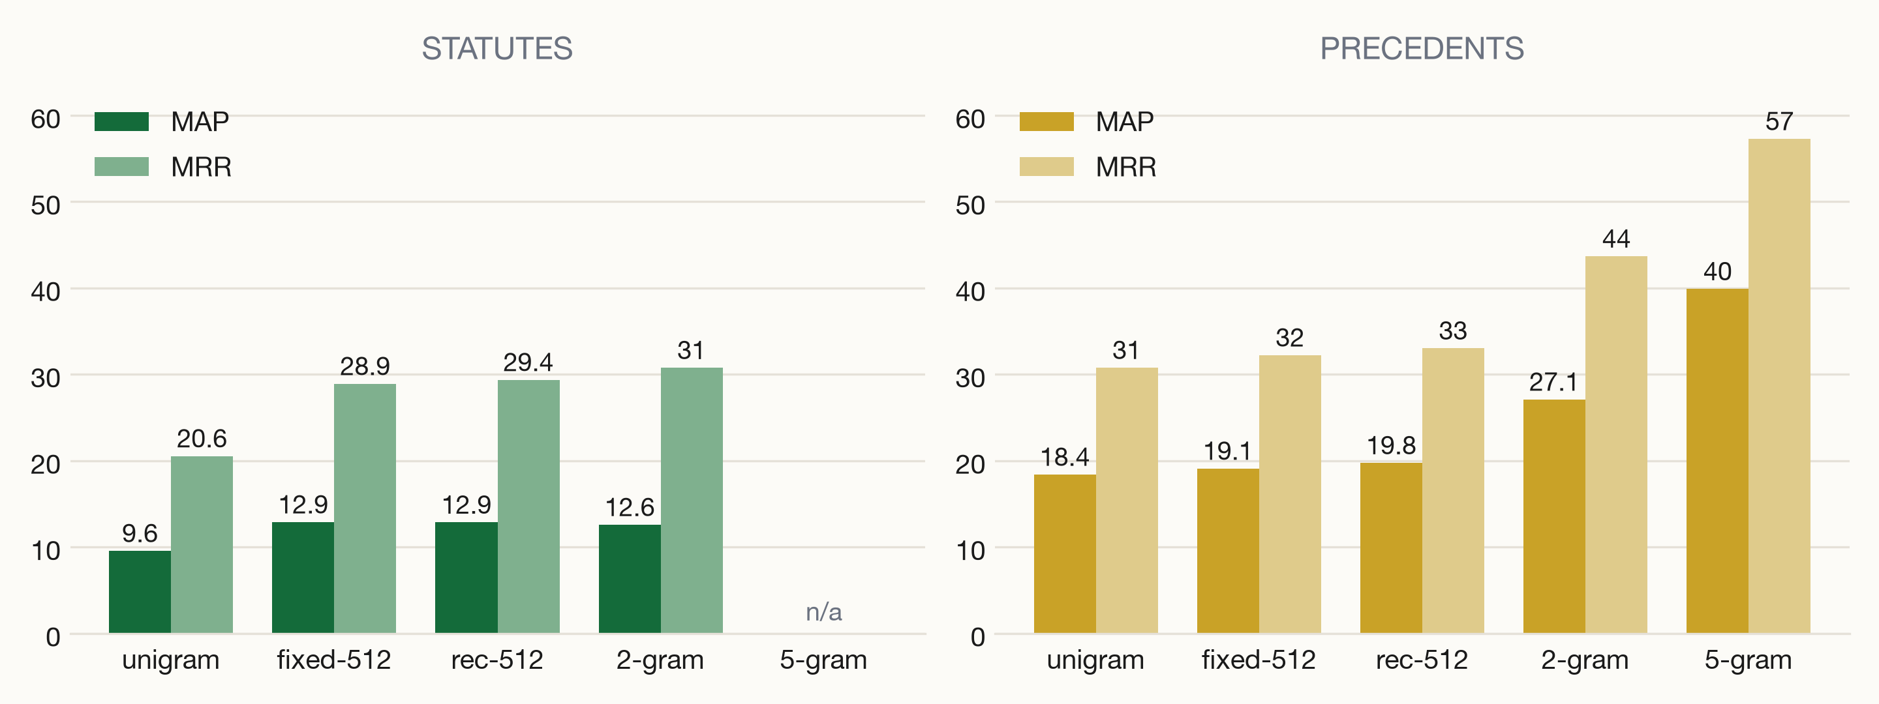
Lexical retrieval
MAP on the dev split. 5-gram phrases are the strongest precedent retriever; they do not transfer to statutes.
8

Slide 9
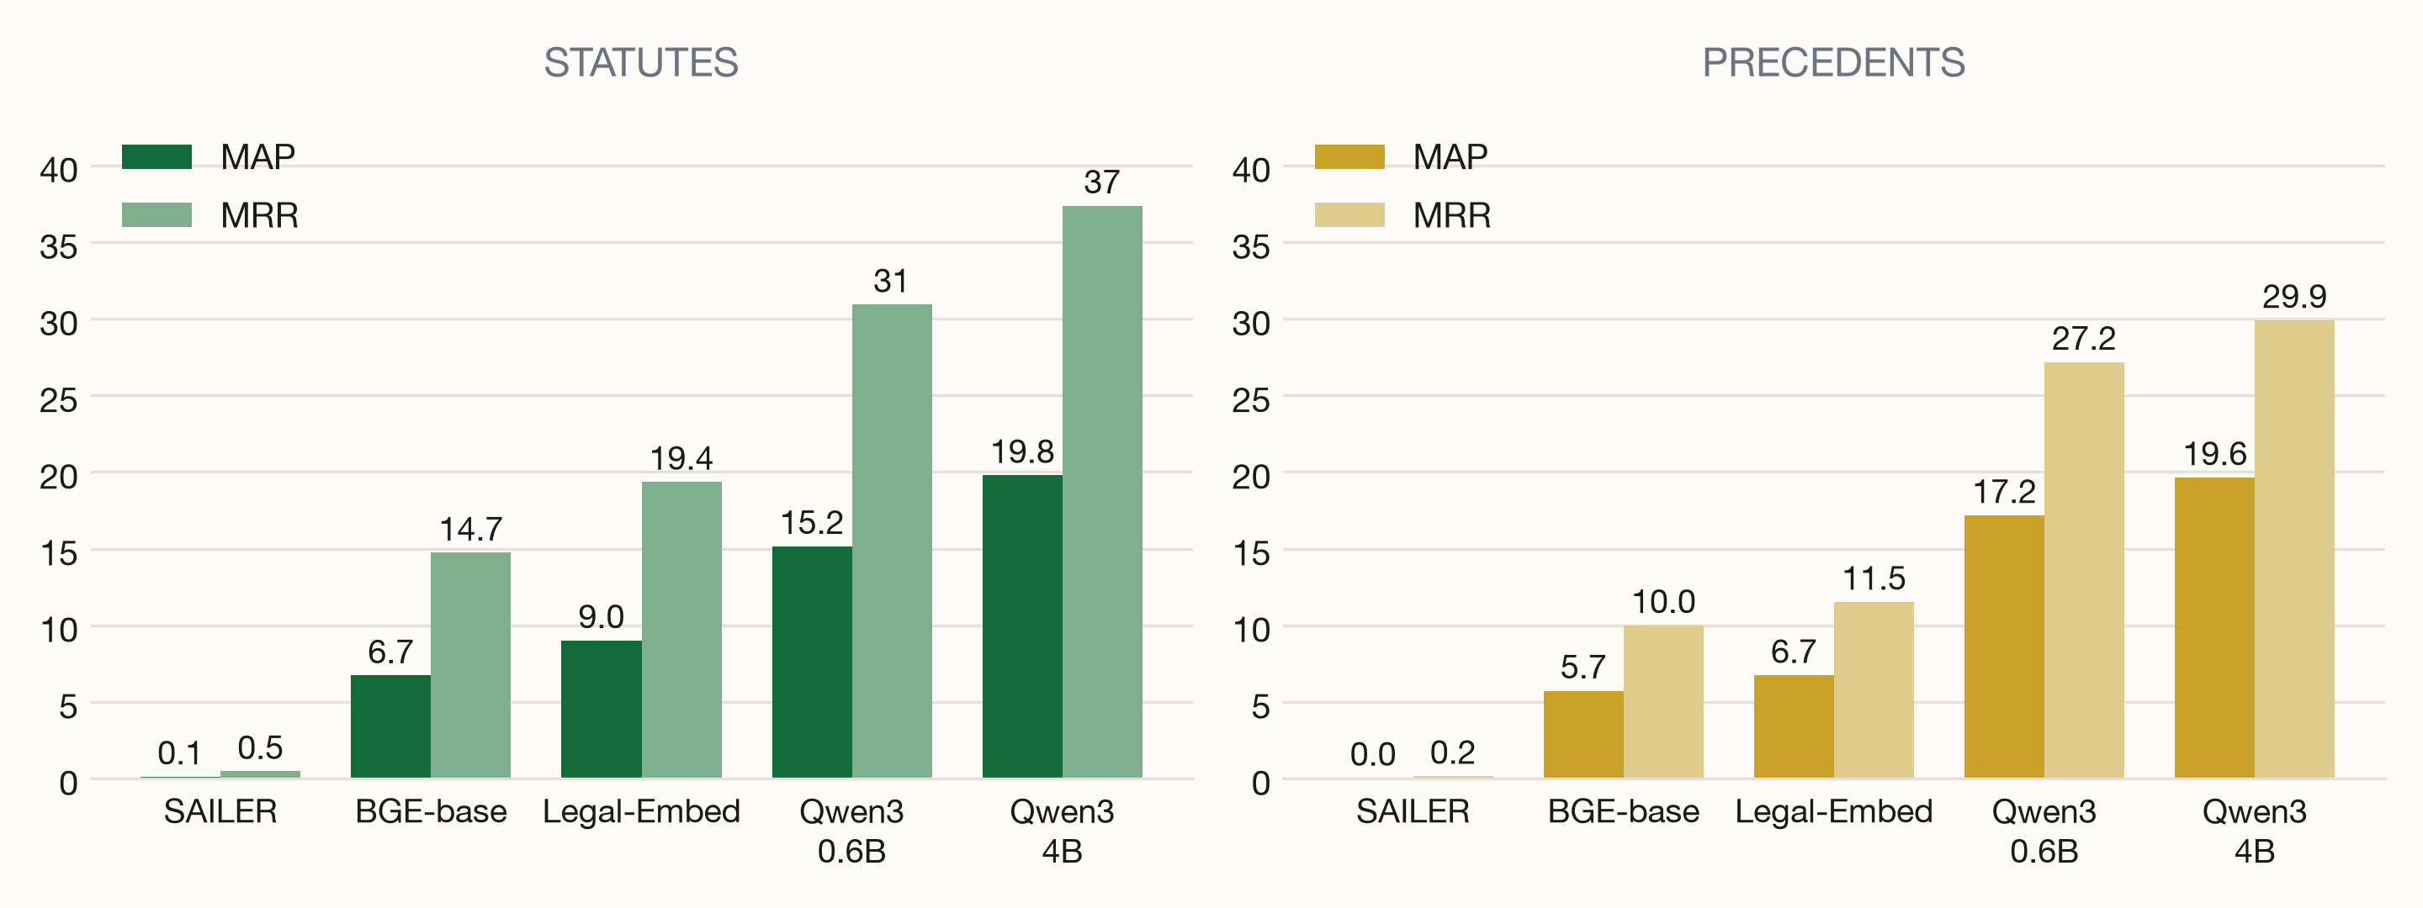
Dense encoders
MAP on the dev split. Short-context encoders see only the first page of a 3,600-word query.
9

Slide 10
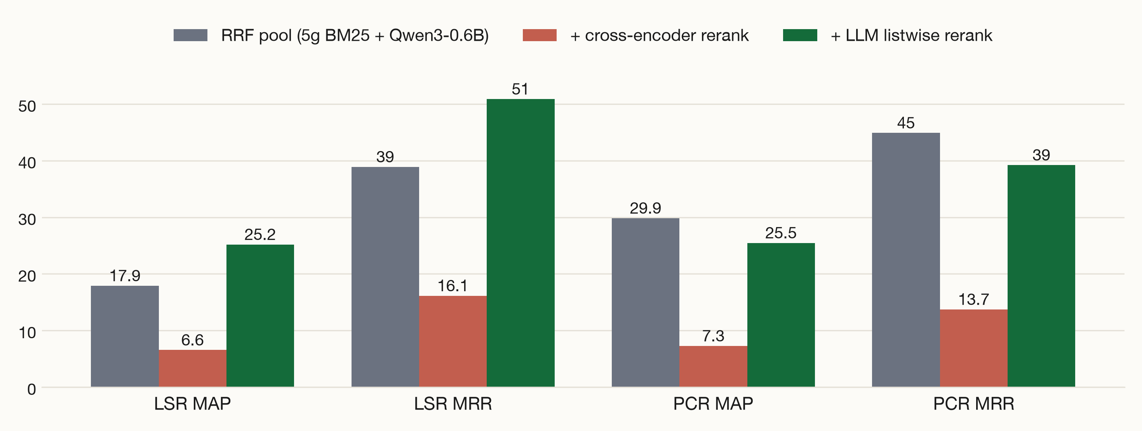
Fusion and second-stage reranking
LLM listwise rerank gains 7.3 MAP and 12.0 MRR on statutes; cross-encoder collapse is a context failure.
10

Slide 11
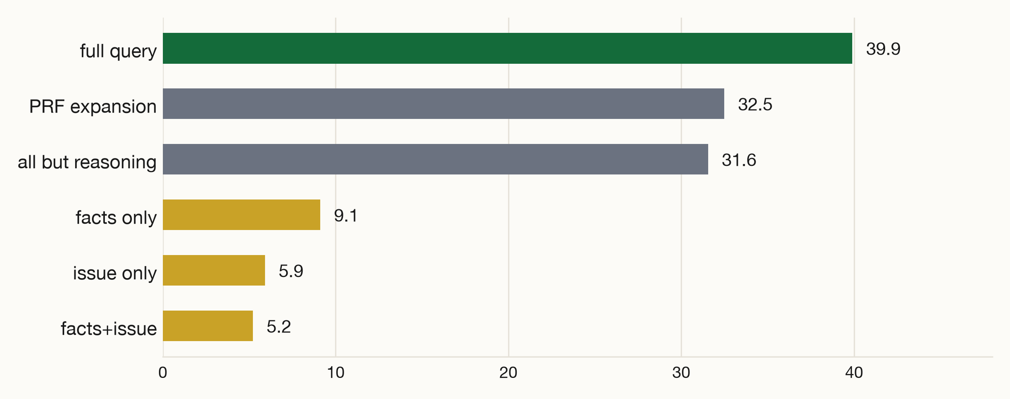
Query interventions
Precedent MAP against the unmodified query. All interventions reduce it.
11

Slide 12
The two tasks differ
STATUTE RETRIEVAL
PRECEDENT RETRIEVAL
is semantic
is lexical
Dense legs win.
Qwen3-4B doubles the BM25 unigram MAP
(19.79 vs 9.57 on the dev split).
Citation phrases decide relevance.
Five-gram BM25 doubles the best dense MAP.
On entity-masked AILA text, 4B dense overtakes it.
Fusion improves ranking only when the two legs are already competitive.
12

Slide 13
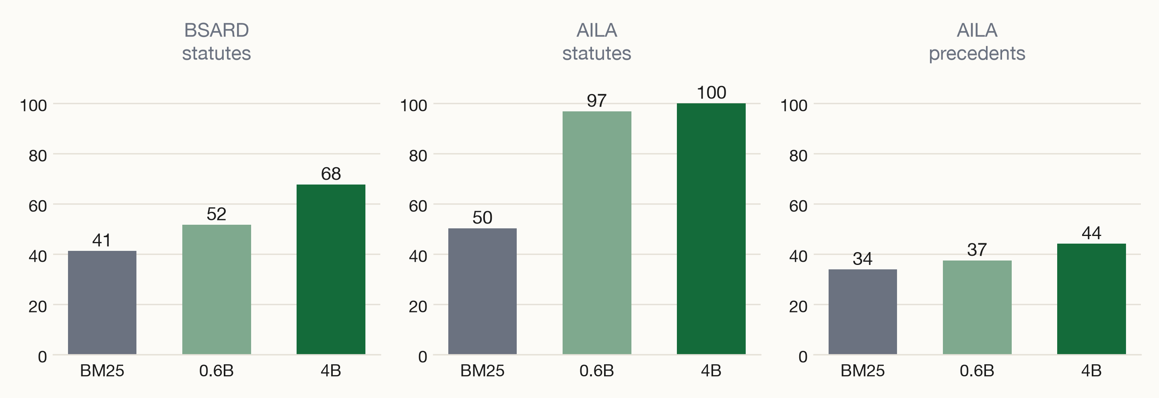
External validation
R@100 on held-out corpora, zero-shot. Statute recall reaches 100 on AILA at 4B.
13

Slide 14
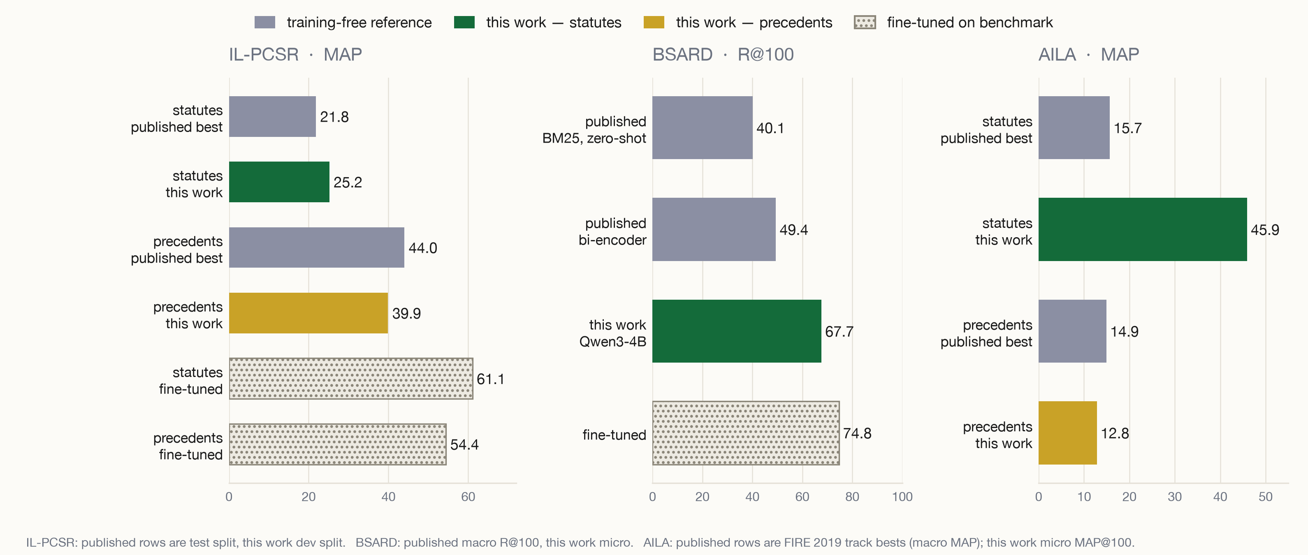
Comparison with published systems
Best training-free statute score on every corpus; the dotted tier alone sits higher, and it is benchmark-trained.
14

Slide 15
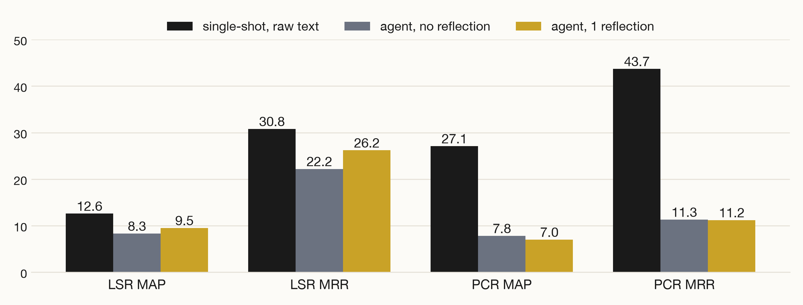
Agent evaluation
Route
Retrieve
Reflect
Synthesise
Validate
49/50
complete dossiers
167
citations emitted
0
invalid after validation
LLM calls help synthesis and citation validation; LLM-written queries hurt retrieval.
single-shot: 627 dev queries; agent arms: 50
15

Slide 16
Derived retrieval design
STATUTE LEG
LLM
synthesis
BM25
context-prepend
Qwen3
4B dense
RRF then
LLM rerank
+
case
text
citation
validation
PRECEDENT LEG
5-gram BM25
whole document
single leg, no fusion
grounded
dossier
Each leg uses the configuration that measured best for its task.
16

Slide 17
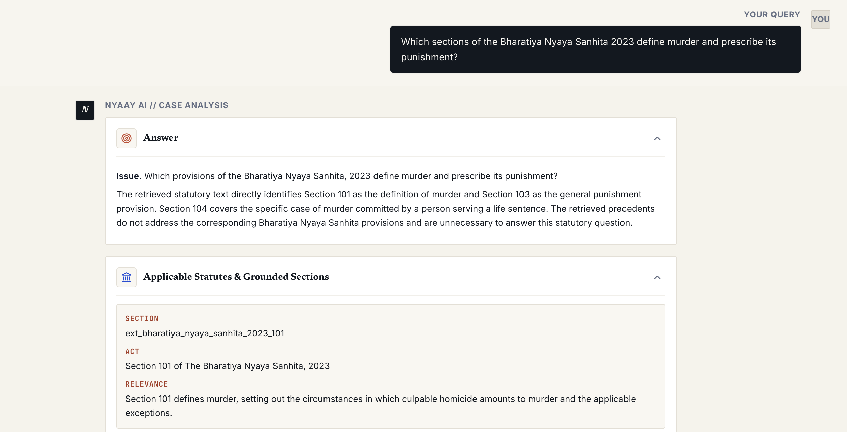
Demo application
What you can ask it
Tenant stops paying rent and claims adverse possession. Remedies?
What statutes apply to murder under the BNS?
Anticipatory bail: which precedents control?
Cheque dishonour under section 138 NI Act?
Dossier for a BNS murder query: issue statement,
grounded sections with relevance, verified citations.
Returns a dossier of applicable statutes,
precedents and verified citations.
17

Slide 18
Example runs
"What statutes apply to murder under the BNS?"
Retrieves IPC murder sections, flags that BNS is not in the corpus, links indiacode.nic.in. Cites Bachan Singh v. State of Punjab.
"Landlord wants to evict a tenant claiming adverse possession."
States no governing eviction statute was retrieved; returns adverse-possession precedents including P.T. Munichikkanna Reddy v. Revamma (2020).
"Supplier delivered defective goods; buyer wants refund plus damages."
Finds only a partial analogy (Indus Airways, Section 138 NI Act) and reports the evidence as insufficient rather than inventing support.
"quantum entanglement pasta recipe for my bicycle"
Refuses: "no discernible legal issue." Zero citations emitted rather than fabricated ones.
18

Slide 19
Summary
1.
No component is trained on a benchmark.
2.
Statutes and precedents need different retrievers; fusion is conditional.
3.
The same configuration transfers to AILA and BSARD unchanged.
4.
The assembled system is running as a citation-verified web application.
Thank you.
github.com/sakshi-patil-1111/legal-rag
19

Slide 20
Backup: first-stage results, dev split
Configuration | LSR MAP | LSR MRR | PCR MAP | PCR MRR
BM25 unigram, whole doc | 9.57 | 20.55 | 18.41 | 30.78
BM25, recursive-512 | 12.87 | 29.38 | 19.75 | 33.03
BM25 2-gram, recursive-512 | 12.59 | 30.77 | 27.11 | 43.68
BM25 5-gram, whole doc | n/a | n/a | 39.90 | 57.28
BGE-base, 512-token | 6.72 | 14.73 | 5.73 | 10.00
Legal-Embed | 9.01 | 19.35 | 6.74 | 11.52
SAILER | 0.12 | 0.47 | 0.04 | 0.16
Qwen3-Embedding-0.6B | 15.16 | 30.93 | 17.18 | 27.18
Qwen3-Embedding-4B | 19.79 | 37.38 | 19.65 | 29.91
RRF: 5-gram + Qwen3-4B | 19.12 | 40.53 | 31.60 | 46.42
627 dev queries, micro-averaged. RRF row fuses the best leg of each family.
20

Slide 21
Backup: external validation
Corpus / config | R@100 | MAP@100
BSARD · BM25 + context | 41.23 | 17.31
BSARD · Qwen3-0.6B | 51.65 | 26.71
BSARD · Qwen3-4B | 67.67 | 36.91
AILA statutes · BM25 | 50.23 | 8.07
AILA statutes · Qwen3-0.6B | 96.77 | 41.64
AILA statutes · Qwen3-4B | 100.0 | 45.91
AILA precedents · BM25 | 33.85 | 10.46
AILA precedents · Qwen3-0.6B | 37.44 | 7.69
AILA precedents · Qwen3-4B | 44.10 | 12.82
Zero-shot on both corpora; published zero-shot BSARD rows: BM25 40.13, bi-encoder 49.41.
21

