Slide 1
Prediction of CO2 emission from vehicles using Machine Learning Algorithms
Group : Discover Decipher
Nimisha Patel - AU1940146
Sakshi Shah - AU1940213
Astha Patel - AU1940312
Kareena Matwani - AU1940314

Slide 2
INTRODUCTION
The main goal is to predict CO2 emissions with highest accuracy and to know which features mainly contribute to CO2 emission.
Classifying the light duty cars into certain categories based on CO2 emission and predicting its values also helps in practical implementation as follows:
Designing and testing in green manufacturing.
Saves cost of trial to reduce CO2 emission by using different components, the features that mainly contribute to CO2 emissions can be regulated. (Feature Importance).
CO2 emissions prediction can help regulate laws, policies and rules on the co2 emission like high taxation.
A better understanding and approach for the reduction emission of the Co2 through many relevant ways to improve the AQI in the states of India.

Slide 3
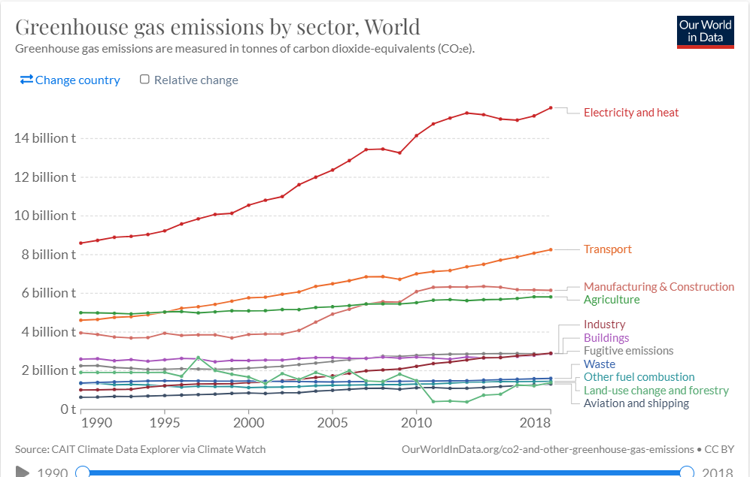
WHAT IS THE PROBLEM
India’s ranks under TOP 5 for the most polluted countries in the world list.
The problem lies in the fact that one of the most dominant factors contributing 29% (in world carbon dioxide emission) severely to the environment is transportation.
Harmful gasses like Co2 released affects most of the environment leading to risks like Rising air bone disease, global warming and breathing issue.
Source : Our world in data

Slide 4
Problem statement
CO2 emissions severely affect the environment and humans for which the prediction of emissions and analysis is necessary.
Where is the problem
The problem is in many parts of the world but predominantly in India and in Northern states of India
The consequences are worse due to high levels of carbon dioxide (shown in AQI[Air Quality Index]).
Why there is problem
Due to massive consumption of non renewable fuel (a non renewable source) and other components that are used in the light duty vehicle like engine size(L) and cylinders.
Source : IQAir, AQi

Slide 5
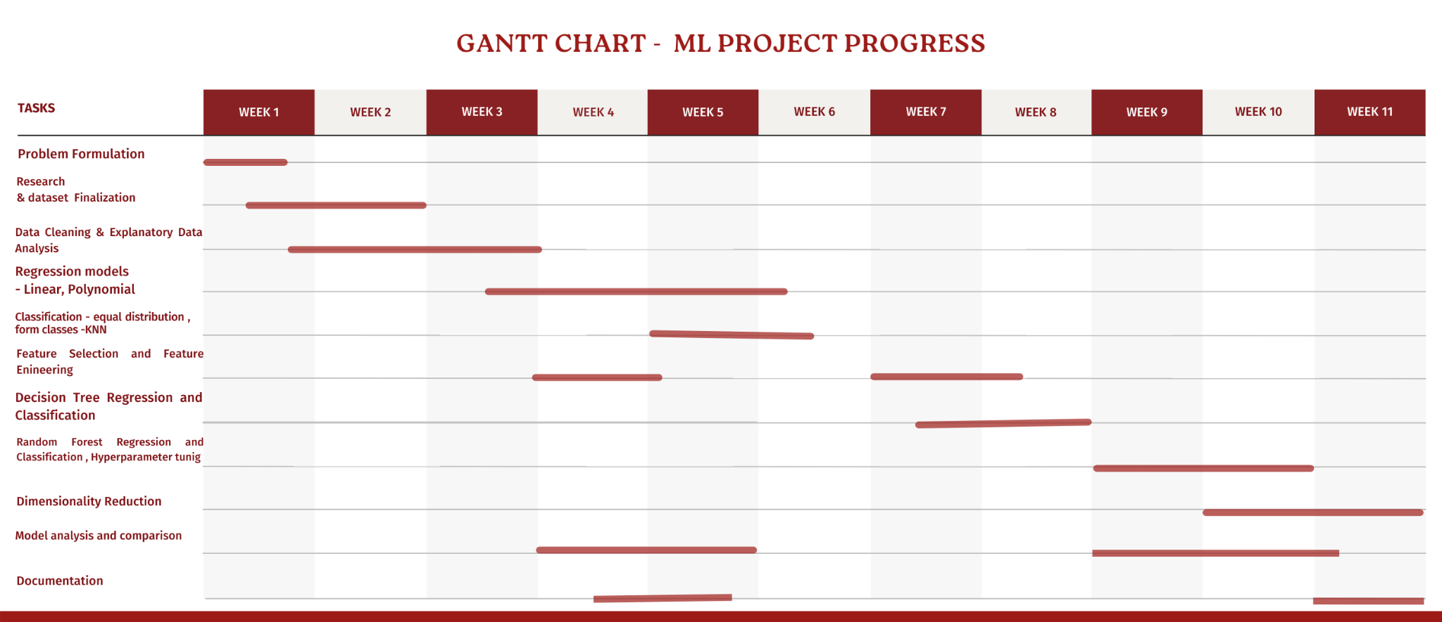
GANTT CHART - ML PROJECT PROGRESS

Slide 6
EXISTING BODY OF WORK
The frequently used techniques like SVM , PCA have been used to generate accurate results and other classification algorithms have been used to implement across countries globally, there have been use of these algorithms but in India , there is a need of a accurate and a precise model to be implemented for reducing AQI and creating a green environment. The implementation on the basis of quality performance measures are taken into consideration across globe which needs to be implemented in countries where AQI is getting degraded.
The Model reach will be very vast in the countries like India , Bangladesh , Iraq etc . as they rank under 10 for the most polluted countries , In India there has been technological advancements , in which some leading to severely affecting mother earth , the prediction of Co2 can then be implemented to set limits , save carbon footprints , policies with stringent rules for vehicles and industries emitting C02 as byproduct etc.
Methods & Implementation
Future Scope
Source : Iop science
Source : EEER
Notes:
https://www.eeer.org/upload/eer-1489554553.pdf
https://iopscience.iop.org/article/10.1088/1757-899X/114/1/012148/pdf

Slide 7
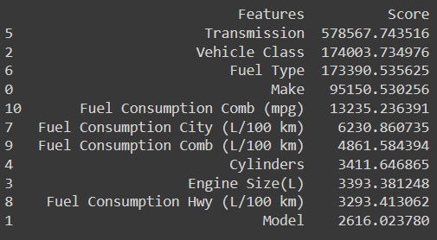
APPROACH
Numeric Features | Non - Numeric Features
Engine Size (L) | Fuel Type
Cylinders | Transmission
Fuel consumption city | Model
Fuel consumption hwy | Make
Fuel consumption comb | Vehicle class
CO2 emission (g/km)
Dataset from kaggle, published by the Canadian Government has 7385 rows, 11 features including 5 non numerical columns.
Includes light duty vehicles data for vehicles modeled from 2017-2021.
Data cleaning and processing : dropped duplicates and outliers, and checked null values or any other not applicable values.
Feature Engineering :
Non Numeric Columns Fuel Type, Vehicle class, transmission
important aspects in prediction of CO2 emissions
To include these features, the unique values were counted and the column was converted to a dictionary such that each similar value would get a similar numeric value.
As the data columns were multi categorical, adding columns with 0, 1 encoding was not feasible.
Feature Selection : Chi2 Score, Cross Validation and Feature Importance Score for each model.
Chi score

Slide 8
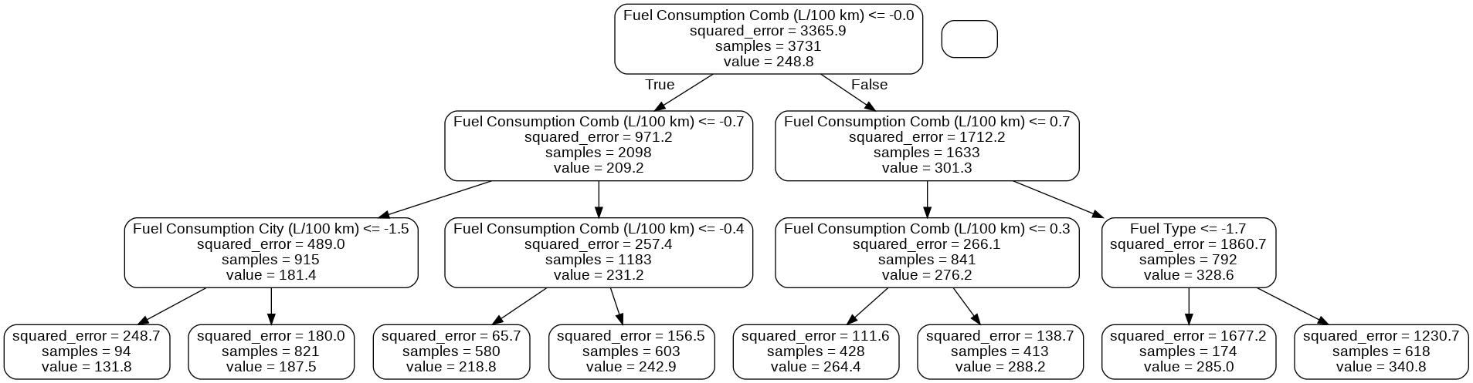
Linear Regression
Single linear regression which helped us know more about the dependency and the prediction among feature variable
Multivariable linear regression implemented considering feature importance but the regression line did not fit accurately to the true data. (Accuracy : 90%)
Decision Tree Regression
Precise resulting by division into small intervals.
Feature Importance and Cross Validation Elimination. Hyper parameter tuning
Test Accuracy : 99.61%
Random Forest Regression
More precise model than decision tree, same procedure of feature importance and cross validation.
RMSE: 4.5461, MAE: 1.9547, R2_score: 0.9940
Evalues all possible outcomes here and works well on high dimensions.
Feature Importance and Cross validation Feature elimination
Chosen Imp Features
Engine Size (L)
Cylinders
Fuel consumption city(L/100 km)
Fuel consumption hwy(L/100 km)
Fuel consumption comb (L/100 km)
Fuel consumption comb (mpg)
Feature ranking after RFECV: [1 1 1 1 1 1]

Slide 9
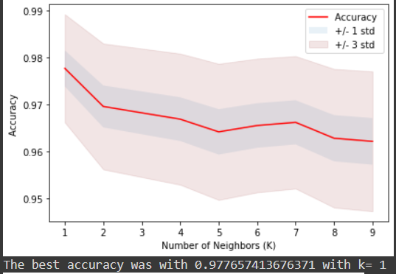
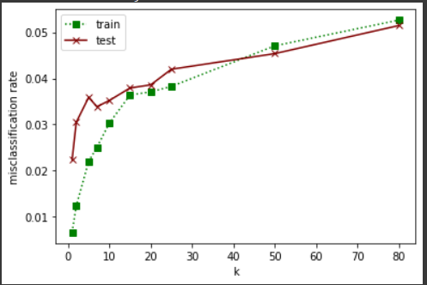
KNN Classification
To classify the light duty vehicles on the basis of CO2 emission, optimal value of K=1, gives minimum generalisation gap and minimum test error. The maximum accuracy 98% is obtained
Decision Tree Classification
Tuned Hyperparameters , Feature Selection
Accuracy of Decision Tree classifier on training set: 0.99
Accuracy of Decision Tree Classifier on test set: 0.98
Random Forest Classification
Random forest algorithm provides higher accuracy by cross validation for larger dataset with easy interpretability. random forest classification on the dataset including non categorical feature values,the accuracy of the model turned out to be as follows with correct hyperparameter tuning.
Accuracy of Random Forest classifier on training set: 0.999
Accuracy of Random classifier on test set: 0.98
Accuracy
Test error and train error
2 | 0 | 0 | 0
0 | 291 | 3 | 0
0 | 10 | 874 | 5
0 | 0 | 7 | 285
2 | 0 | 0 | 0
0 | 292 | 2 | 0
0 | 13 | 869 | 7
0 | 0 | 10 | 282
Random Forest Classifier
Decision tree classifier

Slide 10
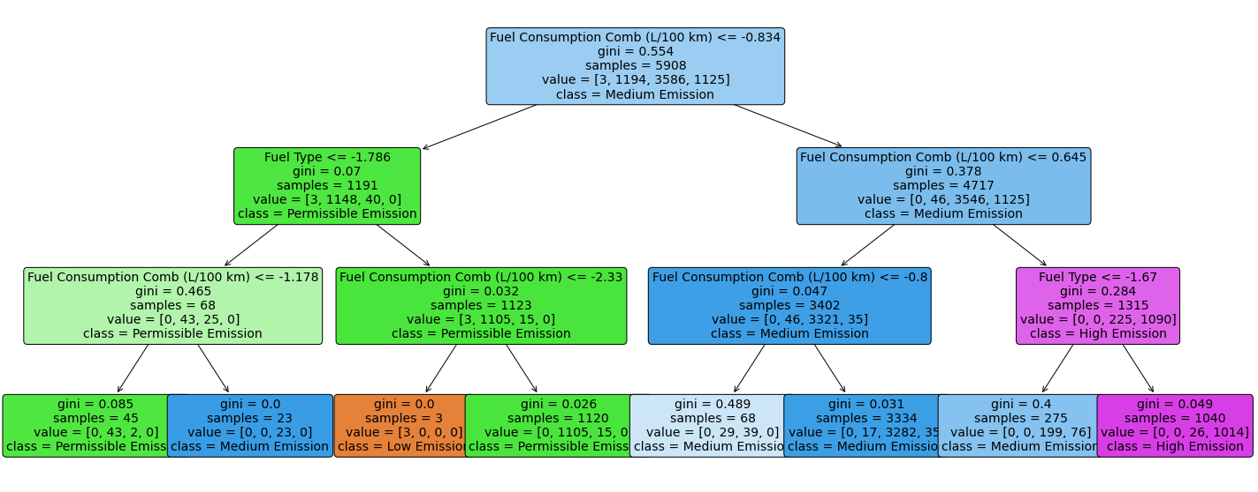
Decision Tree Classification

Slide 11
RESULTS
Features highly responsible for CO2 emissions(dependent)
After evaluating feature engineering methong, feature analysis, feature selection and feature importance scores for different models the top features that contribute to CO2 emissions largely and are strongly depend are :
While performing feature selection and cross validation method for feature importance, for random forest classifier , decision tree classifier, decision tree regression and knn the importance score of these 5 features remained higher and while modeling models with 5 features, accuracy was maintained.
Engine Size(L),Fuel Type,Fuel Consumption City (L/100 km), Fuel Consumption Comb (L/100 km), Fuel Consumption Comb (mpg).

Slide 12
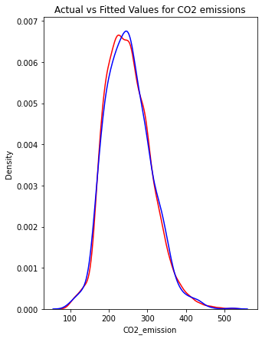
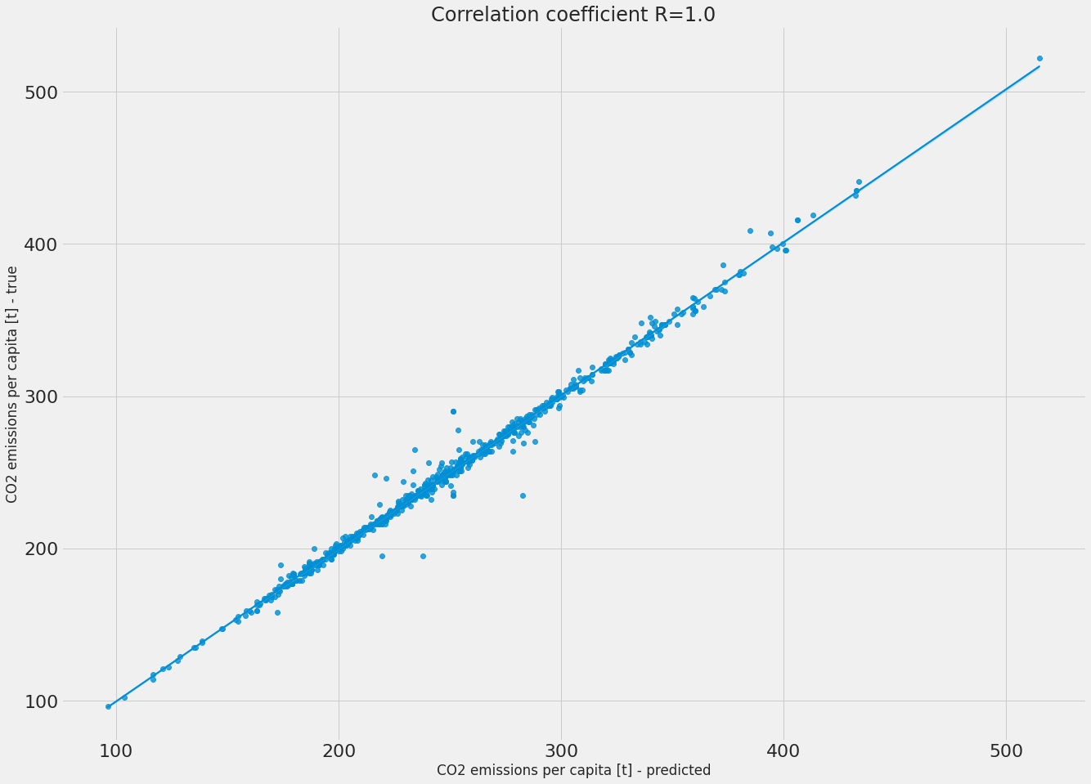
RESULTS
Decision Tree Regression
Accuracy achieved : 0.9961 for Decision Tree Regression, with 5 feature variable input the model predicts real value of CO2 Emission in g/km.The decision tree regressor works well to predict the answers with infinite possibility, which here is a real value of CO2 emission in g/km.
Actual vs Fitted Values
RMSE - train 0.95 | RMSE - test 3.63 | MAE - train 0.32 | MAE - test 1.75 | R2 - train 0.9997 | R2 - test 0.9961
Regression line for Decision Tree

Slide 13
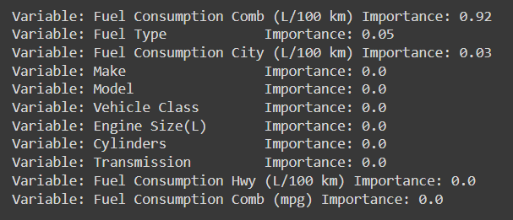
Feature Importance for Decision Tree Regression
Best number of estimators | 1600
Best max_features | sqrt
max_depth | 20
Min_samples_split | 2
Min_samples_leaf | 1
Hyperparameter tuning for Decision Tree Regression

Slide 14
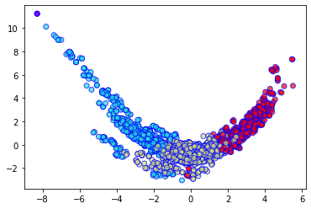
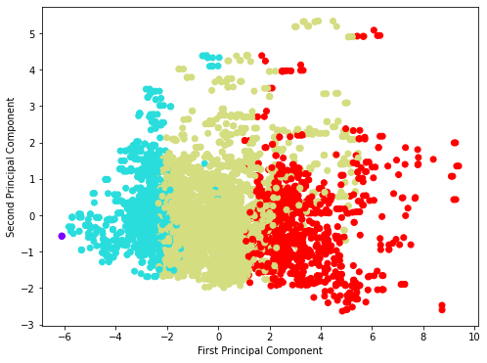
RESULTS
Random Forest Classifier
Accuracy achieved 0.98 for random forest classifier, input the feature variables and output will be the class label in which the vehicle belongs.
No major change was noted while modelling the random forest classifier with the important features obtained from feature importance score or cross validation feature importance.
Tuned Hyperparameters, minor rise in accuracy to 0.985
The accuracy of the random forest classifier decreased to 0.90 and 0.77 for LDA and PCA transformed columns.
4 class - random forest classifier after LDA
Accuracy - train set - 0.999 | Accuracy - test set - 0.98
PCA Components

Slide 15
2 | 0 | 0 | 0
0 | 292 | 2 | 0
0 | 13 | 869 | 7
0 | 0 | 11 | 281
accuracy |  |  | 0.98 | 1477
Macro avg | 0.98 | 0.98 | 0.98 | 1477
Weighted avg | 0.98 | 0.98 | 0.98 | 1477
Confusion Matrix
 | precision | recall | f1-score | support
0 | 1.00 | 1.00 | 1.00 | 2
1 | 0.96 | 0.99 | 0.97 | 294
2 | 0.99 | 0.98 | 0.98 | 889
3 | 0.98 | 0.96 | 0.97 | 292

Slide 16
ROLE OF EACH GROUP MEMBER
Nimisha Patel
Sakshi Shah
Astha Patel
Kareena Matwani
Research
Implementation
General analysis for report
Research
General analysis for report ,
Some part of Implementation
Research
General analysis for report ,
Some part of Implementation
Research
General analysis for report ,
Some part of Implementation

Slide 17
CONCLUSIONS
Classification, and the higher accuracy model predictions will help in future implementation as follows :
Implementation approach that can be useful in the future
The main five features contributing to CO2 emissions can be regulated to lower the CO2 emissions due to transportation and vehicles.
The manufacturers should aim for green manufacturing, where each new model developed would be responsible for least CO2 emissions. And the practical implementation like one point predictions can help them analyze the changes in designing and manufacturing.
This implementation can be helpful to government and transportation authorities in order to impose taxation, duty fair, road tax and other policies on the basis of CO2 emissions of the vehicle to regulate the use of vehicles with lesser CO2 emissions

Slide 18
REFERENCES
D. Podder, “CO2 emission by vehicles,” Kaggle, 05-Aug-2020. [Online]. Available: https://www.kaggle.com/datasets/debajyotipodder/co2-emission-by-vehicles. [Accessed: 22-Apr-2022].
Eeer.org. 2022. [online] Available at: <https://www.eeer.org/upload/eer-1489554553.pdf> [Accessed 24 April 2022].
“CO emissions from cars: The facts - transport & environment.” [Online]. Available: https://www.transportenvironment.org/wp-content/uploads/2021/07/2018_04_CO2_emissions_cars_The_facts_report_final_0_0.pdf. [Accessed: 22-Apr-2022].
“Fuel consumption ratings,” Open Government Portal. [Online]. Available: https://open.canada.ca/data/en/dataset/98f1a129-f628-4ce4-b24d-6f16bf24dd64#wb-auto-6. [Accessed: 22-Apr-2022].
J Mater Environ Sci.com, Journal of Materials and Environmental Science. [Online]. Available: https://www.jmaterenvironsci.com/Journal/vol11-2.html. [Accessed: 22-Apr-2022].
Iopscience.iop.org. 2022. ShieldSquare Captcha. [online] Available at: <https://iopscience.iop.org/article/10.1088/1757-899X/114/1/012148/pdf > [Accessed 21 April 2022].

