Slide 1
Parsing and Embedding of 10-K Files
For S&P 500 Company from 2010-2019
Jingxian Li Sakshi Singla

Slide 2
Contents
Overview of Project
Parsing of 10-K documents
Literature review
10-K documents
Method and Procedure
Outcome and Statistical Numbers
Word Embedding Using Word2vec
Word2Vec
Our Model
Future Work
Other Model: BERT

Slide 3
Overview of Project
Word Embeddings-Based Uncertainty Detection in Financial Disclosures
Expand financial uncertainty words through both a generic and domain-specific embedding model
Original Domain Specific Corpus
Text Preprocessing
Corpus
Clean General Corpus
Clean Domain Specific Corpus
Modeling
Embedding
Trained on Wikipedia
Expend
Wikipedia Plus 10-K
Similar words
Word Counts
Count 1
Count 2
Measurement of uncertainty
Stock volatility (index per company per year)
A dictionary of words representing uncertainty

Slide 4
Literature review
Literature
Strategic Disclosure Misclassification
Explore motivation and effect behind purposely misclassified 8-K documents
FinBERT: pre-trained model on SEC filings for financial natural language tasks
Training BERT model on 10-Q corpus
10-K Document
Parsing
Modeling
Notes:
Literature
What are the inspiration of literature

Slide 5
Parsing of 10-K Documents
10-K Document:
Annual report required by SEC
Comprehensive summary of a company's financial performance
Includes: company history, organizational structure, executive compensation, equity, subsidiaries, and audited financial statements, etc.
10-K vs. 10-Q, 8-K
Sample 10-k file
Sample 10-K document 1
Sample 10-K document 2
10-K File
10-K Document
Exhibits
XML
ZIP
Graphic
XBRL-related
Excel
JSON
Corresp, Cover, Rendered
Notes:
More detailed information compared to the version share to shareholders

Slide 6
Method and Procedure
Step 1:Split files
Original File
Splitted files
10-K file
Procedure
Split documents according to type
Filter documents that are not primarily human language
Parsing:
Mainly use BeautifulSoup and Regex
Remove redundant part
Remove weblink
Discard table with more than 10% numbers
Keep only natural language text
10-K
10-K
XMLs
XML and Exhibits
Exhibits
Other types
Step 2: Parse documents
10-K parser
XML parser
Exhibits
parser
Parsed 10-K
Parsed XML
Parsed Exhibits

Slide 7
Method and Procedure
Parsing details for 10-K files
BeautifulSoup lxml parser
Remove anchor links <a>
Remove numeric tables
Remove whole text before ITEM 1-contain repeated info
Remove whole text after PART IV-contain signatures and non-natural text
Parsing details for XML files
BeautifulSoup html parser
Remove weblinks <a>
Remove numeric tables
Find natural language under <p> <font>
Remove explanatory non natural language text
Improvements
Duplicate text extraction when <p> and <font> are nested

Slide 8
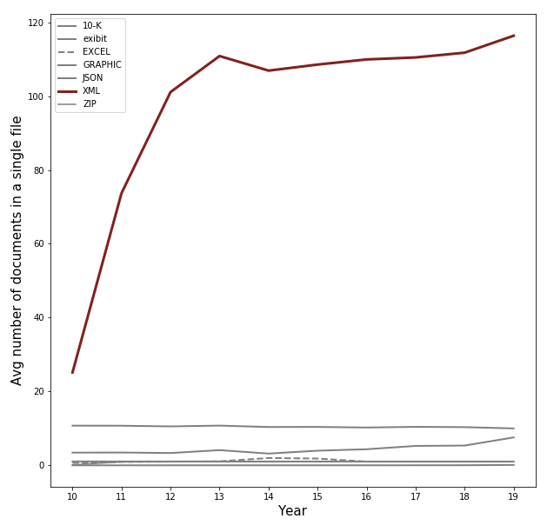
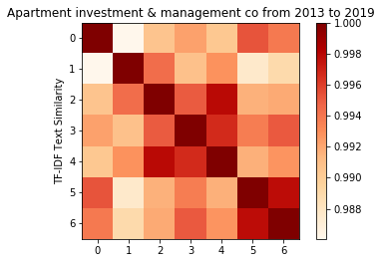
Outcome and Statistical Numbers
How shall we deal with these XML files?
Include for the embedding part but exclude when we do the word counts
Build model and count words with and without XML and exhibits, compare the results
Calculate the normalized word count
If high similarity exists between XML files, shall we keep them or remove them?

Slide 9
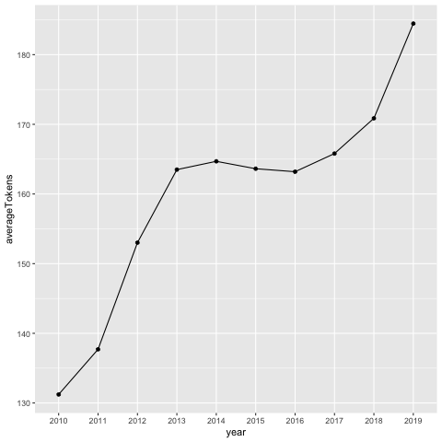
Outcome and Statistical Numbers
Tokenized word count for 10-K 2010-2019

Slide 10
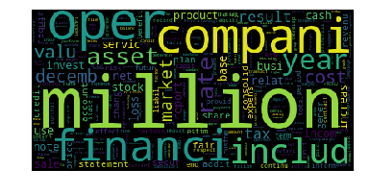
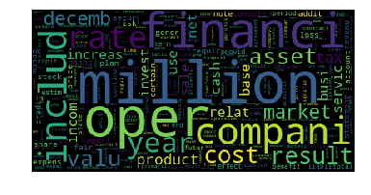
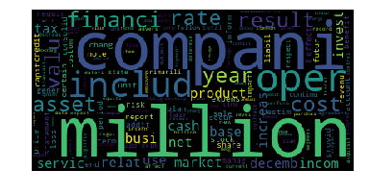
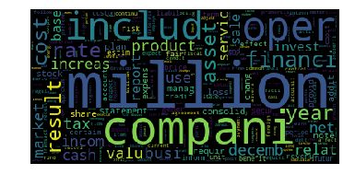
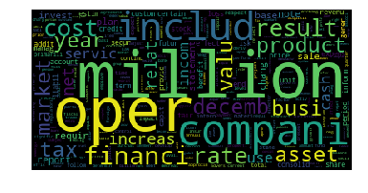
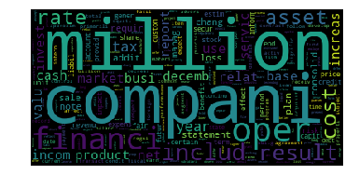
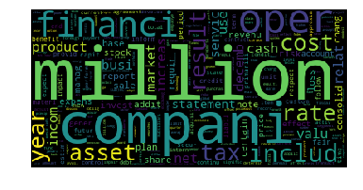
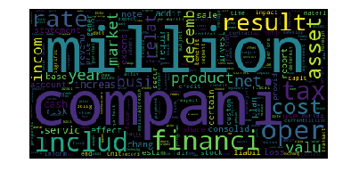
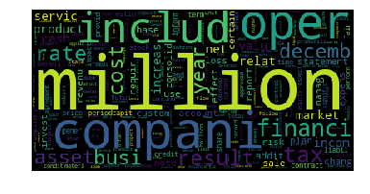
Outcome and Statistical Numbers
Word Cloud for 10-K files from 2011- 2019

Slide 11
Modelling:

Slide 12
Loughran & McDonald’s Dictionary
An existing financial domain dictionary containing 297 uncertain terms
-Shown to possess explanatory power of future stock return volatility
-Contains terms marking imprecision (eg. “could”, “may”, “probably”,..) and terms referring to risk and uncertainty (eg. “Anomaly”, ”risk”, ”uncertainty”, “volatility”)
Goal: Expand this existing dictionary of uncertainty triggers using SEC 10K documents to see if expanded dictionary is better predictor of stock volatility and uncertainty from 10K documents

Slide 13
How we will use expanded uncertainty dictionary...
Expansion should boost automatic detection of uncertainty.
Cumulative tf-idf of uncertain terms in a set of 10-Ks shares a positive and highly significant relation with future stock return volatility.
Important measure for automatic detection of uncertainty from 10K documents
Compute tf-idf scores of uncertain terms in the 10K documents
SEC 10K document
Uncertainty dictionary

Slide 14
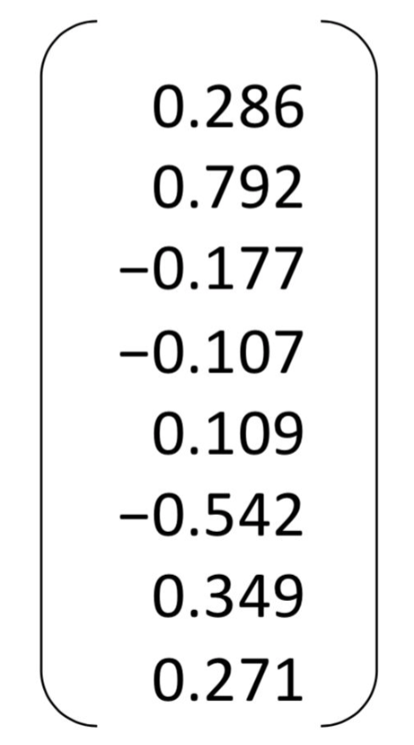
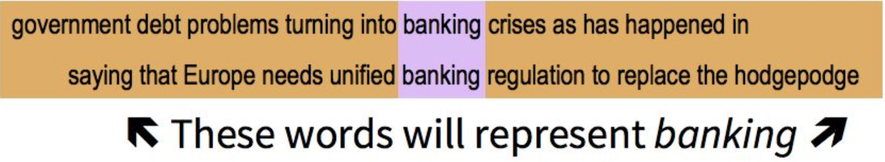
How to expand dictionary - Word embeddings
How do we represent meaning of the word?
Idea: take the 5 words around a given word to represent the given word
Build a N-dimensional vector for each word, chosen so that
it is similar to vectors of words that appear in similar contexts
Banking=

Slide 15


Learn the word embeddings
Learning word similarities from large corpora
Wikipedia
Trained word embeddings (GLOVE)
Embeddings trained on financial documents
SEC 10K documents corpus

Slide 16

Learn Word Embeddings Using Word2vec
SEC 10K Filings corpus
d=50
Vocabulary
Length = |V|
|V|
Anomaly = (0.446, 0.317, 0.097,..)
probably =
(0.647, -0.164, 0.196,..)
Word2Vec model
Word2vec is a framework for training word embeddings

Slide 17
How to expand dictionary - word similarity
Compute similarity (cosine similarity) from word v to all other words.
Word embeddings
d
Change
|V|
0.9
-0.3
-0.1
-0.9
0.3
…..
0.2
Product
Risk
=
Anomaly
.
.
.
Change
Product
Anomaly
Company
Strategy
Business
Result is |V| sized vector of similarities.
Get 20 most similar words to each word in the 297 uncertain terms.
This would be our expanded dictionary

Slide 18
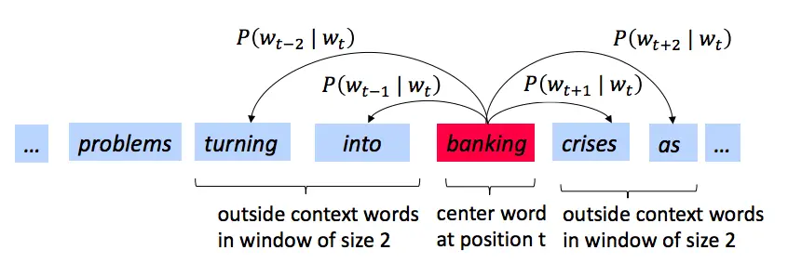
Word2Vec:
Word2vec is a framework for training word embeddings
Flavors of Word2vec models:
Continuous bag of words (CBOW)
Skip-gram
Notes:
Idea:
We have a large corpus of text
Every word in a fixed vocabulary is represented by a vector
Go through each position t in the text, which has a center word x and context (“outside”) words y

Slide 19
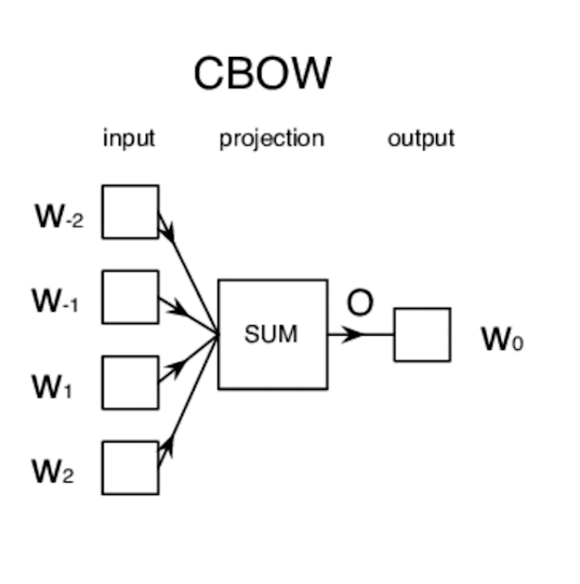
Continuous bag of words (CBOW)
Predict target word from the context.
Generally better for predicting frequent words
turning | into |  | crisis | as
banking

Slide 20
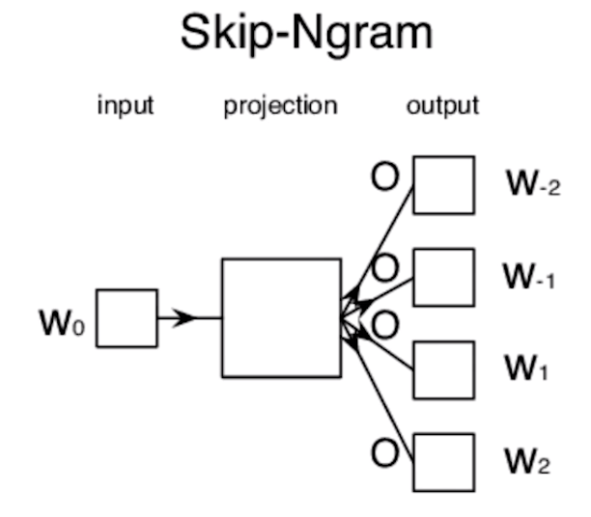
Skip Gram
Predict the context words from target.
Generally better for predicting rare words
banking
turning | into |  | crisis | as

Slide 21
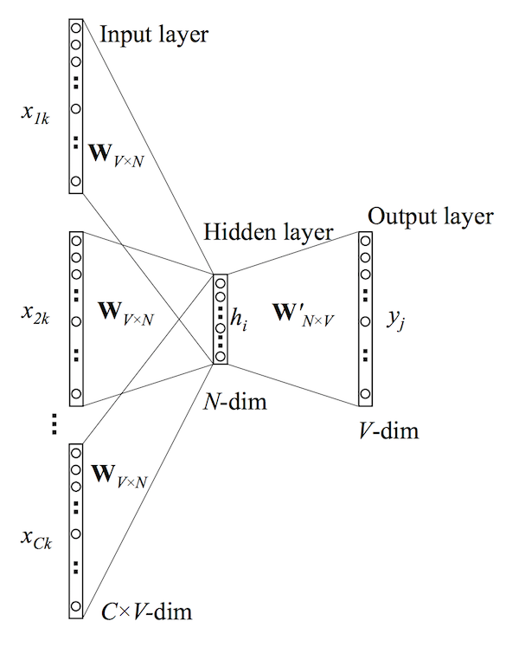
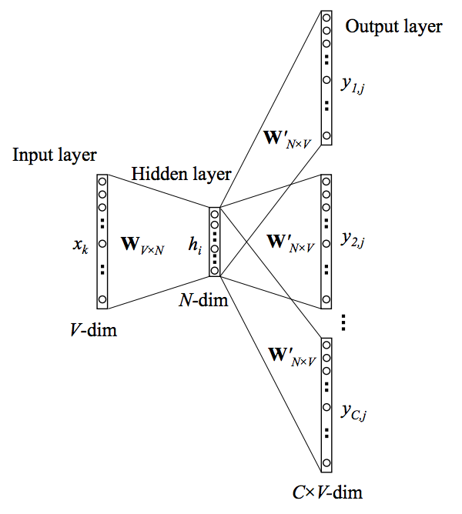
Models architecture:
CBOW
Skip-gram

Slide 22
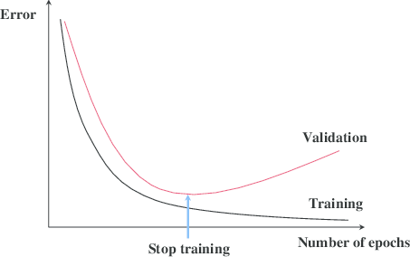
Some techniques used to improve the models:
Early stopping:
Early stopping keeps track of the validation loss, if the loss stops decreasing for several epochs in a row the training stops.

Slide 23
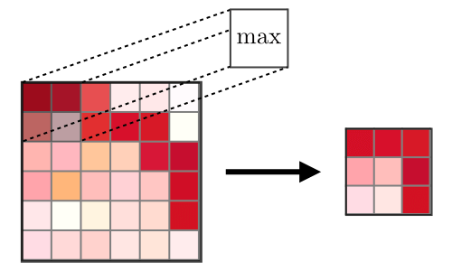
Some techniques used to improve the models:
Batch processing:
In each cycle, training is done
over a chunk or subset of the data

Slide 24
Our progress in Word2Vec Model
We have implemented CBOW and skip-gram models in pytorch.
Issues being faced: working on the subset of files but taking lot of time to train on whole corpus (was not able to complete even 1 epoch in 1 week)
With improvement techniques like batch-processing and early stopping, model has improved(Now, completing 1 epoch in around 2 days)
Further improvements required:
Run the model training process on GPU
Implement few improvement techniques like hierarchical softmax and negative sampling

Slide 25
Future Work
BERT model on financial documents
“He went to the prison cell with his cell phone to extract blood cell samples from inmates”
Word2vec word embeddings are context independent- these models output just one vector (embedding) for each word, combining all the different senses of the word into one vector.
BERT can generate different word embeddings for a word that captures the context of a word - that is its position in a sentence.
Notes:
“He went to the prison cell with his cell phone to extract blood cell samples from inmates”, where the word cell has different meanings based on the sentence context, these models just collapse them all into one vector for “cell” in their output
For instance, for the same example above “He went to the prison cell with his cell phone to extract blood cell samples from inmates”, both Elmo and BERT would generate different vectors for the three vectors for cell. The first cell (prison cell case) , for instance would be closer to words like incarceration, crime etc. whereas the second “cell” (phone case) would be closer to words like iphone, android, galaxy etc..

Slide 26
Thank You

