Slide 1

ZenSpace.AI
“AI-Powered Interior Design Platform”
Aayush Thakur - 23107015
Durvesh Wagle - 23107019
Yash Shinde - 23107020
Ahan Upadhye - 23107027
Project Guide
Ms. Aavani N

Slide 2
Outline
Introduction
Literature Survey of the existing systems
Limitations of the existing systems
Problem statement
System Design
Technologies and methodologies
Implementation
Conclusion
References

Slide 3
Sustainable Development Goals (SDG) mapped
1] SDG 9: Industry, Innovation and Infrastructure
Description: Build resilient infrastructure, promote sustainable industrialization and foster innovation.
Mapping: Zenspace.AI uses AI, computer vision, and 3D visualization to innovate in the interior design industry. It promotes digital infrastructure for design and makes advanced technologies accessible to common users.
2] SDG 12: Responsible Consumption and Production
Description: Ensure sustainable consumption and production patterns.
Mapping: By offering pricing transparency and virtual previews, Zenspace.AI reduces impulse purchases and furniture waste. It helps users make informed decisions, supporting eco-friendly consumption and minimizing unnecessary production.
3] SDG 8: Decent Work and Economic Growth
Description: Promote sustained, inclusive, and sustainable economic growth, full and productive employment, and decent work for all.
Mapping: By integrating e-commerce options, Zenspace.AI opens opportunities for local furniture businesses, artisans, and designers to reach wider audiences, boosting digital economy growth.

Slide 4
Introduction
Interior designing is often expensive, time-consuming, and requires professional expertise.
Many people struggle to visualize how furniture, colors, or themes will look in their space before making decisions.
To solve this, Zenspace.AI is a web-based platform that combines AI, computer vision, and 3D visualization to help users upload images/videos of their rooms and instantly explore multiple design options.
The system not only suggests styles and layouts but also provides cost estimation and customization features, making interior planning more accessible, affordable, and user-friendly.

Slide 5
Motivation
Many individuals find it difficult to visualize how a room will look after interior changes.
Hiring professional designers can be expensive and not accessible to everyone.
A lot of money and resources are wasted due to wrong purchases or design mismatches.
There is a growing need for AI-driven tools that make interior designing easy for no-experts.
With urbanization, space-saving and sustainable designs are crucial for modern living.

Slide 6
Objectives
Enable users to input a custom prompt describing their desired room and style, and instantly generate AI-driven personalized interior design variations.
Provide AR models of furniture that users can view in their physical space through QR codes creating an immersive experience to better judge design fit and scale.
Provide interactive 3D models of rooms and furniture with real-time color customization for effective design visualization.
Instant cost calculator for pricing of selected design & furniture with a favorites feature for user to save design option easily.

Slide 7
Literature Survey of the existing system
Sr. No | Title | Author | Year | Outcomes | Methodology | Demerits
1 | Modsy : AI for Interior Visualization | Modsy Inc. | 2021 | Creates 3D models of rooms and suggests furniture arrangements | AI + 3D Rendering (Three.js, AR/VR integration) | Paid Services; Limited Free accessibility; No open customization

Slide 8
Literature Survey of the existing system
Sr. No | Title | Author | Year | Outcomes | Methodology | Demerits
2 | Planner 5D: Online Interior Design Tool | Planner 5D Team | 2020 | Allows users to design rooms in 2D/3D and visualize furniture placement | WebGL,3D rendering engines | Manual design process ; not AI- driven ; time – consuming for users

Slide 9
Literature Survey of the existing system
Sr. No | Title | Author | Year | Outcomes | Methodology | Demerits
3 | Roomify: AI-Powered Room Design Tool | John Doe et al | 2019 | Provides AI-based room layout suggestions using user images. | Deep Learning for image recognition, rule-based layout algorithms | Limited customization; lacks real-time 3D interaction

Slide 10
Limitations of existing systems
Accuracy of 3D Reconstruction - The quality of the 3D room model depends on the clarity of the video/image uploaded. Low-quality scans may reduce accuracy.
Limited Design Suggestions - AI-generated design ideas are based on the dataset and may not always capture personal or cultural preferences.
Device & Performance Constraints - Running 3D rendering and AI visualization in the browser may be resource-heavy for low-end devices.
Dependency on Internet Connectivity - Since the system is cloud-based, poor internet can affect performance and real-time rendering.
Pricing Approximation - Cost estimates for furniture and materials may not always match actual market variations.
Data Privacy Concerns - Users uploading room images/videos may have concerns about data storage and misuse.
Limited Real-World Testing - AI suggestions may not always perfectly align with physical feasibility (e.g., exact wall dimensions, lighting conditions).

Slide 11
Problem statement
Challenges
Visualizing room interiors before execution is difficult, leading to confusion and costly mistakes.
Traditional design services are time-consuming, expensive, and often lack flexibility for users.
Gap Identified
Current solutions fail to provide an affordable and easy-to-use AI platform for personalized design visualization.
Most tools lack real-time customization, 3D extraction, and multiple design options tailored to user needs.
Proposed Solution – ZenSpace.AI
ZenSpace.AI enables users to scan or upload their room, extract its 3D layout, and receive AI-generated design suggestions.
The platform offers interactive customization, providing multiple themes, furniture arrangements, and color options.
Expected Output
Users get a cost-effective and accessible tool to visualize their interiors in realistic 3D before implementation.
This reduces errors, saves expenses, and empowers users to make confident design decisions without expert help.

Slide 12
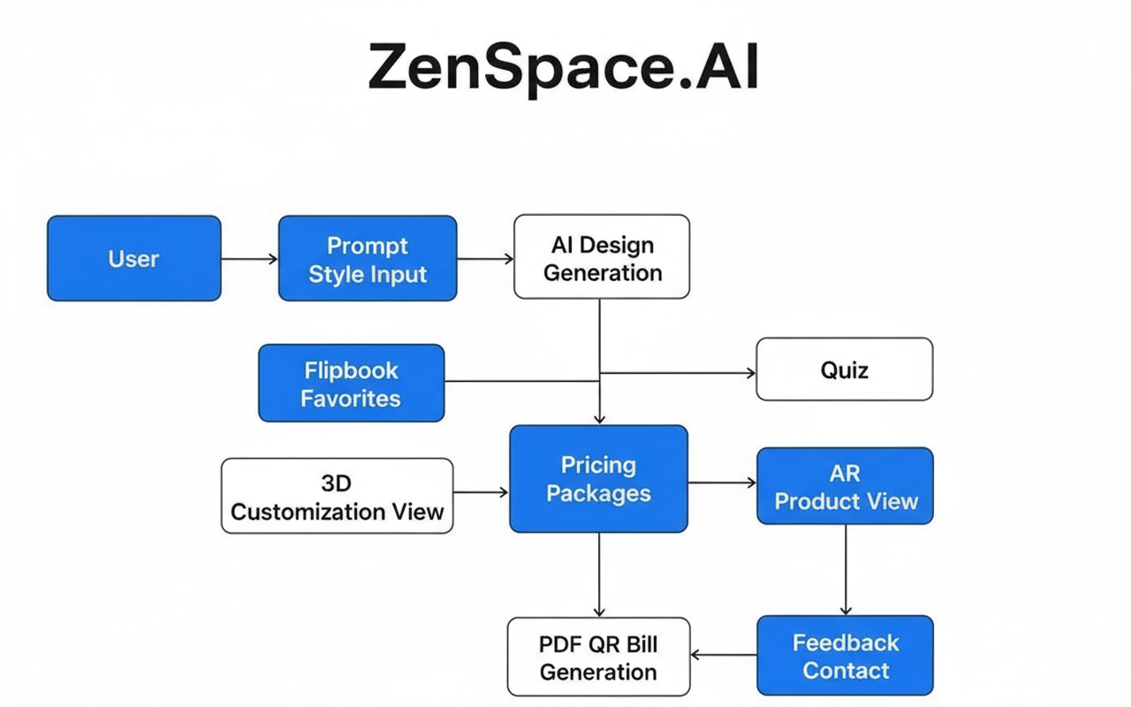
System Design

Slide 13
Technologies and methodologies
Backend: Node.js + Express (API handling)
Database: Firebase (user data, designs)
Computer Vision / 3D: OpenCV + Three.js (basic room scan + 3D view)
Frontend: React.js + Tailwind CSS (UI for uploading room video & viewing designs)
AI Model: Pre-trained CNN + Stable Diffusion API (for design suggestions)

Slide 14
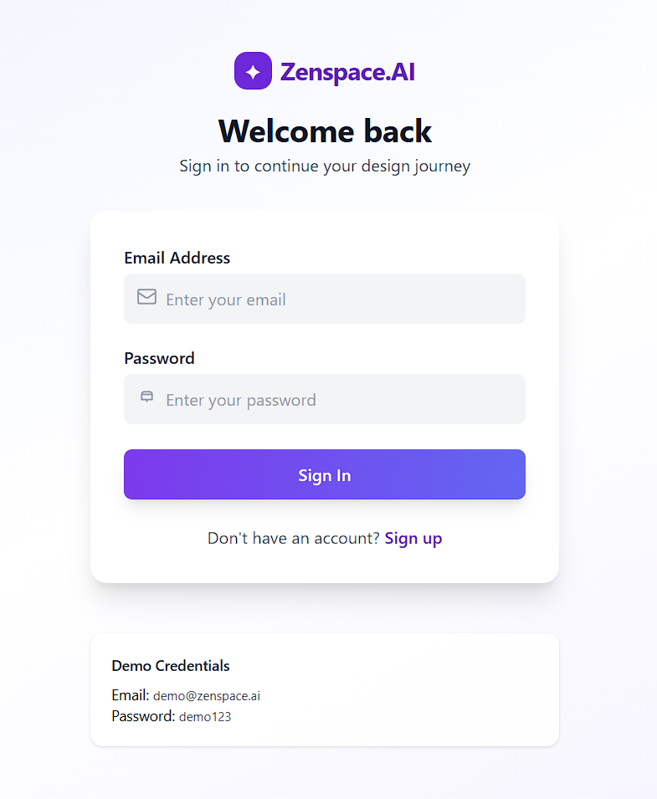
Implementation

Slide 15
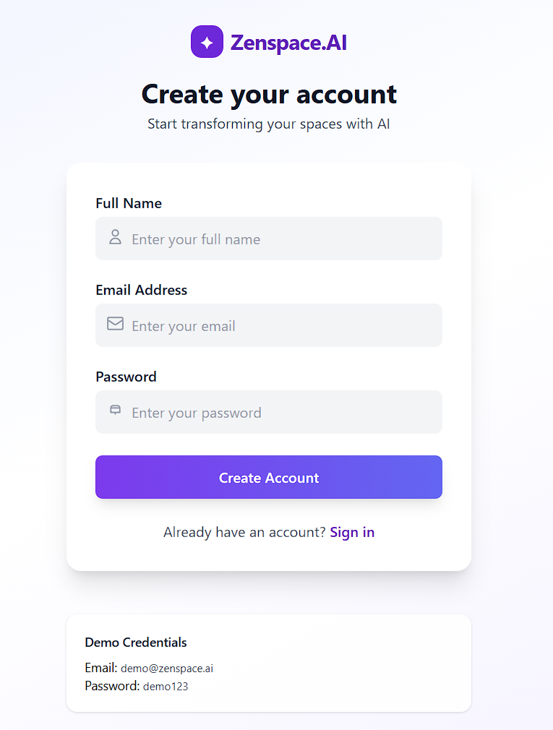

Slide 16
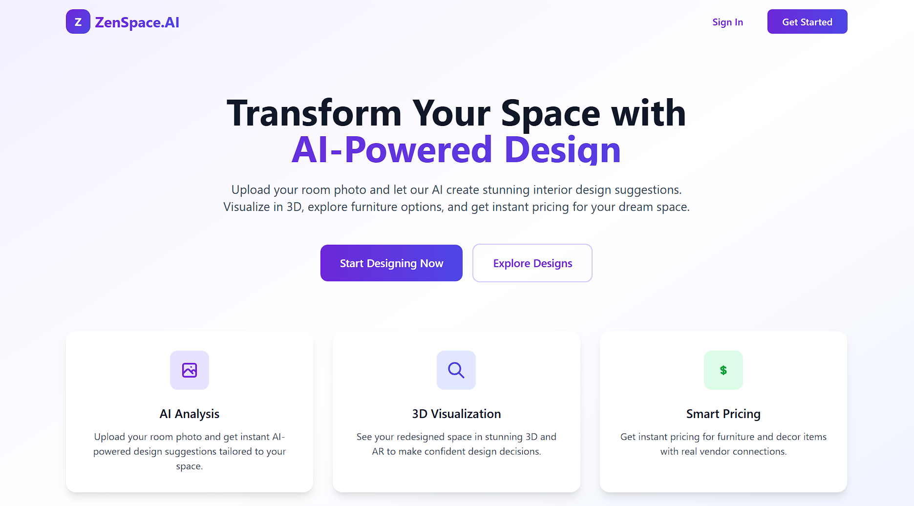

Slide 17
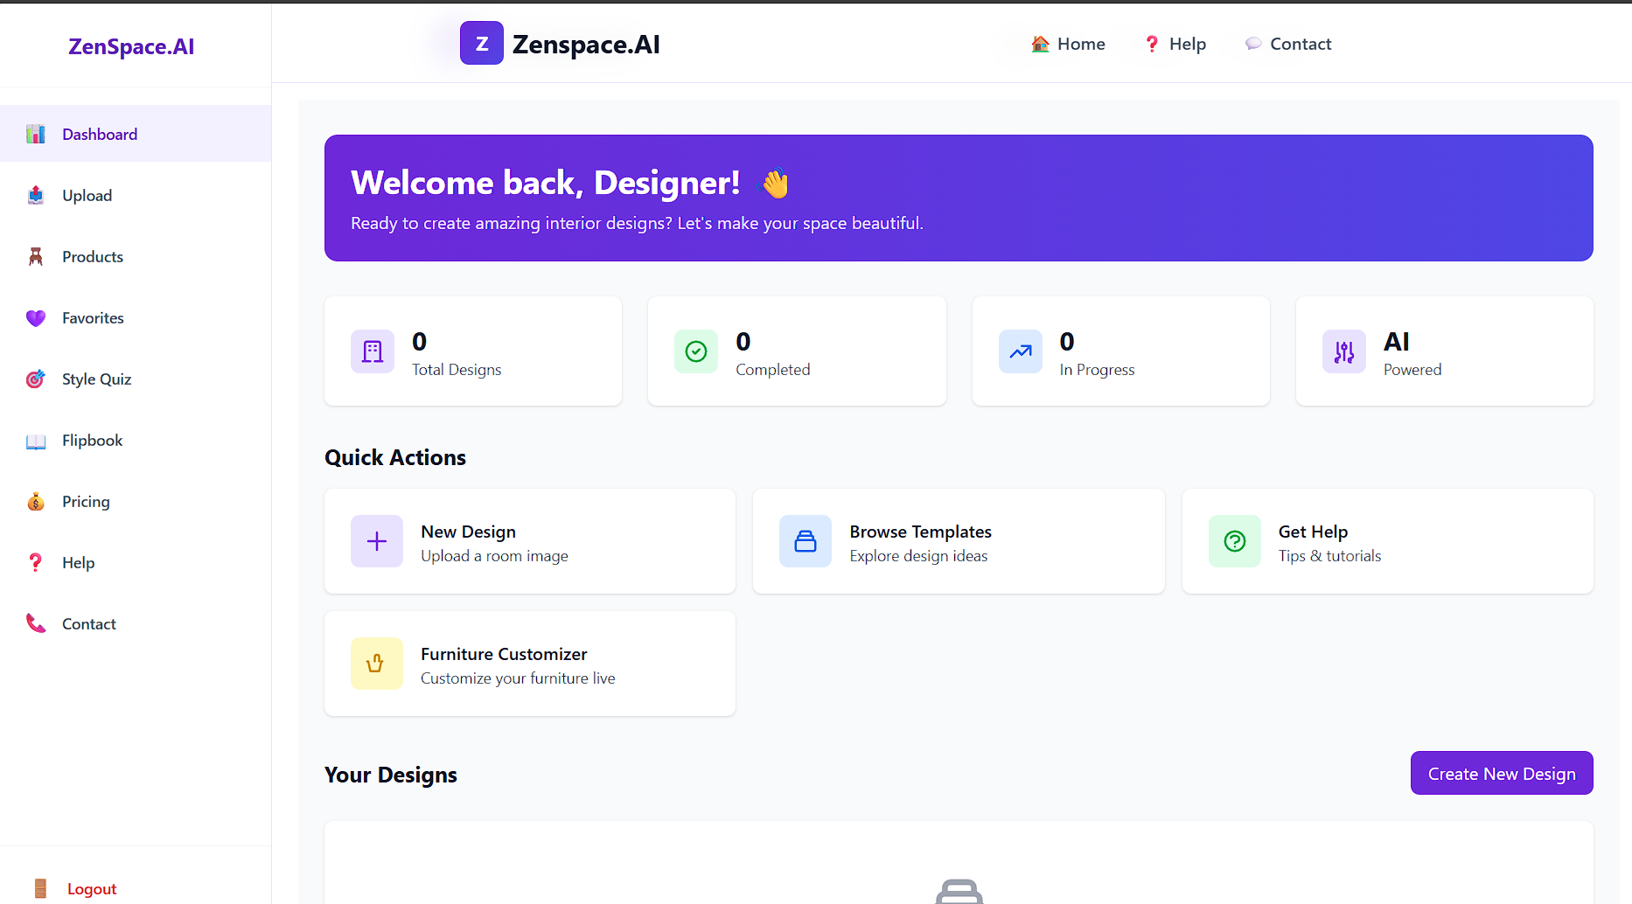

Slide 18
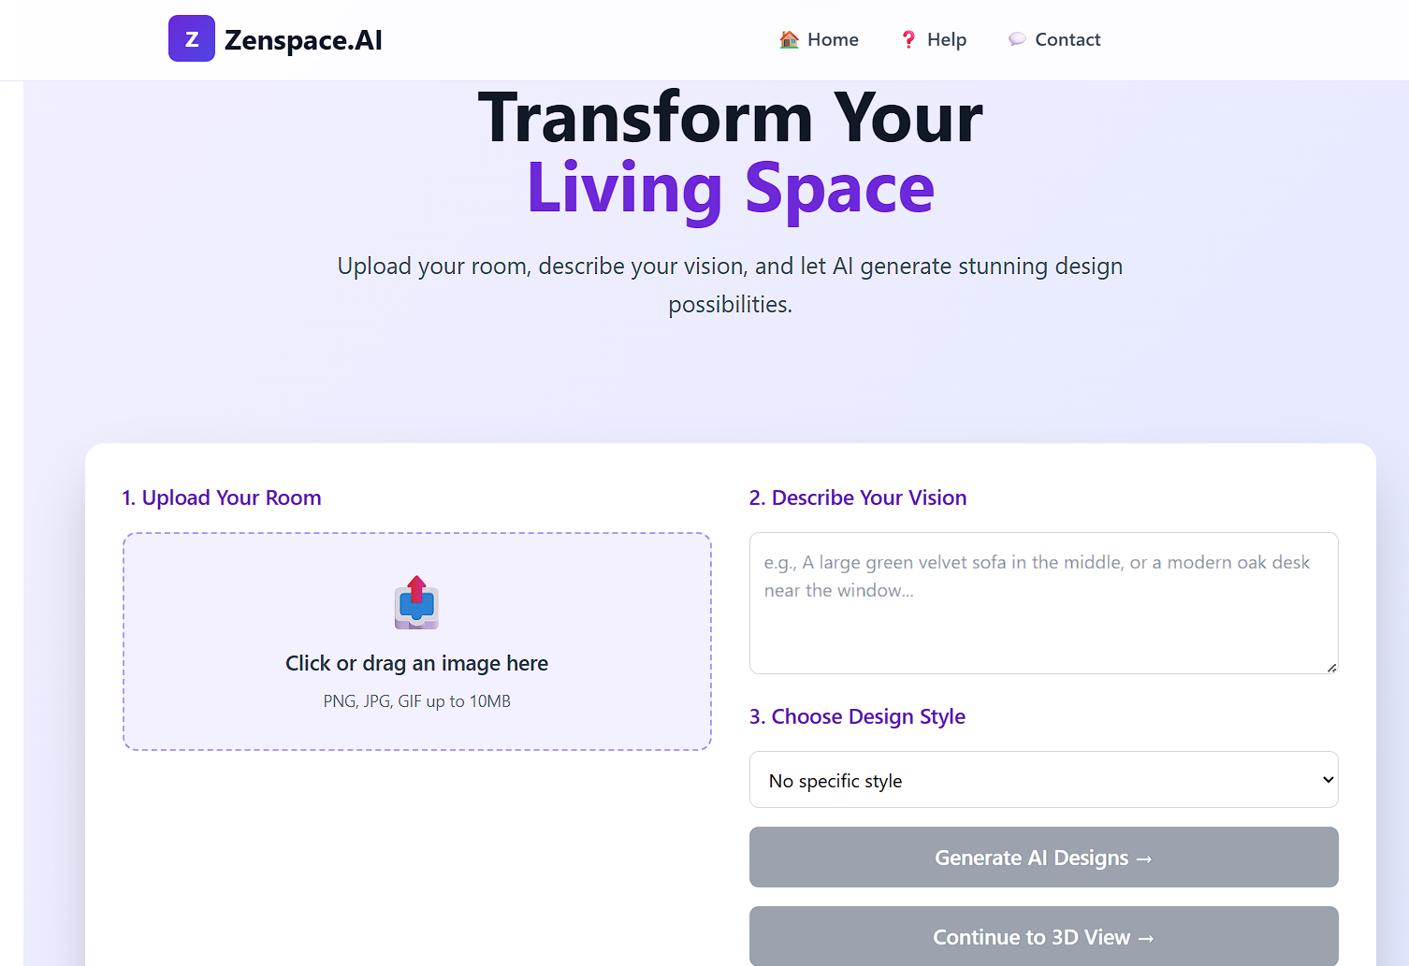

Slide 19
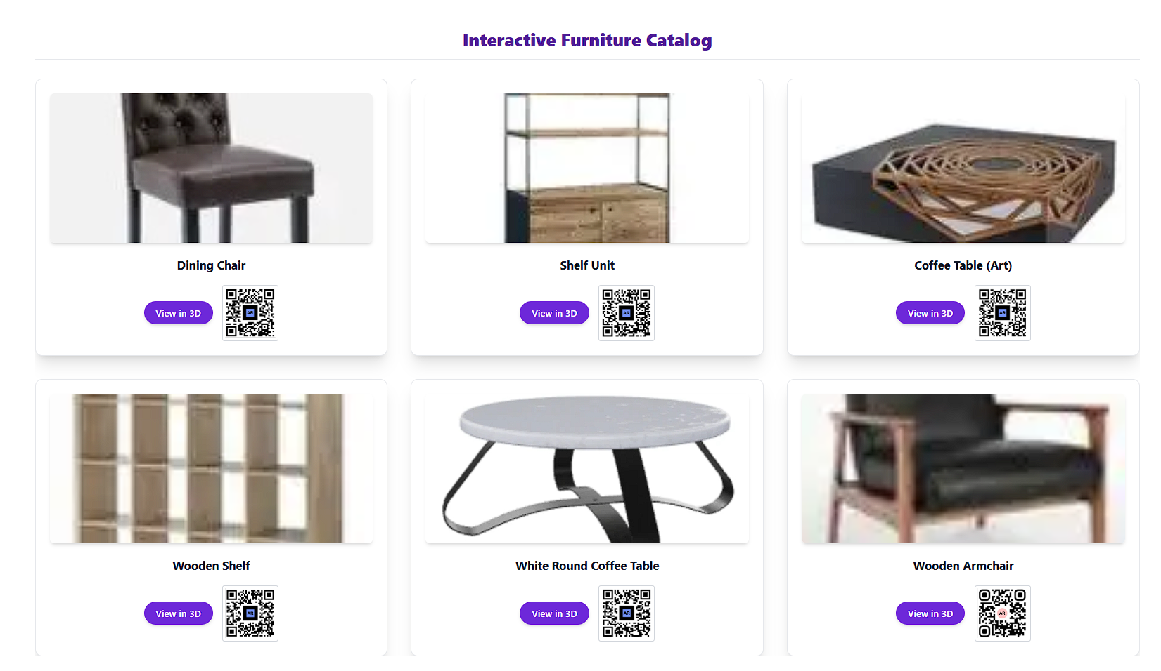

Slide 20
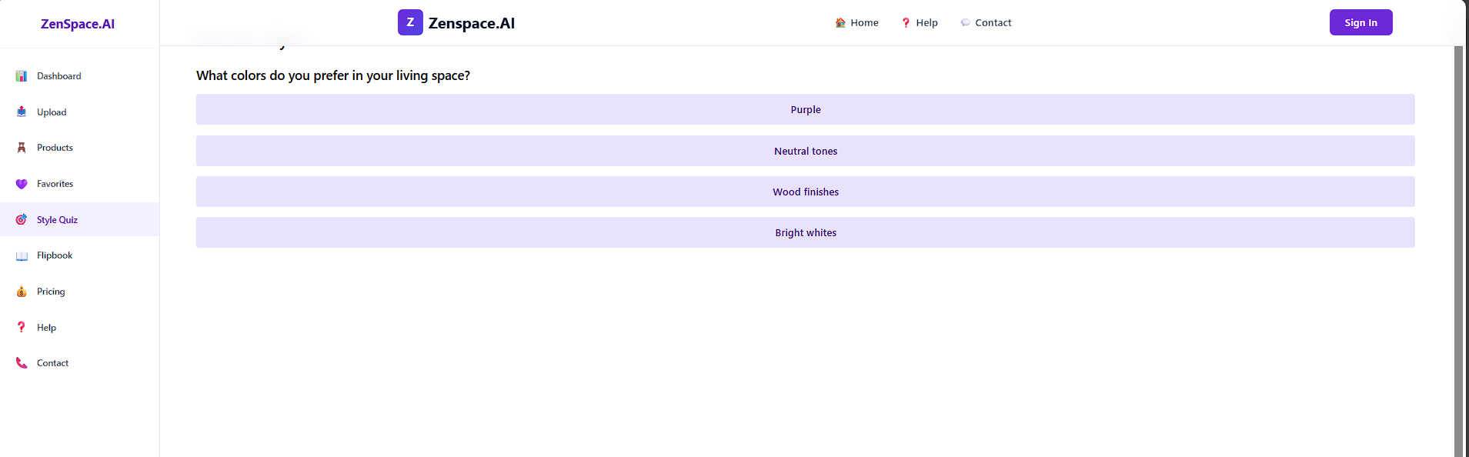

Slide 21
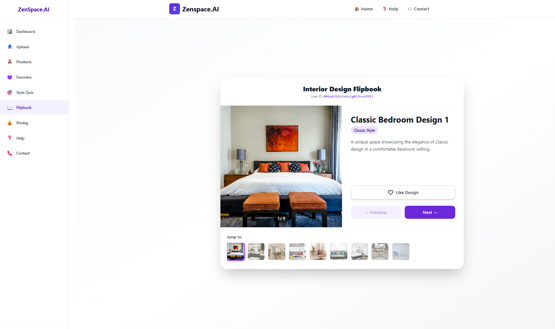

Slide 22
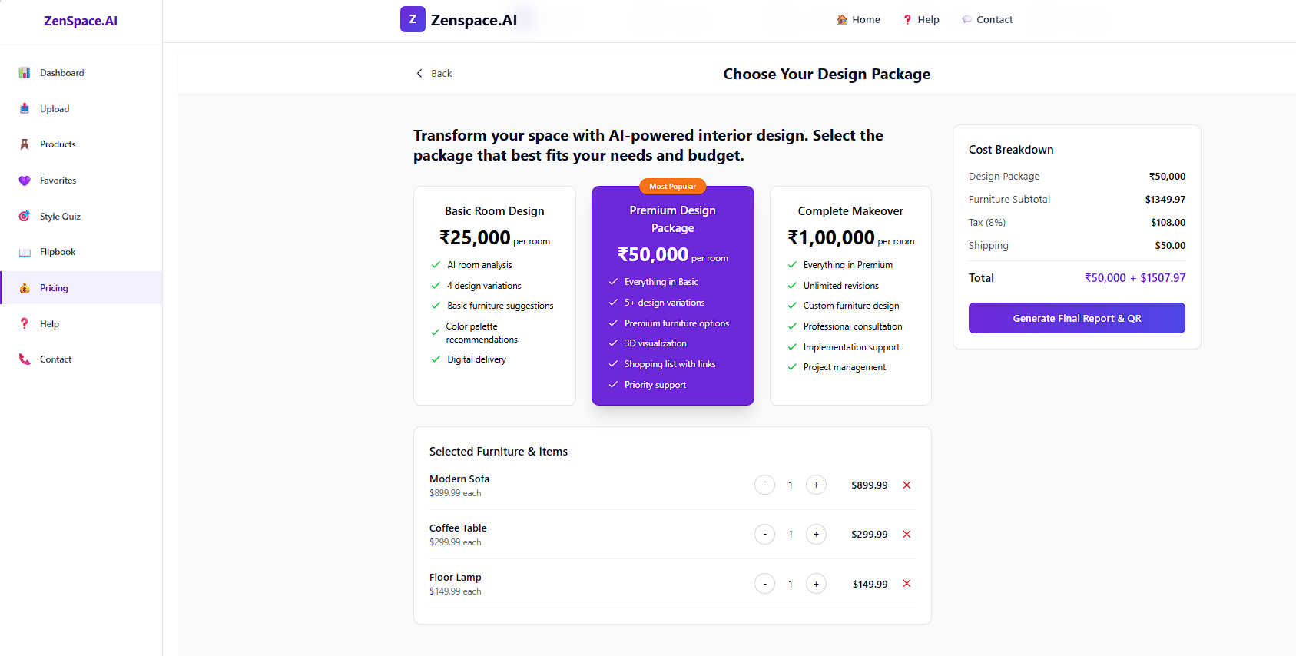

Slide 23
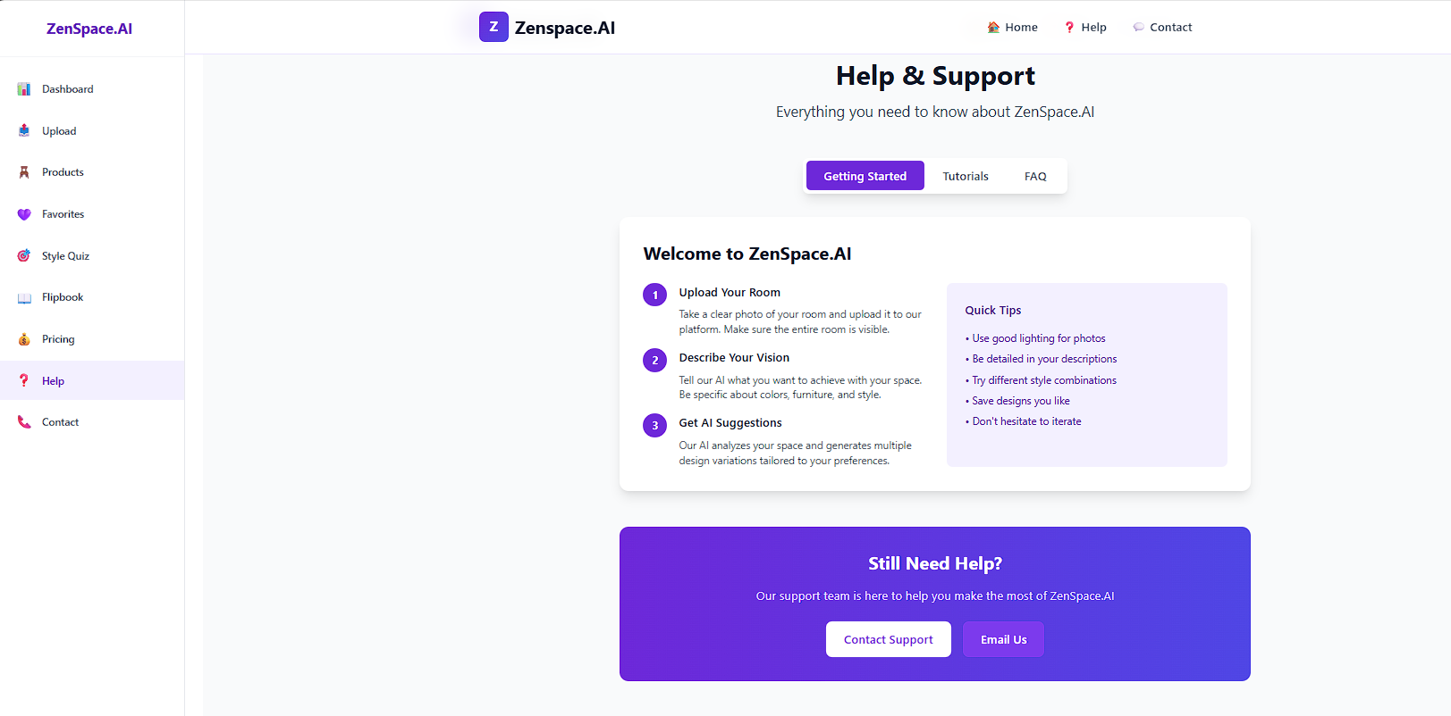

Slide 24
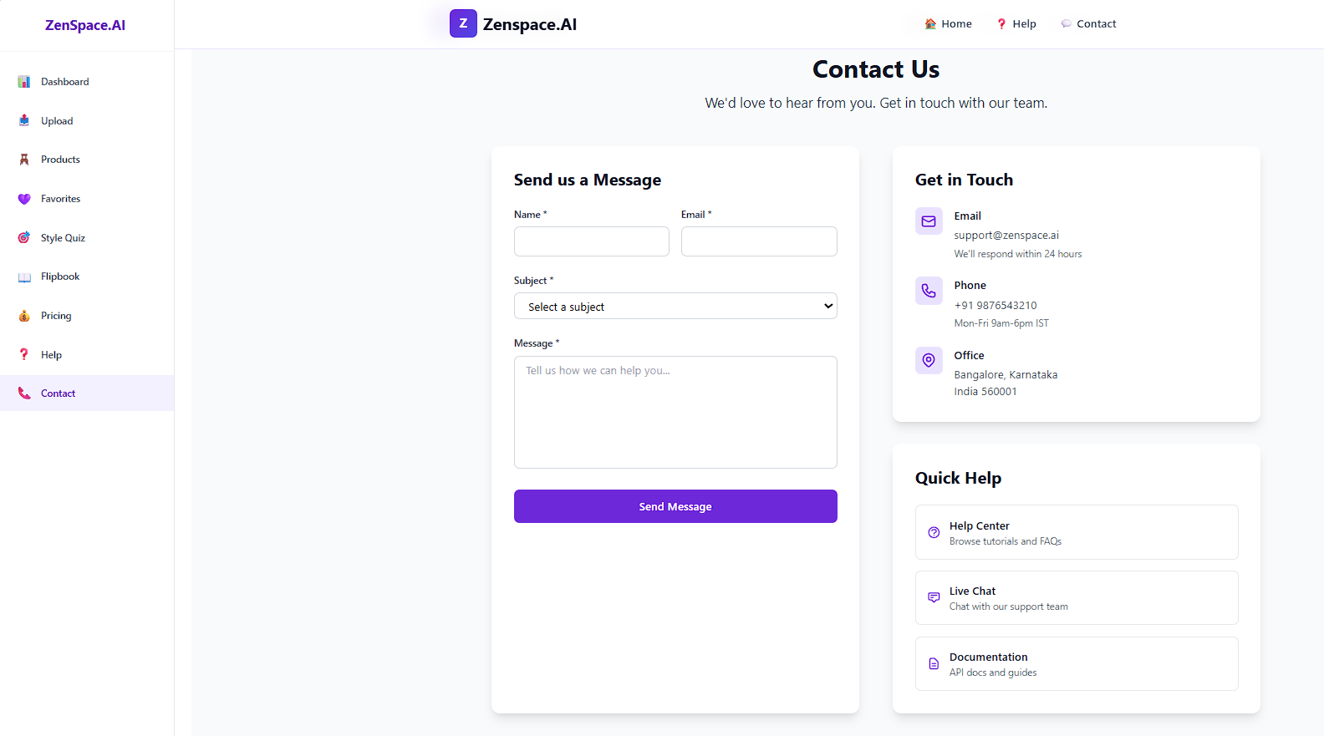

Slide 25
Conclusion
Zenspace.AI offers an innovative step forward in interior design by combining computer vision, 3D modeling, and generative AI into a single platform. Unlike traditional tools, which often require manual effort and expertise, Zenspace automates the process of analyzing room structure and generating personalized design suggestions. This makes interior designing faster, more affordable, and accessible to a wider audience.
The project addresses the challenges of limited customization, lack of automation, and difficulty in visualizing designs by providing real-time AI-powered recommendations with immersive visualization. As a result, users can experiment with multiple design options, preview changes instantly, and achieve professional-quality outcomes without prior technical knowledge.
Overall, Zenspace.AI stands as a solution that transforms interior design into a smart, interactive, and user-centric experience, paving the way for future advancements in intelligent home design systems.

Slide 26
References
John Doe et al. (2019). Roomify: AI-Powered Room Design Tool.
Planner5D Team. (2020). Planner5D: Online Interior Design Tool.
Autodesk. (2021). Homestyler: Online Room Decor Tool.
Modsy Inc. (2021). AI for Interior Visualization.

Slide 27
Thank You...!!

