Slide 1
Nykaa Automation Platform

Slide 2
Test Coverage
Category navigation
Search products, brands
Filters, Offers, Add To Bag
Pro and other Store
Sign in, Sign up, Wishlist etc.
Mobile Simulation and Cloud Mobile Devices
Browser Compatibility – Firefox, Opera, Chrome, Safari
Device OS version compatibility
MonkeyRunner for crashes in Android.
API response comparison

Slide 3
Features
Framework is built in java along with third party library/tool - selenium/kobiton/appium etc.
Handling of dynamic content (like offers, search suggestions etc or platform specific objects) via a REST API.
Framework caters:
Customization and addition of actions
Support cross browser testing
Extendable to Web and Apps
Extended html reports
Step wise execution time in execution
Wrapper (of Google APIs) to access User Inbox for OTP
Retry Step / Retry Case
Continuous Live Feature Monitoring

Slide 4
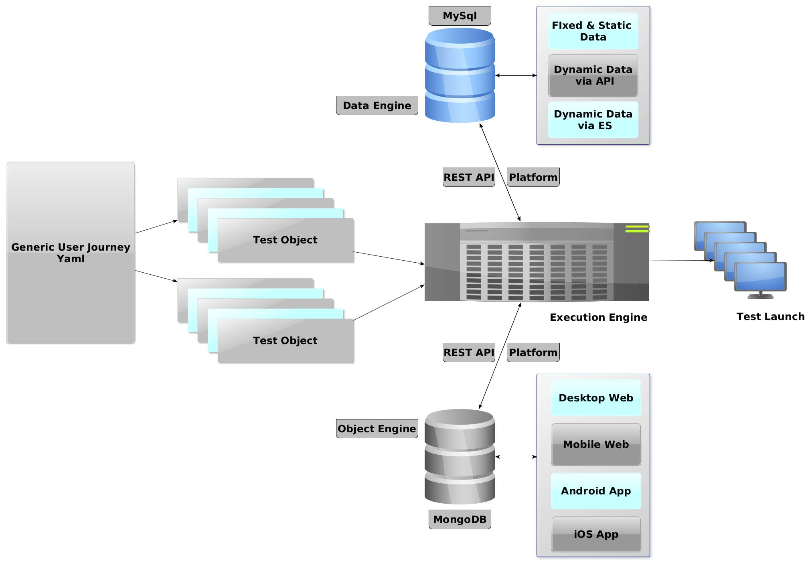
What’s New

Slide 5
Components
User Journey as Yaml:
User journey will be written in Yaml files which will be loaded in memory during execution.
Yaml files gives the tree structured configuration which can be easily mapped to a POJO.
ObjectEngine and dataEngine APIs:
To make journey common, we have taken out the Dynamic and Platform dependent elements and handled at Server level. These are fetched ONLY during execution thus eliminate the need to duplicate client journey.
Now only specific journeys need to be built, rest will be reused.
CI:
Auto Checks Of Yaml files Before Git Merge

Slide 6
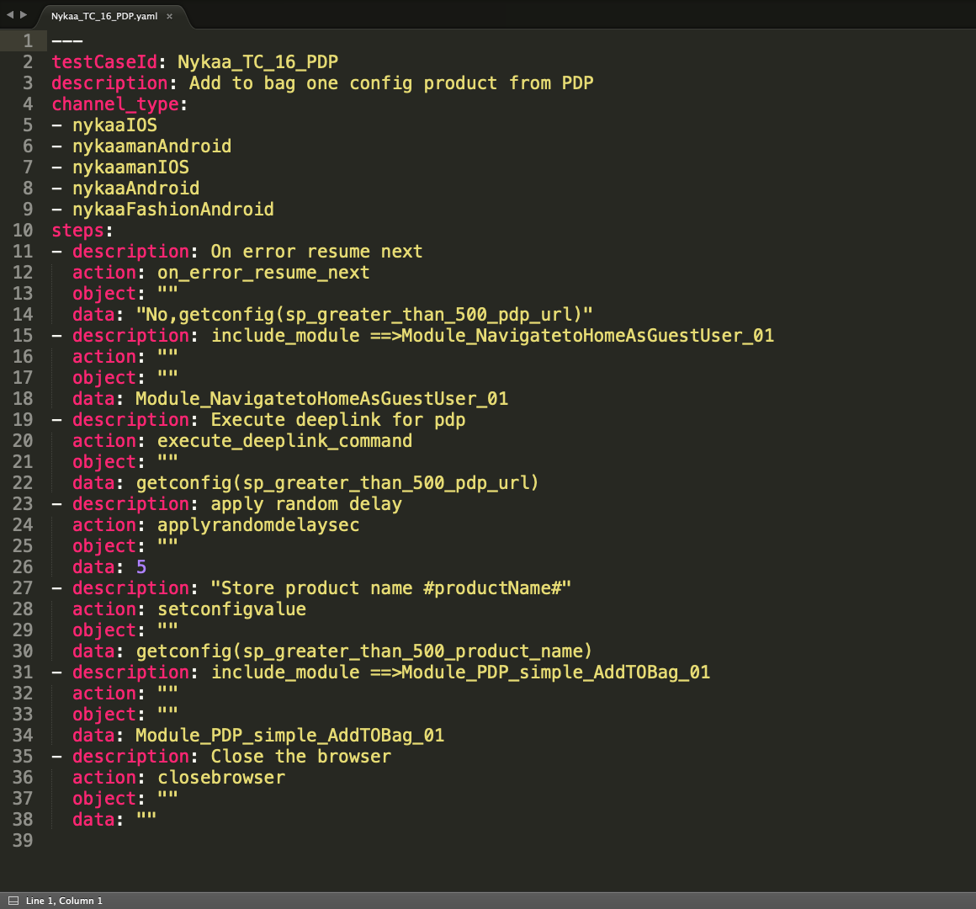
Sample Journey

Slide 7
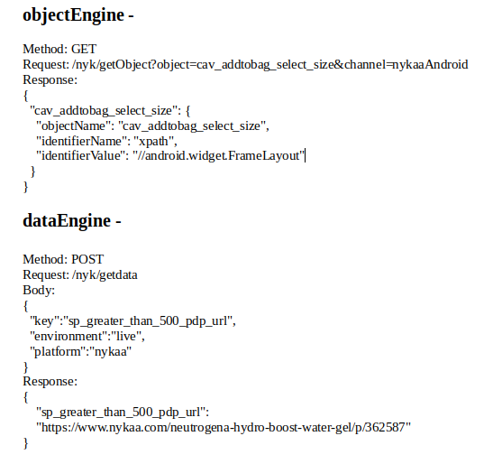
API Signature

Slide 8
Integration Plan
Git repo and Execution environment setup.
Integration will be done for Apps first, either of Android or iOS can be picked up.
First common User Journey will be rolled out using fixed / static data and then those with dynamic data.
Jenkins integration, if required.
Rest as required -

Slide 9
Q&A
Lets see Demo and then Questions ….

