Slide 1
Portfolio Management
Ms. Alexandra Koslishnyick
Notes:
Objective

Slide 2
AGENDA
Objective
Background
Key findings
Recommendations
Appendix:
Data sources
Data methodology
Data model validations
Notes:
Objective

Slide 3
OBJECTIVE
Stock Analysis from different Industry Group with respect to Market Index.
Portfolio Creation based on the Stock Analysis & Investor Persona.
Provide recommendations to our investor - Ms. Alexandra Koslishnyick.
Notes:
Objective

Slide 4
BACKGROUND
Market Index S&P500.
We are provided with 12 different stock price data from 4 Industry Groups along with Market Index S&P500 data.
The dataset contains 10 years data from 1st Oct 2010 to 30th Sep 2020.
Investor wishes to invest in stocks which shows promise but are also stable.
Notes:
Objective

Slide 5
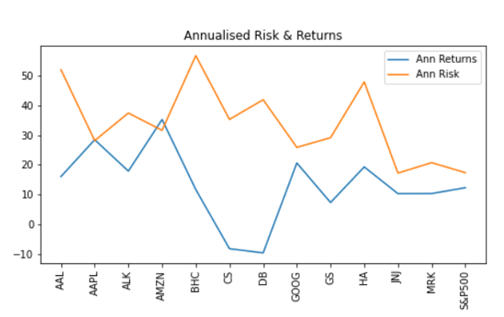
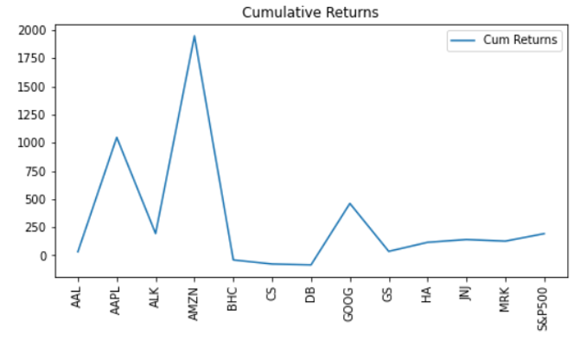
TECHNOLOGY – GOOD CHOICE FOR INVESTMENT
Amazon has highest Returns followed by Apple & Google while Deutsche Bank has lowest Returns.
Bausch Health is most risky asset followed by American Airlines Group & Hawaiian Holdings while Johnson & Johnson is least risky asset.
Stocks from Finance, Healthcare and Technology are correlated with S&P500.
Notes:
Objective

Slide 6
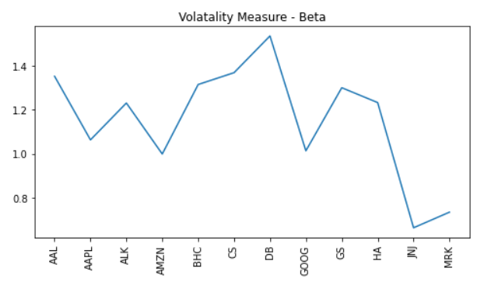
TECHNOLOGY HAS STRONG CORRELATION WITH MARKET
High Volatile Stocks are American Airlines, Alaska, Bausch Health, Credit Suisse, Deutsche Bank, Goldman Sachs & Hawaiian Holdings.
Apple, Amazon and Google are correlated with the market.
Less Volatile Stocks are Johnson & Johnson and Merck and CO.
Notes:
Objective

Slide 7
HIGH RETURNS VS LOW RISK TRADE-OFF
Google, Apple, Amazon - Low Risk, High Returns
Deutsche Bank, Credit Suisse, Bausch Health - Negative Cumulative Returns, High Risk
American Airlines Group - Good Returns, High Risk
Goldman Sachs - Good Returns, Low Risk
Alaska Air Group - Good Returns, Less Risk
Hawaiian Holdings - High Returns, High Risk
Johnson & Johnson, Merck and CO - High Returns, Less Risk
Notes:
Objective

Slide 8
RECOMMENDATIONS
Stocks selected are Google, Apple, Goldman Sachs and Alaska Air Group.
Portfolio Beta is 1.1524
Portfolio Returns is 14.1%
Notes:
Objective

Slide 9
APPENDIX - DATA SOURCES:
Here is a snapshot of our data dictionary.
Stock Attributes are Volume, Open, Close, High, Low & Adjusted Close Price.
Stocks belong to Technology, Aviation, Finance & Healthcare Industry.
The team used the following data sources:
NYSE Stock Data
Benchmark/Market Index S&P500 data
The team conducted an interview with Investor to understand and formulate the requirement.
Notes:
Objective

Slide 10
APPENDIX - DATA METHODOLOGY
We conducted a thorough analysis of the stocks. The process included:
Cleaning the data set and fix the incorrect columns.
Concatenated the files to single dataset and kept required columns.
Performed calculations of various metrics such as Daily/Annualized Returns, Risk/Volatility, Cumulative Returns & Correlation Analysis using various plots.
Notes:
Objective

Slide 11
APPENDIX - DATA VALIDATIONS
CAPM Model for calculation of Expected Returns, Portfolio Beta and Portfolio Returns.
CAPM Validation using Sharpe Ratio which is 0.58 and Portfolio Risk is 22.91%.
Stock Price Prediction using VAR method and evaluation using RMSE & MAPE values.
Notes:
Objective

