Slide 1
Session 1: Window Functions

Slide 2
Rank: Syntax
RANK() OVER (
PARTITION BY <expression>[{,<expression>...}]
ORDER BY <expression> [ASC|DESC], [{,<expression>...}]
)
Types of Rank:
RANK(): Rank of current row within its partition, with gaps
DENSE_RANK(): Rank of current row within its partition, without gaps
PERCENT_RANK(): Percentage rank value
Note: We’ll cover PARTITION BY at a later stage

Slide 3
Dense and Percent Ranks: Syntax
DENSE_RANK() OVER (
PARTITION BY <expression>[{,<expression>...}]
ORDER BY <expression> [ASC|DESC], [{,<expression>...}]
)
PERCENT_RANK() OVER (
PARTITION BY <expression>[{,<expression>...}]
ORDER BY <expression> [ASC|DESC], [{,<expression>...}]
)
Note: We’ll cover PARTITION BY at a later stage

Slide 4
Row Number Rank: Syntax
ROW_NUMBER() OVER (
PARTITION BY <expression>[{,<expression>...}]
ORDER BY <expression> [ASC|DESC], [{,<expression>...}]
)
Note: We’ll cover PARTITION BY at a later stage

Slide 5
Named Windows
WINDOW window_name AS (window_spec)
[, window_name AS (window_spec)] ...
SELECT
FROM
[JOIN]
WHERE
GROUP BY
HAVING
WINDOW
ORDER BY
It appears after the FROM table_name and the GROUP BY section of the query.
Each WINDOW clause within the same query must have a unique name.
The WINDOW function appears before the ORDER BY function.

Slide 6
Frames
Row 1
Row 1
Row 2
Row 2
Row 3
Row 3
Row 4
Row 4
Row 5
Row 5
Row 6
Row 6
Row 7
Row 7
Row 8
Row 8
Row 9
Row 9
Row 10
Row 10
Row 11
Row 11

Slide 7
Frames
frame_clause:
frame_units frame_extent
frame_clause
frame_units
frame_extent
ROWS
frame_start
frame_end
frame_between
RANGE
BETWEEN frame_start AND frame_end
CURRENTROW
UNBOUNDED PRECEDING
UNBOUNDED FOLLOWING
expr PRECEDING
expr FOLLOWING

Slide 8
Frames: Examples
Row 1
ORDER BY X ROWS 3 PRECEDING
ORDER BY X ROWS BETWEEN 1 PRECEDING AND 1 FOLLOWING
ORDER BY X ASC ROWS BETWEEN 1 FOLLOWING AND 3 FOLLOWING
ORDER BY X DESC ROWS BETWEEN 1 FOLLOWING AND UNBOUNDED FOLLOWING
Row 11
Row 2
Row 10
Row 3
Row 9
Frame
Row 4
Row 8
Row 5
Current Row
Frame
Row 7
Row 6
Row 6
Row 7
Current Row
Frame
Row 5
Row 8
Row 4
Row 9
Row 3
Frame
Row 10
Row 2
Row 11
Row 1

Slide 9
Lead and Lag Functions: Syntax
LEAD() function:
LEAD(expr[, offset[, default]])
OVER (Window_specification | Window_name)
LAG() function:
LAG(expr, [, offset[, default]])
OVER (Window_specification | Window_name)
The ‘lead’ function is for including the next row, wheras the ‘lag’ function is for including the previous row.

Slide 10
Session 2: Programming Constructs and Stored Functions

Slide 11
Case Statements: Syntax
CASE
WHEN condition1 THEN result1
WHEN condition2 THEN result2
.
.
.
.
WHEN conditionN THEN resultN
ELSE result
END as column_name;

Slide 12
User-Defined Functions (UDFs)
CREATE FUNCTION is a DDL Statement.
Syntax:
CREATE FUNCTION function_name(func_parameter1, func_parameter2, ..)
RETURN datatype [characteristics]
/* func_body */
BEGIN
<Mysql Statements>
RETURN expression;
END
The function body must contain one RETURN statement.

Slide 13
Stored Procedure: Syntax
Stored procedure:
DELIMITER $$
CREATE PROCEDURE Procedure_name (<Parameter List>)
BEGIN
SQL Statement of the stored procedure
END$$
DELIMITER ;
Call statement:
CALL Procedure_name;

Slide 14
Function vs Stored Procedure
Function
Stored Procedure
A function supports only the input parameter, not the output.
It cannot call a stored procedure.
It can be called using any Select statement.
It must return a value.
Only Select operation is allowed.
A stored procedure supports in, out, and in-out parameters.
It can call functions.
It can be called using only a CALL statement.
It need not return a value.
All database operations are allowed.

Slide 15
Session 3: Query Optimisation and Best Practices

Slide 16
Best Practices
Write appropriate comments.
Always use table aliases when your SQL statement involves more than one source.
Assign simple descriptive names to columns and tables.
Write keywords of SQL in all caps and the names of columns, tables, and variables in lower case.
Always use column names in the ORDER BY clause instead of numbers.
Maintain the right indentation for different sections of a query.
Use new lines for different sections of a query.
Use a new line for each column name.
Use the SQL Formatter or the MySQL Workbench Beautification tool (Ctrl+B).

Slide 17
Index: Syntax
Index is a DDL statement.
Creating an index
CREATE INDEX index_name ON table_name ( column1, column2,...);
Adding an index
ALTER TABLE table_name ADD INDEX index_name(column1,column2,….);
Dropping an index:
ALTER TABLE table_name DROP INDEX index_name;

Slide 18
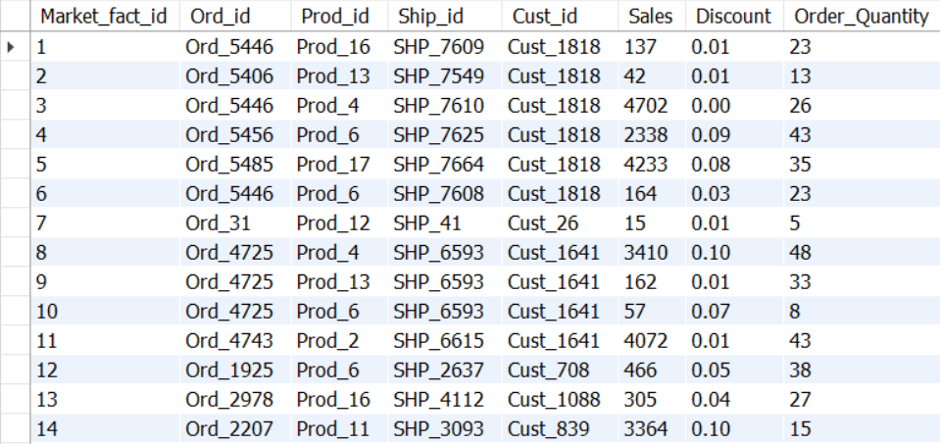
Types of Indices
Clustered Index
Non-Clustered Index

Slide 19
Clustered Index vs Non-Clustered Index
Clustered Index
Non-Clustered Index
This is mostly the primary key of the table.
It is present within the table.
It does not require a separate mapping, as this index is part of the table.
It is faster than a non-clustered index.
It is a combination of one or more columns of the table.
The unique list of keys is present outside the table
The external table will point to different sections of the main table.
It is slower than a clustered index.

Slide 20
Order of Query Execution
FROM (including JOINs)
WHERE
GROUP BY
HAVING
WINDOW functions
SELECT
DISTINCT
ORDER BY
LIMIT and OFFSET

Slide 21
Session 4: Problem-Solving with SQL

Slide 22
Profitability Analysis
Problem statement: The growth team wants to identify sustainable (profitable) product categories.
Sustainability can be achieved when we make large profits or at least positive profits.
We can look at the total profits per product category.
We can look at the total profits per product subcategory.
We can check the average profit per order
We can also consider the average profit % per order
Tables that we will use:
market_fact_full
prod_dimen
orders_dimen

Slide 23
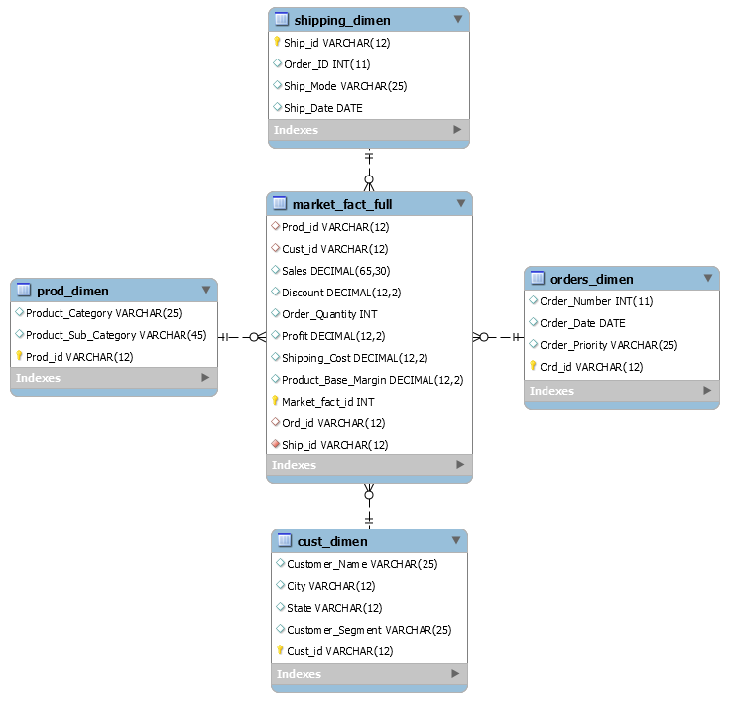
Schema

Slide 24
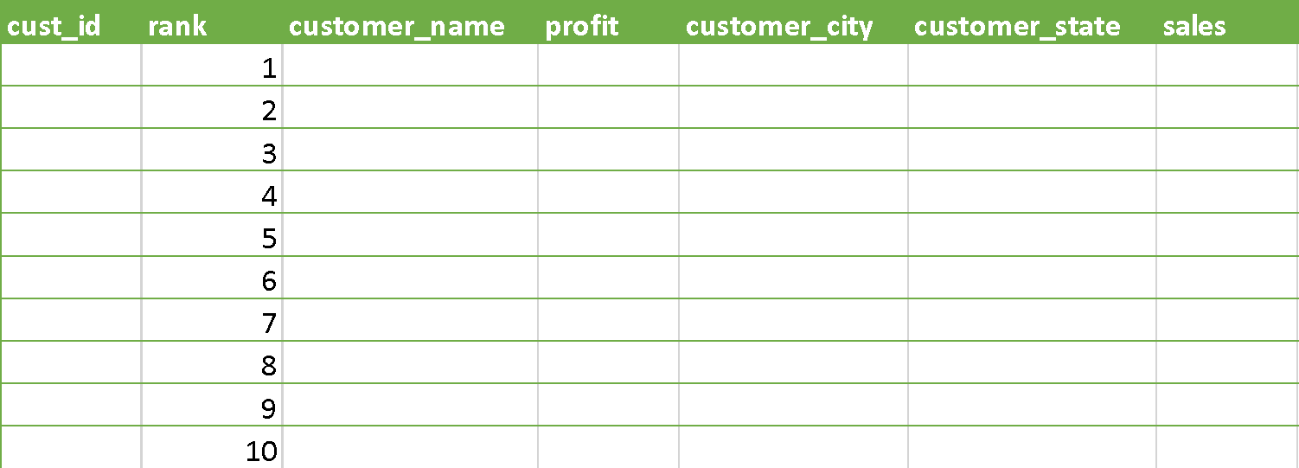
Profitable Customers
Problem statement: Extract the details of top 10 profitable customers in the form of the table given below.
Tables that we will use:
cust_dimen
market_fact_full

Slide 25
Schema

Slide 26
Customers Without Orders
Problem statement: Share the following details of the customers who have not placed any order yet:
Cust_id
Customer_Name
City
State
Customer_Segment
Flag to indicate that there is another customer with the exact same name and city but a different customer ID (to understand if the same customer signed up again)
Tables that we will use:
cust_dimen
market_fact_full

Slide 27
Schema

