Slide 1
Team Data Pirates presents:
Bloom
A solution towards healthy and beautiful skin

Slide 2
THE PROBLEM
PROBLEM
CAUSES
There are several skin diseases like Melasma, Vitiligo, caused due to unhealthy skin
These diseases occur because people are unaware of the skin type.
Hence, identification of the skin type is of utmost need.
Normal
Oily
Dry

Slide 3
OUR SOLUTION
1
Skin Type
Nearby Clinics
4
Using AI, know your skin type - Dry or Oily
Visit the derma clinics within reach
2
Diagnosis
Book Appointment
3
Check if you got any skin disease using robust DL model.
Check empty slots to consult with dermatologist.

Slide 4
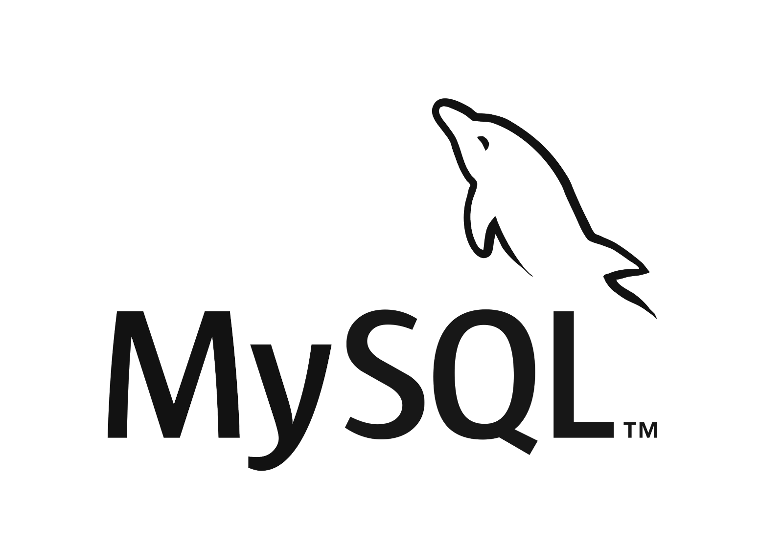





Tech Stack
FrontEnd:
HTML/CSS/
Photoshop
Database:
MySQL
Automation:
Selenium Bot
BackEnd:
Flask
Image Recognition:
Deep Learning

Slide 5
DEMO

Slide 6
BUSINESS MODEL
Customer relationship:
>Helps users keep to book an appointment
>checking type of skin
>Prescription History
>Diagnosis for skin disease
Key activities:
>Classification of skin type - Dry or Oily
>Diagnosis of skin disease
>Booking appointment
> Searching nearby clinics
>Prescriptions data history
Value proposition:
>Knowing the skin type
>Skin disease diagnosing
Channels:
>Web application
>Website
>Developers tools and API
Customer segment:
Get to know the type of skin, diagnosis of any disease, prescription history, booking online appointment and have a virtual meet.
Key resources:
Skin type and disease knowledge.
Key partners:
Dermatologists
Premium Users
Cost Structure:
>Developing server
>Website and program maintenance
>Extracting models
>Technical and health expert incentives
>Marketing
Revenue streams:
>Premium users will get personalised skin care routines.
>Giving dermatologist suggestion

Slide 7
THANK
YOU

