Slide 1


Slide 2
Project Presentation On Student Management System
Presenter : 1.Sakshi Kulkarni
2.Prajkta Iratkar
3.Vaibhavi Kaware
4.Mohini Chavan
5.Madhavi Varpe
Guided By
Batch No:6521 Indrakka Malli Mam

Slide 3
Introduction
The project “ Student Management System” is developed using Spring boot framework,which mainly focuses on basic operations of student information system. Like Inserting,Deleting,Updating and getting all records of students information.

Slide 4
Student Module
In the student module the students can perform :
1.Fetch all students records.
2.Fetch student record by student id.
3.Fetch student record by student email.
4.Fetch student record by student name.
5.One student can eligible to apply for many courses.

Slide 5
Course Module
In the Course Module :
We can fetch all the course details as well as student details .
We can get the student details and delete the record by using course id.

Slide 6
Objectives
It provides “better and efficient” service”.
Faster way to get information about the students.
Provide facility for proper monitoring and reduce paper work .
All details will be available on a click.

Slide 7
System Overview
The Student management system will be automated the traditional system.
There is no need to use paper and pen.
Checking a student details is very easy.
Adding new student record is very easy.
Deleting or updating a record of a particular student is simple.

Slide 8
Software Requirements
Operating System: Windows /7/8/10/11
Data base: Mysql
Framework: Spring Boot
Development Tools: STS and postman as client

Slide 9
Database Table Design Table: Student Data
Si NO | Field Name | Data Type
1 | ID | Int
2 | Name | String
3 | Email | String
4 | Fees | String
5 6 | Username Password | String String

Slide 10
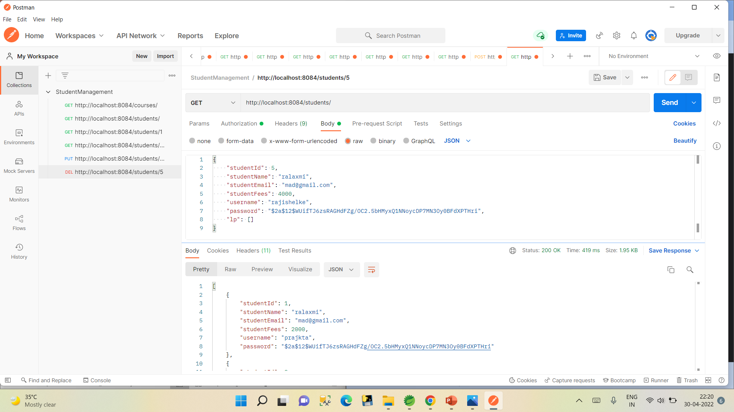
FETCH DATA

Slide 11
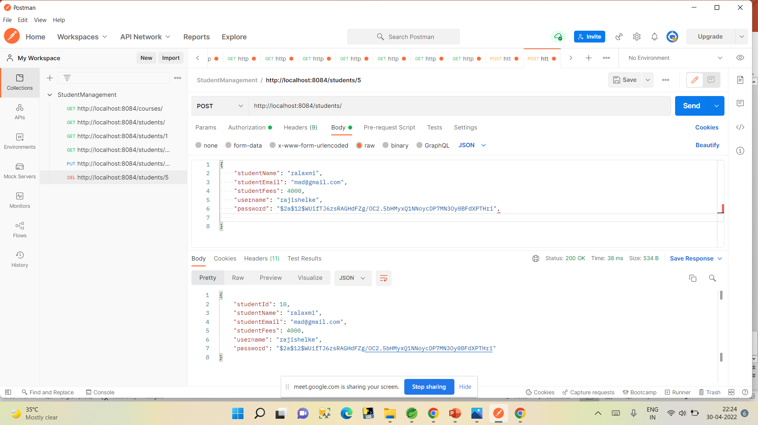
INSERT DATA

Slide 12
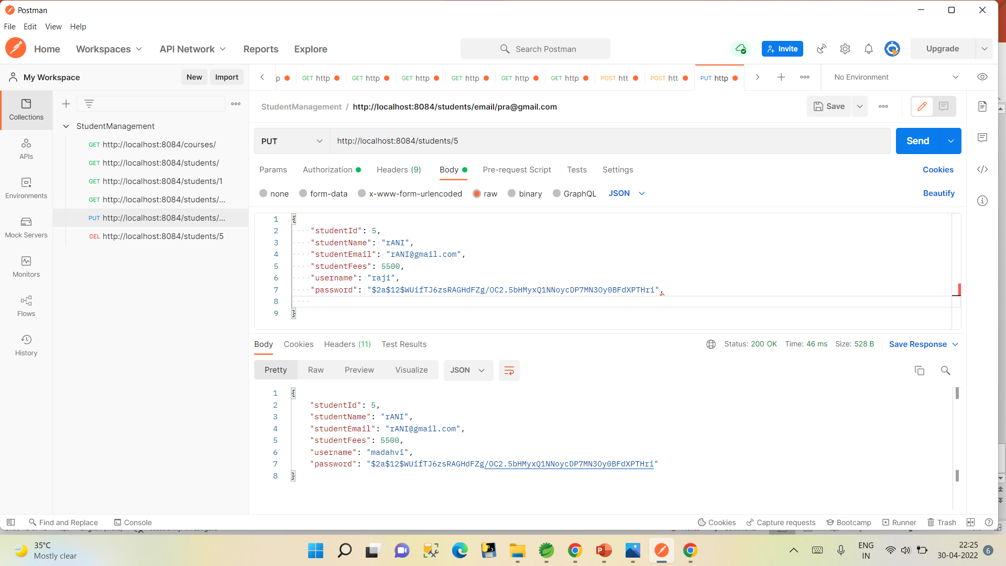
UPDATE DETAILS

Slide 13
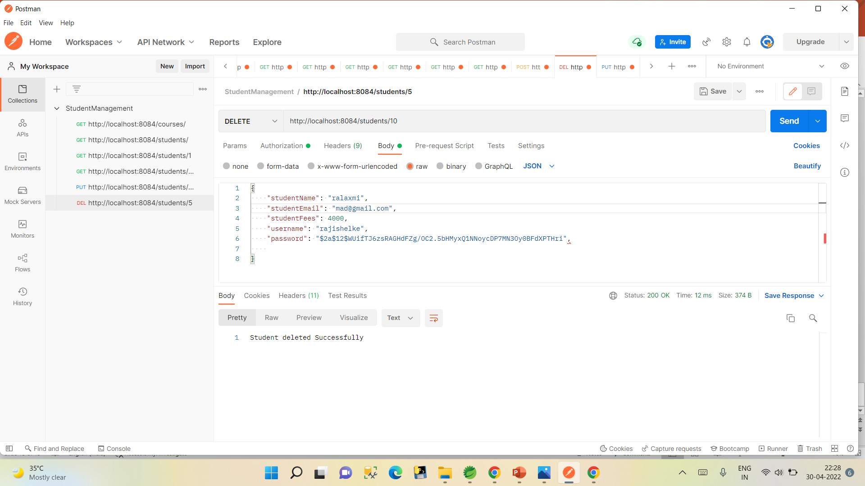
DELETE RECORD

Slide 14
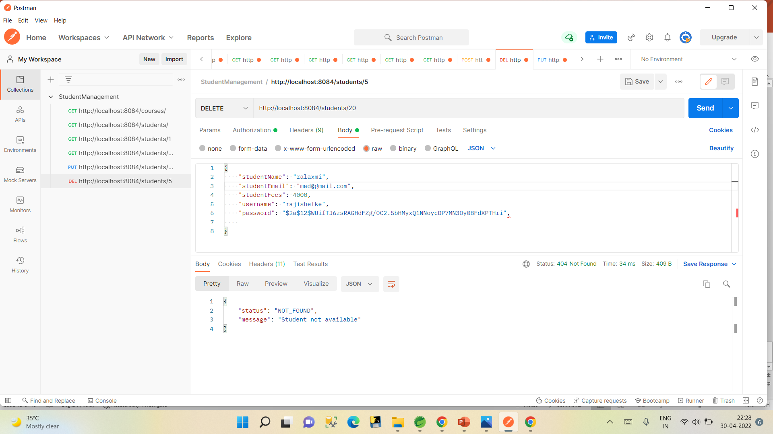
EXCEPTION

Slide 15
FUTURE SCOPE
A few more minor tweaks an there for the application more visually appealing and have statistics and analytics.
The whole project will available for far more ease of use and mobility.

Slide 16
THANK YOU!!

