Slide 1
Curve Modeling
Bézier Curves
Dr. S.M. Malaek
Assistant: M. Younesi

Slide 2
Introduction
Given such a parametric form, it is difficult to know the underlying geometry it represents without some further analysis.
It is almost impossible to predict the change of shape if one or more coefficient are modified.

Slide 3
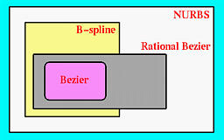
Introduction
Bézier, B-spline and NURBS curves advantage:
A user layouts a set of control points for the system.
A user can change the positions of some control points and some other characteristics for modifying the shape of curve.

Slide 4
Introduction
If necessary, a user can add control points.
They are very geometric, intuitive.
The transition from curve to surface will not cause much difficulty.

Slide 5
Bézier
Curves

Slide 6
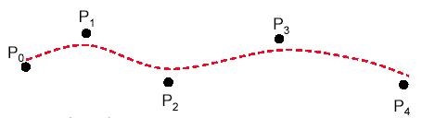
Bézier Curves
Bézier splines are:
spline approximation method;
useful and convenient for curve and surface design;
easy to implement;
available in Cad system, graphic package, drawing and painting packages.

Slide 7
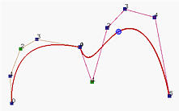
Bézier Curves
In general, a Bézier curve section can be fitted to any number of control points.
The number of control points to be approximated and their relative position determine the degree of the Bézier polynomial.

Slide 8
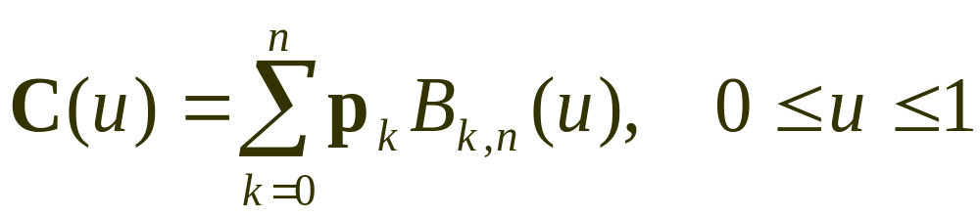
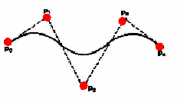
Bézier Curves
Given n+1 control point positions:
These coordinate points can be blended to produced the following position vector C(u), which describes the path of an approximating Bézier polynomial function between P₀ and P_{n}.

Slide 9
Properties
of
Bézier ‍Curves

Slide 10
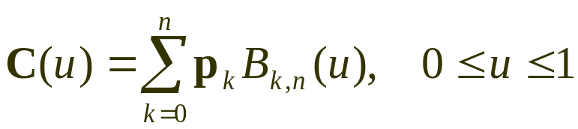
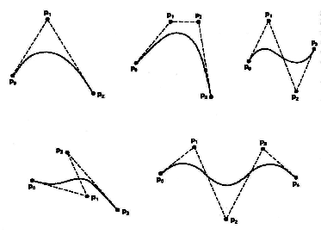
Properties of a Bézier ‍Curve
The degree of a Bézier curve defined by n+1 control points is n:
Parabola Curve
Cubic Curve
Cubic Curve
Cubic Curve

Slide 11
Properties of a Bézier ‍Curve
The curve passes though the first and the last control point C(u) passes through P₀ and P_{n}.

Slide 12
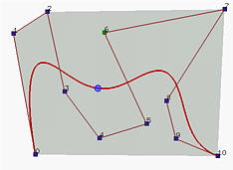
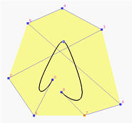
Properties of a Bézier ‍‍‍Curve
Bézier curves are tangent to their first and last edges of control polyline.
2
7
4
6
5
1
3
3
8
2
0
5
8
9
6
0
4
10
1
7

Slide 13
Properties of a Bézier Curve
The Bézier curve lies completely in the convex hull of the given control points.
Note that not all control points are on the boundary of the convex hull. For example, control points 3, 4, 5, 6, 8 and 9 are in the interior. The curve, except for the first two endpoints, lies completely in the convex hull.

Slide 14
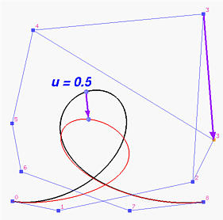
Properties of a Bézier ‍‍Curve
Moving control points:

Slide 15
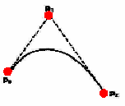
Properties of a Bézier ‍‍Curve
Moving control points:

Slide 16
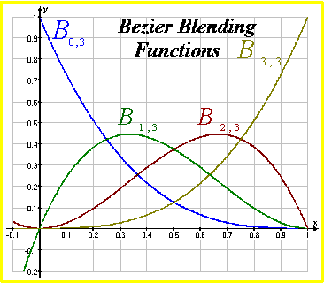
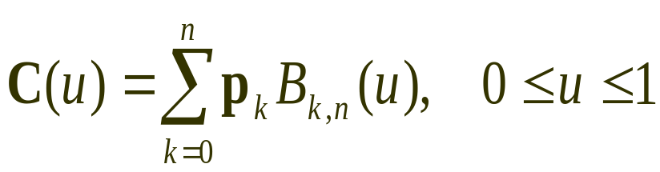
Bézier Curves
The point that corresponds to u on the Bézier curve is the "weighted" average of all control points, where the weights are the coefficients B_{k,n}(u).

Slide 17
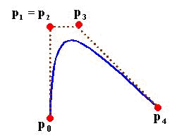
Design Techniques Using Bézier ‍Curve
(Weights)
‍‍Multiple control points at a single coordinate position gives more weight to that position.

Slide 18
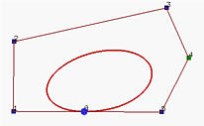
Design Techniques Using Bézier ‍Curve
(Closed Curves)
‍‍Closed Bézier curves are generated by specifying the first and the last control points at the same position.
4
5
3
2
0
8
6
1
7
‍‍Note: Bézier curves are polynomials which cannot represent circles and ellipses.

Slide 19
Properties of a Bézier Curve
If an affine transformation is applied to a Bézier curve, the result can be constructed from the affine images of its control points.

Slide 20
Construction
of
Bézier ‍Curves

Slide 21
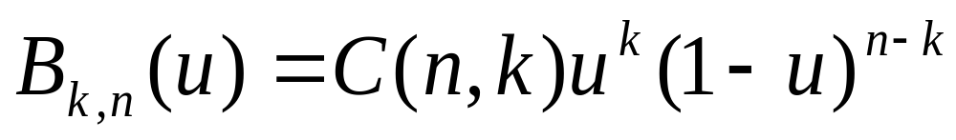
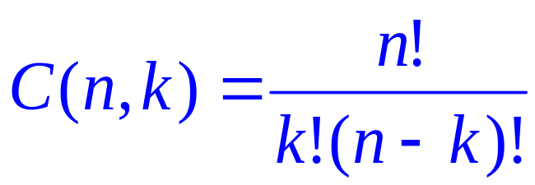
Bézier Curves
Given n+1 control point positions:
The Bézier blending functions are the Bernstein polynomials:
The C(n,k) are the binomial coefficients:

Slide 22
Cubic equation with four control points
P(t) = B₀(1-t)³ + B₁3t(1-t)² + B₂3t²(1-t) + B₃t³
^{(B0,B1,B2,B3} are control points)
Example:
B₀[1 0] , B₁[3 3] , B₂[6 3] , B₃[8 1]
X(t) = [1](1-t)³ + [3]3t(1-t)² + [6]3t²(1-t) + [8]t³
Y(t) = [0](1-t)³ + [3]3t(1-t)² + [3]3t²(1-t) + [1]t³
Change the value of t from 0 to 1 by .1 and find the values

Slide 23
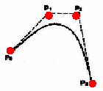
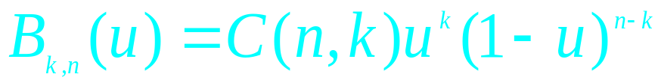
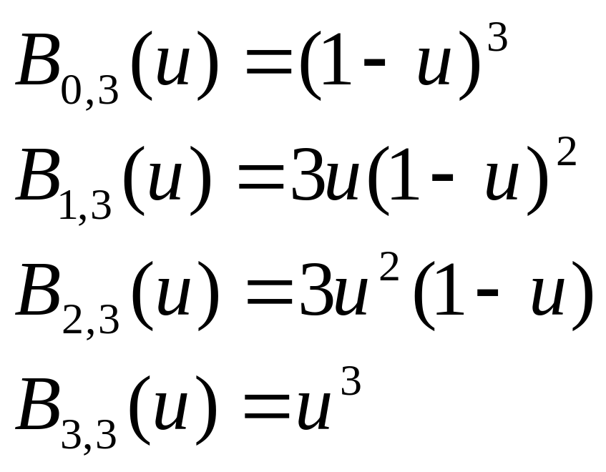

Example
Cubic Bézier Curves
Cubic Bézier curves are generated with four control points.
The four blending functions for cubic Bézier curves (n=3):

Slide 24
Cubic
Bézier Curves

Slide 25
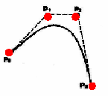
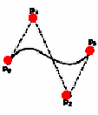
Cubic Bézier Curves
Cubic Bézier curves gives reasonable design flexibility while avoiding the increased calculations needed with higher order polynomials.

Slide 26
Cubic Bézier Curves
Cubic Bézier curves are generated with four control points.
The four blending functions for cubic Bézier curves (n=3):

Slide 27
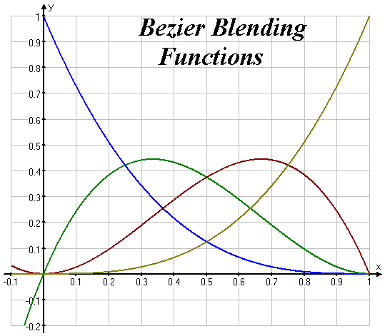
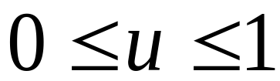
Cubic Bézier Curves
At u=0, B_{0,3}=1, and at u=1, B_{3,3}=1. thus, the curve will always pass through control points P₀ and P₃.
The functions B_{1,3} and B_{2,3}, influence the shape of the curve at intermediate values of parameter u, so that the resulting curve tends toward points P₁ and P₃.
At u=1/3, B_{1,3} is maximum, and at u=2/3, B_{2,3} is maximum.

Slide 28
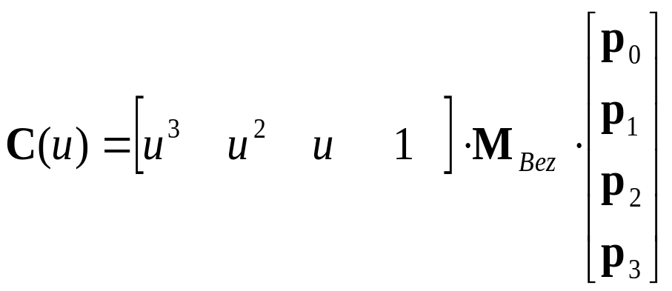
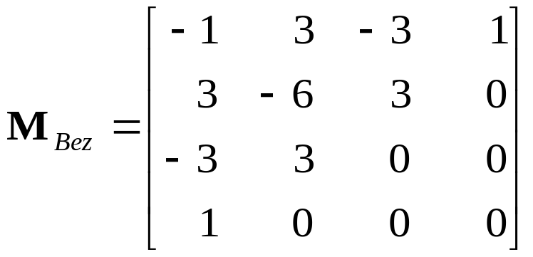
Cubic Bézier Curves
At the end positions of the cubic Bézier curve, The parametric first and second derivatives are:
With C¹ and C² continuity between sections, and by expanding the polynomial expressions for the blending functions: the cubic Bézier point function in the matrix form:

Slide 29
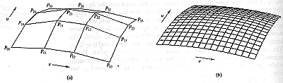

Slide 30
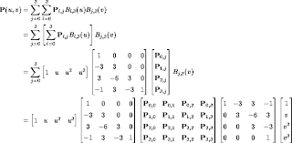

Slide 31
Bezier Surfaces

Slide 32

Recall how we constructed a Bezier Curve
P(t) is a continuous function in 3 space defining the curve with N discrete control points B_{i}. t=0 at the first control point (i=0) and t=1 at the last control point (i=N).
t=1
P(t)
t=0

Slide 33
As in the case of a Bezier curve, it is required to relax strict requirements of cubic spline for a flexible design. A Bezier surface provides this flexibility
The Cartesian or tensor product Bezier surface is
represented as:
n m
B₁ B₂
Q(u, w) = ΣΣ B
B₀
J (u)K (w)
B₁
B₂
i, j n,i
m, j
^{B}0
B₁
B₀
i=0 j =0
B₂B
3
J (u) = ^{n!} u^{i} (1− u)^{n−i}
B
n,i
i!(n − i)!
2
B₀
K (w) = ^{m!} w ^{j} (1− w)^{m− j}
m, j
j!(m − j)!
B₁
B_{ij} are the vertices of the defining polygon net

Slide 34
Properties of Bezier Surfaces
The degree of the surface in each polynomial direction is one less than the number of defining polygon vertices in that direction
The continuity of the surface in each parametric direction is two less than the number of defining polygon vertices
The surface generally follows the shape of the defining polygon net.
The surface is contained in the convex hull of the polygon net.
The surface is invariant under an affine transform
Each of the boundary curve in this case is a Bezier curve

Slide 35
Shape Control
D
C
^{B}0,3 ^{B}1,3 ^{B}2,3 ^{B}3,3
^{B}0,2 ^{B}1,2 ^{B}2,2 ^{B}3,2
^{B}0,1 ^{B}3,1
These vertices influence the twist vectors at A, B, C, D
^{B}1,1 ^{B}2,1
^{B}0,0 ^{B}1,0 ^{B}2,0 ^{B}3,0
A
B
These vertices influence the tangent vector at A

Slide 36
Matrix formulation of Bezier Surface
We can think of a matrix formulation now for Bezier surface. Consider a
similar formulation as used in Bezier curve
Q(u, w) = [U ]N[B][M ][W ]
[U ]= [U ^{n}
[W ]= [W ^{n}
{^{B}0,0
|
_{U} n−1
_{W} n−1
... 1]
... 1]^{T}
Where
… …
%
^{B}0,m †
|
|
B = |
{
%
… …
}
|
|⎝^{B}n,0
|
^{B}n,m |J

Slide 37
Matrix formulation of Bicubic Bezier Surface
We have 4X4 polygon net for a bicubic Bezier surface
J−1 3 − 3
| 3 − 6 3
|− 3 3 0
| 1 0 0
¹]^{JB}0,0
^{B}0,1 ^{B}0,2
^{B}1,1 ^{B}1,2
^{B}2,1 ^{B}2,2
3,1 3,2
^{B}0,3 ]
B
|
[
_{u}2
]
^{0|| B}1,0
Q(u, w) = u³
u
₁ |
||
1,3
|
^{0||B}2,0
^{B}2,3 |
₀||_{B}
|
⎝ J−1 3 − 3 1]Jw³ ]
| 3 − 6 3
|− 3 3 0
| 1 0 0
]⎝
B B B
3,3 ]
3,0
₀||_{w2} |
Q(u, w) = ΣΣ B_{i, j} J_{n,i} (u)K_{m, j} (w)
i=0 j =0
× |
|| |
n m
0|| _{w} |
₀|| ₁ |
⎝
]|⎝ |]

Slide 38
Derivatives of a Bezier Surface
We find the derivatives w.r.t u,w and the cross derivative
Q(u, w) = ΣΣ B_{i, j} J_{n,i} (u)K_{m, j} (w)
i=0 j =0
n m
Q_{u} (u, w) = ΣΣ B_{i, j} J_{n}′_{,i} (u)K_{m, j} (w)
i=0 j =0
Q_{w} (u, w) = ΣΣ B_{i, j} J_{n,i} (u)K_{m}′ _{, j} (w)
i=0 j =0
Q_{uw} (u, w) = ΣΣ B_{i, j} J_{n}′_{,i} (u)K_{m}′ _{, j} (w)
i=0 j =0
Q_{uu} (u, w) = ΣΣ B_{i, j} J_{n}′_{,i} (u)K_{m, j} (w)
i=0 j =0
Q_{ww} (u, w) = ΣΣ B_{i, j} J_{n,i} (u)K_{m}′_{, j} (w)
i=0 j =0
n m
n m
n m
n m
n m

