Slide 1
ONLINE LEARNING DATABASE

Slide 2
INTRODUCTION
Welcome to the presentation of my SQL project, which focuses on the creation of an online learning database. This project is designed to address the growing need for efficient and scalable database solutions in the realm of online education. With the rapid shift towards digital learning, it's imperative to have a robust system that can manage the intricate details of online courses, user interactions, and educational content delivery.

Slide 3
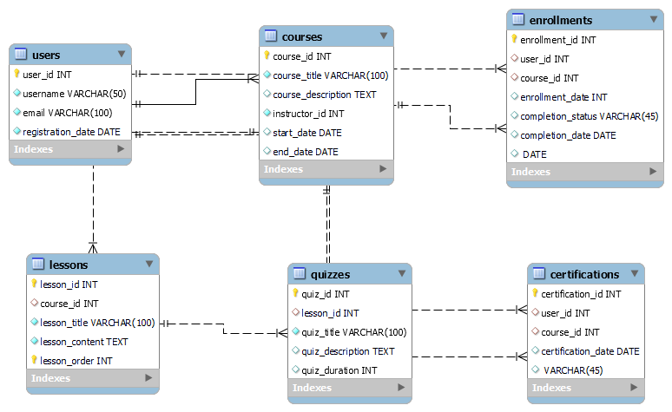
ER DIAGRAM

Slide 4
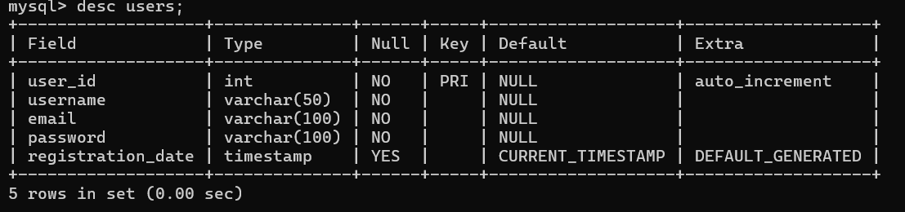
STRUCTURE OF THE TABLE
USERS TAB LE-
This table stores information about user including their user name, user_id and password.
SYNTAX-
Desc users;

Slide 5
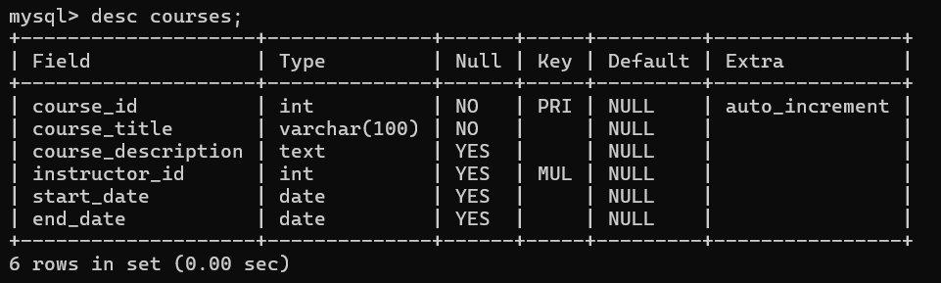
Structure of the table
COUSERS TABLE-
This table stores information about course_id, course_titile, description about course and course starting date and ending date.
Syntax-
Desc courses;

Slide 6
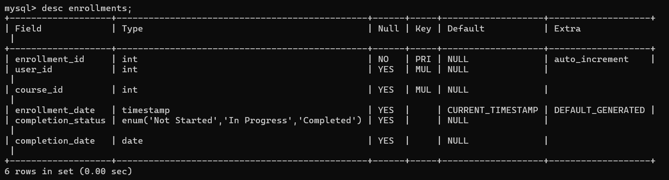
STRUCTURE OF THE TABLE
ENROLLMENTS TABLE-
This table stores information about enrollment_id , enrollment date, and completion status.
Syntax-
Desc enrollments;

Slide 7
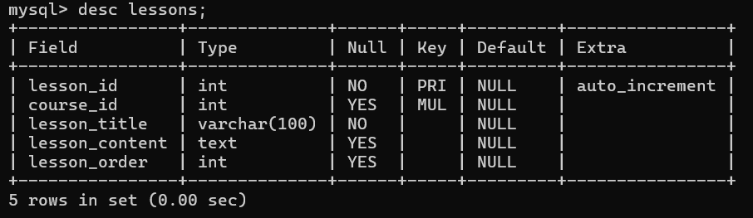
STRUCTURE OF THE TABLE
LESSONS TABLE-
This Table stores information about lessons including lesson_id, lesson title, lesson content
Syntax-
Desc lessons;

Slide 8
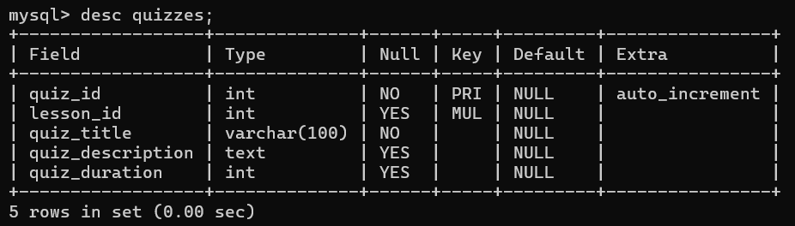
STRUCTURE OF THE TABLE
QUIZZES TABLE-
This table stores information about quizzes including quiz title, description and quiz duration.
Syntax-
Desc quizzes;

Slide 9
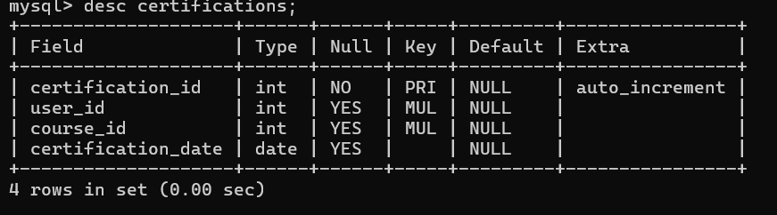
Structure of the table
CERTIFICATION TABLE-
This table stores information about certifications including certification_id and certification_date.
Desc certifications;

Slide 10
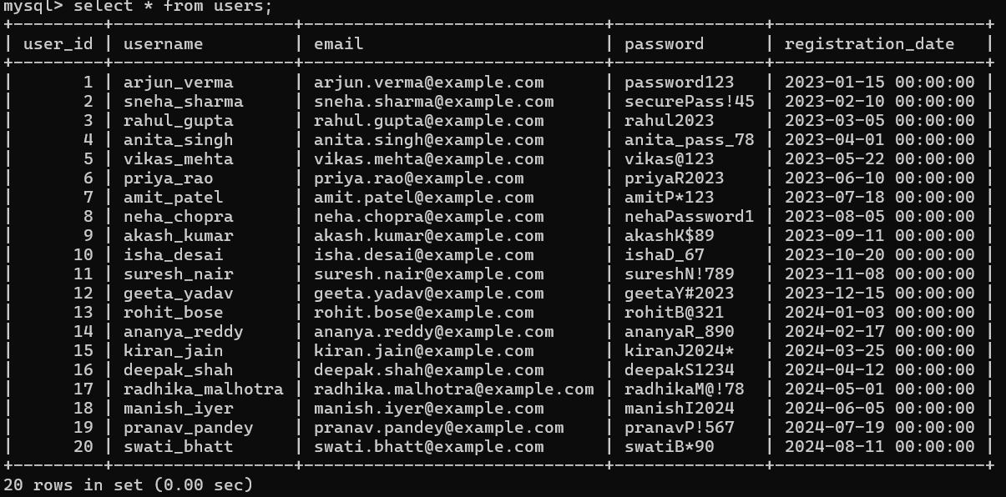
Content of the table

Slide 11
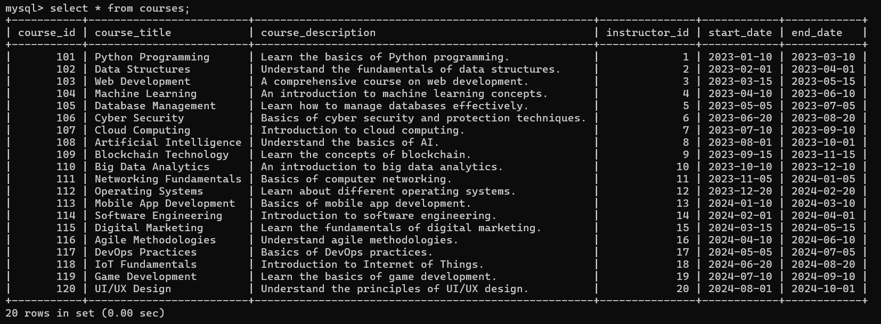
CONTENT OF THE TABLE

Slide 12
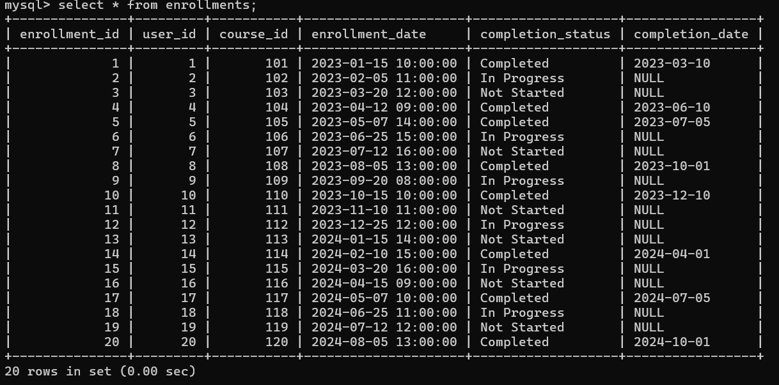
CONTENT OF THE TABLE

Slide 13
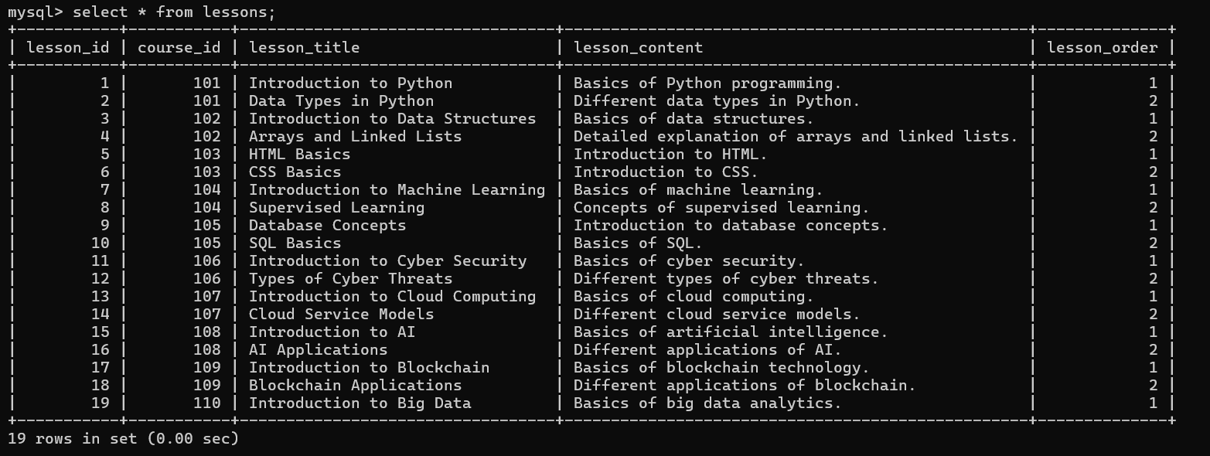
CONTENT OF THE TABLE

Slide 14
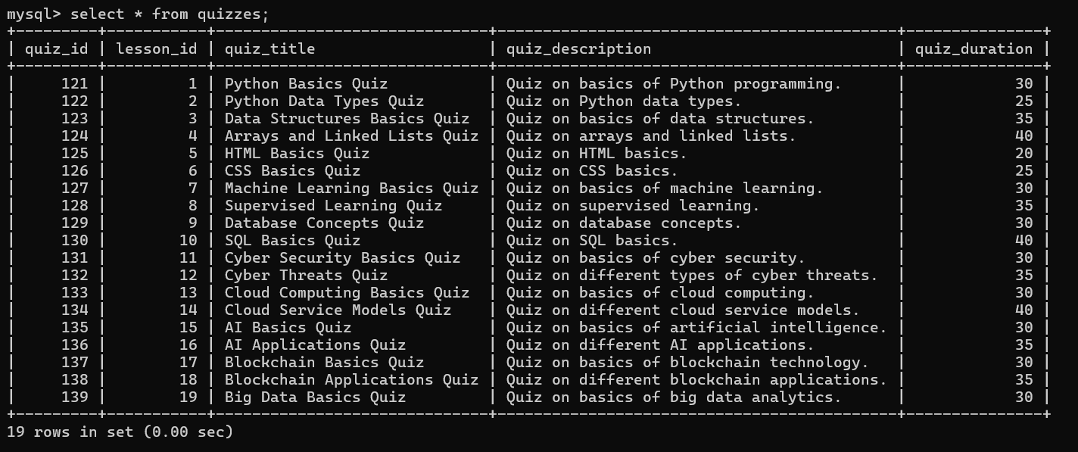
CONTENT OF THE TABLE

Slide 15
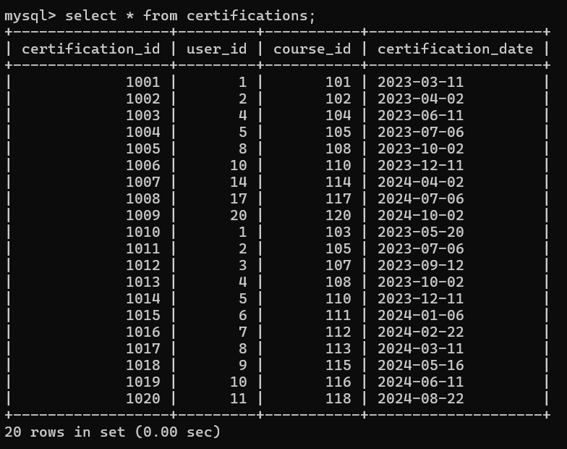
CONTENT OF THE TABLE

Slide 16
subqueries

Slide 17
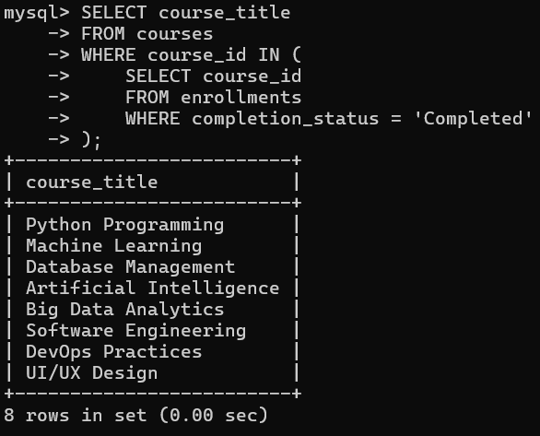
subqueries
List the titles of courses where student has completed the course –
SYNTAX-
SELECT course_title
FROM courses
WHERE course_id IN (
SELECT course_id
FROM enrollments
WHERE completion_status = 'Completed');

Slide 18
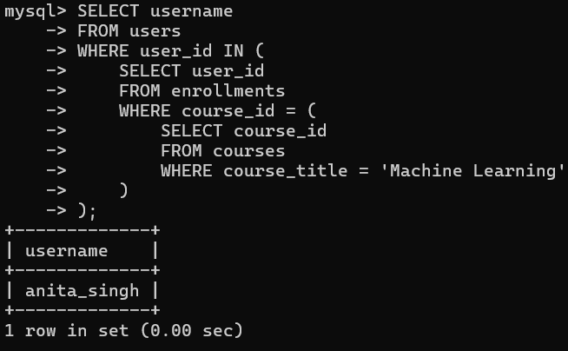
SUBQUERY
Find the names of users who are enrolled in the 'Machine Learning' course-
SYNTAX-
SELECT user_name
FROM users
WHERE user_id IN (
SELECT user_id
FROM enrollments
WHERE course_id = (
SELECT course_id
FROM courses
WHERE course_title = 'Machine Learning’ ));

Slide 19
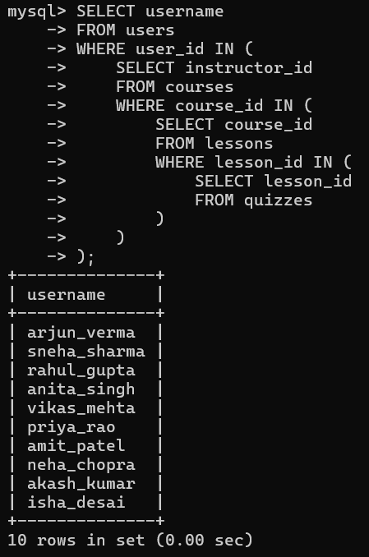
SUBQUERY
Get the list of instructors who are teaching courses that have quizzes-
SYNTAX-
SELECT usernameFROM usersWHERE user_id IN ( SELECT instructor_id FROM courses WHERE course_id IN ( SELECT course_id FROM lessons WHERE lesson_id IN (SELECT lesson_id FROM quizzes )));

Slide 20
JOINS

Slide 21
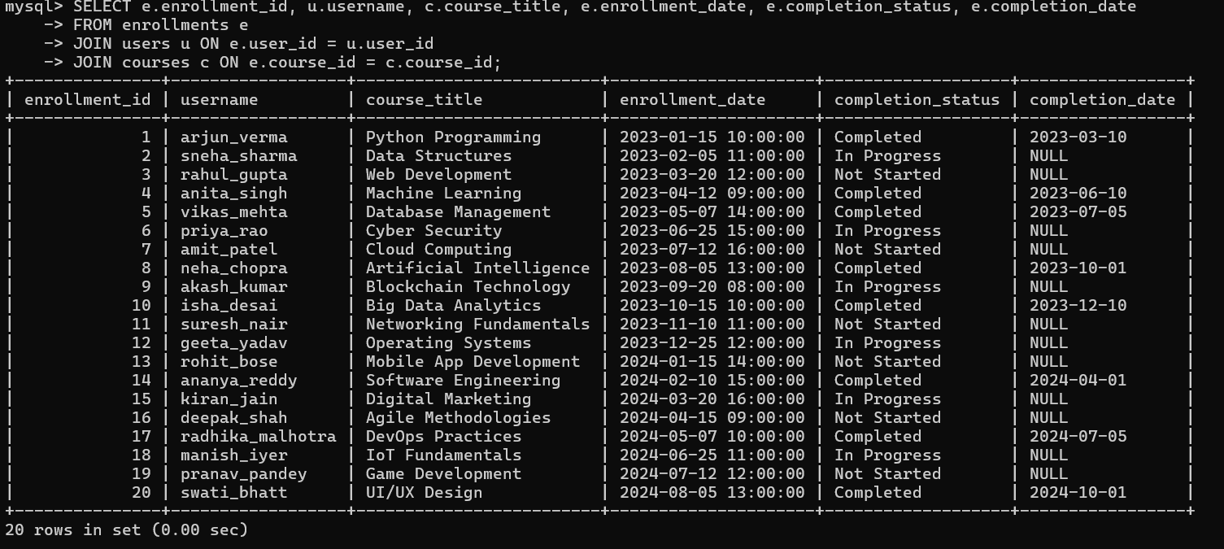
JOINS
List all enrollments with the corresponding user names and course titles-
SYNTAX-
SELECT e.enrollment_id, u.username, c.course_title, e.enrollment_date, e.completion_status, e.completion_date
FROM enrollments e
JOIN users u ON e.user_id = u.user_id
JOIN courses c ON e.course_id = c.course_id;

Slide 22
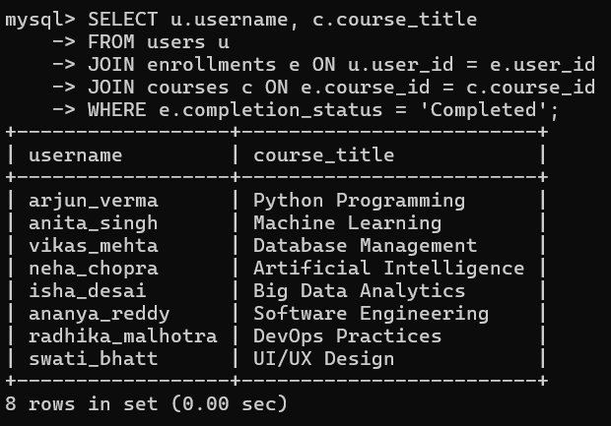
JOINS
Find the names of users along with the titles of the courses they have completed-
SYNTAX-
SELECT u.username, c.course_titleFROM users uJOIN enrollments e ON u.user_id = e.user_idJOIN courses c ON e.course_id = c.course_idWHERE e.completion_status = 'Completed';

Slide 23
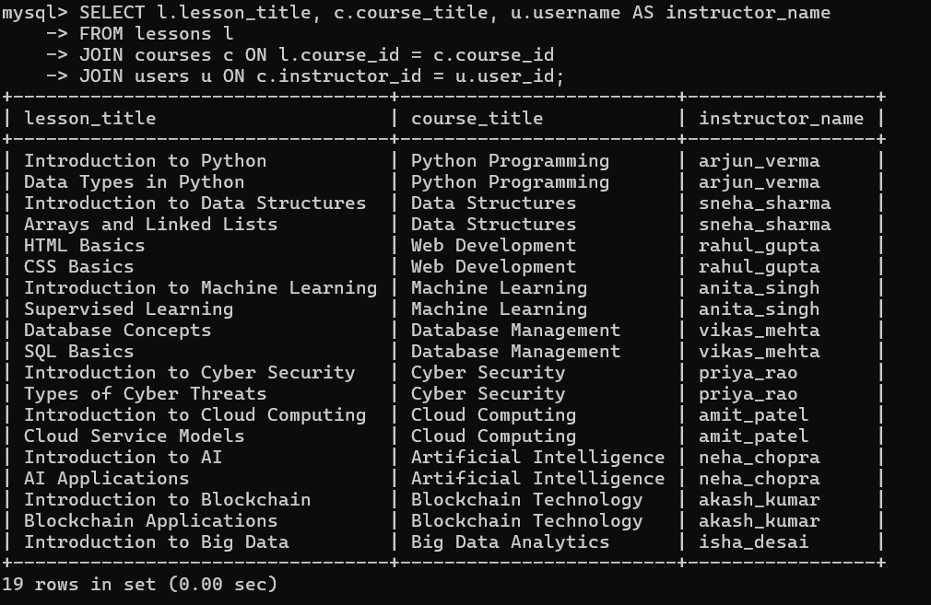
JOINS
List all lessons along with the course
titles they belong to and the
instructor names-
SYNTAX-
SELECT l.lesson_title, c.course_title,
u.usernameAS instructor_name
FROM lessons l
JOIN courses c ON l.course_id =
c.course_id
JOIN users u ON c.instructor_id =
u.user_id;

Slide 24
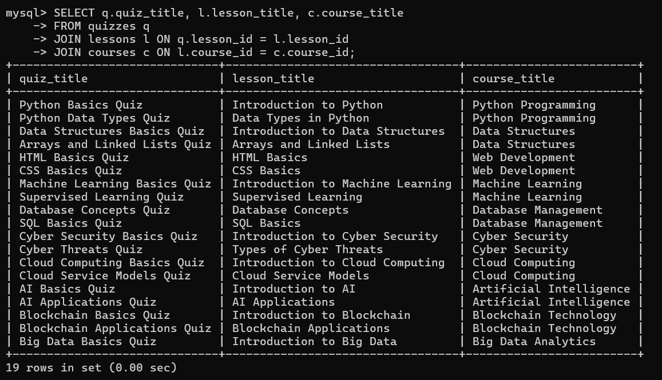
JOINS
Find all quizzes along with the corresponding lesson titles and course titles-
SYNTAX-
SELECT q.quiz_title, l.lesson_title, c.course_titleFROM quizzes qJOIN lessons l ON q.lesson_id = l.lesson_idJOIN courses c ON l.course_id = c.course_id;

Slide 25
THANK YOU
- SAKSHI PATIL

