Slide 1
blinkit
India’s Last Minute App

Slide 2
Objective :
To conduct a comprehensive analysis of Blinkit’s sales performance, customer satisfaction and inventory distribution to identify key insights and opportunities for optimization using various KPIs and visualization in Power BI.
KPIs Requirement :
Total Sales : The overall revenue generated from all items sold.
Average Sales : The average revenue per sales.
Number of Items : The total count of different items sold.
Average Rating : The average customer rating for items sold.

Slide 3
Topics :
Data Cleaning
Data Modeling
Data Processing
DAX Calculation
Dashboard Development

Slide 4
Chart’s Requirement :
Total Sales by Fat Content.
Total Sales by Item Type.
Fat Content by Outlet for Total Sales.
Total Sales by Outlet Establishment.
Sales by Outlet Size.
Sales by Outlet Location.
All Metrics by Outlet Type.

Slide 5
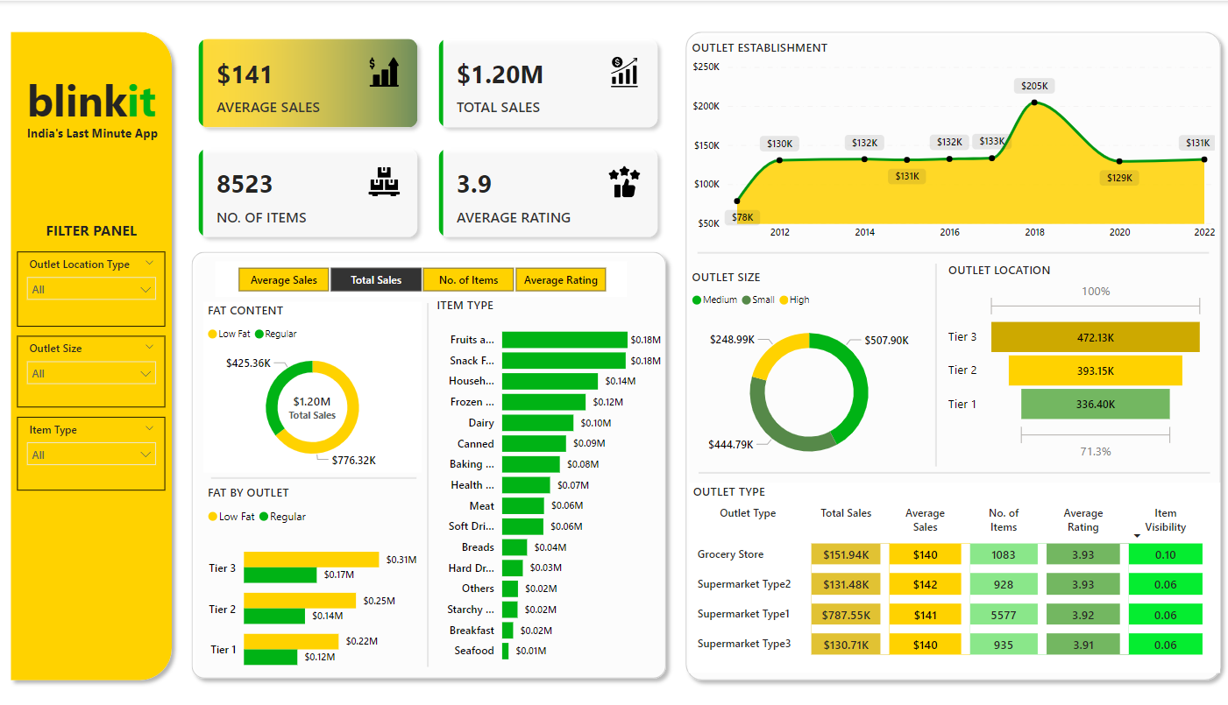
Blinkit Sales Performance Dashboard :

