Slide 1

PROJECT
COFFEE SALES

Slide 2
INTRODUCTION :
With the ever-growing popularity of coffee shops and the diverse range of coffee products available, analyzing coffee sales data has become increasingly important for businesses. By understanding sales trends, customer preferences, and market dynamics, businesses can make informed decisions to optimize their operations, marketing strategies, and product offerings.
This analysis aims to delve into coffee sales data to uncover valuable insights. By examining various aspects such as sales volume, revenue, customer demographics, and product performance, we can identify key trends, opportunities, and challenges within the coffee industry. The findings from this analysis will provide valuable information for businesses to improve their overall performance and stay competitive in the dynamic coffee market.

Slide 3
Tools and Techniques
Python Libraries :
Pandas:
Data manipulation and analysis
Reading and writing various file formats (CSV, Excel, etc.)
Data cleaning and preprocessing
Time series analysis
NumPy:
Numerical operations on arrays
Mathematical computations
Matplotlib and Seaborn:
Data visualization
Creating various plots (line plots, bar charts, histograms, etc.)
Scikit-learn:
Machine learning algorithms
Model building and evaluation

Slide 4
Techniques :
Exploratory Data Analysis (EDA):
Data Cleaning: Handle missing values, outliers, and inconsistencies.
Data Summarization: Calculate summary statistics (mean, median, mode, standard deviation, etc.).
Data Visualization: Create visualizations to understand data distribution, trends, and relationships.
Product Analysis:
Product Performance: Analyze sales of different products to identify best-sellers and underperforming items.
Product Bundling: Identify products that are often purchased together to create effective bundles.
Machine Learning:
Predictive Modeling: Build models to predict future sales, customer churn, or product demand.
Recommendation Systems: Recommend products to customers based on their purchase history and preferences.

Slide 5
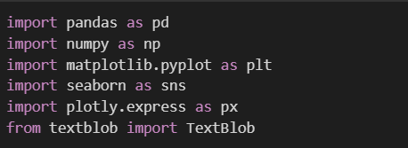

IMPORTING LIBRARIES OF PYTHON
IMPORTING DATA OF COFFEE SALES

Slide 6
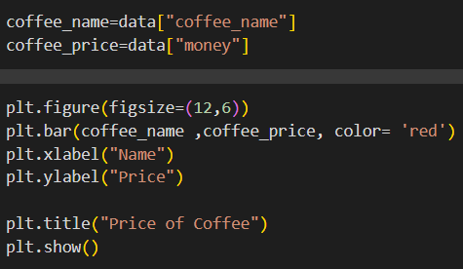
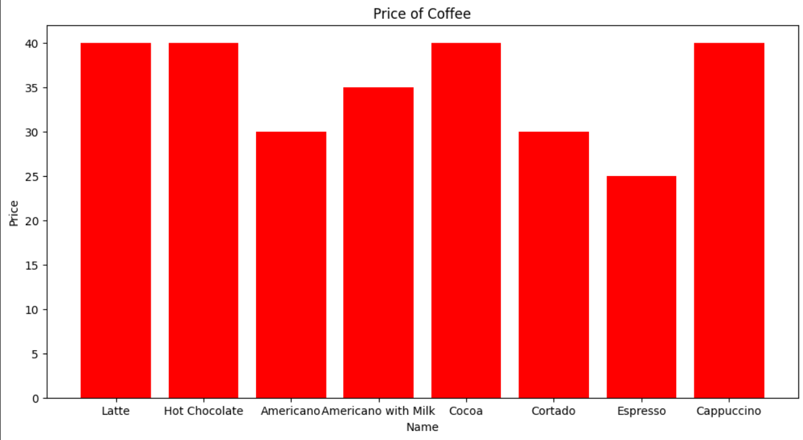
PRICE OF EACH COFFEE.

Slide 7
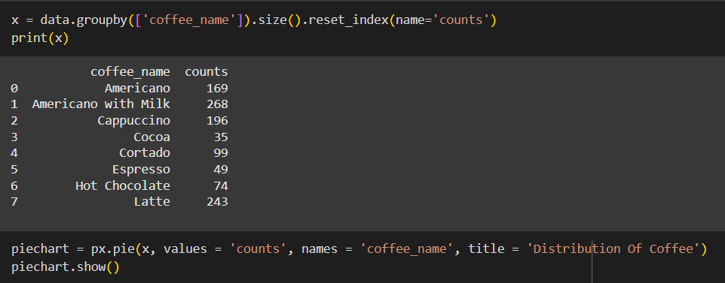
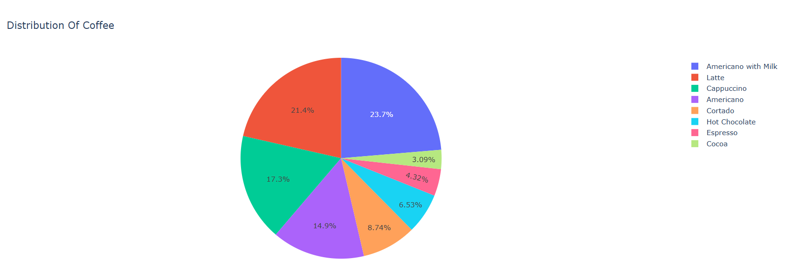
DISTRIBUTION OF COFFEE

Slide 8
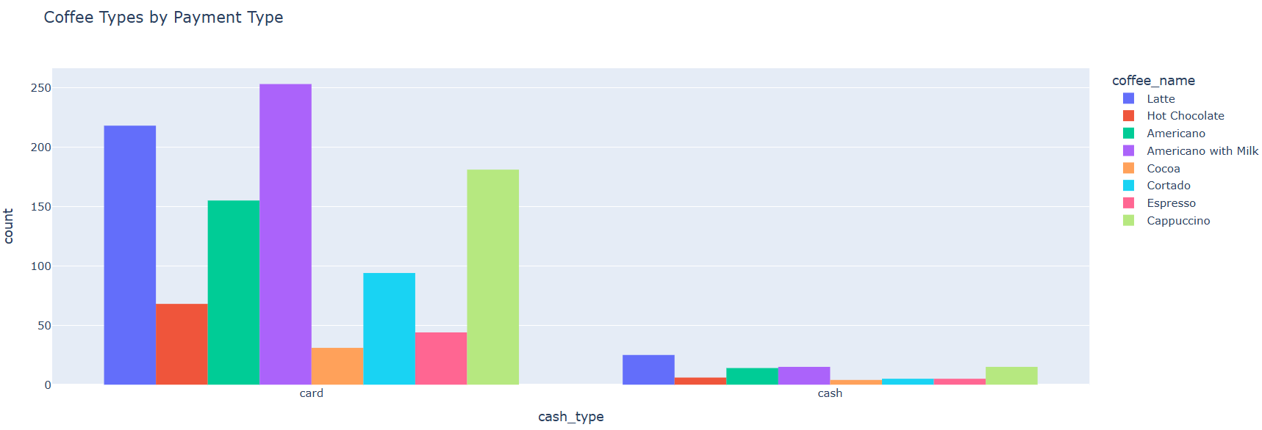
COFFEE TYPES BY PAYMENT TYPES

Slide 9
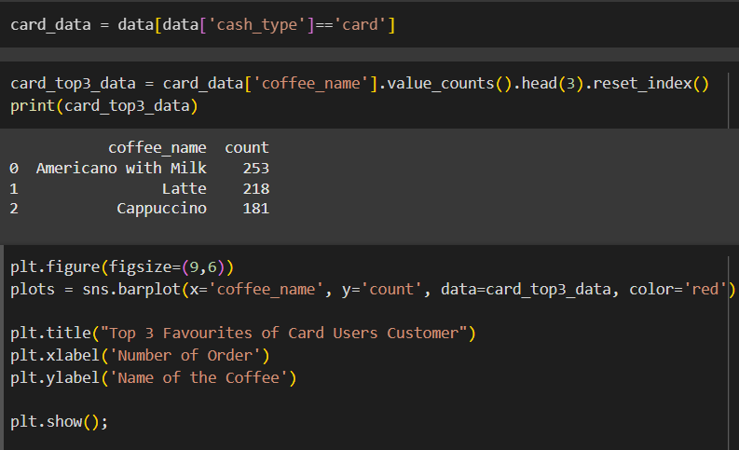
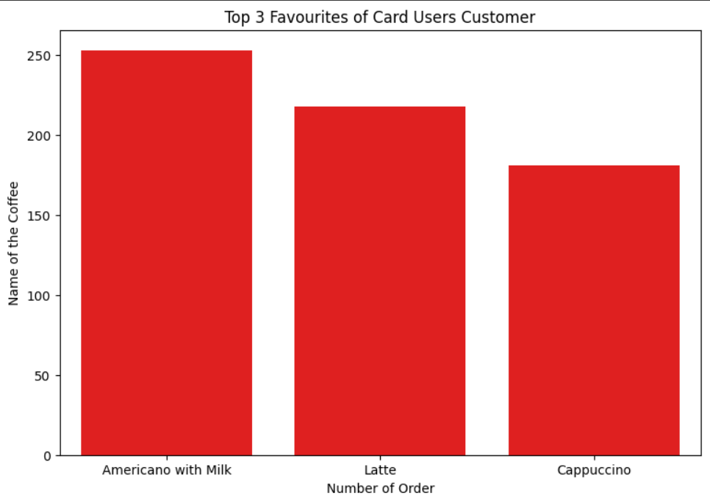
TOP 3 FAVOURITE COFFEE OF CARD USER CUSTOMERS.

Slide 10
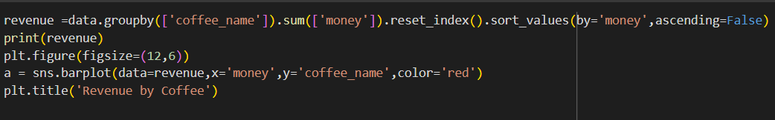
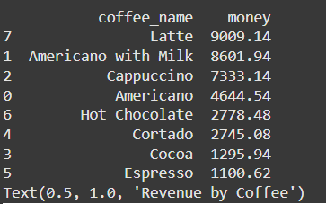
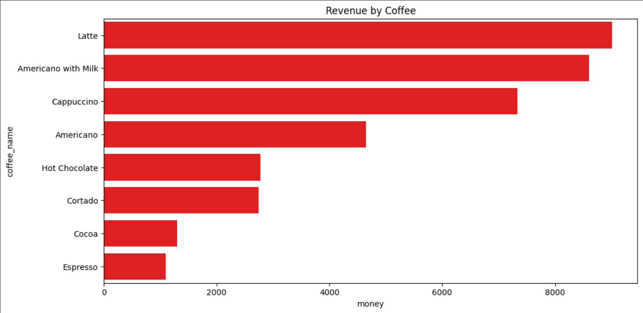
REVENUE OF COFFEE SALES

Slide 11
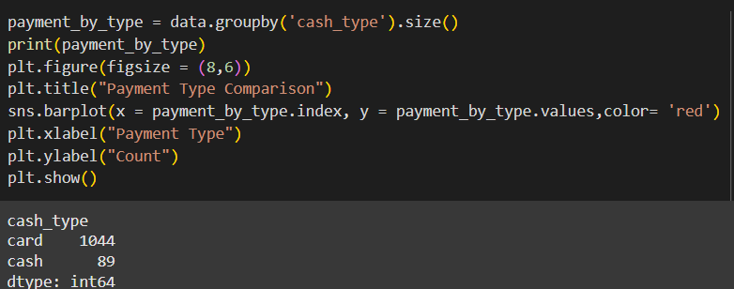
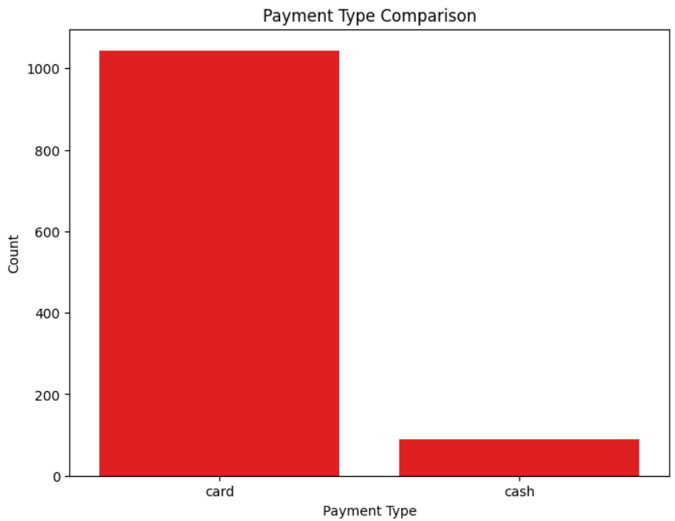
PAYMENT TYPE COMPARISON

