Slide 1

PROJECT
Netflix Data: Cleaning, Analysis and Visualization

Slide 2
INTRODUCTION :
Netflix, a dominant force in the streaming industry, relies heavily on data-driven decision-making. To maintain its competitive edge and subscriber growth, Netflix must continuously analyze vast amounts of data to identify trends, preferences, and opportunities.
This analysis aims to explore Netflix's data to answer key questions such as:
What are the most popular genres and content types among different demographics?
What type of content produce on Netflix per year ?
Which countries produce most content on the Netflix?
Top directors on the Netflix?
By addressing these questions, we can provide actionable insights to help Netflix refine its content strategy, improve user experience, and drive business growth.

Slide 3
Tools and Techniques
Python Libraries
Pandas:
Data manipulation and analysis
Reading and writing various file formats (CSV, JSON, etc.)
Data cleaning and preprocessing
NumPy:
Numerical operations on arrays
Mathematical computations
Matplotlib and Seaborn:
Data visualization
Creating various plots (line plots, bar charts, histograms, etc.)
Scikit-learn:
Machine learning algorithms
Model building and evaluation
Feature engineering and selection

Slide 4
Techniques :
Exploratory Data Analysis (EDA):
Data Cleaning: Handle missing values, outliers, and inconsistencies.
Data Summarization: Calculate summary statistics (mean, median, mode, standard deviation, etc.).
Data Visualization: Create visualizations to understand data distribution, trends, and relationships.
Content Analysis:
Content Performance: Analyze the performance of different content types (movies, TV shows, documentaries, etc.) based on viewership, ratings, and completion rates.
Content Recommendations: Utilize collaborative filtering and content-based filtering to recommend content to users.
Machine Learning:
Predictive Modeling: Build models to predict user churn, content popularity, or future viewership trends.
Natural Language Processing (NLP): Analyze text data (e.g., movie descriptions, reviews) to extract insights and improve content recommendations.

Slide 5
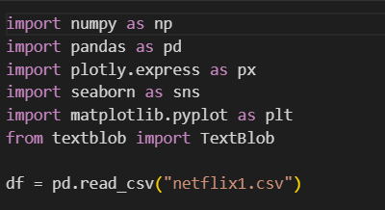
IMPORTING LIBRARIES OF PYTHON AND DATA OF NETFLIX

Slide 6
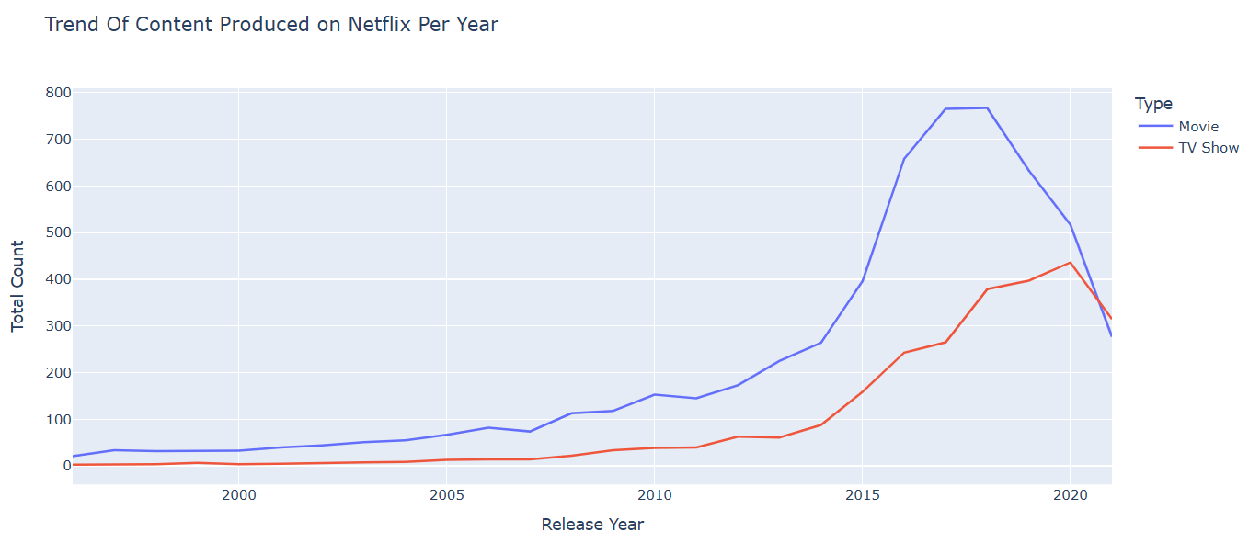
TREND OF CONTENT PRODUCE ON NETFLIX PER YEAR.

Slide 7

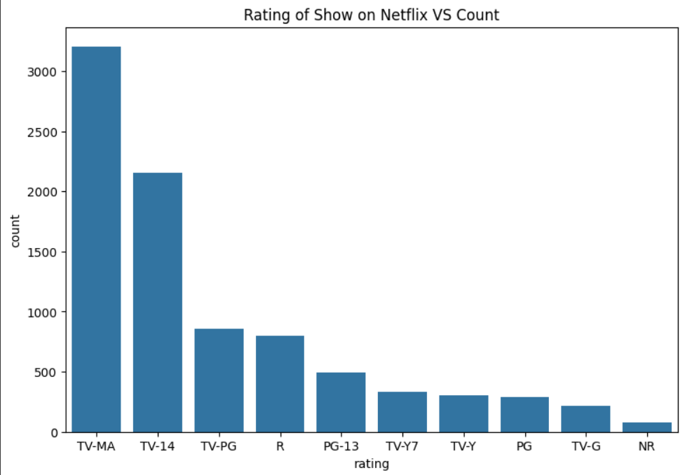
RATING OF SHOW ON NETFLIX .

Slide 8
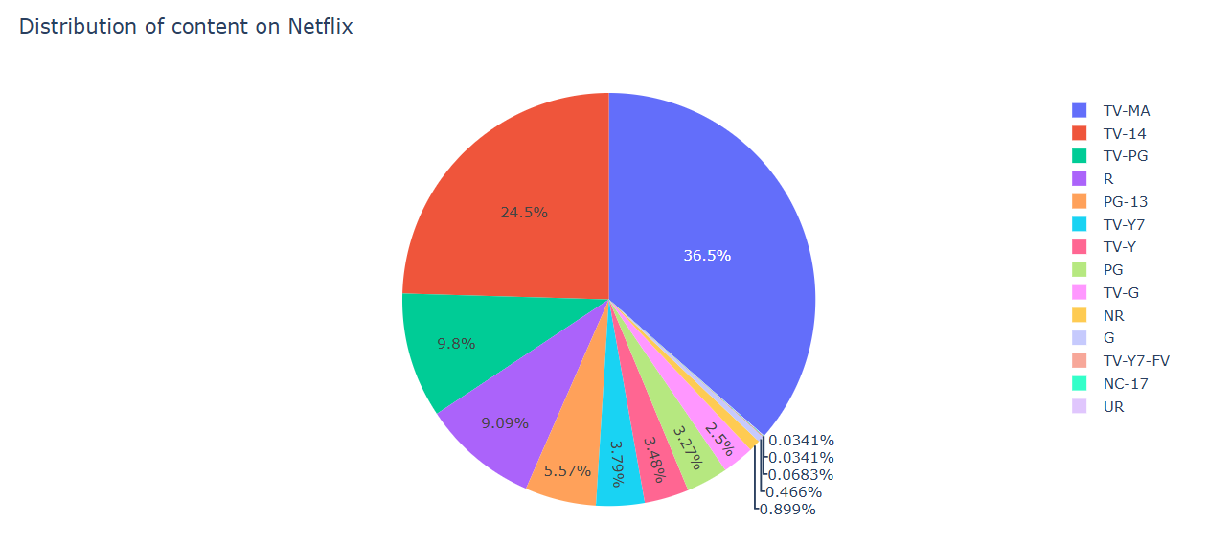
DISTRIBUTION OF CONTENT ON NETFLIX.

Slide 9
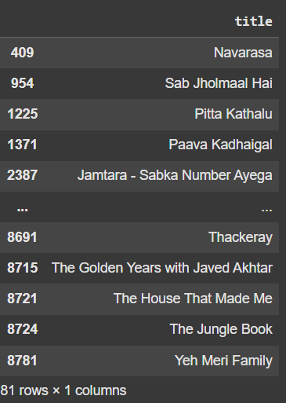
SHOW ONLY THE TITLES OF ALL TV SHOWS THAT WERE RELEASED ONLY IN INDIA

Slide 10
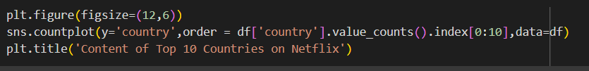
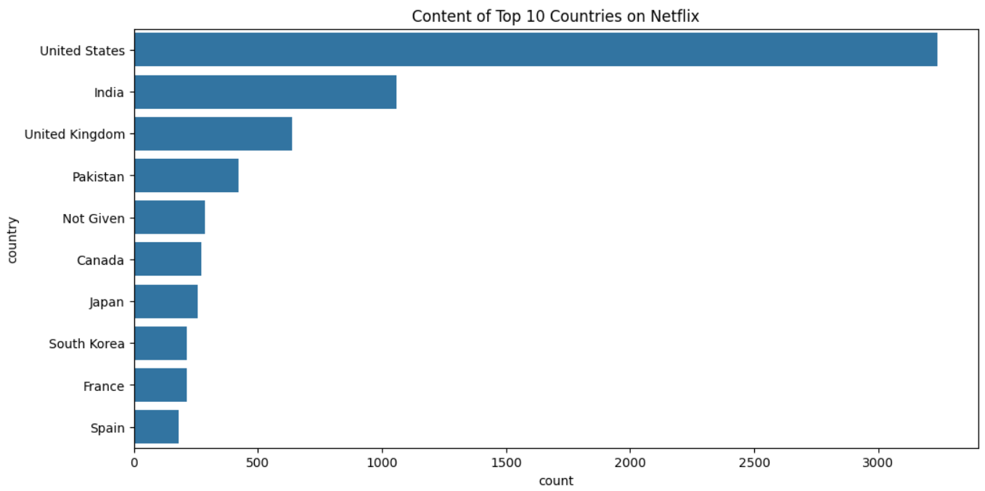
CONTENT OF TOP 10 COUNTRIES ON NETFLIX.

Slide 11
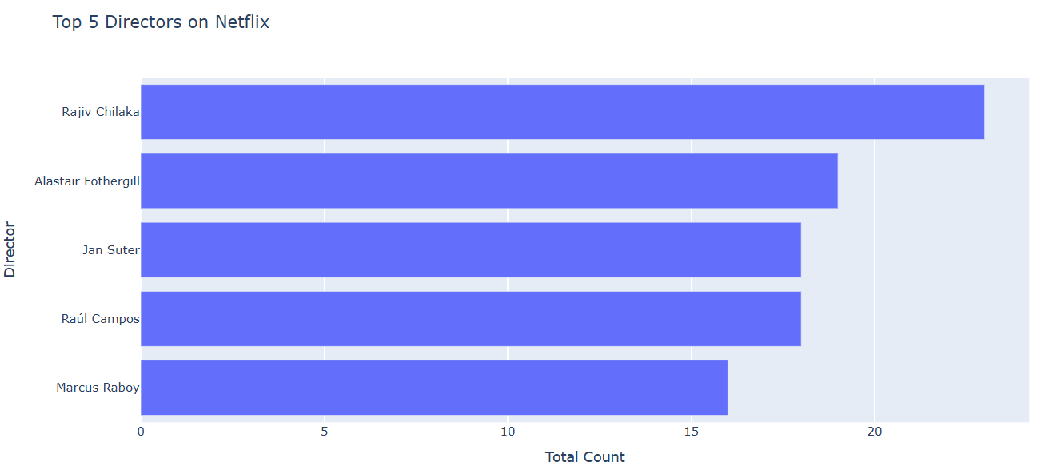
TOP 5 DIRECTORS ON NETFLIX .

Slide 12

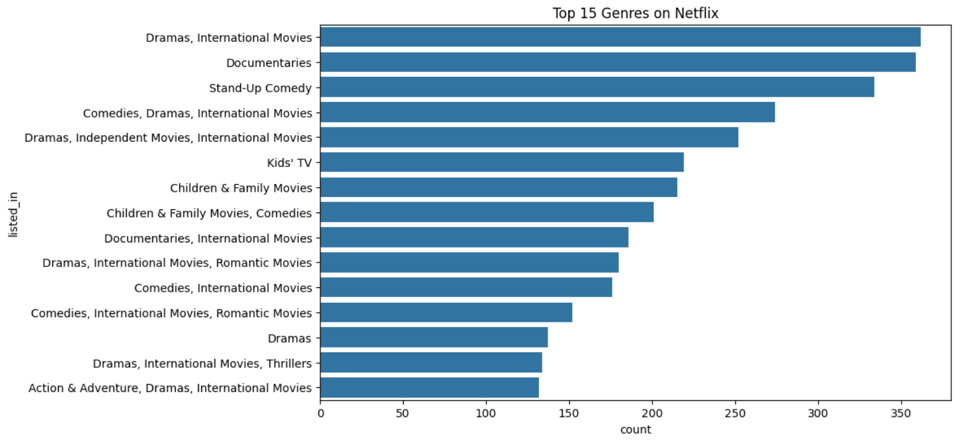
TOP 15 GENRES ON NETFLIX.

