Slide 1

PROJECT PIZZA SALES

Slide 2
INTRODUCTION :
To conduct a comprehensive analysis of Pizza Sales revenue, identify trends, and provide insights to improve sales, customer satisfaction and inventory distribution to identify key insights and opportunities for optimization using various KPIs and visualization in Tableau. This analysis will delve into key performance metrics and trends to identify opportunities for optimization and future growth. By examining historical data and current market dynamics, we aim to uncover actionable insights that will drive our business forward.
KPIs Requirement :
Total Revenue : The sum of total price of all pizza orders.
Average Order Value : The average amount spent per order.
Total Pizza Sold : The sum of the quantities of all pizzas sold.
Total Orders : Th total number of order placed.
Average Pizzas Per Order : The average number of pizzas sold per order.

Slide 3
Techniques:
Descriptive Analysis:
Calculate key metrics like total sales, average order value, customer count, etc.
Analyze sales trends over time (daily, weekly, monthly, yearly).
Identify peak sales periods and slow periods.
Exploratory Data Analysis (EDA):
Visualize data using charts and graphs (bar charts, line charts, pie charts).
Identify patterns, trends, and outliers in the data.
Segment data by different variables (e.g., pizza type, size, customer demographics).
Tools:
Data Analysis Tools:
Microsoft Excel: Basic data cleaning, analysis, and visualization.
SQL: Data querying and manipulation.
Data Visualization Tools:
Tableau: Powerful data visualization and business intelligence tool.

Slide 4


RETRIVES THE TOTAL NUMBER OF ORDER PLACED.
CALCULATE THE TOTAL REVENUE GENERATED FROM PIZZA SALES.

Slide 5




WHAT IS AVERAGE ORDER VALUE ?
TOTAL PIZZA SOLD

Slide 6
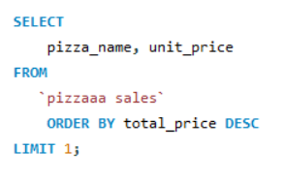

INDENTIFY THE HIGHEST-PRICED PIZZA.

Slide 7
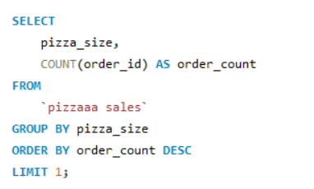

IDENTIFY THE MOST COMMON PIZZA SIZE ORDERED

Slide 8
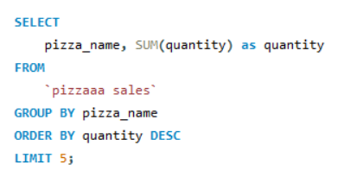
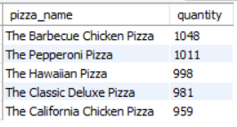
LIST THE TOP 5 MOST ORDERED PIZZA TYPES ALONG WITH THEIR QUANTITIES

Slide 9
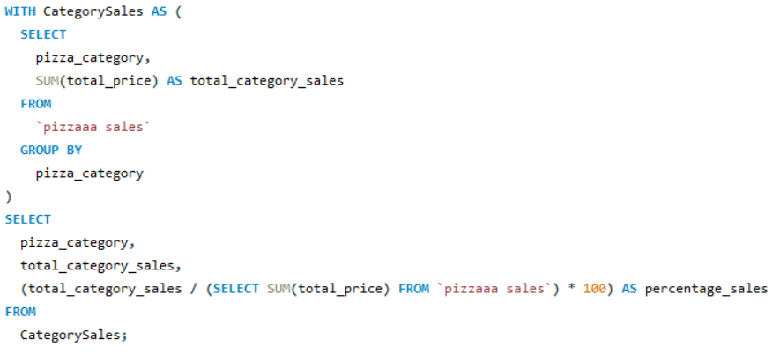
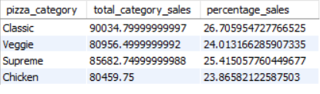
PERCENTAGE OF PIZZA SALES BY CATEGORY

Slide 10
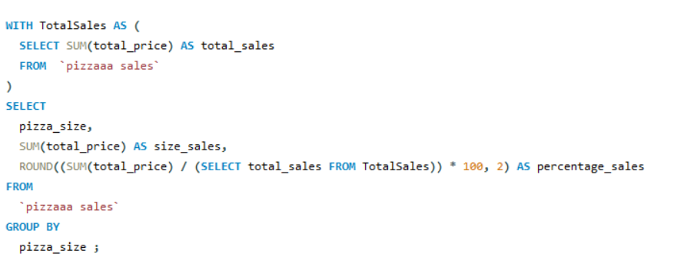
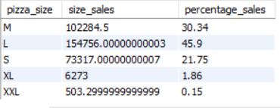
PERCENTAGE OF PIZZA SALES BY SIZE

Slide 11
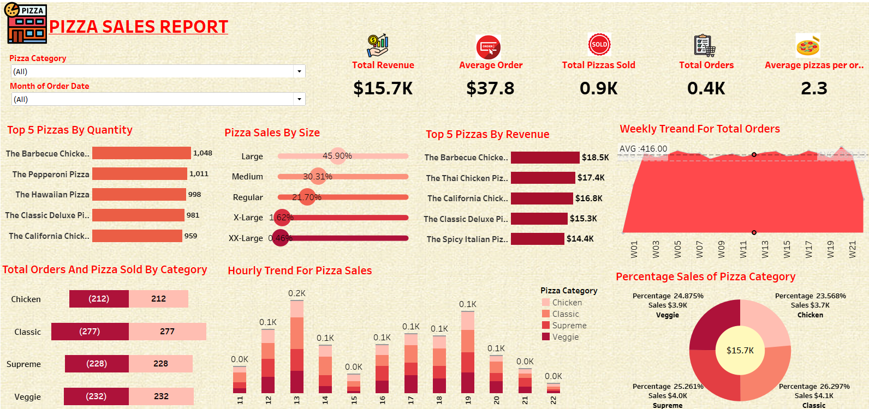
PIZZA SALES REPORT :

