Slide 1
Swami
Store Report

Slide 2
Objective
Swami store wants to create an annual sales report for 2022. So that , they can understand their customers and grows more sales in 2023.

Slide 3
Content
Data Cleaning
Data Processing
Data Analysis
Data Visualization
Creating Reports

Slide 4
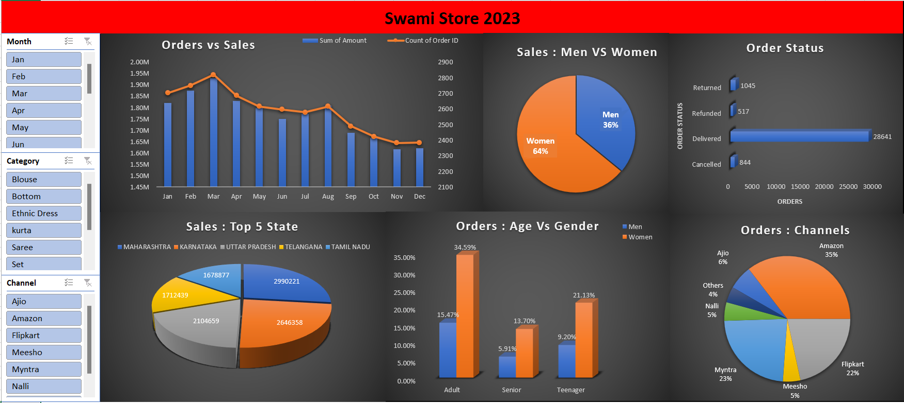
Swami Store 2022 Sales Report

Slide 5
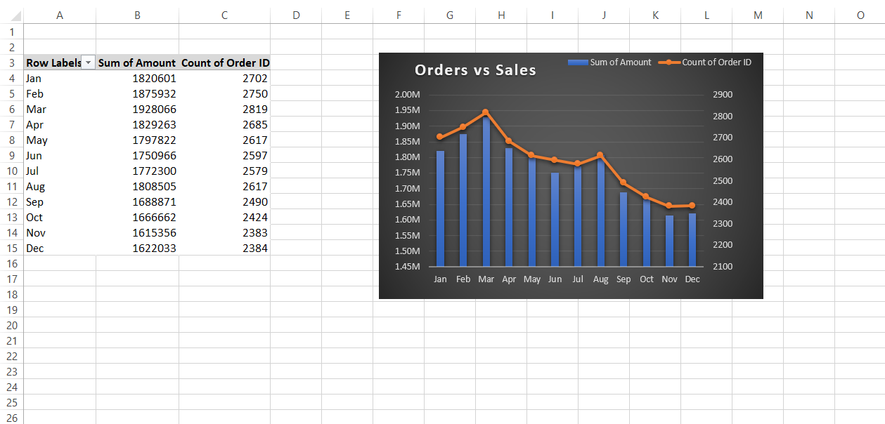
Which month got the highest sales and orders ?

Slide 6
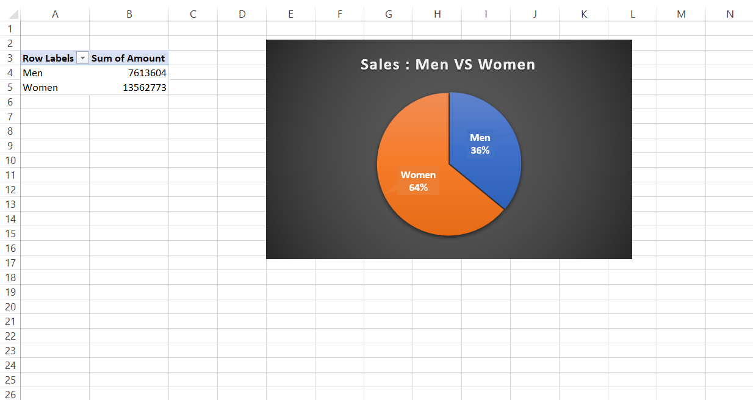
Who purchased more –Men or Women in 2022 ?

Slide 7
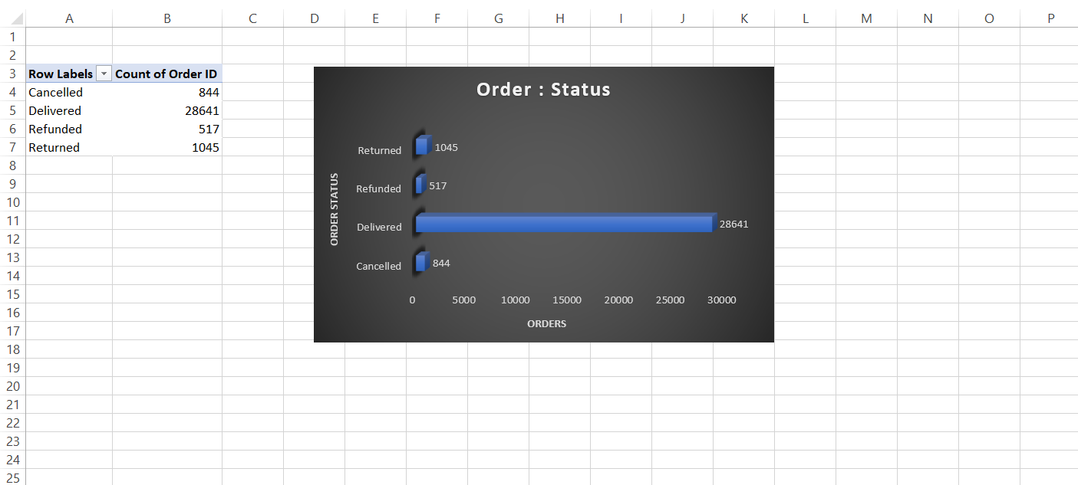
What are different order status in 2022 ?

Slide 8
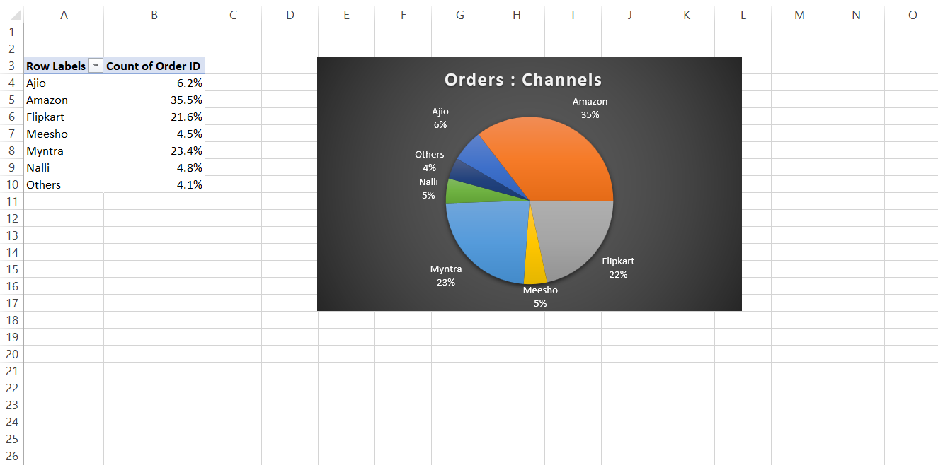
Which channel is contributing to the sales ?

Slide 9
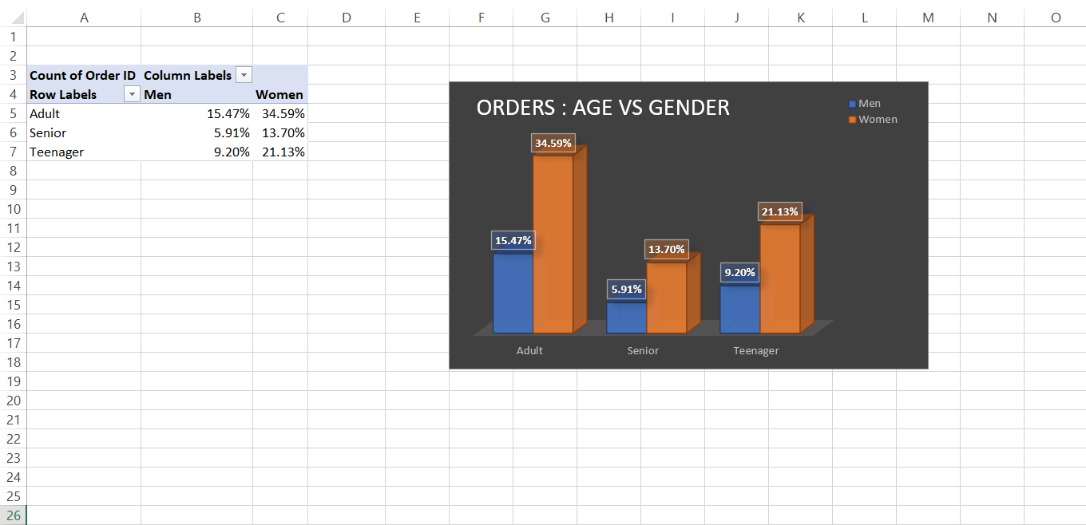
Relation between age and gender based on number of orders

Slide 10
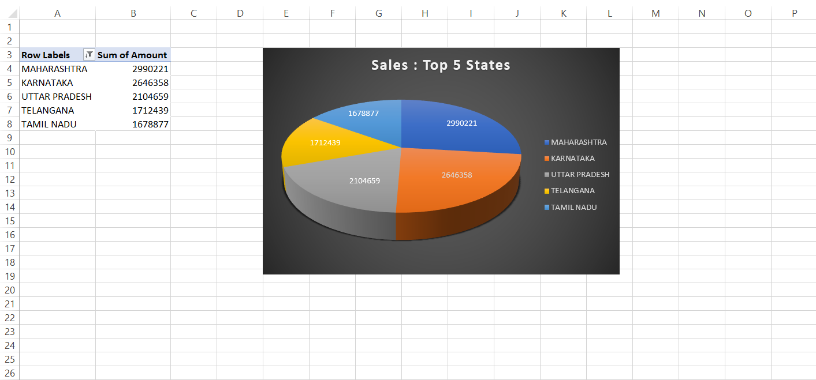
List top 5 states contributing to the sales

Slide 11
Sample Insights
Women are more likely to buy compared to men : 65%
Maharashtra, Karnataka and Uttar Pradesh are the top 3 states : 35%
Adult age group 30 to 49 years is max contributing : 50%
Amazon, Flipkart and Myntra channels are max contributing : 80%

