Slide 1

R Programming
By- Ashutosh Shankhdhar
Assistant Professor
GLA University

Slide 2
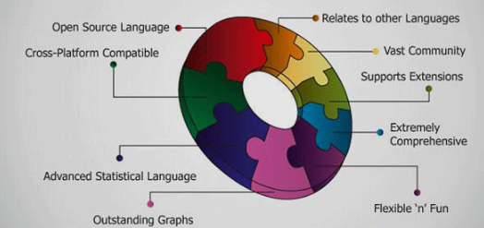
WHY Learn R?
all
all
region
Europe
...
North_America
country
Germany
...
Spain
Canada
...
Mexico
city
Frankfurt
...
Vancouver
...
Toronto
office
L. Chan
...
M. Wind

Slide 3
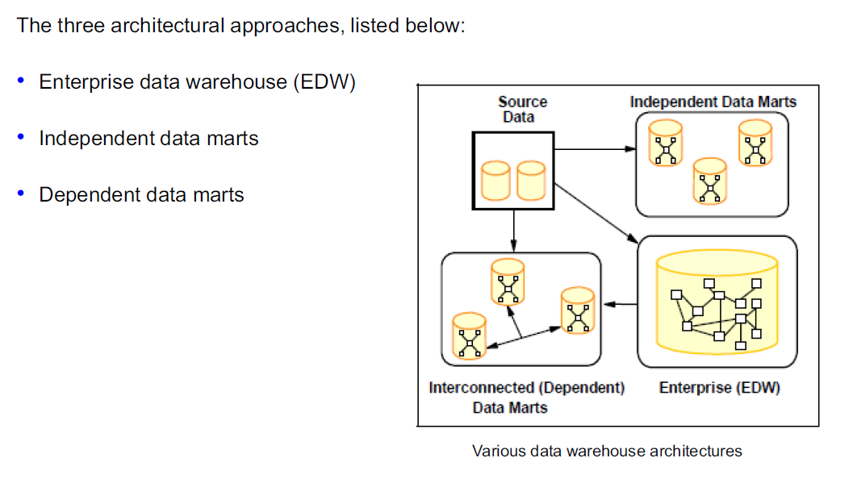
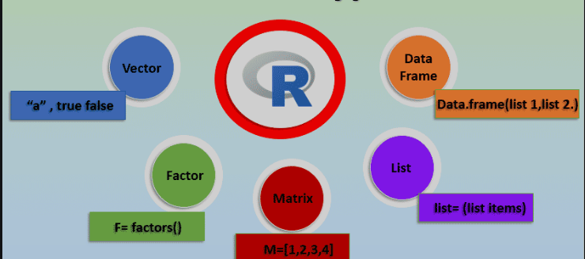
‘R’ DATA TYPES

Slide 4
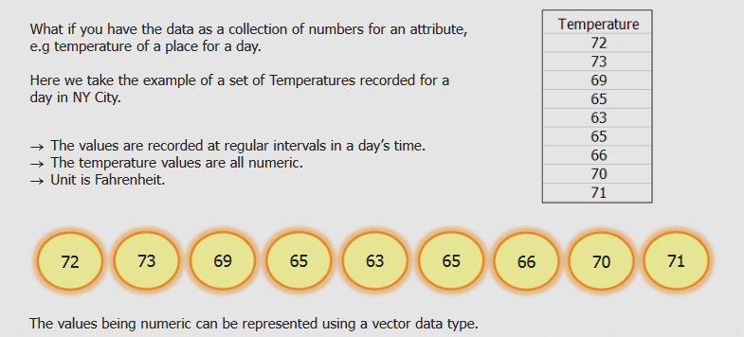
Vector

Slide 5
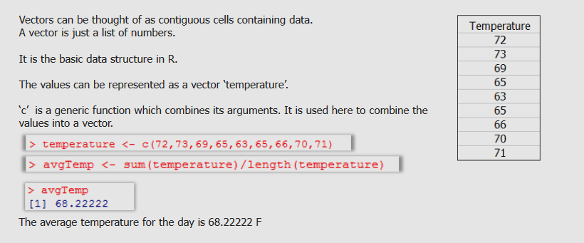
Vector

Slide 6
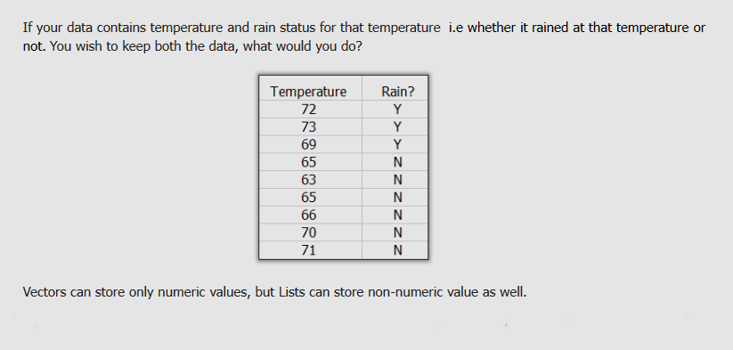
LIST

Slide 7
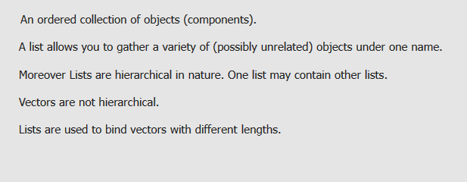
LIST VS VECTOR

Slide 8
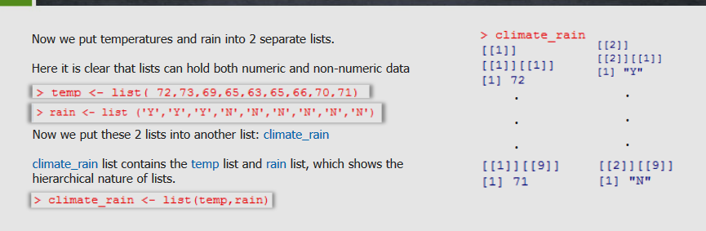
LIST

Slide 9
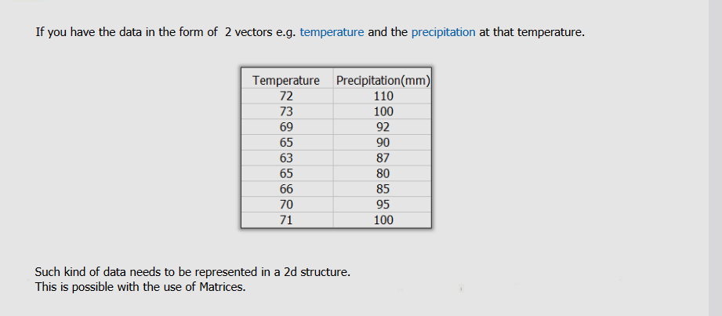
NEED OF 2D

Slide 10
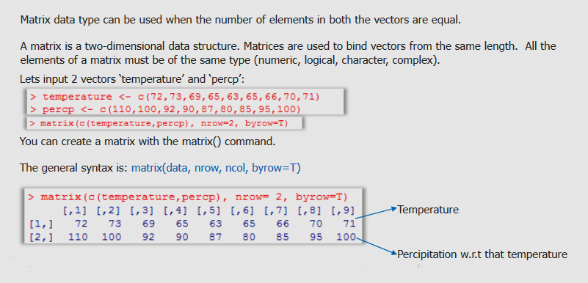
MATRIX

Slide 11
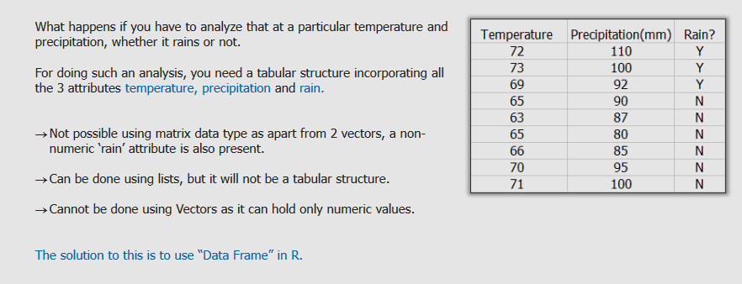
Data Frame

Slide 12
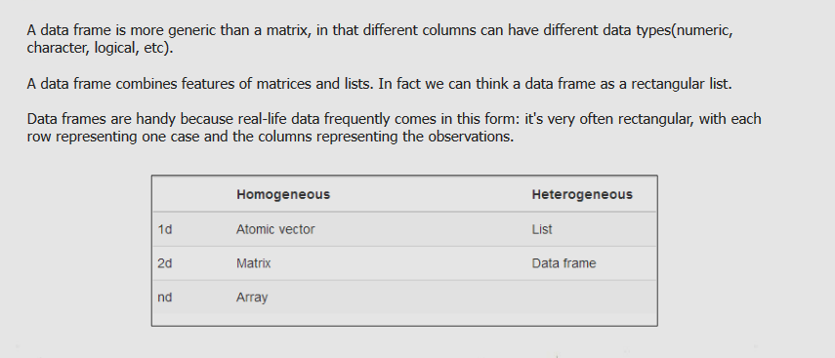
Data Frame

Slide 13
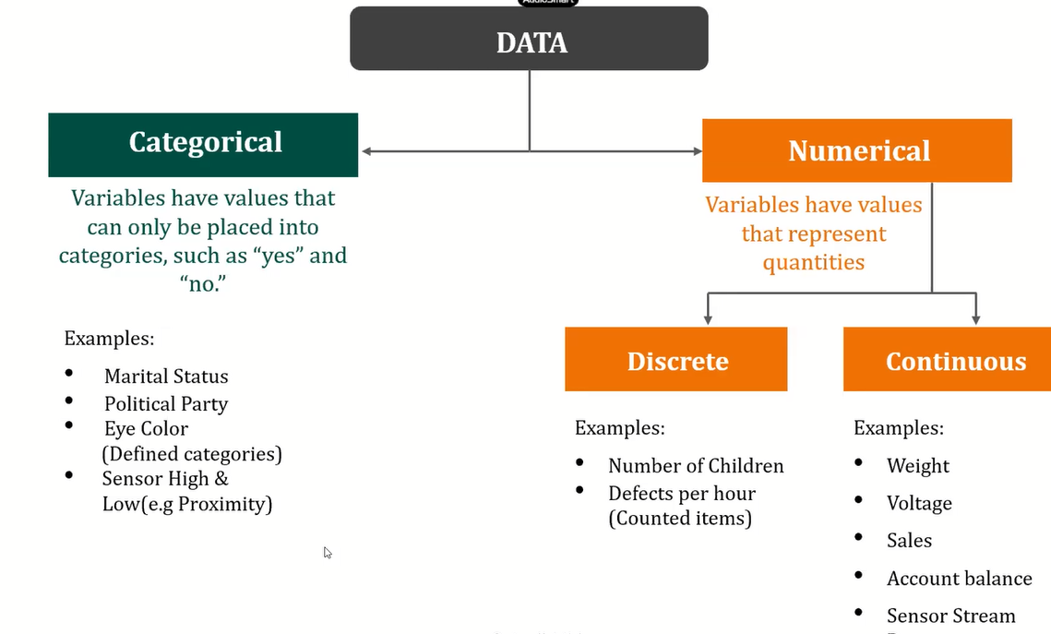

Slide 14
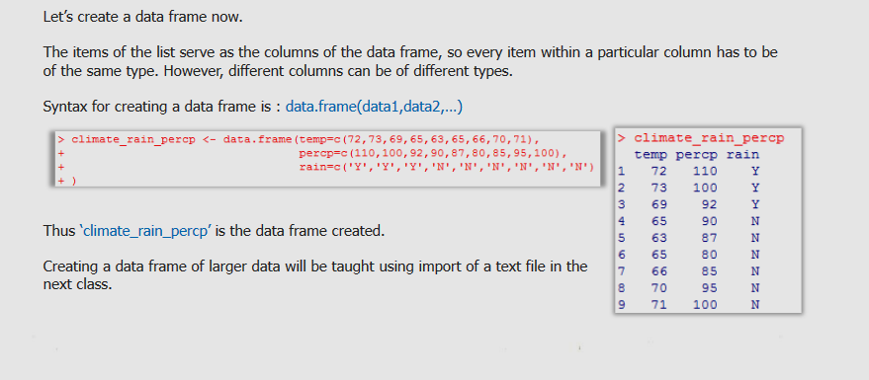
Data Frame

Slide 15
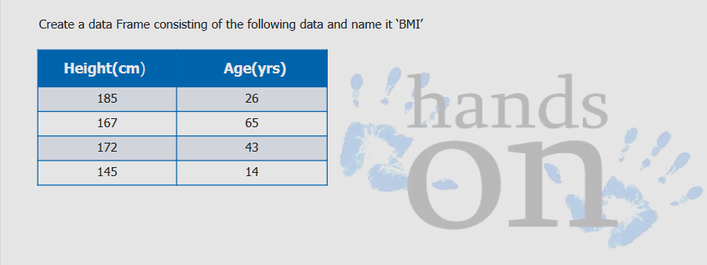
Assignment

Slide 16
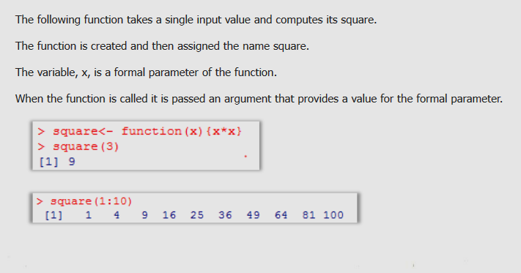
Function in R

Slide 17
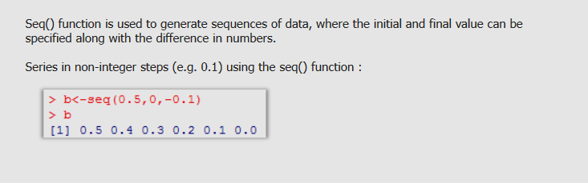
Sequence Function

