Slide 1
William Stallings Computer Organization and Architecture
Chapter 1 Introduction

Slide 2
Introduction to Computer System & its sub-modules
Computer?
Digital electronic device
Binary number system
The smallest unit of information that is represented in computer is known as Bit ( Binary Digit ), which is either 0 or 1.
Four bits together is known as Nibble, and Eight bits together is known as Byte.

Slide 3
Architecture & Organization
Computer Architecture is those attributes visible to the programmer/direct impact on logical execution of a pgm
Instruction set, number of bits used for data representation, I/O mechanisms, addressing techniques, data types
Computer Organization refers to operational units and their interconnections that realize the architectural specifications-how features are implemented
Control signals, interfaces, memory technology.

Slide 4
COMPUTER ARCHITECTURE | COMPUTER ORGANIZATION
Way hardware components are connected together to form a computer system. | Structure and behaviour of a computer system as seen by the user.
It acts as the interface between hardware and software. | It deals with the components of a connection in a system.
Helps us to understand the functionalities of a system. | How exactly all the units in the system are arranged and interconnected.
A programmer can view architecture in terms of instructions, addressing modes and registers. | Whereas Organization expresses the realization of architecture.
While designing a computer system architecture is considered first. | An organization is done on the basis of architecture.
Computer Architecture deals with high-level design issues. | Computer Organization deals with low-level design issues.
Architecture involves Logic (Instruction sets, Addressing modes, Data types, Cache optimization) | Organization involves Physical Components (Circuit design, Adders, Signals, Peripherals)

Slide 5
Architecture & Organization
All Intel x86 family share the same basic architecture
The IBM System/370 family share the same basic
architecture
This gives code compatibility (it can run the same executable code, typically machine code for a general-purpose computer CPU, that another computer system can run)
Organization differs between different versions
LATEST VERSION OF PROCESSOR IN PC??

Slide 6
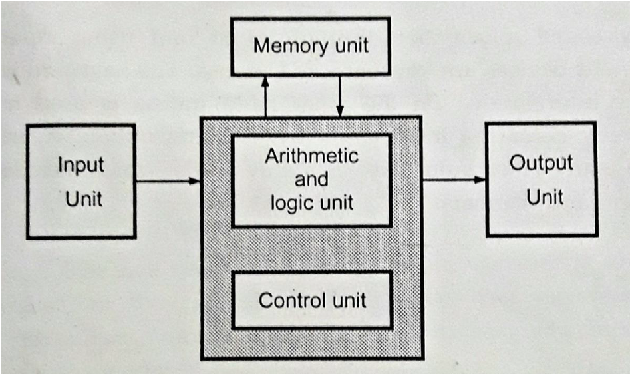
Basic Organization of Computer

Slide 7
Input Unit
With the help of input unit data from outside can be supplied to the computer
Keyboard, Mouse, Hard disk, Floppy disk, CD-ROM drive etc.
Memory Unit
The memory unit is used to store programs and data.
2 types-primary storage memory device and secondary storage memory device.
Primary memory is also known as Main memory or Internal memory-storage of programs and active data – semi-conductor memories
Volatile Memory : RAM (Random Access Memory).
Non-Volatile Memory : ROM (Read only Memory), PROM (Programmable ROM)

Slide 8
Secondary memory is also known as External memory or Auxiliary memory- non volatile memory and it is used for permanent storage of data and program.
Examples: Hard Disk, Floppy Disk, Magnetic Tapes, etc
Arithmetic and Logic Unit
responsible for performing arithmetic operations such as add, subtract, division and multiplication, and logical operations (such as ANDing, ORing, Inverting etc)
To perform these operations operands (object of mathematical operation) from the main memory are brought into high speed storage element called registers of the processor

Slide 9
Output Unit
The output unit sends the processed results to the user using output devices such as video monitor, printer, plotter, etc
Control unit
co-ordinates and controls the activities amongst the functional units.
fetch the instructions stored in the main memory, identify the operations and the devices involved in it, and accordingly generate control signals to execute the desired operations.
Has a set of registers and control circuit to generate control signals.
The arithmetic and logic unit in conjunction with control unit is commonly called Central Processing Unit (CPU).

Slide 10
The input unit accepts the digital information from user with the help of input devices such as keyboard, mouse, microphone etc.
The information received from the arithmetic and logic unit to perform the desired operation.
The program stored in the memory decides the processing steps and the processed output is sent to the user with the help of output devices or it is stored in the memory for later reference.
All the above mentioned activities are coordinated and controlled by the control unit.

Slide 11
Structure & Function
Structure is the way in which components relate to each other
Function is the operation of individual components as part of the structure

Slide 12
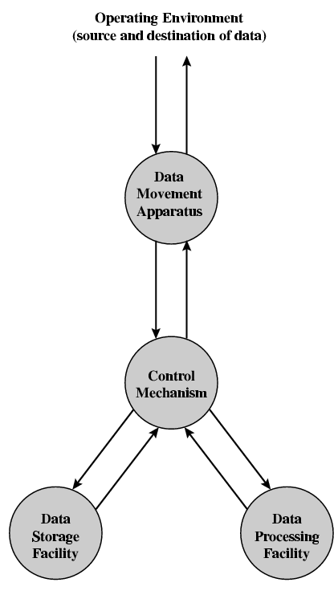
Functional View

Slide 13
Function
All computer functions are:
Data processing-wide variety of data and processing
Data storage-Files of data are stored on the computer for subsequent retrieval and update
Data movement- computer serve as sources or destinations of data-
When data are received from or delivered to a device that is directly connected to the computer, the process is known as input–output (I/O), and the device is referred to as a peripheral.
When data are moved over longer distances, to or from a remote device, the process is known as data communications.
Control-control unit manages the computer’s resources and orchestrates the performance of its functional parts in response to instructions.

Slide 14
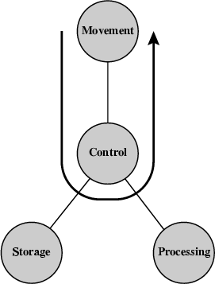
Possible Computer Operations Operations (a) Data movement
Transferring
data from one peripheral or communications line to another

Slide 15
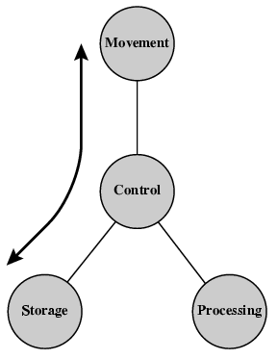
Operations (b) Storage
data transferred from the external environment
to computer storage (read) and vice versa (write).

Slide 16
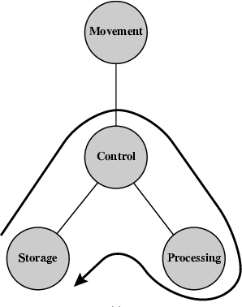
Operation (c) Processing from/to storage

Slide 17
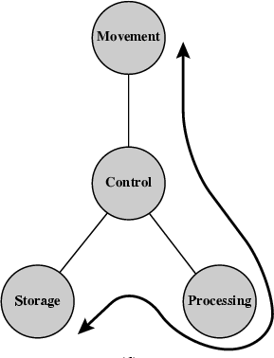
Operation (d) Processing from storage to I/O

Slide 18
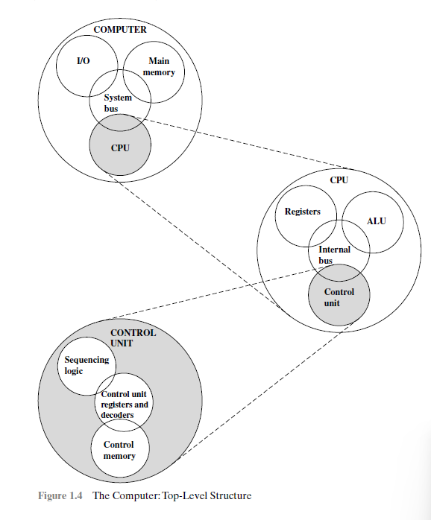
Computer top-level structure

Slide 19

Structure - Top Level simple single-processor computer
Peripherals
Computer
Central Processing Unit
Main Memory
Computer
Systems Interconnection
Input
Output
Communication lines

Slide 20
Top-down approach-beginning with a top view and decomposing the system into its subparts-effective
Simple single-processor computer
Central processing unit (CPU): Controls the operation of the computer and performs its data processing functions-processor.
Main memory: Stores data.
I/O: Moves data between the computer and its external environment.
System interconnection: Some mechanism that provides for communication among CPU, main memory, and I/O.
A common example of system interconnection is by means of a system bus, consisting of a number of conducting wires to which all the other components attach.

Slide 21
Structure - The CPU
CPU
Computer
Arithmetic and
Logic Unit
Registers
I/O
System CPU Bus
Internal CPU Interconnection
Memory
Control
Unit

Slide 22
Major structural components of CPU are:
Control unit: Controls the operation of the CPU
Arithmetic and logic unit (ALU): Performs the computer’s data processing functions.
Registers: Provides storage internal to the CPU.
CPU interconnection: Some mechanism that provides for communication among the control unit, ALU, and registers.
Several approaches to the implementation of the control unit
Microprogrammed implementation-A microprogrammed control unit operates by executing microinstructions that define the functionality of the control unit.

Slide 23
Structure - The Control Unit
Control Unit
CPU
Sequencing Logic
ALU
Internal Bus
Control Unit
Control Unit Registers and Decoders
Registers
Control Memory

Slide 24
multicore computer structure
When these processors all reside on a single chip, the term multicore computer is used, and each processing unit (consisting of a control unit, ALU, registers, and perhaps cache) is called a core
Central processing unit (CPU): That portion of a computer that fetches and executes instructions. It consists of an ALU, a control unit, and registers
Core: An individual processing unit on a processor chip. A core may be equivalent in functionality to a CPU on a single- CPU system
Processor-The Processor is the computer component that interprets and executes instructions. If a processor contains multiple cores, it is referred to as a multicore processor.

Slide 25
William Stallings Computer Organization and Architecture
8th Edition
Chapter 2 Computer Evolution and
Performance

Slide 26
Von Neumann architecture
Fixed Program Computers – Their function is very specific and they couldn’t be reprogrammed, e.g. Calculators.
Computers based on Stored Program concept-programs and data are stored in a separate storage unit called memories and are treated the same-easier to reprogram.
Uses a single processor
Uses one memory for both instructions and data.
Executes programs following the fetch-decode-execute cycle
Princeton Institute for Advanced Studies
– Design of new stored program computer, referred to as the IAS computer (Institute for Advanced Study)
Completed 1952
It consists of
Main memory storing programs and data
ALU operating on binary data
Control unit interpreting instructions from memory and executing
Input and output equipment operated by control unit

Slide 27
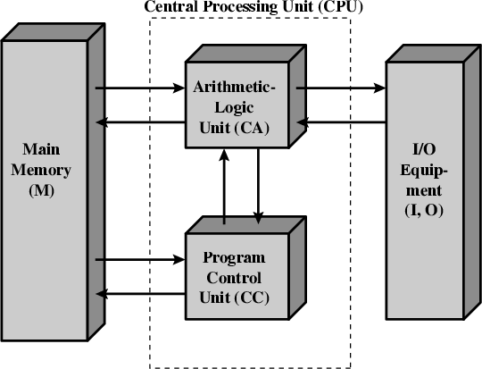
Structure of Von Neumann machine

Slide 28
CA-Central arithmetical part perform the elementary operations of arithmetic (Addition, Subtraction, Comparisons. It performs Logical Operations, Bit Shifting Operations, and Arithmetic operations. )
CC- Central control-proper sequencing of its operations/logical control of the device
M-Main memory-collection of storage cells together with associated circuits needed to transfer information in and out of the storage. The memory stores binary information in groups of bits called words.
I,O-capable of delivering data (output) to and receiving data from a computer (input)

Slide 29
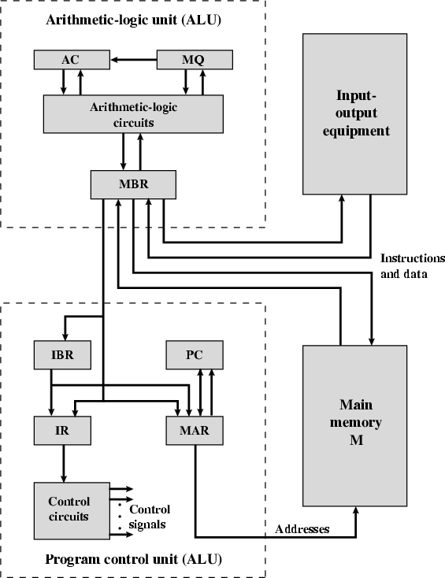
Structure of IAS – detail

Slide 30
Both the control unit and the ALU contain storage locations, called registers
Memory buffer register (MBR): Contains a word to be stored in memory or sent to the I/O unit, or is used to receive a word from memory or from theI/O unit.
Memory address register (MAR): Specifies the address in memory of the word to be written from or read into the MBR.
Instruction register (IR): Contains the 8-bit opcode (identifies which basic computer operation in the instruction set is to be performed.) instruction being executed.
Instruction buffer register (IBR): Employed to hold temporarily the right hand instruction from a word in memory.
Program counter (PC): Contains the address of the next instruction-pair to be fetched from memory.
Accumulator (AC) and multiplier quotient (MQ): Employed to hold temporarily operands and results of ALU operations

Slide 31
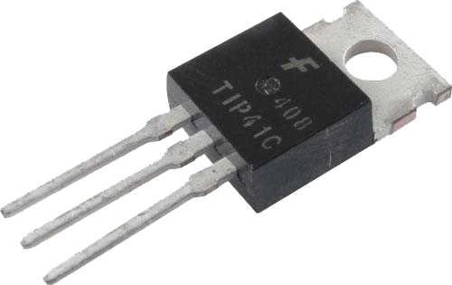
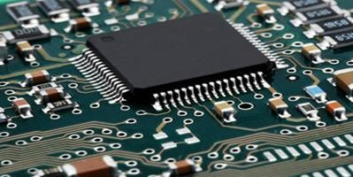
Generations of Computer
Vacuum tube - 1946-1957
Transistor - 1958-1964
Small scale integration - 1965
Up to 100 devices on a chip
Medium scale integration - to 1971
100-3,000 devices on a chip
Large scale integration - 1971-1977
3,000 - 100,000 devices on a chip
Very large scale integration - 1978 -1991
– 100,000 - 100,000,000 devices on a chip
Ultra large scale integration – 1991 -Over 100,000,000 devices on a chip

Slide 32
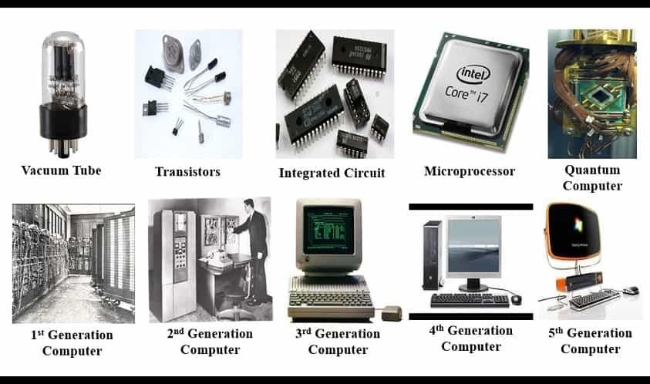

Slide 33
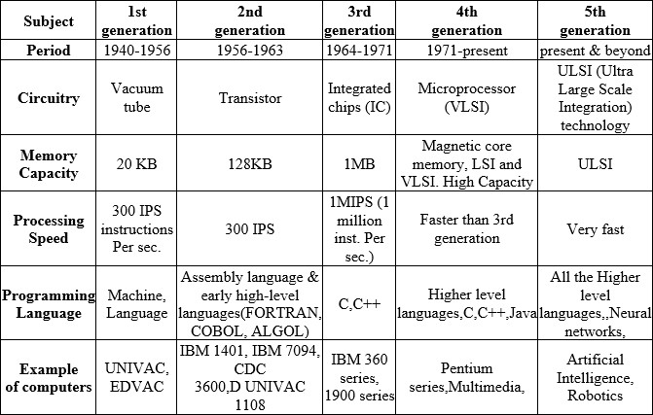

Slide 34
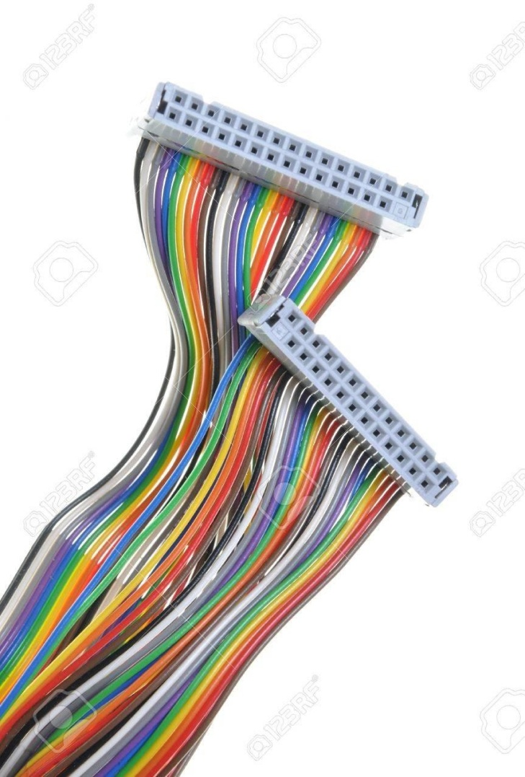
What is a Bus?
A communication pathway connecting two or more devices
Data connection between 2 or more devices connected to the computer
Usually broadcast ,Often grouped
For Ex: A bus enables a computer processor to communicate with the memory or video card to communicate with the memory
several lines of a bus can be used to transmit binary digits simultaneously e.g. 32 bit data bus is 32 separate single bit channels
Power lines may not be shown

Slide 35
it is a shared transmission medium-Multiple devices connect to the bus, and a signal transmitted by any one device is available for reception by all other devices attached to the bus.
If two devices transmit during the same time period, their signals will overlap and become garbled-Only one device at a time can successfully transmit.
Bus consists of multiple communication pathways/ lines
A bus that connects major computer components (processor, memory, I/O) is called a system bus

Slide 36
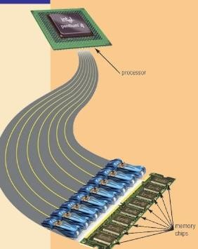
Buses
There are a number of possible interconnection systems
Single and multiple BUS structures are most common
e.g. Control/Address/Data bus (PC)
e.g. Unibus (DEC-PDP)
(Digital Equipment Corporation-Programmed Data Processor)

Slide 37
Functions of Buses in Computers
Data sharing - Serial/Parallel transmission, 8-bit, 16-bit, 32-bit or even 64-bit buses.
Addressing -
A bus has address lines which allows data to be sent to or from specific memory locations.
A bus supplies power to various peripherals connected to it.
System clock-synchronize the peripherals attached to it with the rest of the system.
Power -
Timing -
Eg: The expansion bus facilitates easy connection of more or additional
components and devices on a computer such as a TV card or sound card.

Slide 38
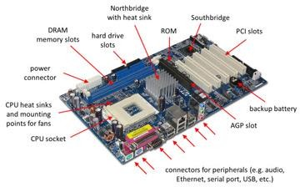

Slide 39
Bus Structure
A system bus consists, typically, of from about 50 to hundreds of separate lines
lines can be classified into three functional groups: data, address, and control lines.

Slide 40
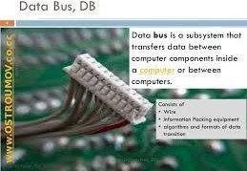
Data Bus
Data lines=Data bus
data bus may consist of 32, 64, 128, or even more separate lines
number of lines being referred to as the width of the data bus.
Carries data
– Remember that there is no difference between “data” and “instruction” at this level
Width is a key determinant of performance-no: of lines determine amount of bits transferred
– 8, 16, 32, 64 bit

Slide 41
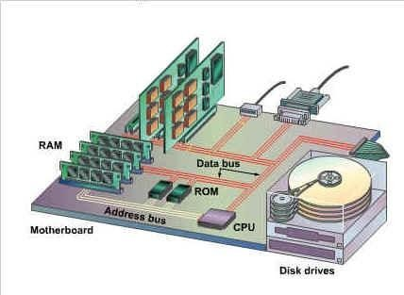
Address bus
Identify the source or destination of data-Eg 1000H,1200H
e.g. CPU needs to read an instruction (data) from a given location in memory
Bus width determines maximum memory capacity of system
2 ^nos of address lines=Memory Capacity
e.g. 8080 has 16 bit address bus giving 64k address space
– 32 bit?64bit ? 2 ^
(16.777216 million terabyte)

Slide 42
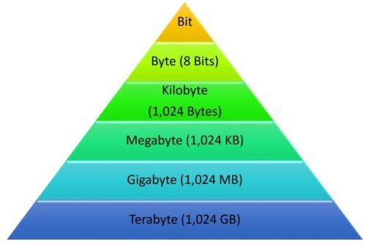
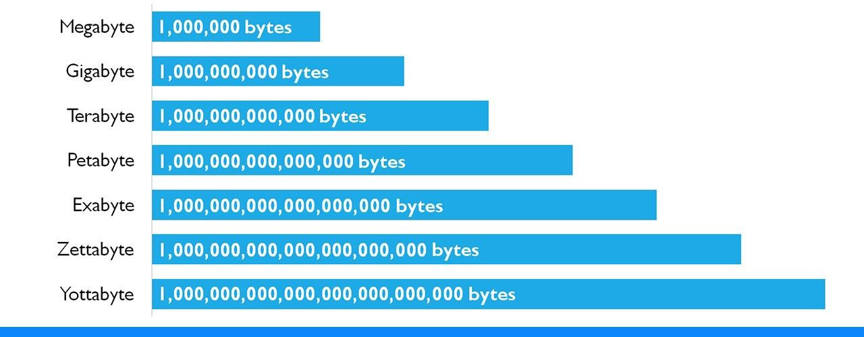

Slide 43
Control Bus
Controls activities of all units of a computer- control the access to and the use of the data and address lines
Control signals transmit both command (specify operations to be performed) and timing information (validity of data and address information) among system modules.
Main Function is to carry control signals generated by control unit
Ex: One line of control bus is used to indicate whether the CPU is reading/writing to the main memory
Control and timing information
Memory read/write signal
Interrupt request
Clock signals

Slide 44
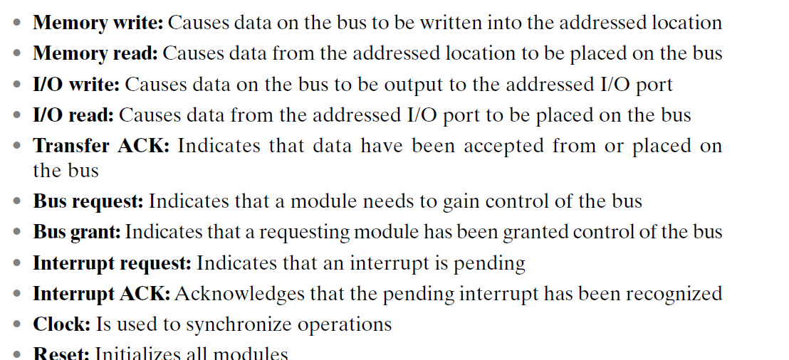
Examples of control lines

Slide 45
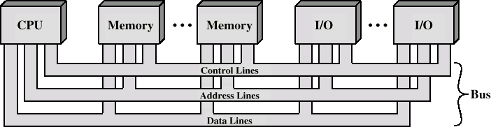
Bus Interconnection Scheme
System

Slide 46
If one module wishes to send data to another,
(1) obtain the use of the bus, and
(2) transfer data via the bus.
If one module wishes to request data from another module, it must
(1) obtain the use of the bus, and
(2) transfer a request to the other module over the appropriate control and address lines. It must then wait for that second module to send the data.

Slide 47
Single Bus Problems
Lots of devices (greater the bus length) on one bus leads to:
Propagation delays
Long data paths mean that co-ordination of bus use can adversely affect performance
If aggregate data transfer approaches bus capacity
Remedy-by increasing the data rate that the bus can carry and by using wider buses
Most systems use multiple buses to overcome these problems

Slide 48
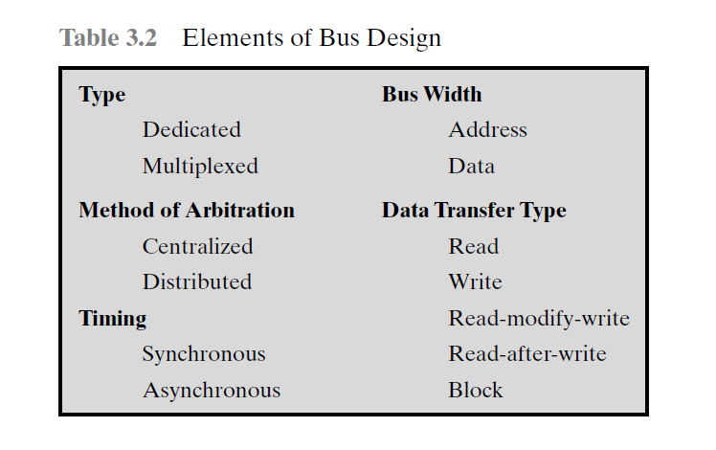

Slide 49
Bus Types
Dedicated
permanently assigned either to one function or to a physical subset of computer components
Eg: of functional dedication-Separate data & address lines
Multiplexed
-Assigned too many functions based on some parameters-Shared lines
-Eg:- Address and data information may be transmitted over the same set of lines using an Address Valid control line.
At the beginning of the data transfer the address is placed on the bus and the address valid line is activated.
The address is then removed from the same bus line & is used for data transfer.
Address valid or data valid control line

Slide 50
same lines for multiple purposes is known as time multiplexing.
Advantage - fewer lines (space and cost are saved)
Disadvantages
More complex control
Reduction in performance
Physical dedication refers to the use of multiple buses, each of which connects only a subset of modules.
A typical example is the use of an I/O bus to interconnect all I/O modules
High throughput, because there is less bus contention (when two outputs drive the same signal at the same time).
A disadvantage is the increased size and cost of the system.

Slide 51
Bus Arbitration
Only one module may control bus at one time-e.. CPU and DMA controller
More than one module controlling the bus-data corruption and system instability
Bus arbitration is the process of resolving conflicts that arise when multiple devices attempt to access the bus at the same time
Ensure that only one device has access to the bus at any given time.
Arbitration may be centralised or distributed

Slide 52
Centralised or Distributed Arbitration
Centralised
Single hardware device controlling bus access-responsible for allocating time on the bus
Bus Controller
Arbiter
May be part of CPU or separate
Distributed
Each module may claim the bus
No central controller
Control logic on all modules

Slide 53
purpose is to designate one device, either the processor or an I/O module, as master-initiate a data transfer (e.g., read or write) with some other device, which acts as slave for this particular exchange.

Slide 54
Introduction to PCI Bus
Bus
highways that take information and power from one place to another.
channel or path between the components in a computer
lets you connect components to the computer's processor
hard disks, memory, sound systems, video systems , graphics card etc…
PCI Bus
Nowadays USB-
Used as the standard in most computers' high-speed buses
Firewire ?
ISA Bus- Industry Standard Architecture
IT PROVIDES DIRECT ACCESS TO SYSTEM MEMORY FOR CONNECTED DEVICES
Intel created the PnP standard and incorporated it into the
design for PCI.

Slide 55
PCI-peripheral component interconnect (PCI)
high-bandwidth,processor-independent, low cost bus that can function as a peripheral bus
PCI delivers better system performance for high-speed I/O subsystems (e.g., graphic display adapters, network interface controllers, disk controllers)
Current standard allows the use of up to 64 data lines at 66 MHz, for a raw transfer rate of 528 MByte/s, or 4.224 Gbps
Requires very few chips to implement and supports other buses attached to the PCI bus.
PCI is designed to support a variety of microprocessor-based configurations, including both single- and multiple-processor systems
It makes use of synchronous timing and a centralized arbitration scheme.

Slide 56
FEATURES
Plug & Play capability
Hot-plug ability
Hot swappable
High speed
Backward compatibility-Older versions of independent bus can be connected to PCI slot
Independent bus-Device operates independently without CPU intervention
High operational frequency-upto 133 MHz
Supports 3 independent address spaces-memory, (memory mapped i/o functions) i/o (used within the processor) & configuration (for PCI plug & play capability)

Slide 57
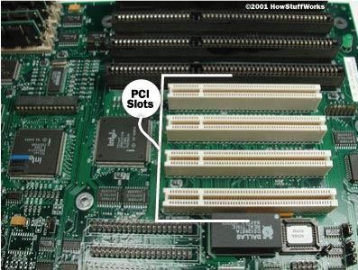
PCI Bus-Peripheral Component Interconnect
Intel released to public domain-32 bit and 64 bit versions
PCI bus connects the CPU and expansion boards
Examples of PCI devices
Modem
Network Card
Sound Card,Video Card,etc

Slide 58
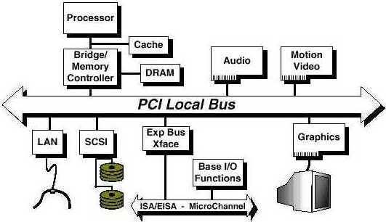
PCI may be configured as a 32- or 64-bit bus
Table 3.3 Mandatory PCI Signal Lines & Optional Signal lines-Refer

Slide 59
PCI Bus Lines (required)
Systems lines
Including clock and reset
Address & Data
32 time mux lines for address/data
Interrupt & validate lines (carry the addresses and data)
Interface Control (Control the timing of transactions and provide coordination among initiators and targets.)
Arbitration
Not shared
PCI master has its own pair of arbitration lines that connect it directly to the PCI bus arbiter.
Error lines

Slide 60
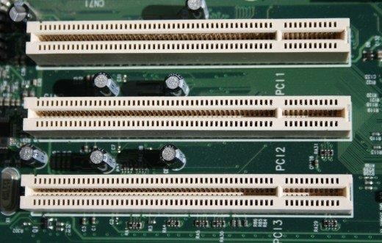
PCI Bus Lines (Optional)

Slide 61
PCI Bus Lines (Optional)
Interrupt lines
Not shared
generate requests for service
Cache support- support a memory on PCI that can be cached in the processor or another device
64-bit Bus Extension
Additional 32 lines time multiplexed for addresses and data and that are combined with the mandatory address/data lines to form a 64-bit address/data bus
used to interpret and validate the signal lines that carry the addresses and data
2 lines to enable devices to agree to use 64-bit transfer

Slide 62
PCIe (PCI Express®) is the more recently introduced standard for connecting devices to computers.
It's software-compatible with PCI but has higher potential bandwidth and greater flexibility than PCI

Slide 63
Let's say that you have just added a new PCI-based sound card to your Windows XP computer. Here's an example of how it would work.
You open up your computer's case and plug the sound card into an empty PCI slot on the motherboard
You close the computer's case and power up the computer.
The system BIOS initiates the PnP BIOS.
The PnP BIOS scans the PCI bus for hardware. It does this by sending out a signal to any device connected to the bus, asking
the device who it is.
The sound card responds by identifying itself. The device ID is sent back across the bus to the BIOS.
The PnP BIOS checks the ESCD to see if the configuration data for the sound card is already present. Since the sound card was just installed, there is no existing ESCD record for it.
The PnP BIOS assigns IRQ, DMA, memory address and I/O settings to the sound card and saves the data in the ESCD.
Windows XP boots up. It checks the ESCD and the PCI bus. The operating system detects that the sound card is a new device and displays a small window telling you that Windows has found new hardware and is determining what it is.
In many cases, Windows XP will identify the device, find and load the necessary drivers, and you'll be ready to go. If not, the "Found New Hardware Wizard" will open up. This will direct you to install drivers off of the disc that came with the sound card.
Once the driver is installed, the device should be ready for use. Some devices may require that you restart the computer before you can use them. In our example, the sound card is immediately ready for use.
You want to capture some audio from an external tape deck that you have plugged into the sound card. You set up the recording software that came with the sound card and begin to record.
The audio comes into the sound card via an external audio connector. The sound card converts the analog signal to a digital signal.
The digital audio data from the sound card is carried across the PCI bus to the bus controller. The controller determines which device on the PCI device has priority to send data to the CPU. It also checks to see if data is going directly to the CPU or to system memory.
Since the sound card is in record mode, the bus controller assigns a high priority to the data coming from it and sends the
sound card's data over the bus bridge to the system bus.
The system bus saves the data in system memory. Once the recording is complete, you can decide whether the data from the sound card is saved to a hard drive or retained in memory for additional processing.

Slide 64
Introduction to SCSI Bus
Pronounced "scuzzy"
Fast bus that can connect lots of devices to a COMPUTER at the same time, including hard drives, scanners, CD-ROM/RW drives, printers and tape drives unlike USB connected for small devices.
Helps to put multiple items on one bus.
Also works with most computer systems.
Prob---
Limited BIOS support as it has to be configured for each computer
No common SCSI software interface
All different types of SCSI have different speeds,bus widths,connectors Which can be confusing !

Slide 65
Standard interface for connecting peripheral devices to PC(16 peripheral devices via a single bus and a host adapter)
Deliver faster data transfer, increase performance etc
It is less commonly used in desktop PCs
Either embedded on motherboard or a host adapter is inserted into the expansion slot on motherboard

Slide 66
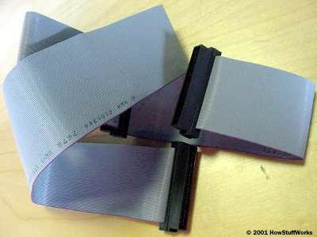
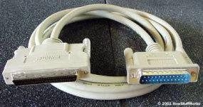
External SCSI devices connect using thick, round cables
Internal SCSI devices connect to a ribbon cable.

Slide 67
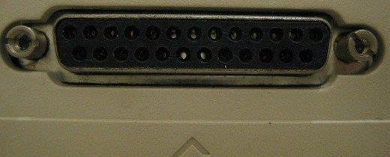
SCSI-Small Computer System Interface
Set of standard electronic interfaces that allow personal computers PC’s to communicate with peripheral hardware such as disk drives,tapes,CDs,Printers,scanners,etc
Faster.
SCSI standards are generally backward compatible
– A parallel interface standard used by Apple Macintosh computers, PCs and Unix systems for attaching peripheral devices to a computer.

Slide 68
SCSI interfaces used internally in computers to connect different types of hardware devices directly to a motherboard or storage controller card.
When used internally, devices are attached through a ribbon cable.
External connections are also common and typically connect via an external port on a storage controller card using a cable.
Within the controller is a memory chip that holds the SCSI BIOS, which is a piece of integrated software that's used to control the connected devices.

Slide 69
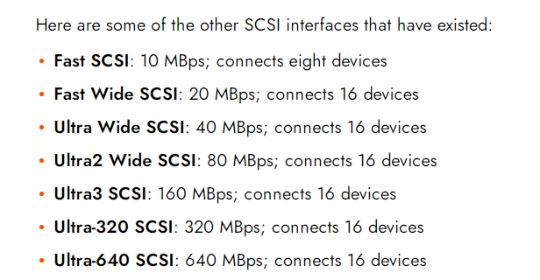
There are several SCSI technologies that support different cable lengths, speeds, and a number of devices that can be attached to one cable

Slide 70
A SCSI controller coordinates between all of the other devices on the SCSI bus and the computer. Also called a host adapter, the controller can be a card that you plug into an available slot or it can be built into the motherboard.
Each SCSI device must have a unique identifier (ID) in order for it to work properly
Internal devices connect to a SCSI controller with a ribbon cable.
If the SCSI bus were left open, electrical signals sent down the bus could reflect back and interfere with communication between devices and the SCSI controller.
The solution is to terminate the bus, closing each end with a resistor circuit. If the bus supports both internal and external devices, then the last device on each series must be terminated.

Slide 71
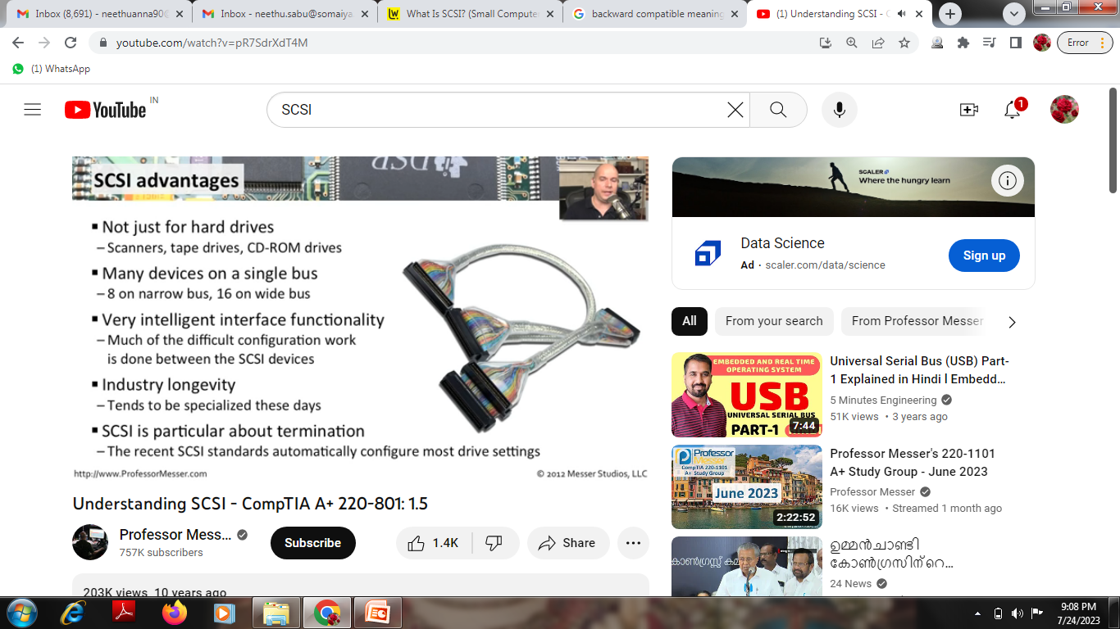
SCSI advantages

Slide 72
SCSI disadvantages
Refer
Why it is not common nowadays?

