Slide 1
Module-4
MEMORY

Slide 2
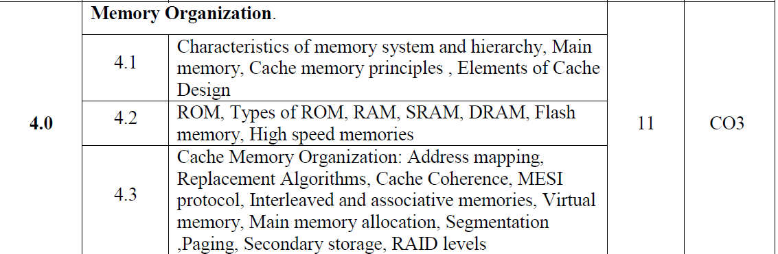

Slide 3
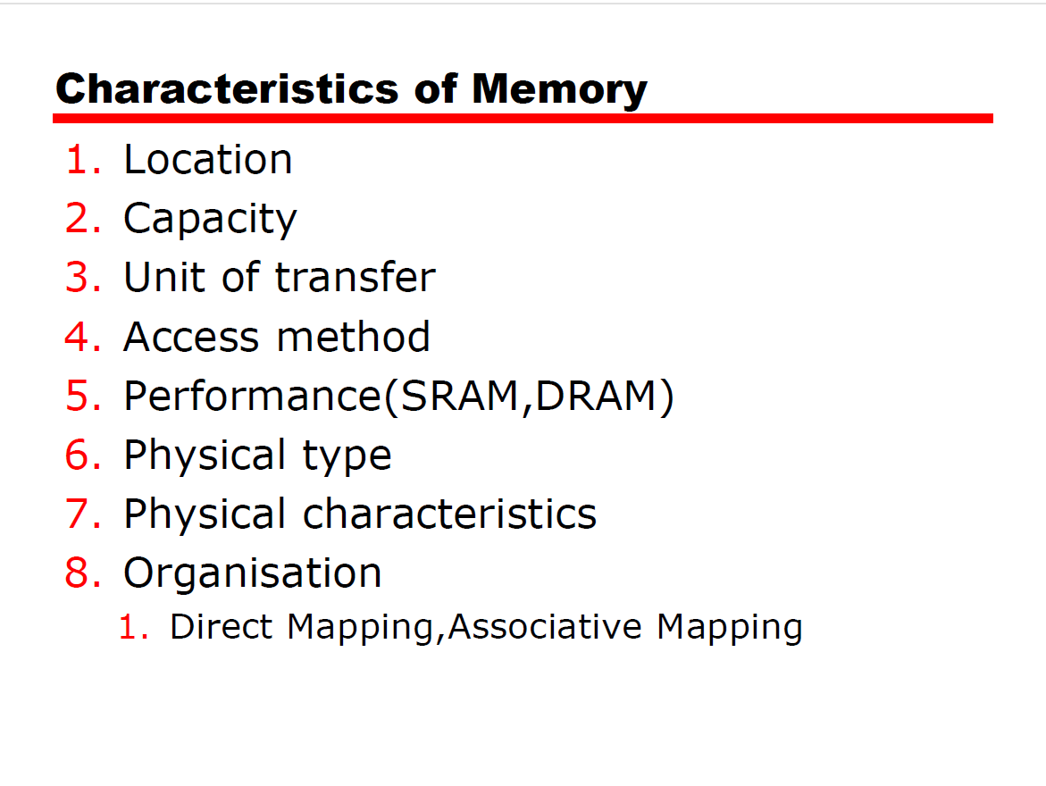

Slide 4
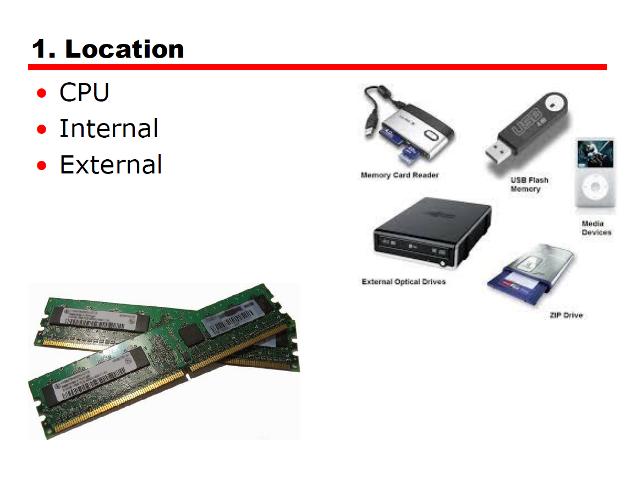

Slide 5
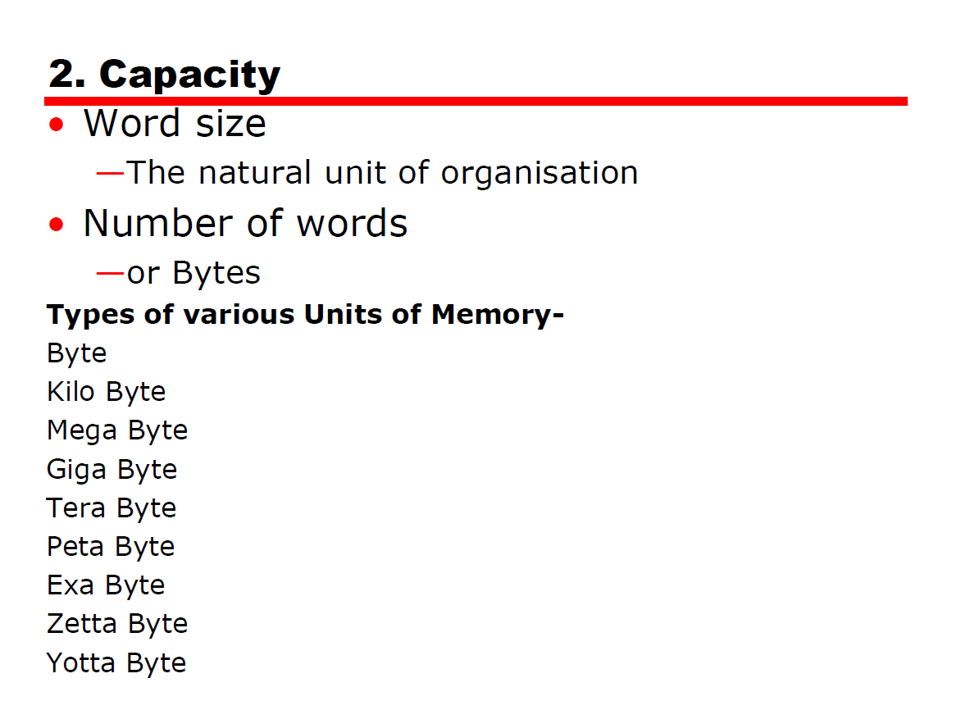

Slide 6
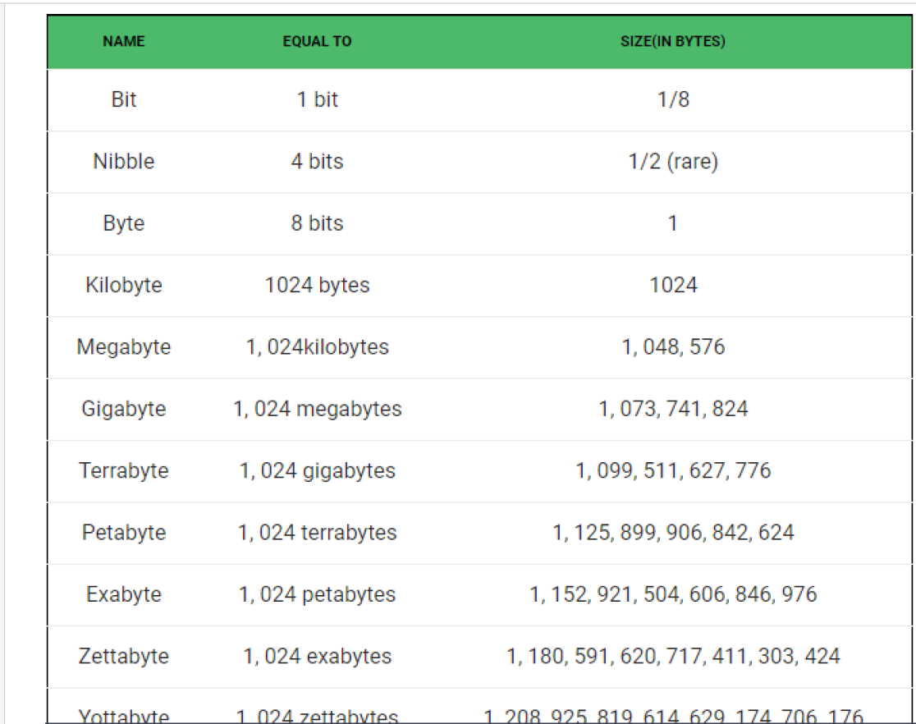

Slide 7
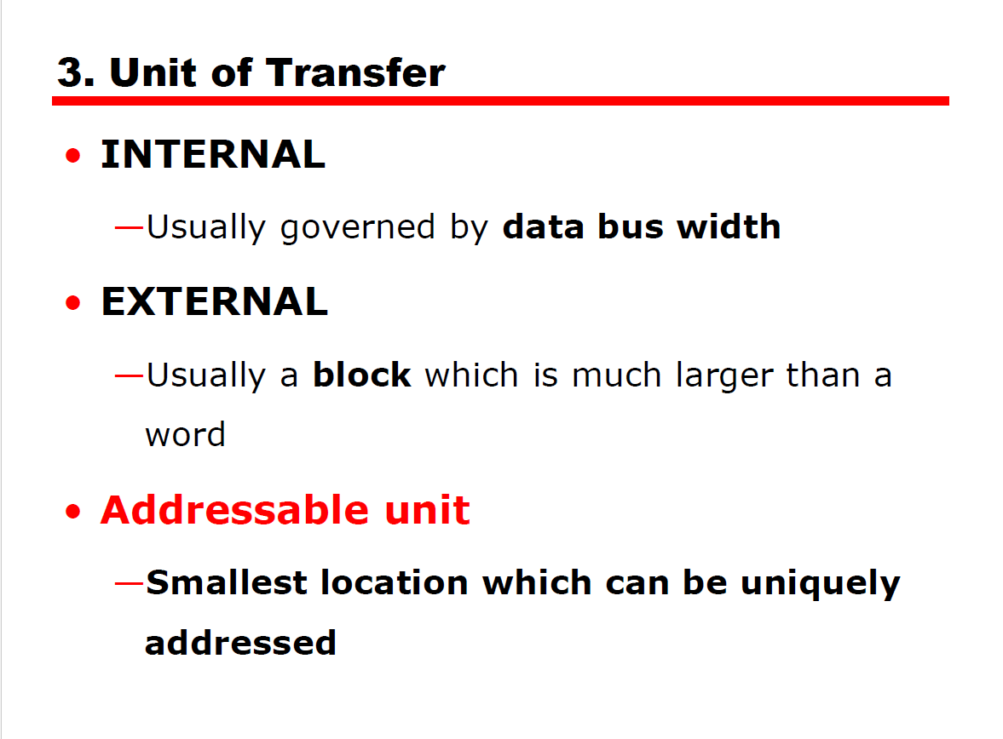

Slide 8
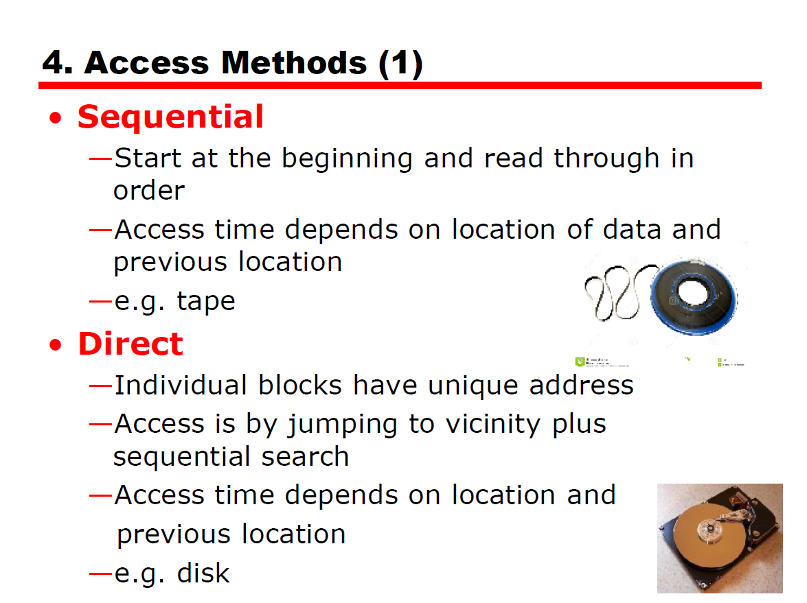

Slide 9
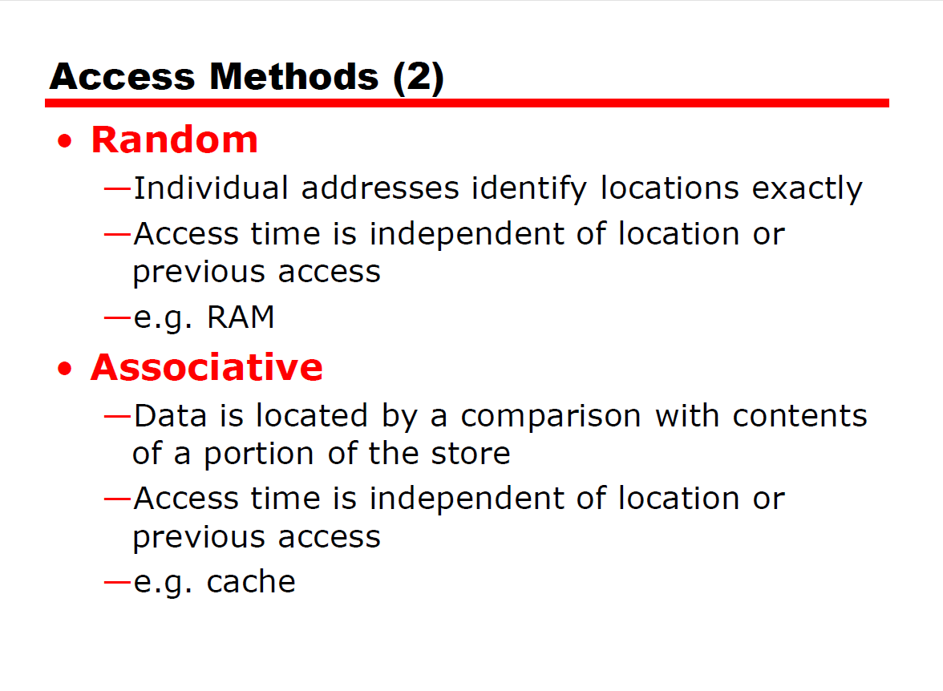

Slide 10
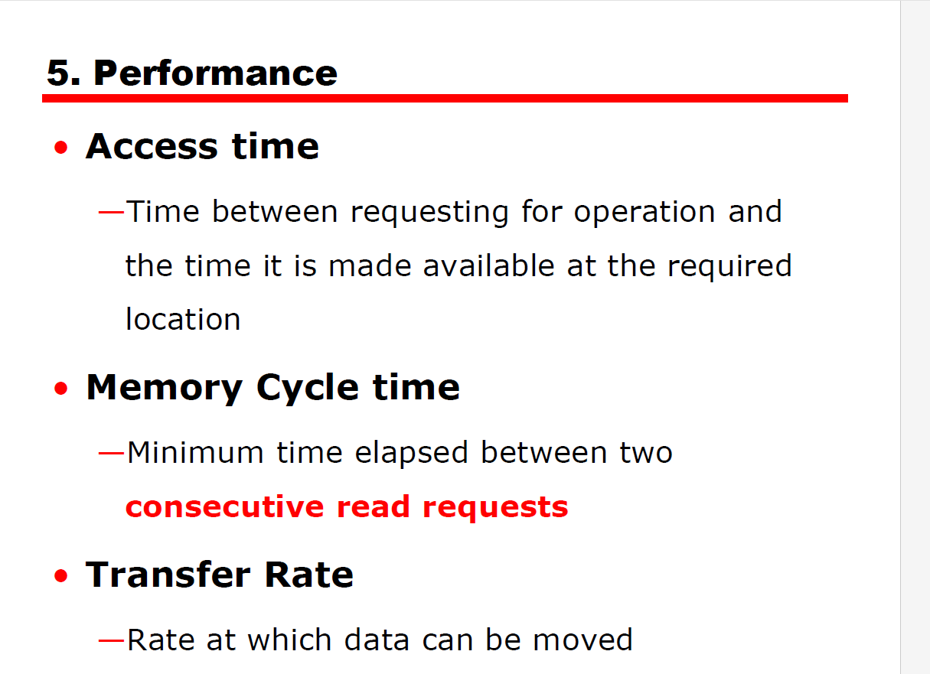

Slide 11
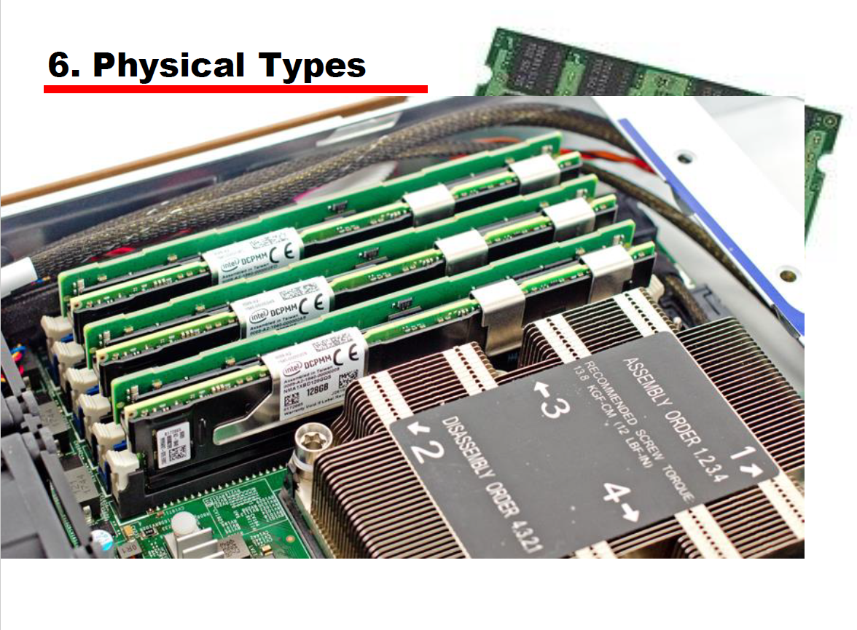

Slide 12
PHYSICAL TYPES
physical types-
semiconductor memory,
magnetic surface memory,-used for disk and tape,
optical and magneto-optical

Slide 13
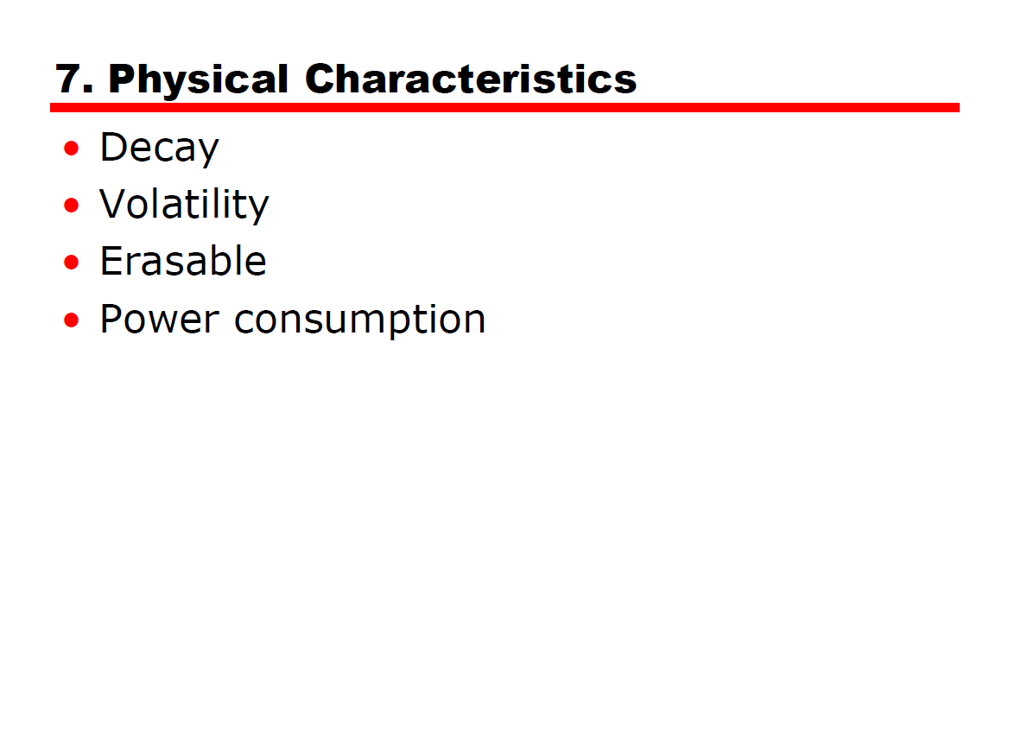

Slide 14
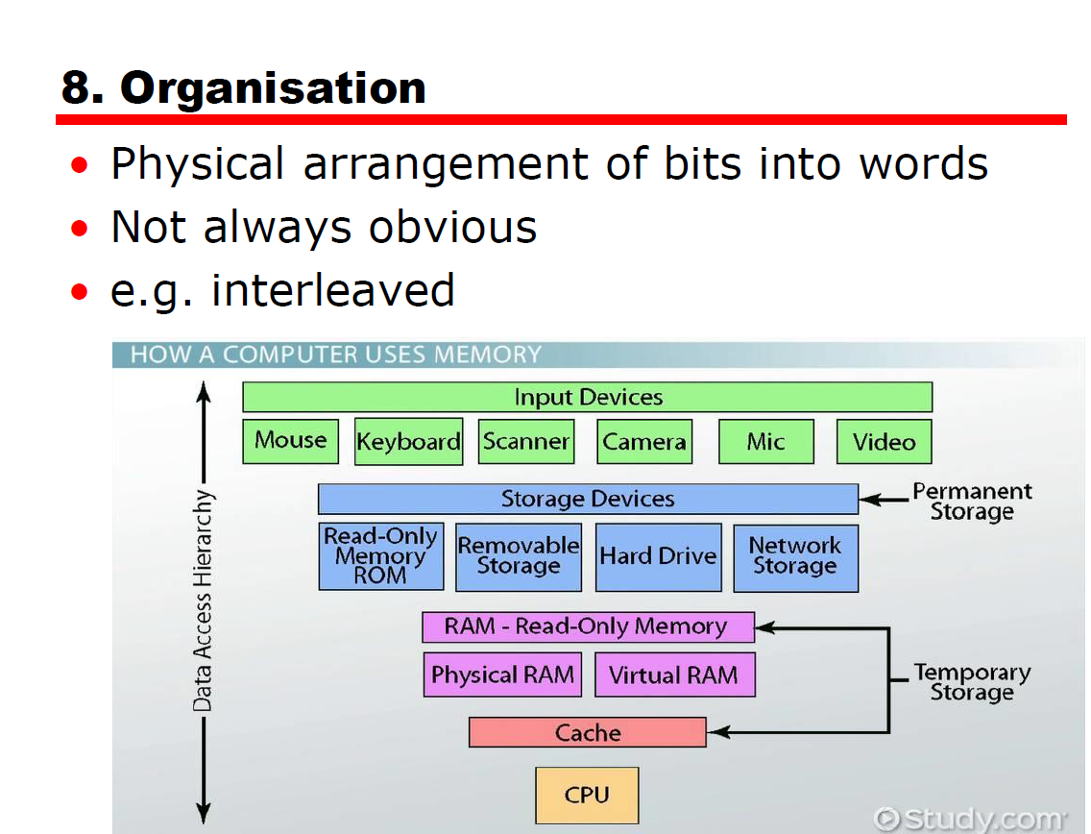

Slide 15
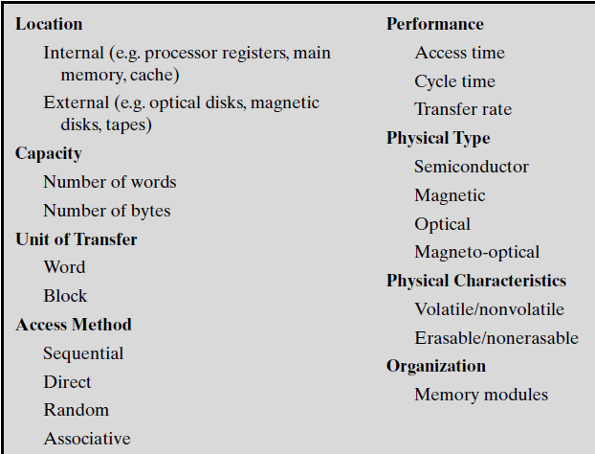

Slide 16
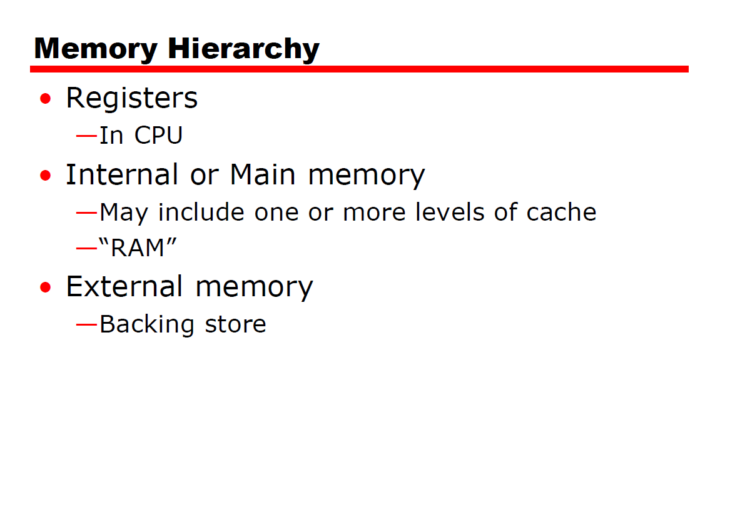

Slide 17
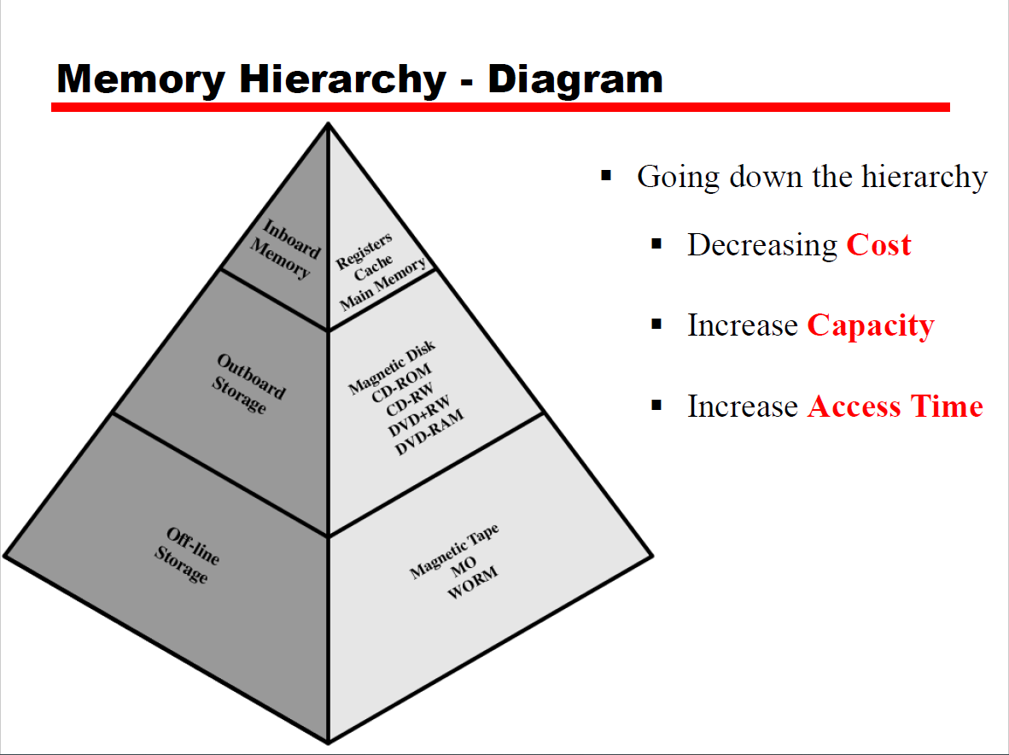

Slide 18
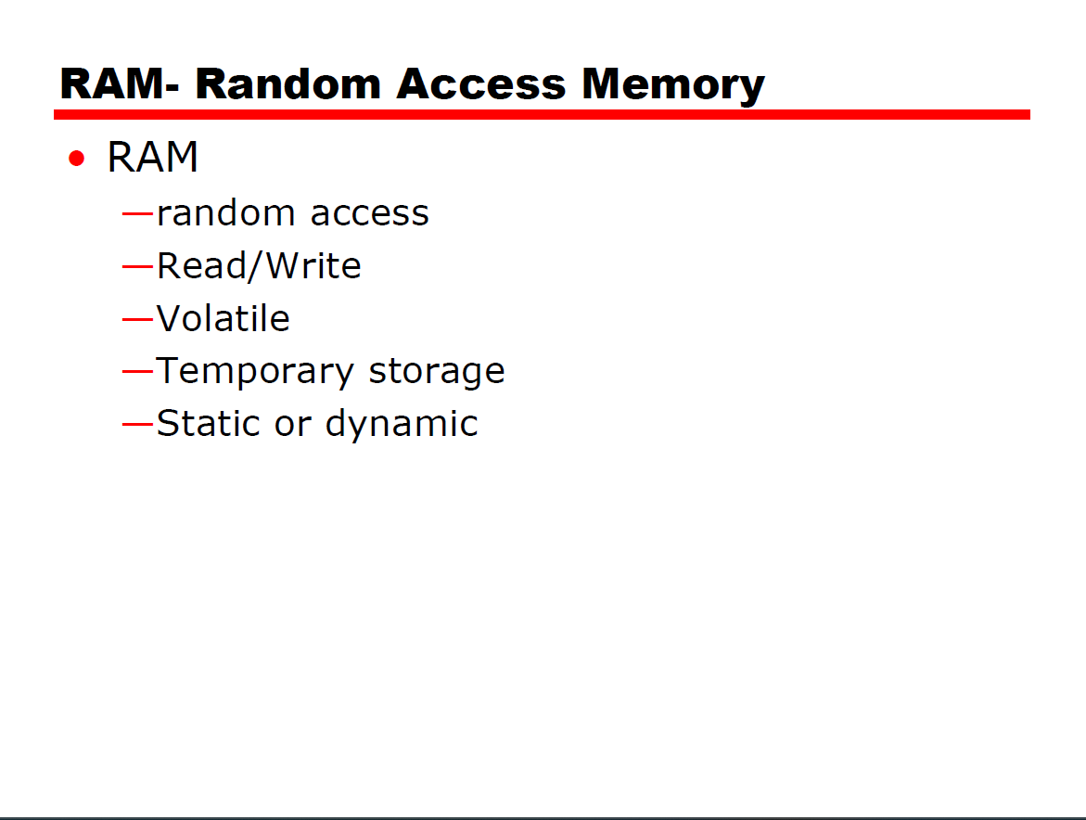

Slide 19
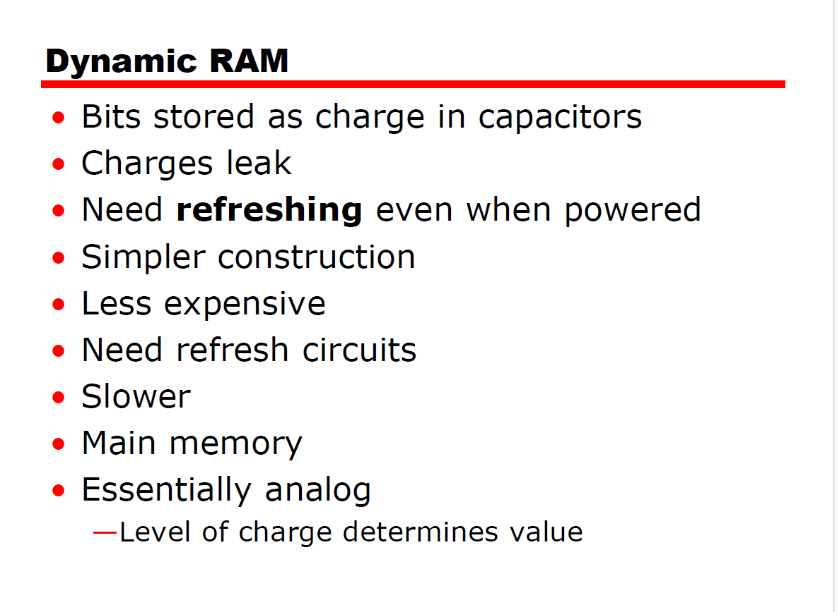

Slide 20
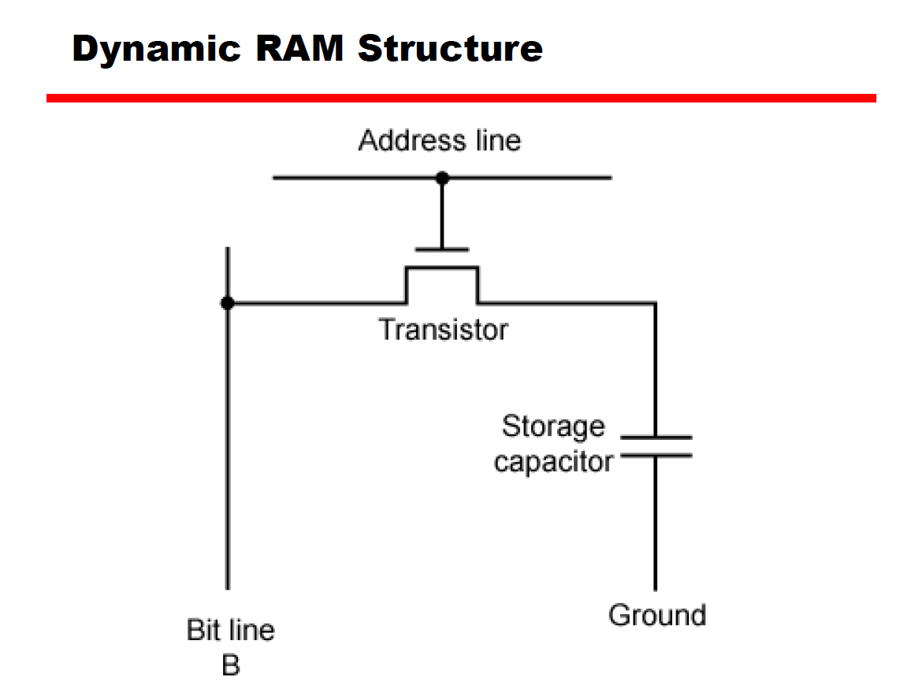

Slide 21
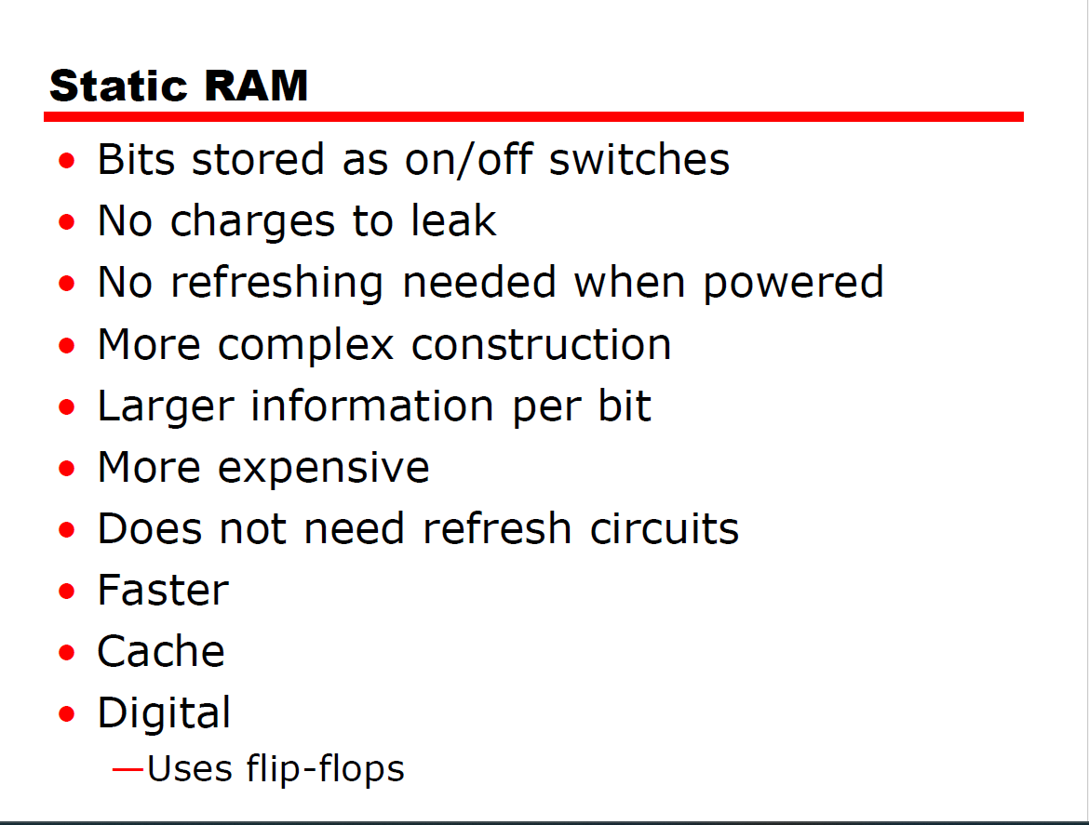

Slide 22
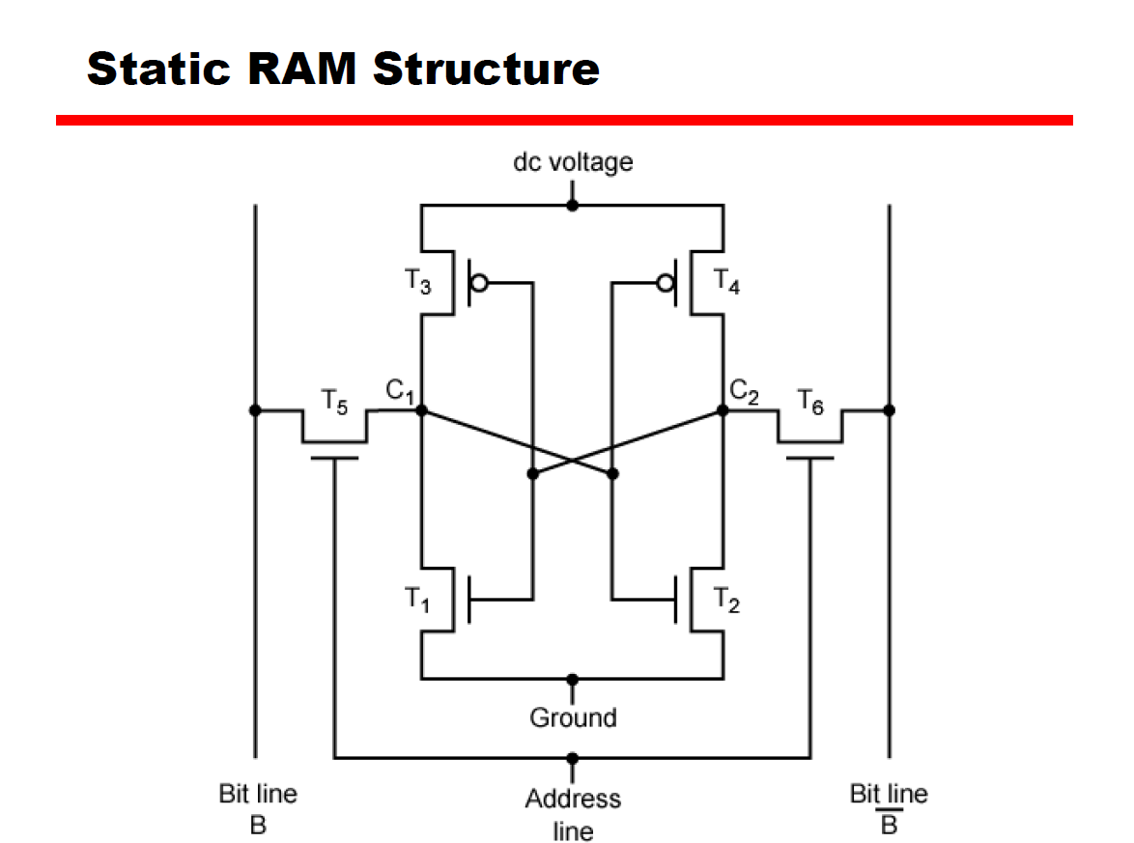

Slide 23
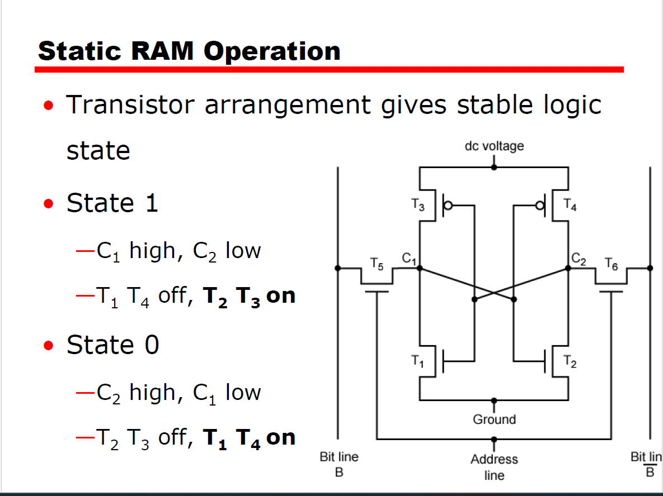

Slide 24
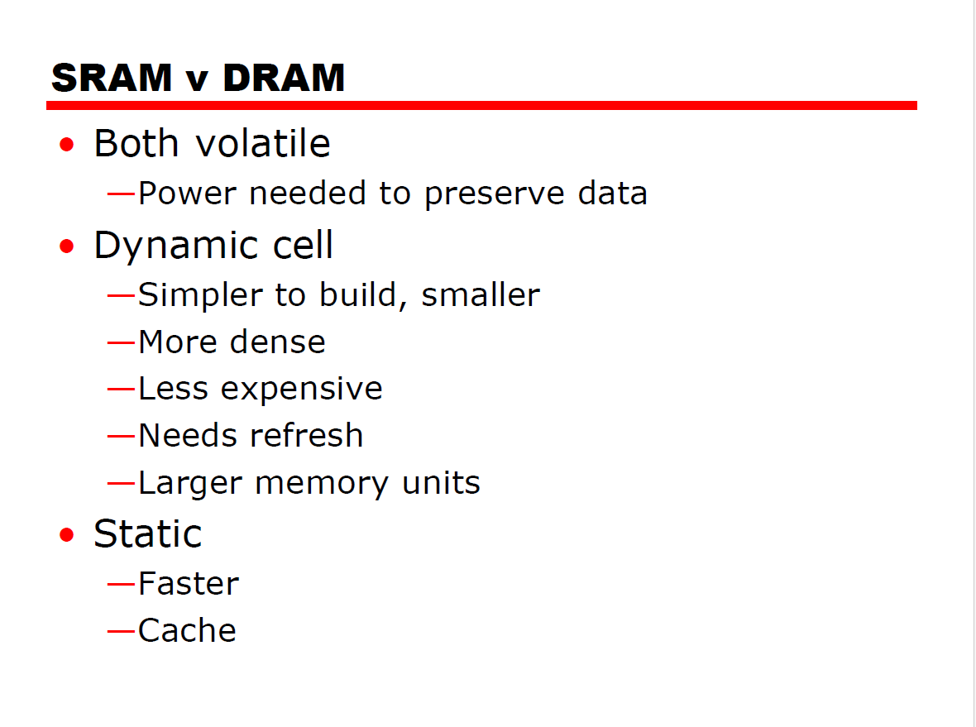

Slide 25
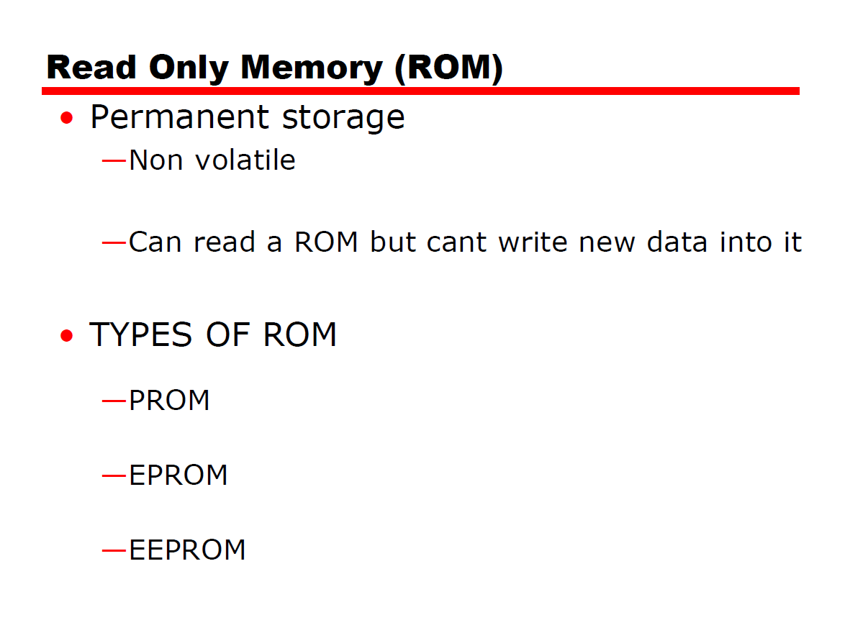

Slide 26
PROM-Programmable Read Only Memory
PROM-Programmable ROM
•Written by user.
•Programmable (“once”)
—PROM
—Small amount of data to be written
—Less expensive
—Non volatile, written only once
—Writing performed electrically by the user(fabricated without writing)

Slide 27
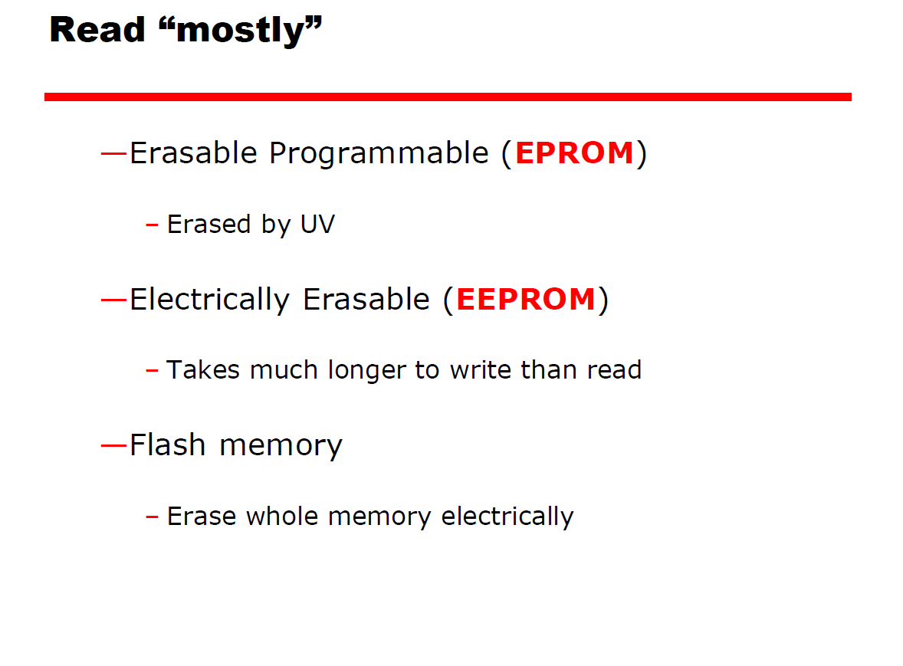

Slide 28
EPROM
Read and write-
—All storage cells should be erased to initial state by exposure to UV radiation .
—Can be altered multiple times and holds data virtually indefinitely
—More expensive than PROM

Slide 29
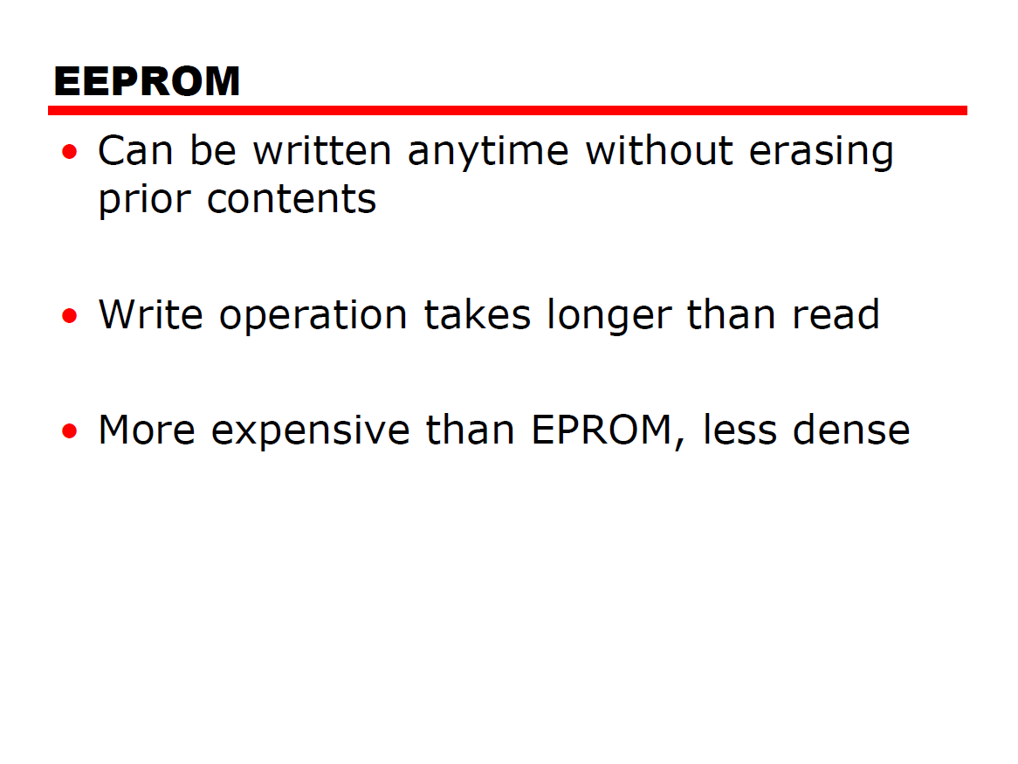

Slide 30
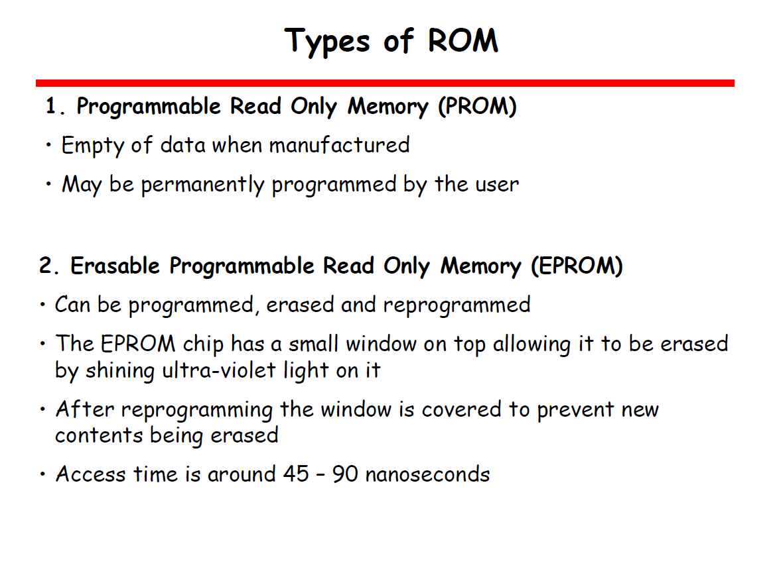

Slide 31
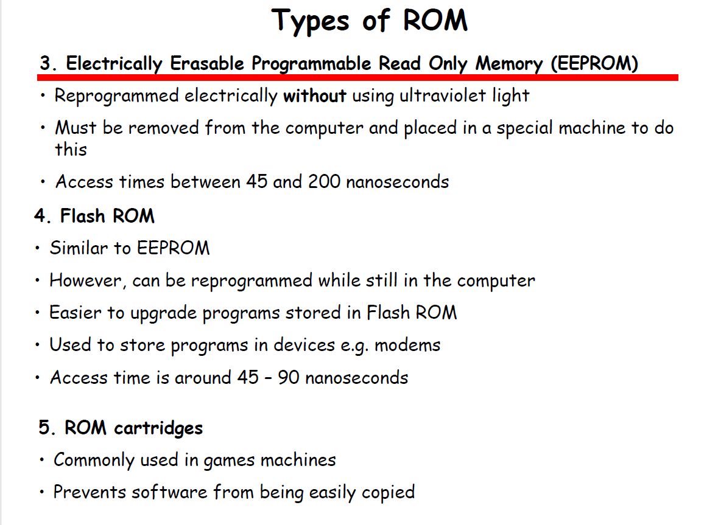

Slide 32
CACHE MEMORY
Cache memory is intended to give –
memory speed approaching that of the fastest memories available.
Provide a large memory size at the price of less expensive types of semiconductor memories.
A relatively large and slow main memory together with a
smaller, faster cache memory.
The cache contains a copy of portions of main memory.

Slide 33
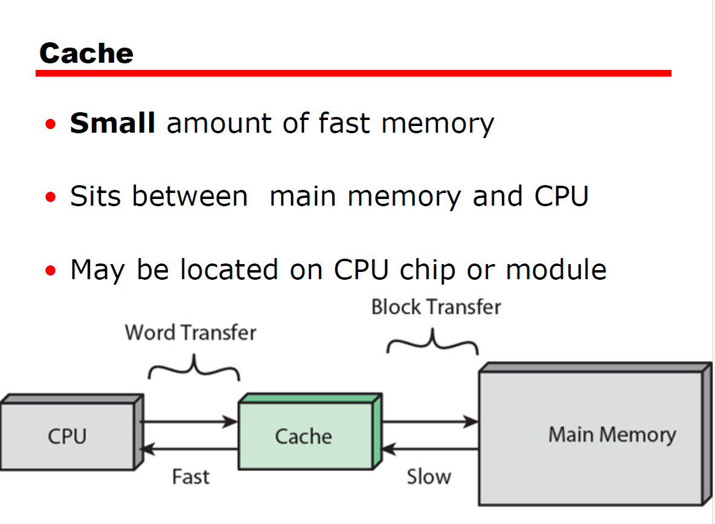

Slide 34
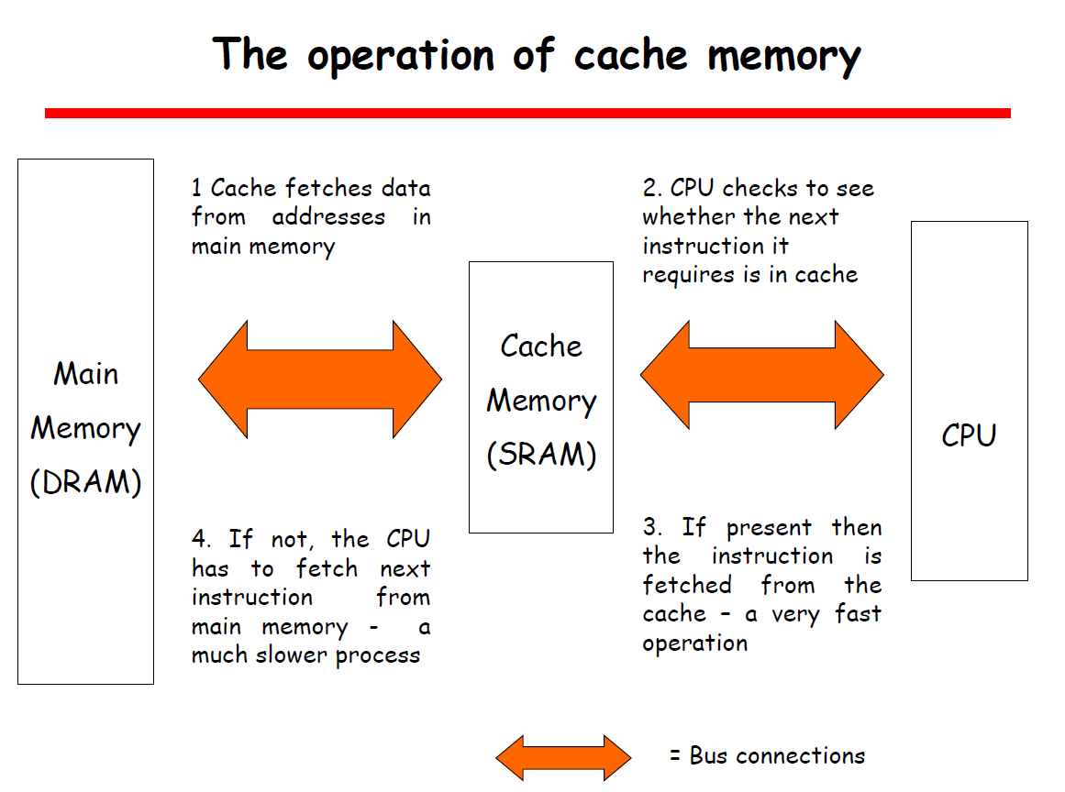

Slide 35
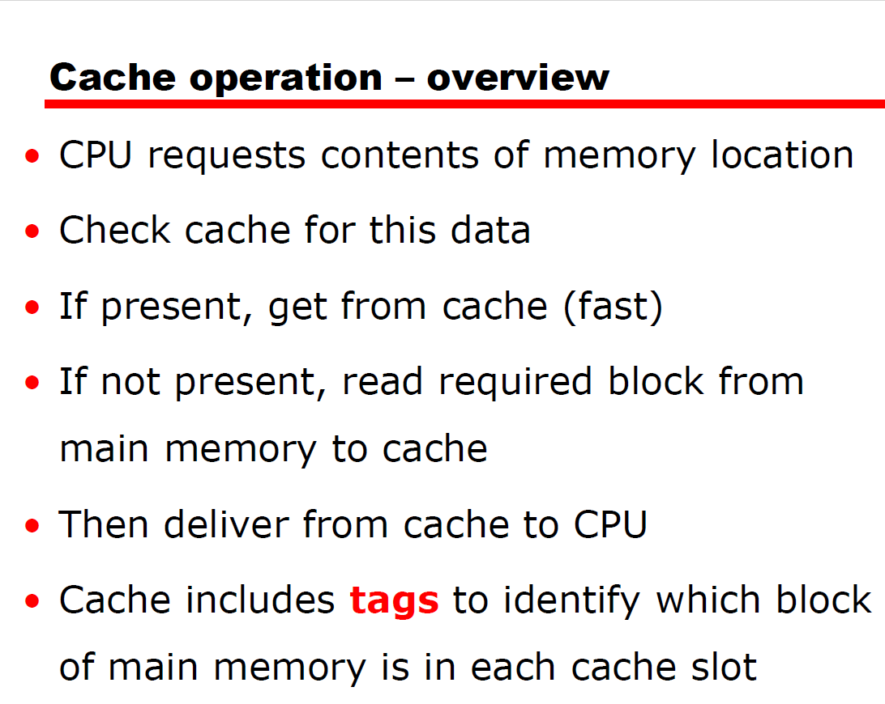

Slide 36
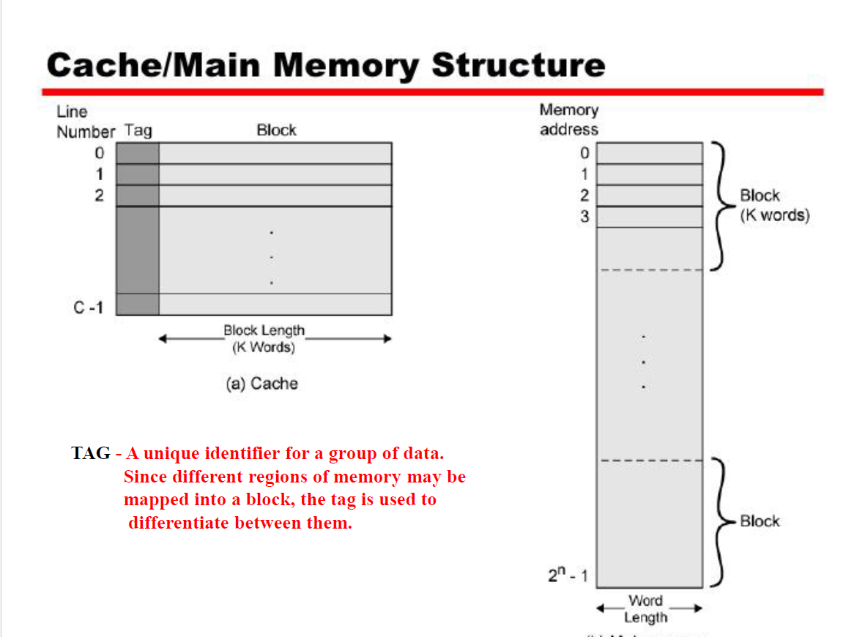

Slide 37
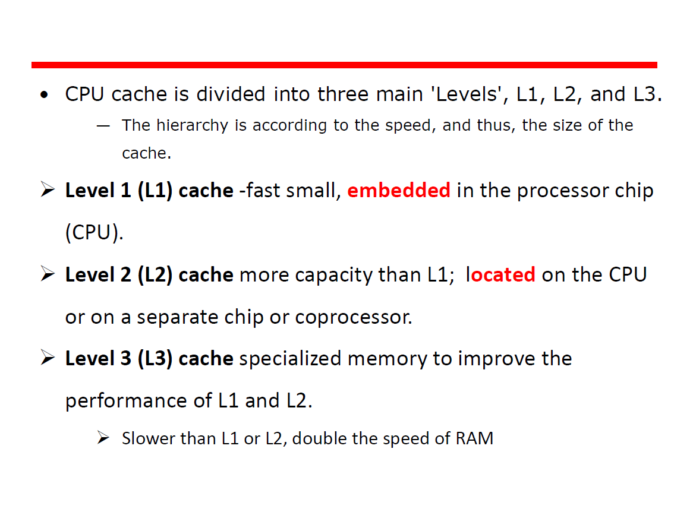

Slide 38
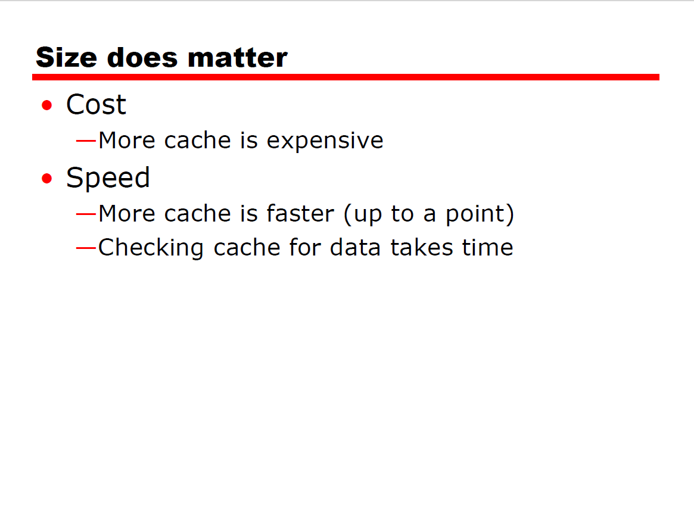

Slide 39
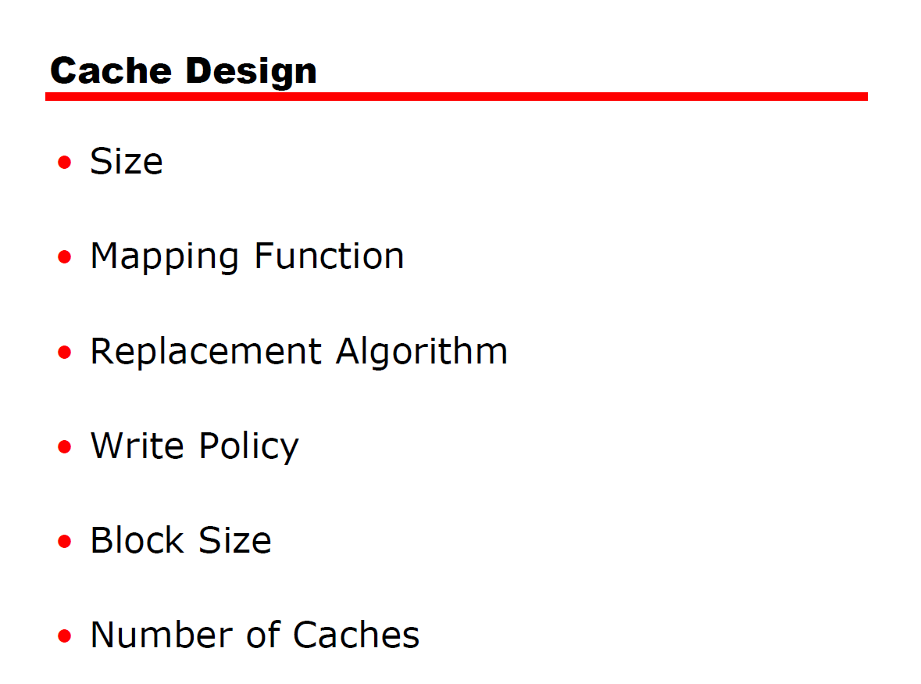

Slide 40
Mapping
Because there are fewer cache lines than main memory blocks, an algorithm is needed for mapping main memory blocks into cache lines.
Also, a means is needed for determining which main memory block currently occupies a cache line.
The choice of the mapping function decides how the cache is organized.
Three techniques can be used: direct, associative, and set associative.

Slide 41
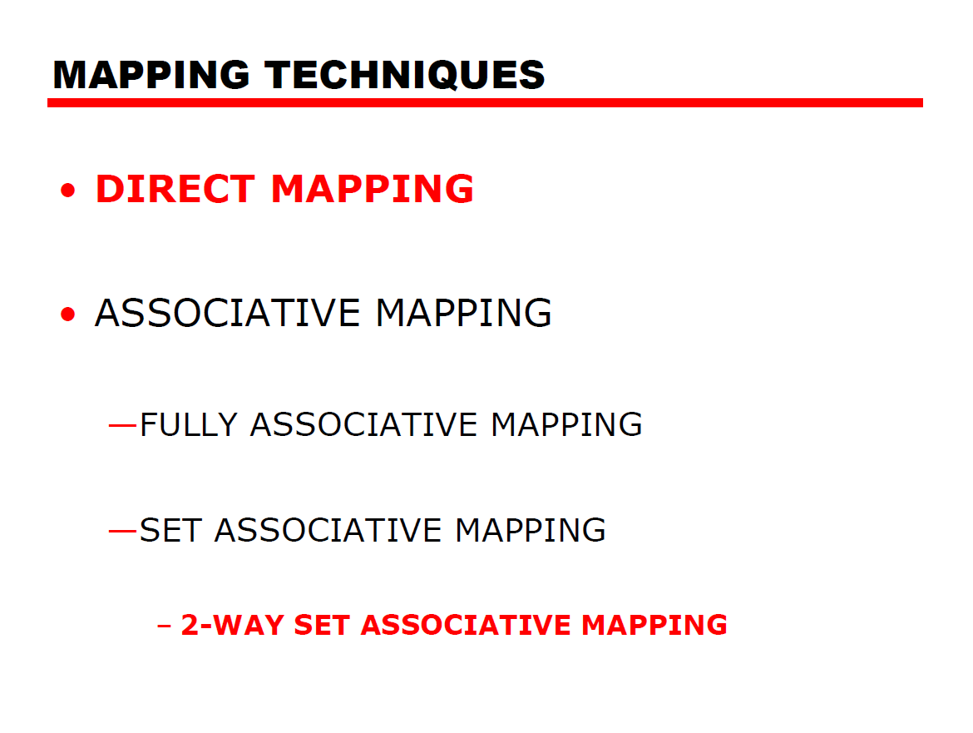

Slide 42
Direct Mapping: Each block from main memory has only one possible place in the cache organization in this technique.
As in the diagram shown, one block of Main memory to one particular block(line) of cache.

Slide 43
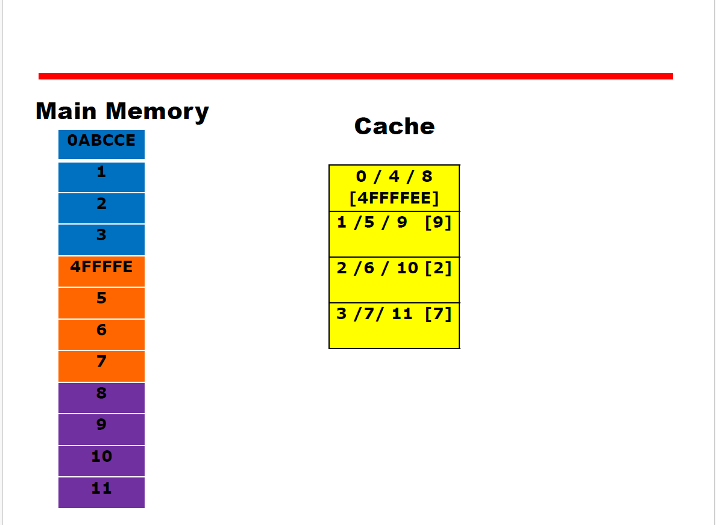

Slide 44
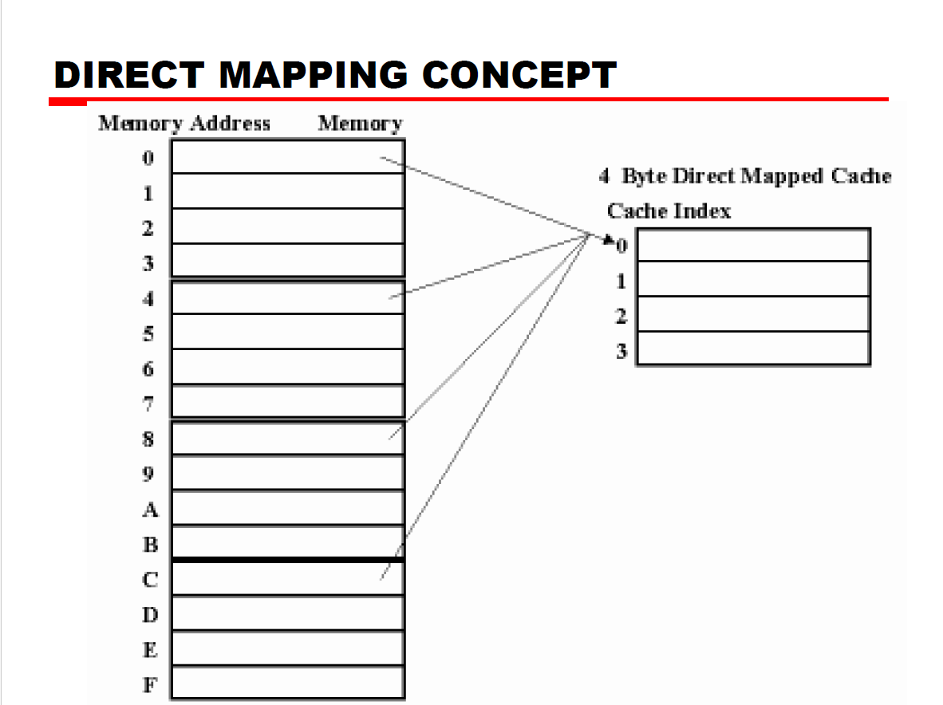

Slide 45
Explaining with Example
Consider an MM of 64 bits , block size=4 words
No : of blocks in MM=64/4=16
Cache =16 words
Block size=4 words.

Slide 46
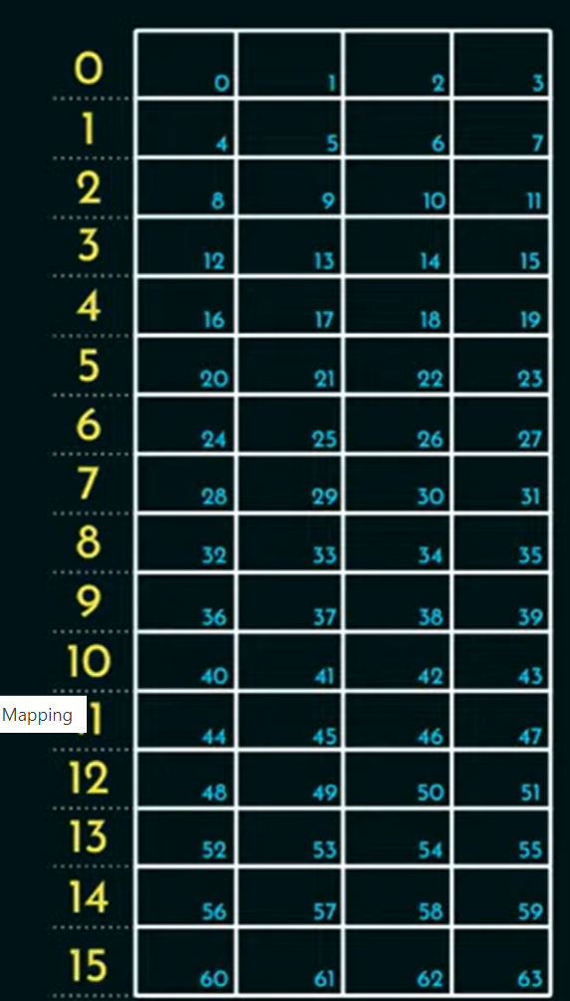

Slide 47
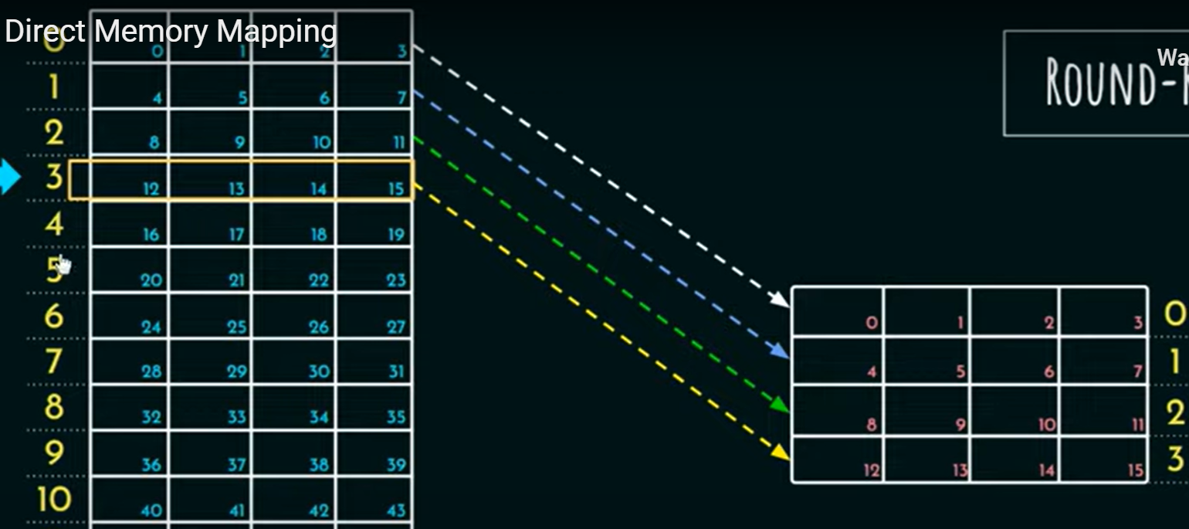

Slide 48
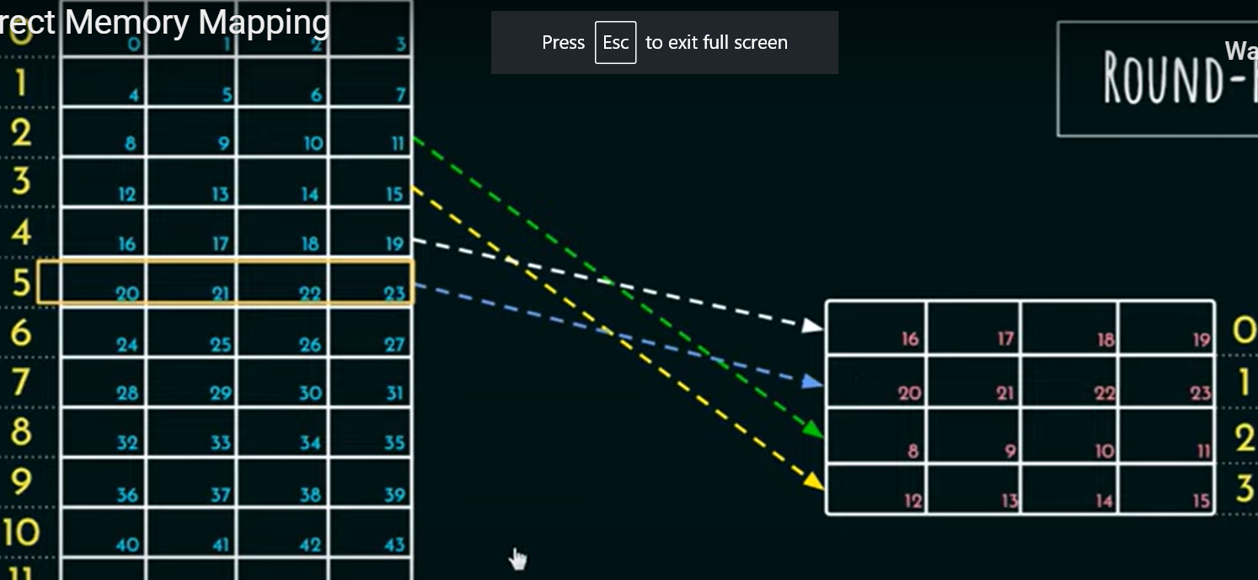

Slide 49
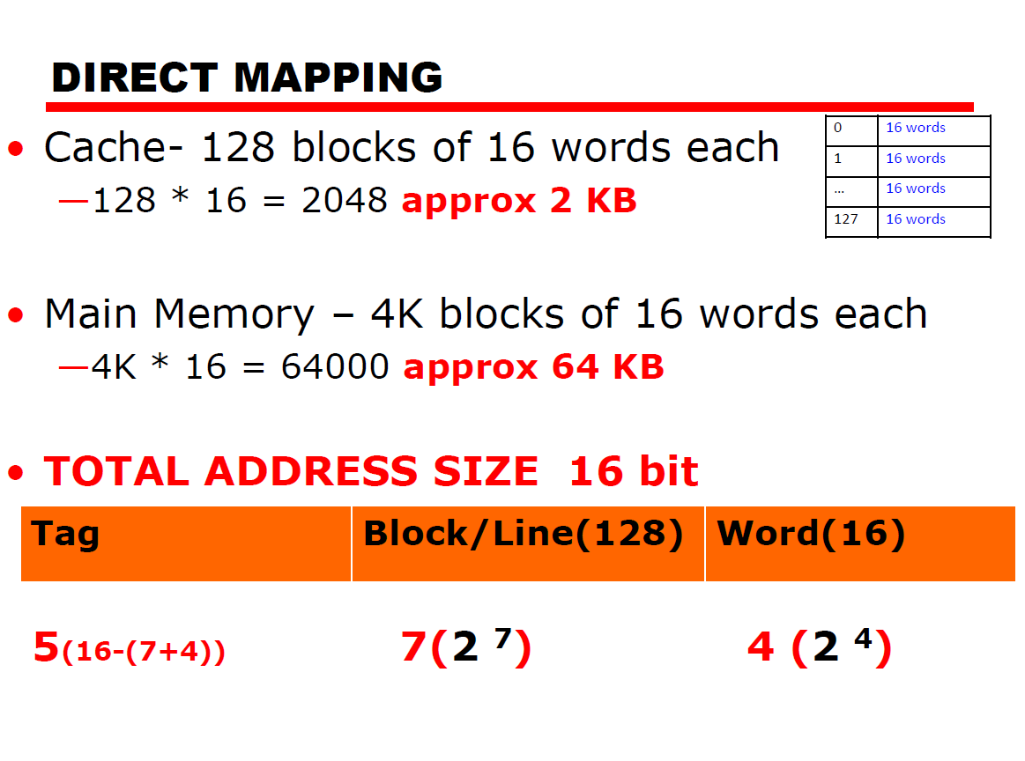

Slide 50
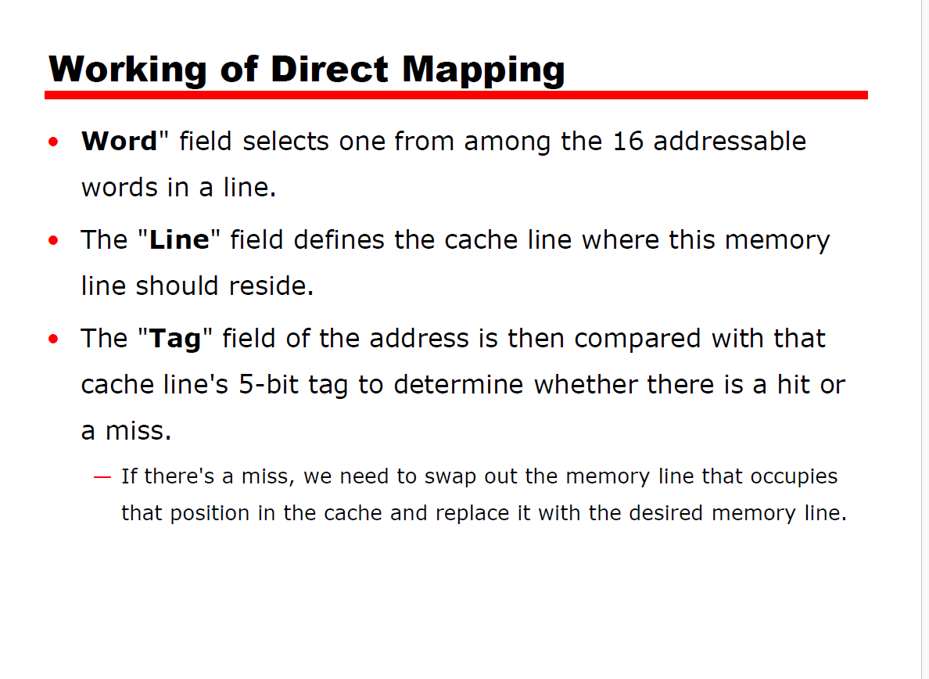

Slide 51
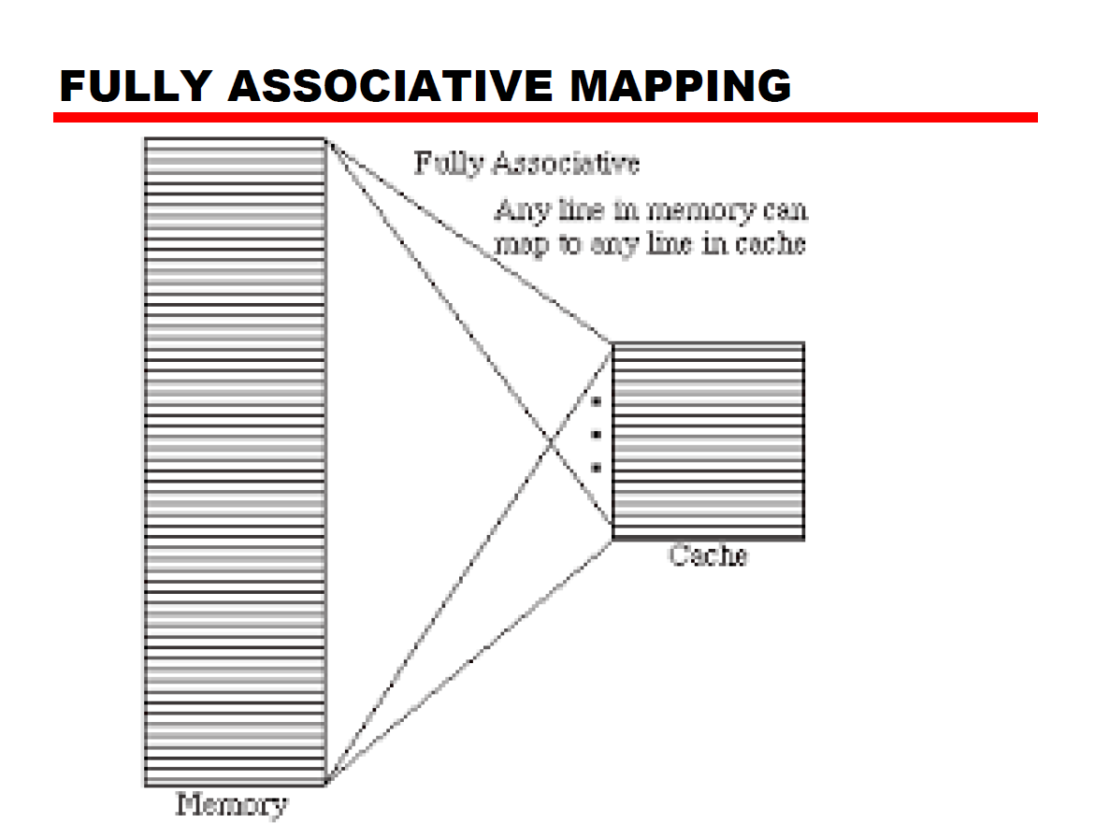

Slide 52
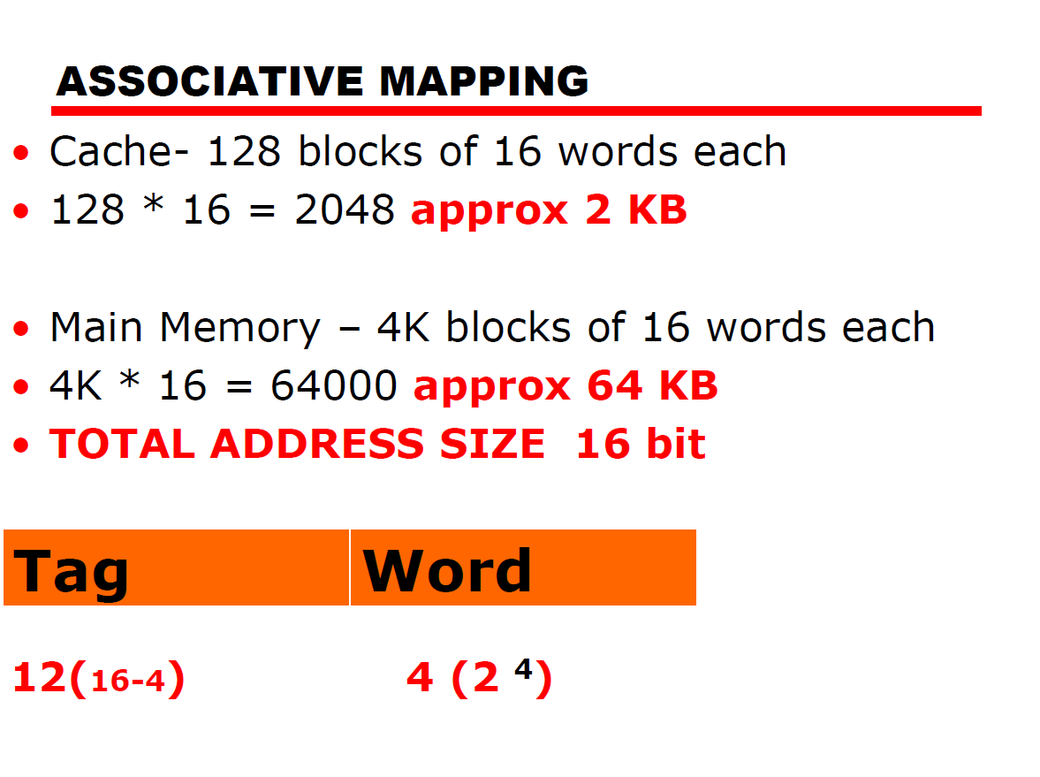

Slide 53
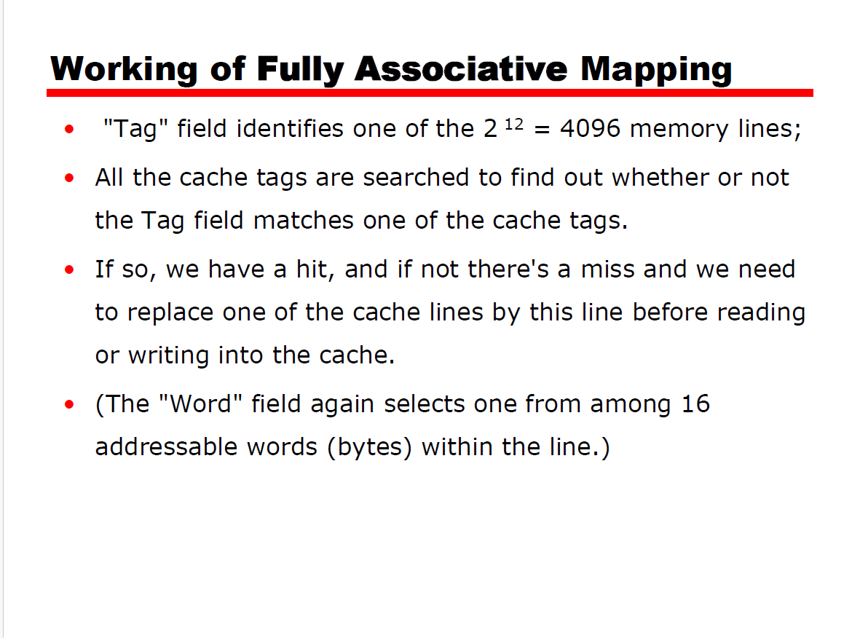

Slide 54
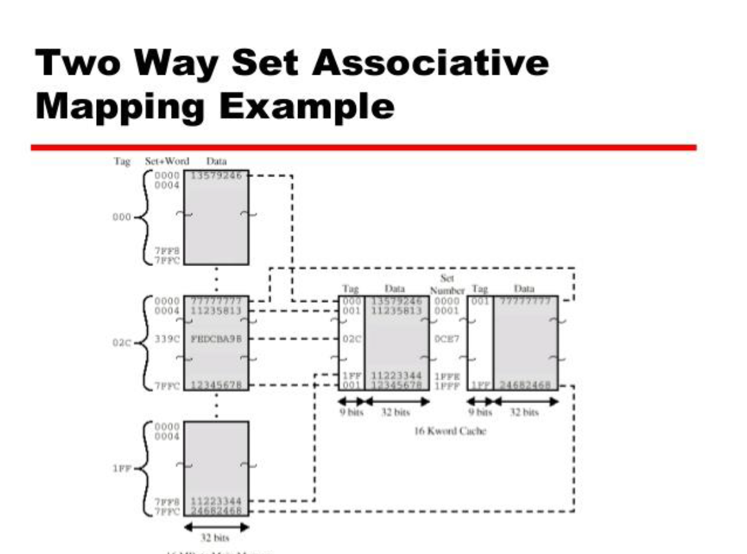

Slide 55
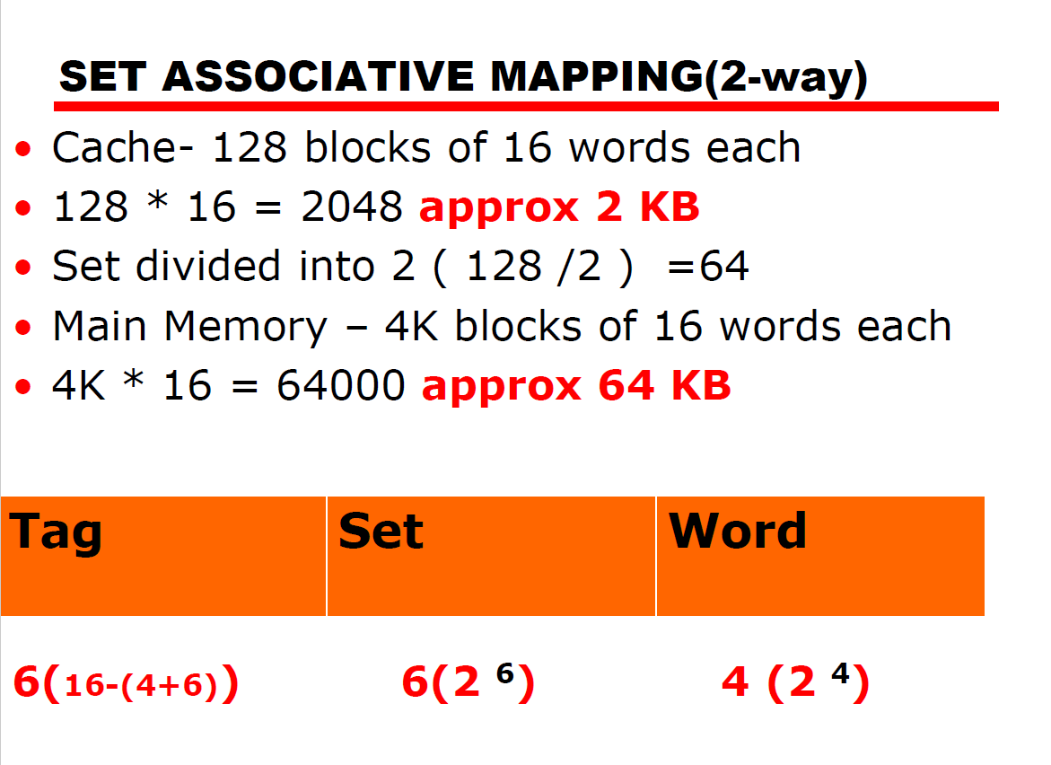

Slide 56
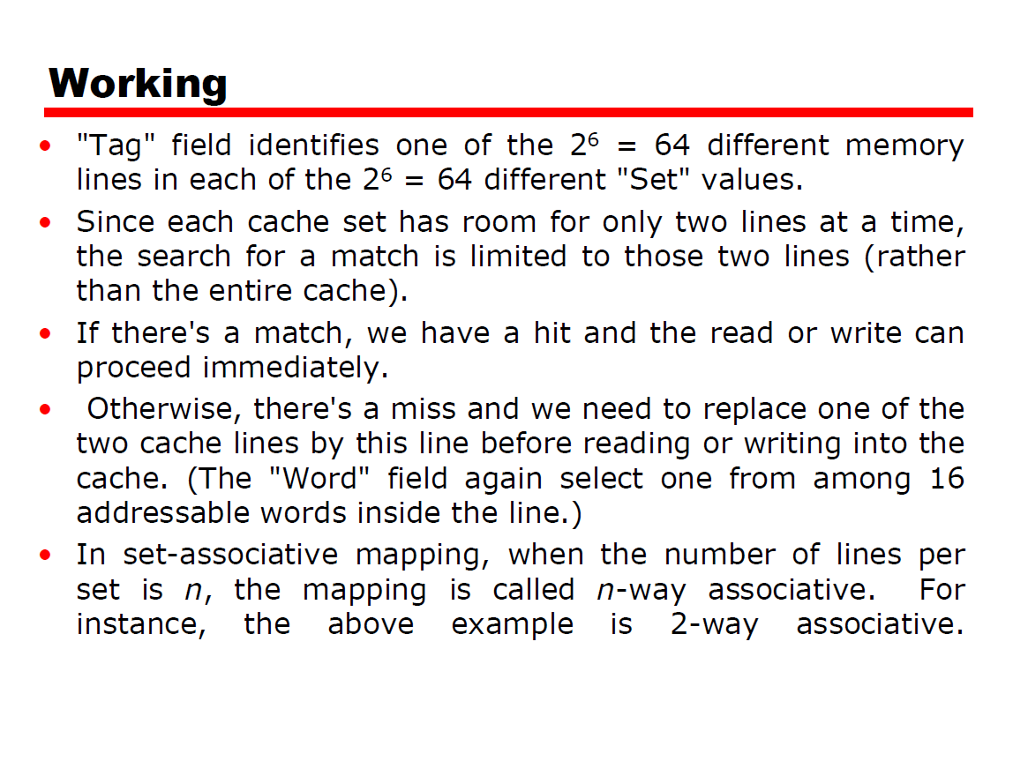

Slide 57
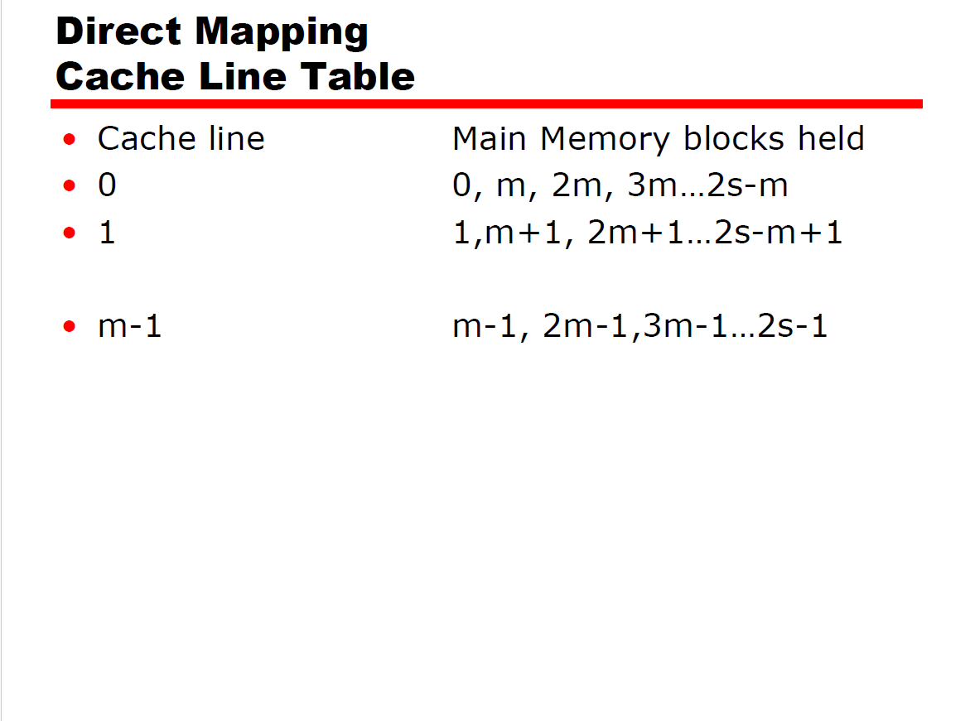

Slide 58
Direct mapping
The direct mapping technique is simple and inexpensive to implement.
Its main disadvantage is that there is a fixed cache location for any given block.
Thus, if a program happens to reference words repeatedly from two different blocks that map into the same line, then the blocks will be continually swapped in the cache, and the hit ratio will be low (a phenomenon known as thrashing).

Slide 59
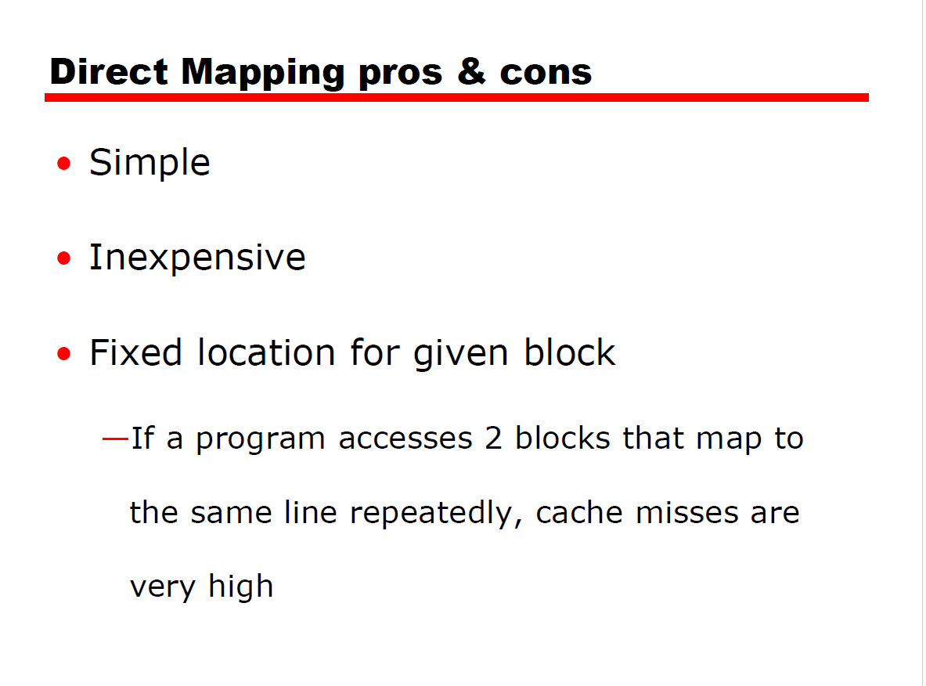

Slide 60


Slide 61


Slide 62


Slide 63


Slide 64


Slide 65
Replacement Algorithms
Once the cache has been filled, when a new block is brought into the cache, one of the existing blocks must be replaced.
-Four of the most common-
Least recently used (LRU)
First-in-first-out (FIFO)
Least frequently used (LFU)

Slide 66
Write Policy
When a block that is resident in the cache is to be replaced, there are two cases to consider.
-Old block in the cache has not been altered.
-overwritten without first writing out the old block-
-One write operation has been performed.
- main memory must be updated-

Slide 67
Write Policy
A variety of write policies, is possible.
-Simplest technique called write through-
All write operations are made to main memory & cache, ensuring Main Memory is always valid-
-Disadvantage-
Generates substantial memory traffic.
Alternative method -write back
-Minimizes memory writes.
-Updates are made only in the cache.
When an update occurs, a dirty bit, or use bit, associated with the line is set .Then, when a block is replaced, it is written back to main memory only if dirty bit is set.

Slide 68


Slide 69


Slide 70


Slide 71


Slide 72
Write policies & cache coherence Approaches
Write back: Write operations are usually made only to the cache. Main memory is only updated when the corresponding cache line is flushed from the cache.
Write through: All write operations are made to main memory as well as to the cache, ensuring that main memory is always valid.
Cache coherence approaches -
Divided into software and hardware approaches.
Some adopt a strategy involving both software and hardware elements

Slide 73


Slide 74


Slide 75
Hardware solutions
Hardware-based solutions are generally referred to as cache coherence protocols.
Because the problem is only dealt with when it actually arises, there is more effective use of caches, leading to improved performance over a software approach.
These approaches are transparent to the programmer and the compiler, reducing the software development burden.
Hardware schemes differ in a number of particulars, including where the state information about data lines is held, how that information is organized, where coherence is enforced, and the enforcement mechanisms. In general, hardware schemes can be divided into two categories: directory protocols and snoopy protocols.

Slide 76


Slide 77
Snoopy Protocol
2 Basic Approaches of SNOOPY PROTOCOL
-1.Write Invalidate
-2.Write update

Slide 78


Slide 79


Slide 80


Slide 81


Slide 82


Slide 83


Slide 84


Slide 85


Slide 86


Slide 87


Slide 88


Slide 89


Slide 90


Slide 91


Slide 92


Slide 93


Slide 94


Slide 95


Slide 96


Slide 97


Slide 98


Slide 99


Slide 100


Slide 101


Slide 102


Slide 103


Slide 104

.

Slide 105
RAID (Redundant Array Of Independent Disks)
Secondary Storage-Very Slow-
-Additional gain in performance is obtained by using multiple parallel components.
In disk storage - arrays of disks are developed that operate independently and in parallel.
With Multiple disks,-separate I/O requests handled in parallel, as long as the data required is on separate disks.

Slide 106
RAID
With use of multiple disks- wide variety of ways in which the data organized and redundancy added to improve reliability.
So standardized scheme for multiple-disk database design, known as RAID –Redundant Array of Independent Disks.
RAID scheme consists of seven levels, zero through six.

Slide 107
RAID
These levels designate different design architectures that share three common characteristics:
1. RAID is a set of physical disk drives viewed by the operating system as a single logical drive.
2. Data are distributed across the physical drives of an array in a scheme known as striping.
3. Redundant disk capacity is used to store parity information, which guarantees data recoverability in case of a disk failure.

Slide 108


Slide 109
RAID
The RAID strategy employs –
Multiple disk drives and
Distributes data in these disk drives to enable simultaneous access to data from multiple drives.
Improving I/O performance and allowing increases in capacity.

Slide 110


Slide 111
RAID LEVEL-0 (FOR HIGH DATA TRANSFER CAPACITY)
NO Redundancy
Improved Performance & Capacity .
Low cost.
User & system data distributed across all disks.
Parallel issue of request-Reducing I/O Queuing time.
The disk s divided into strips (like blocks or frames in MM).
Best performance-but no fault tolerance.

Slide 112


Slide 113
RAID LEVEL-1
Redundancy of data.
Redundancy achieved by duplicating data.
Every disk in the array has a mirror disk with same data.
A read request can be serviced by either of the 2 disks-Improving read performance.
Write request is done in parallel.
Failure recovery very easy-data still present in second drive.
Costly-twice disk space.

Slide 114


Slide 115
RAID LEVEL-2
Parallel access technique-All member disk takes part in execution of every I/O request.
Data striping is used-as in other levels-with very smaller strips.
Error correcting code –calculated across corresponding bits on each data disk and stored in multiple parity disks.
Some discs store error correcting & parity info.
Hamming code used-error correction(correct single bit errors & detect double bit errors).
Fewer disks than RAID 1-but still costly
No: of redundant disks proportional to log(no : of data disk).

Slide 116


Slide 117
RAID-3
Organized in a similar fashion to RAID 2-
Difference –This requires only a single disk to storing parity, no matter how large the disk array.
Employs parallel access, with data distributed in small strips.
A simple parity bit is computed for the set of individual bits in the same position on all of the data disks.
REDUNDANCY- In the event of a drive failure, the parity drive is accessed and data is reconstructed from the remaining disks in the array.
Once the failed drive is replaced, the missing data can be restored on the new drive and operation resumed.

Slide 118
RAID-3
PERFORMANCE -Data are striped in very small strips, RAID 3 can achieve very high data transfer rates.
Any I/O request will involve the parallel transfer of data from all of the data disks.
Only one I/O request can be executed at a time.
Thus, in a transaction-oriented environment, performance suffers.

Slide 119


Slide 120
RAID_4
Separate I/O requests can be satisfied in parallel.
Uses large stripes-means a user can read records from any single drive.
Suitable for applications- that require high I/O request rates
and
less suited for applications -that require high data transfer rates.
A bit-by-bit parity strip is calculated across corresponding strips on each data disk, and the parity bits are stored in the corresponding strip on the parity disk.

Slide 121
RAID-4
Each update requires, -updating the user data and also the parity drive.
To calculate the new parity, -read the old user strip and the old parity strip.
Then update these two strips with the new data and the newly calculated parity.
Thus, each strip write involves two reads and two writes.

Slide 122


Slide 123
RAID-5
RAID 5 is organized in a similar fashion to RAID 4.
The difference - parity information is striped across each drive, enabling the array to function, even if one drive were to fail.
A typical allocation is a round-robin scheme.
For an n-disk array, the parity strip is on a different disk for the first n stripes, and the pattern then repeats.

Slide 124


Slide 125
RAID-6
Here, two different parity calculations are carried out and stored in separate blocks on different disks.
1) Exclusive-OR calculation used in RAID 4 and 5.
2) An independent data check algorithm.
In RAID-6,if user data require N disks consists of N +2 disks.
Data check algorithm makes it possible to regenerate data even if two disks containing user data fail.
The advantage of RAID 6 is that it provides extremely high data availability.
RAID 6 incurs a substantial write penalty, because each write affects two parity blocks.
RAID 6 controller suffer more than a 30% drop in overall write performance
compared with a RAID 5 implementation.

Slide 126


Slide 127


Slide 128


Slide 129


