Slide 1
Grammar

Slide 2
Definition of a Grammar
Definition 4.1 A phrase-structure grammar (or simply a grammar) is (V_{N}, ∑, P , S )where
(i) V_{N} is a finite non empty set whose elements are called variables,
(ii) ∑ is a finite non empty set whose elements are called terminals,
(iii) V_{N} ∩ ∑ = ø
(iv) S is a special variable (i.e, an element of V_{N} ) called the start symboL
(v) P is a finite set whose elements are α->β, where α and β are strings on V_{N} U ∑ . α has at least one symbol from V_{N .} Elements of P are called productions or production rules or rewriting rules.

Slide 3
Definition of a Grammar
The production rules.
Reverse substitution is not permitted.
For example, if S ->AB is a production,
then we can replace S by AB,
but we cannot replace AB by S.
No inversion operation is permitted.
For example. if S -> AB is a production.
It is not necessary that AB -> S is a production.

Slide 4
Grammar : Example 1
G = (V_{N} ,∑, P, S) is a grammar
where
V_{N} = {<sentence>, <noun>, <verb>, <adverb>}
∑ = [Ram, Sam, ate, sang, well]
S =<sentence>
P consists of the following productions:
<sentence> -> <noun> <verb>
<sentence> -> <noun> <verb> <adverb>
<noun> -> Ram
<noun> -> Sam
<verb> -> ate
<verb> -> sang
<adverb> -> well

Slide 5
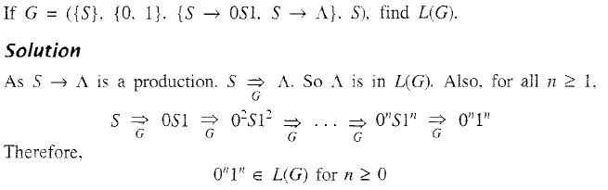
Grammar : Example 2

Slide 6
Grammar : Example 2

Slide 7
Grammar : Example 2
In the above derivation, S ->0S1 is applied at every step except
in the last step. In the last step, we apply S -> ^).
L(G) = {0^{n}1^{n} , n>=0}

Slide 8
Grammar : Example 3
If G = ({ S}, {a}, {S ->SS}, S), find the language generated by G.

Slide 9
Grammar : Example 3
If G = ({ S}, {a}, {S ->SS}, S), find the language generated by G.

Slide 10
Grammar : Example 3
If G = ({ S}, {a}, {S ->SS}, S), find the language generated by G.
Solution
L(G) = ø
Since the only production S -> SS in G has no terminal on the right-hand side.

Slide 11
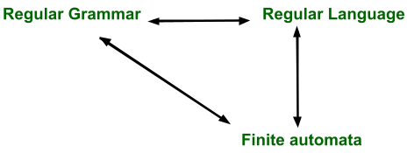

Slide 12
Regular Grammar
Regular grammar is a formal grammar in which every production is restricted to have one of the following forms:-
A->aB
A->a
where A and B are the non-terminals, a is a terminal symbol
With ε productions permitted as special case when L(G) contains ε

Slide 13
Regular Grammar
It is called as regular grammar, because if the format of every production is limited to A->aB, A->a
then the grammar can specify only regular sets and hence there exists a finite automata accepting L(G), if G is regular

Slide 14
Equivalence of Regular Grammar and Finite Automata RG to FA
Given a regular grammar G, a finite automata accepting L(G) can be obtained as follows:-
The number of states of the automata will be equal to the number of non-terminals of the grammar plus one, i.e.
there will be a state corresponding to every non-terminal of the grammar and one more state will be there, which will be the final state of the automata.

Slide 15
Equivalence of Regular Grammar and Finite Automata RG to FA
The state corresponding to the start symbol of the grammar will be initial state of the automata
If L(G) contains ε then make start state also as the final state

Slide 16
Equivalence of Regular Grammar and Finite Automata RG to FA
The transitions in the automata can be obtained as follows:-
For every production A->aB do make
δ(A,a)=B
For every production of the form A->a do make
δ(A,a)=final state

Slide 17
RG to FA-Example 1
Consider a regular grammar given below:-
S->0S|1A|1
A->0A|1A|0|1
Author-Dr. OG Kakde

Slide 18
RG to FA-Example 1
Consider a regular grammar given below:-
S->0S|1A|1
A->0A|1A|0|1
Author-Dr. OG Kakde

Slide 19
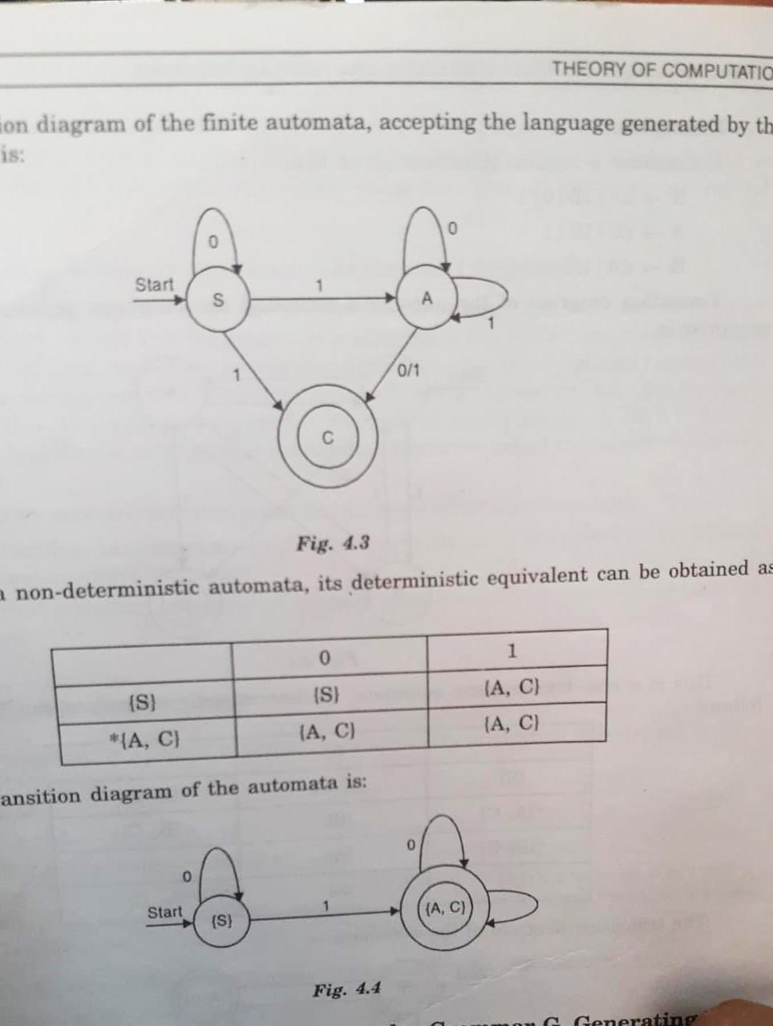
RG to FA-Example 1
Consider a regular grammar given below:-
S->0S|1A|1
A->0A|1A|0|1
Transition Diagram for the finite automata:-
Author-Dr. OG Kakde

Slide 20
RG to FA-Example 1
Its NDFA:
Corresponding DFA transition table:-
Author-Dr. OG Kakde

Slide 21
RG to FA-Example 1
Its NDFA:
Corresponding DFA transition diagram:-
Author-Dr. OG Kakde

Slide 22
RG to FA-Example 2
Consider a regular grammar given below:-
A->aB/bA/b
B->aC/bB
C->aA/bC/a

Slide 23
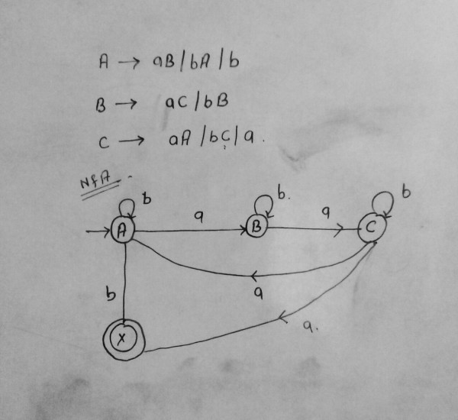
RG to FA-Example 2
Consider a regular grammar given below:-
A->aB/bA/b
B->aC/bB
C->aA/bC/a
<
GateOverflow

Slide 24
RG to FA-Example 2
Consider a regular grammar given below:-
A->aB/bA/b
B->aC/bB
C->aA/bC/a
<
DFA Transition Table | Next State
Present State | a | B
->A | B | *{A,X}
B | C | B
{*A,X} | B | *{A,X}
C | *{A,X} | C
GateOverflow

Slide 25
RG to FA-Example 3
Consider a regular grammar given below:-
S→ 0A|1A
A→ 0A|1A|+B|-B
B→ 0B|1B|0|1

Slide 26
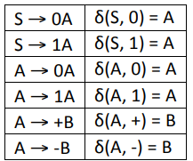
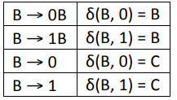
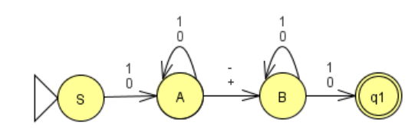
RG to FA-Example 3
Consider a regular grammar given below:-
S→ 0A|1A
A→ 0A|1A|+B|-B
B→ 0B|1B|0|1
NFA-
C

Slide 27
RG to FA-Example 3
Consider a regular grammar given below:-
S→ 0A|1A
A→ 0A|1A|+B|-B
B→ 0B|1B|0|1
NFA-
C
DFA Transition Table | Next State
Present State | 0 | 1 | + | -
->S | A | A
A | A | A | B | B
B | {B,C} | {B,C}
{B,C} | {B,C} | {B,C}

Slide 28
Generating Regular Grammar from Given Finite Automata – Convert FA to RG
Associate suitable variables like A,B,C with the states of the automata. The labels of the states can be used as variable names
Obtain the productions of the grammar as follows:-
If δ(A,a)=B, then add a production A->aB to the list of productions of the grammar.
If B is a final state, then add either A->a or B-> ε to the list of productions
The variable associated with the initial state of the automata is the start symbol of the grammar

Slide 29
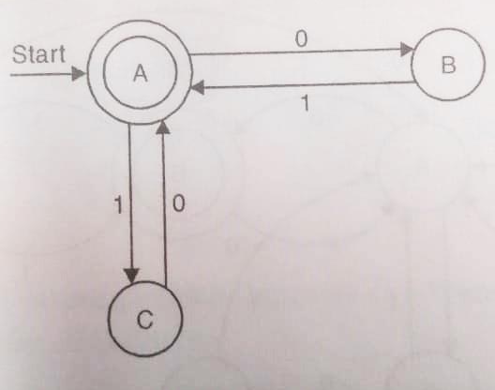
FA to RG–Example 1
Consider a FA given below:-
Author-Dr. OG Kakde

Slide 30
FA to RG–Example 1
Consider a FA given below:-
Author-Dr. OG Kakde

Slide 31
FA to RG–Example 1
Consider a FA given below:-
A->0B|1C|ε
B->1A
C->A
or
A->0B|1C
B->1A|1
C->0A|0
Both the grammars are same,
The first one contains ε transitions,
The second one is ε free.
Author-Dr. OG Kakde

Slide 32

FA to RG–Example 2
Consider a FA given below:-
https://www.tutorialspoint.com/

Slide 33
FA to RG–Example 2
Consider a FA given below:-
Regular Grammar with NULL-
A→aB
B→aB|bB|ε
Null Free Grammar-
A→aB|a
B→aB|bB|a|b
https://www.tutorialspoint.com/

Slide 34
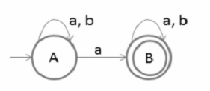
FA to RG–Example 3
Consider a FA given below:-
https://www.tutorialspoint.com/

Slide 35
FA to RG–Example 3
Consider a FA given below:-
Regular Grammar with Null-
A→aA|bA|aB
B→aB|bB|ε
Null Free Grammar-
A->aA|bA|aB|a
B->aB|bB|a|b
https://www.tutorialspoint.com/

Slide 37
Generating Regular Expression from Regular Grammar
Replace -> symbol in the production by “=“ symbol to get a set of equations
Solve the the set of equations obtained above to get the value of the variable S, where S is the start symbol of the grammar, The result is the regular expression specifying L(G)

Slide 38
Generating Regular Expression from Regular Grammar-Example 1
Consider the grammar:
S->01S|01
KnowledgeGate

Slide 39
Generating Regular Expression from Regular Grammar-Example 1
Consider the grammar:
S->01S|01
Ans-
S=(01)*01
KnowledgeGate

Slide 40
Generating Regular Expression from Regular Grammar-Example 2
Consider the grammar:
S->0011S|01|10
KnowledgeGate

Slide 41
Generating Regular Expression from Regular Grammar-Example 2
Consider the grammar:
S->0011S|01|10
Ans-
S=(0011)*(01+10)
KnowledgeGate

Slide 42
Generating Regular Expression from Regular Grammar-Example 3
Consider the grammar:
S->01A|B11
A->011A|01
B->101B|11
KnowledgeGate

Slide 43
Generating Regular Expression from Regular Grammar-Example 3
Consider the grammar:
S->01A|B11
A->011A|01
B->101B|11
Ans)
A=(011)*01
B=(101)*11
S=01(011)*01+(101)*1111
KnowledgeGate

Slide 44
Generating Regular Expression from Regular Grammar-Example 4
Consider the grammar:
S->0A|0|1B
A->1A|1
B->0B|1S
Author-Dr. OG Kakde

Slide 45
Generating Regular Expression from Regular Grammar-Example 4
Consider the grammar:
S->0A|0|1B
A->1A|1
B->0B|1S
Author-Dr. OG Kakde

Slide 46
Generating Regular Expression from Regular Grammar-Example 4
Consider the grammar:
S->0A|0|1B
A->1A|1
B->0B|1S
S=0A|0|1B
A=1A|1
B=0B|1S
B=0*1S
A=1*1
S=01*1|0|10*1S
S= ( 01*1|0) |(10*1S )
S=(10*1)S|(01*1|0)
S=(10*1)*(01*1|0)
Regular Expression is
(10*1)*(01*1|0)
(10*1)*(01⁺|0)
Author-Dr. OG Kakde

Slide 47
Generating Regular Expression from Regular Grammar-Example 5
Consider the grammar:
S->011A|101B
A->110A|00
B->11B|S
Author-Dr. OG Kakde

Slide 48
Generating Regular Expression from Regular Grammar-Example 5
Consider the grammar:
S->011A|101B
A->110A|00
B->11B|S
Ans)
A=(110)*00
B=(11)*S
S=011(110)*00|101(11)*S
S=101(11)*S|011(110)*00
S=(101(11)*)*011(110)*00
Author-Dr. OG Kakde

Slide 49
Regular Grammar
Regular grammar is a formal grammar in which every production is restricted to have one of the following forms:-
A->aB
A->a
where A and B are the non-terminals, a is a terminal symbol
With ε productions permitted as special case when L(G) contains ε

Slide 50
Regular Grammar
Regular grammar is a type of grammar that describes a regular language.
This grammar can be of two forms:
Right Linear Regular Grammar
Left Linear Regular Grammar

Slide 51
Right Regular Grammar
Right Linear Regular Grammar
In this type of regular grammar, all the non-terminals on the right-hand side exist at the rightmost place, i.e; right ends.
Example 1 :
A ⇢ a,
A ⇢ aB,
A ⇢ ∈
where, A and B are non-terminals,
a is terminal, and ∈ is empty string

Slide 52
Right Regular Grammar
Example 2 :
S ⇢ 00B | 11S
B ⇢ 0B | 1B | 0 | 1
where, S and B are non-terminals, and
0 and 1 are terminals

Slide 53
Left Regular Grammar
Left Linear Regular Grammar
In this type of regular grammar, all the non-terminals on the right-hand side exist at the leftmost place, i.e; left ends.
Example 1 :
A ⇢ a,
A ⇢ Ba,
A ⇢ ∈
where, A and B are non-terminals,
a is terminal, and ∈ is empty string

Slide 54
Left Regular Grammar
Example 2 :
S ⇢ B00 | S11
B ⇢ B0 | B1 | 0 | 1
where S and B are non-terminals, and
0 and 1 are terminals

Slide 55
End of Lecture

Slide 56
Conversion of Right Linear Grammar to Left Linear Grammar
Obtain a regular expression for the language generated by the given grammar
Reverse the regular expression obtained in Step 1
Obtain the regular/right linear grammar for the regular expression obtained in step 2 by drawing FA
Reverse the right side of every production of the grammar obtained in step 3
The resultant grammar will be an equivalent left linear grammar
Author-Dr. OG Kakde

Slide 57
Conversion of Right Linear Grammar to Left Linear Grammar
Consider Right Linear grammar:-
S->01B|0
B->1B|11
Author-Dr. OG Kakde

Slide 58
Conversion of Right Linear Grammar to Left Linear Grammar
Consider Right Linear grammar:-
S->01B|0
B->1B|11
Author-Dr. OG Kakde

Slide 59
Conversion of Right Linear Grammar to Left Linear Grammar
Consider Right Linear grammar:-
S->01B|0
B->1B|11
Author-Dr. OG Kakde

Slide 60
Conversion of Right Linear Grammar to Left Linear Grammar
Consider Right Linear grammar:-
S->01B|0
B->1B|11
Obtain a regular expression
S=01B|0
B=1B|11
B=1*(11)
S=011*(11)|0
Regular Expression=(011*(11)|0)
Author-Dr. OG Kakde

Slide 61
Reversal of a Regular Expression
Basis: If E is a symbol a, ε, or ∅, then E^{R} = E.
Induction: If E is
E=F+G, then E^{R} = F^{R} + G^{R}.
E=FG, then E^{R} = G^{R}F^{R}
E=F*, then E^{R} = (F^{R})*.
Author-Dr. OG Kakde

Slide 62
Conversion of Right Linear Grammar to Left Linear Grammar
Regular Expression=(011*(11)|0)
Reverse Regular Expression=(0|(11)1*10)=(0|111*10)
Author-Dr. OG Kakde

Slide 63
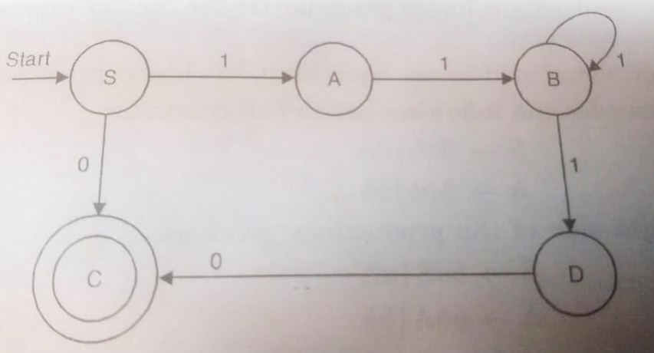
Conversion of Right Linear Grammar to Left Linear Grammar
Reverse Regular Expression=(0|(11)1*10)=(0|111*10)
Finite Automata accepting the language specified by the RE
Thus, the right linear grammar generating the language accepted by the FA is:
S->1A|0C|0
A->1B
B->1D|1B
D->0C|0
Author-Dr. OG Kakde

Slide 64
Conversion of Right Linear Grammar to Left Linear Grammar
Thus, the right linear grammar generating the language accepted by the FA is:
S->1A|0C|0
A->1B
B->1D|1B
D->0C|0
Since C is not useful eliminating C gives:-
S->1A|0
A->1B
B->1D|1B
D->0
Author-Dr. OG Kakde

Slide 65
Conversion of Right Linear Grammar to Left Linear Grammar
S->1A|0
A->1B
B->1D|1B
D->0
This can be further simplified
S->1A|0
A->1B
B->1B|10
Further simplified as
S->11B|0
B->1B|10
Author-Dr. OG Kakde

Slide 66
Conversion of Right Linear Grammar to Left Linear Grammar
S->11B|0
B->1B|10
Reversing the right side of the productions give:
S->B11|0
B->B1|01
Which is equivalent Left Linear grammar
Author-Dr. OG Kakde

Slide 67
Conversion of Left Linear Grammar to Right Linear Grammar
Reverse the right side of every production of the given grammar
Obtain a regular expression for the language generated by the grammar obtained in step 1
Reverse the regular expression obtained in Step 2
Obtain the regular/right linear grammar for the regular expression obtained in step 3
The resultant grammar will be an equivalent left linear grammar

Slide 68
Conversion of Left Linear Grammar to Right Linear Grammar
Consider the following Left Linear Grammar:-
S->Sab|Aa
A->Abb|bb

Slide 69
Conversion of Left Linear Grammar to Right Linear Grammar
Consider the following Left Linear Grammar:-
S->Sab|Aa
A->Abb|bb

Slide 70
Conversion of Left Linear Grammar to Right Linear Grammar
Consider the following Left Linear Grammar:-
S->Sab|Aa
A->Abb|bb

Slide 71
Conversion of Left Linear Grammar to Right Linear Grammar
Consider the following Left Linear Grammar:-
S->Sab|Aa
A->Abb|bb
Reversing the right side of the productions gives us:
S->baS|aA
A->bbA|bb
Obtain the Regular expression specifying the language –
S=baS|aA
A=bbA|bb
We get A=(bb)*bb
S=baS|(a(bb)*bb)
S=(ba)*(a(bb)*bb)
Reversed RE=(bb (bb)*a)(ab)*
Author-Dr. OG Kakde

Slide 72
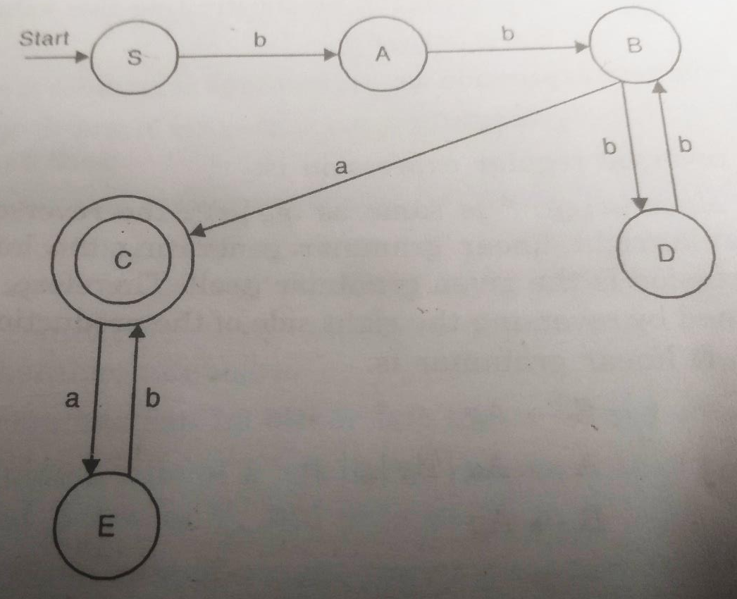
Conversion of Left Linear Grammar to Right Linear Grammar
RE=(bb (bb)*a)(ab)*
FA for the Reversed RE
Regular Grammar for the FA
S->bA
A->bB
B->cA|bD|a
D->bB
C->aE
E->bC|b
Author-Dr. OG Kakde

Slide 73
Conversion of Left Linear Grammar to Right Linear Grammar
Regular Grammar for the FA
S->bA
A->bB
B->cA|bD|a
D->bB
C->aE
E->bC|b
can be reduced to:
S->bbB
B->aaE|bbB|a
E->baE|b
Required Right Linear Grammar
Author-Dr. OG Kakde

Slide 74
Conversion of Left Linear Grammar to Right Linear Grammar
Regular Grammar for the FA
S->bA
A->bB
B->cA|bD|a
D->bB
C->aE
E->bC|b
can be reduced to:
S->bbB
B->aaE|bbB|a
E->baE|b
Required Right Linear Grammar
Author-Dr. OG Kakde

Slide 75
Exercise
RLG to LLG
Consider the following grammar:
S->gA
A->aA|gB|g
B->gA
Obtain an equivalent left linear grammar
Author-Dr. OG Kakde

Slide 76
Exercise
RLG to LLG
Consider the following grammar:
S->gA
A->aA|gB|g
B->gA
Obtain an equivalent left linear grammar
Obtain RE for above grammar:-
S=gA
A=aA|gB|g
B=gA
Substituting the value of B in A
S=gA
A=aA|ggA|g
A=(a|gg)A|g
A=(a|gg)*g
S=g(a|gg)*g
Regular Expression=g(a|gg)*g
Author-Dr. OG Kakde

Slide 77
Exercise
RLG to LLG
Regular Expression=g(a|gg)*g
Reversed Regular Expression=g(gg|a)*g
But since (a|gg)* is same as (gg|a)*
The reversed regular expression is same
Hence the regular/right linear grammar generated by the reverse RE is the given grammar itself
An equivalent left linear grammar can be obtained by reversing the right side of the production of the given grammar
Thus, Equivalent left linear grammar is
S->Ag
A->Aa|Bg|g
B->Ag
Author-Dr. OG Kakde

