Slide 1
TM

Slide 2
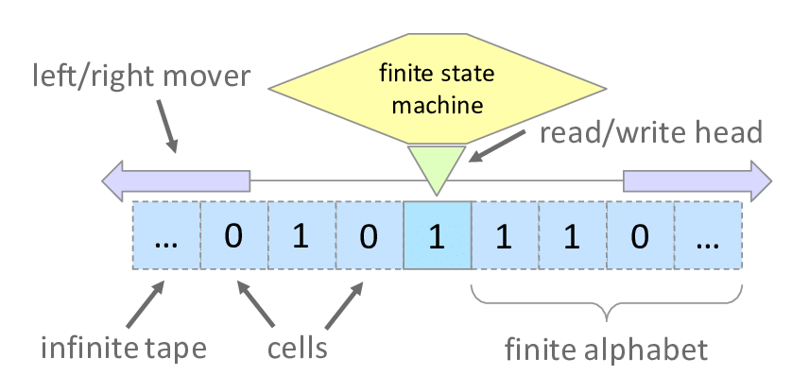
Turing Machine
Consists of:-
A Tape
Tape is infinite extending on either sides, divided into cells, each cell capable of holding one symbol
Head-
Associated with tape is read-write head that can travel left or right on tape and read a single symbol on each move

Slide 3
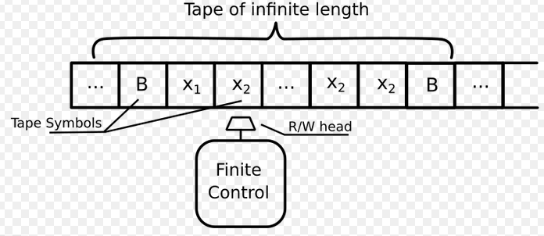
Turing Machine
Consists of:-
Tape Symbols-
Finite set of symbols, consists of lowercase letters, digits, usual punctuation marks and the Blank B
States-
Set of states in which the machine can reside

Slide 4
Turing Machine
A Turing machine is a mathematical model of computation that defines an abstract machine[1] that manipulates symbols on a strip of tape according to a table of rules
-Wikipedia

Slide 5
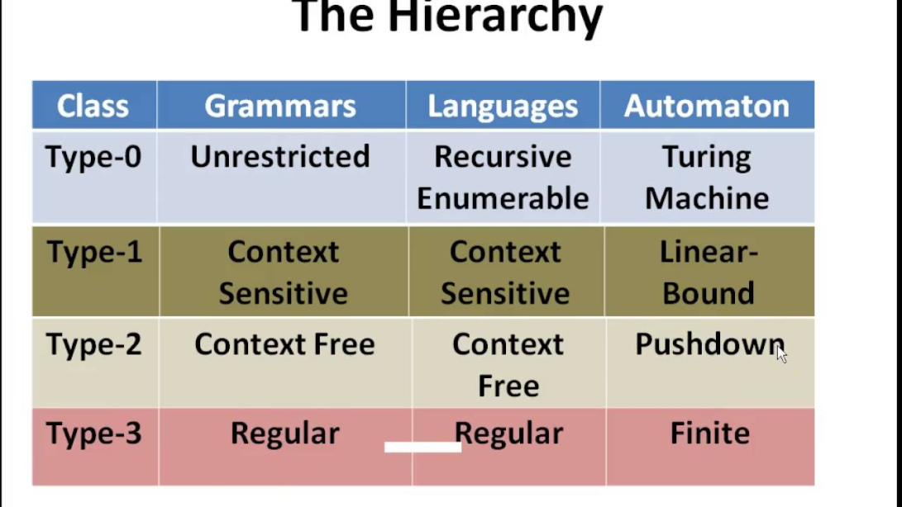
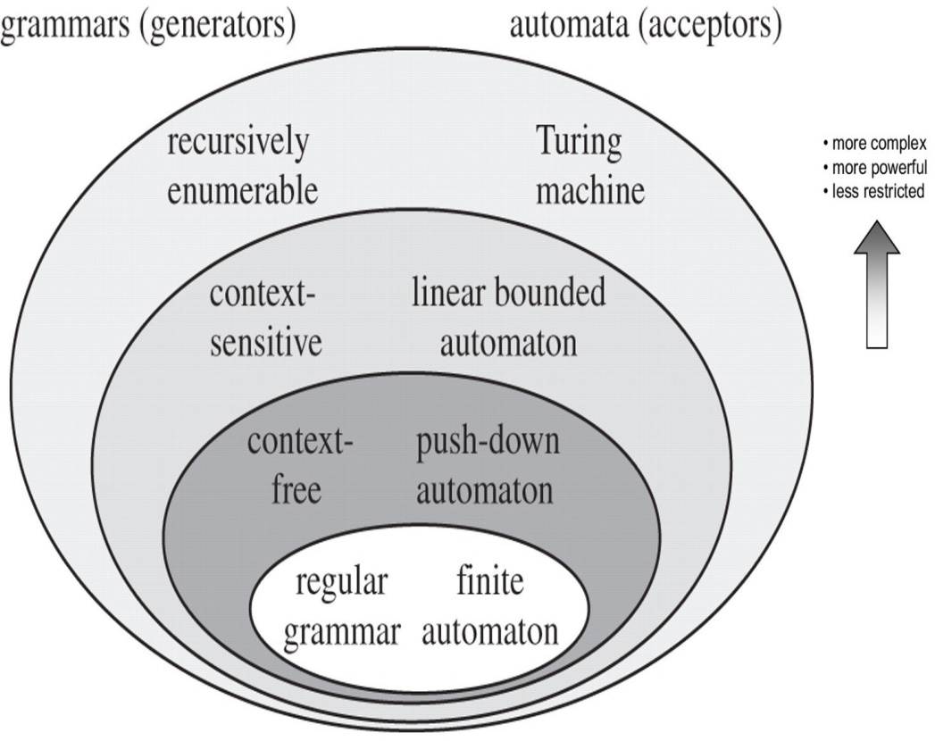
Turing Machine
Turing Machine was invented by Alan Turing in 1936
Accepts Recursive Enumerable Languages (generated by Type-0 Grammar).

Slide 6
TM: Formal Definition
PDA is denoted by 7 Tuple: M=(Q, ∑, ᴦ, δ, q₀, B, F) where
Q:Finite set of Internal states of the Control Unit
∑:Finite input alphabet
ᴦ: Finite Set of Tape Symbols
δ:Q X ᴦ ->Q X ᴦ X {L,R,N}: Transition function(TF)
q₀: Start state of Control Unit, q0 ∈ Q
B : Blank Symbol
F: Set of Final States/ Accept State, F ⊆ Q
∑ ⊆ ᴦ -{B}
∑ is a subset of ᴦ and B does not belong to ∑

Slide 7
PDA: Formal Definition
PDA is denoted by 7 Tuple: M=(Q, ∑, ᴦ, δ, q₀, z, F) where
Q:Finite set of Internal states of the Control Unit
∑:Finite input alphabet
ᴦ: Finite Set of Stack Symbols/Pushdown symbols
δ:Q X (∑ U {ε}) X ᴦ ->Q X ᴦ *: Transition function(TF)
or
δ:Q X ∑_{ε} X ᴦ_{ε} ->Q X ᴦ_{ε} *
q₀: Start state of Control Unit, q0 ∈ Q
z : Stack start Symbol, z ∈ ᴦ, Initially present in the stack
F: Set of Final States/ Accept State, F ⊆ Q

Slide 8
δ Function
δ Function:-
δ:Q X ᴦ ->Q X ᴦ X {L,R,N}: Transition function(TF)
If δ(q,X)=(p,Y,L)
If present state is q and the next symbol on the tape is X then the Turing Machine changes the state to p, replaces the symbol X by symbol Y and moves the tape head one position left.
If δ(q,X)=(p,Y,R)
If present state is q and the next symbol on the tape is X then the Turing Machine changes the state to p, replaces the symbol X by symbol Y and moves the tape head one position right.

Slide 9
TM Example 1
Transition Rules
Construct a TM to replace each occurrence of ‘a’ by ‘b’ for the strings over ∑={a,b}

Slide 10
TM Example 1
Transition Rules
Construct a TM to replace each occurrence of ‘a’ by ‘b’ for the strings over ∑={a,b}

Slide 11
TM Example 1
Simulation
Construct a TM to replace each occurrence of ‘a’ by ‘b’ for the strings over ∑={a,b}

Slide 12
TM Example 2
Design a TM accept the language containing substring “aba” over ∑={a,b}
Logic-
During the process if TM discovers “aba” on the tape, it halts and thereby accepts entire input string
M=(Q, ∑, ᴦ, δ, q₀, B, F)

Slide 13
TM Example 2
Design a TM accept the language containing substring “aba” over ∑={a,b}
δ(q0,a)=(q1,a,R)
δ(q0,b)=(q0,b,R) self loop
δ(q1,a)=(q1,a,R) self loop
δ(q1,b)=(q2,b,R)
δ(q2,b)=(q0,b,R) go back
δ(q2,a)=(qf,a,N)

Slide 14
TM Example 3
Design a TM to recognize all strings consisting of even no of 1’s

Slide 15
TM Example 4
Transition Diagram ,Table
Design a TM to replace all occurrences of ‘111’ by ‘101’ over ∑={0,1}

Slide 16
TM Example 4
Transition Rules and Simulation
Design a TM to replace all occurrences of ‘111’ by ‘101’ over ∑={0,1}

Slide 17
TM Example 5
Transition Rules
Design a TM to replace all occurrences of ‘101’ by ‘011’ over ∑={0,1}

Slide 18
Modifications of Turing Machines or Variants of Turing Machines
Multi Tape Turing Machine
Non-Deterministic Turing Machine

Slide 19
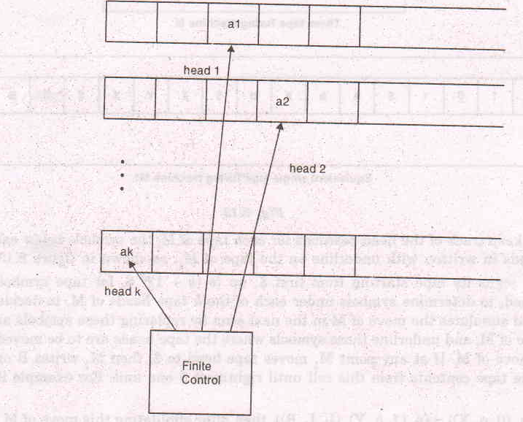
Multi Tape Turing Machine
A Multitape Turing Machine-

Slide 20
Multi Tape Turing Machine
It is a Turing Machine with several tapes , each has its own tape heads
It consists of a finite control with k tape heads and k tapes (k>1)
The move of this Turing machine depends on the present state of the finite control and the symbol scanned by each of the tape heads.

Slide 21
Multi Tape Turing Machine
In each move, depending on the present state and the symbols scanned by each of the tape heads , the machine can
change state of the finite control
print a new symbol on each of cells scanned by each of the tape heads
move each tape one cell left or one cell right independently

Slide 22
Multi Tape Turing Machine
The transition function of Multitape turing machine is :
δ:Q X {ᴦ1 X ᴦ2 X ………. ᴦk} ->Q X {ᴦ1 X ᴦ2 X ………. ᴦk} X { {L,R,N} X {L,R,N} ……………{L,R,N} k times}
δ(q1, (a1,a2,……ak) )=(p,(b1,b2,…….bk),(L,R,L,L……k times))

Slide 23
Multi Tape Turing Machine
All Variants have same power, every multitape turing machine has an equivalent single tape Turing machine

Slide 24
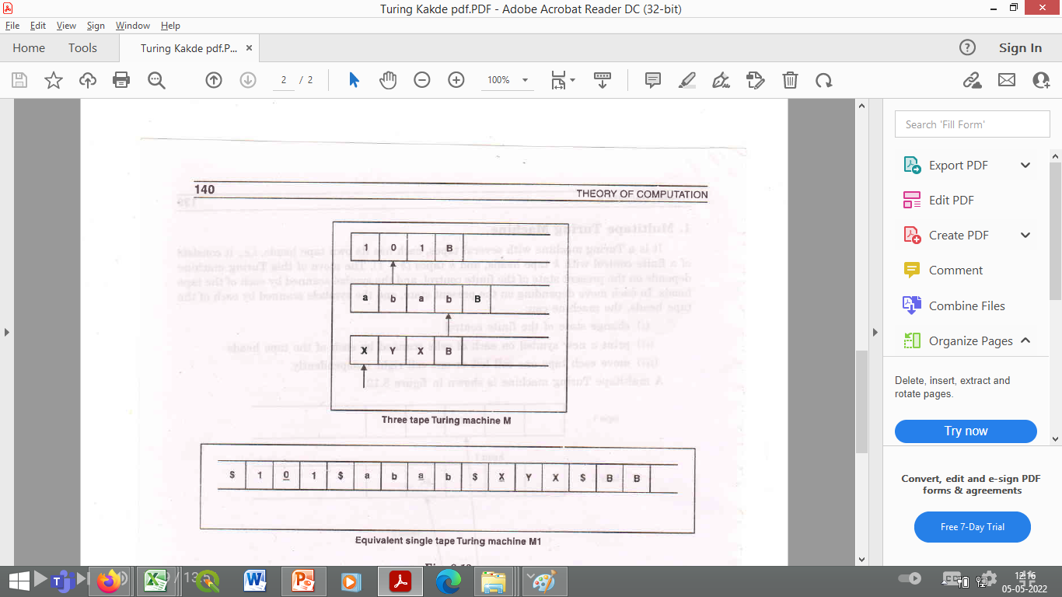

Multi Tape Turing Machine
Let M be a k tape Turing Machine(k>1)
Let us construct a single tape turing machine M1, which simulates M as follows:-

Slide 25
Multi Tape Turing Machine
M1 stores the information available on the k tapes of M on its tape, using a symbol $ as delimiter
To keep a track of the head positions for each tape of M, the symbols below each of these tape heads are written with underline on the tape of M1

Slide 26
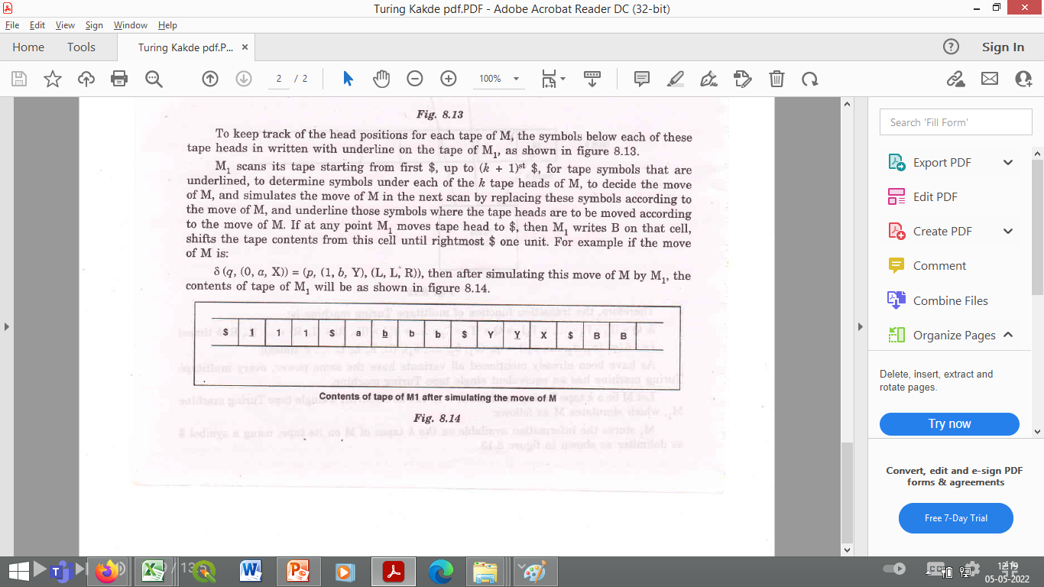
Multi Tape Turing Machine
M1 scans its tape starting from first $ up to (k+1)st $ for tape symbols that are underlined to simulate the move by replacing these symbols according to the move of M
δ(q, (0,a,X) )=(p,(1,b,Y),(L,L,R))
After this move the contents of the tape are-

Slide 27
Non-Deterministic Turing Machine
Turing Machine which at any point while carrying out computation , may proceed according to several possibilities
For a tape symbol scanned, The machine has a finite number of choices of next move
The transition function defines mapping from
Q X ᴦ to a finite subset of Q X ᴦ X {L,R,N}
It accepts input, if some sequence of choices of moves lead to an accepting state

Slide 28
Non-Deterministic Turing Machine
All variants have the same power, thus Every Non-Deterministic Turing Machine has an equivalent deterministic Turing machine

Slide 29
Non-Deterministic Turing Machine
For a Non-Deterministic Turing machine M,
It is always possible to construct a turing machine M1, which tries all possible sequences of computations or branches of computations of M
If M enters into an accept state on any of these branches, M1 accepts otherwise continues to simulate Mwithout termination
Thus, M1 is accepting the same language as M

Slide 30
TM Example 5
Transition Rules
Design a TM which recognizes the language L=01*0 for ∑={0,1}
Lets take string 0110

Slide 31
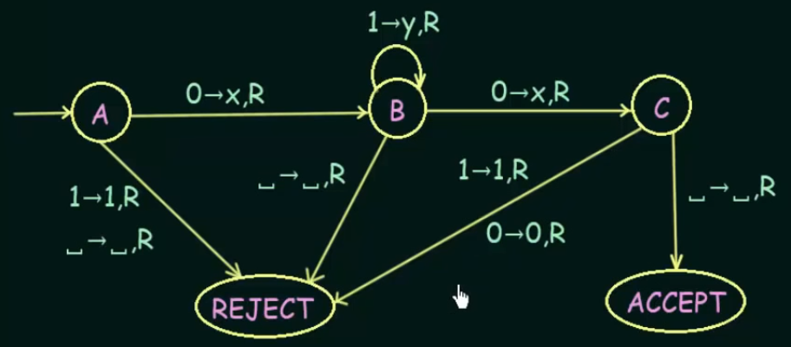
TM Example 5
Design a TM which recognizes the language L=01*0 for ∑={0,1}
0 | 1 | 1 | 0 | B
X | Y | Y | X | B

Slide 32
TM Example 5
Design a TM which recognizes the language L=0^{N}1^{N} for ∑={0,1}

Slide 33
TM Example 5
Design a TM which recognizes the language L=0^{N}1^{N} for ∑={0,1}
Algorithm-
Change 0 to X
Move Right to first “1”
If None:Reject
Change “1” to “y”
Move LEFT to Leftmost “0”
Repeat the above steps until no more “0”s
Make sure no more “1”s remain

Slide 34
TM Example 5
Simulation for L=0^{N}1^{N} , String 00001111
Algorithm-
Change 0 to X
Move Right to first “1”
If None:Reject
Change “1” to “y”
Move LEFT to Leftmost “0”
Repeat the above steps until no more “0”s
Make sure no more “1”s remain

Slide 35
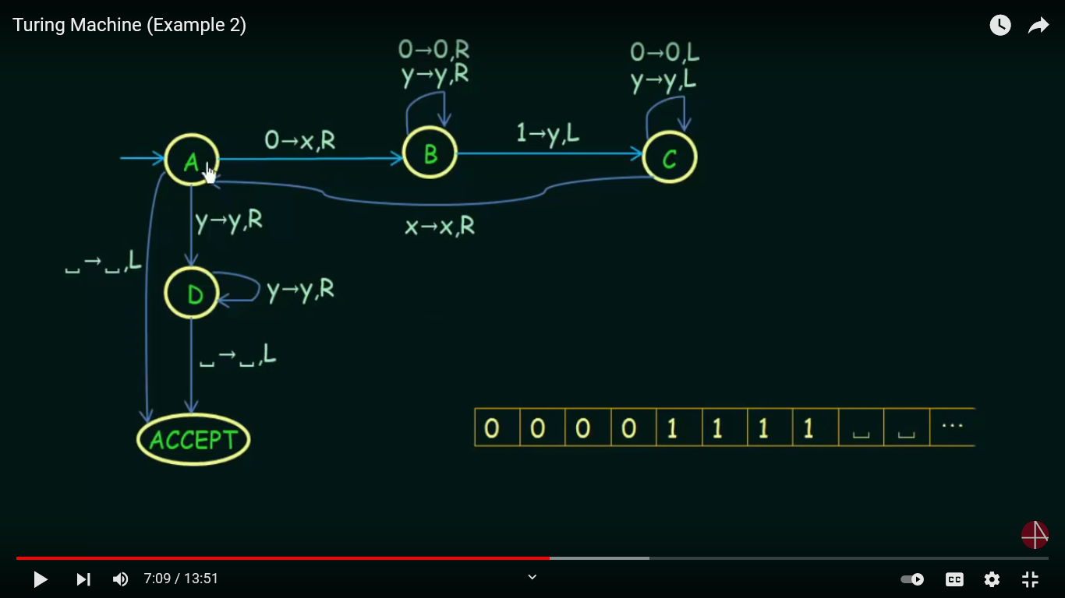
TM Example 5
Design a TM which recognizes the language L=0^{N}1^{N} for ∑={0,1}
Algorithm-
Change 0 to X
Move Right to first “1”
If None:Reject
Change “1” to “y”
Move LEFT to Leftmost “0”
Repeat the above steps until no more “0”s
Make sure no more “1”s remain

Slide 36
TM Example 5
Design a TM which recognizes the language L=0^{N}1^{N} for ∑={0,1}
Algorithm-
Change 0 to X
Move Right to first “1”
If None:Reject
Change “1” to “y”
Move LEFT to Leftmost “0”
Repeat the above steps until no more “0”s
Make sure no more “1”s remain

