Slide 1
PHP AND MYSQL
Module 5

Slide 2
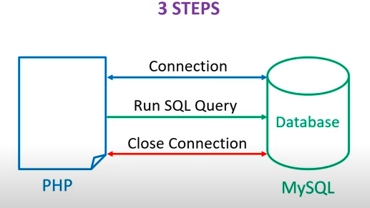
PHP MySQL Connection

Slide 3
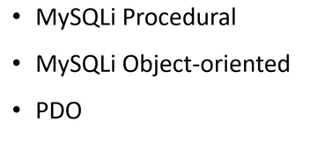
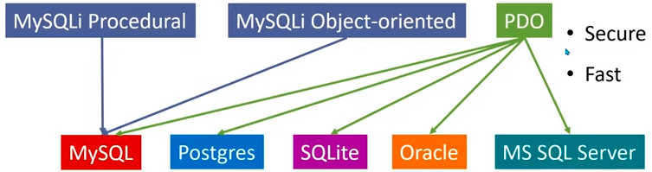
Methods
PDO (PHP Data Object)
It will work on 12 different database systems,
whereas MySQLi will only work with MySQL databases.

Slide 4
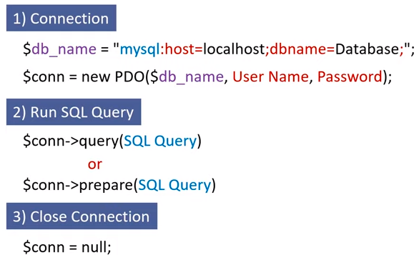
Steps to Connect PHP-Mysql

Slide 5
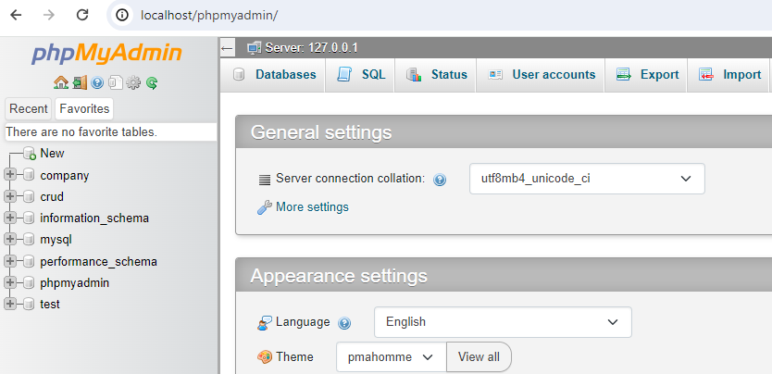
Steps to create database
Go to browser and type URL- localhost/phpmyadmin

Slide 6
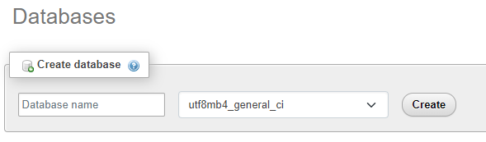
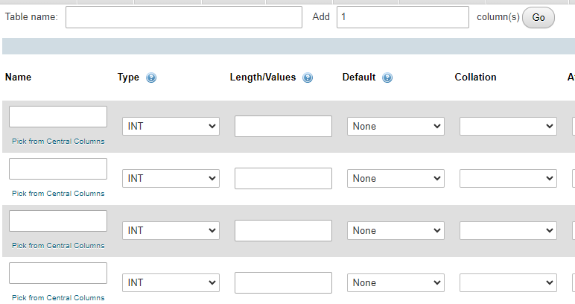
Click on New-
Write database name and click on ‘create’ .
Select database- click on New to create New table.
Enter table name and no. of columns and click on ‘go’.

Slide 7
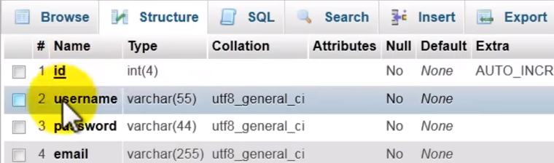
You can see the structure of your table – select ‘Stucture’ tab.

Slide 8
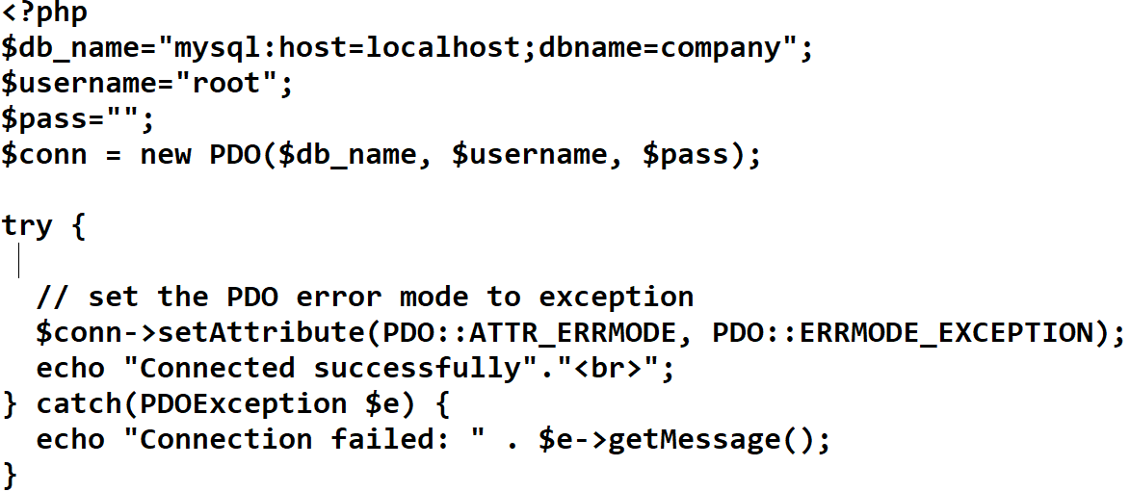
Test the connection

Slide 9
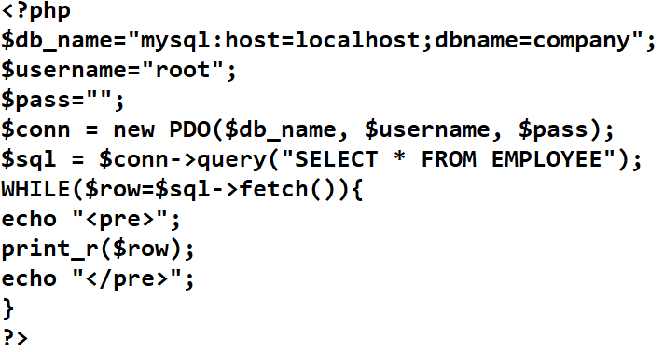
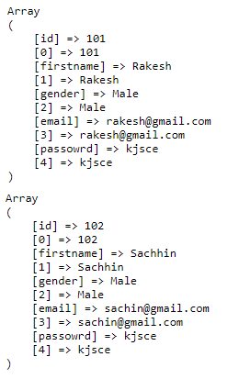
Example

Slide 10

FETCH style for fetch function

Slide 11
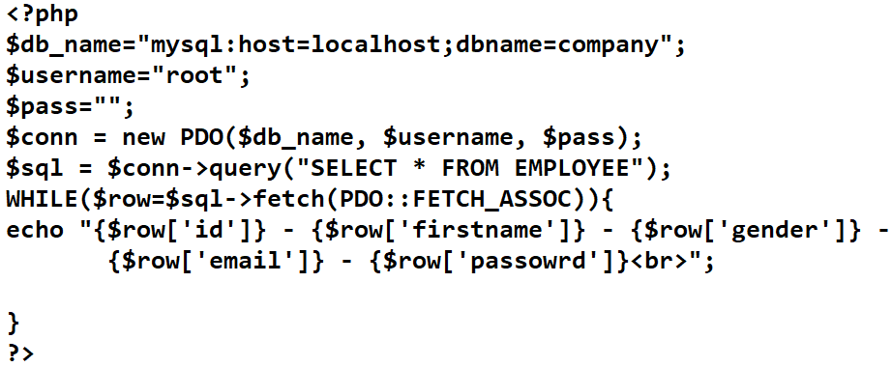

Slide 12
FETCH_NUM
echo "{$row[0]}-{$row[1]}-{$row[3]}<br>";
FETC_OBJ
echo "{$row->'id'}-{$row->firstname}-{$row-gender}<br>";

Slide 13
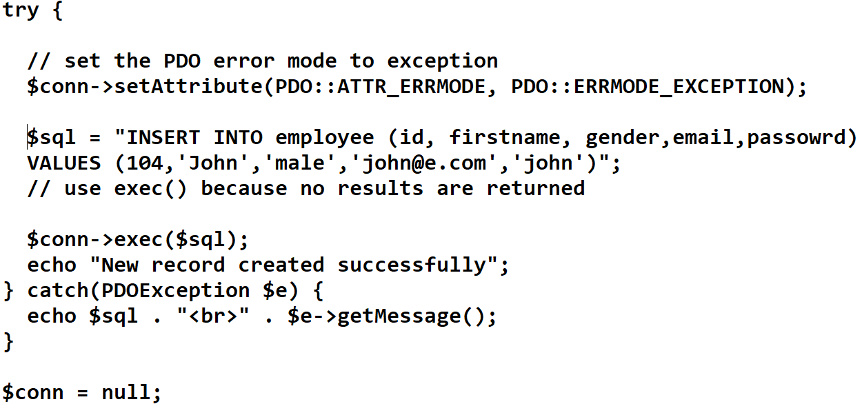
Insert new record

Slide 14
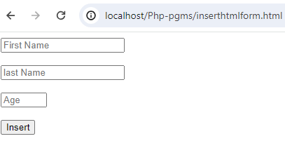
Insert record by using form
Insertrec.html
<html>
<head><title>
<meta charset="utf-8">
<title>PHP Insert Operations using PDO Extension </title>
<meta name="viewport" content="width=device-width, initial-scale=1">
</head>
<body>
<form action="insertrec.php" method="post">
<input type="text" name="fname" required placeholder="First Name"><br><br>
<input type="text" name="lname" placeholder="last Name"><br><br>
<input type="number" name="age" placeholder="Age" min=10 max=90><br><br>
<input type="submit" name="Insert" value="Insert">
</form>
</body>
</html>

Slide 15
Insert data using form – “insertrec.php”
<?php
if(isset($_POST['Insert']))
{
try{
$servername = "localhost";
$username = "root";
$password = "";
$dbname = "mysql:host=$servername;dbname=company";
$conn = new PDO($dbname,$username,$password);
}
catch(PDOException $e) {
echo "connection failed" . $e->getMessage();
exit();
}
$fname=$_POST['fname'];
$lname=$_POST['lname'];
$age=$_POST['age'];
$sql="INSERT INTO student(fname,lname,age) VALUES (:fname,:lname,:age)";
$res=$conn->prepare($sql);
$res->bindParam(':fname',$fname);
$res->bindParam(':lname',$lname);
$res->bindParam(':age',$age);
$res->execute();
echo "Data inserted successfully";
}
$conn = null;
?>

